Slide 1
Introduction to python
June 15, 2021

Slide 2
Why python
Free, opensource
Wide community support
Emerging as standard, or at least most popular, in many geo-science applications
Easy to use (?)

Slide 3
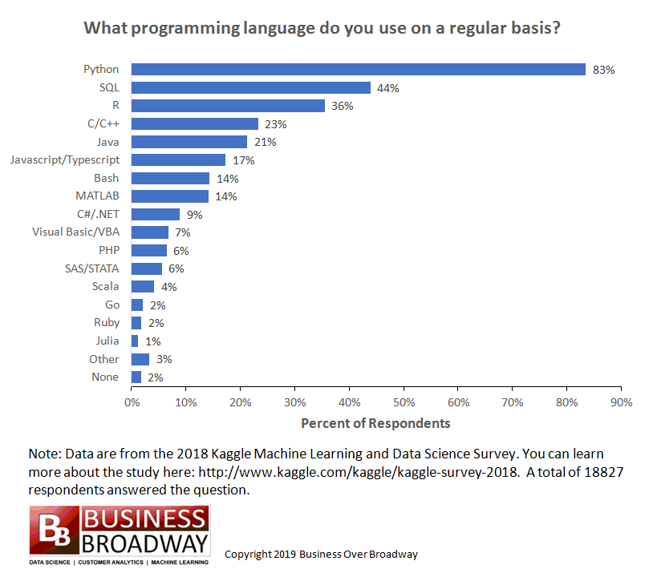

Slide 4
Background
Jupyter is a way to provide interactive, web-based access to programming (Julia, python, R)
Some sites run Jupyter Hubs (e.g., UH/ITS)
Jupyter Hub has Jupyter Labs
Jupyer Labs allows us to:
Run commands in a terminal
Run python commands in a console
Run jupyter notebooks

Slide 5
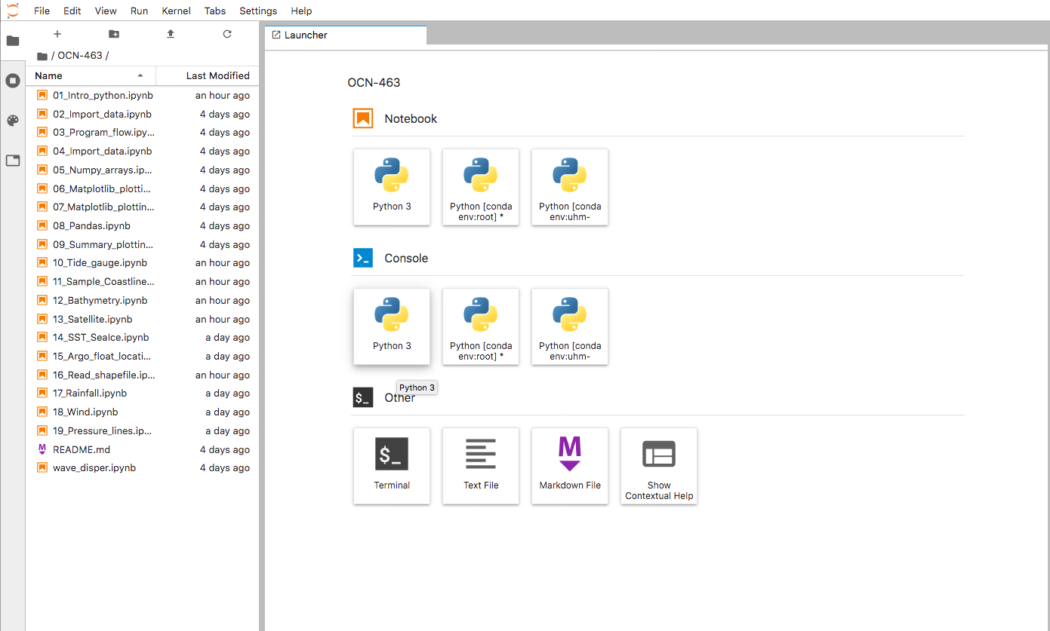
1. Layout and functions
There are a few different areas of the initial screen (note this is configurable, so may look different for you)
Top menu bar
Quick links
Files (notebooks, etc.)
“sessions”

Slide 6
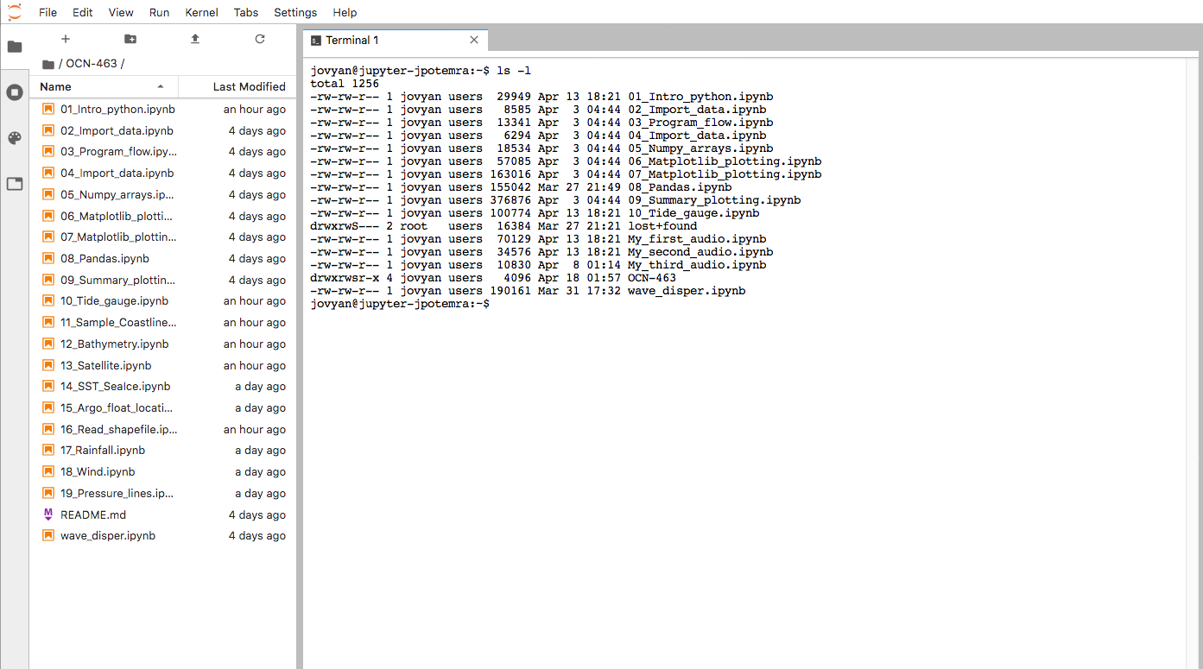
Open a terminal session

Slide 7
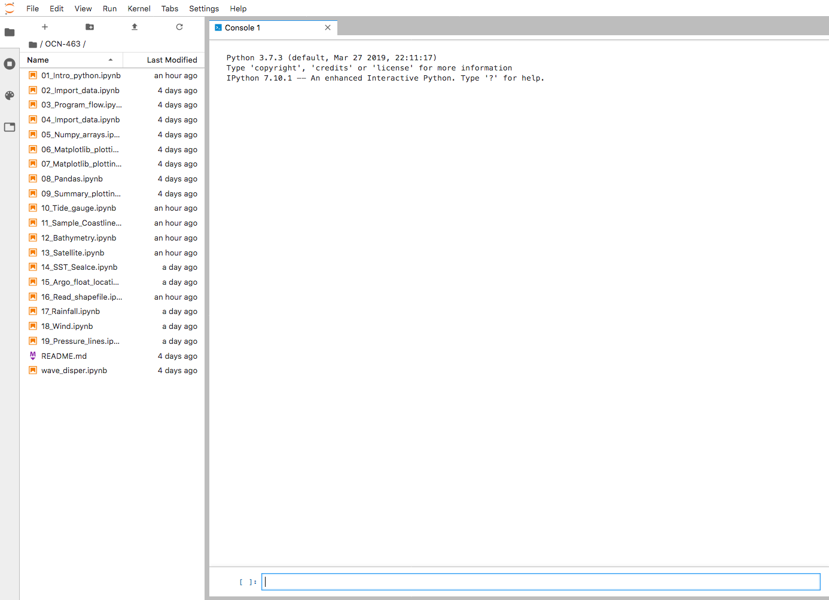
Open a python session

Slide 8
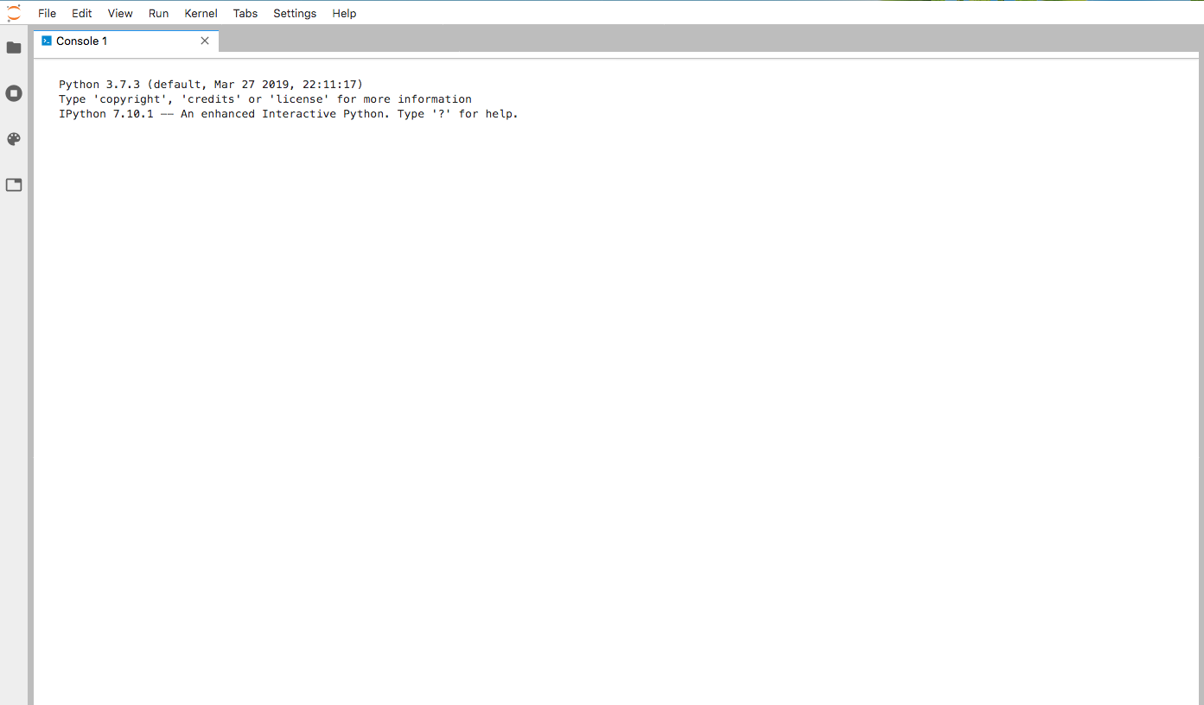
Toggle view

Slide 9
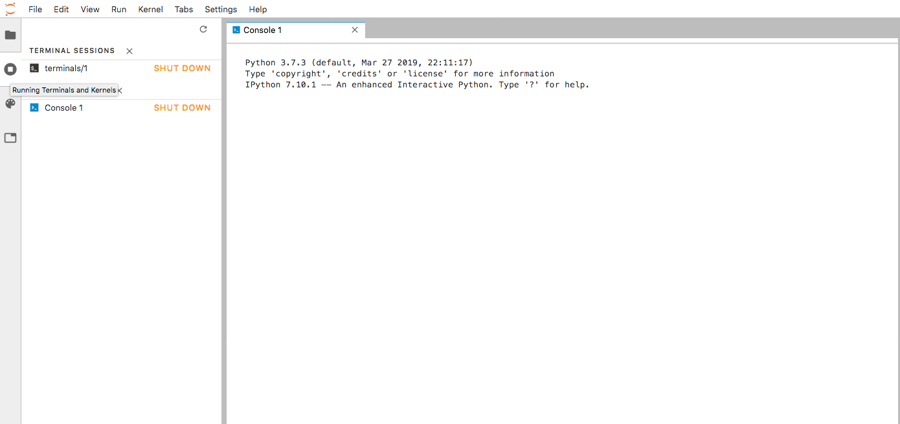
List and optionally stop/start sessions

Slide 10
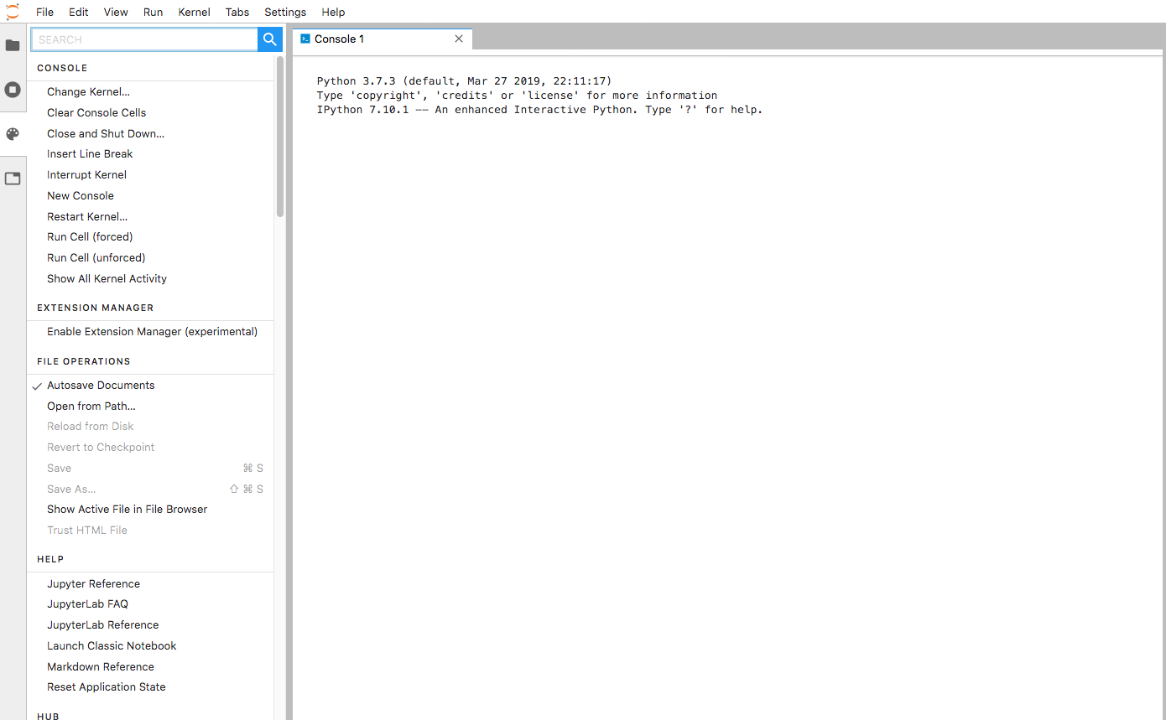
The main items include:
Console
Extension Manager
File Operations
Help
Hub
Image Viewer
Kernel Operations
Launcher
Main Area
Notebook Cell Operations
Notebook Operations
Settings
Show Contextual Help
Terminal
Text Editor
Theme
Command list

Slide 11
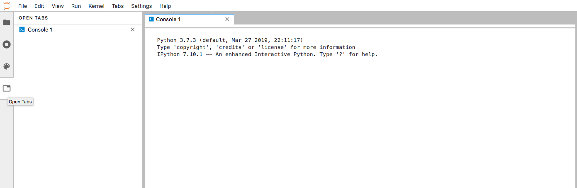
Open tabs

Slide 12
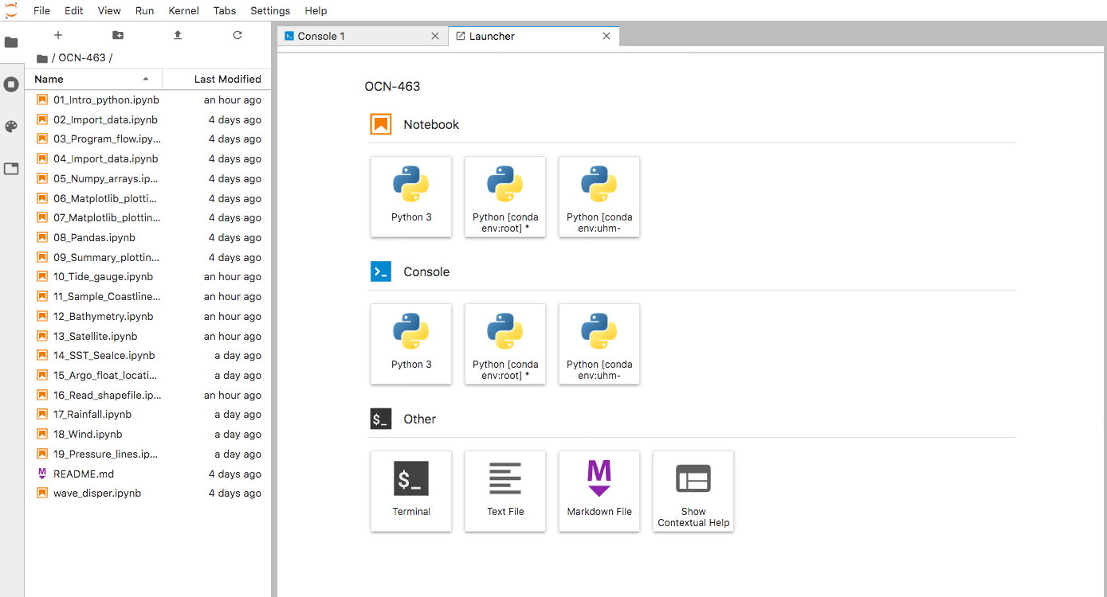
Open a “launcher” window

Slide 13
Open a new folder

Slide 14
Upload files to workspace

Slide 15
File
New (terminal, session, etc)
New Launcher
Export Notebook As
Hub Control Panel
Log Out
Edit
Undo/Redo
Cut/Copy/Paste
Find
View
Show/hide side bars
Run
Kernel
Tabs
Settings
Help
Upload files to workspace

