Slide 1
Before we begin…
Lectures
  Focus on the big picture – the high-level concepts
  Have some important details, clarifications, and corrections
  Provide some slides, but will focus on code examples
Assignments
  Focus on doing – the application of concepts and details with coding and tools
  Do not focus on checking if you read the books or watched the lectures (exams will)
Exams
  Focus on the books, lectures, and some applications of the material
  Do not focus on coding, but there may be some on it
This is the trade-off
  You have fewer assignments, and they focus on applying, which I know you like
  But you must study the books and watch the lectures to do well
Recommendation: Keep a personal study journal (See Course Resources)

Slide 2
Three Characteristics of an Object
State – An object’s properties and current values; its internal condition at a given time.
Behavior – The actions or operations an object can perform; how it responds to interactions.
Class methods
Sometimes called “implementation”
Identity – A object’s unique identifier (class type + internal identifier) that distinguishes it from another.
Sometimes referred to as “type,” but type is only one component of it
Class members, data members, attributes, fields
Sometimes referred to as the “address,” but Java does let you see the address
Represented by a hash code

Slide 3
Relationships Types Between Classes
Dependence (“uses-a”) - A class uses another class
A class uses or manipulates another class
Example: The Order uses the Account to check a customer’s credit status
Aggregation (“has-a”) – A class contains another class
A class has an instance of another class
Example: An Employee has an Address
Inheritance (“is-a”) – A more specialized version of a general class
Relationship expressed by a hierarchy
Example: A Student is a Person

Slide 4
Inheritance Hierarchical Relationship
Expresses the “is-a” relationship
Parent-child relationship – one parent, many children
Superclass (base class) and subclass (derived class)
Allows the implementation of the inheritance concept
Subclasses gain state, behavior, and identity from the superclass
Usage depends on requirements
Should be natural to what you are representing

Slide 5

Relationship Types Among Classes
Scratching Post
Cheezburger
Claws
Feline
Cat
Tiger
Lion

Slide 6
Types of Inheritance
Single – A class inherits from one parent class
Multilevel – A class inherits from a parent class, which itself inherits from another class
Hierarchical – Multiple classes inherit from the same parent class
Multiple - A class inherits from more than one parent class
Hybrid - A combination of two or more types of inheritance

Slide 7
Aspects of Inheritance
Inheritance of State
Inherits direct access to the public and protected class members
Inherits package-private access to class members depending on packaging
Does not inherit private access to class members
Inherits state initialization behavior (subclass must call a superclass constructor)
Inheritance of Behavior (or Implementation)
Inherits direct access to the public and protected methods
Inherits package-private access to methods depending on packaging
Does not inherit private access to methods
Does not inherit constructors (subclass must call a superclass constructor)
Inheritance of Type
Inherits the superclass type
Inherits the interface type
Does not inherit the internal identifier

Slide 8
Inheritance of Behavior
Overloading – same name, different signature (name + parameters)
Occurs only within the same class
Cannot have two methods with the same signature
Not involved in inheritance
Overriding
Subclass method with the same signature as a superclass method
Calls to the method will invoke the subclass version
Subclass can call the superclass version using super
Only occurs between inheriting classes
Overloaded methods in a superclass are inherited
Can be prevented using final

Slide 9
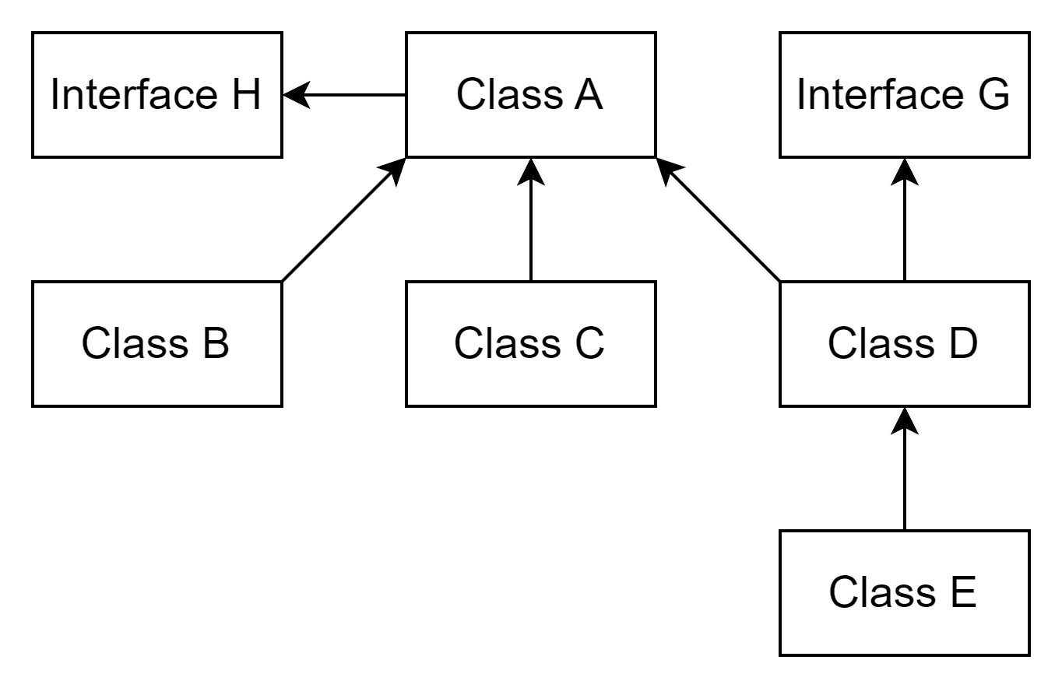
Polymorphism
Ability of an object to take on many forms
An object can pass more than one “is-a” test
All Java objects are polymorphic
  Cast up into the superclass type
  Cast down back into the subclass type
  Cannot polymorph into sibling types
Types of polymorphism
  Compile-time
  Runtime

Slide 10
Polymorphism Types
Compile-Time
Static binding or early binding
Runtime
Dynamic binding or late binding
The compiler resolves method calls
Method overloading
Fast execution because it has already determined the method to execute
Inheritance not involved
Calls resolved during execution
Method overriding
Slower execution because the determination of methods occurs during execution
Inheritance involved

Slide 11
Multiple Inheritance
Allowing a class to have more than one superclass
“Java does not support multiple inheritance.”
Consider the three aspects: state, behavior, and type
Multiple inheritance of state statement above is true
Multiple inheritance of behavior statement above is true
Multiple inheritance of type statement above is false

Slide 12
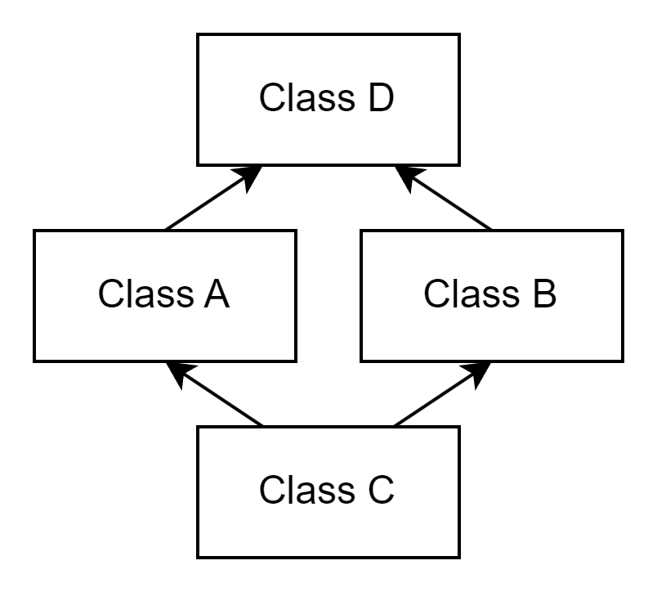
Multiple Inheritance – The Diamond Problem
Suppose: Class D has method something()
Class A and Class B inherit something()
Remember:
A method has a signature
Only one method with that signature can be in a class
Class A and Class B inherit something() – no problem
But which method does Class C inherit?
Class A? Class B? Class D?
Challenge: Think about how multiple inheritance would affect class members.

Slide 13
Multiple Inheritance
Interfaces are not objects
There are no constructors
There are no class members, only static constants
Abstract methods have no implementation and must be overridden
Default methods only exist if the class does not define one
Private interface methods only exist to support default methods
There is a type, but not an identity, because they are not instantiated
You cannot have two types that are the same

Slide 14
Multiple Inheritance
A class…
Can “extend” only one other class
An interface…
Can “implement” any number of interfaces
Cannot “extend” an interface
Cannot “implement” a class
Can “extend” any number of interfaces
Cannot “implement” an interface
Cannot “extend” a class
Cannot “implement” a class

