Slide 1
Advanced Data Modeling

Slide 2
Specialization Hierarchy
Hierarchical relationships - Parent-child relationship
  One parent has many children, one child has one parent
  Supertype and subtype entities
  Implements inheritance concept
  Requires special types of constraints
    Disjoint vs. overlapping
    Completeness
  Usage depends on requirements
  Should be natural to the data represented
Person
Employee
Student
Administrator
Professor
Graduate
Undergraduate

Slide 3
Specialization Hierarchy
Supertype
  Parent entity – has one or more children
  Generalized entity type related to one or more entity subtypes
  Contains the common attributes of all the subtypes
Subtype
  Child entity – has one parent
  Specialized entity related to its parent, and may have further subtypes
  Contains unique attributes of the subtype

Slide 4
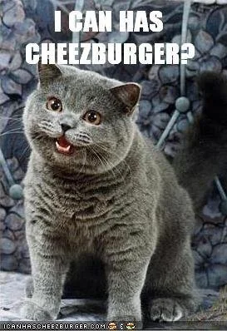
Specialization Hierarchy
Inheritance – subtypes gain attributes and relationships from supertypes
  “has a” – (entity) “has a” (entity)
  “is a” – subtype “is a” (supertype entity)
    Relationship directly resulting from the hierarchy
    Only exists in the context of the supertype
    Inherits attributes and relationships
Cheezburger
Claws
Feline
Cat
Tiger
Lion

Slide 5
Specialization Hierarchy
Implementation
  All entity subtypes inherit their primary key attribute from their supertype
    The primary key of the parent is the primary key and foreign in the child
  Supertype and its subtype(s) maintain a 1:1 relationship
  Supertype requires a special attribute – subtype discriminator
    Determines to which entity subtype the supertype occurrence is related
    Equality is common – e.g., subtype discriminator value = some value, it is subtype A
    Can use inequalities – e.g.,
      subtype discriminator value is < some value, it is subtype A
      subtype discriminator value is > some value, it is subtype B

Slide 6
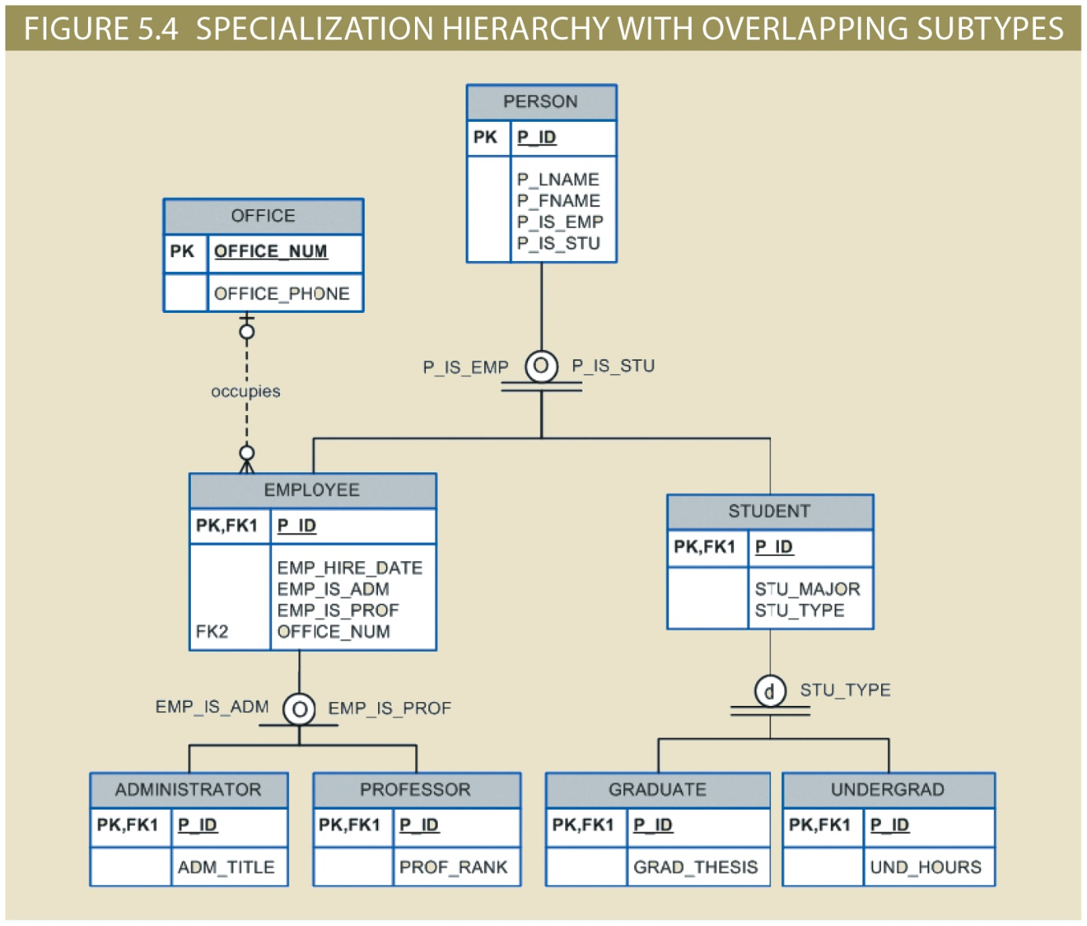
Specialization Hierarchy
Subtype discriminator
  Person
  Student
  Employee
Remember
  It is an attribute
  Use good naming
  Keep it simple
  Example: P_Type may be better than P_IS_EMP and P_IS_STU in this ERD

Slide 7
Specialization Hierarchy
Special types of constraints
  Disjoint subtypes
    Contains a unique subset of the supertype entity set
    Supertype entity occurrence can be only one of the subtypes
  Overlapping subtypes
    Contain nonunique subsets of the supertype entity set
    Supertype entity occurrence can be one or more of the subtypes
  Completeness: specifies if supertype occurrence must also be a subtype
    Partial completeness
      Not every supertype occurrence is a member of a subtype
    Total completeness
      Every supertype occurrence must be a member of a subtype

Slide 8
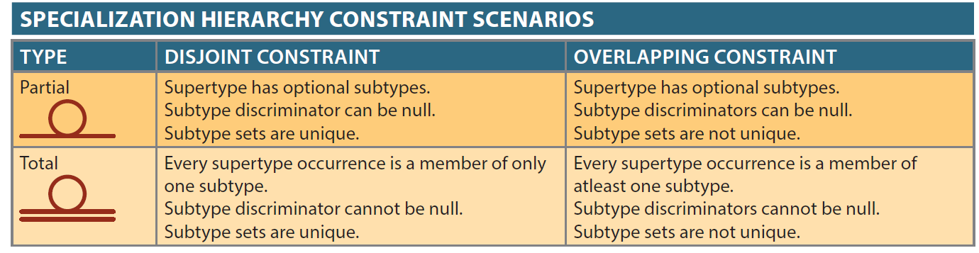
Specialization Hierarchy
d in the circle means disjoint
o in the circle means overlapping

Slide 9
Specialization Hierarchy

Slide 10
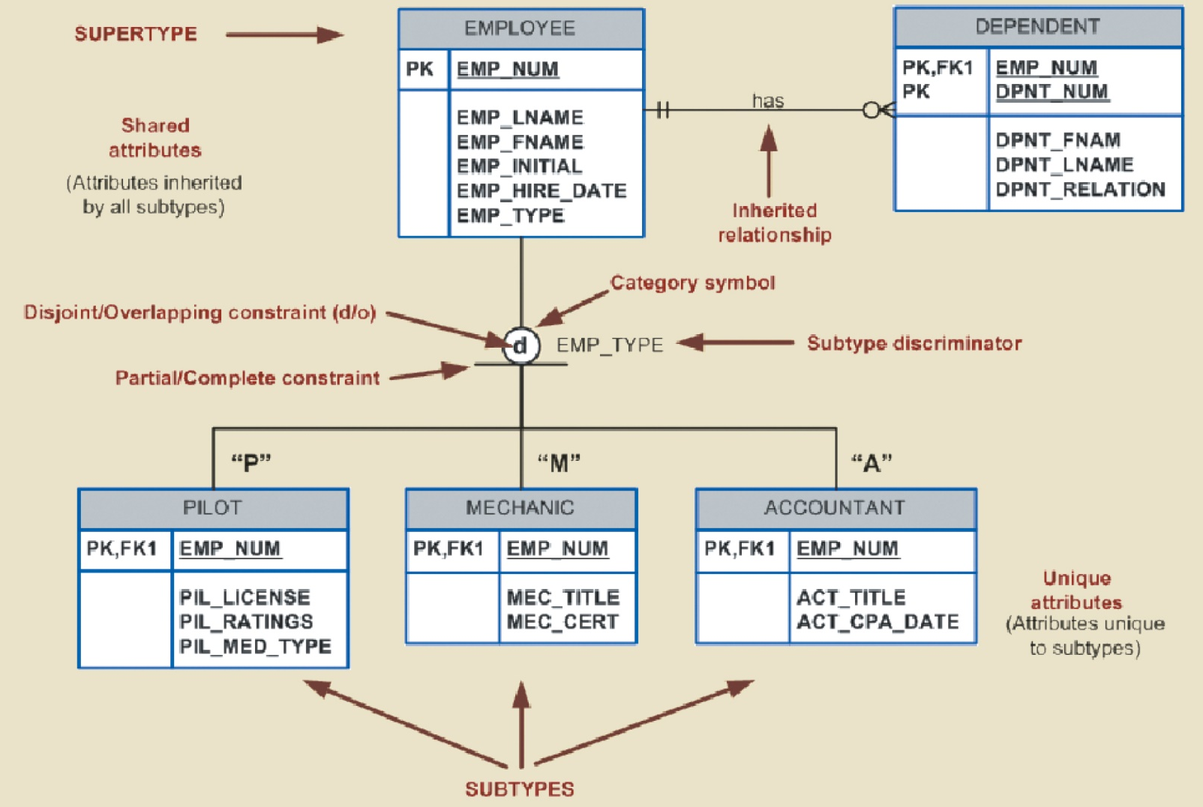
Specialization Hierarchy

Slide 11
Specialization Hierarchy
PERSON(p_id, p_lname, p_fname, p_is_emp, p_is_stu)
EMPLOYEE(p_id, emp_hire_date, emp_is_adm, emp_is_prof, office_num)
STUDENT(p_id, stu_major, stu_type)
ADMINISTRATOR(p_id, adm_title)
PROFESSOR(p_id, prof_rank)
GRADUATE(p_id, grad_thesis)
UNDERGRAD(p_id, und_hours)
OFFICE(office_num, office_phone)

Slide 12
Specialization Hierarchy
Granite Sales Company keeps information on employees and their work departments.
The department name, internal mailbox number, and office phone extension are kept for each department.
A department can have many assigned employees, each assigned to only one department.
Employees can be salaried employees, hourly employees, or contract employees.
All employees are assigned an employee number, which is kept along with the employee’s name and address.
For hourly employees, hourly wage and target weekly work hours are stored (e.g., the company may target 40 hours/week for some, 32 hours/week for others, and 20 hours/week for others).
Some salaried employees are salespeople who can earn a commission in addition to their base salary.
The yearly salary amount is recorded in the system for all salaried employees.
For salespeople, their commission percentage on sales and commission percentage on profit are stored in the system. For example, John is a salesperson with a base salary of $50,000 per year plus a 2-percent commission on the sales price for all sales he makes plus another 5 percent of the profit on each.
For contract employees, the beginning date and end dates of their contract are stored along with the billing rate for their hours.

Slide 13
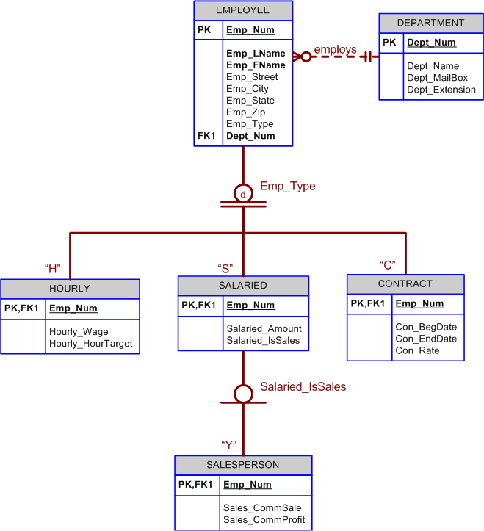
Specialization Hierarchy

