Slide 1
Relational Database Model

Slide 2
Characteristics of a Relational Table
Perceived as a 2D structure of rows and columns
Each row is a single entity occurrence within the entity set
Each column is an attribute and has a distinct name
Each intersection of a row and column is a single data value
All values in a column conform to the same data format
Each column has an attribute domain (specific range of values)
Order of columns and rows is immaterial to the DBMS
Each table must have a key that uniquely identifies each row

Slide 3
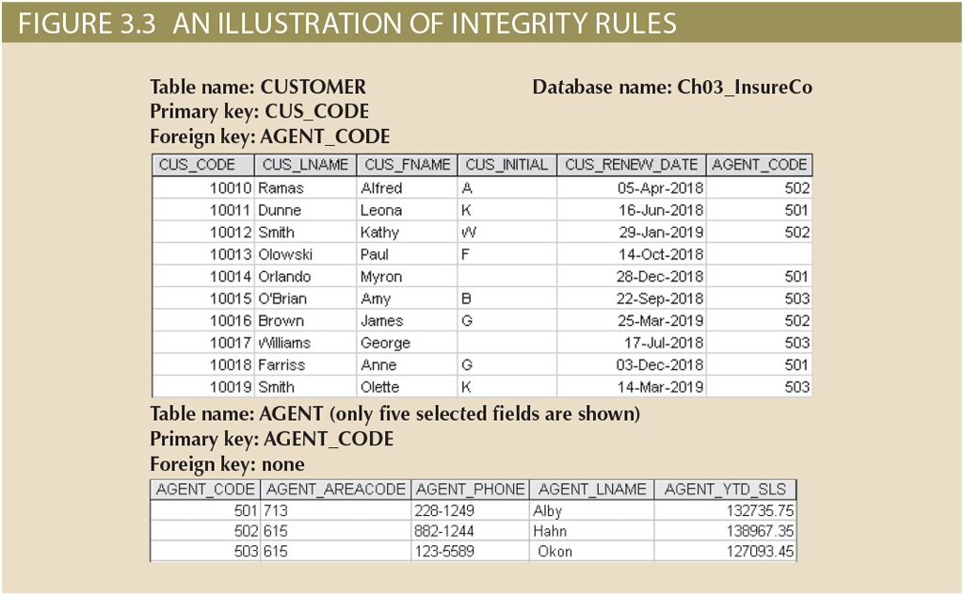
Characteristics of a Relational Table
Table: Customer
Attributes
  Code (key, numeric)
  Last Name (character string)
  First Name (character string)
  Initial (character)
  Renew Date (date)
  Agent Code (numeric)
Note the empty cells—these are null values, i.e., unknown or no value

Slide 4
Keys
Key – one or more attributes that determine other attributes
  Key attribute – an attribute that is a part of the key
  Composite key – key composed of multiple attributes
  Ensures each row is uniquely identifiable
  Ensures the integrity of the data
Superkey – any set of attributes that can uniquely identify a row
Candidate key – minimal superkey (no more attributes than necessary)
Primary Key (PK) – selected candidate key to uniquely identify a row
Secondary key – key used strictly for data retrieval purposes
Surrogate key – used to simplify the identification of a row (section 5-3d)
Foreign key (FK) – PK of a table placed in another to create a relationship

Slide 5
Keys
Superkeys
  CODE
  CODE + LNAME
  CODE + FNAME
  CODE + INITIAL
  CODE + LNAME + FNAME
  CODE + RENEW DATE
  CODE + all attributes
In other words, any combination of attributes that contain key attributes

Slide 6
Keys
Candidate keys
  CODE – minimal superkey
Primary key
  CODE – only possible candidate key to select
Secondary key
  LNAME + FNAME (possibly?)
Surrogate key
  None in this example
Foreign key
  Agent Code

Slide 7
Integrity Rules
Entity Integrity
  Requirement
    All PK entries are unique, no PK attribute can be null
  Purpose
    Each row has a unique identity
    FK values can properly reference PK key values
  Example
    No two invoices can have the same invoice number
    The invoice number cannot be null
    Any table referring to the invoice table can identify the invoice using the number

Slide 8
Integrity Rules
Referential Integrity
  Requirement
    FK value matches an existing PK value of the related table or can be null
    However, a FK cannot be null if it is a PK attribute of the table where it resides
  Purpose
    It is impossible to have an invalid FK value (i.e., it must reference an existing entity occurrence in the related table or be null)
    Makes it impossible to delete the row being referenced by the FK
  Example
    A customer may not have a sales representative, but if it does, the sales representative must exist in the sales representative table
    The sales representative cannot be removed from the sales representative table if a customer refers to it

Slide 9

Relationships – One-to-Many (1:M)
One row of Table A links with many rows of Table B
However, only one in row of Table B links to one row of Table A

Slide 10
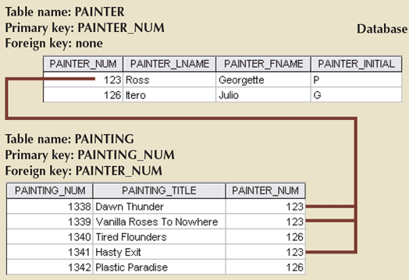
Relationships – One-to-Many (1:M)
PK of Painter
PK of Painting
FK of Painting
In all cases of painter-paintings:
  A painter paints many paintings
  A painting is painted by one painter
The PK from the “one-side” is placed as a FK in the “many-side.” Why?

Slide 11
Relationships – One-to-Many (1:M)
The PK from the “one-side” is placed as a FK in the “many-side.” Why?
PAINTER_NUM | PAINTER_LNAME | PAINTER_LNAME | PAINTER_INITIAL | PAINTING1 | PAINTING2 | PAINTING3
123 | Ross | Georgette | P | 1338 | 1339 | 1341
126 | Itero | Julio | G | 1340 | 1342
PAINTER_NUM | PAINTER_LNAME | PAINTER_LNAME | PAINTER_INITIAL | PAINTING
123 | Ross | Georgette | P | 1338
123 | Ross | Georgette | P | 1339
123 | Ross | Georgette | P | 1341
126 | Itero | Julio | G | 1340
126 | Itero | Julio | G | 1342

Slide 12
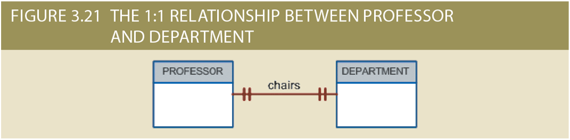
Relationships – One-to-One (1:1)
One row of Table A links with only one row of Table B
And only one in row of Table B links to only one row of Table A

Slide 13
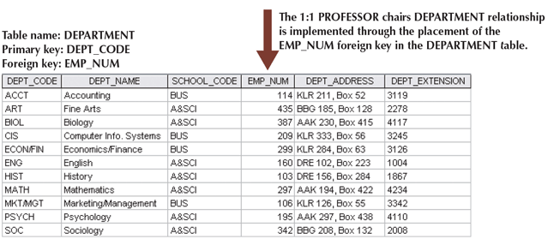
Relationships – One-to-One (1:1)
PK is dept_code
FK is emp_num
Why not have dept_code as the FK in the employee table instead?
EMP_NUM | PROF_OFFICE | PROF_EXTENSION | PROF_HIGH_DEGREE
105 | DRE 102 | 8665 | Ph.D.
114 | KLR 211 | 4436 | Ph.D.
301 | KLR 244 | 4683 | Ph.D.

Slide 14
Relationships – One-to-One (1:1)
General rule: The PK from one table is placed in the other table to minimize redundant data and null entries in the FK
EMP_NUM | PROF_OFFICE | PROF_EXTENSION | PROF_HIGH_DEGREE | CHAIRS_DEPT
105 | DRE 102 | 8665 | Ph.D.
114 | KLR 211 | 4436 | Ph.D. | ACCT
301 | KLR 244 | 4683 | Ph.D.

Slide 15

Relationships – Many-to-Many (M:N)
Many rows of Table A links with many rows of Table B
And many rows of Table B links to many rows of Table A

Slide 16
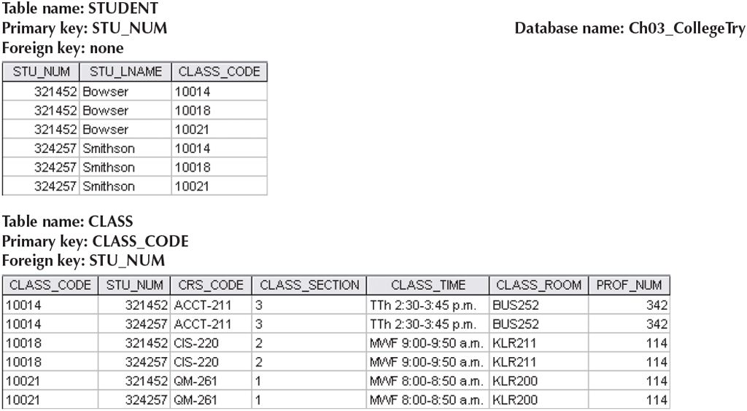
Relationships – Many-to-Many (M:N)
PK of Student?!?
  stu_num – not possible
  Must be stu_num and class_code
PK of Class?!?
  class_code – not possible
  Must be class_code and stu_num
  But what if a class currently does not have any students?
Results in a lot of redundant data, complicated composite keys, and complex queries
Note the common attributes are stu_num and class_code

Slide 17
Relationships – Many-to-Many (M:N)
Many-to-Many relationships are resolved with bridge entities
  Bridge entities are also called associative or composite entities
  Resolving the M:N
    Form a bridge entity composed of the PK of each entity
    The PK of the bridge entity is a composite primary key
    Each PK attribute of the bridge entity is a FK to another table
    Remember that the PK attribute cannot be null, so the FK attributes cannot be null
    Suppose we allow a null FK, why does that not make sense intuitively?
  You can have additional attributes in the bridge entities
    These typical exist because of the relationship; they describe something about it
  The M:N relationships still exists!

Slide 18
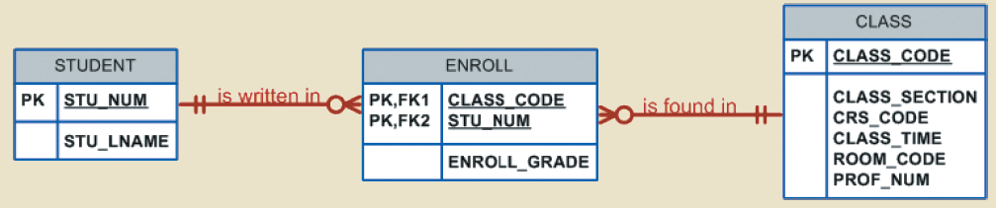
Relationships – Many-to-Many (M:N)
Many students enroll in many class, and many classes are taken by many students—the M:N relationship is maintained
Important: Unless otherwise specified, all M:N relationships must be resolved in any work we complete for this course

Slide 19
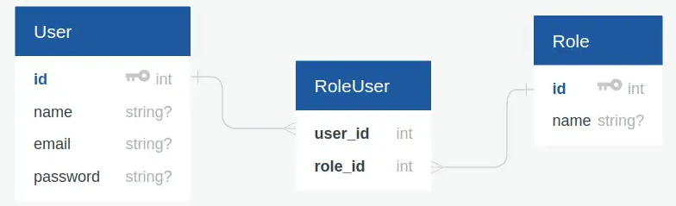
Relationships – Many-to-Many (M:N)
https://www.itsolutionstuff.com/post/laravel-many-to-many-eloquent-relationship-tutorialexample.html

Slide 20
Selecting Primary Keys
Natural keys
  Real world, generally accepted identifier
  Familiar to end-users
Primary key guidelines
  The PK is to ensure entity integrity, not describe the entity
  The PK is used to establish relationships unseen by the end user
Desirable PK characteristics
  Non-intelligent
  No change over time
  Preferably single-attribute
  Preferably numeric
  Security compliant

Slide 21
Selecting Primary Keys
Composite keys
  Used in bridge entities
  Used in weak entities (we will see this later)
  Not favored in other entities
Surrogate keys
  When there is no natural or suitable primary key
  Good when the only other option are large composite keys
  Good when the other at option does not meet the desirable characteristics

