Slide 1



Slide 2

RESTful Services
Joseph Powell IV

Slide 3

I have complete faith that you will learn all you need to know about RESTful Services from my man Joseph!
Ambassador of BIG BRAIN ENTERPRISE
Michael

Slide 4
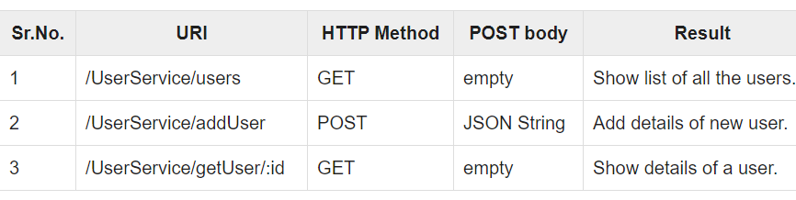
REST & RESTful Web Services
Creator: Roy Fielding in 2000
REpresentational State Transfer.
REST is not HTTP or a Protocol, but a guideline to build a performable & scalable system for the web.
It uses HTTP Protocols & HTTP Methods
GET = Provides a read only access to a resource.
POST = Used to create a new resource.
DELETE = Used to remove a resource.
PUT = Used to update an existing resource or create a new resource.
The makeup of REST Architecture
REST server provides access to resources, the REST client accesses, then modify these resources. (text, JSON, XML, etc. JSON being most popular)
Identify URLs/global IDs.
RESTful Web Services = a collection of open protocols and standards used for exchanging data between applications or systems.
RESTful is the implementation of REST (guidelines) Architecture
Defines a URI & provides resource representation such as JSON and set of HTTP Methods.
Various programming languages and running on various platforms exchanging data is due to the use of open standards.

Slide 5
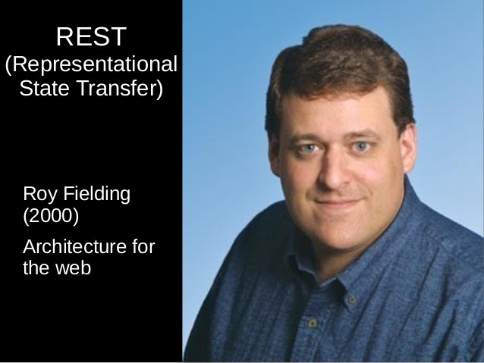
REST API
Introduction of REST revolutionized software engineering
In the field of APIs, REST (Representational State Transfer) is today the “be all and end all” in service app development. – BBVA API Market 2016
REST is any interface between systems using HTTP to obtain data and generate operations on those data in all possible formats, such as XML and JSON.
API is an application programming interface.
REST determines how the API looks like.
Each URL is called a request while the data sent back to you is called a response.
Fielding, Father of the HTTP Specification.

Slide 6
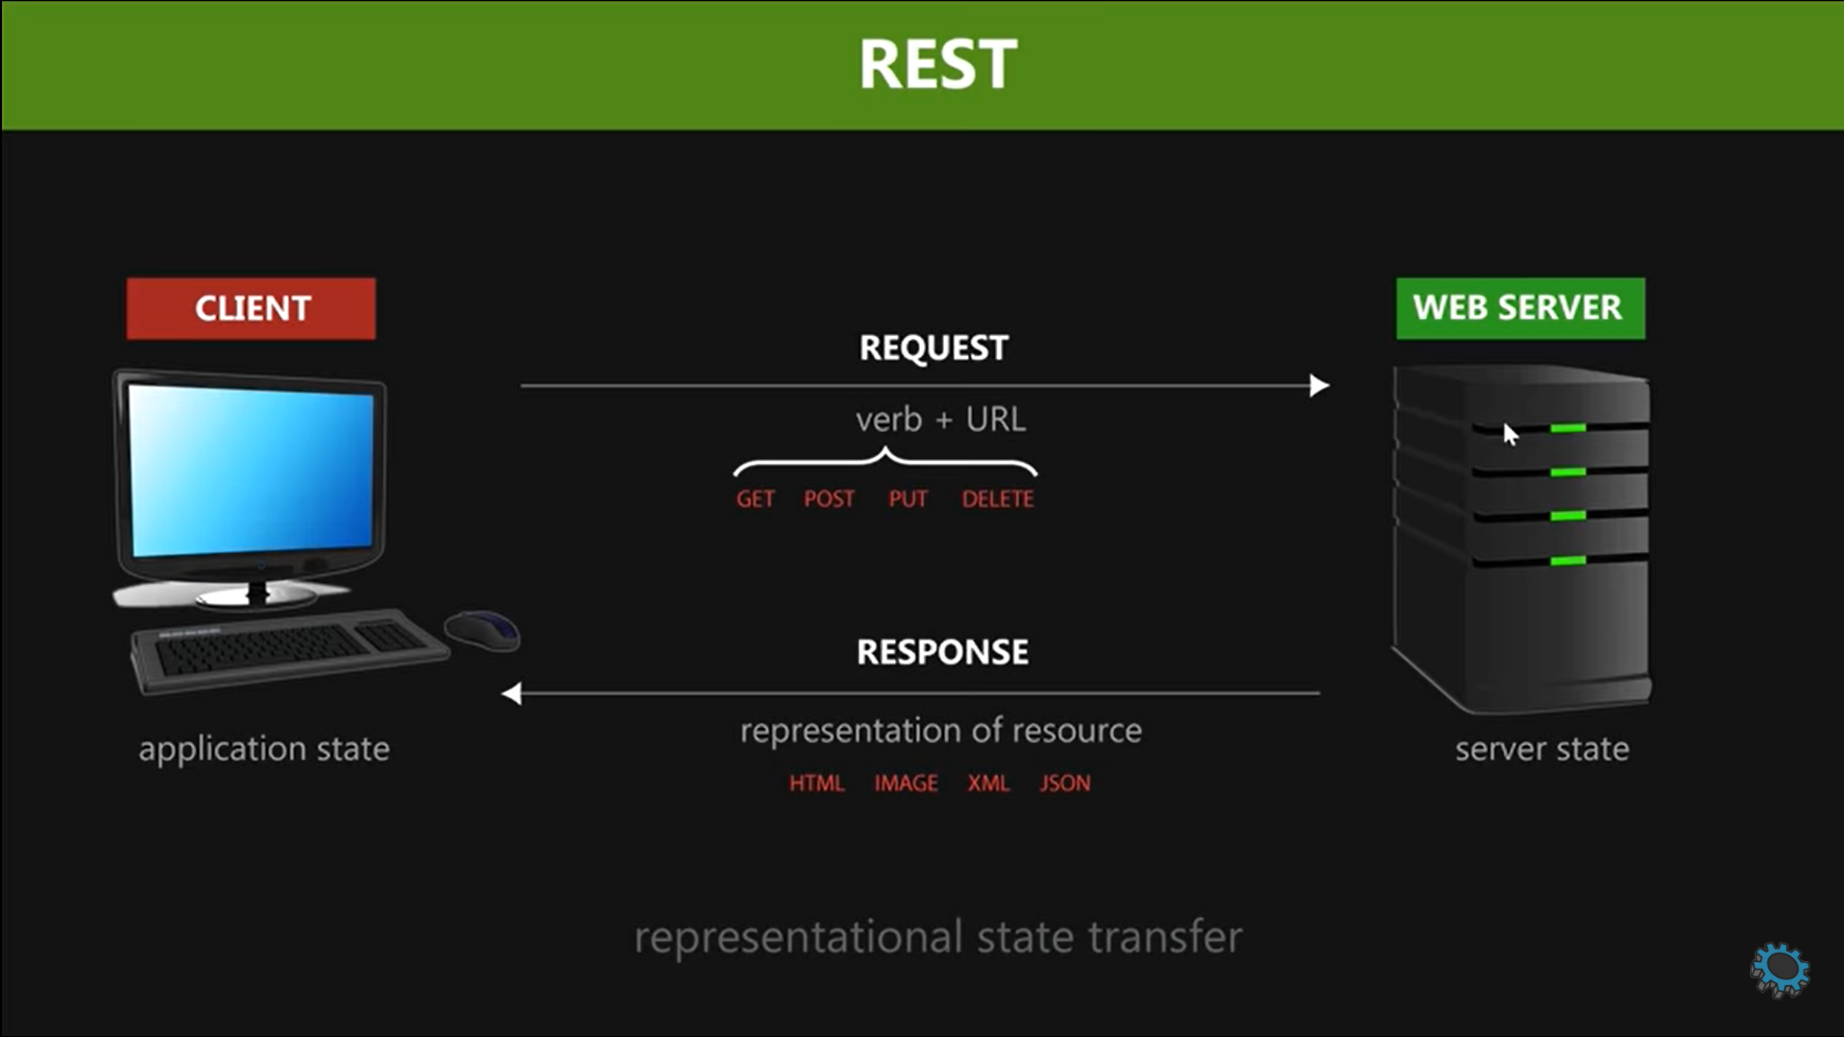

Slide 7
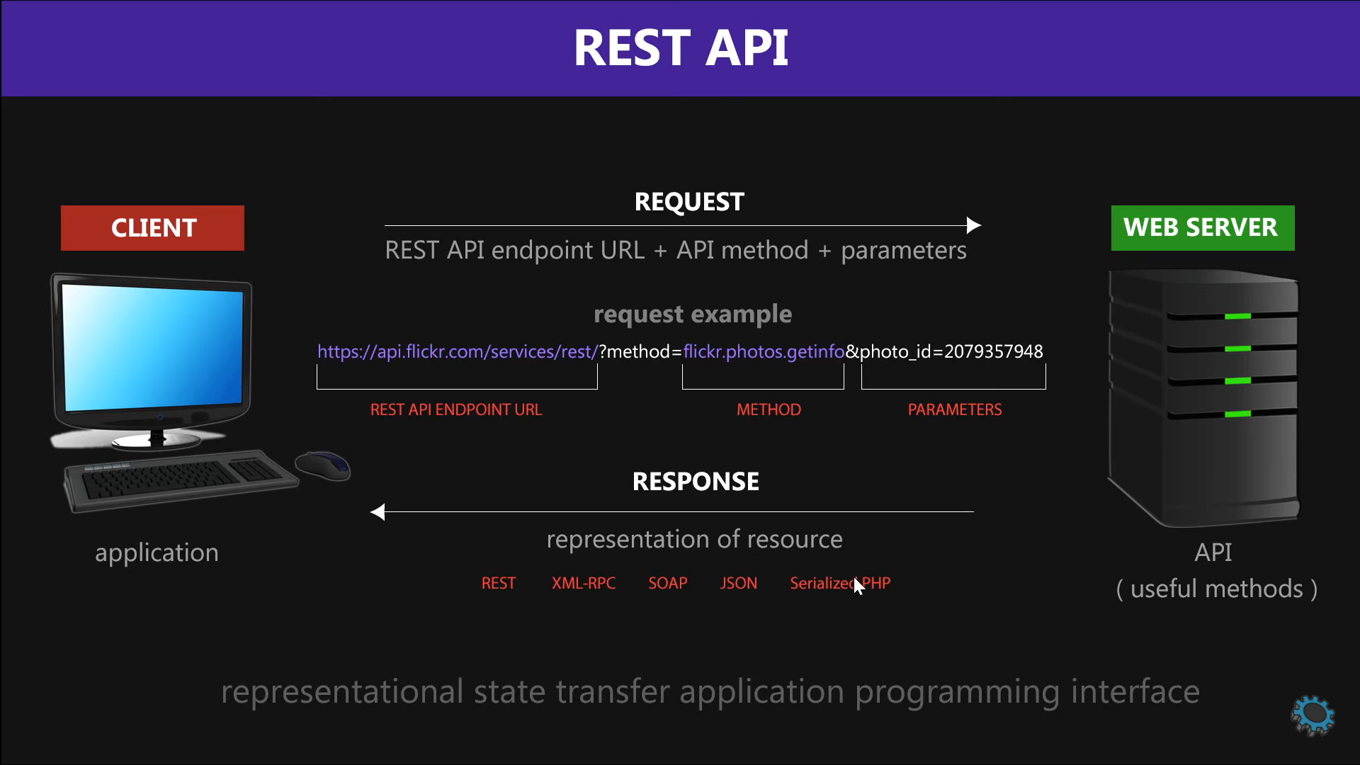

Slide 8
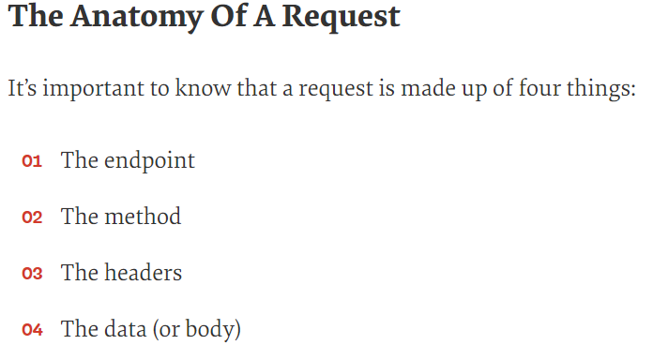
Examining URL
REQUEST
RESPONSE
GET STUDENTS
GET /API/students
[
{id: 1, name: ‘Alphonse ’ },
{id: 2, name: ‘Elric ’ },
….
]
GET A STUDENT
GET /API/ students/ 1
{id: 1, name: ‘Alphonse ’ }
Endpoint: http://una.edu.com/api/students
UPDATE A STUDENT
PUT /API/ students/ 1
{ name: ‘ Roberto’ }
{id: 1, name: ‘Roberto ’ }
DELETE A STUDENT
DELETE /API/ students/ 1
CREATE A STUDENT
POST /API/ students/ 1
{ name: ‘Mustang ’ }
{id: 2, name: ‘Mustang ’ }

Slide 9
References
https://ahmetozlu93.medium.com/mastering-rest-architecture-introduction-28f7f2d67a7
https://www.smashingmagazine.com/2018/01/understanding-using-rest-api/
https://www.bbvaapimarket.com/en/api-world/rest-api-what-it-and-what-are-its-advantages-project-development/
https://roy.gbiv.com/
https://www.tutorialspoint.com/restful/restful_introduction.htm
https://www.youtube.com/watch?v=SLwpqD8n3d0

