Slide 1
Improving the security of "Lukuhaaste" web application
JP Paalassalo 21.5.2021

Slide 2
Scope
Existing single-user MEAN stack web application:
  Perform threat analysis
  New feature: implement user login and access tokens

Slide 3
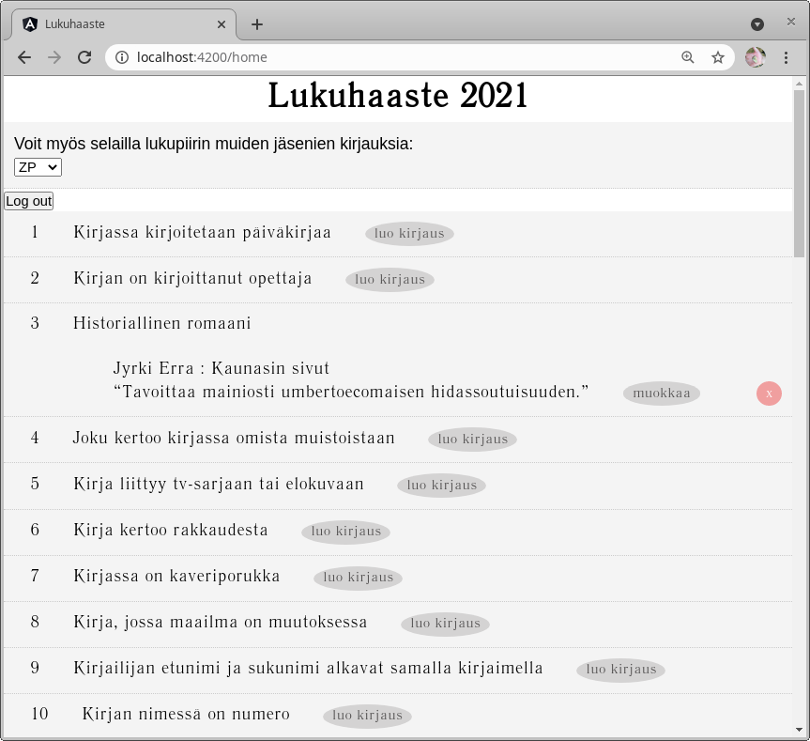
App Functionality
App presents list of reading challenges
User can post achievements including freetext comments

Slide 4
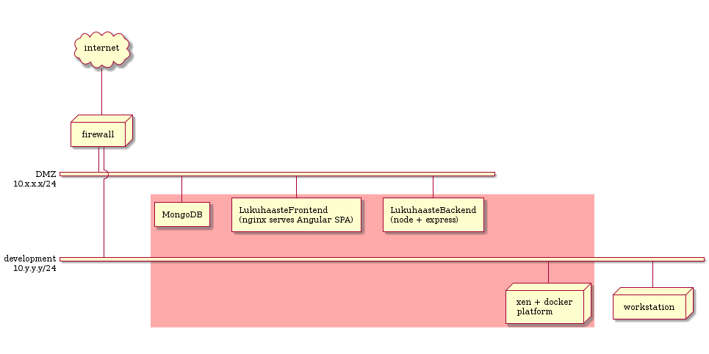
App Deployment
Attack surface contains not only app interfaces, but sysadmin/developer layer too

Slide 5
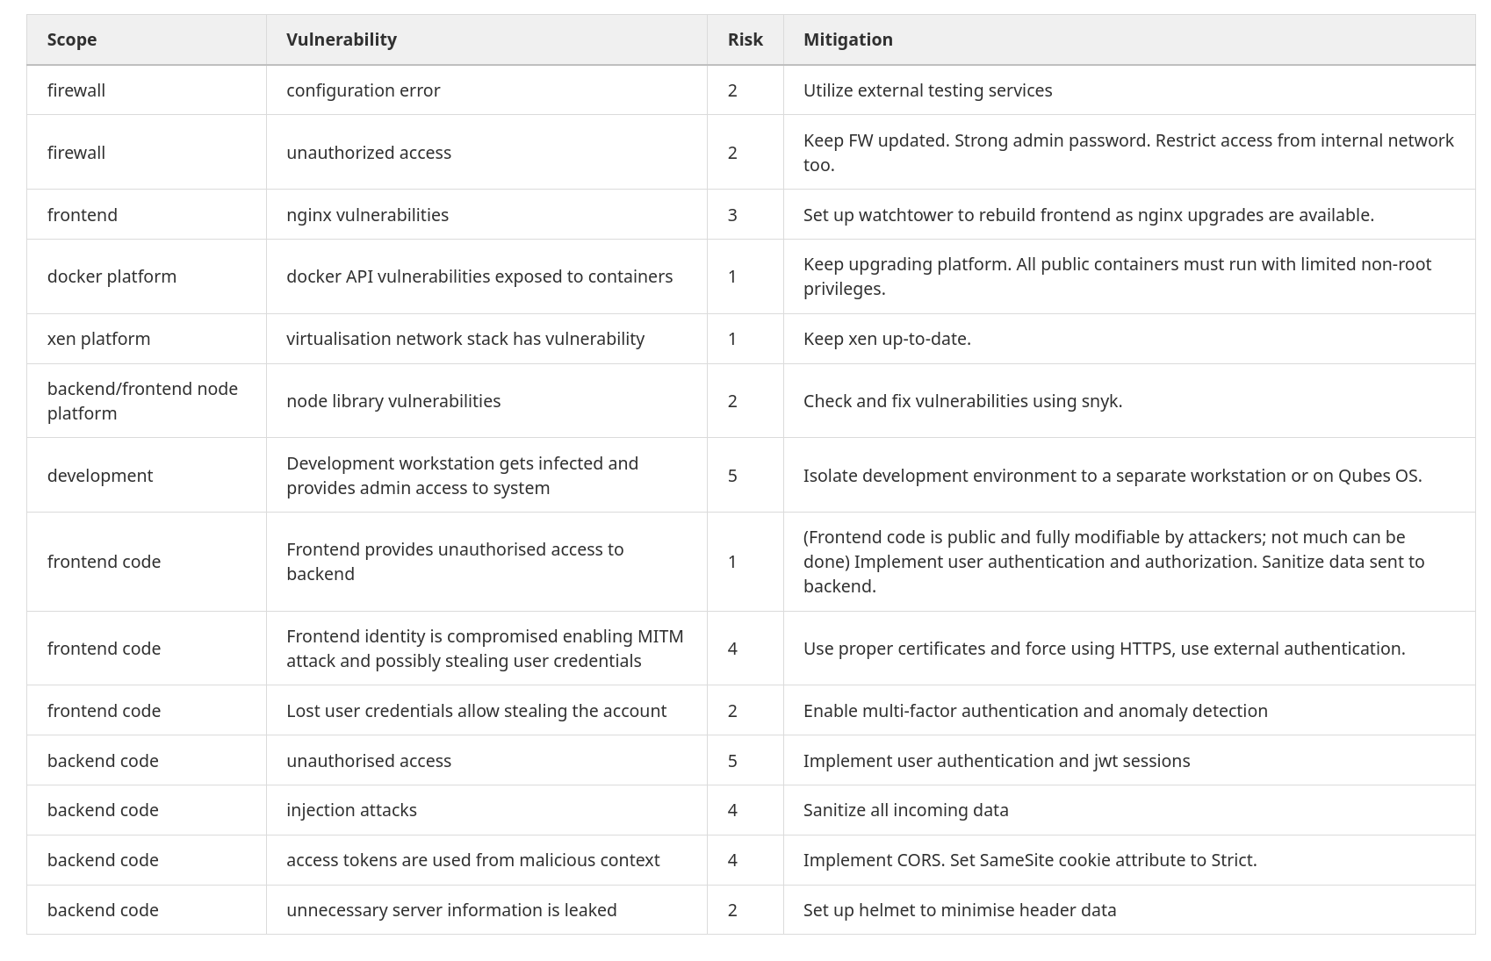
Detailed Threat Analysis

Slide 6
Key Attack Vectors
SPA = public code
Must protect API
[coding]
Must isolate
[process]

Slide 7
Implementing authentication
Decided to use external authentication service
  Separates authentication security issues from app
  Provides MFA if needed
Selected auth0
  Supports google/github etc credentials
  Supports standard authentication protocols: OAuth2, JWT
In SPA context use "Authorization Code Flow with PKCE" (proof Key for Code Exchange).

Slide 8
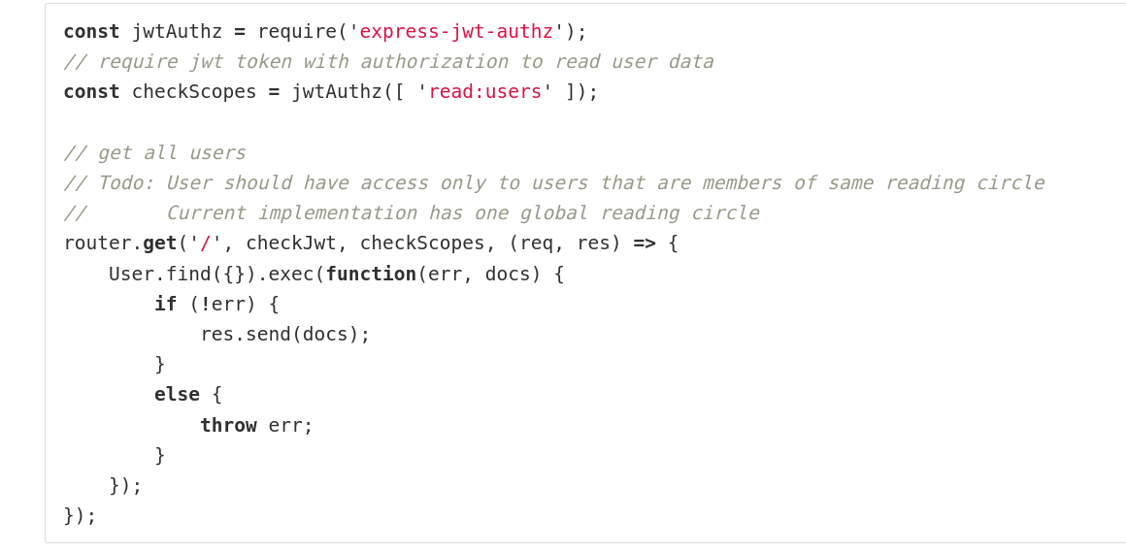
Backend user auth: /api/users

Slide 9
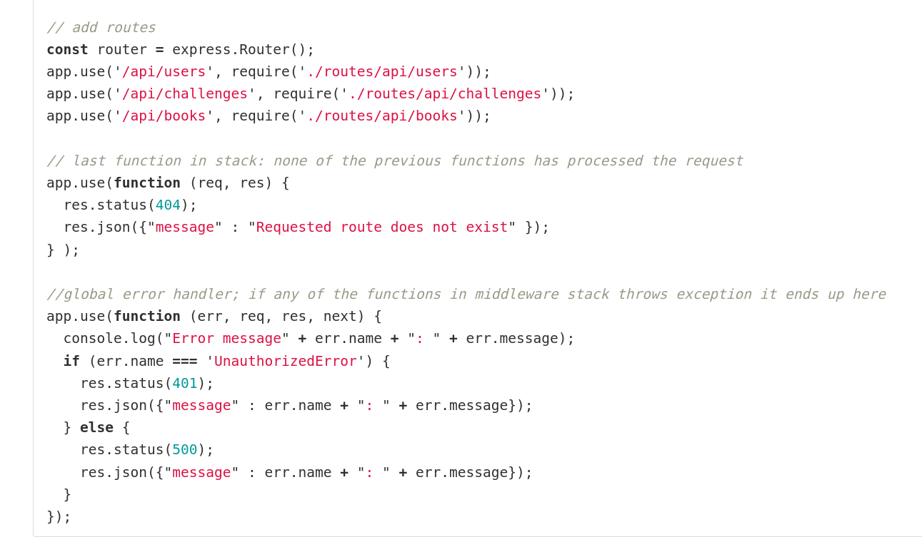
...backend index.js

Slide 10
Testing
Backend: nodejs library vulnerabilities were checked with snyk
  Will send alert emails when new vulnerabilities are found
App testing with OWASP ZAP
  Is a proxy server between browser and app

Slide 11
Dev environment isolation
Tested Qubes OS: enables running isolated VM’s on xen with configurable firewalls for each VM
  Problem: not enough memory on test laptop to run Windows VM’s in order to use Teams efficiently…
  Will use this with next laptop
Set up isolated VM for development, no browsing or unnecessary downloads from that

