Slide 1
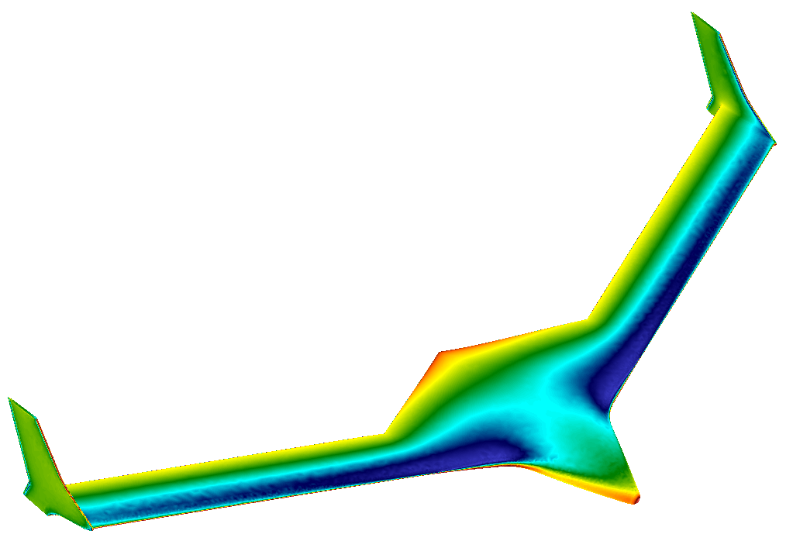
mAEWing1 Steady Fluid Flow CFD Results
April 2, 2015
CMSoft Inc. Updates
Thuan Lieu
Alexandre Coderre-Chabot

Slide 2
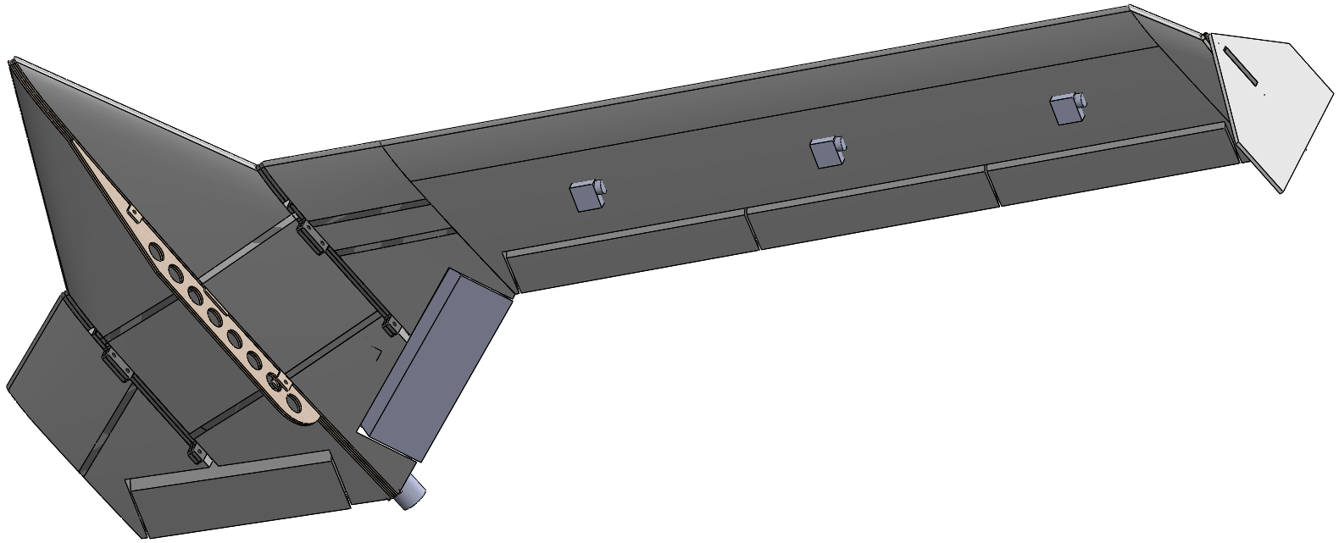
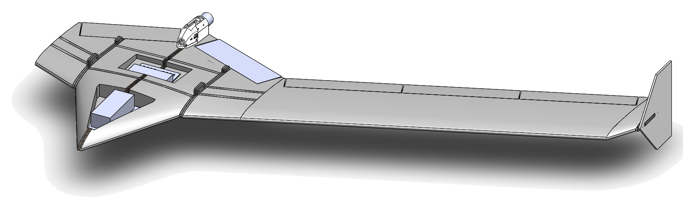
mAEWing1 Full CAD Model

Slide 3
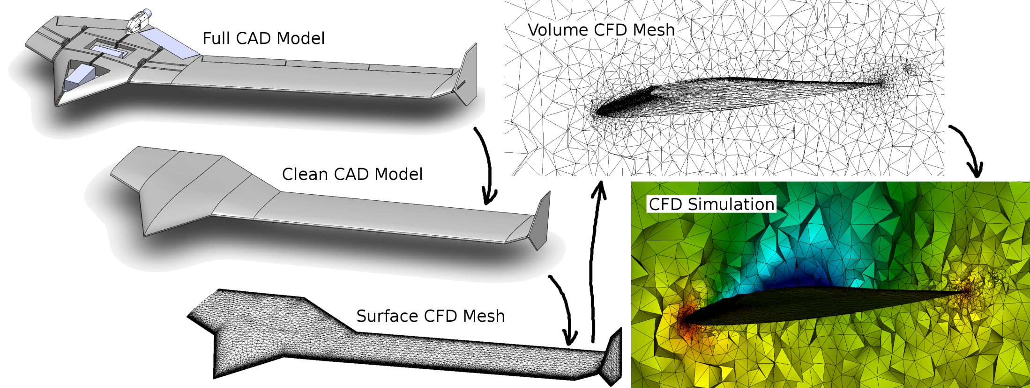
mAEWing1 CFD Procedure

Slide 4
mAEWing1 Parameters
Wing Chord:
c = 11.7 in (from the CAD model)
Root Chord:
c_{root} = 33.5 in (from the CAD model)
Span:
b = 119 in (from the CAD model)
Planform Area:
S = 1,628 in² (from the CAD model)
Reference Area for Lift & Drag Coefficients:
A_{ref} = 1,663 in² (same value used in David Schmidt’s vortex lattice model)

Slide 5
mAEWing1 Parameters
Fluid mesh:
Inviscid: 530,000 nodes
Viscous: 1.6 million nodes, including 20 prism layers
Sea-Level Conditions:
T = 518.67 °R
P = 14.696 lb∙in⁻²
ρ = 1.1463∙10⁻⁷ slug∙ft∙in⁻⁴
μ = 2.5951∙10⁻⁹ slug∙ft∙s⁻¹∙in⁻²
Flight Conditions:
M = 0.11
Re₁ = 36,000 Re_{c} = 763,000

Slide 6
mAEWing1 Comparison with VLM
At sea-level, M = 0.06047 and 0 degrees of angle of attack, we have:
David Schmidt’s VLM Model:
C_{L} = 0.098, C_{D} = 0.00044
CFD Viscous Model:
C_{L} = 0.120, C_{D} = 0.0354

Slide 7
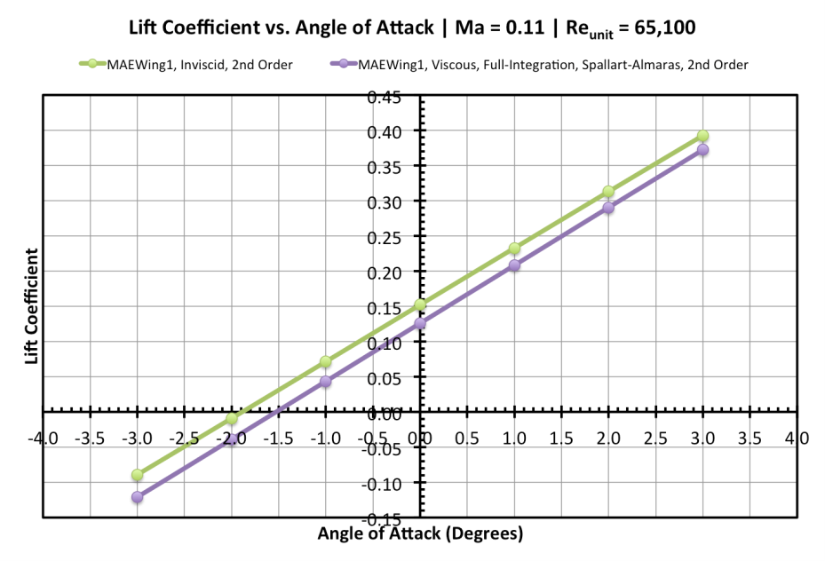
mAEWing1 Steady Fluid Results
Inviscid and viscous use different volume meshes.
Viscous has many more nodes near the surface.

Slide 8
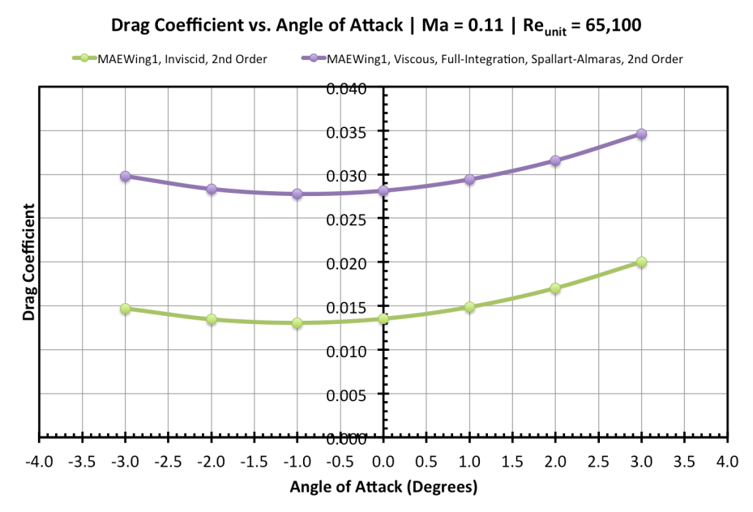
mAEWing1 Steady Fluid Results
Viscous captures the boundary layer.

Slide 9
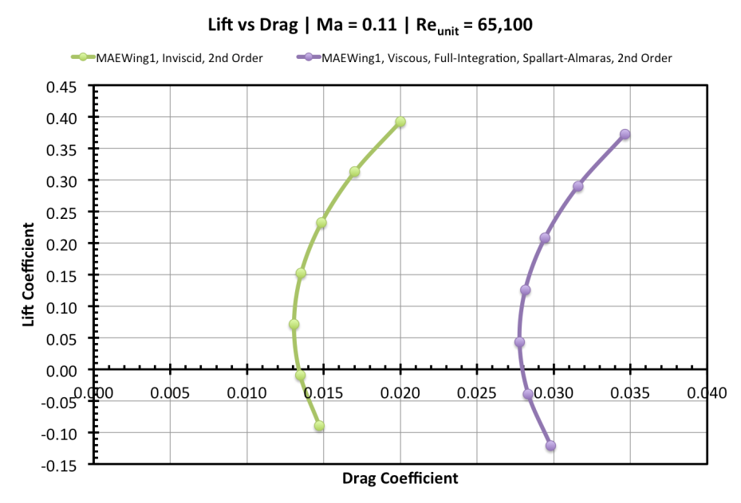
mAEWing1 Steady Fluid Results

Slide 10
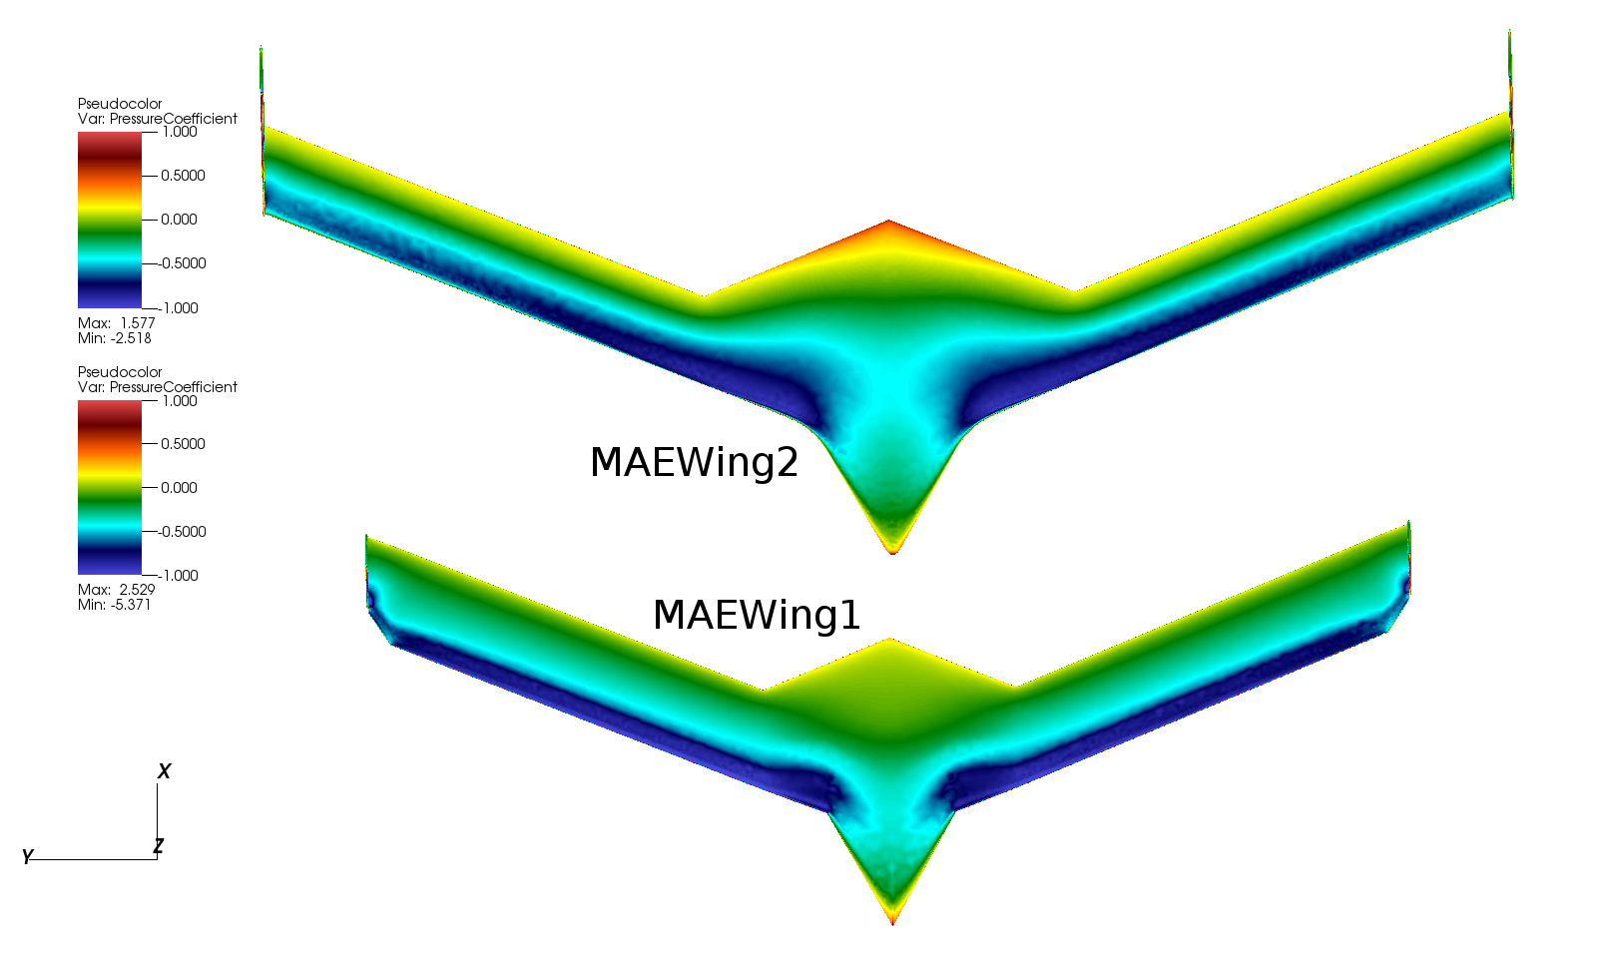
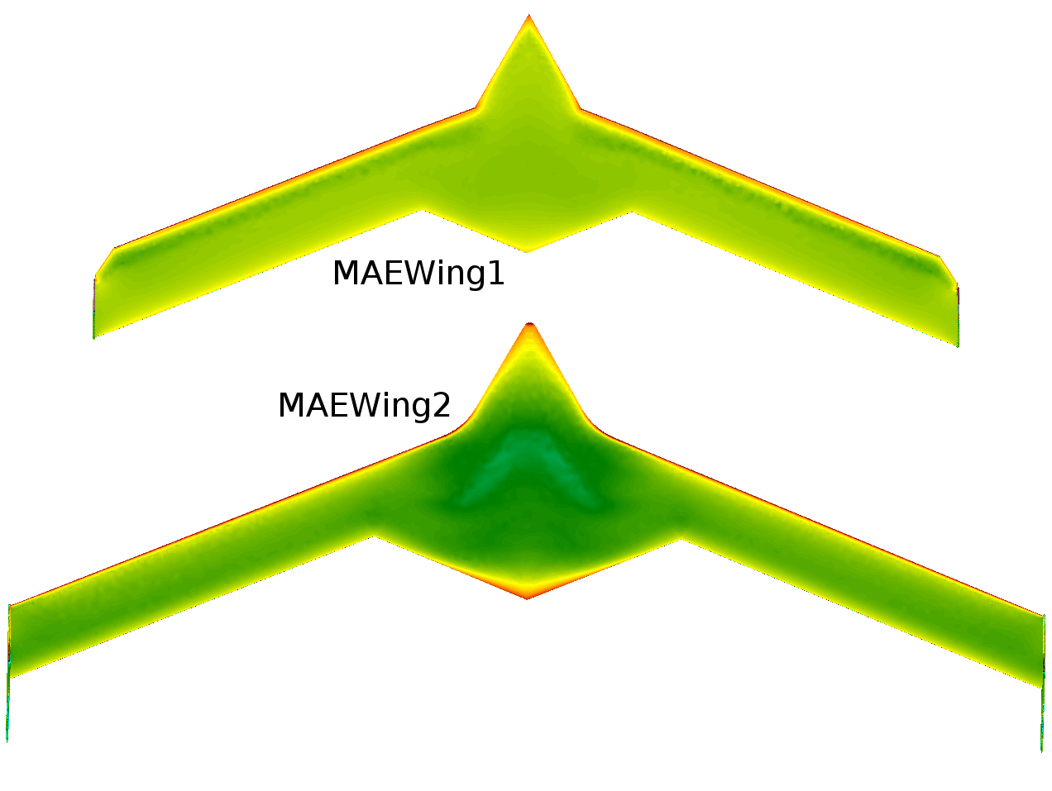
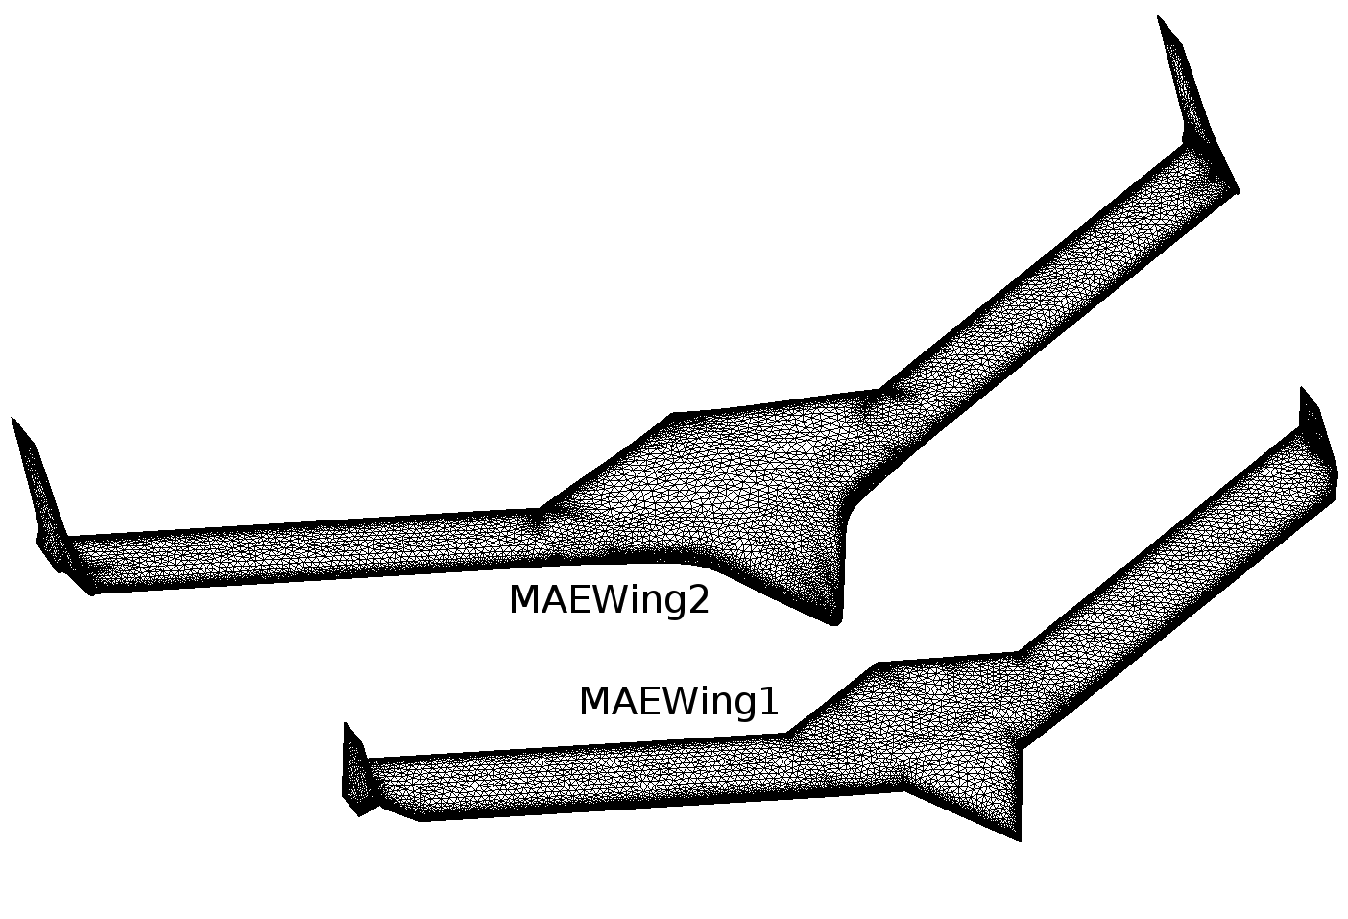
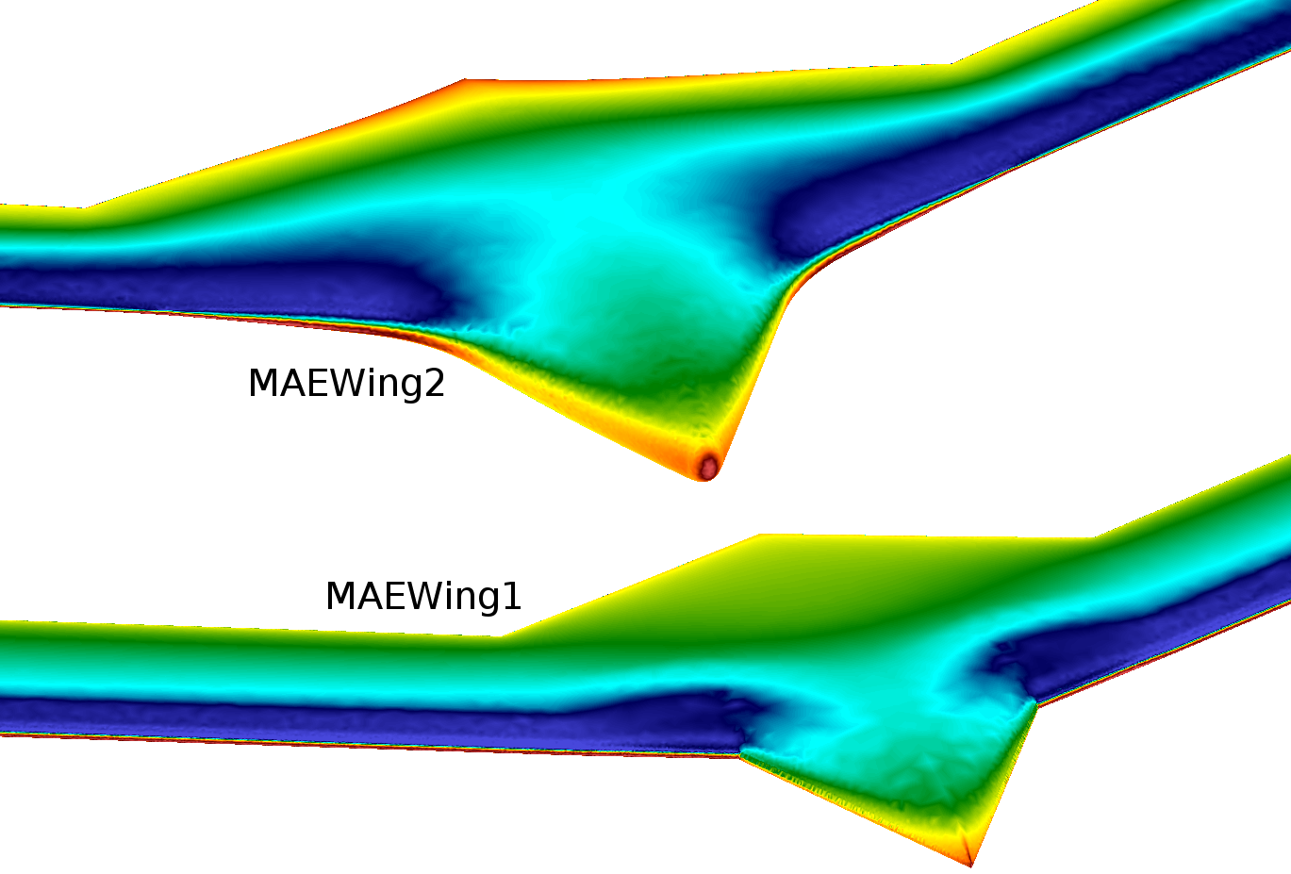
mAEWing1 & mAEWing2 Steady Fluid Results

Slide 11
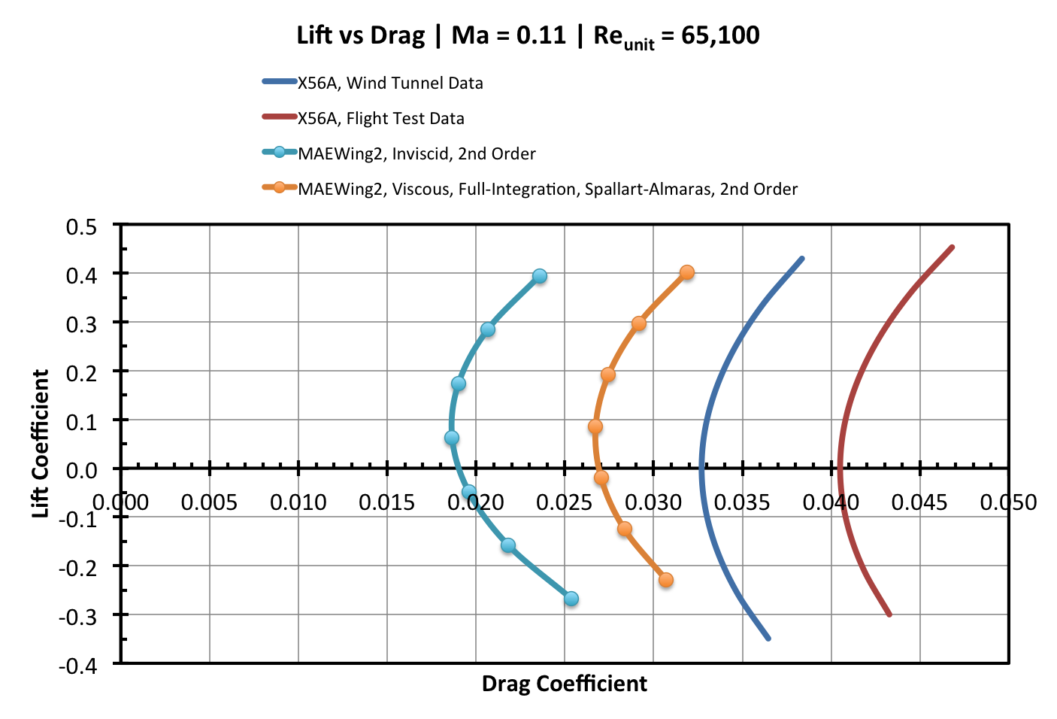
mAEWing2 Steady Fluid Results
Reference Area for Lift & Drag Coefficients:
A_{ref} = 1,482 in² (Span x Wing Chord)

Slide 12
Questions?
Thuan Lieu
tlieu@cmsoftinc.com
Alexandre Coderre-Chabot
acoderre@cmsoftinc.com

