Slide 1
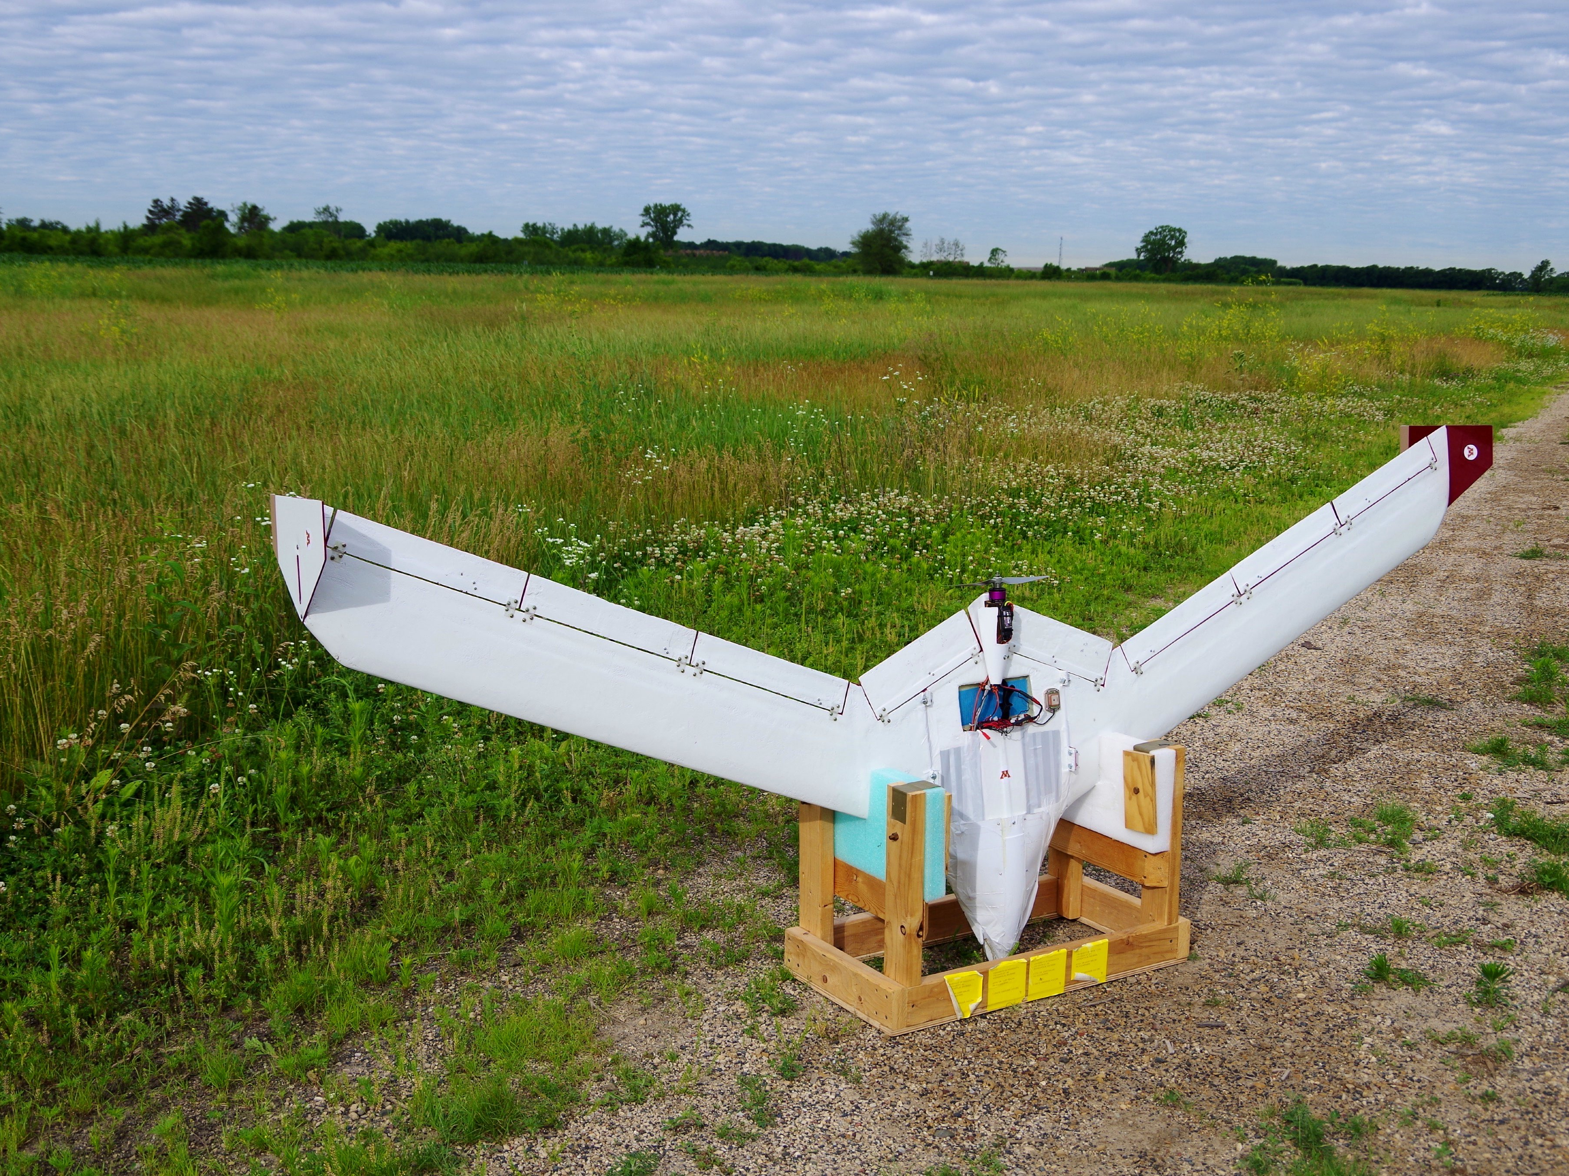
PAAW / ASE Group Design Build and Test Status Update April 2, 2015

Slide 2
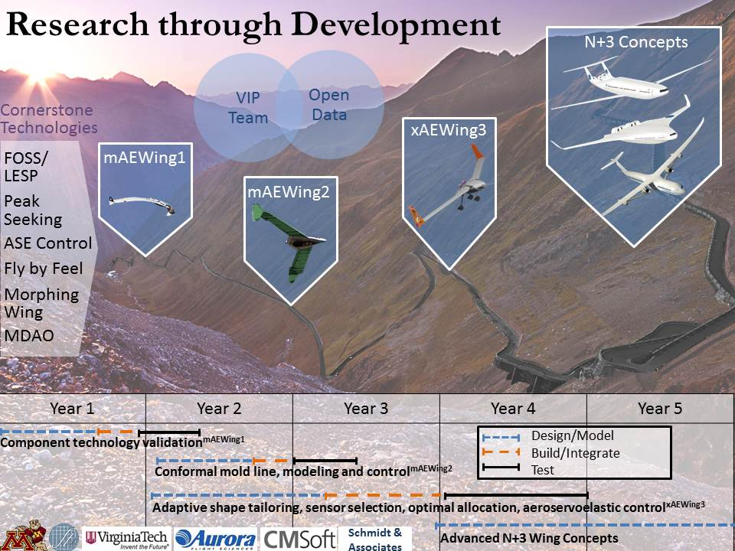

Slide 3
Design, Build, and Test Status
mAEWing1
Design v2.3 released
Considered the Build-to configuration for the structure
Wiring and system installation definition in-work (ECD 4/10)
Build
Wings nearing completion
Actuators and linkages installed
Final wiring and installation of accelerometer on-hold for parts (ECD 4/7)
Centerbody held for parts
Test
Static and Dynamic wing tests complete for spars and wing forms
Wing static and dynamic test (ECD 4/10)
Freeplay test conducted,
mAEWing2
xAEWing3

Slide 4
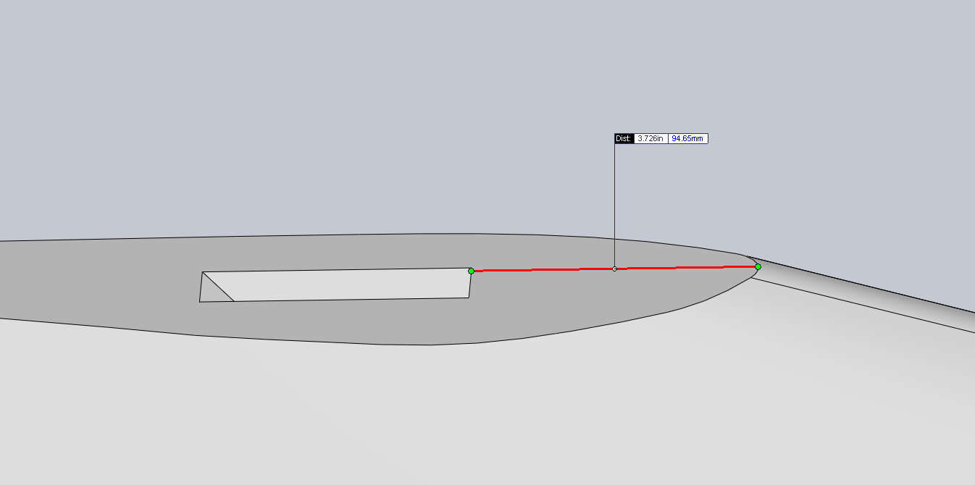
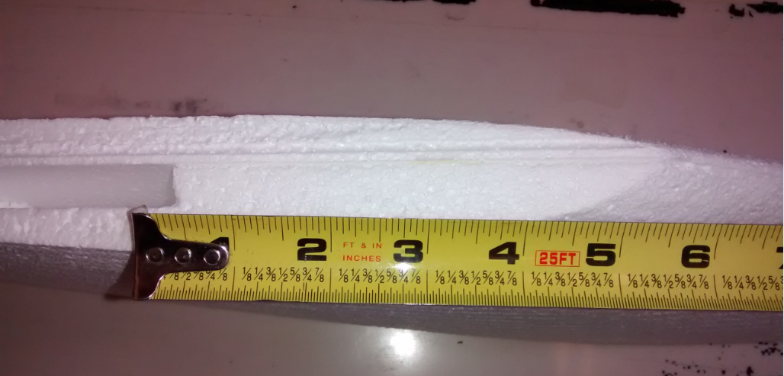
mAEWing1 Centerbody
Foam Components Received
~2” out of tolerance
Supplier working remake, due next week

Slide 5
mAEWing1 Wing Test Results
Wings are stiffer and heavier than desired
Excess adhesive used to bond the wing foam to the spar
Left wing was very excessive, Right wing was slightly excessive
Clear effect on weight, Unknown effect on stiffness
Left Wing
Right Wing
 | Mass (g) | EI (N-m^2) | GJ (N-m^2)
Target |  | 97.65 | 56.48
Predicted | Spar: 264 Wing Form: 365 Wing Form w/Fiber: 736 Complete Wing: 1354 | 97.43 | 59.13
Spar #6 | 312 | 105.95 (std = 5.40%) | 73.83 (std = 4.45%)
Wing Form | 693 | 143.89 (std = 7.13%) | 108.21 (std = 10.56%)
Wing Form w/ Fiberglass | 1126
Complete Wing
Complete Wing w/Cuts
 | Mass (g) | EI (N-m^2) | GJ (N-m^2)
Target |  | 97.65 | 56.48
Predicted | Spar: 264 Wing Form: 365 Wing Form w/Fiber: 736 Complete Wing: 1354 | 97.43 | 59.13
Spar #5 | 308 | 108.81 (std = 4.98%) | 81.59 (std = 2.63%)
Wing Form | 663 | 127.96 (std = 2.54%) | 95.21 (std = 13.43%)
Wing Form w/ Fiberglass
Complete Wing
Complete Wing w/Cuts

Slide 6
mAEWing1 – Work Burndown
Completion slipped at least 1 week
Held for parts; centerbody foam, plywood, hinges

