Slide 1
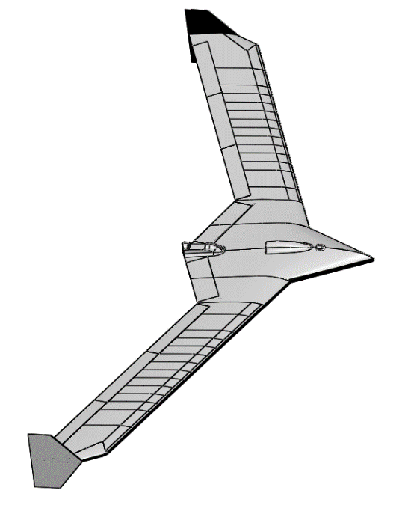
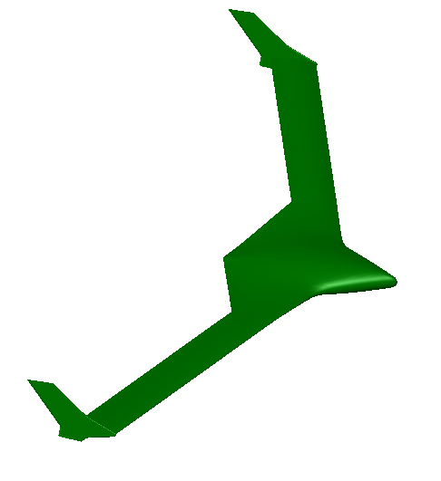
mAEWing1
Based on BFF / mini MUTT
10 ft span
mAEWing2
Scaled down X-56
About a 12 ft span
Differences in airfoil, center-body, wing shoulder, wing chord, and winglet from BFF

Slide 2

Set of low drag shapes
May be a lookup table or parameterized
Similar to Nhan Nguyen’s “Elastically Shaped Future Air Vehicle Concept” paper
Explore range of bending and twist of mAEWing2 to find minimum drag shapes

Slide 3
Determine Flexibility Needed to Achieve Shape
Determine Flutter Modes and Frequencies
Optimize Control Surface and Sensor Layout
Performance Criteria (Rigid Body and Flex Control)
Control Analysis using ROMs
Generate ROMs

Slide 4
Validate Aerodynamic Shape
Optimize Structural Design (spar dimensions & position)
Detailed Control Design
Fly
Validate Structural Model, Update Models and Control Laws
Build mAEWing2

