Slide 1

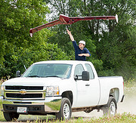
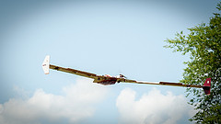
Overview of ASE (Control-Oriented) Modeling Approach January 22, 2015

Slide 2
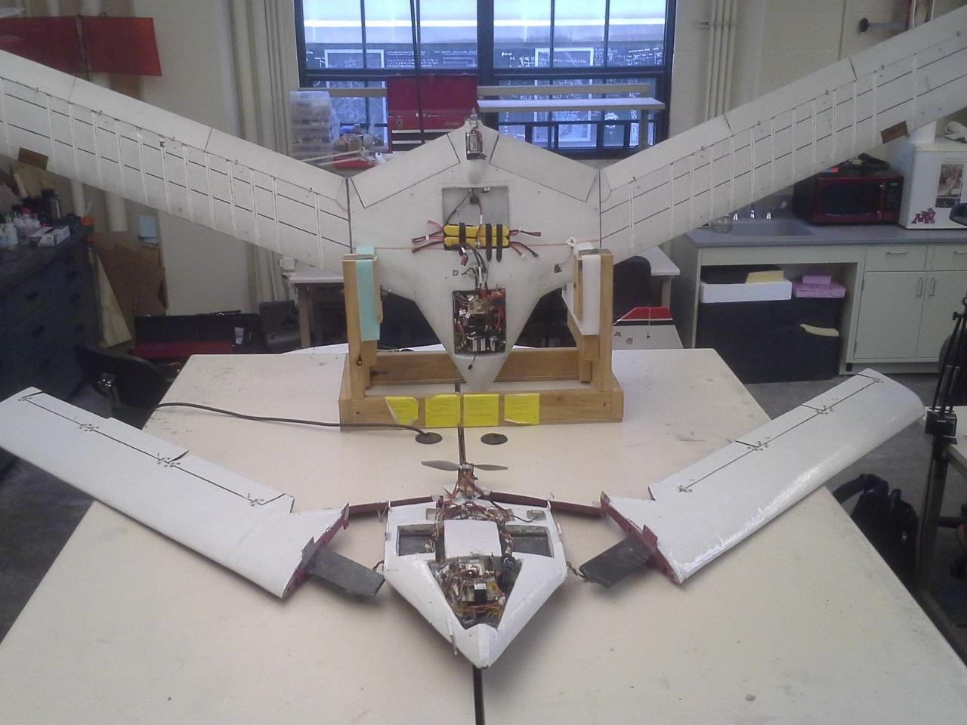
BFF and Mini-Mutt

Slide 3
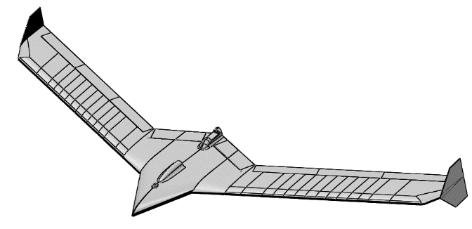
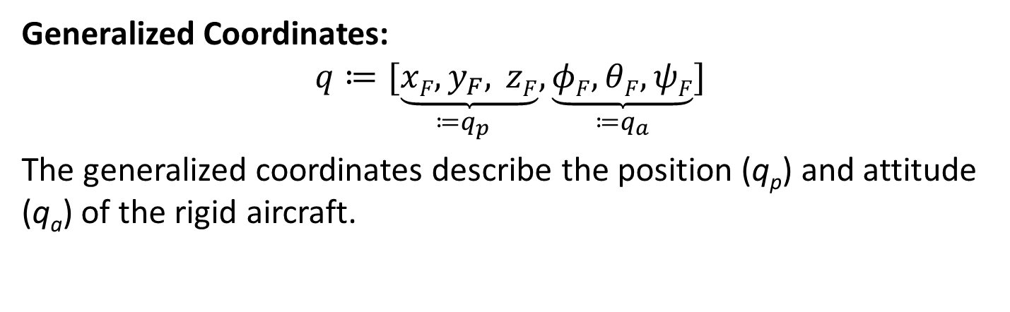
Rigid Body: Standard Lagrangian Formulation
Generalized Coordinates:
$$q≔\underset{≔q_{p}}{[\underbrace{xF,y_{F}, zF}}, \underset{≔q_{a}}{\underbrace{φF, θF, ψF}}]$$
The generalized coordinates describe the position (q_{p}) and attitude (q_{a}) of the rigid aircraft.
i_{F}
O_{F}
i_{I}
j_{F}
O_{I}
j_{I}
k_{F}
k_{I}
Inertial Frame
Aircraft (Fuselage) Frame

Slide 4
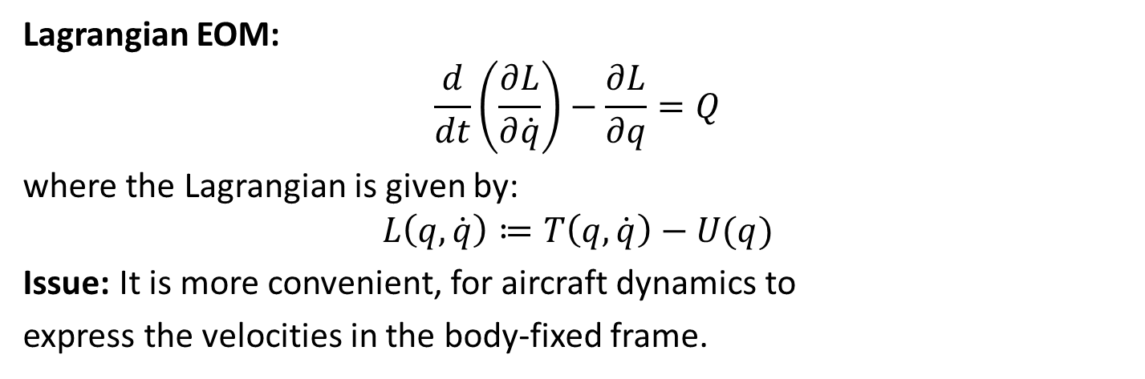
Rigid Body: Standard Lagrangian Formulation
Lagrangian EOM:
$$\frac{d}{dt}\left(\frac{∂L}{∂\dot{q}}\right)−\frac{∂L}{∂q}=Q$$
where the Lagrangian is given by:
$$L\left(q,\dot{q}\right)≔T\left(q,\dot{q}\right)−U(q)$$
Issue: It is more convenient, for aircraft dynamics to
express the velocities in the body-fixed frame.
i_{F}
O_{F}
i_{I}
j_{F}
O_{I}
j_{I}
k_{F}
k_{I}
Inertial Frame
Aircraft (Fuselage) Frame

Slide 5
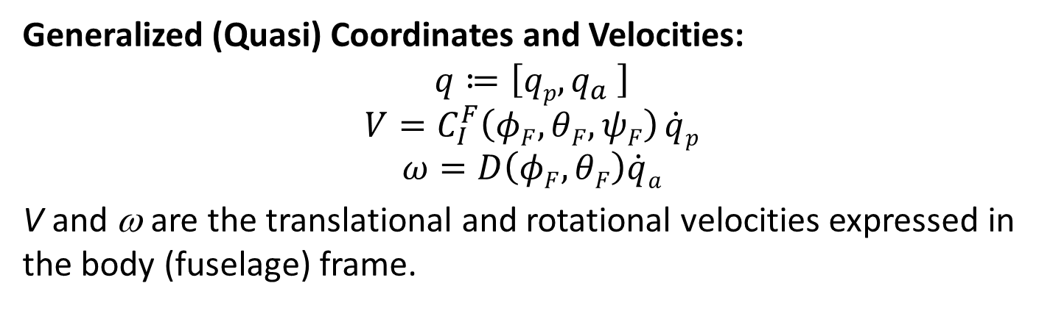
Rigid Body: Lagrangian with Quasi-Velocities
Generalized (Quasi) Coordinates and Velocities:
$$q≔\left[qp,q_{a} \right]$$
$$V=C_{I}^{F}\left(φF, θF, ψF\right) \dot{q}p$$
$$ω=D\left(φF, θF\right)\dot{q}a$$
V and ω are the translational and rotational velocities expressed in the body (fuselage) frame.
i_{F}
O_{F}
i_{I}
j_{F}
O_{I}
j_{I}
k_{F}
k_{I}
Inertial Frame
Aircraft (Fuselage) Frame

Slide 6

Notation
Given a 3-by-1 vector r, define r^{x} as the following 3-by-3 skew symmetric matrix:
$$r^{×}≔\left[\begin{matrix}0 & −r3 & r2 \\ r3 & 0 & −r1 \\ −r2 & r1 & 0\end{matrix}\right]$$

Slide 7
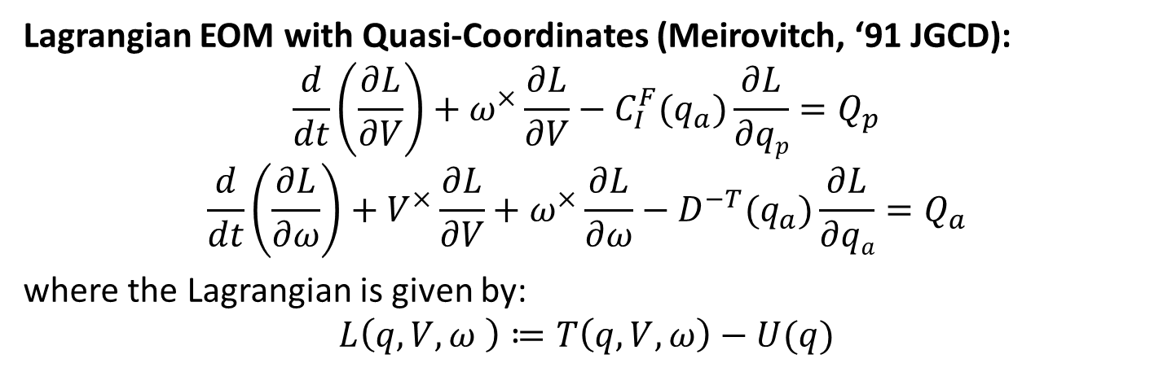
Rigid Body: Lagrangian with Quasi-Velocities
Lagrangian EOM with Quasi-Coordinates (Meirovitch, ‘91 JGCD):
$$\frac{d}{dt}\left(\frac{∂L}{∂V}\right)+ω^{×}\frac{∂L}{∂V}−C_{I}^{F}(q_{a})\frac{∂L}{∂qp}=Q_{p}$$
$$\frac{d}{dt}\left(\frac{∂L}{∂ω}\right)+V^{×}\frac{∂L}{∂V}+ω^{×}\frac{∂L}{∂ω}−D^{−T}(q_{a})\frac{∂L}{∂qa}=Q_{a}$$
where the Lagrangian is given by:
$$L\left(q,V,ω \right)≔T\left(q,V,ω\right)−U(q)$$
i_{F}
O_{F}
i_{I}
j_{F}
O_{I}
j_{I}
k_{F}
k_{I}
Inertial Frame
Aircraft (Fuselage) Frame

Slide 8
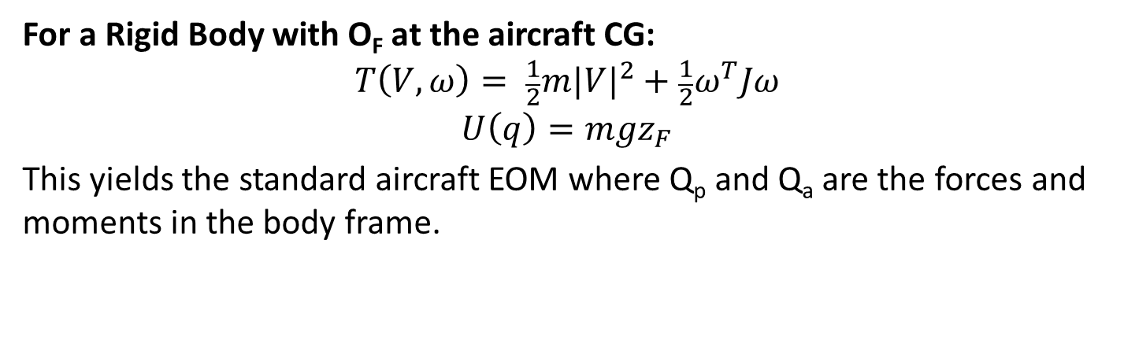
Rigid Body: Lagrangian with Quasi-Velocities
For a Rigid Body with O_{F} at the aircraft CG:
$$T\left(V,ω\right)= \frac{1}{2}m{|V|}^{2}+\frac{1}{2}ω^{T}Jω$$
$$U\left(q\right)=mgz_{F}$$
This yields the standard aircraft EOM where Q_{p} and Q_{a} are the forces and moments in the body frame.
i_{F}
O_{F}
i_{I}
j_{F}
O_{I}
j_{I}
k_{F}
k_{I}
Inertial Frame
Aircraft (Fuselage) Frame

Slide 9
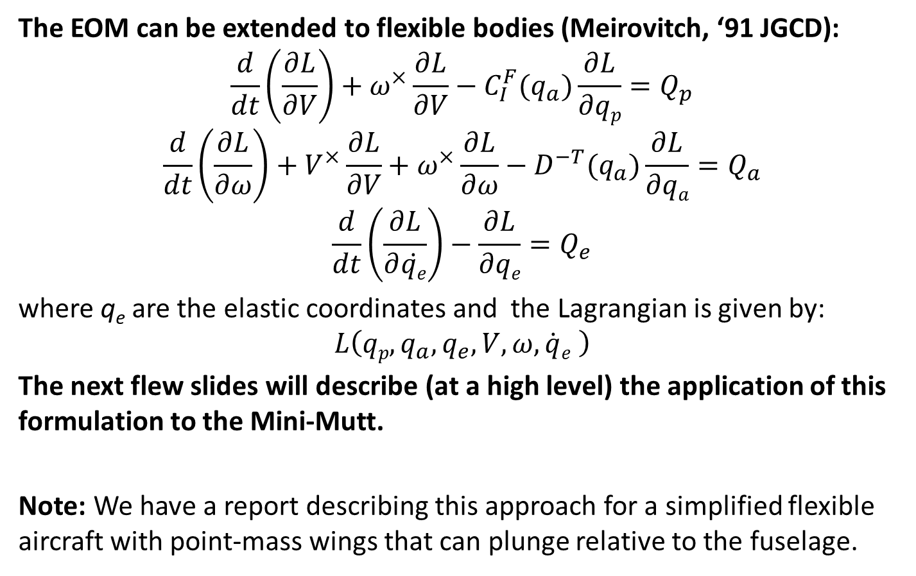
Extension to Flexible Bodies
The EOM can be extended to flexible bodies (Meirovitch, ‘91 JGCD):
$$\frac{d}{dt}\left(\frac{∂L}{∂V}\right)+ω^{×}\frac{∂L}{∂V}−C_{I}^{F}(q_{a})\frac{∂L}{∂qp}=Q_{p}$$
$$\frac{d}{dt}\left(\frac{∂L}{∂ω}\right)+V^{×}\frac{∂L}{∂V}+ω^{×}\frac{∂L}{∂ω}−D^{−T}(q_{a})\frac{∂L}{∂qa}=Q_{a}$$
$$\frac{d}{dt}\left(\frac{∂L}{∂\dot{qe}}\right)−\frac{∂L}{∂qe}=Q_{e}$$
where q_{e} are the elastic coordinates and the Lagrangian is given by:
$$L\left(qp,q_{a},q_{e},V,ω,\dot{q}e \right)$$
The next flew slides will describe (at a high level) the application of this formulation to the Mini-Mutt.
Note: We have a report describing this approach for a simplified flexible aircraft with point-mass wings that can plunge relative to the fuselage.

Slide 10
Mini-Mutt Components
Right Wing
Fuselage
Left Wing
Assumptions:
1. The fuselage is a rigid body.
2. The wings are rigidly attached to the fuselage.
3. Rigid wings are shown but we’ll focus on the flexible wing case.
Assume the wings can plunge and twist only (Details on following slides)

Slide 11
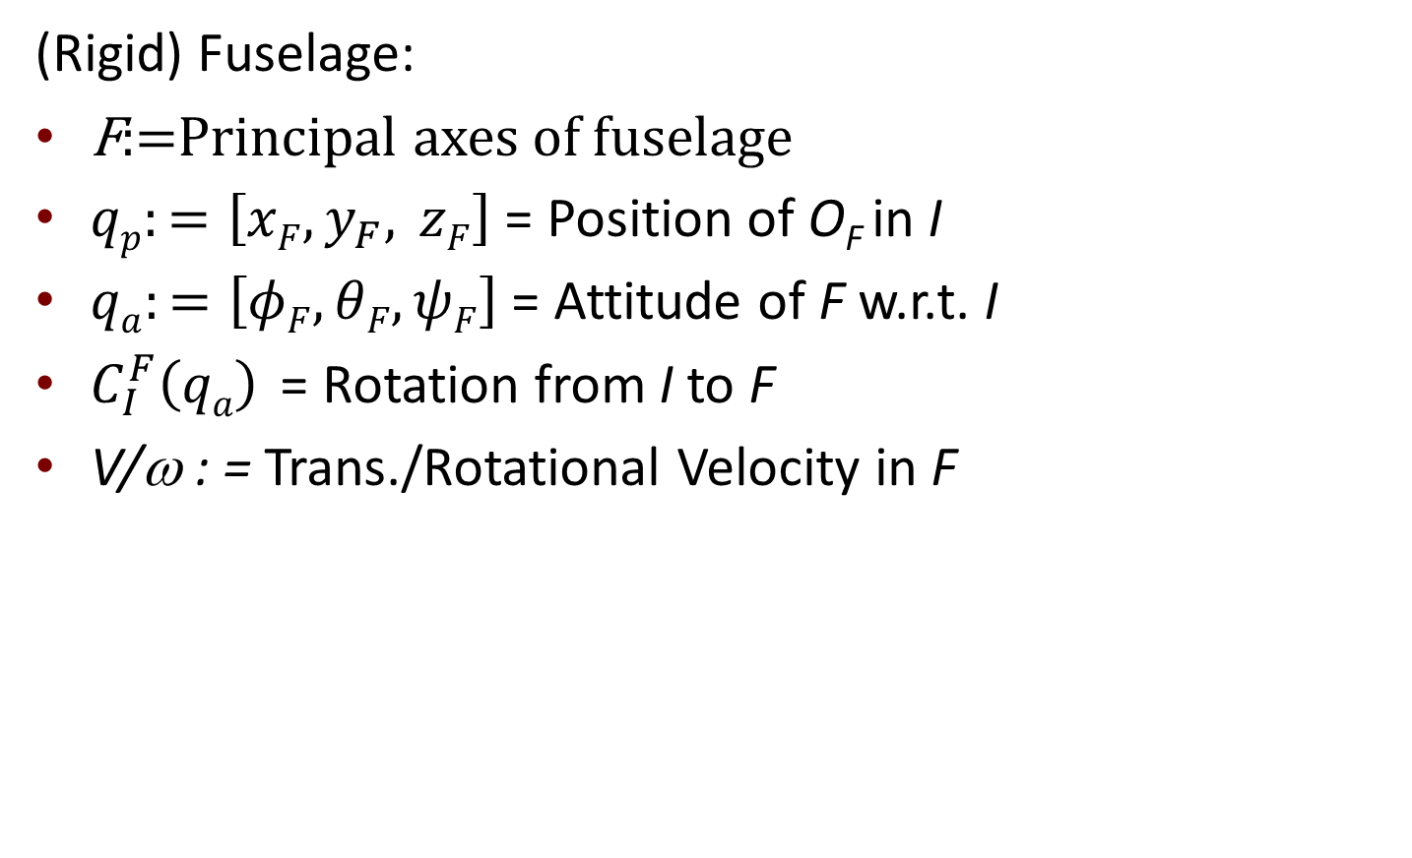
Coordinates: Fuselage
(Rigid) Fuselage:
F:=Principal axes of fuselage
$qp:=\left[xF,y_{F}, zF\right]$ = Position of O_{F} in I
$qa:=\left[φF, θF, ψF\right]$ = Attitude of F w.r.t. I
$C_{I}^{F}\left(qa\right)$ = Rotation from I to F
V/ω : = Trans./Rotational Velocity in F
O_{F}
i_{F}
j_{F}
k_{F}
i_{I}
O_{I}
j_{I}
k_{I}
Inertial Frame
Aircraft (Fuselage) Frame

Slide 12
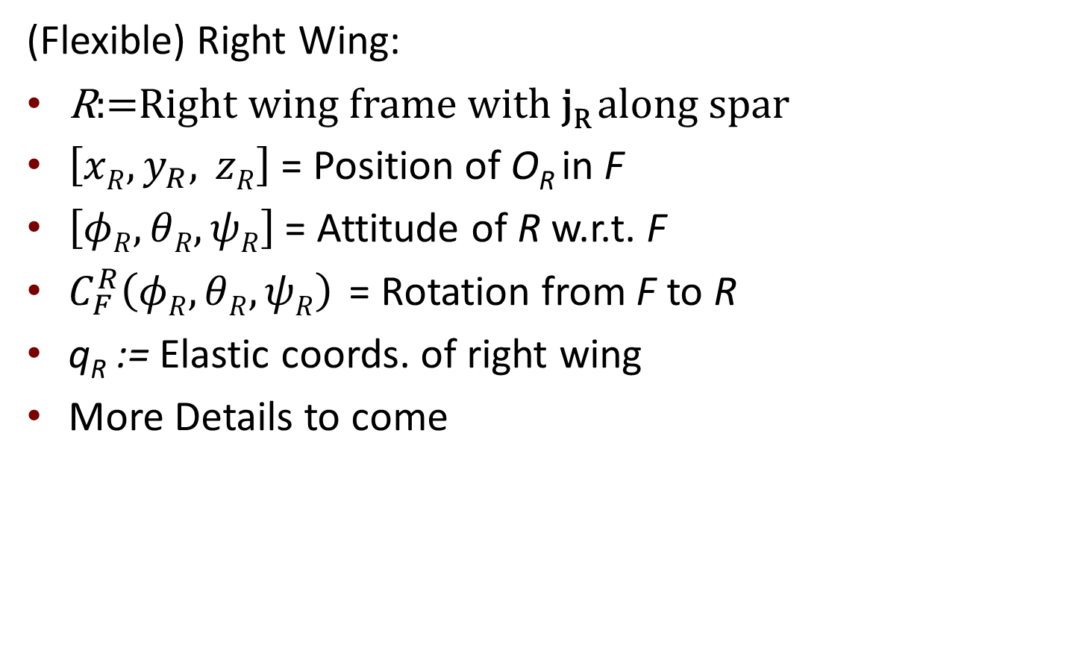
Coordinates: Right Wing
(Flexible) Right Wing:
R:=Right wing frame with j_{R} along spar
$\left[xR,y_{R}, zR\right]$ = Position of O_{R} in F
$\left[φR, θR, ψR\right]$ = Attitude of R w.r.t. F
$C_{F}^{R}\left(φR, θR, ψR\right)$ = Rotation from F to R
q_{R} := Elastic coords. of right wing
More Details to come
O_{F}
i_{F}
j_{F}
i_{R}
O_{R}
k_{F}
j_{R}
i_{I}
k_{R}
O_{I}
j_{I}
k_{I}
Inertial Frame
Right Wing Frame

Slide 13

Coordinates: Left Wing
(Flexible) Left Wing:
L:=Left wing frame with j_{L} along spar
$\left[xL,y_{L}, zL\right]$ = Position of O_{L} in F
$\left[φL, θL, ψL\right]$ = Attitude of L w.r.t. F
$C_{F}^{L}\left(φL, θL, ψL\right)$ = Rotation from F to L
q_{L} := Elastic coords. of left wing
More details to come
j_{L}
O_{L}
i_{L}
O_{F}
k_{L}
i_{F}
j_{F}
i_{R}
O_{R}
k_{F}
j_{R}
i_{I}
k_{R}
O_{I}
j_{I}
k_{I}
Inertial Frame
Left Wing Frame
Note: We use L for both the left wing frame and the Lagrangian.

Slide 14
Lagrangian
The next few slides build the Lagrangian from the three main components of the Mini-Mutt
Fuselage
Right Wing
Left Wing
Each component contributes
Kinetic energy
Graviational potential energy
Elastic potential energy (wings only)

Slide 15
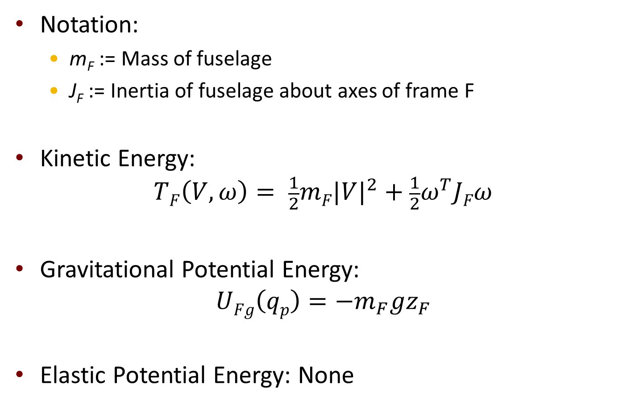
Energy: Fuselage
Notation:
m_{F} := Mass of fuselage
J_{F} := Inertia of fuselage about axes of frame F
Kinetic Energy:
$$TF\left(V,ω\right)= \frac{1}{2}mF{|V|}^{2}+\frac{1}{2}ω^{T}JFω$$
Gravitational Potential Energy:
$$UFg\left(qp\right)={−m}_{F}gz_{F}$$
Elastic Potential Energy: None

Slide 16
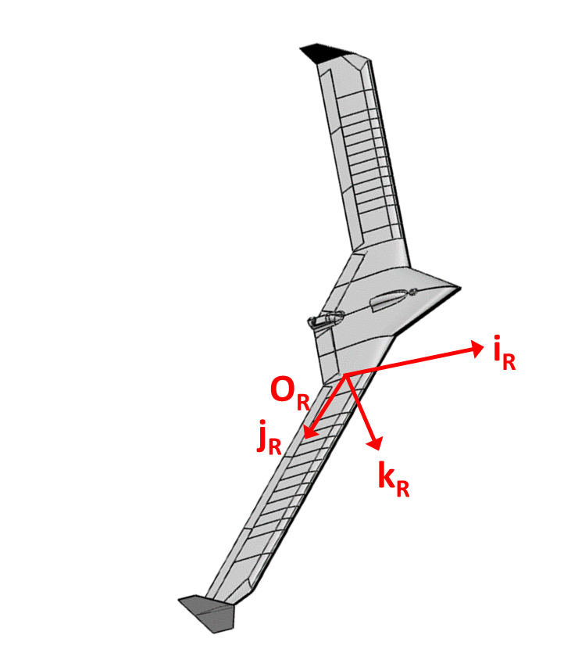
Right Wing: Deformation
Assume:
Wing can bend in the k_{R} direction, denoted b_{R}(y,t)
Wing can twist about the j_{R} axis, denoted γ_{R}(y,t)
Other deformations are negligible
Bending/Twisting stiffness is provided entirely by the spar and is uniform along span (EI / GJ)
O_{R}
y
j_{R}
b_{R}(y,t)
γ_{R}(y,t)
k_{R}

Slide 17
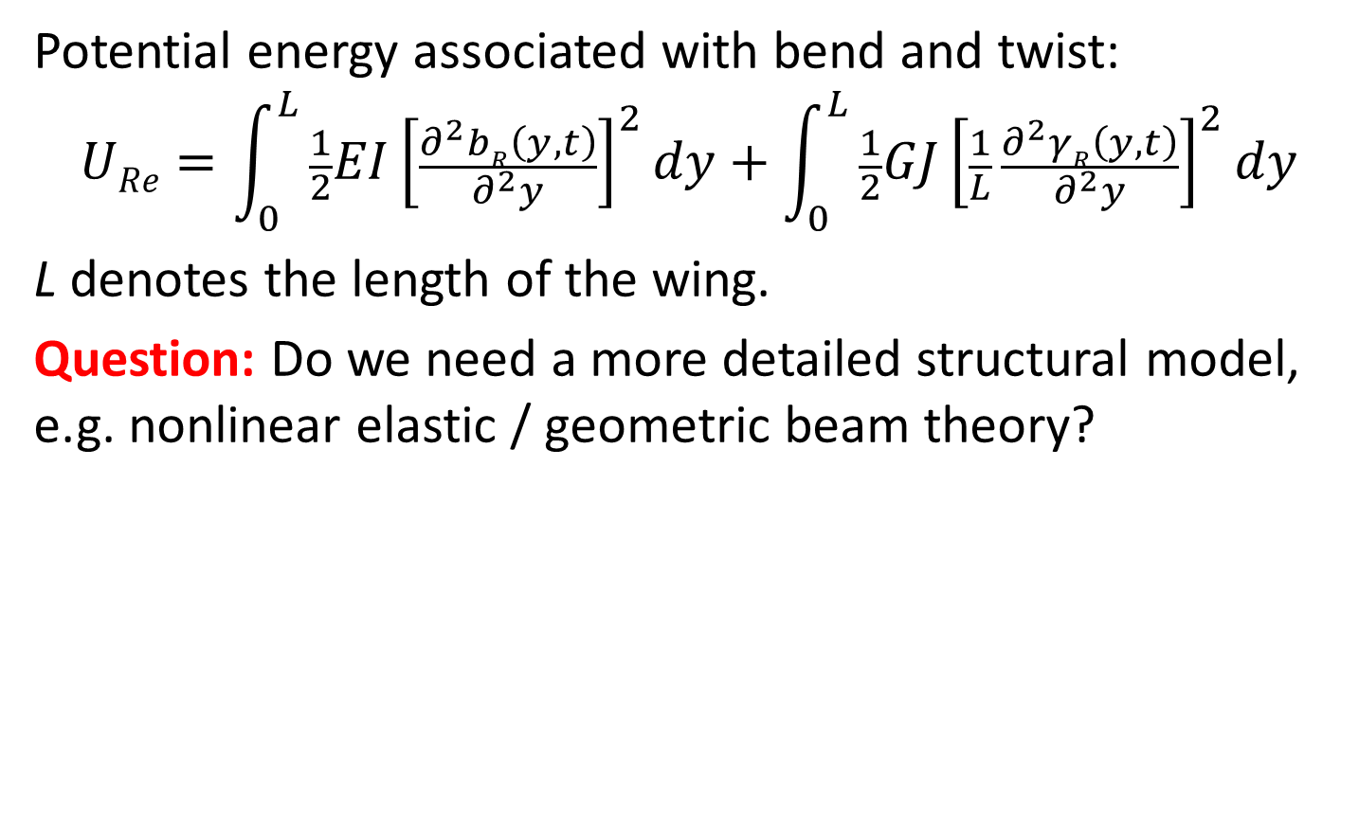
Right Wing: Elastic Potential Energy
Potential energy associated with bend and twist:
$$URe=\int_{0}^{L}{\frac{1}{2}EI{\left[\frac{∂^{2}bR\left(y,t\right)}{∂^{2}y}\right]}^{2}dy}+\int_{0}^{L}{\frac{1}{2}GJ{\left[\frac{1}{L} \frac{∂^{2}γR\left(y,t\right)}{∂^{2}y}\right]}^{2}dy}$$
L denotes the length of the wing.
Question: Do we need a more detailed structural model, e.g. nonlinear elastic / geometric beam theory?
O_{R}
y
j_{R}
b_{R}(y,t)
γ_{R}(y,t)
k_{R}

Slide 18
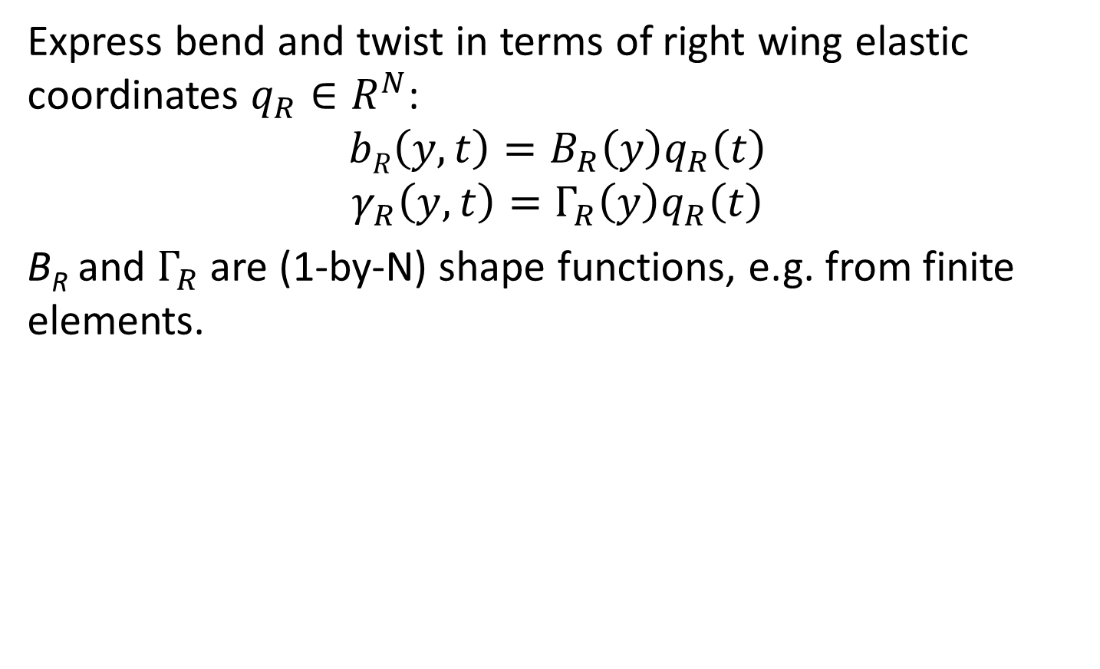
Right Wing: Shape Functions
Express bend and twist in terms of right wing elastic coordinates $q_{R}∈R^{N}$:
$$bR\left(y,t\right)=B_{R}\left(y\right)q_{R}\left(t\right)$$
$$γ_{R}\left(y,t\right)=Γ_{R}\left(y\right)q_{R}\left(t\right)$$
B_{R} and $Γ_{R}$ are (1-by-N) shape functions, e.g. from finite elements.
O_{R}
y
j_{R}
b_{R}(y,t)
γ_{R}(y,t)
k_{R}

Slide 19

Right Wing: Elastic Potential Energy
Express elastic potential energy in terms of q_{R}:
$$URe\left(q_{R}\right)=q_{R}^{T}Kq_{R}$$
where
$$K:=\int_{0}^{L}{\frac{1}{2}EI{\frac{∂^{2}BR\left(y\right)}{∂^{2}y}}^{T}\frac{∂^{2}BR\left(y\right)}{∂^{2}y}dy}+\int_{0}^{L}{\frac{1}{2}\frac{GJ}{L^{2}} {\frac{∂^{2}ΓR\left(y\right)}{∂^{2}y}}^{T}\frac{∂^{2}ΓR\left(y\right)}{∂^{2}y}dy}$$
O_{R}
y
j_{R}
b_{R}(y,t)
γ_{R}(y,t)
k_{R}

Slide 20
Right Wing: Mass Distribution
Calculation of the KE and gravitational PE requires some assumptions on:
the mass distribution, and
how this distribution is affected by the wing bend/twist.
O_{R}
y
j_{R}
b_{R}(y,t)
γ_{R}(y,t)
k_{R}

Slide 21
Right Wing: Mass Distribution
For simplicity, assume the wing mass/inertia is given by
μ:=mass per unit length located on beam axis
Question: Do we need a more detailed model?
Wing thickness is negligible but chord is not.
Treat wing as a plate that bends/twists along the elastic axis?
Consider point mass for servos, winglets, etc.?
O_{R}
y
j_{R}
b_{R}(y,t)
γ_{R}(y,t)
k_{R}
Note: The current FEM by UMN is only slightly more general as it also has point mass/inertia.

Slide 22
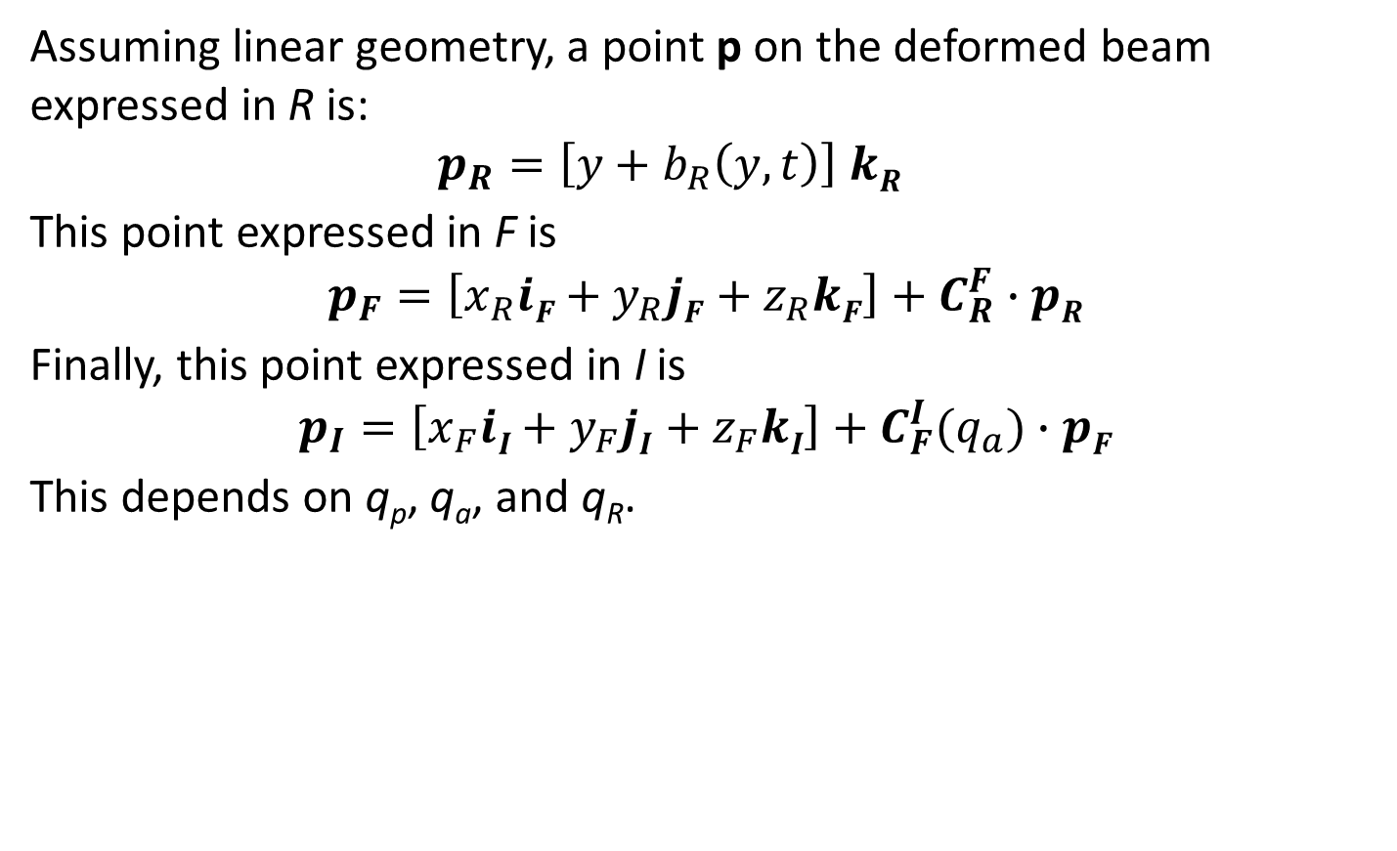
Right Wing: Gravitational PE
Assuming linear geometry, a point p on the deformed beam expressed in R is:
$$p_{R}=\left[y+b_{R}\left(y,t\right)\right] kR$$
This point expressed in F is
$$p_{F}=\left[x_{R}iF+y_{R}jF+z_{R}kF\right]+C_{R}^{F}∙pR$$
Finally, this point expressed in I is
$$p_{I}=\left[x_{F}iI+y_{F}jI+z_{F}kI\right]+C_{F}^{I}(q_{a})∙pF$$
This depends on q_{p}, q_{a}, and q_{R}.
O_{R}
y
j_{R}
b_{R}(y,t)
γ_{R}(y,t)
k_{R}

Slide 23

Right Wing: Gravitational PE
The gravitational potential energy is given by:
$$U_{Rg}\left(z_{F},q_{a},q_{R}\right)=−\int_{0}^{L}{gμ p_{I}∙k_{I}dy}$$
$$=−m_{R}gz_{F}−gμ k_{I}∙C_{F}^{I}(q_{a})∙\int_{0}^{L}{pFdy}$$
where $m_{R}=μL.$
O_{R}
y
j_{R}
b_{R}(y,t)
γ_{R}(y,t)
k_{R}

Slide 24

Right Wing: Kinetic Energy
Again, a point p on the deformed beam expressed in F is:
$$p_{F}=\left[x_{R}iF+y_{R}jF+z_{R}kF\right]+C_{R}^{F}∙pR$$
The translational velocity of this point is given by:
$$V_{p}=V+ω×p_{F}+\frac{∂}{∂t}pF$$
Evaluating the last term gives:
$$V_{p}=V+ω×p_{F}+C_{R}^{F}∙ [B_{R}\left(y\right){\dot{q}}_{R}k_{R}]$$
O_{R}
y
j_{R}
b_{R}(y,t)
γ_{R}(y,t)
k_{R}

Slide 25

Right Wing: Kinetic Energy
From the last slide, the velocity of a point p is:
$$V_{p}=V+ω×p_{F}+C_{R}^{F}∙ [B_{R}\left(y\right){\dot{q}}_{R}k_{R}]$$
Integrate over the right wing to get the total contribution to the KE:
$$T_{R}\left(V,ω,q_{R}\right)=\int_{0}^{L}{\frac{1}{2}μ{\left|V_{p}\right|}^{2}dy}$$
This neglects the additional KE due to the twisting velocity $\dot{γ_{R}}.$
O_{R}
y
j_{R}
b_{R}(y,t)
γ_{R}(y,t)
k_{R}

Slide 26
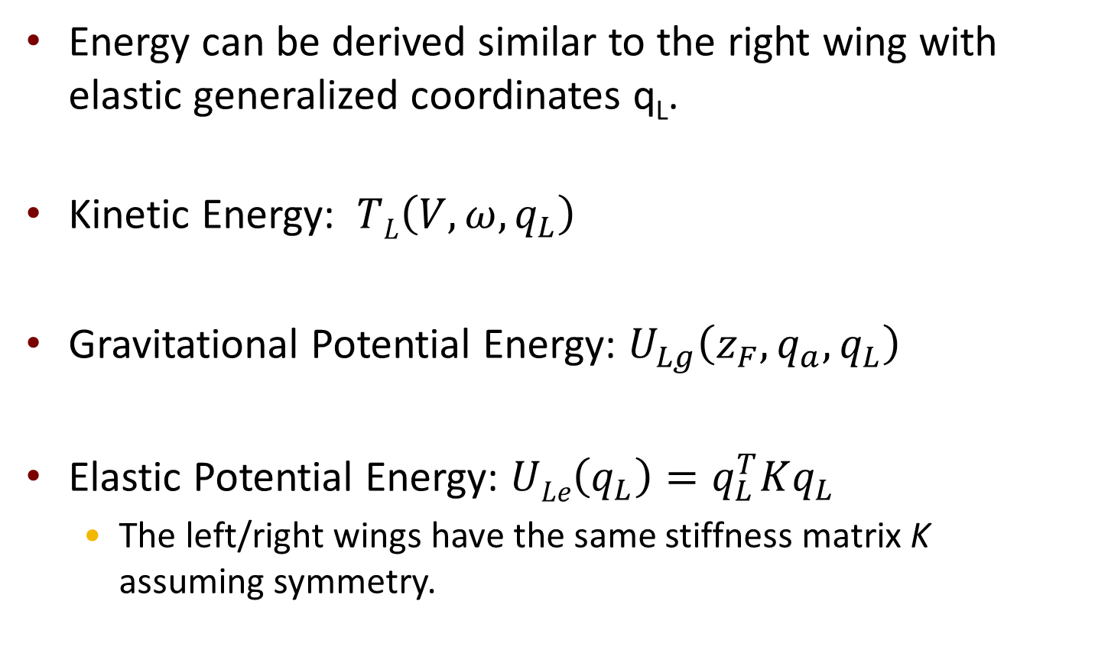
Energy: Left Wing
Energy can be derived similar to the right wing with elastic generalized coordinates q_{L}.
Kinetic Energy: $TL\left(V,ω,q_{L}\right)$
Gravitational Potential Energy: $U_{Lg}\left(z_{F},q_{a},q_{L}\right)$
Elastic Potential Energy: $ULe\left(q_{L}\right)=q_{L}^{T}Kq_{L}$
The left/right wings have the same stiffness matrix K assuming symmetry.

Slide 27
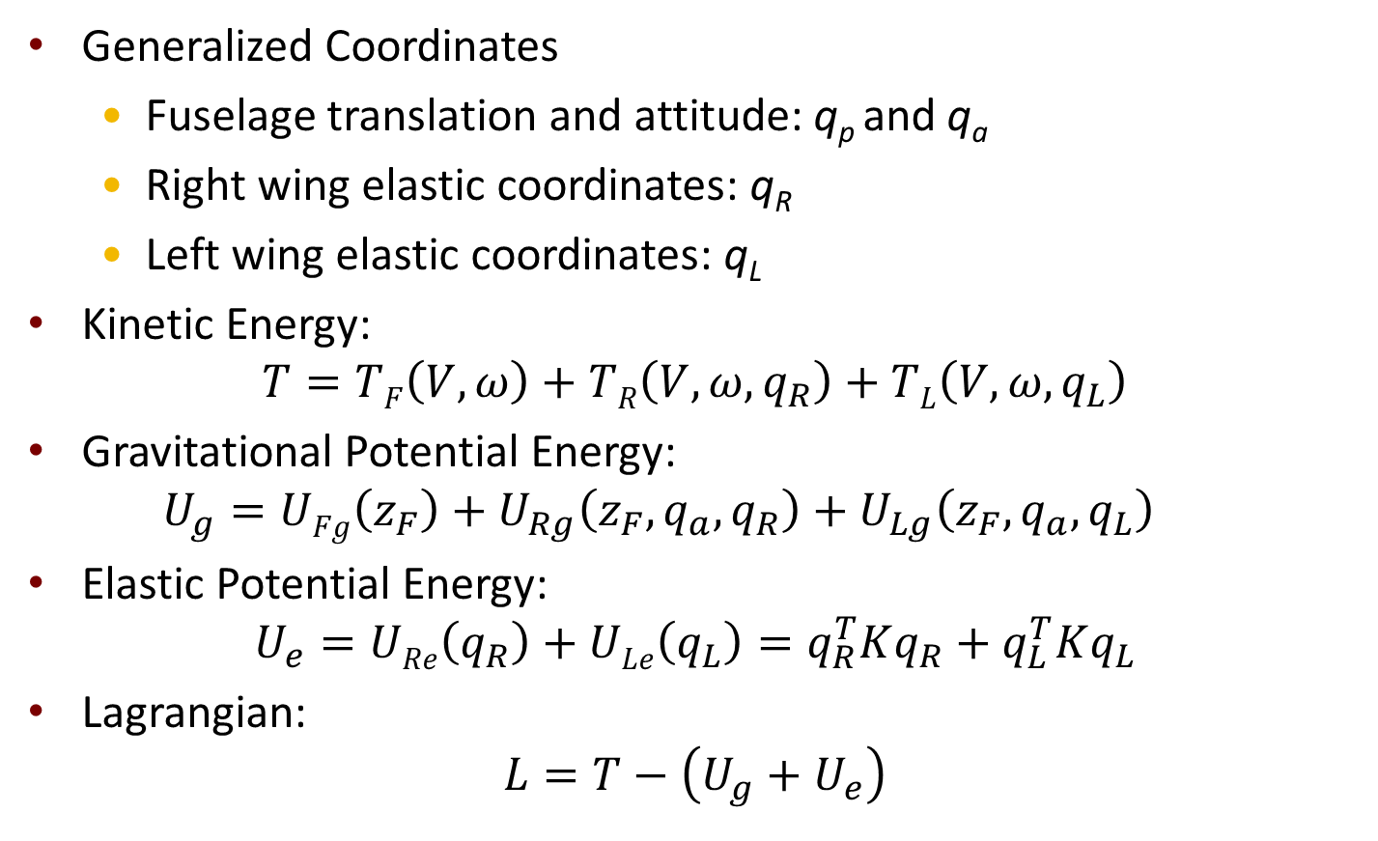
Summary of Lagrangian Terms
Generalized Coordinates
Fuselage translation and attitude: q_{p} and q_{a}
Right wing elastic coordinates: q_{R}
Left wing elastic coordinates: q_{L}
Kinetic Energy:
$$T=TF\left(V,ω\right)+TR\left(V,ω,q_{R}\right)+TL\left(V,ω,q_{L}\right)$$
Gravitational Potential Energy:
$$U_{g}=UFg\left(z_{F}\right)+U_{Rg}\left(z_{F},q_{a},q_{R}\right)+U_{Lg}\left(z_{F},q_{a},q_{L}\right)$$
Elastic Potential Energy:
$$U_{e}=URe\left(q_{R}\right)+ULe\left(q_{L}\right)=q_{R}^{T}Kq_{R}+q_{L}^{T}Kq_{L}$$
Lagrangian:
$$L=T−\left(U_{g}+U_{e}\right)$$

Slide 28
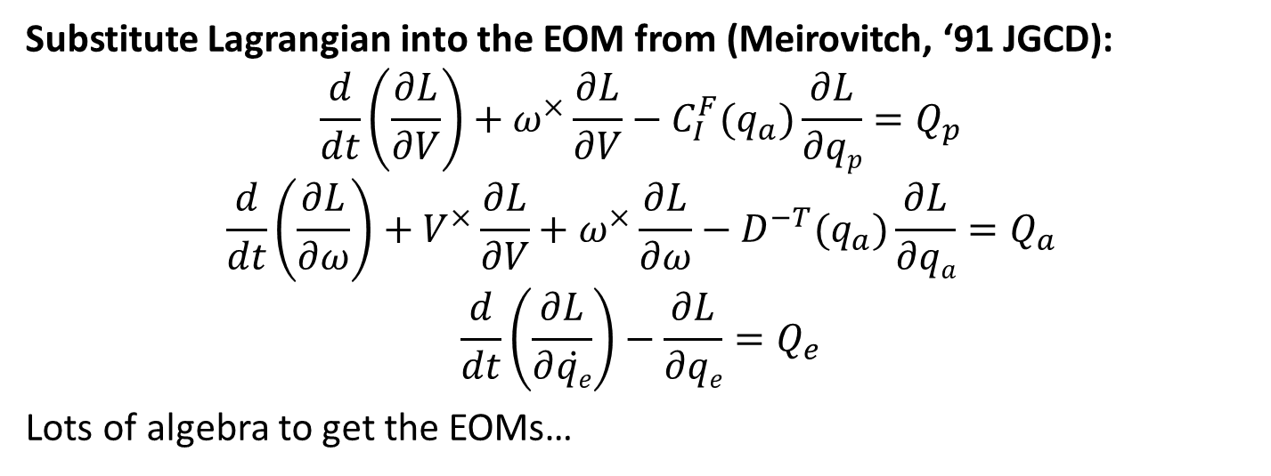
Extension to Flexible Bodies
Substitute Lagrangian into the EOM from (Meirovitch, ‘91 JGCD):
$$\frac{d}{dt}\left(\frac{∂L}{∂V}\right)+ω^{×}\frac{∂L}{∂V}−C_{I}^{F}(q_{a})\frac{∂L}{∂qp}=Q_{p}$$
$$\frac{d}{dt}\left(\frac{∂L}{∂ω}\right)+V^{×}\frac{∂L}{∂V}+ω^{×}\frac{∂L}{∂ω}−D^{−T}(q_{a})\frac{∂L}{∂qa}=Q_{a}$$
$$\frac{d}{dt}\left(\frac{∂L}{∂\dot{qe}}\right)−\frac{∂L}{∂qe}=Q_{e}$$
Lots of algebra to get the EOMs…

Slide 29
Discussion
Summarize and discuss final form of the EOM
The equations for inertial translation/rotation are coupled to the elastic equations because we did not use mean axes.
How should we implement this in Simulink?
Still to discuss:
Aero model to compute the forces
Again, how much detail should we include in the aero model?

