Slide 1
Updated Slides for PAAW Project
Wei Zhao
Ph.D. Candidate in Aerospace Engineering
Rakesh K. Kapania
Mitchell Professor of Aerospace and Ocean Engineering
Neeharika Muthirevula
Rikin Gupta
Jan 22, 2015
Multidisciplinary Analysis and Design Center for Advanced Vehicles Virginia Polytechnic Institute and State University Blacksburg, VA 24061-0203

Slide 2
VT MDAO Work
MDAO
(PAAW Project)
Global Wing Optimization
Minimum induced drag
Local Panel Optimization
EBF3WingOpt
EBF3PanelOpt
Create Geometry
Parametrize Curved spars and ribs
Specify material, boundary conditions, flight conditions, constraints
Extract Panel
Parametrize Curved/Straight Stiffeners
Specify boundary conditions
Model is to be created
Now practicing X-56A
Notes:
We are using X-56A as practice, and familiar this vehicle

Slide 3
Models Summary
In the proposal, “mAEWing2 will be the first wing designed using MDAO tools and will validate their usage”
Available models
CAD of miniMUTT (10 FT - Span)
Simple Beam FEM of BFF
CAD of X-56A (28 FT - Span)
Detailed FEM of X-56A
Model needed – mAEWing2 (12 FT - Span)

Slide 4
mAEWing2
One alternative approach for mAEWing2 model:
Scale model
12ft ← 28ft span
X-56A
VTmodeX56A
MDAO Model
Equivalent Beam FEM
mAEWing2
Equivalent beam FEM will be BFF-like FEM
Equivalent beam FEM will be equivalent to the MDAO Model
Aeroservoelasticity and etc.,

Slide 5
Scale Model
Model Scaling of X-56A
Scale node coordinates (3/7)
Scale value of lumped mass
Scale thickness of shell elements
Scale cross-sectional area of bar elements
Scale stiffness, spring connection
Others (To be decided)
Scaling Objectives?
Match modal information with original X-56A
Natural frequencies
MAC close to 1
Same Aeroelastic behavior with original X-56A
V-g & V-f plot
Divergence speed
Rigid body motion

Slide 6
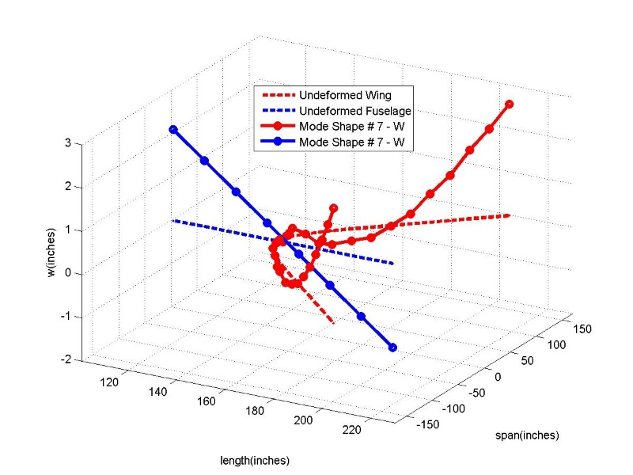
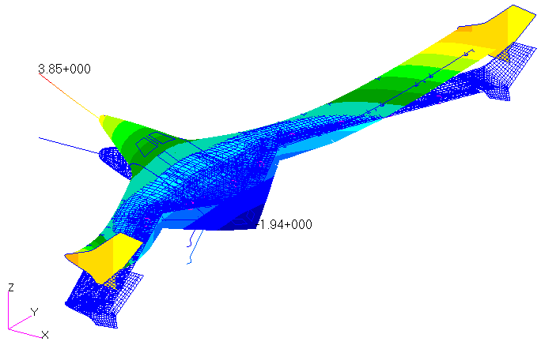
VTmodeX56
VTmodeX56
Report, manual and code of this program will be delivered.

Slide 7
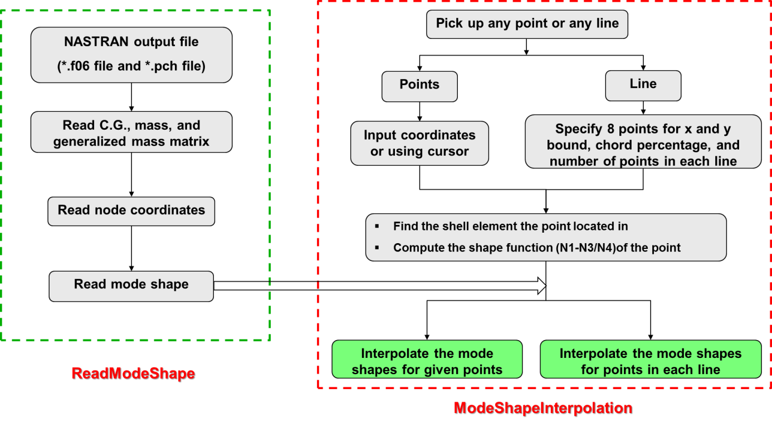
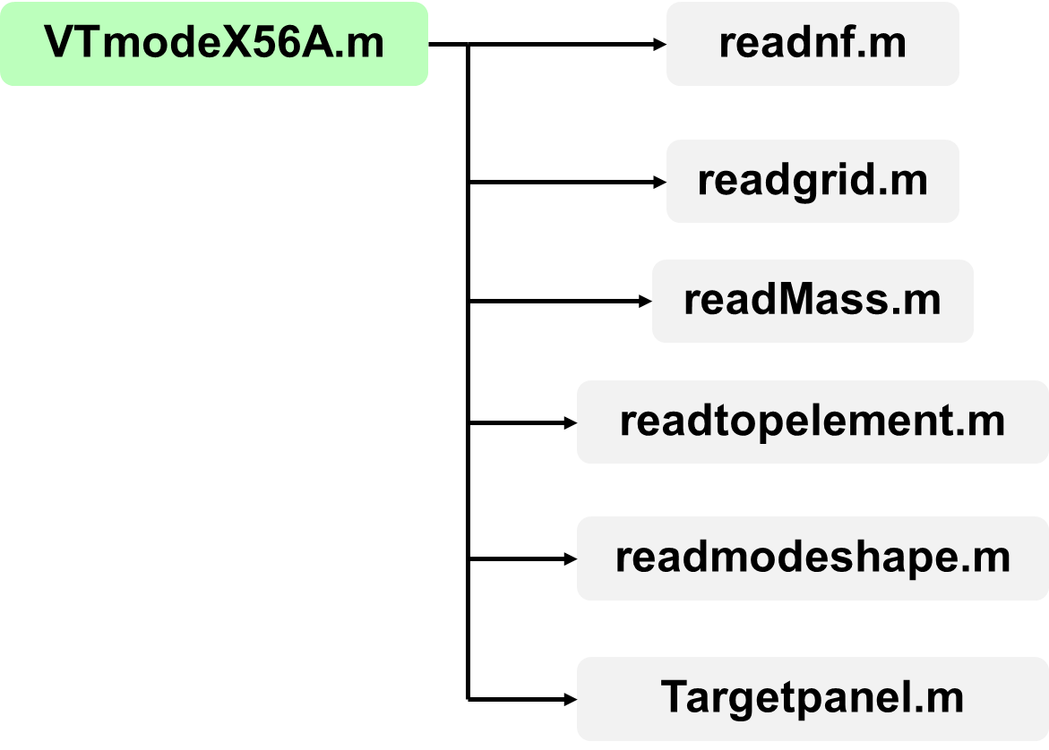
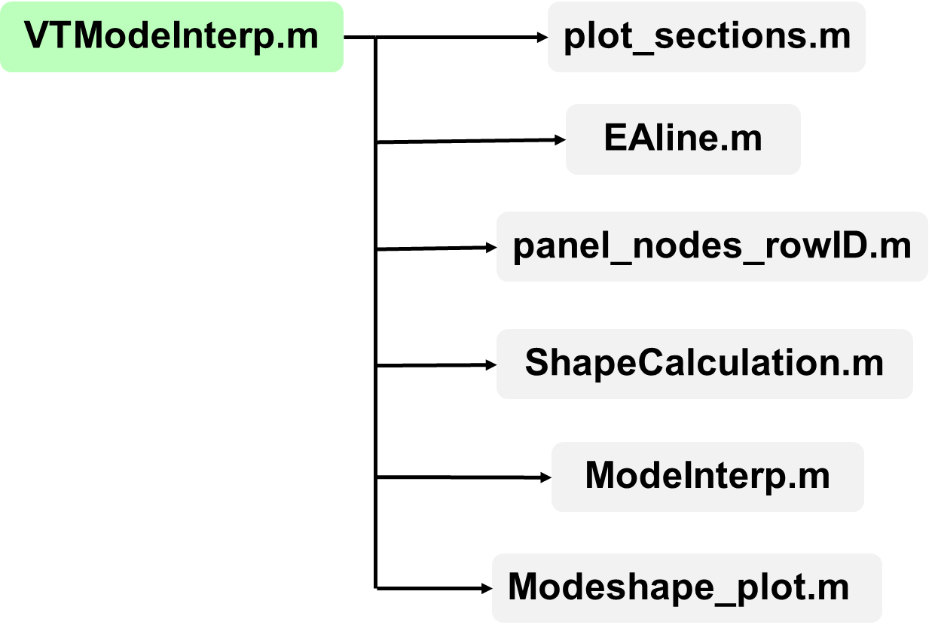
VTmodeX56 Program

Slide 8
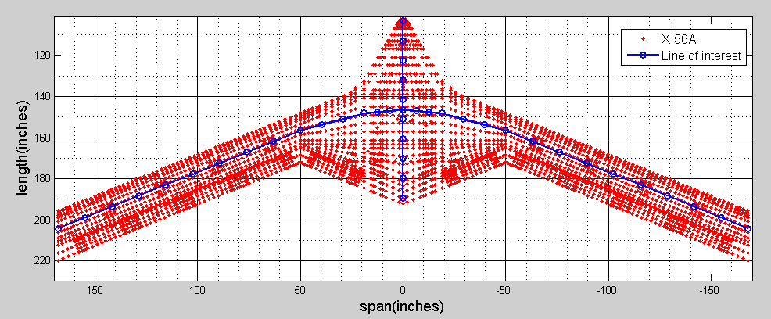
E.A. like beam FEM
We can select other interested points to create miniMUTT-like beam FEM model

Slide 9
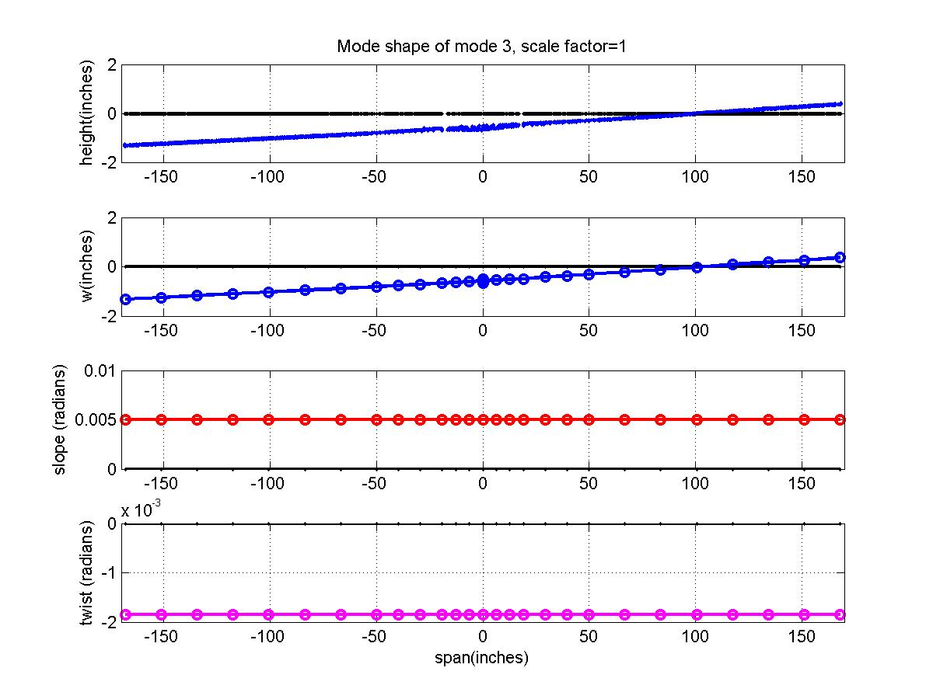
Mode 3 – Rigid Mode

Slide 10
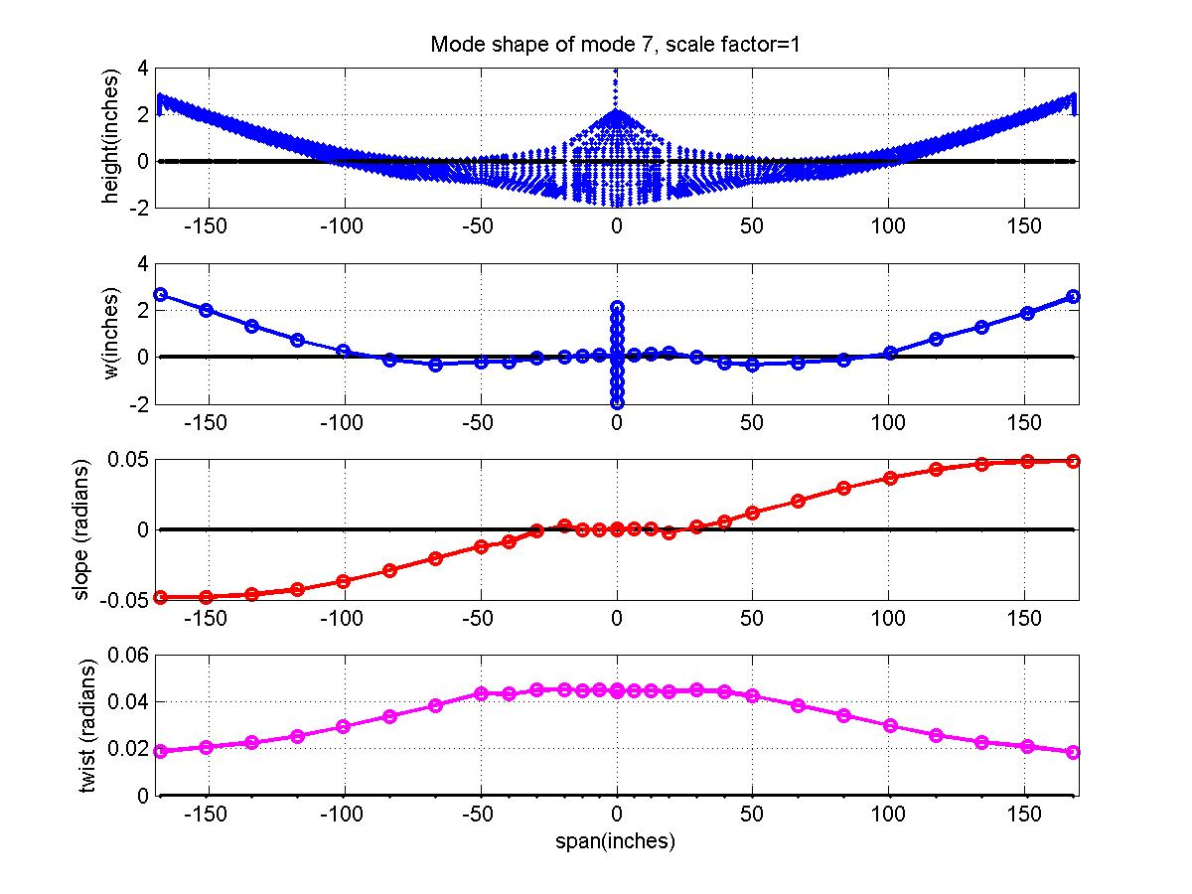
Mode 7 – Elastic Mode

Slide 11
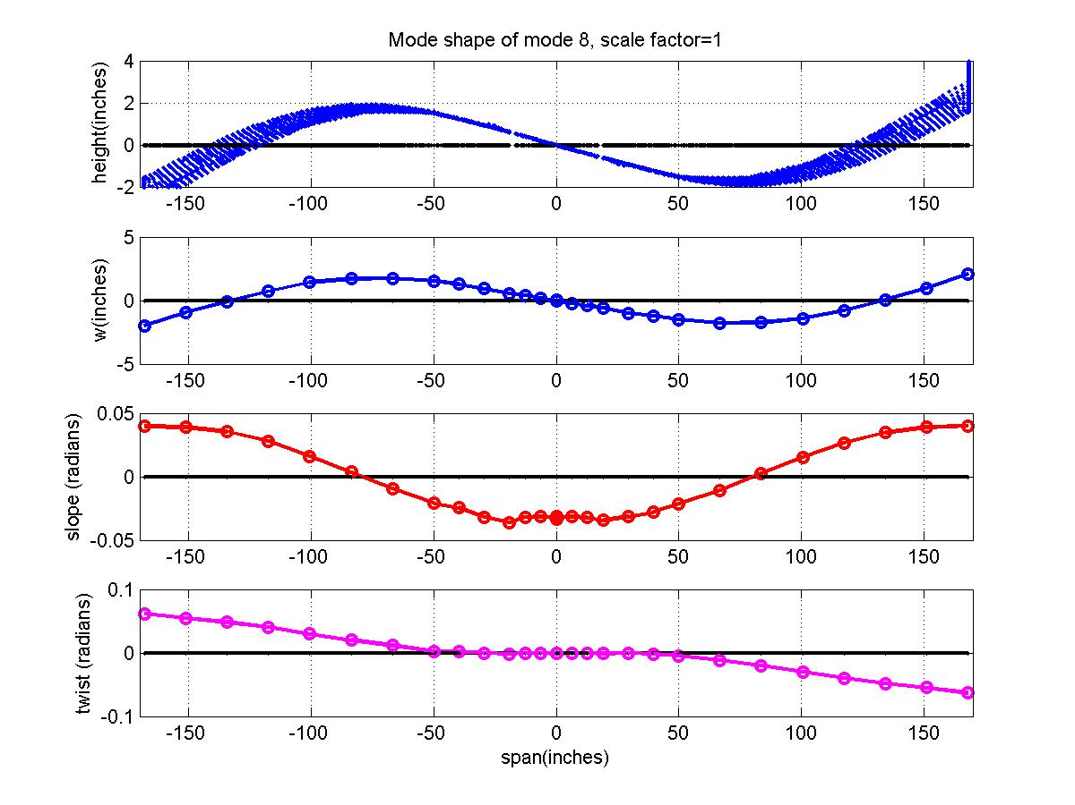
Mode 8 – Elastic Mode

Slide 12
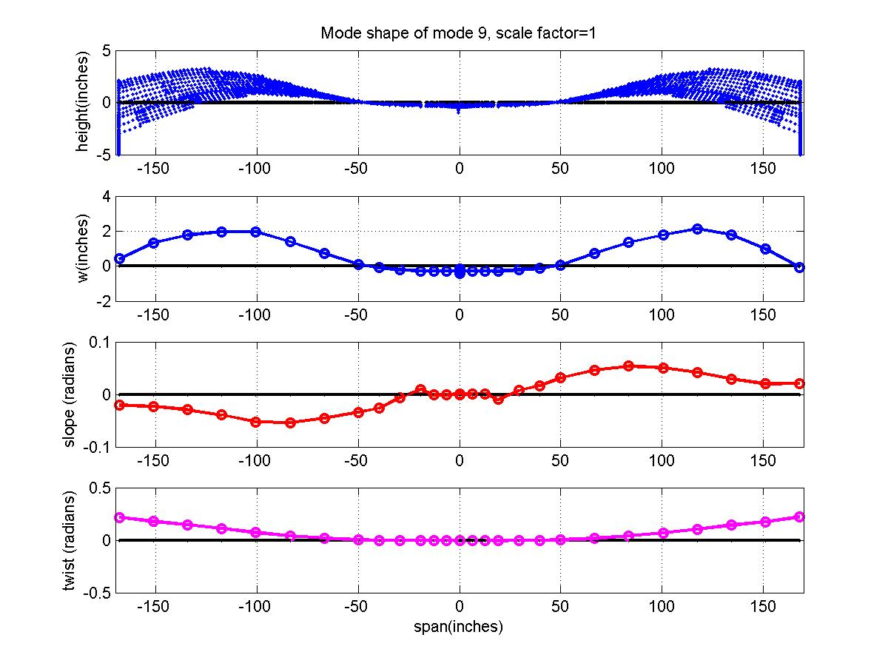
Mode 9 – Elastic mode

Slide 13
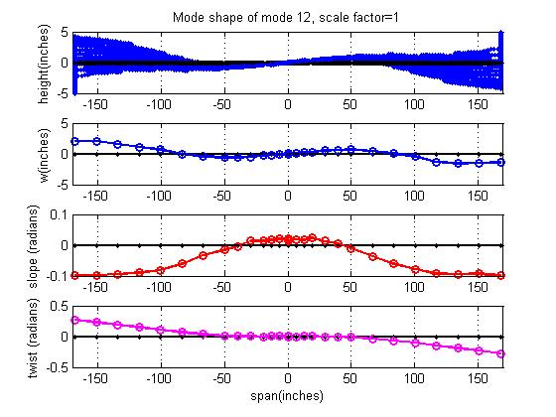
Mode 12 – Elastic mode

Slide 14
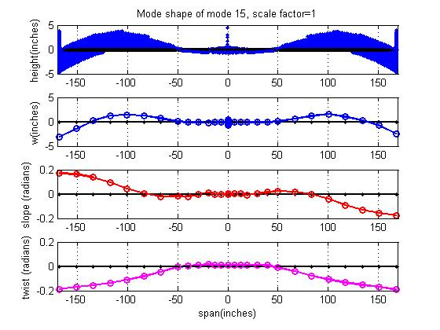
Mode 15 – Elastic mode

Slide 15
Discussions
We need wing box in the MDAO work, how to convert the MDAO model to the model with primary solid spar that mAEWing2 has?
Model scaling-like approach, match structural dynamic behavior and aeroelastic behavior?
Same rigid body motion under maneuvering of control surfaces?
Flight conditions (MDAO Load Cases + minimal induced drag)
Mach? Flight altitude?
3.5g during normal flying
1.5~2.0g from manuevering loads
etc.,

