Slide 1





Numerical Solution of PDEs Using the Finite Element Method
May 15 – 19 2017
Martin Kronbichler (kronbichler@lnm.mw.tum.de)
Luca Heltai (luca.heltai@sissa.it)

Slide 2
Goals
How to use deal.II for Finite Element computations
Refresh numerical PDE knowledge
Also:
  Software best practices
  C++, Debugging, IDEs, Visualization
  Parallel computations with MPI

Slide 3
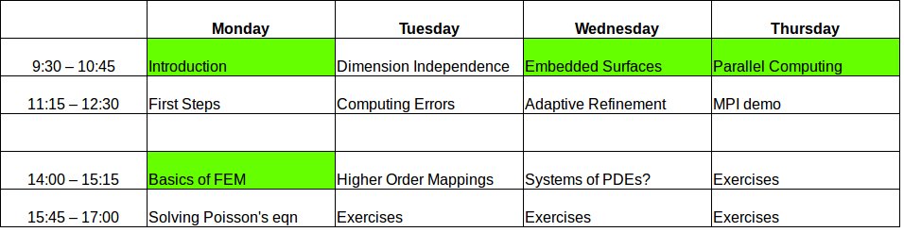
Schedule
See http://indico.ictp.it/event/7751/other-view?view=ictptimetable Green = in lecture room (tentative)
Today:
  What is deal.II?
  Compiling, using an IDE
  Overview about FEM
  Basic tutorials (create mesh, solve Poisson's equation, visualization)
Tuesday:
  Finite Element Analysis (refinement, computing errors)
Wednesday/Thursday:
  Advanced topics
  Time for projects

Slide 4
The plan
Slides, some lectures on blackboard
Many live demonstrations
Exercises:
  Work in groups of two!
  Ask questions!
Projects:
  Required for MHPC students
  Groups of two

Slide 5
Resources
http://indico.ictp.it/event/7751/overview
  Schedule, Rooms, etc.
http://dealii.org
  Manual
  Tutorial steps
  Tutorial videos
On your machine: folder /scratch/smr1909/
  Slides
  Example programs
  Exercises
  Other files

Slide 6

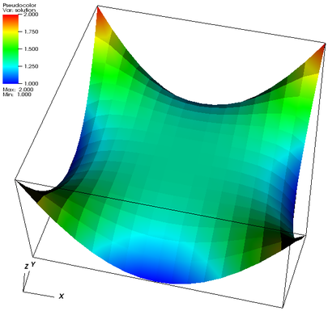
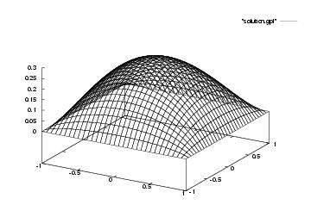
Finite Element Method
Solve partial differential equations numerically
Example:

Slide 7
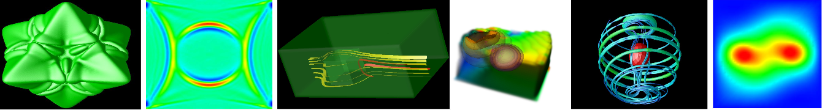
deal.II
“A Finite Element Differential Equations Analysis Library”
Open source, c++ library
I am one of the four maintainers
One of the most widely used libraries:
  900+ papers using and citing deal.II
  ~600 downloads/month
  100+ people have contributed in the past 15 years
  ~500,000 lines of code
  10,000+ pages of documentation
Website: www.dealii.org

Slide 8
Features
1d, 2d, 3d computations, adaptive mesh refinement (on quads/hexes only)
Finite element types:
  Continuous and DG Lagrangian elements
  Higher order elements, hp adaptivity
  Raviart-Thomas, Nedelec, …
  And arbitrary combinations
PDEs on surfaces embedded in higher dimensions

Slide 9
Features, part II
Linear Algebra
  Own sparse and dense library
  Interfaces to PETSc, Trilinos, UMFPACK, BLAS, ..
Parallelization
  Laptop to supercomputers
  Multi-threading on multi-core machines
  MPI: 64,000+ processors
Output in many visualization file formats

Slide 10
Development of deal.II
Professional-level development style
Development in the open, repository on github.com
Mailing lists for users and developers
Test suite with 8,700+ tests after every change
Platform support:
  Linux/Unix
  Mac
  Windows
Hope to see you on github.com or the mailing list!

Slide 11
Lab Setup
deal.II and all required dependencies are already installed at
  /scratch/smr2909/
(Demo, show lab01.pdf and run included step-1)

Slide 12
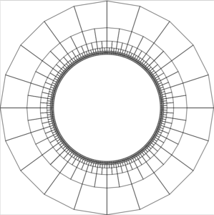
Lab 1 (step-1)
See lab01.pdf
Topic: creating meshes

Slide 13
Running examples
In short:
  cd examples/step-1
  cmake .
  make run
cmake:
  Detect configuration, only needs to be run once!
  Input: CMakeLists.txt
  Output: Makefile, (other files like CMakeCache.txt)
make:
  Code compilation
  Tool to execute commands in Makefile, do every time you change your code
  Input: step-1.cc, Makefile
  Output: step-1 (the binary executable file)
Run your program with
  ./step-1
Or (compile and run):
  make run
Open in qtcreator IDE:
  qtcreator .
Learn to use an IDE! (not vim, emacs, …)
Copy into home directory required!
[Demo the above and open project in qtcreator]

Slide 14
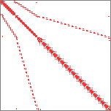
Lab 2 (step-2)
See lab02.pdf
Topic: sparsity patterns of matrices

Slide 15
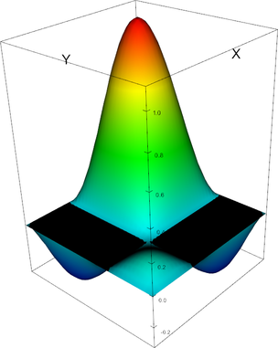
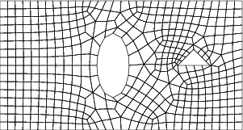
Finite Element Assembly

Slide 16
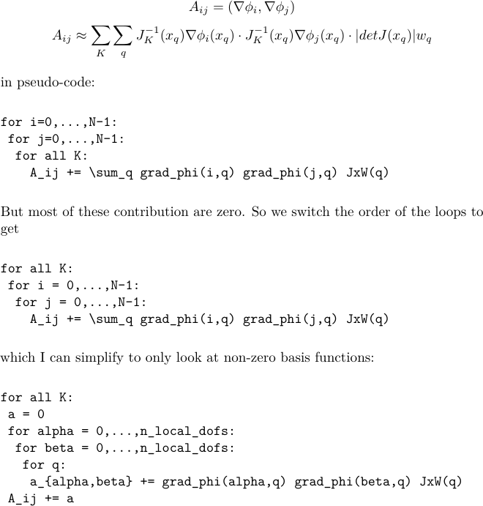

Slide 17
Lab 3 (step-3)
See lab03.pdf
Topic: solving Poisson's equation

Slide 18
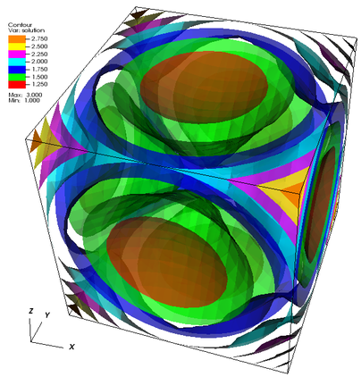
Towards Lab 4 (step-4)
Goals:
  Dimension independent programming
  Need: C++ templates

Slide 19
Templates in C++
“blueprints” to generate functions and/or classes
Template arguments are either numbers or types
No performance penalty!
Very powerful feature of C++: difficult syntax, ugly error messages, slow compilation
More info: http://www.cplusplus.com/doc/tutorial/templates/
http://www.math.tamu.edu/~bangerth/videos.676.12.html
Demos in /scratch/smr2909/lab-04/

Slide 20
Why used in deal.II?
Write your program once and run in 1d, 2d, 3d:
cell->face () is a quad in 3d but a line in 2d
Also: large parts of the library independent of dimension:
  hyper_cube (square vs box), etc.
DoFHandler<dim>::active_cell_iterator
cell = dof_handler.begin_active(),
endc = dof_handler.end();
for (; cell!=endc; ++cell)
{ ...
cell_matrix(i,j) += fe_values.shape_grad (i, q_point)
* fe_values.shape_grad (j, q_point)
* fe_values.JxW (q_point));

Slide 21
Class Templates for Functions
Blueprint for a function
One type called “number”
You can use
“typename” or “class”
Sometimes you need to state which function you want to call:
template <typename number>
number square (const number x) { return x*x; };
int x = 3;
int y = square<int>(x);
template <typename T>
void yell ()
{ T test; test.shout(“HI!”); };
// cat is a class that has shout()
yell<cat>();

Slide 22
Value Templates
Template arguments can also be values (like int) instead of types:
Of course this would have worked here too:
template <int dim>
void make_grid (Triangulation<dim> &triangulation) { …}
Triangulation<2> tria;
make_grid<2>(tria);
template <typename T>
void make_grid (T &triangulation)
{ …// now we can not access “dim” though

Slide 23
Class templates
Whole classes instead of functions built from a blueprint
Same idea:
template <int dim>
class Point
{
double elements[dim];
// ...
}
Point<2> a_point;
Point<5> different_point;
namespace std
{
template <typename number>
class vector;
}
std::vector<int> list_of_ints;
std::vector<cat> cats;

Slide 24
Example
template <unsigned int N>
double norm (const Point<N> &p)
{
double tmp = 0;
for (unsigned int i=0; i<N; ++i)
tmp += square(v.elements[i]);
return sqrt(tmp);
}
Value of N known at compile time, never stored!
Compiler can optimize (unroll loop)
Fixed size arrays faster than dynamic
(dealii::Point<dim> vs dealii::Vector<double>)

Slide 25
Examples in deal.II
Step-4:
template <int dim>
void make_grid (Triangulation<dim> &triangulation) {...}
So that we can use Vector<double> and Vector<float>:
template<typename number>
class Vector< number > { number [] elements; ...};
Default values (embed dim-dimensional object in spacedim):
template<int dim, int spacedim=dim>
class Triangulation< dim, spacedim > { ... };
Already familiar:
template<int dim, int spacedim>
void GridGenerator::hyper_cube (Triangulation< dim, spacedim > & tria, const double left, const double right) {...}

Slide 26
Explicit Specialization
different blueprint for a specific type T or value
template <>
struct NumberCache<2>
{
unsigned int n_levels;
unsigned int n_lines;
unsigned int n_quads;
}
// more clever:
template <>
struct NumberCache<2>: public NumberCache<1>
{
unsigned int n_quads;
}
// store some information
// about a Triangulation:
template <int dim>
struct NumberCache
{};
template <>
struct NumberCache<1>
{
unsigned int n_levels;
unsigned int n_lines;
};

Slide 27
Lab 4 (step-4)
Dimension independent Laplace problem
Triangulation<2>, DoFHandler<2>, …
replaced by
Triangulation<dim>, DoFHandler<dim>, …
Template class:
template <int dim>
class Step4 { … };

Slide 28
Lab 5
Modified step-4 to check correctness
Using the method of manufactured solutions
Computing L2 and H1 errors and check orders

Slide 29
Computing Errors
Important for verification!
See step-7 for an example
Set up problem with analytical solution and implement it as a Function<dim>
Quantities or interest:
Break it down as one operation per cell and the “summation” (local and global error)
Need quadrature to compute integrals

Slide 30
Computing Errors
Example:
Vector<float> difference_per_cell (triangulation.n_active_cells());
VectorTools::integrate_difference (dof_handler,
solution, // solution vector
Solution<dim>(), // reference solution
difference_per_cell,
QGauss<dim>(3), // quadrature
VectorTools::L2_norm); // local norm
const double L2_error = difference_per_cell.l2_norm(); // global norm
Local norms:
mean, L1_norm, L2_norm,Linfty_norm, H1_seminorm, H1_norm, ...
Global norms are vector norms: l1_norm(), l2_norm(), linfty_norm(), ...

Slide 31
Lab 6
Higher order mappings, see step-10/step-11
Start with lab-6. Find a solution so that higher order mapping gives correct convergence order!

Slide 32
More features of deal.II
Adaptive mesh refinement, including dual-weighted error estimators (step-6, step-7)
Linear solvers: direct solvers, iterative solvers, preconditioners, multigrid, etc.
Parallel computing: multithreading (step-9), MPI (step-40)
Vector-valued problems: step-8, step-20, …
Other FE spaces: DG, RT, Nedelec, ...

Slide 33
More features of deal.II b)
Non-homogeneous Neumann conditions, boundary integrals: step-7
Systems of PDEs: step-8, step-20
Nonlinear problems: step-15
Time dependent problems: step-18, ...
Fluid flow (Stokes, Navier-Stokes, …): step-22, step-32, ...
Complicated meshes: step-49
Matrix-free computations: step-37, step-48

Slide 34
Resources
Tutorials (by topic, graph, etc.): https://www.dealii.org/developer/doxygen/deal.II/Tutorial.html
Video lectures:
http://www.math.tamu.edu/~bangerth/videos.html
Manual: https://www.dealii.org/developer/doxygen/deal.II/index.html
Mailing list: https://groups.google.com/forum/#!forum/dealii

Slide 35
Fixing lab 6
Yesterday we saw optimal 3rd order convergence of the L2 norm on the circle even with a linear mapping
It turns out we applied the correct boundary conditions for Omega_h and only computed the error on Omega_h. In essence, we were solving on a piece-wise linear Omega on each refinement level.
Take a look at lab06.pdf...

Slide 36
Lab 7
Based on step-38 (Laplace-Beltrami)
Compute L2 and H1 errors for a half-sphere

Slide 37
Lab 8 & 9
See maple spreadsheets for references
Lab-8:
  Start with lab-7 code and solve on torus
Lab-9:
  Start with lab-9 and solve on parametric surface

Slide 38
Adaptive Mesh Refinement
Typical loop:
  Solve
  Estimate
  Mark
  Refine/coarsen
Estimate is problem dependent:
  Approximate gradient jumps: KellyErrorEstimator class
  Approximate local norm of gradient: DerivativeApproximation class
  Or something else
Mark:
  GridRefinement::refine_and_coarsen_fixed_number(...) or
  GridRefinement::refine_and_coarsen_fixed_fraction(...)
Refine/coarsen:
  triangulation.execute_coarsening_and_refinement ()
  Transferring the solution: SolutionTransfer class (maybe discussed later)

Slide 39
Constraints
Used for hanging nodes (and other things!)
Have the form:
Represented by class ConstraintMatrix
Created using DoFTools::make_hanging_node_constraints()
Will also use for boundary values from now on:
VectorTools::interpolate_boundary_values(..., constraints);
Need different SparsityPattern (see step-6):
DoFTools::make_sparsity_pattern (..., constraints, ...)

Slide 40
Constraints II
Old approach (explained in video):
  Assemble global matrix
  Then eliminate rows/columns: ConstraintMatrix::condense(...)
  (similar to MatrixTools::apply_boundary_values() in step-3)
  Solve and then set all constraint values correctly: ConstraintMatrix::distribute(...)
New approach (step-6):
  Assemble local matrix as normal
  Eliminate while transferring to global matrix:
  constraints.distribute_local_to_global (cell_matrix, cell_rhs,
  local_dof_indices,
  system_matrix, system_rhs);
  Solve and then set all constraint values correctly: ConstraintMatrix::distribute(...)

Slide 41
Vector Valued Problems
(video 19&20)
FESystem: list of FEs (can be nested!)
Will give one FE with N shape functions
Use FEValuesExtractors to do fe_values[velocities].divergence (i, q), ...
Ordering of DoFs in system matrix is independent
See module “handling vector valued problems”
Non-primitive elements (see fe.is_primitive()):
  shape functions have more than one non-zero component, example: RT

Slide 42
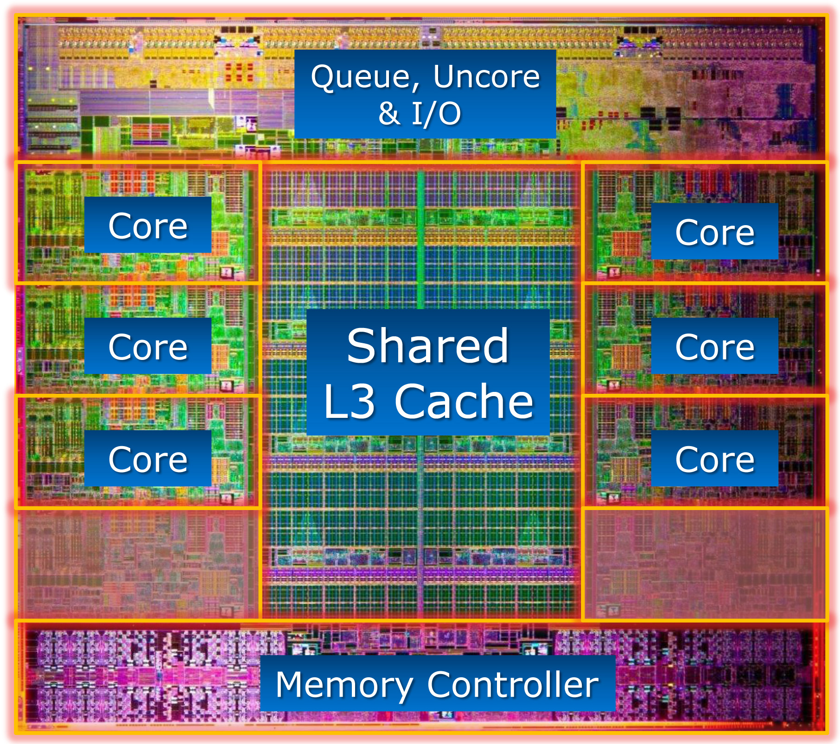
Parallel Computing:
Introduction
A modern CPU: Intel Core i7

Slide 43
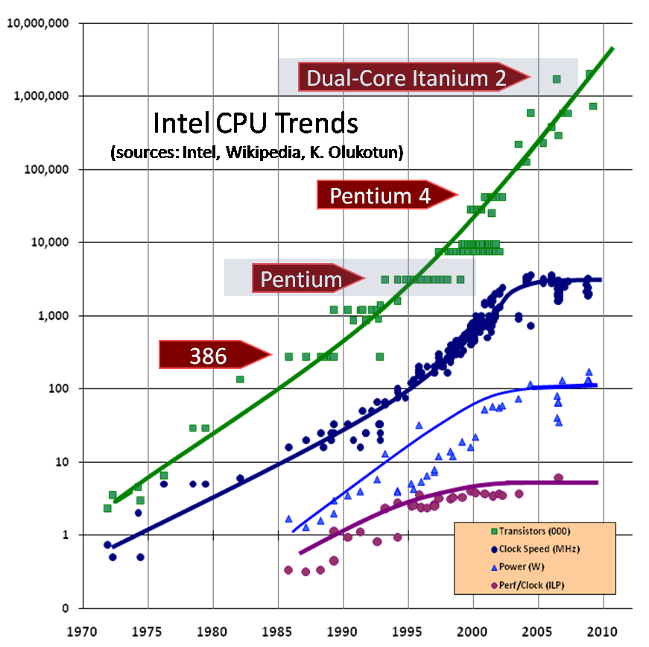
Basics
Single cores are not getting (much) faster
“the free lunch is over”:http://www.gotw.ca/publications/concurrency-ddj.htm
Concurrency is only option:
  SIMD/vector instructions
  Several cores
  Several chips in one node
  Combine nodes into supercomputer

Slide 44
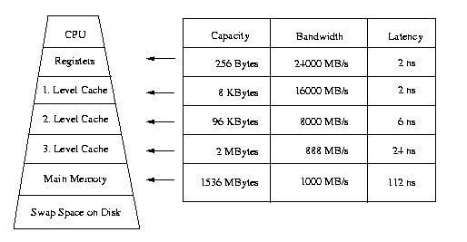
  Hierarchy of memory
Latency: time CPU gets data after requesting
Bandwidth: how much data per second?
prefetching of data, “cache misses” are expensive
automatically managed by processor

Slide 45
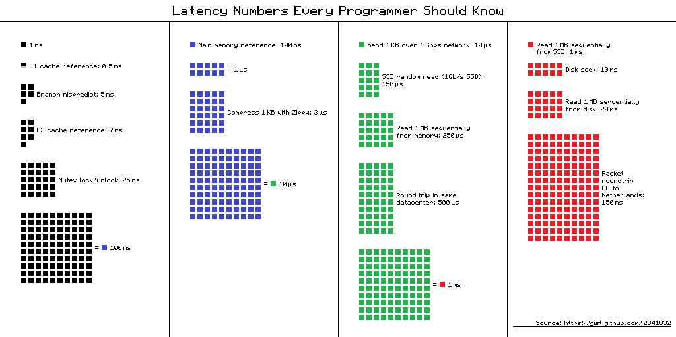
https://gist.github.com/hellerbarde/2843375

Slide 46
Amdahl's Law
Task: serial fraction s, parallel fraction p=1-s
N workers (whatever that means)
Runtime: T(N) = (1-s)T(1)/N + sT(1)
Speedup T(1)/T(N), N to infinity:
max_speedup = 1/ s
http://en.wikipedia.org/wiki/Amdahl%27s_law
Reality: T(N) = (1-s)T(1)/N + sT(1) + aN + bN^2

Slide 47
Summary
Computing much faster than memory access
Parallel computing required: no free lunch!
Communication is serial fraction (or worse when increasing with N!)
Communication in Amdahl's law is main challenge in parallel computing

