Slide 1

R Shiny meetup

Slide 2
Introduction Round
What are your experiences with R?
Do you already have a Shiny project in mind?

Slide 3
Aim of this meetup
Learn Shiny!
What you can do with Shiny.
How to make an actual Shiny web application.
What other useful packages related to Shiny there are.
E.g. Shiny UI Editor, Shiny for python
Collaborate with others on small fun projects.
Learn how to use Git and GitHub for collaborations.

Slide 4
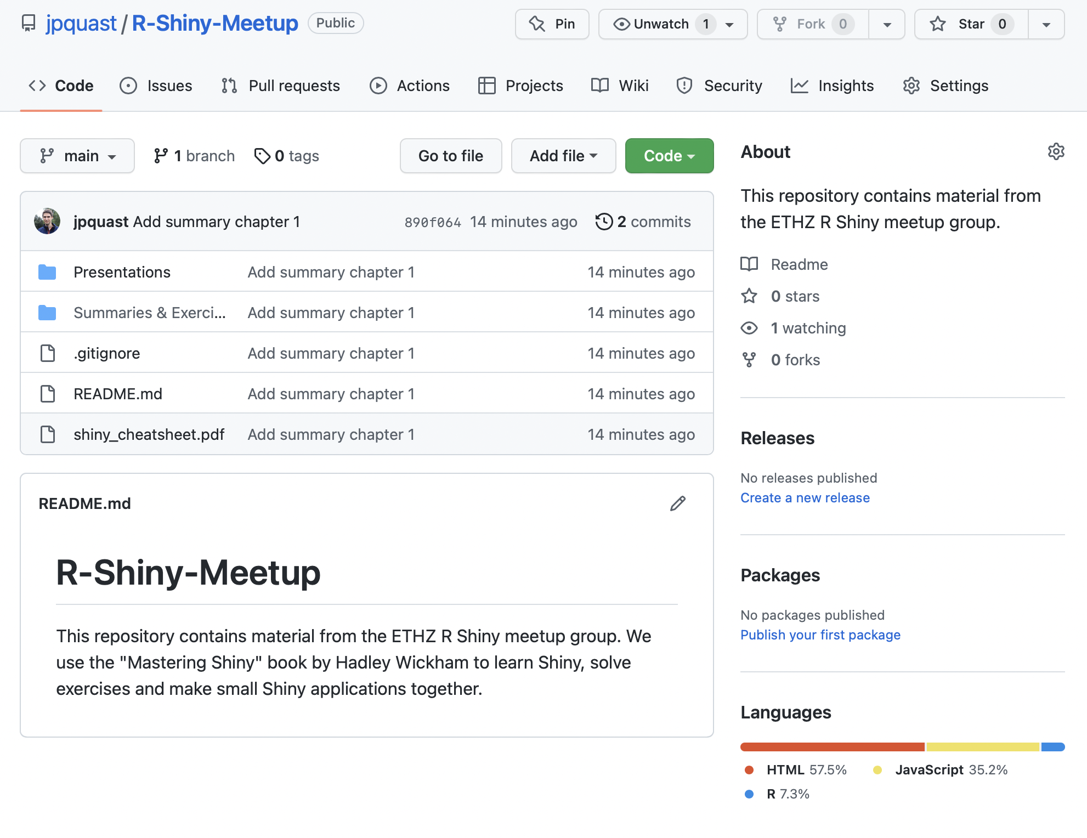
GitHub page
https://github.com/jpquast/R-Shiny-Meetup
Exercises
Presentations
Projects

Slide 5
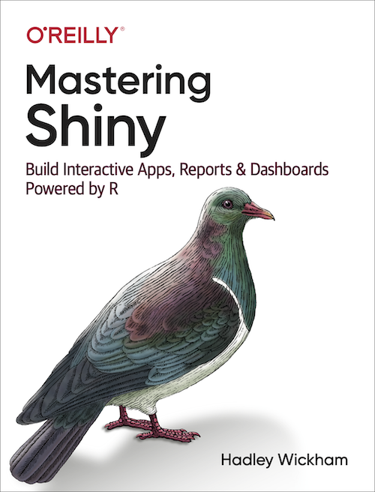
Mastering Shiny
Getting started (1-4)
Basics, UI, server
Shiny in action (5-12)
Build on basics
Mastering Reactivity (13-16)
Advanced reactive programming
Best practices (17-23)
Useful tips for production ready apps
https://mastering-shiny.org/index.html

Slide 6
Meetup Structure
Start with ”Mastering Shiny”
Get to know the basics of Shiny app development.
Exercises
Develop small apps as we go to learn:
UI
Server
Reactivity
Learn about useful information related to Shiny apps
UI packages, how to host apps etc.
Develop more complex apps
When?

Slide 7
Chapter 1
Are any things unclear?
Exercises

