Slide 1
Predicting At-Risk Customers with Data Science
James Richards General Assembly sfdat26 James.richards@trinet.com

Slide 2
About TriNet
Founded in 1980s as an HR services firm
Outsourced HR: payroll, benefits, workers comp, and more
Went public in 2014 – NYSE: TNET
~13,500 clients w/ ~325,000 employees
Diverse client base: tech startups, retail, hotels, restaurants, hedge funds, etc…
$31BN in payroll and $3BN in health insurance premiums
$600MM in net revenue/year
Churn is biggest problem: ~20% of customers leave every year, leaving a $100MM revenue hole to fill before growth.

Slide 3
How we predict at-risk accounts
Each client is assigned to a Human Capital Consultant, or “HCC”
One HCC : 50-100 clients
6-8 HCC’s : 1 Human Capital Director, or “HCD”
Every 2 weeks, HCDs classify clients into Green, Yellow, or Red based on impressions from their HCCs
If client submits low NPS survey response, automatically classified as Red
No objective metrics around Green, Yellow, or Red
Last NPS survey went out in 2015
Only response with Red accounts is to lower price

Slide 4
How BCG told us to predict at-risk accounts
We paid the Boston Consulting Group a lot of money in 2014 to study why clients leave
Their conclusions: churn associated with:
Payroll accuracy – % of inaccurate payrolls we run for a client
Client growth – % growth in headcount a client experiences in a year
Recommendation:
Fix payroll accuracy
Focus HCC and HCD time on clients who are growing quickly

Slide 5
Problems
BCG recommendation is essentially a high-bias, low variance model.
Does that fit the data?
Hedge funds rarely experience any growth in headcount but still churn
Many clients with 100% payroll accuracy churn
No comment as to importance of other features:
Client type/industry
Non-payroll issues – e.g., software bugs, 401k screw ups, etc
Pricing
Tenure
Medical claims/cost of insurance

Slide 6
Using data science to predict at-risk accounts
Data set: 2 years of customer data by account
Questions to answer:
Can we build a model to classify accounts into “likely to churn” and “not likely to churn”?
What features/combination of features are correlated with churn?
Potential models:
Logistic Regression – for probability to churn
Naïve Bayes – to account for conditional probability based on certain features
Random Forest – to classify into “likely” or “not likely” buckets

Slide 7
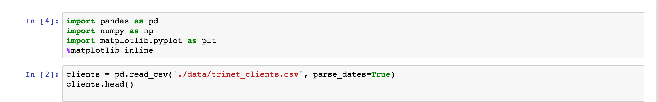
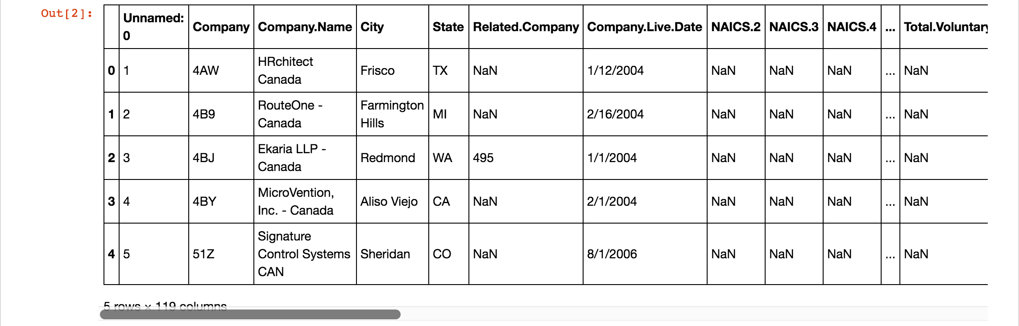
Exploratory data analysis

Slide 8
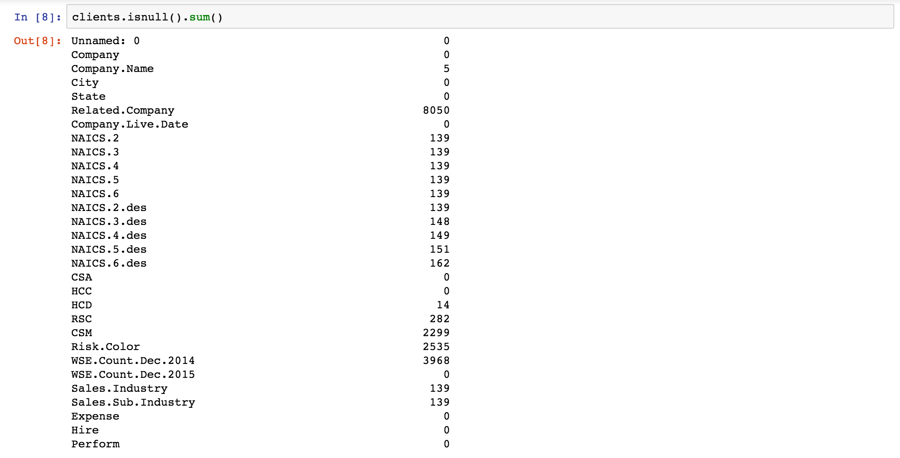
Exploratory data analysis (cont’d)

Slide 9
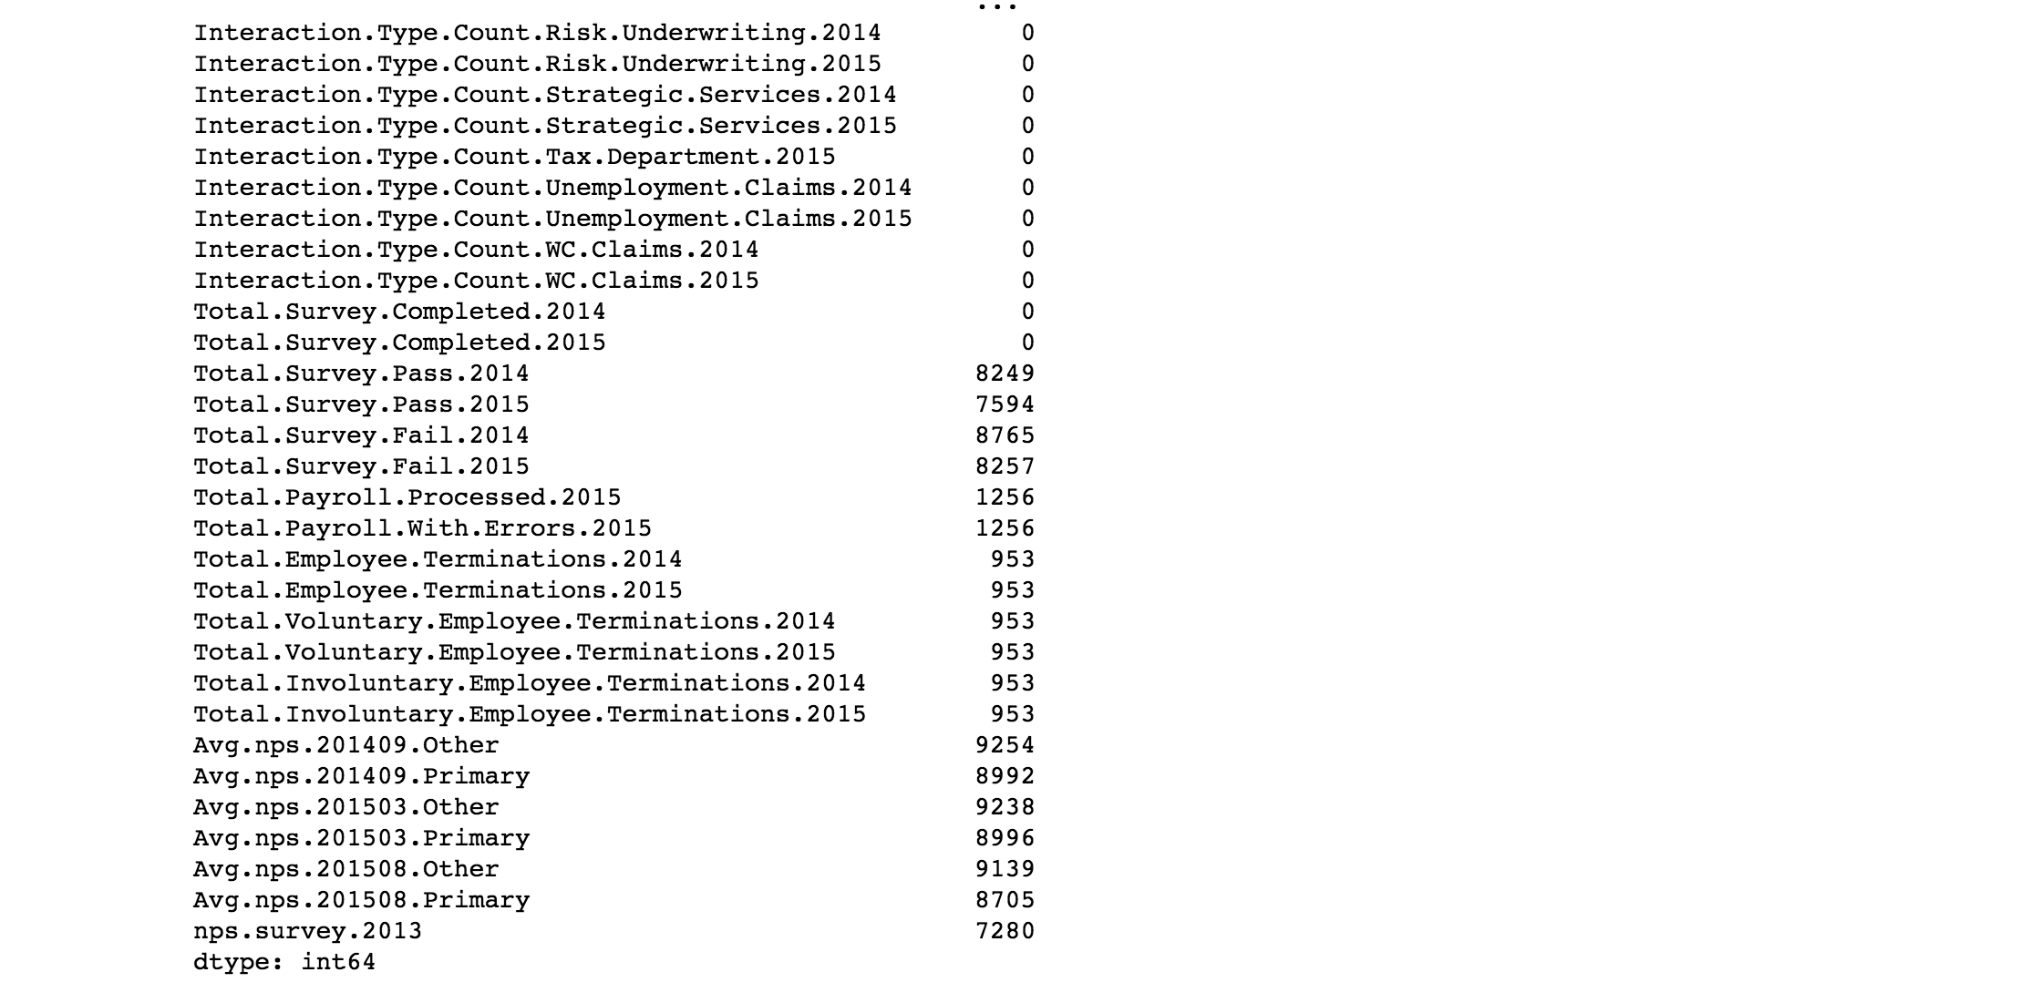
Exploratory data analysis (cont’d)

Slide 10
Next steps
Clean up null values and data types
Continue EDA
Try running basic decision tree to see what features seem important

