Slide 1

Perth Happy Hour
Discover Local Bars
Developed by Bytecode ©

Slide 2
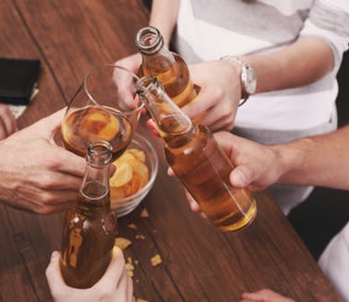
Concept and Motivation
Create an app to help drinkers find a nearby bar
new to the city
getting off public transport in an entertainment area
want to go out in the evening from home

Slide 3
Design Process Technologies/Libraries Used Demonstration
Scope Definition
What pages and features the site required to align with its purpose
Site Map and Wireframe Creation
Basic Pencil/Paper diagram
Content Creation
Driven by data available from API
Age Verification plug in
Visual Elements
Bootstrap Freelancer
Font Awesome
jQuery easing
Modals
Unsplash.com

Slide 4
Future Development
Link to rideshare app
User can sign up to bar newsletter
User can upload their own photos
User can add ratings and comments about bar
User can save favourite bars

