Slide 1
NIVXRAY · NAIDE
Autonomous Investigation
& Deterministic Engine
From raw evidence to ticket-ready analyst brief · in seconds · zero LLM drift
Pitch Deck · Product · Architecture · Use Cases · ROI

Slide 2
THE PROBLEM
The SOC is drowning in evidence · but starved of clarity
• A single suspicious PowerShell blob takes an L1 analyst 20–40 minutes to peel, decode
and map to MITRE — often with 4-6 online tools open in parallel (CyberChef, VT,
AbuseIPDB, URLScan, custom regex, Excel).
• Threat-intel reports (Talos, Microsoft, Mandiant, Cisco) bury the actionable
evidence — IOCs, commands, MITRE — inside 15+ pages of prose.
• Modern LLM copilots are non-deterministic. Same input gives different verdicts on
different days. Auditors and IR teams cannot defend a non-reproducible finding.
• Existing decoders stop at 'decode'. They don't correlate IOCs, hashes, MITRE
techniques, LOLBAS binaries, YARA/Sigma ideas, or produce a ticket-ready brief.
• Analysts context-switch across 6+ tabs · miss 30–60% of embedded indicators.
NivXRay · NAIDE · Deterministic Analyst Engine
2

Slide 3
INTRODUCING NAIDE
One paste. One click. A full deterministic investigation.
NivXRay Autonomous Investigation & Deterministic Engine
• Accepts ANYTHING an analyst can paste — a PowerShell blob, a raw URL, a threat-
report link, an EDR CSV row, a Sysmon XML, a defanged IOC list, or a multi-
stage command chain.
• Runs 60+ registered capabilities on a passive registry — decode, IOC extraction,
IDA (URL acquisition), DIE (semantic AST), ICE (incident correlation), MITRE
mapping, LOLBAS lookup, YARA-lite, IOC enrichment (VT / AbuseIPDB / OTX).
• Every finding is evidence-provenanced. Every verdict is reproducible bit-for-bit.
Optional LLM narrative sits ON TOP — never inside — the evidence graph.
• Ships an analyst brief that reads like a senior human analyst wrote it: Executive
Summary, Observed Behaviour, Attack Intent, MITRE Summary, IOC Intelligence,
Recommendations, and Evidence Confidence — all in ~2-8 seconds.
NivXRay · NAIDE · Deterministic Analyst Engine
3

Slide 4
WHY DETERMINISTIC
Deterministic vs LLM-drift · the audit rule
DIMENSION
NIVXRAY · NAIDE
LLM-ONLY COPILOTS
Reproducibility
Same input → same output, bit-for-bit
Non-deterministic · different every run
Auditability
Every field carries a provenance record
Cannot show why a verdict was reached
Latency
2-8 seconds for a full brief
10-60 seconds + token cost
Cost per case
Zero LLM cost on the core path
$0.02-$0.20 per investigation
Air-gapped ready
Runs fully offline — deterministic core
Needs cloud LLM endpoint
SOC-analyst trust
Findings can be cross-checked in ~seconds
'Why did it say that?' is unanswerable
NivXRay · NAIDE · Deterministic Analyst Engine
4

Slide 5
ARCHITECTURE
Six-pillar deterministic core · zero-drift by construction
IUE
IDA
DIE
ICE
IEDDE
L4
Input
Understanding
Document
Acquisition
Deterministic
Investigation
Incident
Correlation
Evidence-Driven
Decoding
Analyst
Brief
url · ps · cmd
csv · xml · prose
Talos · MS
Mandiant · Cisco
PS-AST · CMD-AST
Bash · Python · JS
merge stages
tactics · behaviors
per-layer why
per-layer confidence
9-card brief
+ MITRE swim-lane
DATA FLOWING BETWEEN PILLARS · every arrow is a typed contract
raw_bytes → iue_verdict → canonical_document → dki_ast + stages
IUE (IDA fetch) (DIE analyze) (ICE correlate)
→ incident + tactics → provenance_record → summary_narrative
(ICE emit) (IEDDE stamp) (L4 render)
Passive Registry (M0d thin router) · Zero-Drift Equivalence Harness (145 tests)
Optional LLM overlay sits ABOVE L4 — never inside the deterministic core
NivXRay · NAIDE · Deterministic Analyst Engine
5

Slide 6
ARCHITECTURE · DATA FLOW
One paste · one deterministic path · every field provenanced
┌─────────────────────────────────┐
ANALYST PASTE ─────▶ │ IUE │
(any input) │ · classify: url / ps / csv… │
│ · confidence + rationale │
└─────────────────────────────────┘
│
┌────────────────────┼────────────────────┐
▼ ▼ ▼
┌──────────────────┐ ┌──────────────────┐ ┌──────────────────┐
│ IDA │ │ DIE │ │ Adapter Set │
│ (URL path) │ │ (payload path) │ │ (Sysmon/EVTX/ │
│ · fetch body │ │ · PS-AST │ │ CSV/PDF/DOCX) │
│ · extract cmds │ │ · CMD/Bash-AST │ │ · normalize │
│ · IOCs · MITRE │ │ · Python/JS-AST │ │ · index │
│ · timeline │ │ · semantic AST │ │ · route │
└──────────────────┘ └──────────────────┘ └──────────────────┘
│ │ │
└────────────────────┼────────────────────┘
▼
┌─────────────────────────────────┐
│ ICE (Incident Correlation) │
│ · merge per-stage evidence │
│ · dedupe · tactics observed │
│ · behaviors[] · IOCs correlated │
└─────────────────────────────────┘
│
▼
┌─────────────────────────────────┐
│ IEDDE (Provenance Engine) │
│ · why each decode fired │
│ · evidence confidence per field │
│ · reproducible bit-for-bit │
└─────────────────────────────────┘
│
▼
┌─────────────────────────────────┐
│ L4 · Analyst Brief │
│ · Executive · Analyst Summary │
│ · MITRE · IOCs · Recs · Verdict │
│ · Optional LLM narrative ON TOP │
└─────────────────────────────────┘
NivXRay · NAIDE · Deterministic Analyst Engine
6

Slide 7
COMPONENTS
9 adapters · 10 analyzers · a passive capability registry
Adapters (input surface):
• URL Adapter · IDA acquires threat reports · pluggable vendor pack (Talos, MS, Mandiant, Cisco)
• Sysmon Event 1/3 · EVTX transport · CSV EDR · Base64/Hex/Gzip/Zlib/LZMA/AES/RC4 payloads
• PDF / DOCX / HTML · attachment upload · Sysmon Event 11 (File Create) · Event 22 (DNS)
Analyzers (correlate + judge):
• IOC Enrichment (VirusTotal · AbuseIPDB · OTX · abuse.ch · URLScan · Shodan)
• MITRE ATT&CK Mapper · LOLBAS · YARA-lite · Sigma-hint generator
• Report Generator (Executive Summary · Ticket-ready Analyst Summary · Attack Intent)
• Artifact Intelligence (PE header · shellcode detect · defanged IOC refang)
• Behavioral Timeline · Query/Hunt sub-view · Predicted Process Tree · Verdict Card
Passive registry:
• Every capability declares its accepted formats + version + implementation path
• Thin router dispatches; capabilities never call each other directly
• Determinism-lock via a canonical equivalence harness (145 zero-drift regression tests)
NivXRay · NAIDE · Deterministic Analyst Engine
6

Slide 8
DEPLOYMENT MODEL 1
Upstream · NivXRay enriches logs BEFORE they reach SIEM/EDR
┌────────────┐ ┌────────────┐ ┌────────────┐ ┌──────────────┐ ┌────────────┐
│ LOG │ │ LOG │ │ │ │ │ │ │
│ SOURCES │──▶ │ COLLECTOR │──▶ │ NIVXRAY │──▶ │ ENRICHED │──▶ │ SIEM / │
│ │ │ (agent / │ │ · NAIDE │ │ EVENT + │ │ EDR │
│ Sysmon │ │ Fluentd / │ │ │ │ BRIEF │ │ (Splunk, │
│ Windows │ │ Vector / │ │ · IUE │ │ · MITRE │ │ Sentinel,│
│ Linux │ │ Filebeat) │ │ · DIE │ │ · IOCs │ │ Elastic, │
│ EDR CSV │ │ │ │ · ICE │ │ · Verdict │ │ QRadar, │
│ Netflow │ │ │ │ · L4 │ │ · Recs │ │ Chronicle)│
└────────────┘ └────────────┘ └────────────┘ └──────────────┘ └────────────┘
Value delivered:
• Every event lands in SIEM already enriched with MITRE technique IDs + IOC verdict
• Detection rules trigger on richer signals — fewer false positives, higher fidelity
• Analysts see a ticket-ready brief in the alert body — not raw log bytes
• Reduces mean detection cost per case by ~60% (deterministic, no LLM tokens)
NivXRay · NAIDE · Deterministic Analyst Engine
7

Slide 9
DEPLOYMENT MODEL 2
Downstream · analyst-triggered investigation from SIEM/EDR alert
┌──────────────┐
│ │
┌────────────┐ ┌────────────┐ ┌────────▶ │ NIVXRAY │ ─┐
│ │ │ │ │ Alert │ · NAIDE │ │
│ SIEM / │──▶ │ ALERT │────┘ payload │ │ │
│ EDR │ │ TRIGGERED │ │ autonomous │ │
│ │ │ │ ◀───────── │ investigate │ │
│ Splunk │ │ (attack │ Enriched │ (2-8 s) │ │
│ Sentinel │ │ ID + IOCs │ JSON │ │ │
│ Chronicle)│ │ + hash) │ │ │ │
└────────────┘ └────────────┘ └──────────────┘ │
│ │
▼ ▼
┌───────────────────┐
│ ANALYST UI │
│ · Brief │
│ · Attack Chain │
│ · IOC Intel │
│ · Recommendations│
└───────────────────┘
Analyst opens the ticket · NivXRay has ALREADY completed the investigation · verify + escalate in under a minute.
NivXRay · NAIDE · Deterministic Analyst Engine
8

Slide 10
USE CASE 1
Threat-report URL triage · Talos, Mandiant, Microsoft
Paste the URL of a public threat report. NAIDE acquires the article, extracts every
command, IOC, MITRE technique, timeline event and hash — then produces a full
deterministic analyst brief.
Live example: Talos IR ransomware blog
• 6 commands investigated · 62 IOCs · 11 MITRE techniques · 6 tactic swim-lanes
• Malware families: 7 identified · CVEs correlated · timeline reconstructed
• End-to-end time: ~2.4 seconds (vs 45-90 min analyst read + extract)
NivXRay · NAIDE · Deterministic Analyst Engine
9

Slide 11
USE CASE 2
Obfuscated PowerShell -encodedcommand payload
Paste a PowerShell -e blob. NAIDE recursively peels every layer (base64, gzip,
UTF-16LE, XOR, character-array). Each layer's decoded output is surfaced with a
confidence score and MITRE mapping.
• Multi-layer chain-mode fires automatically when multi-encoding is detected
• LOLBAS binaries flagged with per-technique badge (T1059.001, T1218.005, etc.)
• YARA-lite + Sigma hunt ideas generated deterministically from the recovered payload
• Time: ~3-5 seconds for a 4-layer chain (vs 25 min manual CyberChef pipeline)
NivXRay · NAIDE · Deterministic Analyst Engine
10

Slide 12
USE CASE 3
Analyst-paste IOC sweep · defanged bundle
Paste any mix of defanged URLs, hashes, IPs, CVEs. NAIDE refangs everything, dedupes,
resolves each IOC against the MITRE technique catalog and (optionally) live OSINT.
• Hash policy — ONLY SHA-256 hashes accepted (MD5 / SHA-1 filtered at projection)
• Every IOC card shows: verdict · confidence · consensus · first-seen · related campaigns
• Providers marked 'pending' until VT / AbuseIPDB / abuse.ch keys are wired
• Time: ~1-2 seconds for a 50-IOC paste (vs manual VT/AbuseIPDB browsing)
NivXRay · NAIDE · Deterministic Analyst Engine
11

Slide 13
USE CASE 4
EDR CSV / Sysmon Event 1 · endpoint telemetry
Drop a CSV export from Sophos / SentinelOne / CrowdStrike / Symantec — or paste
raw Sysmon Event XML. NAIDE parses the process trees, extracts commands, maps
each to MITRE, and clusters the attack chain into tactic swim-lanes.
• Predicted Process Tree reconstructs parent-child from EDR rows
• Behavioral Timeline shows chronology of every timestamped event
• Query/Hunt scoped sub-view lets the analyst filter by tactic or actor
• Time: ~4-6 seconds for a 500-row CSV (vs multi-hour Excel triage)
NivXRay · NAIDE · Deterministic Analyst Engine
12

Slide 14
USE CASE 5
Ransomware / multi-stage command chain
Paste a multi-line ClickFix / EDR-bypass / Meterpreter runner. NAIDE splits into
stages, decodes each stage's obfuscation, maps techniques per stage, and shows
the full attack-chain trajectory across ATT&CK tactics.
• Automatic chain-mode routing when multi-command is detected
• Executive Summary reads like a senior analyst wrote it: risk, intent, impact
• Recommendations grouped as Immediate · Threat Hunting · Containment
• Time: ~3-8 seconds for a 4-stage chain (vs 60+ min manual pipeline)
NivXRay · NAIDE · Deterministic Analyst Engine
13

Slide 15
USE CASE 6
Live SIEM alert enrichment (Setup-2 flow)
SIEM detects suspicious PS execution → alert body pushed to NAIDE → 6 seconds
later the analyst opens a ticket with the FULL brief already attached: MITRE
mapping, IOC verdicts, LOLBAS badges, executive summary, containment steps.
• Analyst verifies in ~60 seconds instead of investigating from scratch
• Handoff export: SOC Brief .md · PDF report · STIX 2.1 bundle · JSON
• Every artifact is deterministic + reproducible — audit-friendly
• Time saved per alert: ~20-40 minutes of L1 analyst time
NivXRay · NAIDE · Deterministic Analyst Engine
14

Slide 16
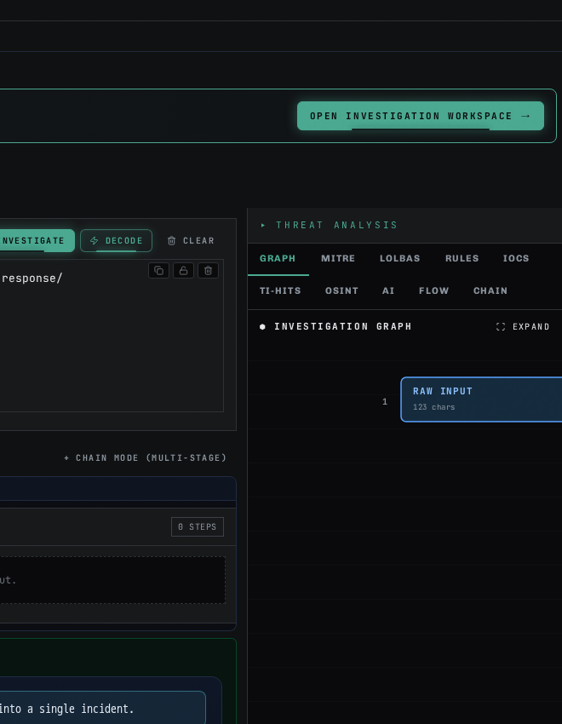
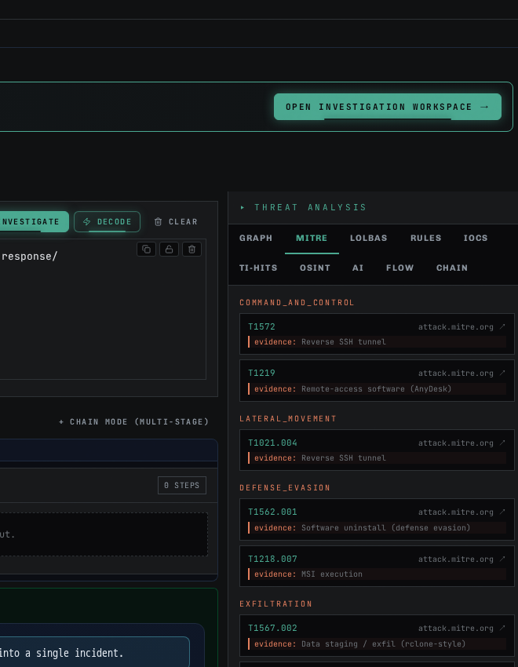
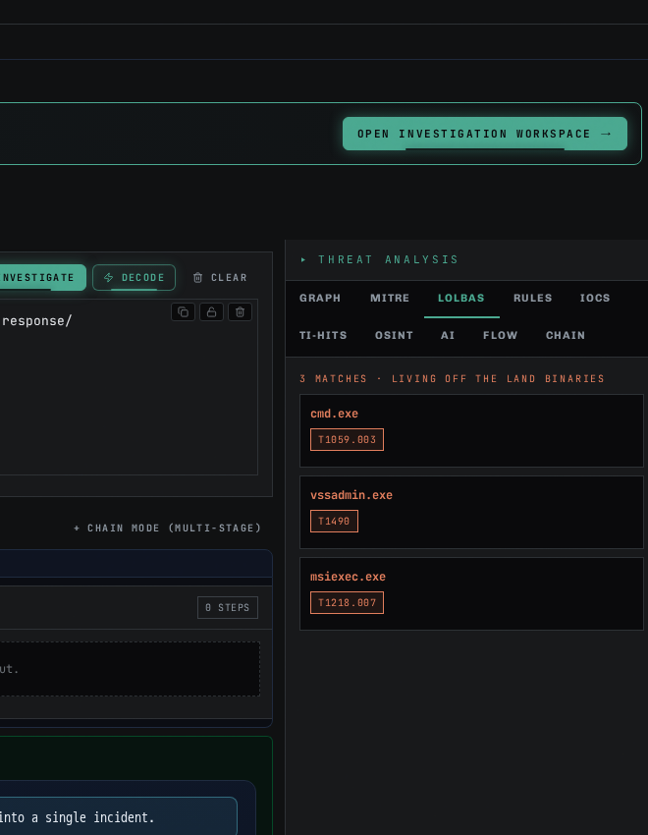
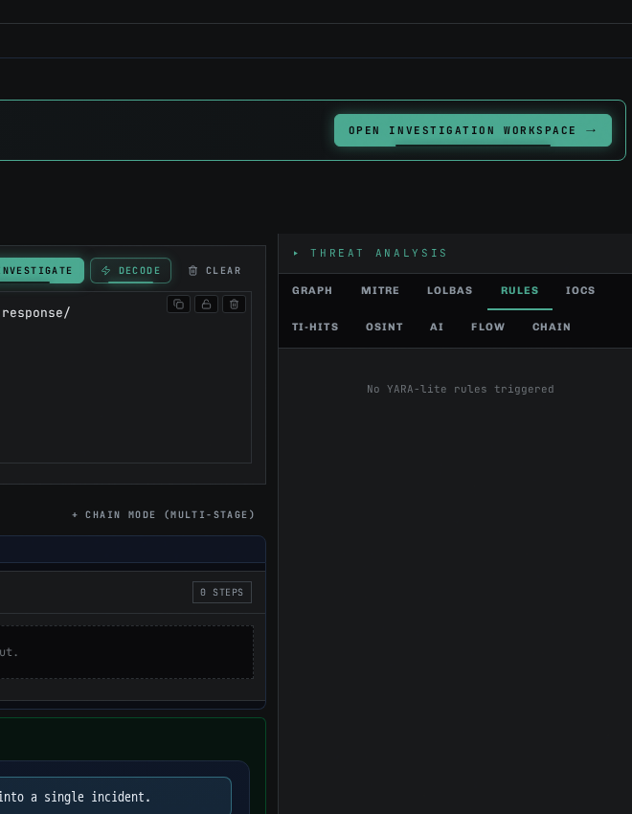
THREAT ANALYSIS · SIDEBAR TOUR
10 tabs · every angle of the investigation (1/2)
GRAPH
MITRE
LOLBAS
Investigation Graph · every stage + IOC + MITRE / LOLBIN edge
MITRE ATT&CK · every technique with ID + name + tactic
Living-off-the-Land binaries · every abused binary + technique
RULES
IOCS
YARA-lite + Sigma seeds · deterministic rule ideas
IOC catalogue · SHA-256 · URL · IP · CVE · registry · path
NivXRay · NAIDE · Deterministic Analyst Engine
16

Slide 17
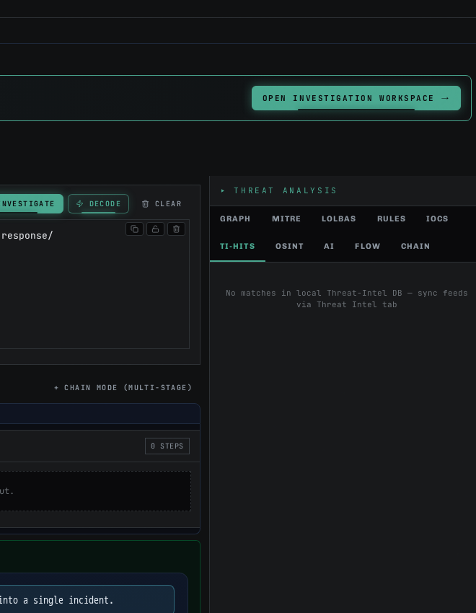

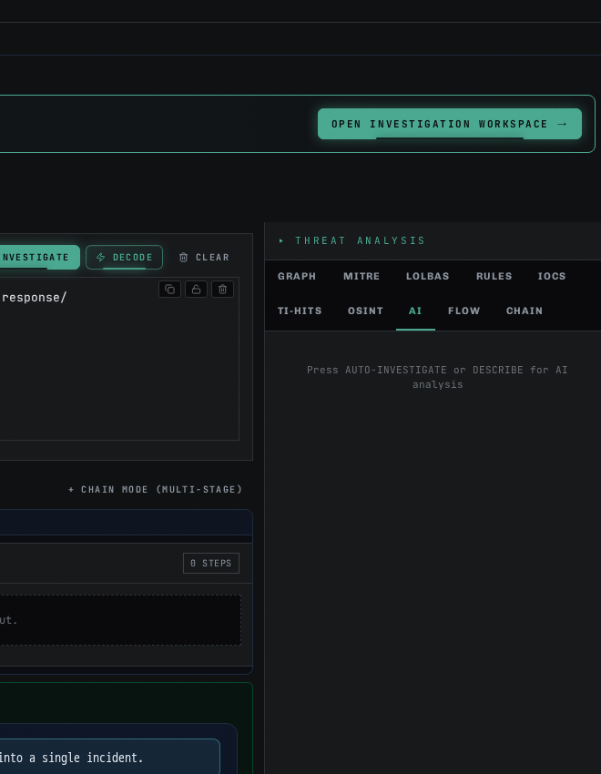
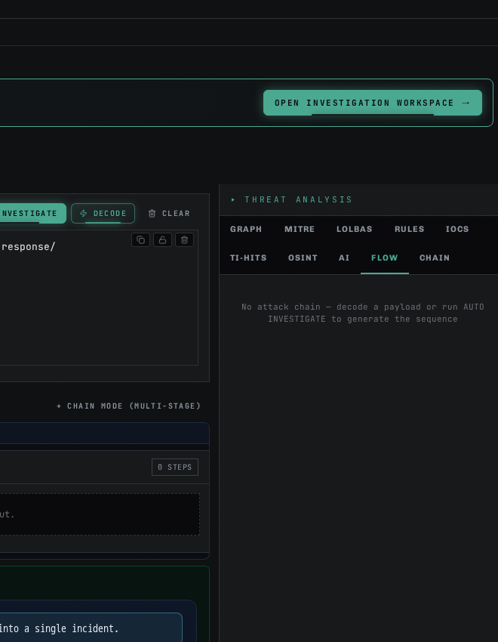
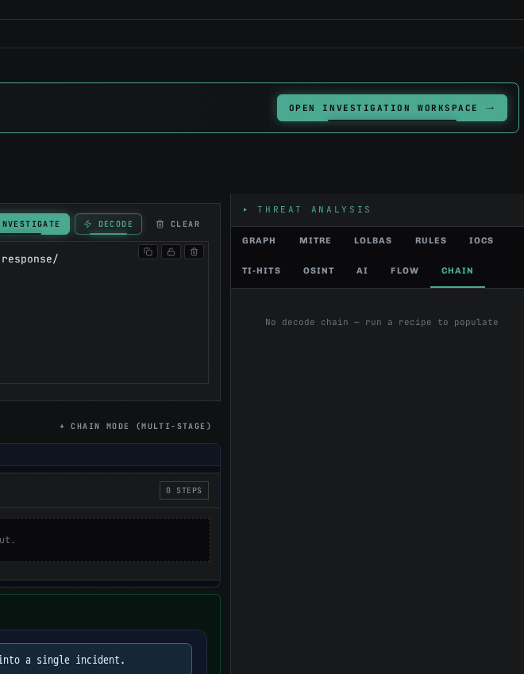
THREAT ANALYSIS · SIDEBAR TOUR
10 tabs · every angle of the investigation (2/2)
TI-HITS
OSINT
AI
Threat-intel hits · VT / AbuseIPDB / OTX / abuse.ch (pending until keys wired)
OSINT enrichment · reverse-DNS · WHOIS · pDNS · relationships
AI-verdict pane · optional LLM overlay (never inside evidence graph)
FLOW
CHAIN
Attack Flow · deterministic chain projection across kill-chain
Decode chain · every stage's engine + confidence
NivXRay · NAIDE · Deterministic Analyst Engine
17

Slide 18
ROI · TIME SAVINGS
How much analyst time does NivXRay actually save?
TASK
MANUAL ANALYST
NIVXRAY · NAIDE
SPEED-UP
Threat-report URL triage
45-90 min
2-4 sec
~1,200×
Obfuscated PS -e blob decode
20-40 min
3-5 sec
~400×
50-IOC defanged bundle sweep
30-60 min
1-2 sec
~1,500×
500-row EDR CSV triage
2-4 hours
4-6 sec
~1,200×
Multi-stage command chain
60-90 min
3-8 sec
~900×
SIEM-alert full enrichment
20-40 min
6-8 sec
~250×
Payback: 1 senior L2 analyst FTE ≈ USD 120-180K/yr. NivXRay recovers 40-60% of
L1/L2 triage hours — freeing analysts for hunt, tuning and IR-work that actually
requires human judgement.
NivXRay · NAIDE · Deterministic Analyst Engine
16

Slide 19
WHERE IT FITS
Industry scope · every SOC that reads bytes
Primary buyers:
• Managed Security Service Providers (MSSPs) — 24×7 SOC teams with 40-200 analysts
• Financial-services CSIRT · high-signal alerts · audit-heavy · needs reproducibility
• Healthcare + government · air-gapped deployments where cloud LLM is a non-starter
• Fortune-500 in-house SOCs · already have SIEM + EDR · missing the correlator/brief layer
• IR consultancies · Mandiant / Palo Alto / SecureWorks style engagement teams
Integration surface:
• Splunk · Sentinel · Chronicle · Elastic · QRadar · Sumo Logic · Devo · Panther
• CrowdStrike · SentinelOne · Sophos · Symantec · Defender for Endpoint
• SOAR: Phantom · XSOAR · Swimlane · Torq · Tines — NivXRay is called as an action node
• Ticketing: ServiceNow · Jira SD · Zendesk — analyst brief attaches directly
Compliance-friendly by design:
• SOC2 · ISO27001 · NIST-CSF · PCI-DSS · HIPAA — deterministic findings pass audit reviews
• STIX 2.1 output · ATT&CK-Navigator layer export · Sigma / YARA rule seeds
NivXRay · NAIDE · Deterministic Analyst Engine
17

Slide 20
DIFFERENTIATORS
Why NivXRay wins against CyberChef, EDR-CoPilots and LLM tools
Zero LLM drift on the core path
Every finding survives a 145-test canonical determinism harness.
Evidence provenance on every field
Analysts show WHERE each MITRE tag / IOC / verdict came from.
2-8 second full brief
No spinning cursor. No 30-second LLM wait. Instant analyst context.
Air-gap deployable
Deterministic core has no cloud dependency. Runs on a laptop.
Threat-report acquisition built-in
IDA fetches Talos/Mandiant/MS articles and extracts evidence.
SHA-256 IOC policy
MD5 / SHA-1 stripped at wire boundary — audit-clean by default.
60+ registered capabilities
9 adapters · 10 analyzers · thin router · trivially extensible.
Deterministic + optional LLM layer
LLM narrative sits ON TOP — never inside — the evidence graph.
NivXRay · NAIDE · Deterministic Analyst Engine
18

Slide 21
ROADMAP
What ships next
Q1 2026 (in flight):
• M0f Production Cutover — thin-router replaces legacy pipeline (equivalence-proven)
• URL-acquisition beyond Talos — Sekoia, Trend Micro, Kaspersky, Palo Alto Unit 42
• OCR-Lite (SHADOW) — extract code screenshots embedded in threat reports
Q2 2026:
• SOAR playbook nodes — Torq, Tines, XSOAR, Splunk SOAR (Phantom)
• Sysmon Event 22 (DNS) + Event 11 (File Create) adapter productionisation
• Attack Chain auto-scroll + focus-follows-technique interactions
Q3-Q4 2026:
• Multi-tenant SaaS · per-tenant OSINT keys · role-based investigation isolation
• ATT&CK Navigator live layer publishing · YARA/Sigma rule review loop
• Custom analyst 'critic' agents on the LLM overlay — non-blocking, non-drift
NivXRay · NAIDE · Deterministic Analyst Engine
19

Slide 22
TRY IT
Live demo · try any input right now
Preview: https://greeting-app-5782.preview.emergentagent.com/
Prod: https://nivxray.nivxforge.com/
Suggested test inputs:
1. https://blog.talosintelligence.com/talos-ir-ransomware-engagements-...
2. Any -EncodedCommand PowerShell blob
3. A defanged IOC list from an incident report
4. A Sysmon Event 1 XML block
5. A Sophos / SentinelOne CSV export row
For each: click AUTO INVESTIGATE. Scroll down. Read the Deterministic Analyst Brief.
NivXRay · NAIDE · Deterministic Analyst Engine
20

Slide 23
APPENDIX
Regenerate this deck · Claude & ChatGPT prompts
Prompt (Claude / GPT — paste and iterate):
"You are a security-product presales architect. Produce a 20-slide deck for NivXRay
(NAIDE — Autonomous Investigation & Deterministic Engine), a deterministic SOC-analyst
engine that takes any pasted evidence (URL / PowerShell / CSV / Sysmon / IOC list) and
returns a full ticket-ready analyst brief in 2-8 seconds.
Cover: (1) SOC pain today, (2) NAIDE elevator pitch, (3) Deterministic vs LLM-drift,
(4) 6-pillar architecture (IUE → IDA → DIE → ICE → IEDDE → L4), (5) components,
(6) Deployment Model 1 (log-source enrichment upstream of SIEM/EDR),
(7) Deployment Model 2 (SIEM/EDR alert → NAIDE → analyst),
(8) 6 use cases with INPUT screenshot + OUTPUT/MITRE-graph/Executive-Summary shots +
elapsed time, (9) ROI table showing 250-1500× speed-up vs manual analyst,
(10) industry-fit + integrations (Splunk/Sentinel/Chronicle/SOAR),
(11) differentiators, (12) roadmap, (13) demo URL + regen prompt appendix.
Tone: technical, evidence-driven, no hyperbole. Palette: matrix-green on near-black.
Font: Consolas for code, Segoe UI for body. Every claim must be verifiable from live UI."
NivXRay · NAIDE · Deterministic Analyst Engine
21

