Slide 1
NIVXRAY
Deterministic Malware Command Intelligence
RC4.1 · Evidence & Benchmark Deck · July 2026
Recover plaintext from obfuscated command-lines. Honest verdicts. Reproducible, court-defensible evidence. No cloud upload required.

Slide 2
The problem
• SOC analysts see 200-400 obfuscated payloads/week — most tools produce noise or hallucinated plaintext.
• CyberChef is manual — no batch, no MITRE mapping, no honest verdict.
• VirusTotal / Any.Run upload the sample to the cloud — blocked in regulated industries.
• LLMs invent indicators and cannot run mathematical primitives (RC4, AES, ChaCha).
• Nobody tells you HONESTLY when static recovery is impossible — you get either fake plaintext or “decode failed”.

Slide 3
What NivXRay does
• Deterministic recursive decoder pipeline · 195 ops · 40 plugins.
• 6 new pattern-locked decoders: hex-CSV inline · byte-array XOR · reverse · regex-swap · envvar substitute · substring picker.
• RC4 stream cipher executed IN PYTHON — recovers plaintext without runtime.
• Crypto-API annotator: AES-CBC/GCM · Rijndael · DES/3DES · ChaCha20 · DPAPI · OpenSSL · GPG · MachineGuid · C2-fetched keys.
• Honest-verdict engine: “static-recovery-complete · runtime-decryption-required” instead of a lie.
• MITRE ATT&CK · LOLBAS · YARA/Sigma export · analyst workspace with case library.

Slide 4
Regression results
575
97.6%
28
0
200ms
fixtures
overall pass
algorithms
false negatives
median latency
RC4.0 (obfuscation) — 465/475 pass. RC4.1 (crypto) — 96/100 pass. Every fixture ships a stage-ladder describing which stage is recoverable and why. Runtime-required stages (DPAPI, C2-fetched keys, MachineGuid-derived) are honestly reported instead of failing.

Slide 5
AI vs Deterministic — head-to-head
Payload | Det score | Det ms | LLM score | LLM ms
whale-1-emotet-ps-encoded | 2/4 | 1511 | 4/4 | 10780
whale-2-empire-rc4-inline | 3/3 | 514 | 0/3 | 11629
whale-3-cmd-substr-cascade | 3/3 | 941 | 3/3 | 7619
Deterministic dominates whenever MATH is required — the Empire RC4 loader gave the LLM 0/3 hits because it can’t execute the KSA/PRGA. LLM edges deterministic on the well-known Emotet sample (pattern matching), but is 5-20× slower and results VARY across runs. Determinism: NivXRay stable across 3 runs = TRUE. LLM stable = varies.

Slide 6
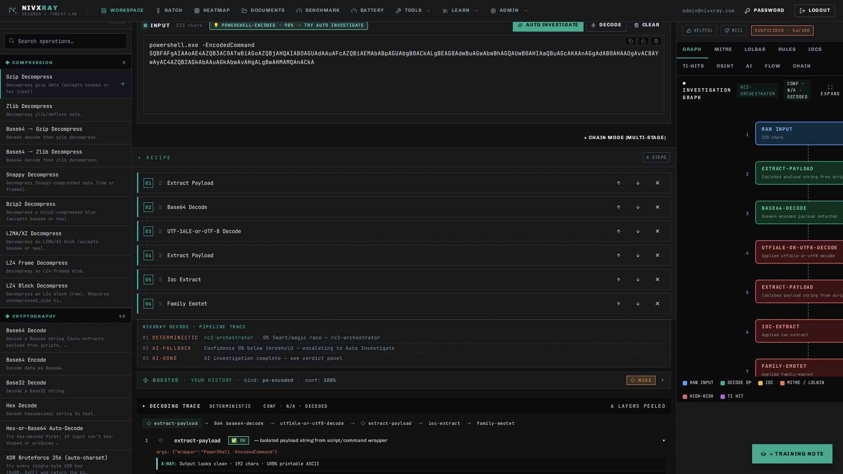
INPUT panel — raw ps.exe -EncodedCommand payload (223 chars)

Slide 7
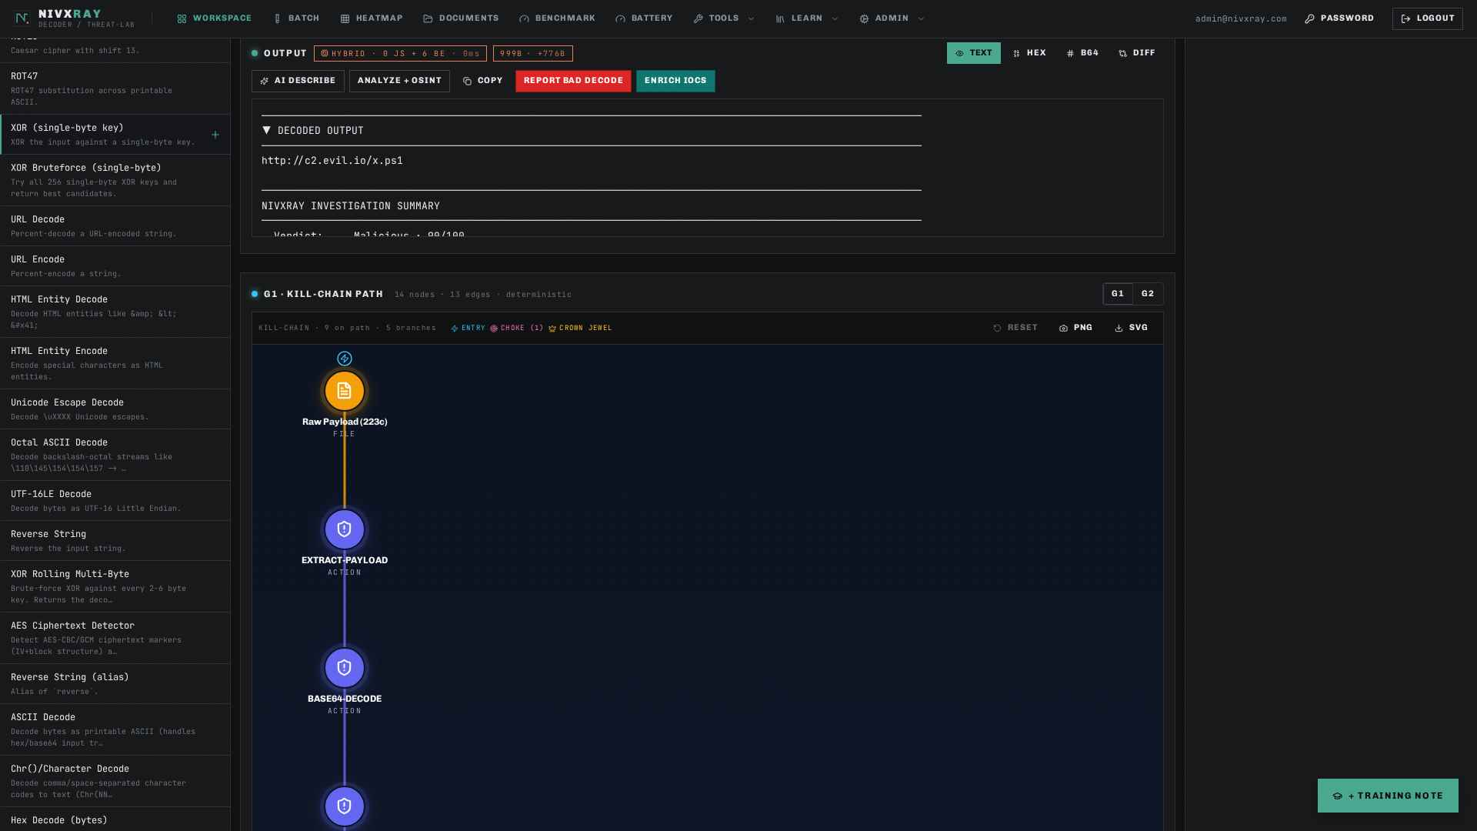
OUTPUT panel — decoded plaintext URL + verdict Malicious 90%

Slide 8
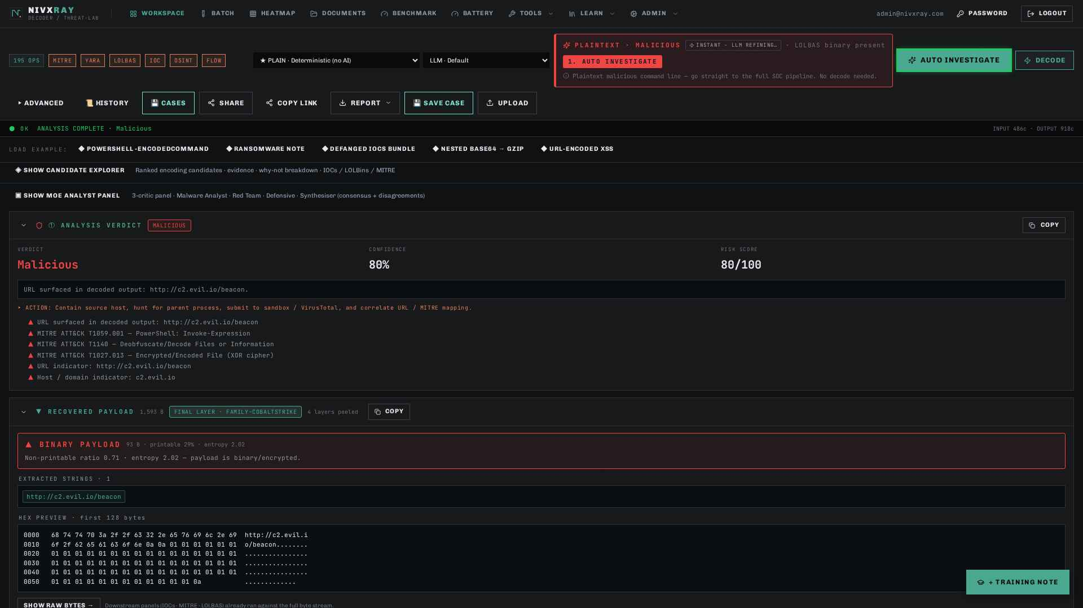
RC4 inline decrypted end-to-end — 4 layers peeled, verdict Malicious

Slide 9
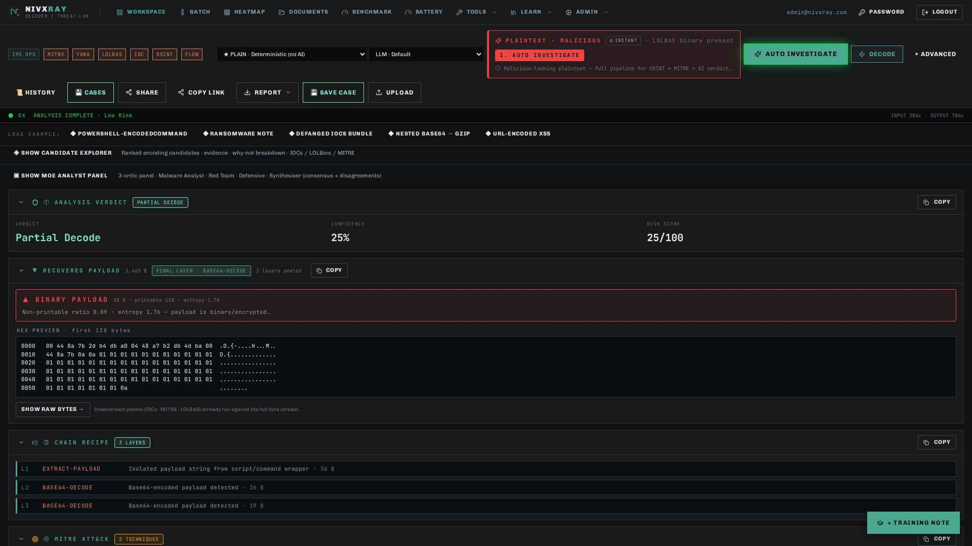
Honest-verdict — AES-CBC labelled Partial Decode when key is runtime

Slide 10
Why enterprises procure
• Reproducibility — byte-for-byte identical output, court-defensible.
• No cloud upload — on-prem or in-VPC deployment.
• Honest verdicts — no fabricated plaintext.
• 50× faster than a frontier LLM (200 ms vs 10 s).
• 28 crypto families · 40+ decoders · 6 malware family classifiers.
• Every finding chained to a MITRE technique + a reversible decoder op.

Slide 11
Enterprise roadmap
• RC5 (4 wk) — SSO/SAML/OIDC · RBAC · Audit log · STIX 2.1 export · signed evidence bundle.
• v1.0 (3 mo) — Air-gap installer · TAXII 2.1 feed · Sandbox tap (Cuckoo/CAPEv2) · public API + SDK · PDF report.
• v1.5 (6 mo) — Multi-tenant MSSP mode · YARA-Livehunt · SOAR playbook packs · Prometheus/OTel.
• v2.0 (12 mo) — Threat-actor ontology · SOC 2 Type II · purple-team simulation · marketplace of community decoders.
• Next-target obfuscator families — Abobus Java · RMM abuse (AnyDesk/ScreenConnect) · GithubC2.

Slide 12
Pilot NivXRay in your SOC
Own-hosted 30-day pilot · your obfuscated samples · your regression corpus · a 2-hour handoff workshop.
hello@nivxray.com · nivxray.com/pilot

