Slide 1

TESTING
WITHOUT
EXAMPLES
WITH EXAMPLES

Slide 2
EXAMPLE
BASED
For a given argument, you get a known return value
TESTING

Slide 3
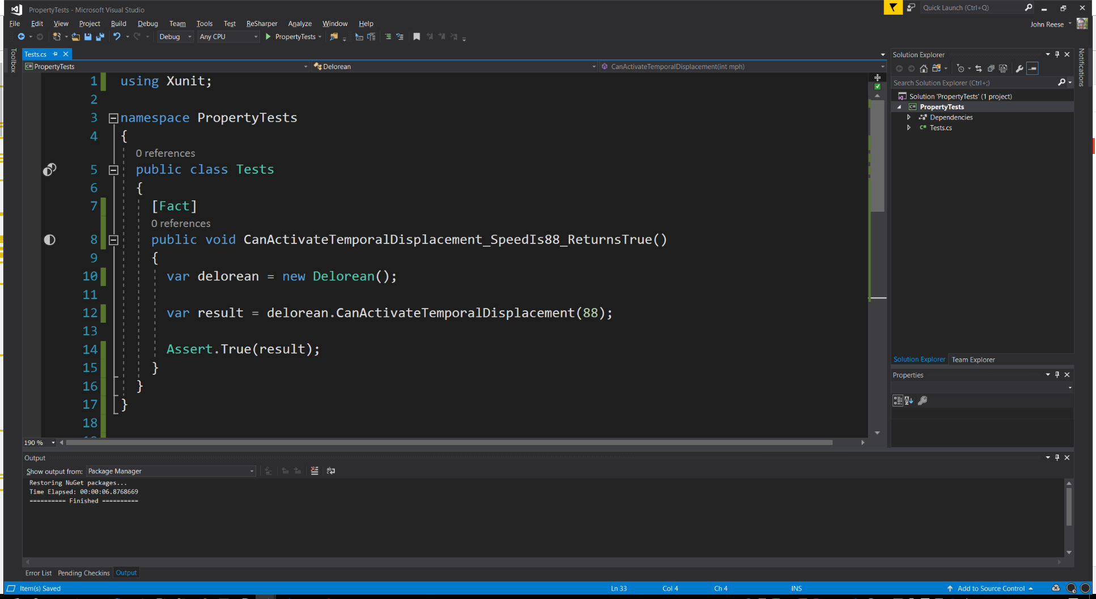

example

Slide 4
PROPERTY
BASED
I have no idea what I’m doing
TESTING

Slide 5

BUT WHY?

Slide 6
E
nterprise
D
eveloper
F
rom
H
ell
aka BOFH
https://en.wikipedia.org/wiki/Bastard_Operator_From_Hell

