Slide 1
Corporate Cybersecurity Overview
MGMT8175: Assessing Corporate Cybersecurity
Week 1

Slide 2
Unit Outcomes
Define cybersecurity
Explain the importance of cybersecurity to business
Explain the critical components of cybersecurity strategy
Discuss the growing importance of cybersecurity for businesses
Explain why cybersecurity is a management problem

Slide 3

Cybersecurity
Cybersecurity is the ongoing application of best practices intended to ensure and preserve confidentiality, integrity, and availability of digital information as well as the safety of people and environments.

Slide 4
Critical Aspects of Cybersecurity
Prevention: Implementing security measures to prevent unauthorized access or breaches.
Detection: Identifying potential threats and vulnerabilities in a system.
Response: Taking necessary actions to mitigate the impact of a security incident.

Slide 5
Cybersecurity Pillars
Cybersecurity Best Practice Pillars
Confidentiality
Integrity
Availability
Safety
CIAS Model

Slide 6
Defining important terms
C | CONFIDENTIALITY | Preserving authorized restrictions on access and disclosure to authorized users and services, including means for protecting personal privacy and proprietary information.
I | INTEGRITY | Protecting against improper modification or destruction, including ensuring non-repudiation and authenticity.
A | AVAILABILITY | Timely, reliable access to data, systems and services for authorized users, services and processes.
S | SAFETY | Reducing risk associated with technologies that could fail or be manipulated by nefarious actors to cause death, injury, illness, damage to or loss of equipment.

Slide 7
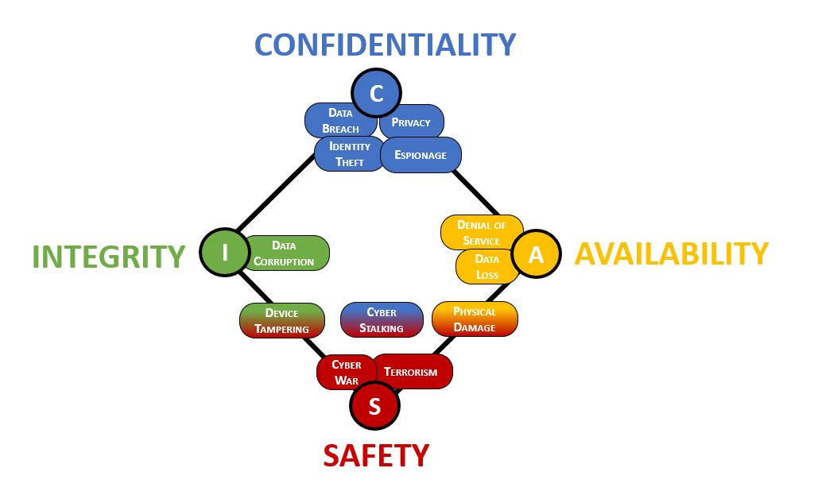
Populating the CIAS Model Credits- https://complianceforge.com/free-guides/confidentiality-integrity-availability-security-cias

Slide 8
Importance of Cybersecurity to Businesses
Sensitive Data
Protection from disruptive cyber threats
Reputation
Financial Security
Compliance
Business Continuity

Slide 9
Consequences of Cyberattacks on Businesses
Operational Disruptions | Operational disruptions - systems downtime or loss of critical data. Consequences - Hinder a company’s ability to deliver products and services, affecting customer satisfaction and potentially leading to contractual penalties.
Financial Losses | Immediate costs include hiring cybersecurity experts, recovering or replacing compromised systems, potential ransom payments, revenue due to downtime, legal fees, and fines for non-compliance with data protection regulations.
Reputation Damage | Loss of trust among customers, partners, and investors. This can result in lost business, as well as difficulties in attracting new customers or securing investments.

Slide 10
critical components of cybersecurity strategy

Slide 11
Cybersecurity Strategy
Protect Organization's Digital Assets
Maintain Customer Trust
Comply with Regulations

Slide 12
Critical Components of Cybersecurity Strategy
Risk Assessment: Identification of potential threats, vulnerabilities and associated impacts on organization.
Security Policies and Procedures: Outline the roles and responsibilities of employees, the acceptable use of technology, and the steps to take in case of a security incident.
Network and Endpoint Security: Implementation of strong security measures such as firewalls, IDS, anti-malware software, secure internet and regular patches.
Access Controls: Implementation of role-based access control and maintain minimum access to sensitive information. Regular audits of user privileges.
Data Encryption: Encryption of sensitive data to protect it from unauthorized access and potential breaches.
Incident Response Plan: Organization’s steps in case of a security breach.
Third-Party Risk Management: Assess the cybersecurity posture of your third-party vendors and partners.

Slide 13
Growing Importance of Cybersecurity for Businesses
Protecting Sensitive Data | Business dependency on sensitive data such as customer’s personal information, user profiles, financial information and intellectual property
Maintaining Business Operations | Cyberattack can cause downtime and disruption in business operations and ultimately business loss.
Regulatory Compliance | Businesses must comply with standard regulations to avoid legal issues.
Building Trust with Customers | Business customers are aware of data privacy acts therefore cybersecurity is important to lead loyalty and long-term relationships.
Market Competition | By implementing robust security measures, businesses can minimize the risk of cyber threats and focus on their core competencies, leading to a competitive advantage.

Slide 14
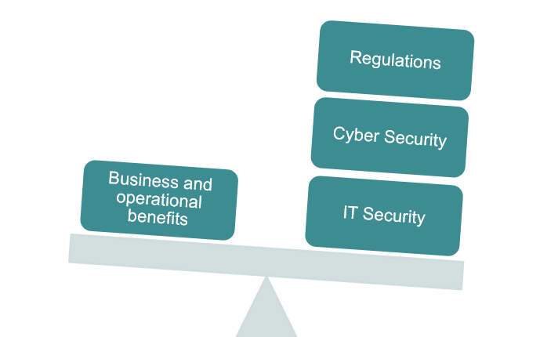
Managerial Perspective on Organizational Cybersecurity
Management team needs to understand potential threats and the various contexts in which threats arise.
Management team needs to be capable of assessing the consequences of a threat in various operating situations, using qualified input values from employees, to make well-informed business or operational decisions.
Business Management → Risk Management

Slide 15
Managerial Perspective on Organizational Cybersecurity
A management team should be able to answer key fundamental questions about cybersecurity:
How well does our capability match the current threat situation in our operating environment?
What are the organization’s most important assets?
How do cyber security risks affect the business’s goals and strategy?
How do we manage our risks, threats and potential attackers?
Are we complying with relevant standards and regulations?
How do we compare with others when it comes to our security level, investments and suchlike?
What incidents have occurred?
What caused these incidents and what have we done about them?
Are we getting better at cyber security and risk management?

Slide 16
References:
https://learning.oreilly.com/library/view/cybersecurity-program-development/9781119429517/c03.xhtml#head-2-7
https://www.ibm.com/topics/cybersecurity

