Slide 1
Corporate Cybersecurity Assessment
MGMT8175: Assessing Corporate Cybersecurity
Topic – Cybersecurity Standards and Frameworks

Slide 2
So, let’s discuss the main keywords
The terms guidelines, policies, standards, and procedures are frequently used interchangeably in many companies.
However, differences among these terms are important to understand before evaluating the adequacy of security within an organization.

Slide 3
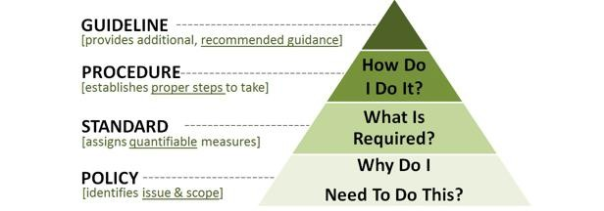
Guidelines vs Policies vs Standards vs Procedures
Guidelines are general, non-mandatory recommendations.
Procedures are detailed step by step instructions to achieve a given goal or mandate.
Standards are mandatory actions or rules that give formal policies support and direction.
Policies are formalized statements that apply to a specific area or task. Policies are mandatory – employees who violate a policy may be disciplined.
Reference - https://www.linkedin.com/pulse/20140611162901-223517409-difference-between-guideline-procedure-standard-and-policy/
Image Reference: frsecure.com

Slide 4
Cybersecurity Standards
Definition:
Cybersecurity standards are the crucial means by which an enterprise ensures its security strategy and policies are implemented in a consistent and measurable manner.
Cybersecurity standards are statements that describe what must be achieved in terms of security outcomes to fulfill an enterprise’s stated security objectives.
Cybersecurity standards implementation and solutions are not the part of the standard itself.

Slide 5
Understanding Cybersecurity Standards
Case Study Review
Refer to the white paper published by CGI in April 2019 on Understanding Cybersecurity Standards (Available under Week 2 eConestoga)
Objective
Paper describes the role of cybersecurity standards in the larger IT context and offers best practices for establishing a cybersecurity standards framework and managing compliance.

Slide 6
Cybersecurity Framework
Definition:
A cybersecurity framework provides a common language and set of standards for security leaders across countries and industries to understand their security postures and those of their vendors.
Benefit - Easier to define the processes and procedures that your organization must take to assess, monitor, and mitigate cybersecurity risk.

Slide 7
Popular Cybersecurity Frameworks and Standards To reduce cyber risk
1 | NIST Cybersecurity Framework | Cybersecurity Framework by National Institute of Standards and Technology | https://www.nist.gov/cybersecurity
2 | ISO 27001 and ISO 27002 | International Organization for Standardization ISO/IEC 27000 family Information security management | https://www.iso.org/standard/iso-iec-27000-family
3 | SOC2 | Service Organization Control – Type 2 By American Institute of Certified Public Accountants (AICPA) | https://www.aicpa-cima.com/topic/audit-assurance/audit-and-assurance-greater-than-soc-2

Slide 8
Popular Cybersecurity Frameworks and Standards To reduce cyber risk
4 | NERC-CIP | North American Electric Reliability Corporation – Critical Infrastructure Protection | For Utility and Power Sector https://www.nerc.com/pa/Stand/Pages/default.aspx
5 | HIPAA | Health Insurance Portability and Accountability Act | Cybersecurity framework for health organizations https://www.hhs.gov/hipaa/index.html
6 | GDPR | General Data Protection Regulation | https://gdpr.eu/
7 | FISMA | Federal Information Security Management Act | https://security.cms.gov/learn/federal-information-security-management-act-fisma

Slide 9

Let’s discuss cybersecurity frameworks and standards through case studies

