Slide 1
Cybersecurity Governance in the Corporate Sector
Ensuring safe and compliant business technology practices
Notes:
AI-generated content may be incorrect. ---

Slide 2
Cybersecurity Governance Overview
Notes:
Importance of Cybersecurity Governance

Slide 3
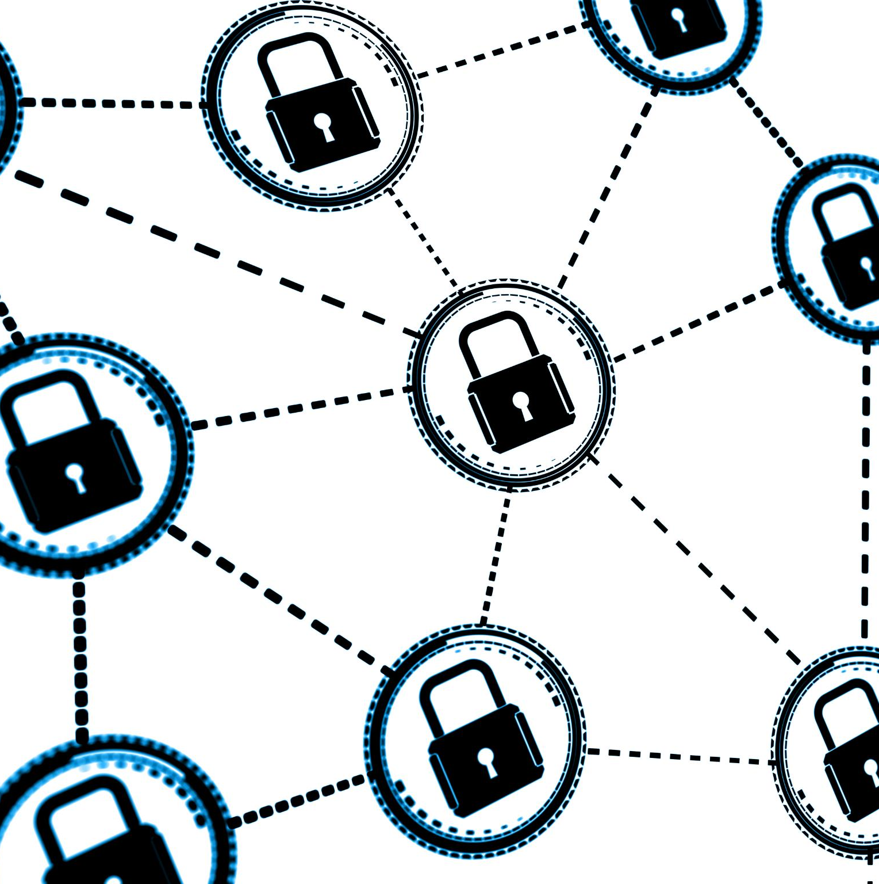
Importance of Cybersecurity Governance
Cybersecurity governance refers to the framework through which organizations direct and control their cybersecurity efforts.
It ensures that cybersecurity aligns with business objectives, risk management practices, and compliance requirements.
Notes:
Cybersecurity governance is essential in the corporate sector as it ensures that security efforts are aligned with the organization's strategic objectives. It provides a structured framework for managing cyber risks, complying with regulatory requirements, and maintaining stakeholder trust. By embedding cybersecurity into the corporate governance structure, organizations can proactively address threats and vulnerabilities, thereby safeguarding their assets and reputation. This governance encompasses risk management practices that identify, assess, and mitigate potential threats. It also ensures compliance with laws and standards such as GDPR, HIPAA, and ISO/IEC 27001, which are critical for legal and operational integrity. Furthermore, cybersecurity governance facilitates strategic alignment by integrating security initiatives with business goals and digital transformation efforts. It builds stakeholder trust by demonstrating a commitment to protecting sensitive data and maintaining operational continuity in the face of cyber incidents.

Slide 4
Importance of Cybersecurity Governance
Framework for Cyber Risk Management
Cybersecurity governance provides a structured framework to identify, assess, and mitigate cyber risks effectively.
Regulatory Compliance
It ensures compliance with key regulations like GDPR, HIPAA, and ISO/IEC 27001, maintaining legal and operational integrity.
Strategic Alignment
Governance integrates cybersecurity initiatives with business goals and digital transformation strategies for cohesive progress.
Building Stakeholder Trust
Effective governance demonstrates commitment to data protection and operational continuity, enhancing stakeholder trust.
Notes:
Cybersecurity governance is essential in the corporate sector as it ensures that security efforts are aligned with the organization's strategic objectives. It provides a structured framework for managing cyber risks, complying with regulatory requirements, and maintaining stakeholder trust. By embedding cybersecurity into the corporate governance structure, organizations can proactively address threats and vulnerabilities, thereby safeguarding their assets and reputation. This governance encompasses risk management practices that identify, assess, and mitigate potential threats. It also ensures compliance with laws and standards such as GDPR, HIPAA, and ISO/IEC 27001, which are critical for legal and operational integrity. Furthermore, cybersecurity governance facilitates strategic alignment by integrating security initiatives with business goals and digital transformation efforts. It builds stakeholder trust by demonstrating a commitment to protecting sensitive data and maintaining operational continuity in the face of cyber incidents.

Slide 5
Benefits of Cybersecurity Governance
Notes:
Advantages of Effective Governance

Slide 6

Benefits of Good Cybersecurity Governance
Improved Cyber Resilience
Good governance strengthens resilience, enabling faster detection and recovery from cyber incidents.
Cost Efficiency
Effective governance reduces breach costs and optimizes cybersecurity investments through strategic planning.
Enhanced Decision-Making
Clear policies and roles enable faster, informed responses to emerging cybersecurity threats.
Security-Aware Culture
Governance promotes a culture where employees prioritize data protection and follow security best practices.
Notes:
Good cybersecurity governance offers numerous benefits that enhance an organization's overall security posture and operational efficiency. One of the primary advantages is improved resilience against cyber threats, enabling organizations to detect, respond to, and recover from incidents more effectively. This resilience minimizes downtime and protects critical assets. Additionally, governance promotes cost efficiency by reducing the financial impact of breaches and optimizing cybersecurity investments through strategic planning. Enhanced decision-making is another benefit, as clear policies and defined roles facilitate faster and more informed responses to emerging threats. Cybersecurity governance also contributes to a security-aware culture, encouraging employees at all levels to prioritize data protection and follow best practices. Moreover, it ensures audit readiness by maintaining structured documentation and controls, which simplifies internal and external audits. These benefits collectively strengthen an organization's ability to navigate the complex cybersecurity landscape while supporting business continuity and growth.

Slide 7
Strategic Integration
Notes:
Cybersecurity Strategies in Operations

Slide 8

Cybersecurity Strategies in Operations
Risk-Based Security Approach
Prioritize security measures by assessing asset criticality and potential threat likelihood for efficient resource allocation.
Security by Design
Embed security features into products, IT systems, and processes from the start to reduce vulnerabilities proactively.
Continuous Monitoring
Use real-time monitoring tools like SIEM systems to detect threats quickly and respond effectively.
Employee Training and Incident Response
Regular cybersecurity training reduces human errors, while incident response plans ensure readiness for cyber attacks.
Notes:
Integrating cybersecurity strategies with organizational operations is crucial for building a secure and resilient enterprise. A risk-based approach is fundamental, as it prioritizes security measures based on the criticality of assets and the likelihood of threats. This ensures that resources are allocated efficiently and that high-risk areas receive appropriate attention. Security by design is another strategic element, involving the incorporation of security features into products, IT infrastructure, and business processes from the outset. This proactive approach reduces vulnerabilities and enhances overall security posture. Continuous monitoring is essential for real-time threat detection and response, often facilitated by tools like Security Information and Event Management (SIEM) systems. These tools provide visibility into network activity and help identify anomalies. Employee training is also a vital strategy, as regular awareness programs reduce human error and insider threats. Finally, incident response plans are critical for operational continuity, providing structured playbooks for various cyber scenarios and ensuring that teams can respond swiftly and effectively.

Slide 9
Governance Frameworks
Notes:
Accountability and Decision-Making

Slide 10
Accountability and Decision-Making
RACI Matrix for Clarity
The RACI Matrix clarifies cybersecurity roles ensuring clear responsibilities and effective communication among teams.
Three Lines of Defense Model
This model divides cybersecurity duties among operational teams, risk and compliance officers, and internal audit for assurance.
Decision-Making Hierarchy
Cybersecurity decisions start with the Board, led by the CISO, and executed by IT and security teams collaboratively.
RACI Matrix (Responsible, Accountable, Consulted, Informed)
Notes:
Accountability frameworks and decision-making hierarchies are foundational to effective cybersecurity governance. The RACI Matrix (Responsible, Accountable, Consulted, Informed) is a widely used tool that clarifies roles and responsibilities in cybersecurity tasks, ensuring that everyone understands their duties and communication flows. Another important model is the Three Lines of Defense, which delineates responsibilities across operational management, risk and compliance functions, and internal audit. The first line involves IT teams and operational managers who implement controls and monitor systems. The second line includes risk and compliance officers who oversee governance and ensure adherence to policies. The third line is internal audit, which provides independent assurance of the effectiveness of controls. Decision-making hierarchies also play a crucial role, starting with the Board of Directors, which sets the strategic direction and ensures oversight. The Chief Information Security Officer (CISO) leads the cybersecurity strategy and reports to executive leadership, while IT and security teams execute the strategy. Business units collaborate with security teams to align operations with governance objectives, ensuring a cohesive and integrated approach to cybersecurity.

Slide 11
Case Studies
Notes:
Accountability and Decision-Making

Slide 12

Target's 2013 Data Breach
Data Breach Overview
Hackers accessed Target’s network via a third-party HVAC vendor compromising millions of customer records.
Governance Failures
Failures in vendor risk management and network segmentation allowed unauthorized access to systems.
Security Lessons Learned
The breach emphasized the need for strict third-party access controls and continuous security monitoring.
Notes:
In 2013, Target experienced a significant data breach when hackers accessed its network through a third-party HVAC vendor. This incident resulted in the compromise of over 40 million credit and debit card records and 70 million customer records. The breach highlighted critical governance failures, particularly in vendor risk management and network segmentation. Target's lack of stringent controls over third-party access allowed attackers to infiltrate its systems. The incident underscored the importance of implementing strict third-party access controls and continuous monitoring to detect and prevent unauthorized access. As a result, organizations learned to enforce comprehensive vendor management policies and enhance network security protocols. This case serves as a cautionary tale about the vulnerabilities introduced by third-party relationships and the need for robust governance practices to mitigate such risks.

Slide 13

Maersk's Ransomware Attack (2017)
Ransomware Impact on Operations
The NotPetya ransomware attack disrupted Maersk's operations at over 600 ports, leading to major financial losses.
Governance Failures Identified
Inadequate patch management and lack of network isolation allowed malware to spread rapidly within the company.
Lessons in Cybersecurity
The case highlights the importance of updated systems, network segmentation, and strong incident response plans.
Recovery and Resilience
Maersk rebuilt its entire IT infrastructure, demonstrating the high cost of poor cybersecurity governance.
Notes:
In 2017, Maersk, a global shipping giant, was hit by the NotPetya ransomware, which infected its IT systems worldwide. The attack disrupted operations across 600 ports and resulted in an estimated financial loss of $300 million. The governance failures in this case included inadequate patch management and lack of network isolation, which allowed the malware to spread rapidly across the organization. Maersk's experience emphasized the need for maintaining updated systems, segmenting networks to contain threats, and having robust incident response plans. The company had to rebuild its entire IT infrastructure, showcasing the devastating impact of poor cybersecurity governance. This case study illustrates the importance of proactive measures, such as timely patching and network segmentation, in preventing widespread damage and ensuring business continuity during cyber incidents.

