Slide 1
Assessing Corporate Cybersecurity
MGMT8175
Topic – Security Governance Objectives and COBIT

Slide 2
Topics | Unit Outcomes
Components of Security Architecture
Approaches to defining cybersecurity objectives
Outline the main process domains for COBIT Cybersecurity framework
Discuss how COBIT cybersecurity framework guarantees secure strategies within the organization

Slide 3
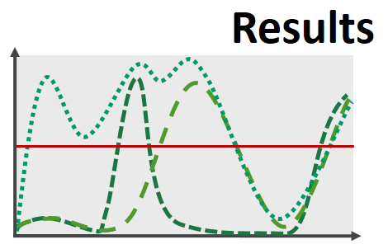

Define outcomes vs objectives
As always it is important to understand the difference between outcomes (results) and objectives/goals/targets
OBJECTIVE (goals)
An objective is qualitative and defines what one wants to achieve
Key results/outcomes are quantitative and define how you will measure progress towards the objective
Notes:
Objective; which is qualitative and defines what one wants to achieve
Key results; which are quantitative and define how you will measure progress towards the objective

Slide 4
Security Program Objectives
The overall objective of an information security program or cybersecurity program is to protect the information and systems that support the operations and assets of the agency.
To safeguard each system is to ensure that the following security objectives can be realized for their information:
Confidentiality - Protecting information from unauthorized access and disclosure.
Integrity - Assuring the reliability and accuracy of the information and IT resources by guarding against unauthorized information modification or destruction.
Availability - Defending information systems and resources to ensure timely and reliable access and use of information.

Slide 5
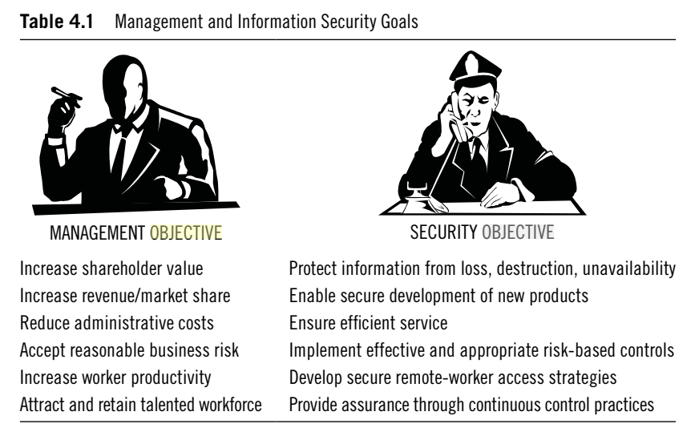

Slide 6
Components of Cybersecurity Architecture
Perimeter Security |  |  | The set of physical & technical security and programmatic policies that provide levels of protection against remote malicious activity; used to and protect the back-end systems from unauthorized access.
Network Security |  |  | The layer that partitions the broader network of assets and connections into groups.
Endpoint Security |  |  | Security protection mechanisms and controls that reside directly on an endpoint device (final devices such as computers, laptops, mobile devices, tablets, etc.) interfacing with any network or system.
Application Security |  |  | Security protection mechanisms and controls that are embedded within the applications residing on the network, enclaves, and Endpoint devices. Examples of such applications could be – MS Office, ERP application, Mobile Apps, etc.
Data Security |  |  | The layer of security that protects data in the Enterprise regardless of the data’s state, that is, whether it is in motion, at rest or in use.
Prevention Policy Management | Cybersecurity Architecture | Operations Monitoring and Response | Prevention: This is achieved by Policies, procedures, training, threat modelling, risk assessment, penetration testing and all other inclusive sustainment activities to posture a secure position. Operations: Constant observation of the Enterprise with a keen eye, coupled with the right tools and processes, to recognize incidents & events, and respond accordingly in a timely manner.

Slide 7
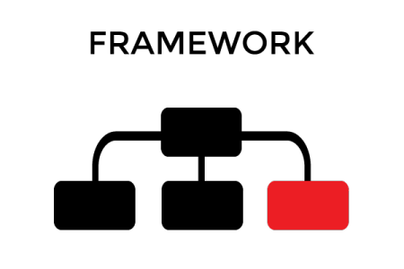

Framework and Roadmap
Notes:
So, let’s look at why I believe frameworks are the answer to many of the problems plaguing security organizations. The two major challenges I believe are repeatability and benchmarking. Security organizations struggle to repeat the successes of their contemporaries and peers – especially since every enterprise feels like a special snowflake. Benchmarking is something our industry is waking up to as board executives start to compare notes across enterprises in which they participate.
A model that starts with outcomes allows you to understand the goals you’re building towards, which addresses effectiveness. You can achieve outcomes through building a set of capabilities across a defined model of functional, core and elements. These capabilities are built through a set of activities which require resources (people, processes, technologies) to operate.
But in the digital program development world there are many iterations of potential measurements, and few of them are expressive and repeatable enough to be business relevant.
So, how do you build an effective CTI program? Start by determining what you want your outcomes to be. From there, you can take the functional building blocks and figure out what capabilities you need to develop to support your outcomes. Then, draft up the activities and resources you’ll require to build up those capabilities. Last, figure out how to measure it all. It’s as simple as that.
Except it’s not. I encourage you to find a framework that fits your organization’s program requirements, business profile and specific needs. Find a framework, adopt it and stick to it. The framework you start on today may be the way you justify budget requests, additional headcount or a promotion tomorrow.

Slide 8
What are security control frameworks and Standards
Todd Fitzgerald, in his book Information Security Governance Simplified (2016), states that: “The terms control frameworks, controls and standards can be interchangeable…
…As the intent of each of them is to provide some definition to a practice or set of practices that, if performed, will protect the organization’s information assets.
These consist of documented, executed, tested, implemented, and monitored controls that reduce the risk of threats succeeding against company vulnerabilities.”

Slide 9
Objectives of Cybersecurity Framework
The cybersecurity framework decreases the probable risk arising from cyberattacks and helps businesses secure critical assets. The objectives of the cybersecurity frameworks are:
Describing the current security state (benchmarking)
Describing target or desired security state
Providing metrics for measuring improvement
Assessing security posture
Keep in mind that the use of a framework is to ensure repeatable and effective processes and outcomes.
Notes:
Remember that Control Frameworks and security standards are often interchangeable terms.

Slide 10
COBiT
COBiT stands for Control Objective for Information and Related Technologies
COBit | Control Objectives for Information Technologies ...
https://www.isaca.org › resources › COBiT
System of governance for digital transformation
The updated COBiT 2019 recognizes that digital transformation is changing the way businesses work. It advises that it’s no longer acceptable for an organization’s governing board to “delegate, ignore, or avoid information and technology-related decisions.” Information and technology are key enablers in a digital world, so governing boards and senior managers need to be closely involved as value-creation reliance on digitalization continues to grow.
Notes:
An excellent article on CIO.com (White, 2019)

Slide 11
COBiT - Enablers and Components
In COBit 2019, components – you might know them as enablers in COBit 5 – exist to help an organization successfully govern and manage enterprise IT. The purpose of each component is defined by the organization’s alignment goals as part of a goals-cascade process.
In COBit, there are seven components:
Principles, policies, and procedures
Processes
Information
Organizational structures
Culture, ethics, and behaviour
People, skills, and competencies
Services, infrastructure, and applications.
These seven components work together to ensure that IT remains in line with the vision of the organization.
Notes:
https://www.joetheitguy.com/cobit-a-z/

Slide 12
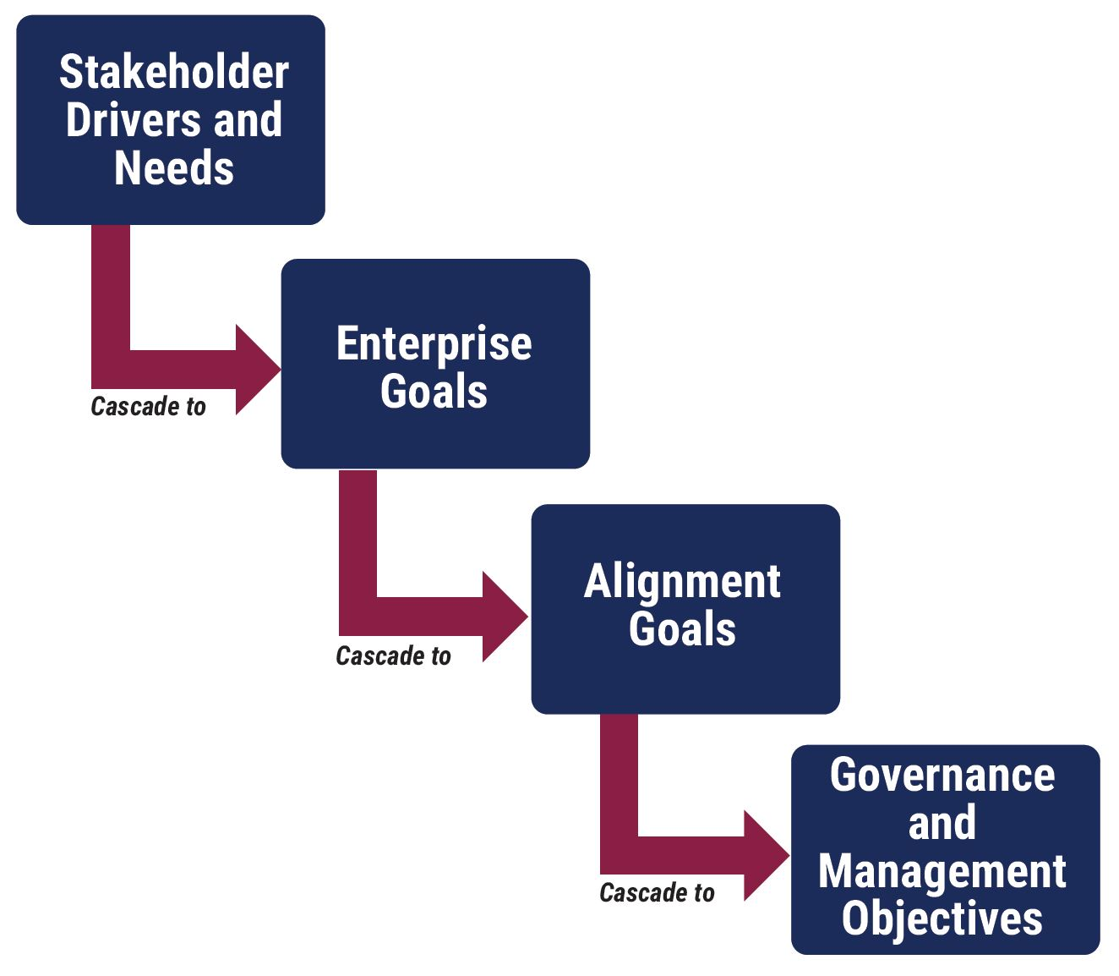
COBiT - Top-down approach
COBiT’s goals-cascade concept is a top-down approach that helps organizations to create enterprise goals from its stakeholder drivers and needs. These enterprise goals then cascade into alignment goals – which are goals that “emphasize the alignment of all IT efforts with business objectives.” And finally, the alignment goals cascade into the governance and management objectives of COBit.

Slide 13
COBiT
Maintain high-quality information to support business decisions.
Generate business value from IT-enabled investments, i.e., achieve strategic goals and realize business benefits through effective and innovative use of IT.
Achieve operational excellence through the reliable and efficient application of technology.
Maintain IT-related risk at an acceptable level.
Optimize the cost of IT services and technology.
Comply with ever-increasing relevant laws, regulations, contractual agreements and policies.
https://youtu.be/Qbl0mMawYRc

Slide 14
COBiT - Key components
COBit is based on a number of key concepts/components, and anything related to COBit stems from at least one of these:
Principles, policies, and procedures – there are six principles, and these are described as “the core requirements for a governance system for enterprise information and technology”
Governance and management objectives – these are grouped into five domains
Goals cascade – a way to ensure that the goals of the enterprise and IT align with the needs of stakeholders
Components of a governance system – enablers and components
Focus areas – these are almost unlimited, and this makes COBit an open-ended model
Design factors – these “influence in different ways the tailoring of the governance system of an enterprise.”
These key concepts are the foundation of COBit 2019 and will drive the successful governance and management of IT/IS in your organization.

Slide 15
COBiT – Various parts
COBit isn’t just a single framework document, there are a number of parts that, put together, make it what it is:
Introduction and Methodology – “The heart of the COBit framework incorporates an expanded definition of governance and updates COBit principles while laying out the structure of the overall framework.”
Governance and Management Objectives – “This publication contains a detailed description of the COBit Core Model and its 40 governance/management objectives.”
Designing an Information and Technology Governance Solution (Design Guide) – “This new publication fills an important need for COBit users—how to put COBit to practical use.”
Implementing and Optimizing an Information and Technology Governance Solution (Implementation Guide) – “This guide is an updated version of the previous COBit 5 Implementation Guide, taking a similar approach to implementation. However, the new terminology and concepts of COBit 2019, including the design factors, are built into this guidance.”

Slide 16
COBiT - Purposeful domains
Because COBit differentiates between governance and management, its 40 processes (up from 37 in COBit 5) are split between these two areas (and are collectively called the COBit Core Model).
The governance area has one domain, and the management area has a further four domains:
Domain 1: Governance
The governance domain is Evaluate, Direct and Monitor (EDM), COBit states that “Governance ensures that enterprise objectives are achieved by evaluating stakeholder needs, conditions and options; setting direction through prioritization and decision making; and monitoring performance, compliance, and progress against agreed-on direction and objectives.”

Slide 17
COBiT - Purposeful domains
Domain 2: Management
Align, Plan, and Organize (APO) looks at optimizing the use of information and technology in order to successfully meet the organization’s objectives. It also shows the way IT is to be structured to achieve benefit realization
Build, Acquire, and Implement (BAI) involves assessing the requirements of IT, acquiring the right technology, and implementing it
Deliver, Service, and Support (DSS) looks at delivering IT, including the use of applications and their outcomes
Monitor, Evaluate, and Assess (MEA) assists with the organization’s strategy, looking into the needs of the company and checking how the current IT setup is performing – is it meeting its objectives and fully compliant?

Slide 18
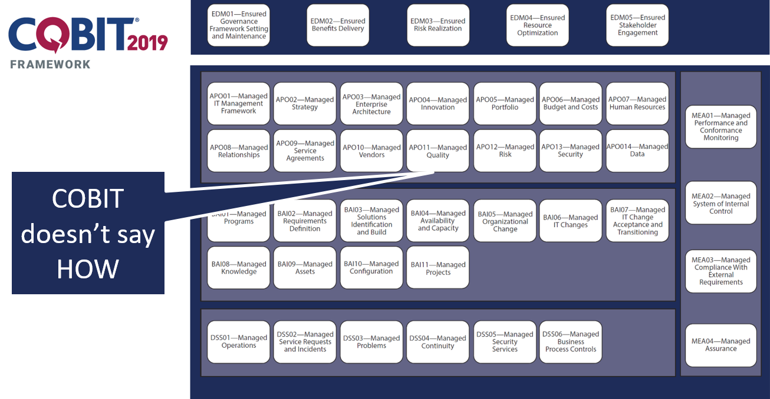
40 processes

Slide 19
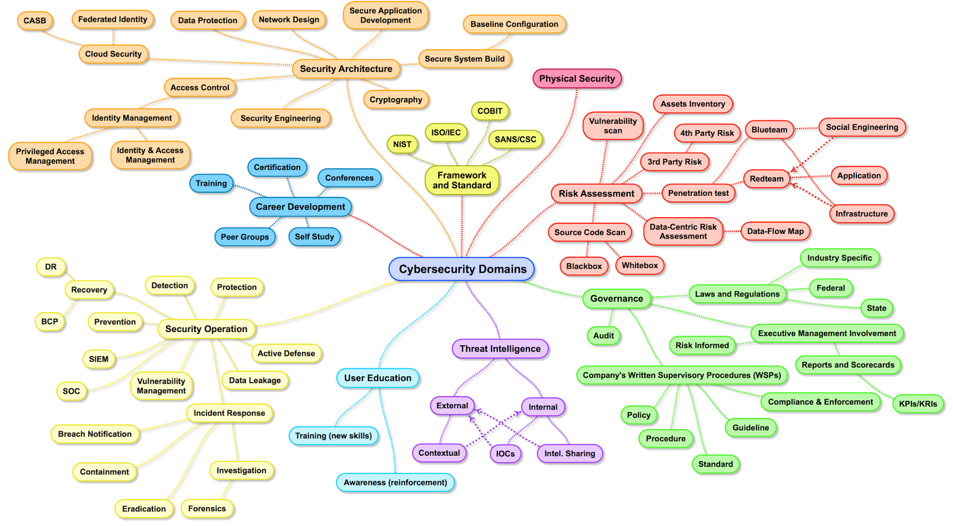
Summary
Notes:
We have just exposed the tip of the iceberg when it comes to IT standards, frameworks and guidance. Some of the most recognized and used have been discussed today:
https://darkinfosec.blogspot.com/2017/04/the-map-of-cybersecurity-domains-henry-jiang.html
The Standards/Framework Value Proposition
Control frameworks and standards provide the roadmap to build a successful information security program. Once in place, continuous review of the policies, standard operating procedures, and implementation of the controls will enhance the effectiveness of the program. Monitoring through audits accompanied by corrective actions and tracking enables refinement of the control framework and standards to reduce the risk of a security event impacting the business in a significant way. Think of the various security control frameworks as each contributing in some way to the infrastructure of a super six-lane freeway. Rather than manage our security programs by ourselves, on an old gravel road at 20 miles per hour, it is time to get on the superhighway supported by the strong plethora of control frameworks and standards and enjoy the ride!
Fitzgerald, Todd. Information Security Governance Simplified (p. 183). CRC Press. Kindle Edition.

Slide 20
Reference
Open Educational Resource (OER) | Digital Textbooks | Todd Fitzgerald. Information Security Governance Simplified (2016). CRC Press. ISBN: 9781439811658.
Open Educational Resource (OER) | Digital Textbooks | Peter H. Gregory. CISM Certified Information Security Manager All-in-One Exam Guide (2018). McGraw-Hill. ISBN: 9781260027044.
Information Security Branch, Office of the Chief Information Officer, Ministry of Citizens’ Services, Province of British Columbia
http://www.cio.gov.bc.ca/cio/informationsecurity/index.page Retrieved January 24.
COBit - https://cobitonline.isaca.org/about , Retrieved Jan 24, 2016
ISO/IEC 27001/27002 http://www.iso.org/iso/home/standards/management-standards/iso27001.htm, Retrieved January 24, 2016

