Slide 1
Assessing Corporate Cybersecurity
MGMT8175
Topic – Cybersecurity Compliance

Slide 2
Topics | Unit Outcomes
1. Why compliance is important in cybersecurity
2. Analyzing type of data subjected to cybersecurity compliance
3. Discussion on process to start a cybersecurity compliance program

Slide 3

What is Compliance?
Are people following rules, policies and procedures etc???
Notes:
IG is not only a tactical program to meet regulatory, compliance, and litigation demands. It can be strategic, in that it is the necessary underpinning for a management strategy that maximizes knowledge worker productivity, while minimizing risk and costs. Further, it treats information as an asset and seeks to maximize its value—perhaps even finding and harvesting newfound value. (smallwood)

Slide 4

What is Cybersecurity Compliance?
Compliance is a control function concerned with meeting an organization’s obligations and requirements.
Compliance is not just a checkbox for government regulations, but also a formal way of protecting your organization from cyberattacks
Notes:
compliance monitoring Being regularly apprised and updated on pertinent regulations and laws and examining processes in the organization to ensure compliance with them. In a records management sense, this involves reviewing and inspecting the various facets of a records management program to ensure it is in compliance. Compliance monitoring can be carried out by an internal audit, external organization, or records management and must be done on a regular basis.

Slide 5
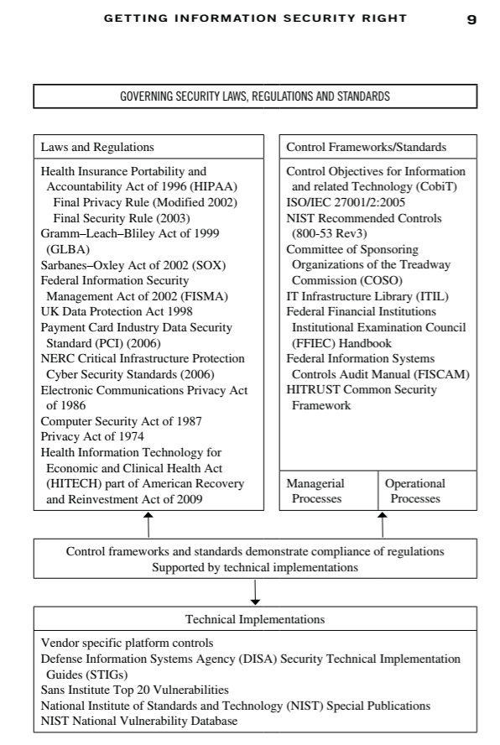
What influences Governance and Compliance?
What influences Governance and Compliance?

Slide 6
How organizations achieve compliance ?
Solution: By establishing risk-based controls
Asset Valuation
Identify Threats
Identify Vulnerabilities
Risk Profiling
Risk Treatment and remediation

Slide 7
Why is Compliance important?
Compliance is part of your organization’s duties to its community and stakeholders.
Without a compliance function, you cannot reliably build or maintain trust with others.
If you have no compliance function, you invite reputational damage.
Compliance helps define an organization is
Compliance helps define and regulate an organization’s “how.” why.”
Compliance can serve as a driver of change and innovation.
Compliance enhances consistency
Compliance can reduce unforced errors.
Notes:
https://riskalts.com/8-reasons-why-the-compliance-function-is-essential-for-organizations/
Compliance is part of your organization’s duties to its community and stakeholders.
Without a compliance function, you cannot reliably build or maintain trust with others.
If you have no compliance function, you invite reputational damage.
Compliance helps define an organization’s “
Compliance helps define and regulate an organization’s “how.” why.”
Compliance can serve as a driver of change and innovation.
Compliance enhances consistency
Compliance can reduce unforced errors.

Slide 8
Cybersecurity Compliance Program (CCP)
Steps to Start CCP
Create a Compliance Team
Setting Up a Risk Analysis Process
Setting Controls: How to Mitigate or Transfer Risk
Creating Policies
Monitoring and Quick Response

Slide 9
Reference
Open Educational Resource (OER) | Digital Textbooks | Todd Fitzgerald. Information Security Governance Simplified (2016). CRC Press. ISBN: 9781439811658.
Open Educational Resource (OER) | Digital Textbooks | Peter H. Gregory. CISM Certified Information Security Manager All-in-One Exam Guide (2018). McGraw-Hill. ISBN: 9781260027044.
https://www.comptia.org/content/articles/what-is-cybersecurity-compliance

