Slide 1
Assessing Corporate Cybersecurity
MGMT8175
Topic – Cybersecurity Compliance Regulations in Major Sectors

Slide 2
Topics | Unit Outcomes
Cybersecurity compliance and regulations for major sectors
Health care
Financial institutions
Retail & e-Commerce
Defense
Energy

Slide 3
Major Cybersecurity Regulations
HIPAA
PCI DSS
GDPR
SOC 2
CMMC
NIST

Slide 4
Cybersecurity Regulations Overview
Notes:
--- This slide references information from the following file: https://www.hhs.gov/hipaa/for-professionals/security/laws-regulations/index.html,https://www.cambridgehealth.edu/healthcare-cybersecurity-privacy/healthcare-cybersecurity-privacy-information/understanding-hipaa-and-its-role-in-cybersecurity/ HIPAA (Health Insurance Portability and Accountability Act), PCI DSS (Payment Card Industry Data Security Standard), SOC 2 (System and Organization Controls 2), GDPR (General Data Protection Regulation), CMMC (Cybersecurity Maturity Model Certification), NIST (National Institute of Standards and Technology)

Slide 5

HIPAA (Health Insurance Portability and Accountability Act)
Privacy Rule Standards
The Privacy Rule regulates how Protected Health Information is used and disclosed, ensuring confidentiality and integrity.
Security Rule Safeguards
The Security Rule mandates administrative, physical, and technical safeguards like encryption and access control for electronic PHI.
Breach Notification Rule
Healthcare entities must notify affected individuals and authorities in case of a data breach to ensure transparency.
Compliance Best Practices
Encryption, role-based access, and employee training are key practices to maintain HIPAA compliance and patient trust.
Notes:
--- This slide references information from the following file: https://www.hhs.gov/hipaa/for-professionals/security/laws-regulations/index.html,https://www.cambridgehealth.edu/healthcare-cybersecurity-privacy/healthcare-cybersecurity-privacy-information/understanding-hipaa-and-its-role-in-cybersecurity/ HIPAA, enacted in 1996, is a critical regulation in the healthcare sector aimed at protecting sensitive patient information. It comprises three main rules: the Privacy Rule, the Security Rule, and the Breach Notification Rule. The Privacy Rule sets standards for how Protected Health Information (PHI) should be used and disclosed, ensuring that patient data is handled with confidentiality and integrity. The Security Rule outlines the administrative, physical, and technical safeguards required to protect electronic PHI (ePHI), including measures like encryption, access control, and employee training. The Breach Notification Rule mandates that healthcare entities notify affected individuals and authorities in the event of a data breach. Real-world examples of HIPAA compliance include encrypting patient records to prevent unauthorized access, implementing role-based access control to ensure only authorized personnel can view sensitive data, and conducting regular employee training sessions to raise awareness about cybersecurity threats. These measures are essential for maintaining trust, avoiding legal penalties, and ensuring the security of patient information in an increasingly digital healthcare environment.

Slide 6

PCI DSS (Payment Card Industry Data Security Standard)
Core PCI DSS Requirements
PCI DSS includes 12 core requirements focused on securing networks, protecting data, and enforcing security policies.
Key Security Controls
Firewalls, data encryption, access restrictions, and regular security testing are essential for PCI DSS compliance.
Compliance Updates with PCI DSS 4.0
PCI DSS 4.0 introduces enhanced compliance obligations and customizable control implementation approaches.
Benefits of PCI DSS Compliance
Compliance prevents data breaches, maintains customer trust, and avoids financial penalties for organizations.
Notes:
--- This slide references information from the following file: https://www.hhs.gov/hipaa/for-professionals/security/laws-regulations/index.html,https://www.cambridgehealth.edu/healthcare-cybersecurity-privacy/healthcare-cybersecurity-privacy-information/understanding-hipaa-and-its-role-in-cybersecurity/ PCI DSS is a comprehensive set of security standards designed to protect cardholder data during processing, storage, and transmission. It applies to all entities that handle credit and debit card transactions, including merchants, payment processors, and service providers. The standard comprises 12 core requirements grouped into six objectives, such as building and maintaining a secure network, protecting cardholder data, and maintaining an information security policy. Key regulations include installing firewalls, encrypting data transmissions, restricting access to cardholder data, and regularly testing security systems. With the release of PCI DSS 4.0, organizations face enhanced compliance obligations, including more detailed self-assessment questionnaires and a customized approach to implementing controls. Examples of compliance include using firewalls to block unauthorized access, encrypting cardholder data during transmission over public networks, and conducting vulnerability scans to identify and mitigate risks. These practices help prevent data breaches, maintain customer trust, and avoid financial penalties associated with non-compliance.

Slide 7
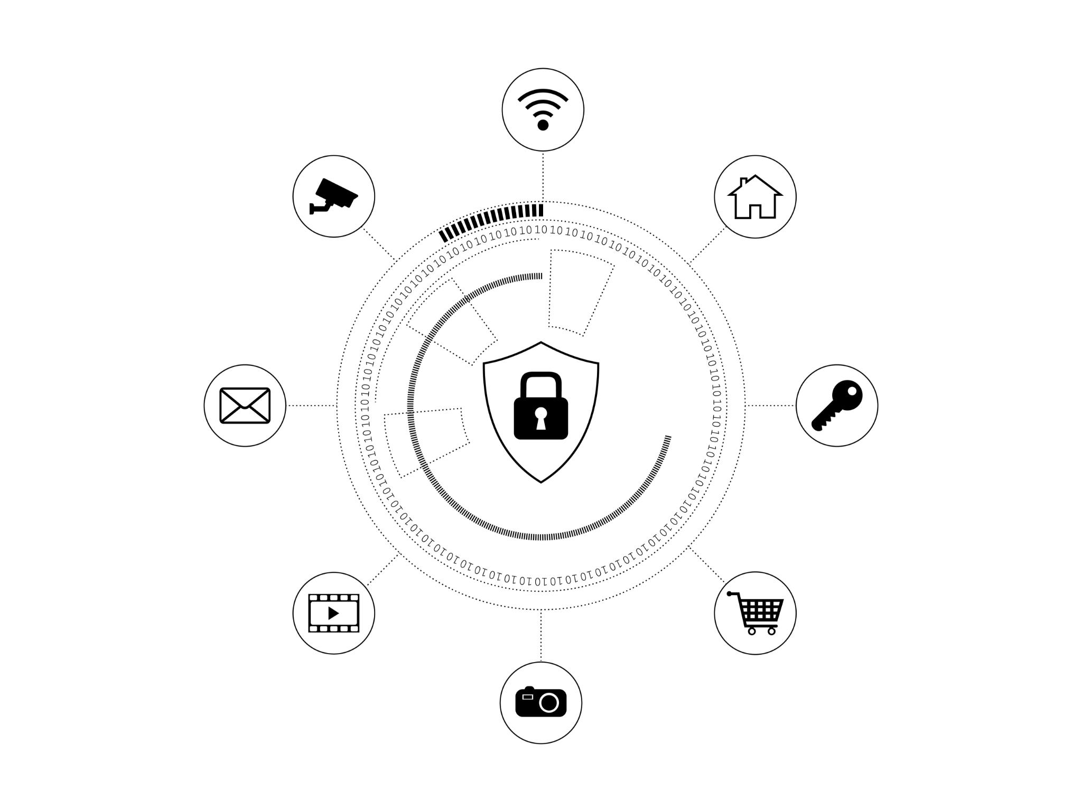
SOC 2 (System and Organization Controls 2)
SOC 2 Framework Overview
SOC 2 ensures secure management of customer data through five Trust Services Criteria, focusing on Security by default.
Compliance Requirements
Compliance involves internal controls, regular audits, and documented policies to maintain data security and integrity.
Security Practices
Common SOC 2 practices include access control, multi-factor authentication, risk assessments, and activity monitoring.
Benefits of SOC 2
Achieving SOC 2 compliance builds client trust, demonstrates data protection commitment, and provides a market advantage.
Notes:
--- This slide references information from the following file: https://www.hhs.gov/hipaa/for-professionals/security/laws-regulations/index.html,https://www.cambridgehealth.edu/healthcare-cybersecurity-privacy/healthcare-cybersecurity-privacy-information/understanding-hipaa-and-its-role-in-cybersecurity/ SOC 2 is a voluntary compliance framework developed by the American Institute of Certified Public Accountants (AICPA) to ensure that service organizations manage customer data securely. It is based on five Trust Services Criteria: Security, Availability, Processing Integrity, Confidentiality, and Privacy. Every SOC 2 report must include the Security category, while the others are optional depending on the organization's services. Compliance involves implementing internal controls, conducting regular audits, and maintaining documentation of policies and procedures. Examples of SOC 2 practices include enforcing access control policies, using multi-factor authentication, conducting risk assessments, and monitoring system activity. Organizations often tailor their SOC 2 policies to align with their operational needs, allowing flexibility in implementation. Achieving SOC 2 compliance demonstrates a commitment to data protection, builds trust with clients, and provides a competitive advantage in industries where data security is paramount.

Slide 8
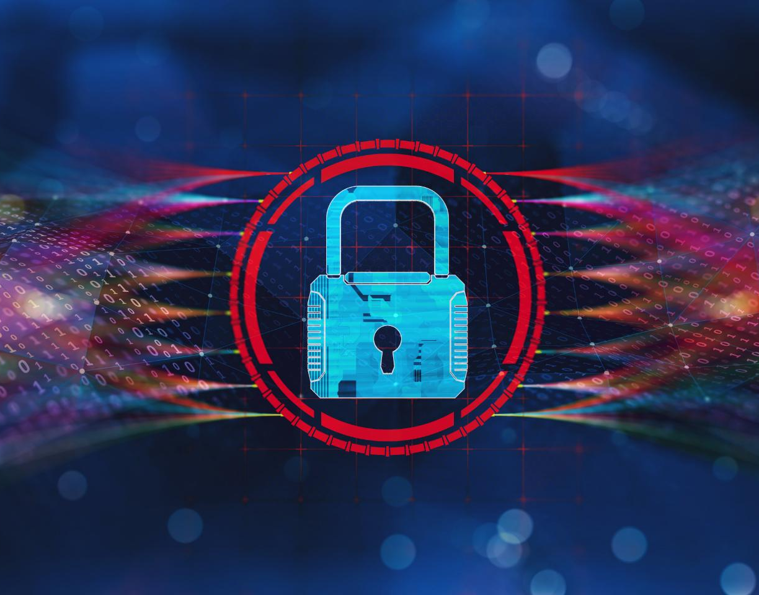
GDPR (General Data Protection Regulation)
Core GDPR Principles
GDPR mandates lawful, fair, transparent processing, data minimization, accuracy, storage limits, and confidentiality.
Organizational Measures
Organizations must apply encryption, access controls, and breach notifications to safeguard personal data.
Individual Rights
GDPR grants individuals rights to access, correct, delete, and restrict processing of their personal data.
Compliance and Penalties
Non-compliance may lead to fines up to €20 million or 4% of global turnover, stressing legal adherence importance.
Notes:
--- This slide references information from the following file: https://www.hhs.gov/hipaa/for-professionals/security/laws-regulations/index.html,https://www.cambridgehealth.edu/healthcare-cybersecurity-privacy/healthcare-cybersecurity-privacy-information/understanding-hipaa-and-its-role-in-cybersecurity/ The GDPR is a comprehensive data protection regulation enacted by the European Union in 2018. It applies to any organization that processes personal data of EU residents, regardless of the organization's location. Key principles include lawful, fair, and transparent processing; data minimization; accuracy; storage limitation; and integrity and confidentiality. Organizations must implement technical and organizational measures to protect personal data, such as encryption, access controls, and breach notification procedures. GDPR also grants individuals rights over their data, including the right to access, correct, delete, and restrict processing. Examples of GDPR compliance include providing clear privacy notices, encrypting personal data during transmission and storage, and reporting data breaches within 72 hours. Non-compliance can result in severe penalties, including fines up to €20 million or 4% of global annual turnover. Adhering to GDPR not only ensures legal compliance but also enhances customer trust and operational resilience.

Slide 9
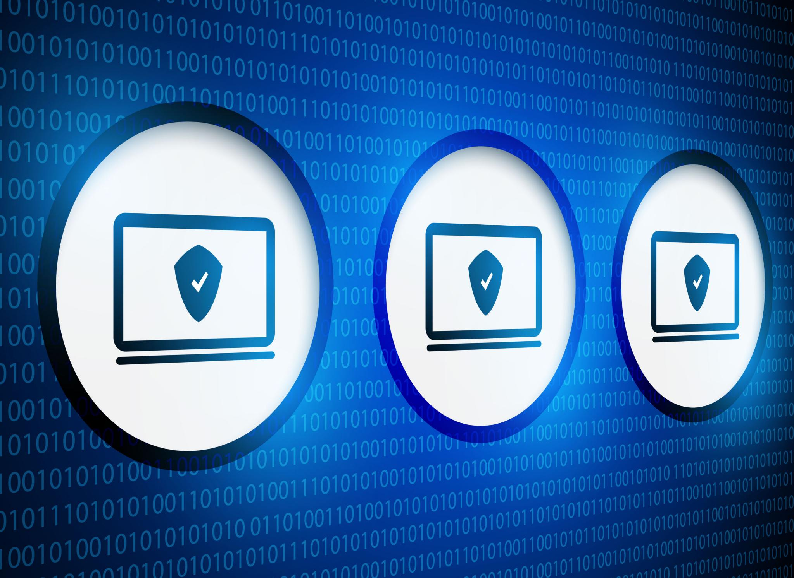
CMMC (Cybersecurity Maturity Model Certification)
CMMC Framework Levels
CMMC 2.0 includes three levels: Foundational, Advanced, and Expert, aligned with data sensitivity and security requirements.
Core Control Domains
The framework covers 14 control domains, including Access Control, Incident Response, Risk Assessment, and System Integrity.
Compliance Practices
Compliance involves multi-factor authentication, vulnerability scans, incident response plans, and system security plans.
Certification Importance
Certification is mandatory at contract award, ensuring protection of Controlled Unclassified Information and contract eligibility.
Notes:
--- This slide references information from the following file: https://www.hhs.gov/hipaa/for-professionals/security/laws-regulations/index.html,https://www.cambridgehealth.edu/healthcare-cybersecurity-privacy/healthcare-cybersecurity-privacy-information/understanding-hipaa-and-its-role-in-cybersecurity/ CMMC is a cybersecurity framework developed by the U.S. Department of Defense to ensure that contractors and subcontractors in the Defense Industrial Base (DIB) adequately protect sensitive government information. CMMC 2.0 streamlines the original five levels into three: Foundational, Advanced, and Expert. Each level corresponds to the sensitivity of the data handled and includes specific security practices derived from NIST SP 800-171 and SP 800-172. The framework covers 14 control domains, such as Access Control, Incident Response, Risk Assessment, and System Integrity. Examples of compliance include implementing multi-factor authentication, conducting regular vulnerability scans, developing incident response plans, and maintaining a system security plan. Certification is required at the time of contract award, making early preparation essential. CMMC compliance not only protects Controlled Unclassified Information (CUI) but also ensures eligibility for DoD contracts and demonstrates a strong cybersecurity posture.

Slide 10
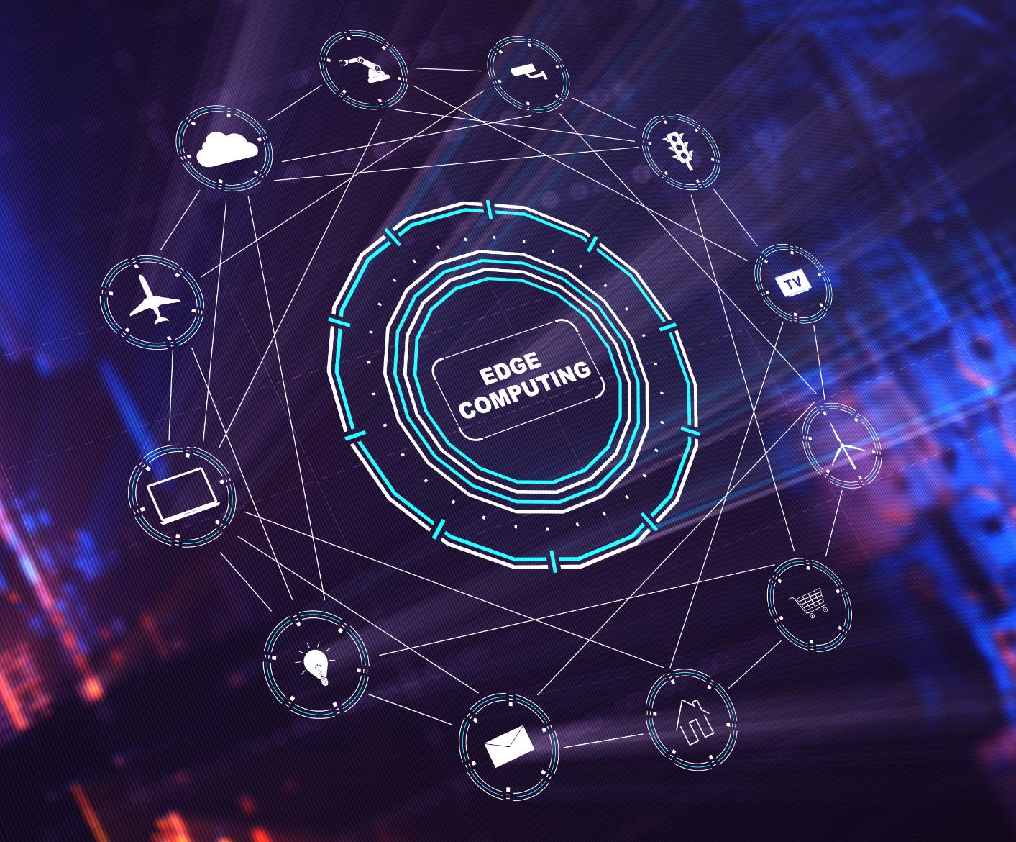
NIST (National Institute of Standards and Technology)
NIST Cybersecurity Framework
NIST framework includes five core functions: Identify, Protect, Detect, Respond, and Recover to reduce cyber risks.
Special Publications and Compliance
NIST publishes guidelines like SP 800-171 to protect sensitive information in non-federal systems.
Industry Applications and Benefits
NIST is widely adopted in sectors like finance, healthcare, and energy to enhance cybersecurity and ensure compliance.
Notes:
--- This slide references information from the following file: https://www.hhs.gov/hipaa/for-professionals/security/laws-regulations/index.html,https://www.cambridgehealth.edu/healthcare-cybersecurity-privacy/healthcare-cybersecurity-privacy-information/understanding-hipaa-and-its-role-in-cybersecurity/ NIST provides a voluntary cybersecurity framework that helps organizations manage and reduce cybersecurity risks. The framework consists of five core functions: Identify, Protect, Detect, Respond, and Recover. It is widely adopted across industries due to its flexibility and alignment with existing standards. NIST also publishes Special Publications like SP 800-171, which outlines requirements for protecting Controlled Unclassified Information in non-federal systems. Examples of NIST compliance include conducting risk assessments to identify vulnerabilities, implementing encryption and access controls to protect data, and developing incident response plans to mitigate breaches. The framework is particularly valuable for organizations in critical infrastructure sectors, such as finance, healthcare, and energy. By adopting NIST guidelines, organizations can enhance their cybersecurity posture, ensure regulatory compliance, and build resilience against evolving cyber threats.

Slide 11
Popular Cybersecurity Frameworks and Standards To reduce cyber risk
1 | NIST Cybersecurity Framework | Cybersecurity Framework by National Institute of Standards and Technology | https://www.nist.gov/cybersecurity
2 | ISO 27001 and ISO 27002 | International Organization for Standardization ISO/IEC 27000 family Information security management | https://www.iso.org/standard/iso-iec-27000-family
3 | SOC2 | Service Organization Control – Type 2 By American Institute of Certified Public Accountants (AICPA) | https://www.aicpa-cima.com/topic/audit-assurance/audit-and-assurance-greater-than-soc-2

Slide 12
Popular Cybersecurity Frameworks and Standards To reduce cyber risk
4 | NERC-CIP | North American Electric Reliability Corporation – Critical Infrastructure Protection | For Utility and Power Sector https://www.nerc.com/pa/Stand/Pages/default.aspx
5 | HIPAA | Health Insurance Portability and Accountability Act | Cybersecurity framework for health organizations https://www.hhs.gov/hipaa/index.html
6 | GDPR | General Data Protection Regulation | https://gdpr.eu/
7 | FISMA | Federal Information Security Management Act | https://security.cms.gov/learn/federal-information-security-management-act-fisma
8 | CMMC | Cybersecurity Maturity Model Certification | CIO - About CMMC

Slide 13
Cybersecurity Regulations Overview
Notes:
Introduction to Sector-Specific Cybersecurity Regulations

Slide 14

Introduction to Sector-Specific Cybersecurity Regulations
Importance of Cybersecurity Regulations
Cybersecurity regulations protect sensitive data and ensure system integrity across diverse industries, enhancing security and trust.
Sector-Specific Challenges
Healthcare, finance, retail, defense, and energy sectors face unique cybersecurity challenges requiring tailored compliance strategies.
Key Regulatory Frameworks
Frameworks like GDPR, HIPAA, SOX, and NIST guide organizations in managing risks and responding to security incidents effectively.
Benefits of Compliance
Compliance helps organizations protect assets, maintain trust, and build stronger relationships with stakeholders.
Notes:
Cybersecurity regulations are essential for protecting sensitive data and ensuring the integrity of systems across various industries. This presentation explores the regulatory landscape for five major sectors: healthcare, financial institutions, retail & ecommerce, defense, and energy. Each sector faces unique challenges and requirements, necessitating tailored approaches to cybersecurity compliance. We will examine key regulatory frameworks including GDPR, HIPAA, SOX, and NIST, highlighting how they apply to each sector. These frameworks provide structured methodologies for managing risks, safeguarding information, and responding to security incidents. Understanding these regulations is critical for organizations to maintain compliance, protect their assets, and build trust with stakeholders.

Slide 15
Healthcare Sector
Notes:
HIPAA and GDPR in Healthcare

Slide 16
HIPAA and GDPR in Healthcare
HIPAA Security Requirements
HIPAA mandates safeguards including encryption, access controls, and audits to protect patient health information.
GDPR Data Protection
GDPR requires consent, data minimization, and breach notifications for healthcare data of EU citizens.
Enhanced Patient Privacy
Both HIPAA and GDPR collectively strengthen patient privacy and security in healthcare institutions.
Notes:
The healthcare sector is governed by stringent cybersecurity regulations to protect patient health information (PHI). The Health Insurance Portability and Accountability Act (HIPAA) mandates administrative, physical, and technical safeguards to ensure the confidentiality, integrity, and availability of PHI. Healthcare providers must implement encryption, access controls, and audit mechanisms to comply with HIPAA. Additionally, the General Data Protection Regulation (GDPR) applies to healthcare organizations handling data of EU citizens, requiring consent for data processing, data minimization, and breach notification. For example, hospitals must encrypt patient records and restrict access to authorized personnel, while also ensuring that data collection practices align with GDPR requirements. These regulations collectively enhance the security posture of healthcare institutions and protect patient privacy.

Slide 17
Financial Institutions
Notes:
SOX and NIST Frameworks in Finance

Slide 18

SOX and NIST Frameworks in Finance
SOX Compliance Controls
SOX mandates internal controls like access restrictions and audit trails to ensure financial reporting accuracy and prevent fraud.
NIST Cybersecurity Framework
NIST provides guidelines for identifying, protecting, detecting, responding to, and recovering from cybersecurity threats in finance.
Integration Benefits
Combining SOX controls with NIST enhances resilience against cyber threats and ensures regulatory compliance in financial institutions.
Notes:
Financial institutions are subject to rigorous cybersecurity regulations to ensure the accuracy and integrity of financial reporting and protect sensitive financial data. The Sarbanes-Oxley Act (SOX) requires organizations to implement internal controls and IT security measures, including access controls and audit trails. These controls help prevent fraud and ensure reliable financial disclosures. Additionally, the NIST Cybersecurity Framework is widely adopted in the financial sector for comprehensive risk management. It provides guidelines for identifying, protecting, detecting, responding to, and recovering from cybersecurity threats. For instance, banks must enforce strict access controls on financial systems and maintain detailed logs of user activities to comply with SOX. By integrating NIST principles, financial institutions can enhance their resilience against cyber threats and maintain regulatory compliance.

Slide 19
Retail & Ecommerce
Notes:
GDPR and PCI DSS in Retail

Slide 20
GDPR and PCI DSS in Retail
GDPR Data Protection
GDPR requires user consent, data minimization, and breach notification to protect personal data in retail.
PCI DSS Security Standards
PCI DSS mandates encryption, access control, and regular testing for secure payment card transactions.
Retail Compliance Benefits
Adhering to GDPR and PCI DSS builds consumer trust and safeguards customer data in ecommerce.
Notes:
Retail and ecommerce businesses handle vast amounts of personal and payment data, making cybersecurity a critical concern. The General Data Protection Regulation (GDPR) mandates that organizations obtain user consent before collecting personal data, implement data minimization practices, and notify authorities in case of data breaches. Ecommerce platforms must ensure that their data collection and processing activities are transparent and secure. Additionally, the Payment Card Industry Data Security Standard (PCI DSS) applies to businesses that handle credit card transactions, requiring robust security measures such as encryption, access control, and regular security testing. For example, an online retailer must obtain explicit consent from users before collecting personal information and ensure that payment data is securely transmitted and stored. Compliance with GDPR and PCI DSS helps retail businesses protect customer data and maintain consumer trust.

Slide 21
Defense Sector
Notes:
NIST SP 800-171 and CMMC in Defense

Slide 22
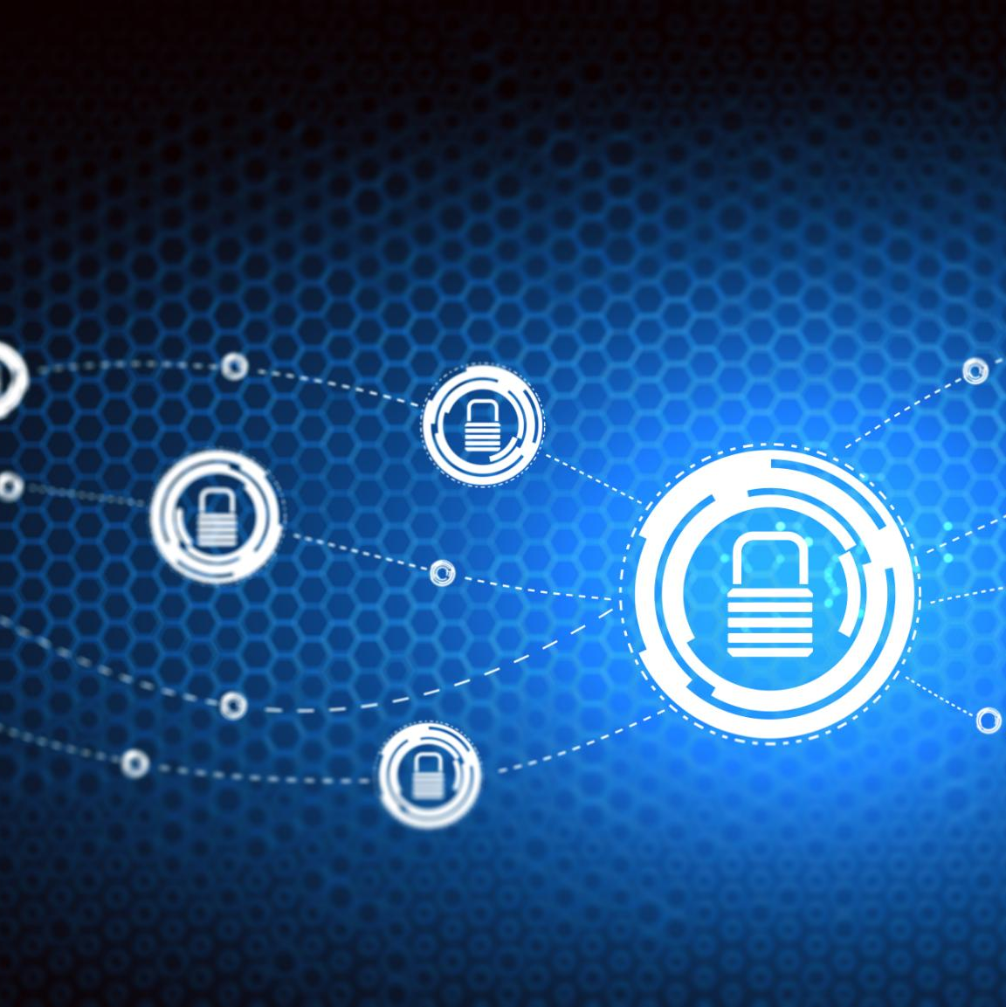
NIST SP 800-171 and CMMC in Defense
Protecting Controlled Unclassified Information
NIST SP 800-171 establishes security requirements to safeguard Controlled Unclassified Information in the defense sector.
Key Security Controls
Controls like multi-factor authentication, log monitoring, and secure communications ensure compliance with cybersecurity standards.
Cybersecurity Maturity Model Certification
CMMC adds maturity levels assessing cybersecurity practices, requiring defense contractors to meet specific compliance levels like Level 3.
Threat Detection and Response
CMMC Level 3 emphasizes proactive threat detection and response to protect sensitive defense information from cyber threats.
Notes:
The defense sector requires robust cybersecurity measures to protect Controlled Unclassified Information (CUI) and ensure national security. The NIST Special Publication 800-171 outlines requirements for safeguarding CUI, including access control, incident response, and system integrity. Defense contractors must implement multi-factor authentication, log monitoring, and secure communication protocols to comply with these standards. Additionally, the Cybersecurity Maturity Model Certification (CMMC) builds upon NIST guidelines by introducing maturity levels that assess the implementation of cybersecurity practices. For example, a defense contractor working with the Department of Defense must demonstrate compliance with CMMC Level 3, which includes proactive threat detection and response capabilities. These frameworks ensure that sensitive defense information is protected from cyber threats and unauthorized access.

Slide 23
Energy Sector
Notes:
NIST and NERC CIP in Energy

Slide 24

NIST and NERC CIP in Energy
NIST Cybersecurity Framework
NIST provides a structured approach for identifying, protecting, detecting, responding to, and recovering from cybersecurity incidents.
NERC CIP Standards
NERC CIP standards mandate security controls for electric utilities to protect bulk electric systems from cyber threats.
Cybersecurity Measures in Energy
Energy providers implement intrusion detection, vulnerability assessments, and incident response plans to secure infrastructure.
Notes:
The energy sector, particularly critical infrastructure such as power grids, is governed by cybersecurity frameworks that emphasize resilience and risk management. The NIST Cybersecurity Framework provides a structured approach to identifying, protecting, detecting, responding to, and recovering from cybersecurity incidents. Energy providers must monitor network traffic, detect anomalies, and respond swiftly to potential threats. Additionally, the North American Electric Reliability Corporation Critical Infrastructure Protection (NERC CIP) standards apply to electric utilities, requiring comprehensive security controls for systems that support the bulk electric system. For example, power grid operators must implement intrusion detection systems, conduct regular vulnerability assessments, and maintain incident response plans. These regulations help ensure the reliability and security of energy infrastructure, safeguarding it against cyber attacks and operational disruptions.

Slide 25
Conclusion
Notes:
Summary of Cybersecurity Regulations

Slide 26
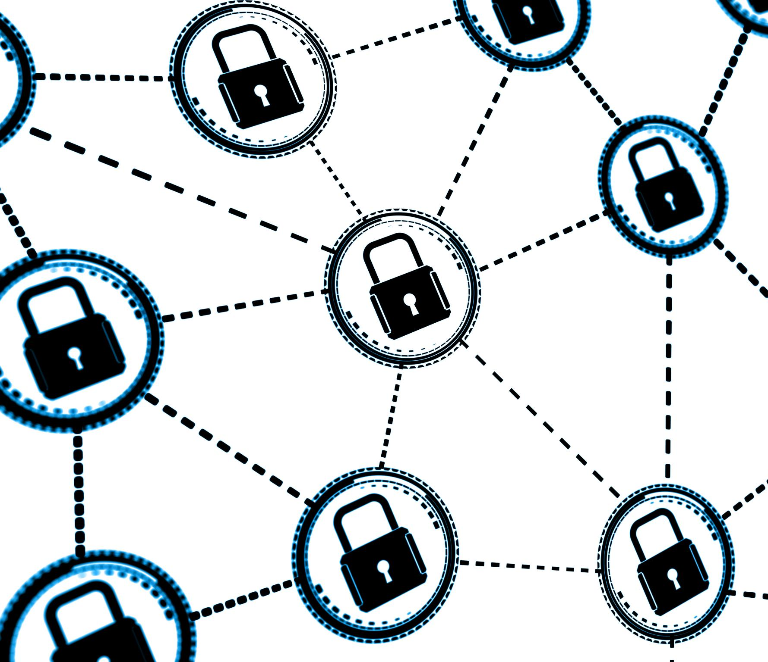
Summary of Cybersecurity Regulations
Common Objectives
Cybersecurity regulations aim to protect sensitive data, ensure system integrity, and manage risks effectively across sectors.
Sector-specific Frameworks
Different industries adopt regulations like GDPR, HIPAA, SOX, NIST, PCI DSS, CMMC, and NERC CIP tailored to sector needs.
Importance of Compliance
Applying regulations builds robust cybersecurity, maintains compliance, and fosters stakeholder trust and confidence.
Notes:
Cybersecurity regulations across different sectors share common objectives: protecting sensitive data, ensuring system integrity, and managing risks effectively. While each sector faces unique challenges, frameworks such as GDPR, HIPAA, SOX, and NIST provide structured approaches to achieving cybersecurity compliance. Healthcare organizations rely on HIPAA and GDPR to safeguard patient data, financial institutions implement SOX and NIST for secure financial reporting, retail businesses adhere to GDPR and PCI DSS for customer data protection, defense contractors follow NIST SP 800-171 and CMMC to secure CUI, and energy providers use NIST and NERC CIP to protect critical infrastructure. Understanding and applying these regulations is essential for organizations to build robust cybersecurity programs, maintain compliance, and foster trust among stakeholders.

Slide 27
Reference
Open Educational Resource (OER) | Digital Textbooks | Todd Fitzgerald. Information Security Governance Simplified (2016). CRC Press. ISBN: 9781439811658.
Open Educational Resource (OER) | Digital Textbooks | Peter H. Gregory. CISM Certified Information Security Manager All-in-One Exam Guide (2018). McGraw-Hill. ISBN: 9781260027044.
The PCI DSS (Payment Card Industry Data Security Standard) is administered by the Payment Card Industry Security Standards Council (PCI SSC)
The SOC 2 from the American Institute of CPAs (AICPA)
NIST information, special publications and frequently asked questions (FAQ) page
Cybersecurity and Infrastructure Security Agency (CISA) website International standards like the ISO 27001

