Slide 1

Tabletop Exercise: PCI-DSS Compliance in a Small Law Office
Ensuring secure payment data handling procedures effectively
Notes:
AI-generated content may be incorrect. ---

Slide 2
Scenario Setup
Notes:
The Retainer Breach

Slide 3

The Retainer Breach
Sensitive Data Handling
The firm processes client retainers via credit cards using a cloud billing platform, handling sensitive data securely.
Transition to Remote Work
Recent remote work adoption requires enhanced cybersecurity measures to protect client information outside the office.
PCI-DSS Compliance Audit
The cybersecurity audit focuses on assessing compliance with PCI-DSS to safeguard payment card data and maintain trust.
Incident Response Exercise
A tabletop exercise simulates a breach to train staff in discovery, investigation, response, and recovery phases.
Notes:
Maple Legal Associates, a small law office, processes client retainers and payments via credit card using a cloud-based billing platform. The firm handles sensitive client data and has recently transitioned to remote work for part of its staff. As part of the internal cybersecurity audit team, your task is to assess the firm's compliance with PCI-DSS regulations. This scenario sets the stage for a tabletop exercise aimed at evaluating the firm's readiness to handle a cybersecurity incident involving payment card data. The exercise will simulate a breach and guide participants through discovery, investigation, response, and recovery phases, emphasizing the importance of PCI-DSS compliance in protecting client data and maintaining trust.

Slide 4
Exercise Objectives
Notes:
Goals of the Tabletop Exercise

Slide 5

Goals of the Tabletop Exercise
PCI-DSS Compliance Assessment
Evaluate the law office’s adherence to PCI-DSS v4.0 standards and identify compliance gaps.
Incident Response Preparedness
Practice decision-making during simulated data breach scenarios to strengthen incident responses.
Risk Awareness and Collaboration
Enhance awareness of cybersecurity risks and foster collaboration among stakeholders.
Strategies for SMB Cybersecurity
Develop practical strategies to improve compliance and resilience specifically for SMBs.
Notes:
The primary objectives of this tabletop exercise are to assess the law office’s compliance with PCI-DSS v4.0, identify gaps in data protection and incident response, practice decision-making during a simulated breach, and understand the implications of non-compliance for small and medium-sized businesses (SMBs). Participants will engage in scenario-based discussions to evaluate the firm's current cybersecurity posture, explore the application of PCI-DSS requirements, and develop strategies for improving compliance and resilience. This exercise aims to enhance awareness, foster collaboration among stakeholders, and prepare the firm for real-world cybersecurity challenges.

Slide 6
Participants
Notes:
Roles in the Exercise

Slide 7
Roles in the Exercise
IT Manager Responsibilities
Oversees technical infrastructure and ensures data security within the law office environment.
Office Manager Role
Handles the administrative processes essential for smooth office operations.
Legal Partner Duties
Ensures legal compliance and oversees the firm's adherence to laws and regulations.
Compliance Officer Functions
Monitors regulatory adherence and manages compliance policies within the firm.
External PCI Consultant Contribution
Provides specialized knowledge on PCI-DSS standards to enhance cybersecurity measures.
Notes:
The tabletop exercise involves key roles within the law office, including the IT Manager, Office Manager, Legal Partner, Compliance Officer, and an External PCI Consultant (played by the instructor or a student). Each participant brings a unique perspective and expertise to the exercise, contributing to a comprehensive assessment of the firm's cybersecurity practices. The IT Manager oversees technical infrastructure and data security, the Office Manager handles administrative processes, the Legal Partner ensures legal compliance, the Compliance Officer monitors regulatory adherence, and the External Consultant provides specialized knowledge on PCI-DSS standards. Collaboration among these roles is essential for effective incident response and compliance management.

Slide 8
Phase 1: Discovery
Notes:
Initial Incident Identification

Slide 9
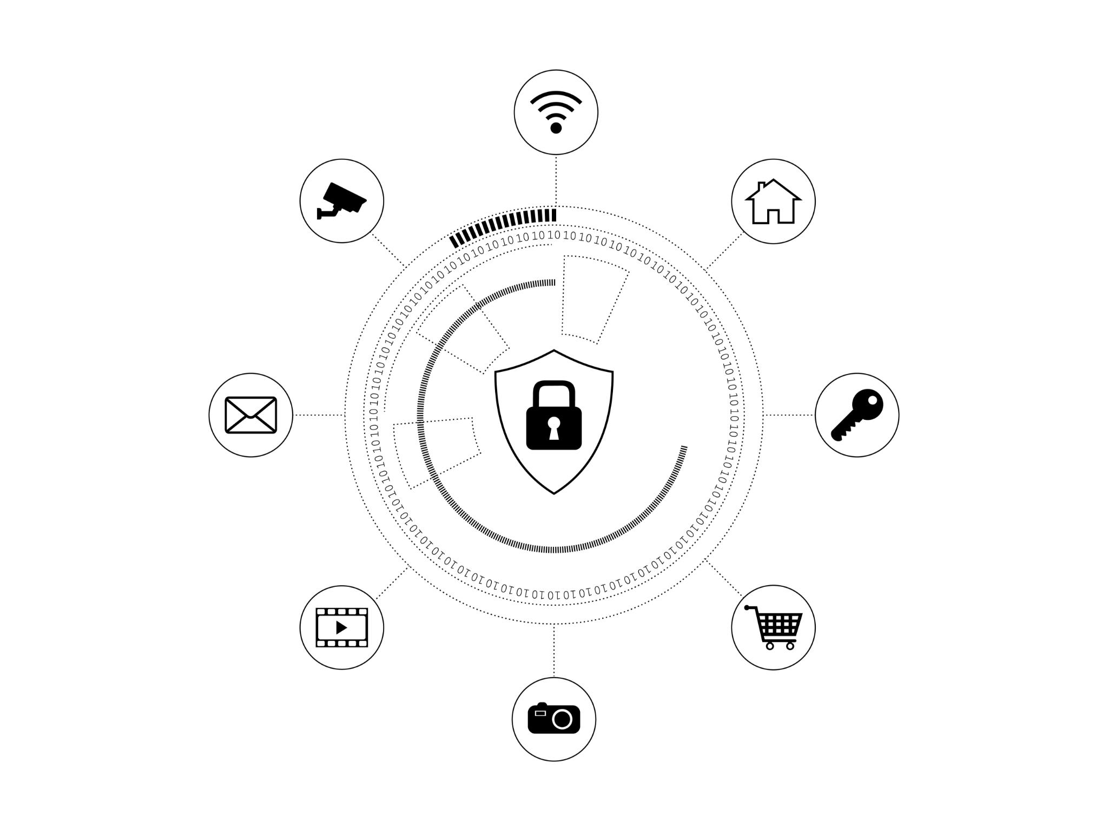
Initial Incident Identification
Trigger Event Overview
The incident starts with a client reporting unauthorized charges after an online payment made via the firm’s portal.
Systems and Data Identification
Participants must identify payment processing systems and verify if cardholder data is stored by the firm.
PCI Compliance Assessment
Assess the firm’s PCI compliance level and select the appropriate Self-Assessment Questionnaire (SAQ).
Structured Response Initiation
Emphasizes documenting processes, secure data handling, and awareness of compliance for effective incident response.
Notes:
The exercise begins with a trigger event: a client reports unauthorized charges on their credit card shortly after paying a retainer via the firm’s online portal. Participants must identify the systems involved in processing payments, determine whether the firm is storing cardholder data, assess the applicable level of PCI compliance, and select the appropriate Self-Assessment Questionnaire (SAQ). This phase emphasizes the importance of understanding payment data flows, recognizing potential vulnerabilities, and initiating a structured response. It sets the foundation for subsequent phases by highlighting the need for thorough documentation, secure data handling practices, and awareness of compliance requirements.

Slide 10
Phase 2: Investigation
Notes:
Analyzing the Breach

Slide 11
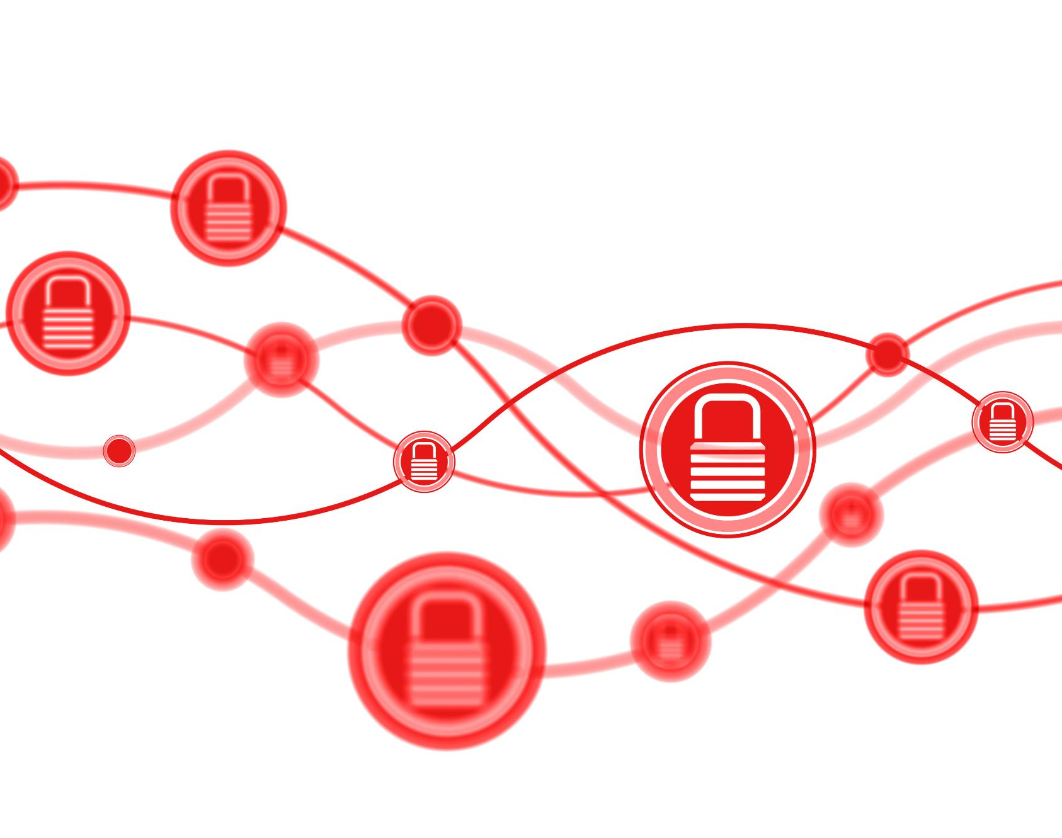
Analyzing the Breach
Unauthorized Access Incident
A staff member accessed billing system from an unprotected personal laptop, triggering suspicious activity alerts.
PCI-DSS Control Violations
Evaluation of violated PCI-DSS controls helps in understanding compliance gaps and strengthening data security.
Access Control and Endpoint Security
Implementing robust access control and endpoint protection is critical to secure remote work environments.
Logging and Incident Response
Logging and monitoring detect unauthorized activity and support development of effective incident response protocols.
Notes:
In this phase, IT discovers that a staff member accessed the billing system from a personal laptop without endpoint protection, and logs show suspicious activity. Participants must evaluate which PCI-DSS controls were violated, discuss appropriate access control and endpoint security measures, identify required encryption standards for stored cardholder data, and determine internal and external response strategies. This phase underscores the risks associated with remote work, the importance of secure device usage, and the need for robust access management. It also highlights the role of logging and monitoring in detecting unauthorized activity and supports the development of effective incident response protocols.

Slide 12
Phase 3: Response
Notes:
Coordinating the Response

Slide 13

Coordinating the Response
Responsibility and Compliance
Identify whether the firm or vendor is responsible for compliance in data exposure incidents and assess related risks.
Client Notification Steps
Outline clear, timely steps for notifying affected clients to ensure transparency and trust after data breaches.
Policy Updates and Improvement
Update incident response and vendor management policies to strengthen security and prevent future breaches.
Notes:
The billing platform vendor confirms a misconfiguration in their API that exposed cardholder data. Participants must determine who is responsible for compliance—the firm or the vendor—evaluate the legal and financial risks of non-compliance, outline steps for notifying affected clients, and update incident response and vendor management policies. This phase explores the complexities of third-party relationships, the shared responsibility for data protection, and the importance of clear contractual agreements. It also emphasizes the need for timely communication, transparency with clients, and continuous improvement of security policies to prevent future incidents.

Slide 14
Phase 4: Recovery & Compliance Review
Notes:
Post-Incident Actions

Slide 15

Post-Incident Actions
Compliance Audit Simulation
Conducting a mock PCI-DSS audit helps identify required documentation and compliance gaps in an SMB legal context.
Continuous Monitoring Strategies
Implementing ongoing monitoring strengthens cybersecurity by detecting and responding to threats promptly.
Staff Training Programs
Regular employee education ensures awareness of compliance requirements and promotes best security practices.
Proactive Risk Management
Learning from incidents and enforcing controls enhances long-term data protection and reduces vulnerabilities.
Notes:
Participants conduct a mock PCI-DSS compliance audit using the SAQ-D checklist. They must identify required documentation, implement continuous monitoring strategies, plan staff training programs, and discuss best practices for maintaining compliance in an SMB legal setting. This phase focuses on recovery, learning from the incident, and strengthening the firm's cybersecurity posture. It reinforces the importance of regular audits, employee education, and proactive risk management. By simulating a compliance review, participants gain practical insights into maintaining long-term adherence to PCI-DSS standards and protecting client data effectively.

Slide 16
Debrief & Learning Outcomes
Notes:
Key Takeaways

Slide 17

Key Takeaways
PCI-DSS Compliance
Identify relevant PCI-DSS requirements specific to law firms to ensure secure payment processing and vendor oversight.
Risk Recognition
Recognize cybersecurity risks related to remote work and unsecured endpoints to mitigate vulnerabilities effectively.
Incident Response Practice
Practice incident response and communication strategies to enhance preparedness for cybersecurity events.
Organizational Resilience
Use tabletop exercises to build resilience, foster security culture, and prepare for real-world legal sector challenges.
Notes:
The debrief summarizes the exercise and highlights key learning outcomes: identifying PCI-DSS requirements relevant to law firms, understanding secure payment processing and vendor oversight, recognizing risks associated with remote work and unsecured endpoints, and practicing incident response and communication strategies. Participants reflect on their decisions, discuss areas for improvement, and develop action plans for enhancing cybersecurity and compliance. This final phase reinforces the value of tabletop exercises in building organizational resilience, fostering a culture of security, and preparing for real-world challenges in the legal sector.

