Slide 1


SECU8010
Fundamentals of InfoSec
Unit 02 - The Cybersecurity Landscape
Malware and Injections
Baljeet S. Bilkhu, BASc., MScIS
bbilkhu@conestogac.on.ca

Slide 2
Today’s Class…
2.0 The Cybersecurity Landscape
2.1 Compare and contrast various security exploits across a network infrastructure
2.2 Identify common security tools used
2.3 Discuss common operational issues across people, process and product
2.4 Discuss common IT services and assets that can be compromised

Slide 3
What is Malware?
Malware (malicious software) is any software intentionally designed to cause damage to a computer, server, client, or network.
Malware spreads through:
Phishing emails
Malicious websites
Infected USB drives
Software vulnerabilities
Social engineering

Slide 4


Backdoor
Attack is able to control the affected system
Botnet
All infected computers receive instructions from the same Command-and-Control (C&C) server
Downloader
Malware that exists to download other malware
Used when attacker first gains access

Slide 5
Information-Stealing
Sniffers, keyloggers, etc.
Launcher
Program that launches other malware
Uses non-traditional techniques to ensure stealth
Rootkit
Malware that conceals the existence of other code
Often paired with a backdoor

Slide 6
Scareware
Attempts to frighten user into action
Ransomware
Malware that restricts access to the infected computer and demands the user
pay a ransom to regain access. Ransomware as a Service (RaaS)
They typically do release your files! Hackers you can trust but not always!
Spam-Sending
Attacker rents machine to spammers
Worms or virus
Malware that can copy itself and infect other systems

Slide 7
Virus
Typically attached to an executable
Requires human to run it, needs human to spread
Worm
Similar to virus (considered sub-class of virus)
Does not require human interaction
Takes advantage of file or information transport features of the infected system

Slide 8
Viruses
Core Components of a Virus
Payload: The part of the virus that performs the malicious action (e.g., deleting files, stealing data).
Replication Mechanism: Code that allows the virus to copy itself to other files or systems.
Trigger: A condition that activates the payload (e.g., a specific date or user action).
Obfuscation: Techniques used to hide the virus from detection (e.g., encryption, polymorphism).

Slide 9
Viruses
Programming Languages Used
Low-level languages like Assembly for stealth and control.
High-level languages like C/C++, Python, or JavaScript for portability and ease of development.
Scripting languages like VBScript or PowerShell for targeting Windows environments.

Slide 10
Viruses
Common Infection Vectors
Infected executable files (.exe, .dll)
Macros in documents (e.g., Word or Excel)
Boot sectors of storage devices
Email attachments or malicious links
Software vulnerabilities

Slide 11
Viruses
1. Infection Phase
The virus is introduced to the system via an infected file or device.
It attaches itself to a legitimate program or file.
2. Execution Phase
When the host file is run, the virus code is executed.
It may immediately activate or wait for a trigger.
3. Replication Phase
The virus copies itself to other files, folders, or systems.
It may modify system settings to ensure persistence (e.g., registry changes).
Virus
Executable
Executable
Virus

Slide 12
Viruses
4. Payload Activation
The virus performs its intended malicious action:
Corrupting or deleting files
Logging keystrokes
Encrypting data (if ransomware)
Spreading to other systems via network shares or email
5. Stealth and Evasion
Many viruses use techniques to avoid detection:
Polymorphic code: Changes its appearance each time it replicates.
Metamorphic code: Rewrites its own code to avoid signature detection.
Rootkits: Hide their presence from antivirus software and system tools.

Slide 13
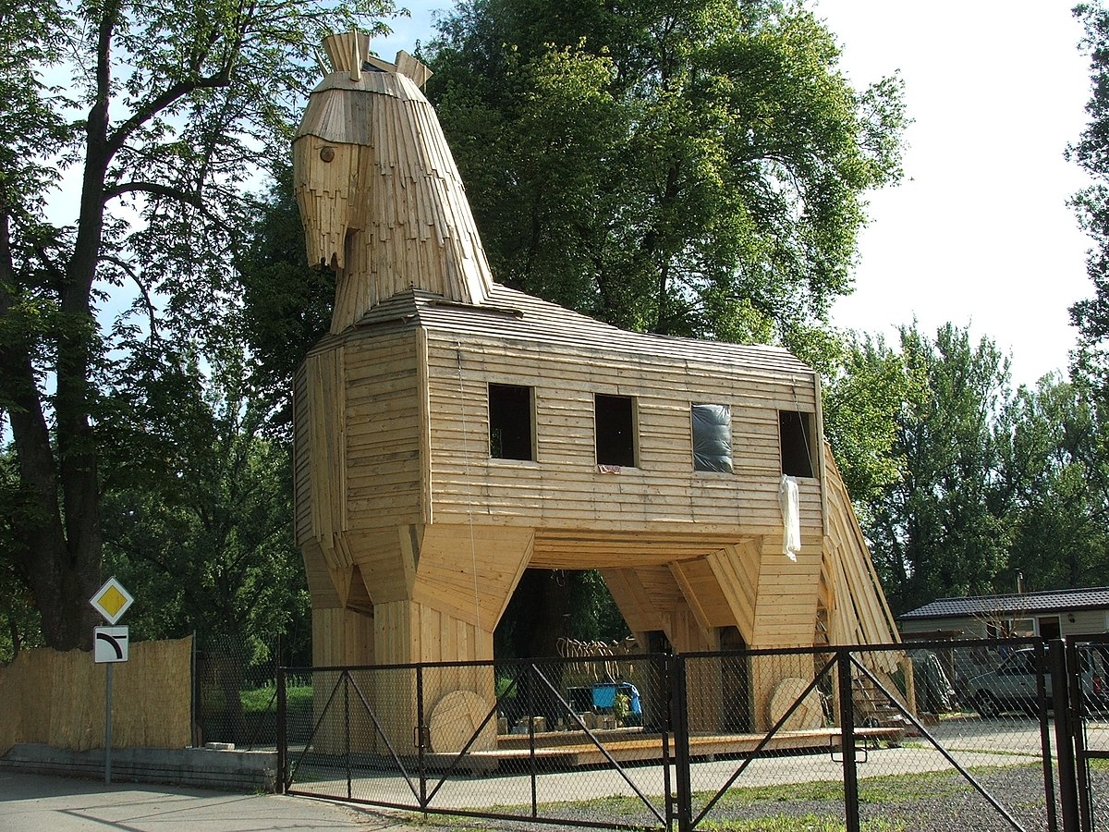
Trojan Horse (or Trojan)
Appears to be useful software
Appears to be from legitimate source
Trick user into opening it
Blended Threats
Malware is often a combination of these
E.g. A Trojan Backdoor
This Photo by Unknown Author is licensed under CC BY-SA

Slide 14

Mass malware
Most common
Attempts to infect as many systems as possible: WannaCry
Targeted malware
Tailored to a specific target
Difficult to detect, prevent and remove
Requires advanced analysis
Stuxnet

Slide 15
Examples of Malware
National Cyber Threat Assessment 2025-2026 - Canadian Centre for Cyber Security
5 Major Malware Attacks on Companies in 2024

Slide 16

Do not get lost in the details
Not important to examine absolutely every part of the code
Focus on key features
Try more than one tool
Find whatever works best
Do not waste time trying to fix hard problems
Malware is constantly improving, “cat and mouse” game

Slide 17
Two different ways you can analyze Malware
Static Analysis
Dynamic Analysis

Slide 18
Examine the malware without running it
Basic static analysis
View the malware without looking at its instructions (its code)
Can confirm whether the file is malicious or not
Fast and easy, but imperfect. Can miss some malware behaviour
Advanced static analysis
Reverse engineer with a disassembler and looking at the instructions
Tells you exactly what the malware does
Complex, requires understanding of the programming code and/or assembly code

Slide 19
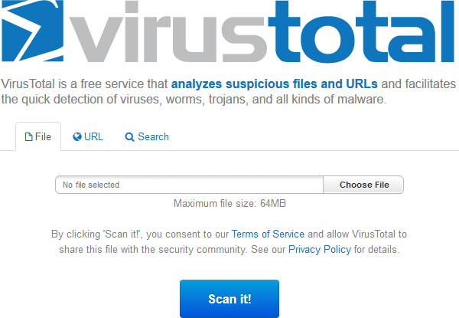
VirusTotal
Analyzes files and URLs
Convenient, but can
alert attackers they’ve been caught
As with any scanner,
malware can easily change its signature and fool the antivirus

Slide 20
Unix strings() command
People have created Windows and other versions
Can extract all the strings that are at least X characters long (4 by default)
Interpret what they may mean, if you have seen them before

Slide 21

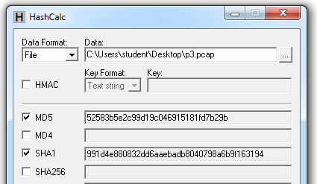
MD5 or SHA-1 functions are most commonly used for malware
Condenses a file of any size down to a fixed-length fingerprint
Uniquely identifies a malicious file
May be collisions (two with same
hash) but are rare
HashCalc

Slide 22
Execute the malware and monitor its effects
Use a virtual machine and take snapshots
Basic dynamic analysis
Easy but requires a safe test environment
Running the malware and observing the behaviour for removing it
Not effective on all malware and can miss important functionality
Advanced dynamic analysis
Run code in a debugger
Examines internal state of the running malware
Provides an alternative way to obtain detailed information

Slide 23
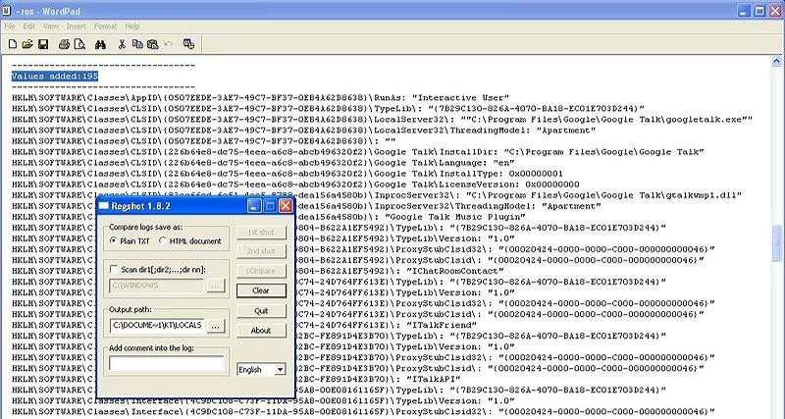
RegShot
Shows you what changes have happened in Windows registry

Slide 24
CaptureBAT
Free Windows tool for capturing location information about a system’s processing
Allows you to observe process, registry, file system and network- level activities on the host

Slide 25
Symptoms of Malware
While the types of malware differ greatly in how they spread and infect computers, they all can produce similar symptoms. Computers that are infected with malware can exhibit any of the following symptoms:
Increased CPU usage
Slow computer or web browser speeds
Problems connecting to networks
Freezing or crashing
Modified or deleted files
Appearance of strange files, programs, or desktop icons
Programs running, turning off, or reconfiguring themselves (malware will often reconfigure or turn off antivirus and firewall programs)
Strange computer behavior
Emails/messages being sent automatically and without user’s knowledge (a friend receives a strange email from you that you did not send)
Etc…

Slide 26

Introduction and Defence

Slide 27

An application level vulnerability
Allows an attack to perform a malicious attack through PHP code that requires input
Code Injection
SQL Injection

Slide 28
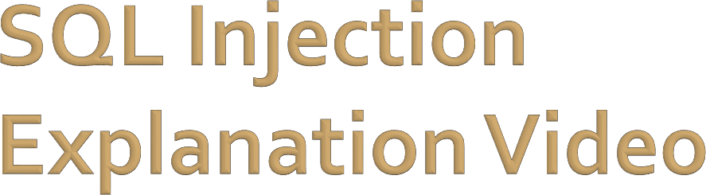
https://www.youtube.com/watch?v=pm7FK5tRpNU

Slide 29


http://xkcd.com/327/

Slide 30
Add new data to a table
Using INSERT command
Modify data in a table
Using UPDATE command
Gain access to user's system capabilities
By obtaining passwords

Slide 31

Use Prepared Statements
Written in PHP
Uses bound variables
SQL statements that are sent to and parsed by the database server separately from any parameters
Combine variables with the complied SQL statement
Variables interpreted as strings, not part of SQL statement
Becomes impossible for a hacker to inject malicious SQL

Slide 32
Use Prepared Statements
$stmt = $dbh->prepare("SELECT * FROM
table WHERE EMAIL = ? ");
/* The statement below sets "?" to an actual value that is stored in the email variable, we are also assuming that the $email variable is set beforehand: */
$stmt->execute($email);

Slide 33
Filter input, check its syntax
Limit length of input
Quotation marks, words like "DROP", "INSERT"
Not always possible
No sweeping privileges
Datatype parameters
If a number is required, make the parameter numeric
Cast input to proper datatype

Slide 34
Encrypt sensitive data
If exposed, nothing of value is gained by hacker
Configure Database error reporting
Default errors often give away valuable information for hackers
Table name, field names, etc.

Slide 35




Any questions?

