Slide 1



SECU8010
Fundamentals of InfoSec
Unit 04 – Data Encryption
Baljeet S. Bilkhu, BASc., MScIS
bbilkhu@conestogac.on.ca

Slide 2
Today’s Class…
4.0 Data Encryption
4.1 Explain the basic concepts of encryption and cryptography in relation to the CIA framework
4.2 Compare and contrast the various methodologies of encryption
4.3 Discuss various usages of encryption such as digital signatures and certificates
4.4 Explain the main concepts around key exchange
4.5 Demonstrate the fundamentals of bitwise encryption
4.6 Utilize common encryption tools to secure data in storage and/or transit

Slide 3
Discussion
Please read the following and tell me what it says:
JYW pz hdlzvtl!!!
What??? You’re unable to read it???!
Would it help if I give you a deciphering key ☺ ?
Perform a shift (of only the letters regardless of case): -7 (so that h/H => a/A, i/I =>b/B, etc…)

Slide 4
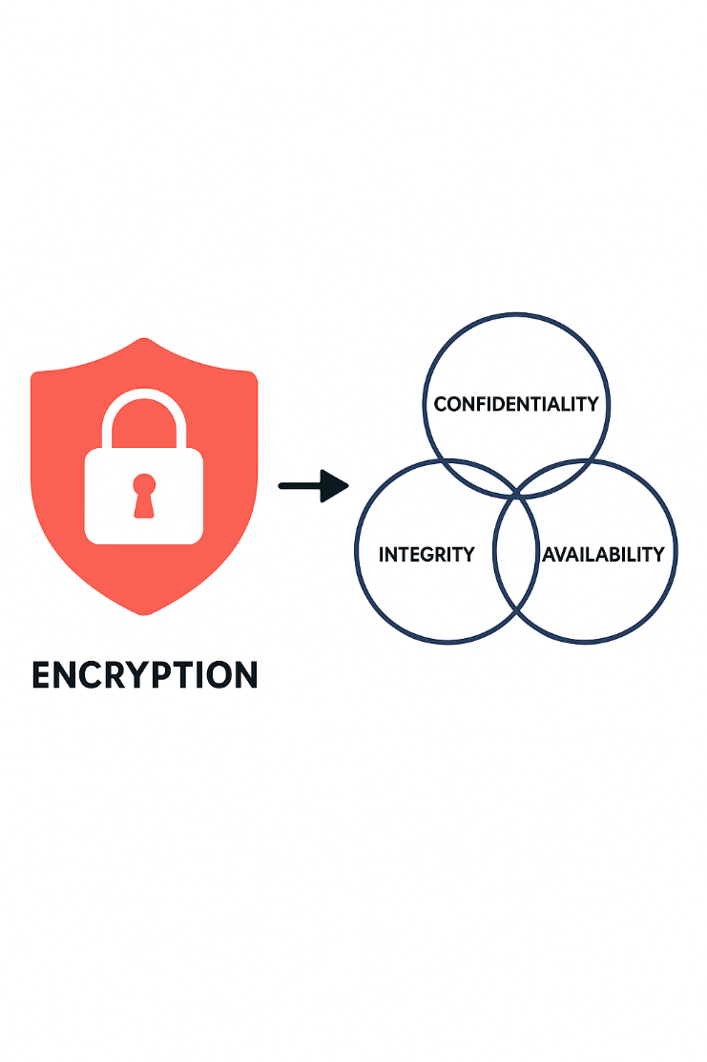
Encryption and the CIA - Confidentiality

Slide 5
Encryption and the CIA - Confidentiality
Confidentiality
Goal: Prevent unauthorized access to information.
How encryption helps:
Data is encrypted so that only authorized users with the correct decryption key can access it.
Examples: HTTPS for secure web browsing, encrypted emails, VPNs.
Techniques:
Symmetric encryption (same key for encryption and decryption)
Asymmetric encryption (public/private key pairs)

Slide 6
Encryption and the CIA - Integrity
Integrity
Goal: Ensure data is not altered or tampered with.
How cryptography helps:
Hash functions (e.g., SHA-256) generate a unique fingerprint of data.
Digital signatures verify that data has not been modified and confirm the sender’s identity.
Example:
A software update file includes a hash. If the hash matches after download, the file is intact.

Slide 7
Encryption and the CIA - Availability
Availability
Goal: Ensure data and systems are accessible when needed.
How cryptography supports this:
While encryption itself doesn’t guarantee availability, it can help protect systems from attacks (e.g., ransomware) that threaten availability.
Redundant encrypted backups ensure data can be restored securely.
Example:
Encrypted cloud backups allow recovery after a cyberattack without exposing sensitive data.

Slide 8






Interruption
Availability Attack
Interception
Confidentiality Attack
Modification
Integrity Attack
Fabrication
Authenticity Attack

Slide 9
Network attacks can be composed of two types:
Network Attacks
Passive
Active

Slide 10
Passive Attacks – Monitoring of transmissions (eavesdropping)
Analyze Traffic
Copy/Release message contents

Slide 11
Active Attacks – Modification of data stream or creation of a false data stream
Replay attack
Modification of messages
Denial of service
Masquerade attack

Slide 12

One tool to create a solution to the problems of network security
Prevents passive networking attacks
Three different types of encryption
Symmetric-key Encryption
Asymmetric-key Encryption
Hybrid Approach

Slide 13
The terms code and cipher are often used interchangeably
In common speak they can be synonymous, but they are in reality separate ideas
When discussing encryption, it is important to keep them
separate

Slide 14
Code
The mapping of a unit into something else
Unit: Word, sentence, phrase, etc.
Something else: Usually a shorter group of symbols
Doesn't have to be
"When I say red, I really mean brown."
Codebook
A list of the code's mappings
A code requires a codebook
Codes operate on semantics, meaning

Slide 15
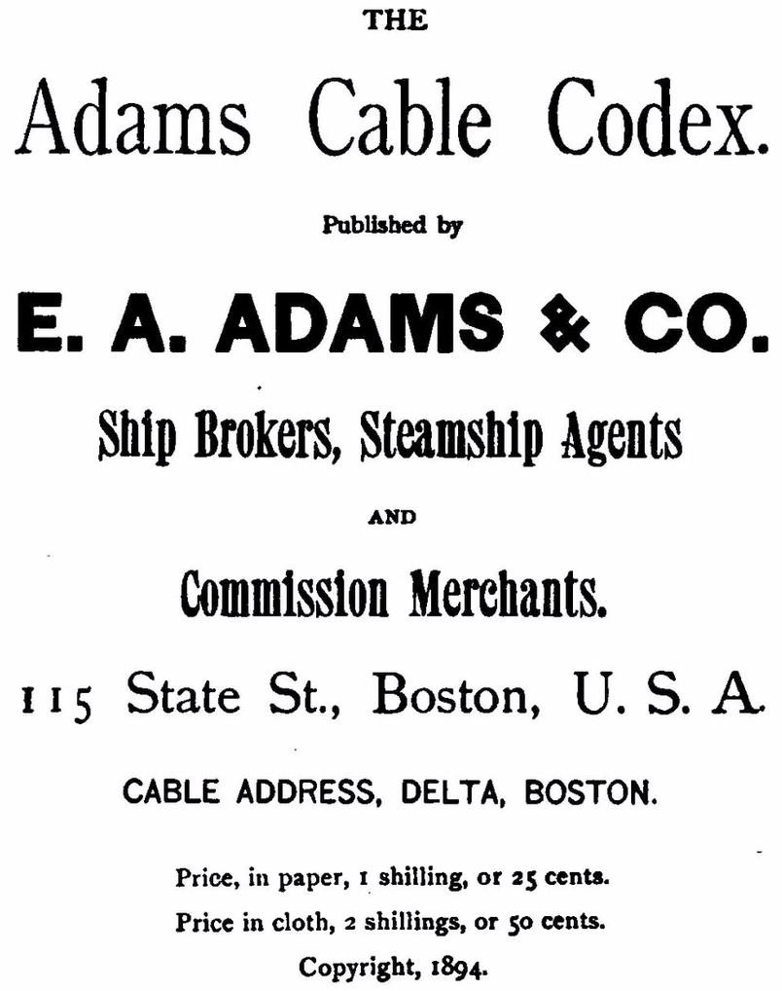
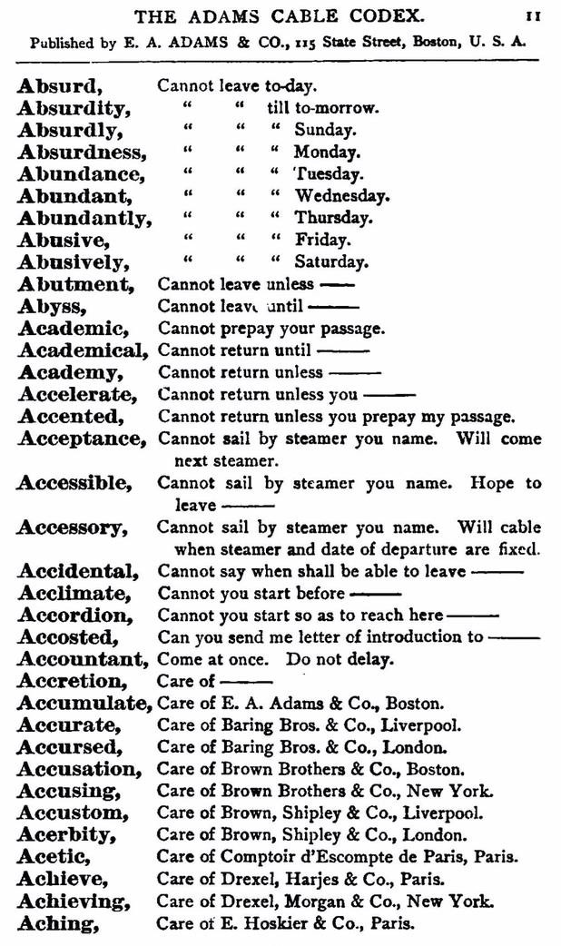

Slide 16
Cipher
Do not involve meaning
Are the result of mechanical operations, known as algorithms
No codebook is required, instead you follow a series of instructions
Every cipher algorithm requires one piece of shared information
This is known as the key
Ciphers operate on syntax, symbols

Slide 17
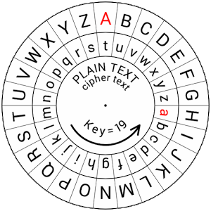
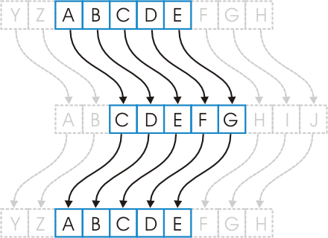
Caesar Cipher
Shift Cipher – try it out for yourself!

Slide 18

Plaintext
Regular text, human readable
Unencrypted text
Ciphertext
Plaintext that has had a cipher applied, generally not human readable
Encrypted text

Slide 19
Cryptography
Essentially, cryptography is the use of mathematical algorithms that transform information from plain-text (non-encrypted) into an encrypted format that is not readable (unless the decryption key / methodology is known).
In most mathematical operations involving Cryptography, the XOR operation is used:
A | B | A XOR B
0 | 0 | 0
1 | 0 | 1
0 | 1 | 1
1 | 1 | 0

Slide 20
Cryptography – Example of a Stream Cipher
Let’s convert some ASCII text into Binary and then encrypt it using an eight-bit key
Suppose, we have the word “HELLO” and we want to encrypt it
First, let’s get it’s binary equivalent:
H | E | L | L | O
01001000 | 01000101 | 01001100 | 01001100 | 01001111

Slide 21
Cryptography - Example
Let’s now, pick a random key (also eight-bit in length): 00100011
Plain Text ASCII | H | E | L | L | O
Plain Text Binary | 01001000 | 01000101 | 01001100 | 01001100 | 01001111
Key | 00100011 | 00100011 | 00100011 | 00100011 | 00100011
XOR’d Output | 01101011 | 01100110 | 01101111 | 01101111 | 01100100
Encrypted CipherText | k | f | o | o | l

Slide 22
Cryptography - Example
Let’s now, perform the reverse using the same key: 00100011
Plain Text ASCII | H | E | L | L | O
Plain Text Binary | 01001000 | 01000101 | 01001100 | 01001100 | 01001111
Key | 00100011 | 00100011 | 00100011 | 00100011 | 00100011
XOR’d Output | 01101011 | 01100110 | 01101111 | 01101111 | 01101100
Encrypted CipherText | k | f | o | o | l
CipherText Binary | 01101011 | 01100110 | 01101111 | 01101111 | 01101100
Key (from above) | 00100011 | 00100011 | 00100011 | 00100011 | 00100011
Plain Text Binary | 01001000 | 01000101 | 01001100 | 01001100 | 01001111
Plain Text ASCII | H | E | L | L | O

Slide 23
Encryption Algorithms
Input the plain text message: P
Input the encryption key: K
Perform the encryption steps using P and K
Generate the ciphertext C

Slide 24
Decryption Algorithms
Input the ciphertext C
Input the K, the decryption key
Perform the decryption using C and K
Output the plaintext message P

Slide 25

Secret Key Encryption
Both the sender and receiver share the same encryption/decryption key
Conventional idea of encryption
What is the drawback?
Must share the key. How?

Slide 26
Cryptanalysis
Relies on the type of algorithm used along with known plaintext- ciphertext pairs
Brute-force attack
Try every possible attack
May take an unreasonable amount of time
This can be improved with newer technology, dictionary attacks

Slide 27
Block Ciphers
Plaintext input and ciphertext output are equal in size
Processed in blocks
DES (Data Encryption Standard)
AES (Advanced Encryption Standard)

Slide 28
Block Ciphers - details
In cryptography, a block cipher is a symmetric key cipher which operates on fixed-length groups of bits, called blocks, with an unvarying transformation.
When encrypting, a block cipher might take a predefined (implementation specific) block of plaintext as input, and output a corresponding block of ciphertext of the same size.
The exact transformation is controlled using a second input —the secret key.

Slide 29
Block Ciphers – details continued…
Decryption is similar: the decryption algorithm takes block of ciphertext together with the secret key, and yields the original block of plaintext.
To encrypt messages longer than the block size, a mode of operation is used.
Block ciphers can be contrasted with stream ciphers; a stream cipher operates on individual digits one at a time, and the transformation varies during the encryption.
The distinction between the two types is not always clear-cut: a block cipher, when used in certain modes of operation, acts effectively as a stream cipher.

Slide 30
Cryptography
DES
Key size is 56 bits, blocks are 64 bits
Began widespread use in 1977
Work began on AES in 1997
In 1998 DES was broken!

Slide 31

AES became official standard in 2001
AES uses 128 bit block size and 128 bit key
As of now, AES is still unbroken
There are no known practical attacks of AES
For now
People are always trying!

Slide 32

https://youtu.be/3MPkc-PFSRI?si=o33R9ZFb90OhF-BO
You do not need to memorize the algorithm
I present it to illustrate the simple manipulation operations behind it
shifts, lookups, etc.

Slide 33

Symmetric-key encryption requires both parties to share the same keys
Must protect these keys from others
How?
Selected by A, given to B somehow
Third party C could provide a key to both A and B
Many issues with this

Slide 34
Also known as Public-key Encryption
Based on mathematical functions rather than operations on bit patterns
Requires two separate keys
Public key and private key used as input to the encryption and decryption algorithm

Slide 35
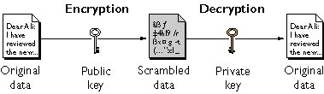
Two keys generated, one placed in public register with collection of public keys
Message is encrypted using the destination's public key
Destination decrypts the message using its private key

Slide 36
RSA for key generation
Invented in 1973 by three MIT professors
Uses mathematics
DES/AES use simple manipulation
1024 bit keys are used
Much larger than symmetric-keys
1000x slower encryption/decryption than DES

Slide 37

https://www.youtube.com/watch?v=QjmHSVjmvGo
You do not need to memorize the algorithm
I present it to illustrate the mathematics behind it

Slide 38
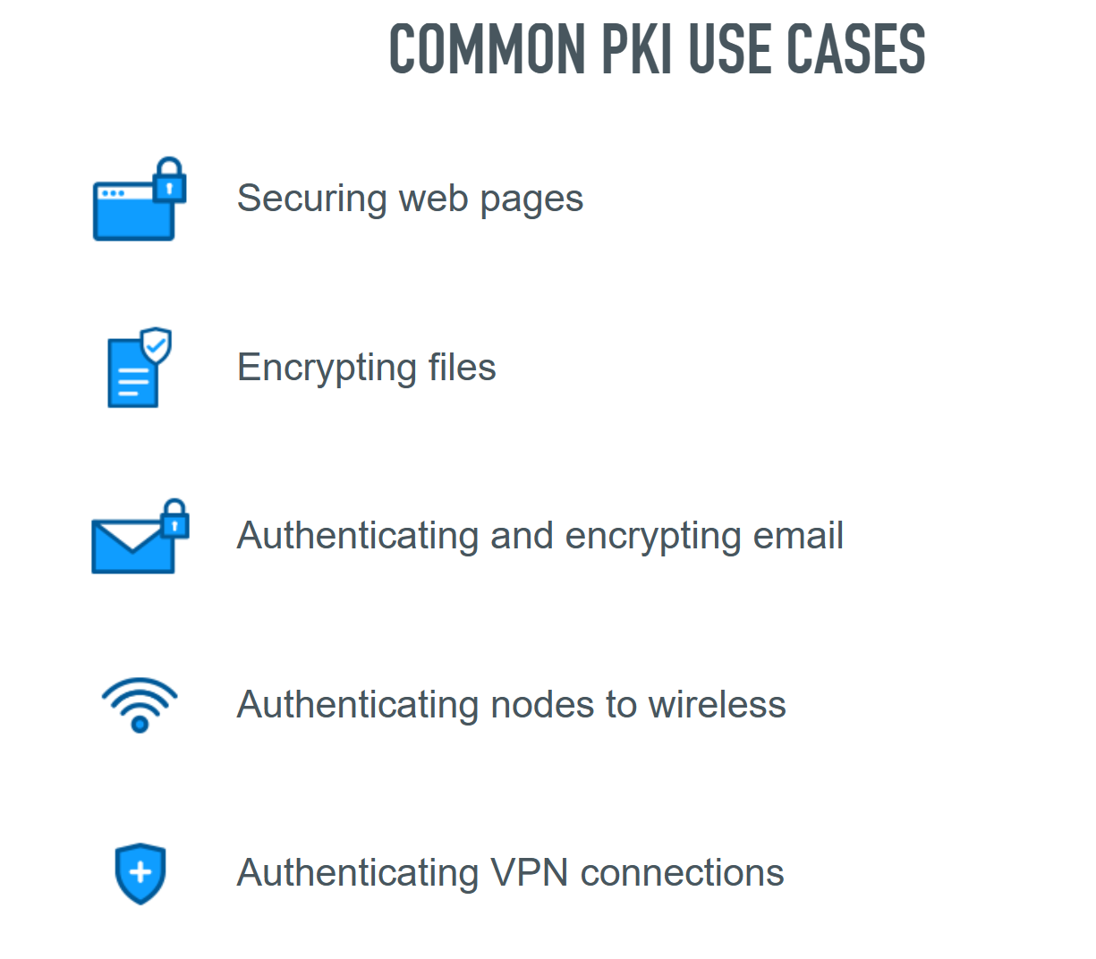
Public Key Infrastructure
Public Key Infrastructure (PKI) implementations combine the strengths of both symmetric and asymmetric key cryptographic methods along with hashing to create robust and secure systems
What is PKI | Public Key Infrastructure | DigiCert
Notes:
What is PKI | Public Key Infrastructure | DigiCert

Slide 39
PKI Services
The Public Key Infrastructure (or PKI) allows for the following services:
Key Generation: using RSA to generate strong/long keys
Key Distribution: typically using Diffie-Hellman algorithms, that help with the creation and secure exchange of symmetric keys - session keys used for one communications session only.
Non-Repudiation: individuals cannot deny performing a specific action
Message Integrity through hashing algorithms
These “hashes” are akin to fingerprints that can be checked before and after any data transmission
If these hashes match, then the data was transmitted with integrity (was not changed);
If they don’t match, then integrity was not preserved.

Slide 40

Encrypt message using conventional encryption with symmetric-key
Encrypt the symmetric key using recipient's public key
Attach encrypted key to encrypted message and send to
recipient

Slide 41
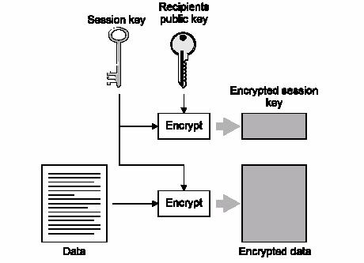
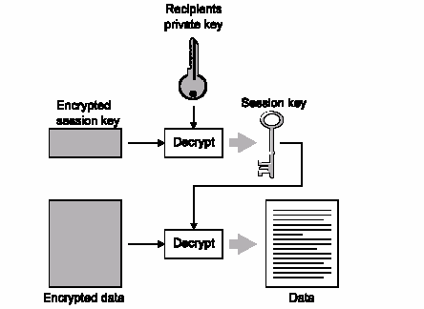
Combine Asymmetric and Symmetric - Hybrid
After the message is sent, the session key is discarded and not reused.

Slide 42
Advantages
Resistant to brute force attacks
More difficult to crack
Require less computing power
Disadvantages
Biggest: Proper exchange of private keys
Compromised private key
One-time key the best option, not user friendly

Slide 43
Advantages
No transfer of keys required
Disadvantages
Computationally costly
Keys are substantially longer
Keys are more vulnerable to brute force
Algorithms are available to crack that are more efficient than brute force
To combat we must use longer and longer keys, more power

Slide 44
Encryption Solutions
Can be broken down into two solutions: static or dynamic
Static (at rest): encrypting entire disks or individual files
Dynamic (in transit): VPNs (IPSec), SSL / TLS (HTTP, FTP)

Slide 45

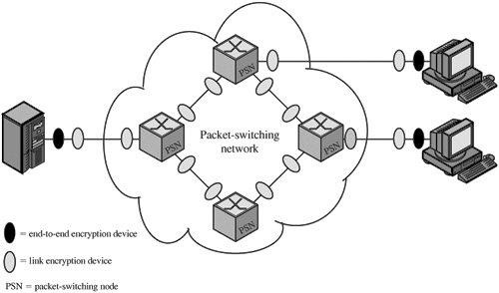
Link Encryption
End-to-End Encryption

Slide 46
Advantages
More flexibility in choosing what gets encrypted and how
Higher granularity of functionality because each application or user
can choose their configuration
Each hop computer does not need to have key and decrypt
Less resources required
Disadvantages
Headers, addresses, routing information not encrypted, not protected

Slide 47

Advantages
Allows you to encrypt the final destination of the message
If the message is intercepted, attacker does not know who it was meant to go
to
Disadvantages
Requires each hop computer to have their own set of keys
More computationally expensive, requires more complicated hardware

Slide 48

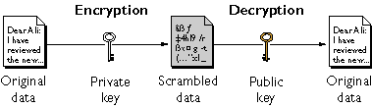
Used to prove the authenticity of a digital message or document
Opposite process of Public-key encryption

Slide 49
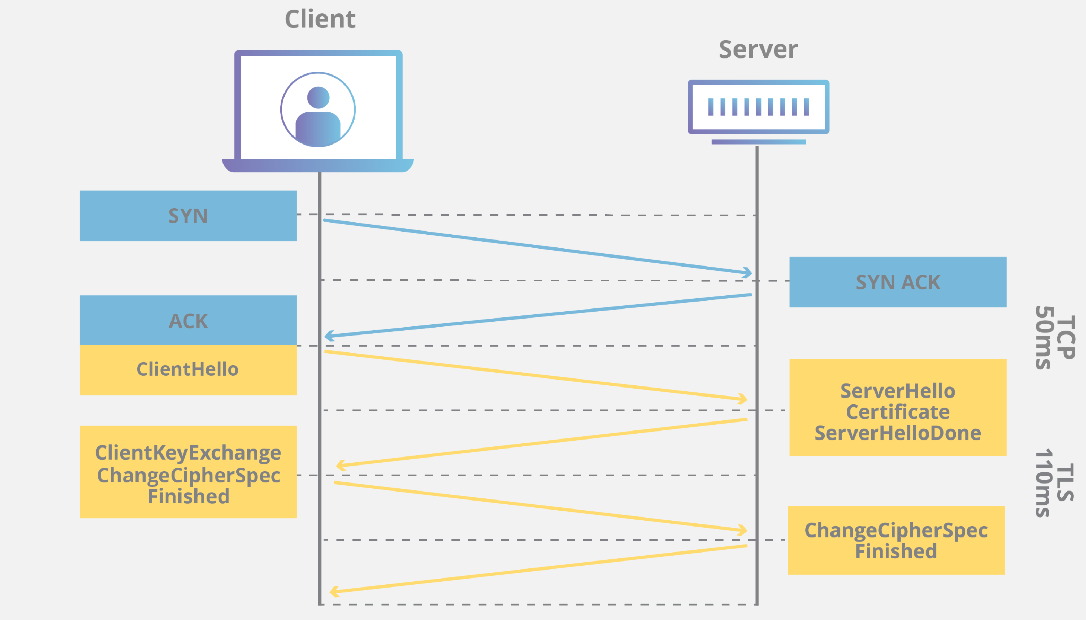
Key Exchange
Let’s consider how secure communications occur over the Internet:
What happens in a TLS handshake? | SSL handshake | Cloudflare – online, retrieved September 18th, 2023

Slide 50
Key Exchange
Definition: Key exchange is the process of securely sharing cryptographic keys between parties to enable encrypted communication.
Why it's needed: Without secure key exchange, encrypted communication cannot begin safely.

Slide 51
Key Exchange
Type | Description | Example Use Case
Symmetric | Same key used for encryption and decryption | VPNs, file encryption
Asymmetric | Public key encrypts, private key decrypts | HTTPS, email encryption

Slide 52
Key Exchange
Key Exchange in TLS/HTTPS
TLS uses a hybrid approach:
Asymmetric encryption to exchange a symmetric session key.
Symmetric encryption for the rest of the session.
TLS 1.3 uses ephemeral Diffie-Hellman for forward secrecy.
Certificate authorities verify identities to prevent MITM attacks.

Slide 53
Certificate Based Encryption
A digital certificate is an electronic document used to prove the ownership of a public key. It is issued by a trusted entity called a Certificate Authority (CA) and is a core component of Public Key Infrastructure (PKI).
Certificates help solve a critical problem in encryption: How can you trust that a public key really belongs to the person or organization it claims to?
They provide:
Authentication: Verifies the identity of the website, server, or user.
Integrity: Ensures the public key hasn’t been tampered with.
Trust: Establishes a chain of trust through the CA.

Slide 54
Certificate Based Encryption
Makes use of a Certificate Authority (CA) that uses ID based encryption to validate that a said party in the secure encryption communications are really who they say they are.
CA’s are generally trusted bodies that issue certificates.
A digital certificate can be thought of as a signature by a trusted certificate authority (CA) that securely binds together several quantities.
These quantities include at least the name of a user and its public key but sometimes other pieces of information such as organization, organizational unit, country, etc… can also be used.

Slide 55
Summary
Methodology | Key Type | Speed | Use Case | Strengths | Limitations
Symmetric Encryption | Single shared key | Fast | File encryption, VPNs, disk encryption | Efficient, simple implementation | Key distribution is a challenge
Asymmetric Encryption | Public/private key pair | Slower | Secure email, SSL/TLS, digital signatures | Secure key exchange, authentication | Computationally intensive
Hashing | No key (one-way) | Very fast | Password storage, data integrity checks | Ensures integrity, irreversible | Not reversible; not for confidentiality
Hybrid Encryption | Combines symmetric + asymmetric | Balanced | Secure messaging, TLS/SSL | Combines speed and secure key exchange | More complex implementation
Homomorphic Encryption | Public/private key pair | Very slow | Secure computation on encrypted data | Enables computation without decryption | Still experimental, resource-heavy
Quantum Encryption | Quantum key distribution | Fast (theoretically) | Future-proof secure communication | Resistant to quantum attacks | Not widely available yet

Slide 56

Any questions?

