Slide 1


SECU8010
Fundamentals of InfoSec
Unit 04 – Data Encryption
Digital Signatures and Certificates
Baljeet S. Bilkhu, BASc., MScIS
bbilkhu@conestogac.on.ca

Slide 2
Today’s Class…
4.0 Data Encryption
4.3 Discuss various usages of encryption such as digital signatures and certificates
4.4 Explain the main concepts around key exchange
4.6 Utilize common encryption tools to secure data in storage and/or transit

Slide 3
Digital Signatures

Slide 4
Introduction to Digital Signatures
A digital signature is a cryptographic technique used to verify the authenticity and integrity of digital messages or documents.
It provides assurance that the message or document has not been tampered with and that it originated from the expected sender.
Digital signatures rely on Public Key Infrastructure (PKI), which uses a pair of cryptographic keys: a private key and a public key.
The private key is used to create the digital signature, while the public key is used to verify the signature

Slide 5
Introduction to Digital Signatures
Suppose Alice sends her bank a message authorizing it to transfer $1000 to Bob. Alice’s bank must be able to verify and prove that the message really came from Alice if she should later disavow sending the message. (This property is called nonrepudiation.)
The bank also wants to know that the message is entirely Alice’s, that it has not been altered along the way. For her part, Alice wants to be certain that her bank cannot forge such messages. (This property is called authenticity.)
Both parties want to be sure that the message is new, not a reuse of a previous message, and that it has not been altered during transmission. Using electronic signals instead of paper complicates this process.
A digital signature is a protocol that produces the same effect as a real signature: It is a mark that only the sender can make but that other people can easily recognize as belonging to the sender. Just like a real signature, a digital signature confirms agreement to a message.

Slide 6
Introduction to Digital Signatures
A digital signature must meet two primary conditions:
It must be unforgeable. If Alice signs message M with signature Sig (S, M), no one else should be able to produce the pair [M, Sig (S, M)].
It must be authentic. If Bob receives the pair [M, Sig (S, M)] purportedly from Alice, Bob can check that the signature is really from Alice. Only Alice could have created this signature, and the signature is firmly attached to M.

Slide 7
Digital Signatures – Hands On Work
Let’s take a look at how:
Digital Signatures are generated (by the sender)
Digital Signatures are verified (by the receiver)

Slide 8

Digital Signatures – Hands On Work
Start your KALI VM (in Host-Only mode)
Open up a Console Terminal
Change to superuser mod (i.e. sudo su)

Slide 9

Digital Signatures – Hands On Work
Generate your private key (i.e. genrsa –out private.pem 2048)
Note: a .pem file stands for Privacy Enhanced Mail and it is a commonly used format for cryptographic information – when someone sees the “.pem” extension, they generally know that it deals with encryption…

Slide 10
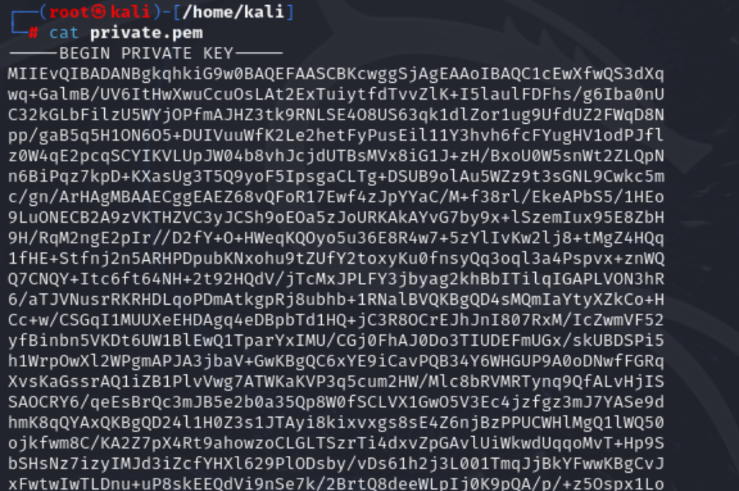
Digital Signatures – Hands On Work
View your private key (i.e. cat private.pem)

Slide 11
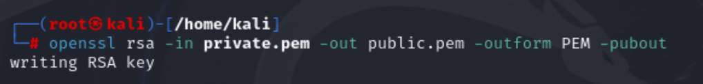
Digital Signatures – Hands On Work
Generate your public key (i.e. openssl rsa -in private.pem –out public.pem –outform PEM pubout) and provide this to your recipient(s).

Slide 12

Digital Signatures – Hands On Work
Create a text file – ensure to have at least two to three full sentences!!
(i.e. nano document.txt)
CTRL+X to exit
Y
Enter to overwrite the filename

Slide 13
Digital Signatures – Hands On Work
Sign the file using your private key as well as the hash
(i.e. openssl dgst –sha256 –sign private.pem –out document.sha256 document.txt)

Slide 14
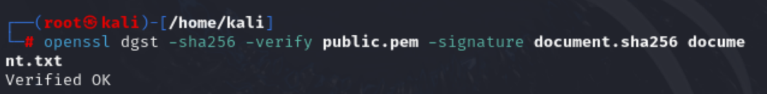
Digital Signatures – Hands On Work
Verify the signature on the recipient’s side using your public key.
(i.e. openssl dgst –sha256 –verify public.pem –signature document.sha256 document.txt)

Slide 15
Certificates

Slide 16
Introduction to Certificates
On the other hand, an encryption certificate contains additional information such as the domain, organization, expiration date, etc. It is usually signed by a different key to ensure its integrity.
While a key is generally just the data needed for encryption, a certificate provides more context and metadata about the key

Slide 17
Introduction to Certificates
As mentioned earlier, digital certificates are simple electronic files.
The X.509 and PKCS standards determine the specific formats for digital certificates, as well as the file types and formats.
Digital certificates come in a variety of file formats, including those with .cer and .pem file extensions. Additionally, there is a variety of types of certificate files, and each of these may fulfill a unique function in a PKI, such as a certificate request file.
Digital certificates can be stored on several types of media, such as USB sticks, mobile devices, internal computer storage, and even centralized repositories on a network or the Internet.

Slide 18
Introduction to Certificates
Certificates come in a variety of types, each type serving one or more purposes such as the following:
Signing and encrypting e-mails
Identifying and authenticating networks
Identifying servers
Digitally signing software, verifying its authenticity from a publisher
Certificates typically contain a variety of information, known as certificate attributes, including the public key of the individual and information that identifies that person, the issuing organization, and valid dates and functions for the certificate to be used

Slide 19
Certificate Lifecycle
Managing a digital certificate from issuance, through use, and finally disposal refers to the process of managing the certificate over its life cycle. That life cycle follows four main stages:
1. Registration by an entity
2. Issuance of certificate from certificate authority
3. Maintenance by the certificate authority
4. End of life through expiration, suspension, or revocation

Slide 20
Certificate Registration
A certificate’s life cycle begins when a user registers to receive a certificate. The person requesting the certificate must provide valid identification to the certificate authority (CA), the entity that issues and controls the digital certificates.
Registration usually means the user must present identification that the issuing organization authenticates, thus verifying the person’s identity.
Valid forms of identification that a requester may submit include her driver’s license, birth certificate, passport, photographs, and any other identification that the issuing organization requires.
Once a user has submitted the required identification, the CA decides whether to issue the certificate and under what circumstances.

Slide 21
Certificate Authority
The certificate authority (or CA) issues and controls digital certificates. The CA might be a commercial organization, such as GoDaddy, or it could be the user’s organization.
Often, private organizations have internal CAs that issue digital certificates used specifically within the logical bounds of the organization. The CA also manages the certificate server (sometimes called the CA server), the host computer that generates keys and produces digital certificate files.
The CA normally handles all user registration, identification, and validation processes, and it issues digital certificates to the user. In larger organizations, to help balance the workload for the CA, registration functions may be delegated to a separate registration authority (RA), which verifies user identities and then passes the information on to the CA for certificate generation.

Slide 22
Certificate Authority
The CA makes decisions on whether to issue the certificate, under what circumstances, and with what caveats. When an entity requests a certificate, it submits a certificate signing request (CSR).
The CA reviews the CSR, which contains the information that will be embedded in the digital certificate, including the public key, organization name, common name, and so on.
The CA then generates a certificate for the requesting entity. That certificate is called an end entity certificate. After generating certificates, the CA must also perform actions on them, such as renewing, suspending, or revoking them, as needed.

Slide 23
Certificate End Of Life
Certificates do not last forever. Certificates remain valid only for a specific period of time, and after that time they expire. This is because, like passwords, certificates could be compromised.
Certificate expiration enables a user and the CA to monitor certificate compromise and periodically reissue certificates to ensure that a compromised certificate isn’t used over long periods of time.
CA rules determine certificate lifetimes. An average time might be three years, but it may be a longer or lesser period, depending upon the circumstances under which the certificate was issued.
For example, a temporary employee might receive a digital certificate that’s good for only a year. Before a certificate expires, the user and the issuing organization must take steps to revalidate the user, as well as their need for the certificate, and reissue it.
A user cannot use an expired and thus an invalid certificate. Most browsers and applications will display errors when trying to use or accept an expired certificate.

Slide 24
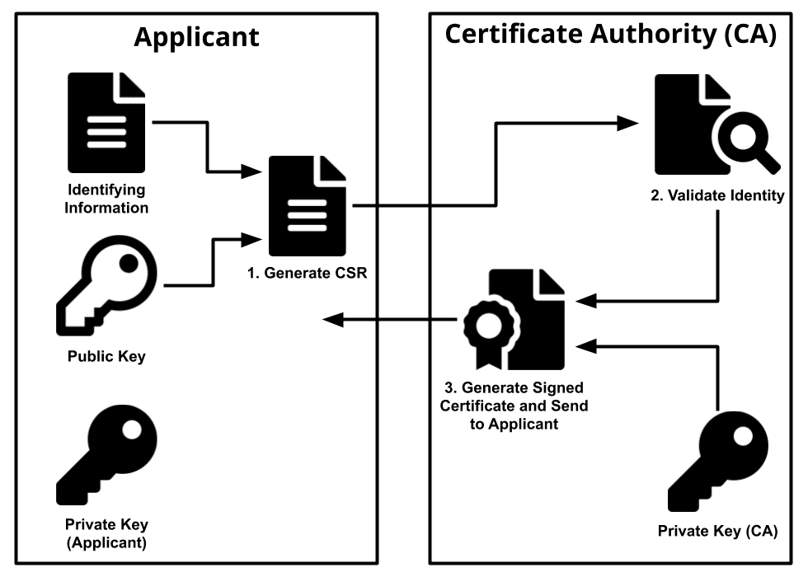
Certificate Authority Workflow
Notes:
https://images.app.goo.gl/4J42fdiwXbd2yWNq7

Slide 25
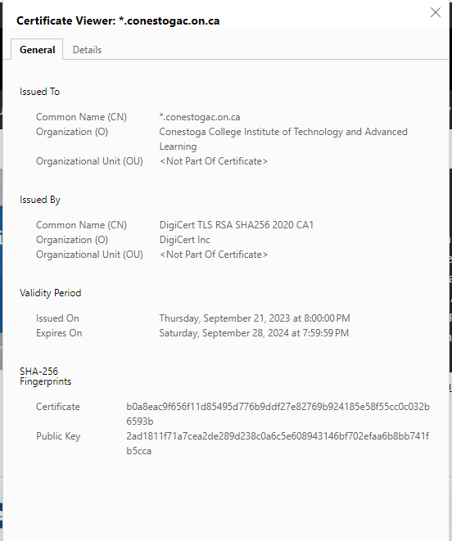
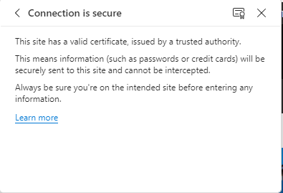
Certificates in a Browser
Access a web site (https://it.conestogac.on.ca)
Click on the lock icon in the address bar
Connection is secure
Click on certificate icon

Slide 26
Certificates – Hands On Work
With one command, we can create a new key (RSA 4096 bit) a certificate that is valid for 365 days using SHA256
(i.e. openssl req -x509 -newkey rsa:4096 -keyout key.pem -out cert.pem -sha256 -days 365 )

Slide 27
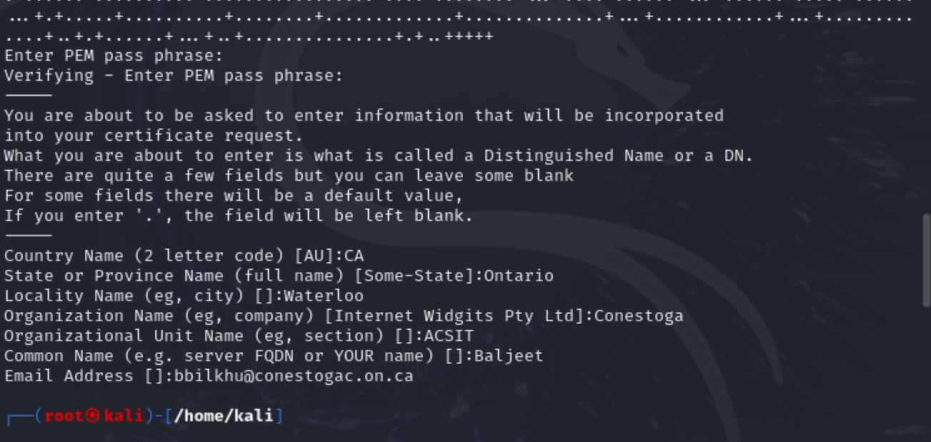
Certificates – Hands On Work
After a while, it will ask you to generate a PEM pass phrase (make sure it is greater than four characters!!!!), put in your country (CA), Province, Locality, Org name, Org Unit, Common Name and email address:

Slide 28
Certificates – Hands On Work
What we did:
We generated a self-signed certificate that are considered insecure for most internet applications – some browsers (FireFox) may treat the site as having an invalid certificate. Chrome on the other hand, may treat the connection as HTTP

Slide 29
Key Exchanges

Slide 30
Introduction to Key Exchanges
Key exchange is a method in cryptography that allows two parties to exchange cryptographic keys, enabling them to use a cryptographic algorithm.
One popular key exchange scheme is the Diffie-Hellman key exchange, where each party generates a public/private key pair and distributes the public key.
After obtaining an authentic copy of each other’s public keys, Alice and Bob can compute a shared secret offline. This shared secret can be used as the key for a symmetric cipher

Slide 31
Diffie-Hellman Key Exchange
The Diffie-Hellman key exchange is a cryptographic protocol that allows two parties who have not previously met to securely establish a shared secret key over an insecure channel.
It is one of the most important developments in public-key cryptography and is still frequently implemented in various security protocols. The protocol enables secure communication between two parties by allowing them to jointly establish a shared secret key without having to exchange it directly.
Here’s how the Diffie-Hellman key exchange works:
Both parties generate their own public-private key pairs.
Each party shares their public key with the other party.
Using their own private key and the other party’s public key, both parties independently compute a shared secret key.
The shared secret key can then be used to encrypt subsequent communications using a symmetric-key cipher.
The Diffie-Hellman key exchange provides a way for two parties to establish a shared secret key even if they have no prior knowledge of each other. This makes it particularly useful for secure communication over an insecure channel, such as the internet.
Please note that while the Diffie-Hellman key exchange is widely used and considered secure, it is important to use appropriate parameters and follow best practices to ensure its effectiveness
Let’s view this video on the Diffie-Hellman Key Exchange: https://youtu.be/NmM9HA2MQGI?si=AoEDDkIZBs14yOKE

Slide 32
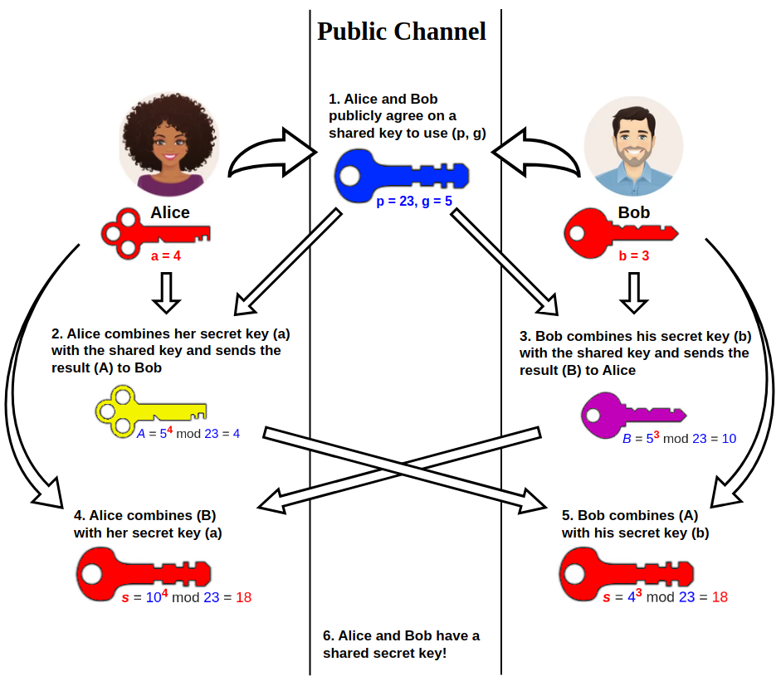
Diffie-Hellman Key Exchange
Notes:
Diffie–Hellman key exchange - Wikipedia

Slide 33

Diffie-Hellman Key Exchange - Example
Suppose Alice and Bob want to communicate with each other using DHKE
Alice and Bob would select a prime number, say… 5 (this is not hidden) – this is their p
Next, they select a number that is a primitive roots modulo of their secret number – say 3 – this is their g
Alice then selects a secret number (say 7) and calculates $A = g^{a}mod p$= (3)⁽⁷⁾ mod 5 = 2187 mod 5 = 2
Bob then selects a secret number (say 9) and calculates B = $g^{b}mod p$= (3)⁽⁹⁾ mod 5 = 19683 mod 5 = 3
They then calculate S (sometimes denoted as K) separately:
Alice: S = K = $B^{a}mod p$= (3)⁽⁷⁾ mod 5 = 2187 mod 5 = 2
Bob: S = K = $A^{b}mod p$= (2)⁽⁹⁾ mod 5 = 512 mod 5 = 2
Alice and Bob now share a secret key (2) that can be used for encryption and decryption

Slide 34

Any questions?

