Slide 1
Starbucks Locations Analysis
Can we predict the scale (low, medium, high) of Starbucks in your zip code?

Slide 2
Data Sets
There are two datasets:
First dataset contains locations information all Starbucks in the US like State, City, Zip code, longitude and latitude.
Second dataset contains census data for all zip code scrape from census.org which includes demographics like population, household, income and 2000/2010 of house median price.

Slide 3
Pre-Processing
Feature engineering for lat/lon into cartesian coordinates.
x = r * cos(lat) * cos(lon)
y = r * cos(lat) * sin(lon) where r = 3958.7558657 miles
Create a column which will be my target.
Joining both datasets resulted in this data set:

Slide 4
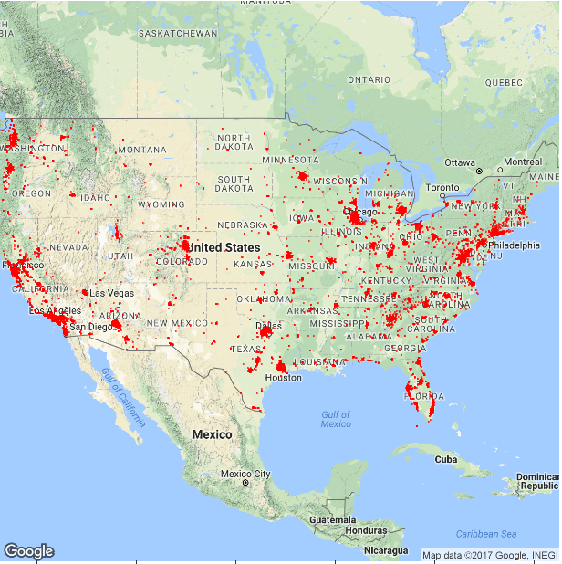
Data Analysis – US (cont’d)

Slide 5
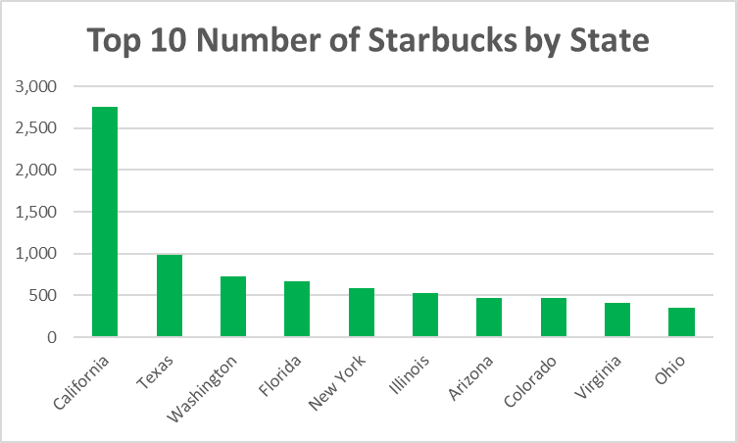
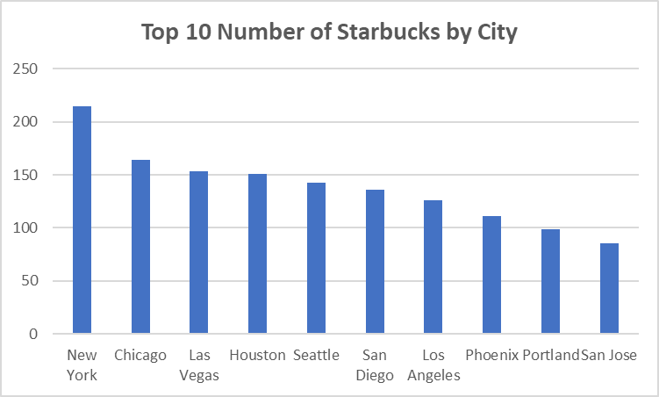
Data Analysis - US

Slide 6
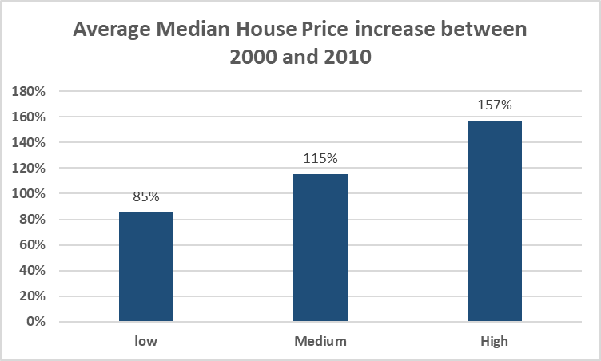
Data Analysis – US (cont’d)

Slide 7
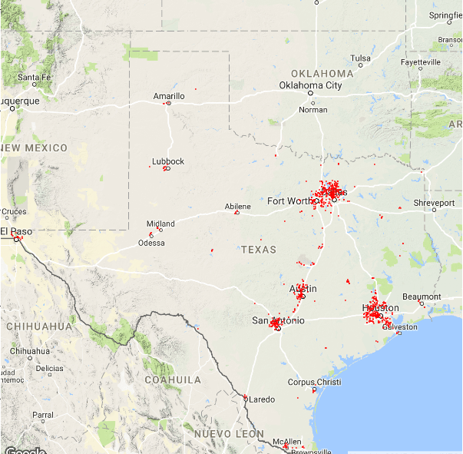
Data Analysis – Texas

Slide 8
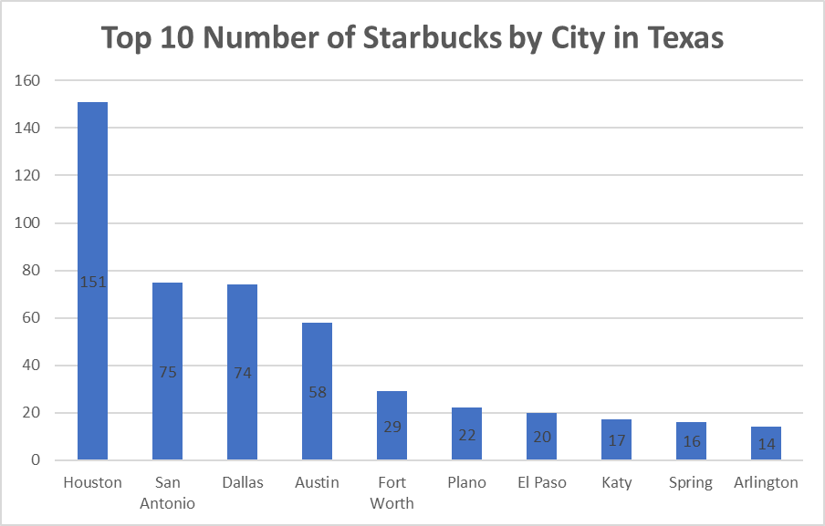
Data Analysis – Texas (cont’d)

Slide 9
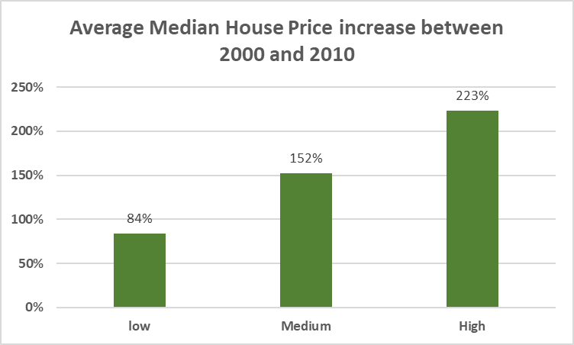
Data Analysis – Texas (cont’d)

Slide 10
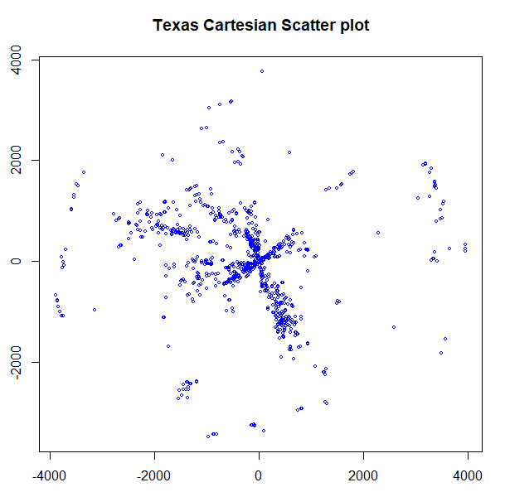
Complete Spatial Randomness Test - Texas
Creating a scatter plot of the x and y coordinates for Texas.

Slide 11
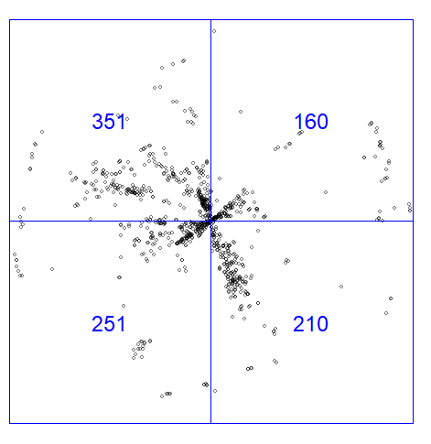
Complete Spatial Randomness Test - Texas
Dividing into 2X2 quadrants

Slide 12
Complete Spatial Randomness Test - Texas
Performing Chi-squared test of CSR using quadrat counts
Since the P value is less the significance level , we cannot accept the null hypothesis. Thus, we conclude this data set was not generated under CSR.

Slide 13
Predicting the scale of Starbucks
Modelling a multinomial logistic regression yielded only a 72% accuracy.
Next Steps:
Implementing a Principal component or other techniques to better improve my accuracy rate.

