Slide 1
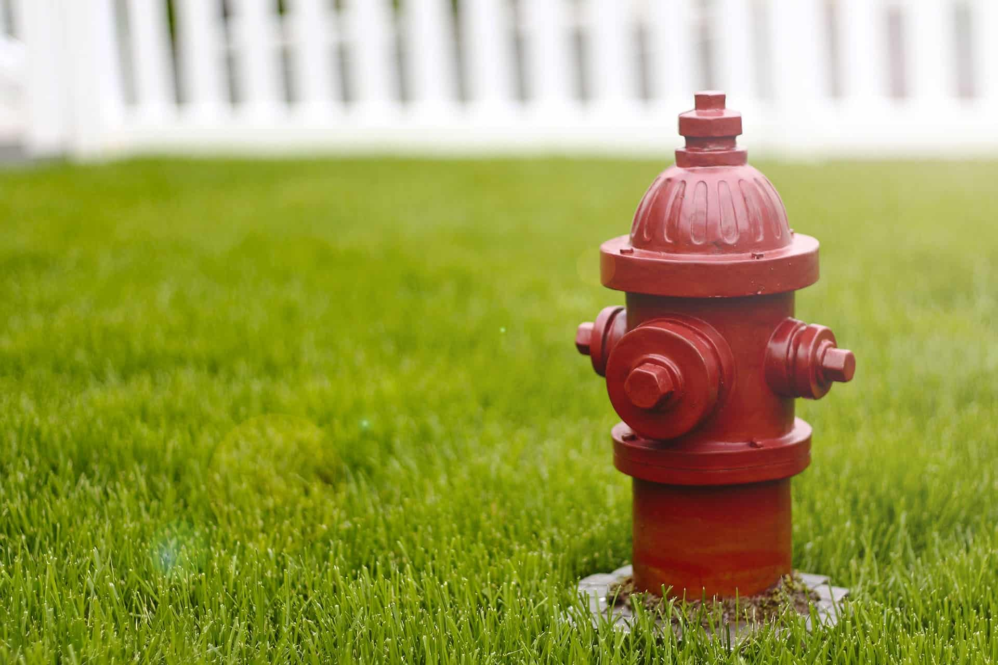
Equitable Fire Hydrant Placement
Johnathan Rhyne

Slide 2
Motivation
Building new housing incurs more costs than just the construction of the building itself
Safety of inhabitants is important
Can affect home insurance rates

Slide 3
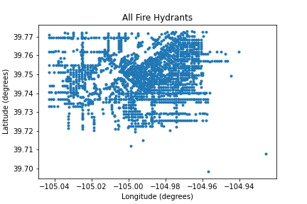
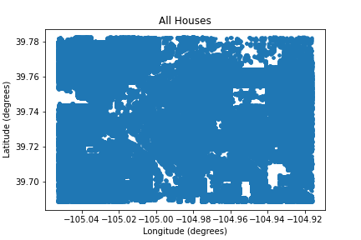
Limitations
A LOT of buildings in our data set
Hard to access official data
Sparse crowd sourced data outside Denver-Metro area

Slide 4
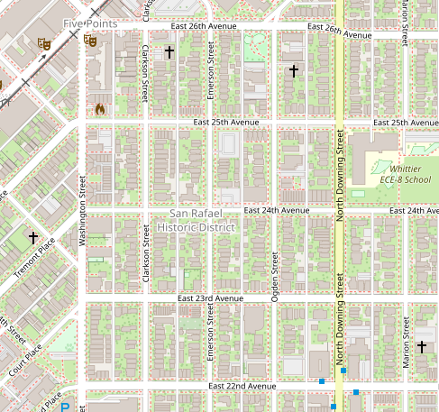
Region Selection Methods
Selecting varying size regions distributed throughout our data set
Could be refined based on other factors

Slide 5
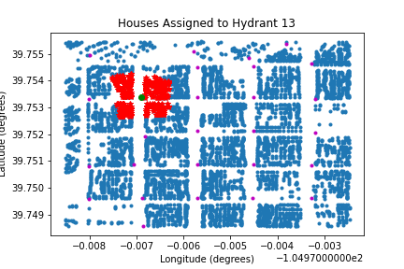
Current State
Assigning every house to its closest hydrant

Slide 6
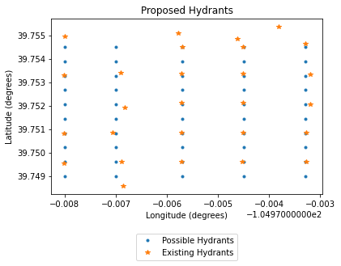
Methods
In each region, determine placement of hydrants to minimize the distance from each building to its hydrant.
Penalize creating new hydrants

Slide 7
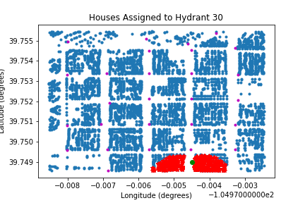
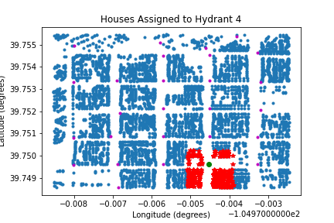
Proposed Placement
Very few differences in our testing

Slide 8
Analysis
No real difference between “ideal” and actual
Consider different penalization for adding new hydrants

Slide 9
Future work
Better data: Clear distinction for homes and businesses
Look at regions with clear disparities in socioeconomic status
Better measure of equitability: Treat higher density apartments as more expensive than homes due to more people
Consider fire risk

Slide 10
Citations
Denver Fire code
Overpass Turbo (Used for getting our data)
Insurance rate increases
Source Code

