Slide 1
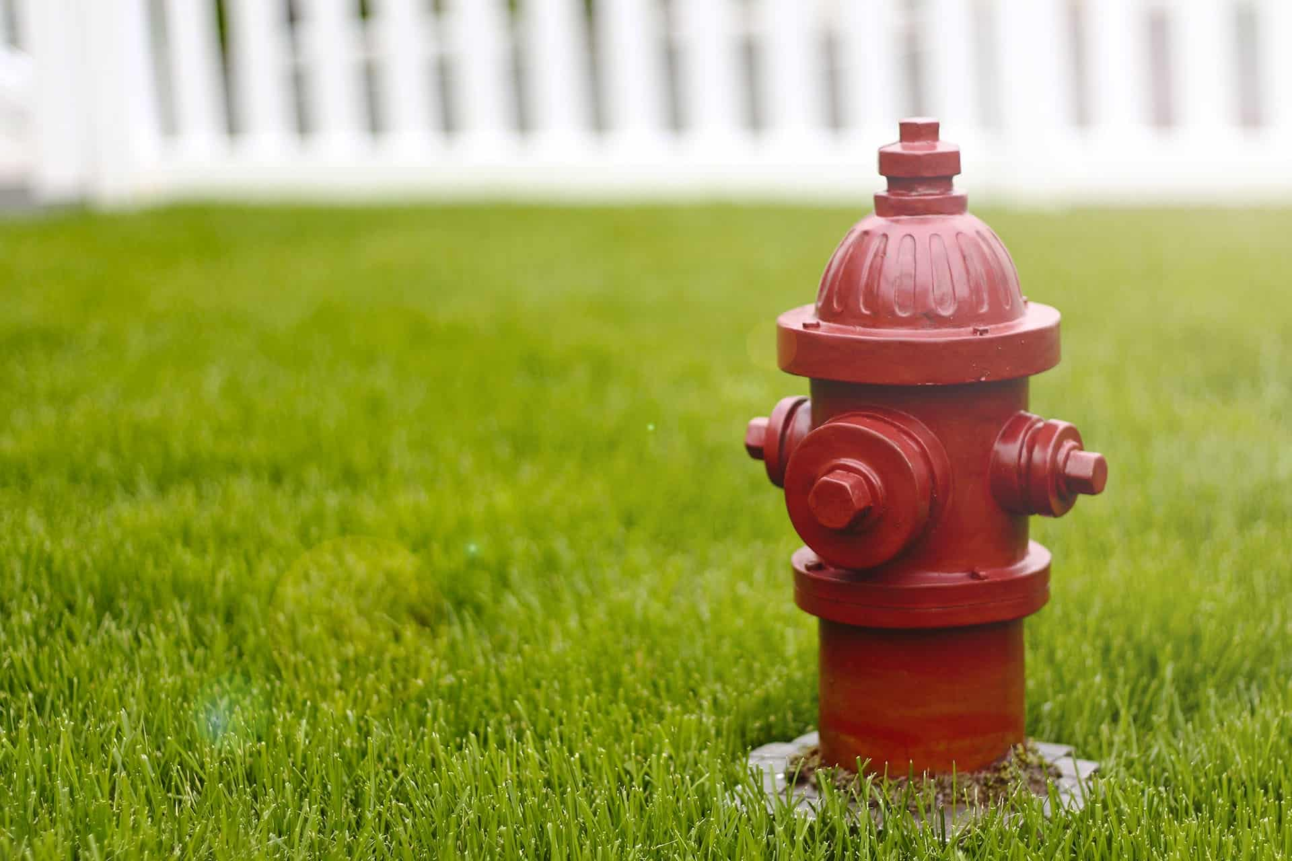
Equitable Fire Hydrant Placement
Johnathan Rhyne

Slide 2
Motivation
Building new housing incurs more costs than just the construction of the building itself
Safety of inhabitants is important
Can affect home insurance rates

Slide 3
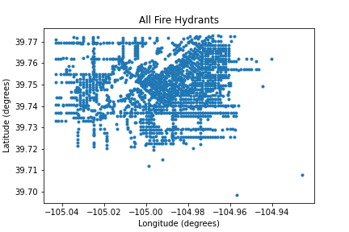
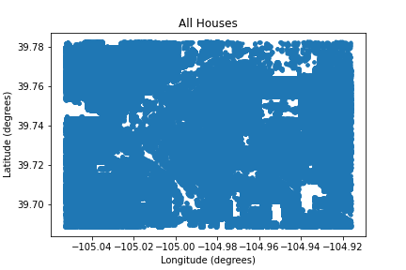
Limitations
A LOT of buildings in our data set
Hard to access official data
Sparse crowd sourced data outside Denver-Metro area

Slide 4
Design Decisions
Precompute all distances
Close proximity means euclidean distance is sufficient

Slide 5
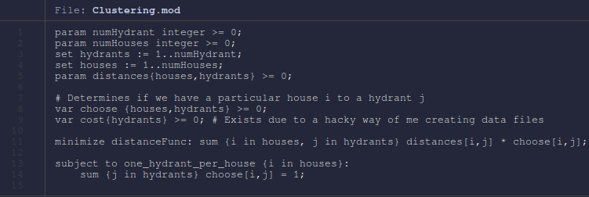
Clustering Program (LP with Integer Solution)

Slide 6
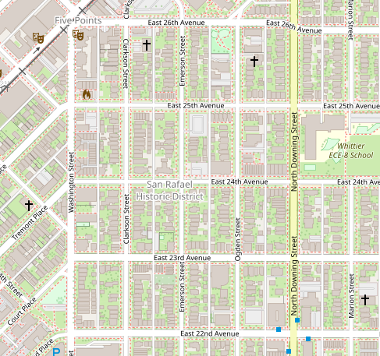
Region Selection Methods
Selecting varying size regions distributed throughout our data set
Could be refined based on other factors

Slide 7
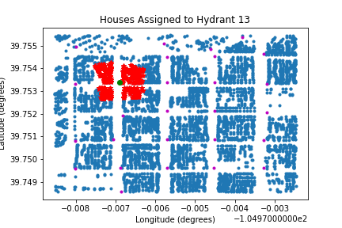
Current State
Assigning every house to its closest hydrant

Slide 8
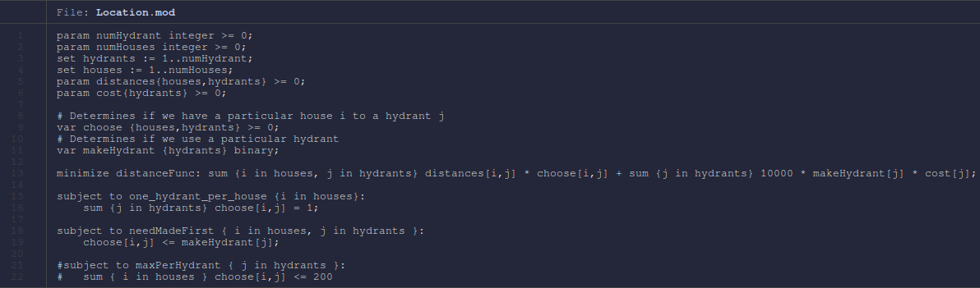
Facility Location Program

Slide 9
Variable Support

Slide 10
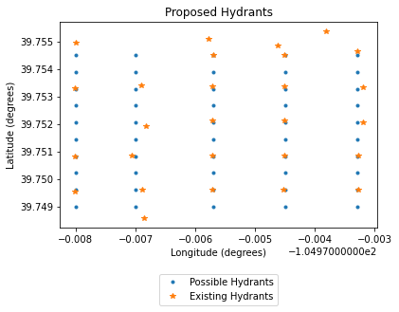
Methods
In each region, determine placement of hydrants to minimize the distance from each building to its hydrant.
Penalize creating new hydrants

Slide 11
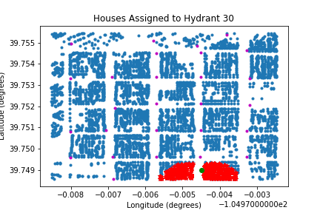
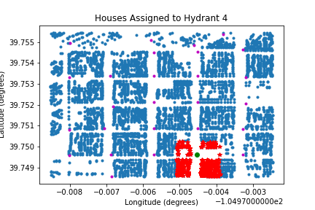
Proposed Placement
Very few differences in our testing

Slide 12
Analysis
No real difference between “ideal” and actual
Consider different penalization for adding new hydrants

Slide 13
Future work
Better data: Clear distinction for homes and businesses
Look at regions with clear disparities in socioeconomic status
Better measure of equitability: Treat higher density apartments as more expensive than homes due to more people
Consider fire risk

Slide 14
Citations
Denver Fire code
Overpass Turbo (Used for getting our data)
Insurance rate increases
Source Code

