Slide 1
Clustering Of Job Loss in Colorado due to COVID-19
Johnathan Rhyne
Notes:
Hello everyone!
My name is Johnathan Rhyne, and today I will be talking about detecting clusters of low income jobs lost throughout the state of Colorado.

Slide 2
Motivation
Job loss due to COVID-19 affected many houses in different ways especially lower income households.
Knowing potential regions that were affected more strongly can help incentivize more preparedness and potential expansions of social welfare programs.
Notes:
Our motivation for looking at this problem is that COVID-19s effects are still being felt by many of us, and knowing if any potential areas were hit harder than others can help provide insight into where more resources are needed to prevent and/or mitigate future issues in a similar vein.

Slide 3
Data
Job Loss: Urban Data Catalog
We are given the total numbers of jobs lost attributed to COVID-19 throughout the country at the county level, which we restrict to Colorado for our analysis.
Population: Colorado Environmental Public Health Tracking
Since the data set mentioned above does not provide populations of the counties, we grabbed estimates for the year of 2022 at the county level
Notes:
We used data from the Urban Data Catalog. The data set breaks down the estimated low income (<40k) jobs lost due to COVID19 broken down into 20 different types of jobs including agriculture, retail, etc. from all across the country at the county level, which we then restrict to only Colorado for ease of analysis.
Note to reader:
[However, one could do a very similar analysis for any other state or potentially between the states themselves.]
The methods that we use need to know what the total population of people that could become a case (lost low income job), however, since we could not find a reliable source of number of low income workers, we use the population of each county as a surrogate.
Note to the reader:
[This should not introduce issues as we only found clusters with really low p-values (of around .001 or lower).]

Slide 4
What does a "cluster" mean here?
In plain English, a collection of counties (potentially a single county) that has an "abnormal" number of jobs lost.
Notes:
We have mentioned the idea of a cluster already, so we should define what this means. In plain English for us, a cluster is some collection of counties (maybe even one) that is "unusual/abnormal" in some way. For us, "abnormal" means that we see more jobs lost than we would expect if everyone had equal chance of losing their job regardless of location.

Slide 5

Methods
Existence of Clustering
We used Moran's I to determine if we have evidence of clustering at all in CO.
With a p-value of around .001, we have evidence to suggest that there is clustering of jobs lost.
Notes:
Before we look at where clusters might exist, we first want to determine if we expect there to be any kind of clustering. We use one of our methods to determine this. We get a statistically significant value with means that many jobs lost in a county is an indicator that nearby counties will also tend to have more jobs lost. This means we expect there to be some kind of clustering, now to find them!

Slide 6
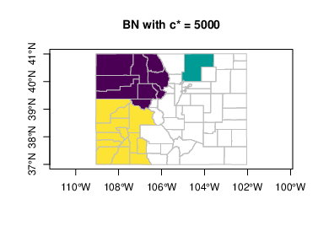
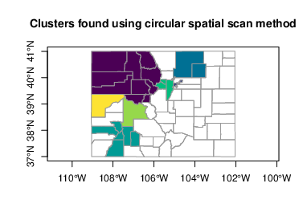
Methods
Location of Clusters​
We used two different methods to determine the locations of the most likely clusters
The two provided plots demonstrate that using different methods gives us similar results: There is likely clustering of jobs lost on the Western half of the state
All clusters have a p-value of .001 or less.
Notes:
We used two different schemes to determine regions that are likely to be clusters.
For sake of time, we won't discuss the specifics of these methods however the main difference is how we determine what collection of counties (denoted windows) we consider. The top left method adds counties to our window until we get a predetermined number of cases while the bottom left method does not have this restriction. So smaller clusters are easier to detect. An interesting commonality between the methods is that both detect a potential cluster in the North West portion of the state.
Note that we only considered clusters that had a p-value of less than .001 (ie the chance of this happening under the previous assumptions is .1% or less)
Note to the reader:
[The null hypothesis for these tests vary slightly and the Besag-Newell (top left) is only considering clusters with 5000 cases in them while the Spatial Scan method (bottom left) considers all possible windows and can detect varying sizes. All provided windows are colored to differentiate between them and even though we used an alpha=.01 value, we only saw very significant clusters. This significance could be due to our population surrogate, but I do not believe we would increase the chance by 2 orders of magnitude so we would likely stay significant for a choice of alpha=.1 which is usually a reasonable choice]

Slide 7

Conclusions/Policy Recommendations
We found evidence to suggest that there is clustering in the western half of the state
Policy recommendations
Increased social safety nets in affected regions
Investment in determining the potential cause of these job losses and any other contributing issues at play
Notes:
In conclusion, we have found evidence to suggest that there is likely a cluster of low-income jobs lost due to COVID19 in the western half of the state, which raises the question of what could be done. Well, before policy is truly being considered, future investment into determining potential causes (lack of access to health care, decreased demand for products, etc) and trying to address these issues.
Another step that could be done is to potentially expand social safety nets especially in the western half to provide support for potential future job loss events like COVID19.

Slide 8
Future Work/Constraints
We used the population of each county as a surrogate to the total number of low-income jobs.
So, we could extend this work by using this as our "population"
Our decision was done as I could not find a legitimate looking data set for number of low-income jobs in each county.
We are using two sources of estimated data, so these numbers are not going to be the exact values.
Since the conclusions we drew were with such low p-values, this should not be a worry, but is something to consider as potential points of
Notes:
We also have a few things to consider is that we used the population of each county as a surrogate for the number of low income jobs, which means that we are saying the number of low income jobs is proportional to the number of people living in a county, which is not an obviously unreasonable assumption to make, however this is still unlikely to be correct.
We are using two sources of data that are estimated, so we are expecting some sort of error in our methods, however to compensate for this, we used a small alpha value of .01. And in addition, we only notice clusters with a p-value of around .001 or lower, so we are fairly confident in our results.

