Slide 1
Evaluating Home Field Advantage
Presented by: JP Rinfret and Samuel Diaz

Slide 2
Executive Summary
Is there home field advantage?
Does the degree of home field advantage vary throughout the season?
Do west coast teams cover when playing on the east coast (NFL only)?
YES
(exc. baseball)
NO
NO

Slide 3
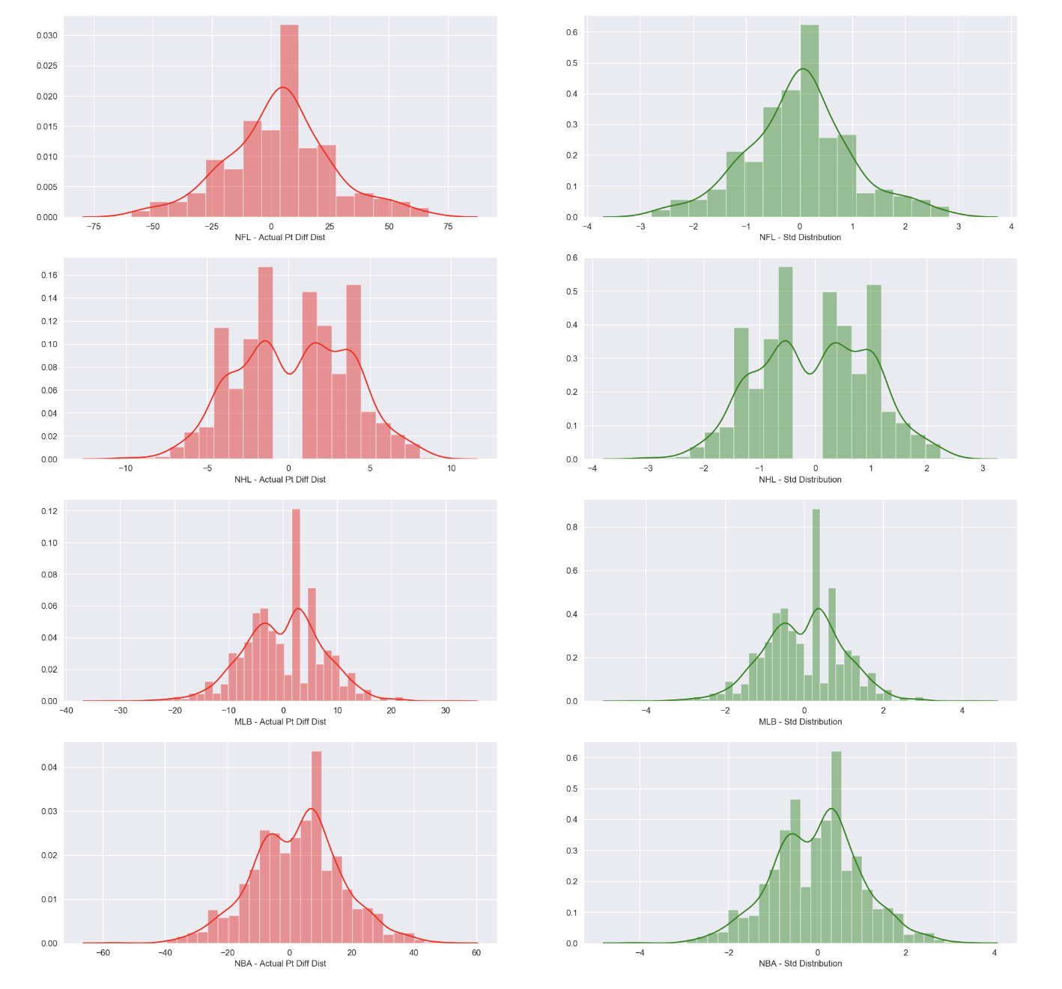
Home Team Point Differential (“the Differential”)
Differential = Home Team Score - Away Team Score
A positive average Differential implies home field advantage
We analyzed and plotted the actual sample means and standardized sample means of the Differential in order to form our hypotheses

Slide 4
First Question
Question 1: Is there a home field advantage in any of the four major sports?
H0: The average home point differential is not significantly different than zero.
H1: The average home point differential is significantly greater than zero, implying "home field advantage"

Slide 5
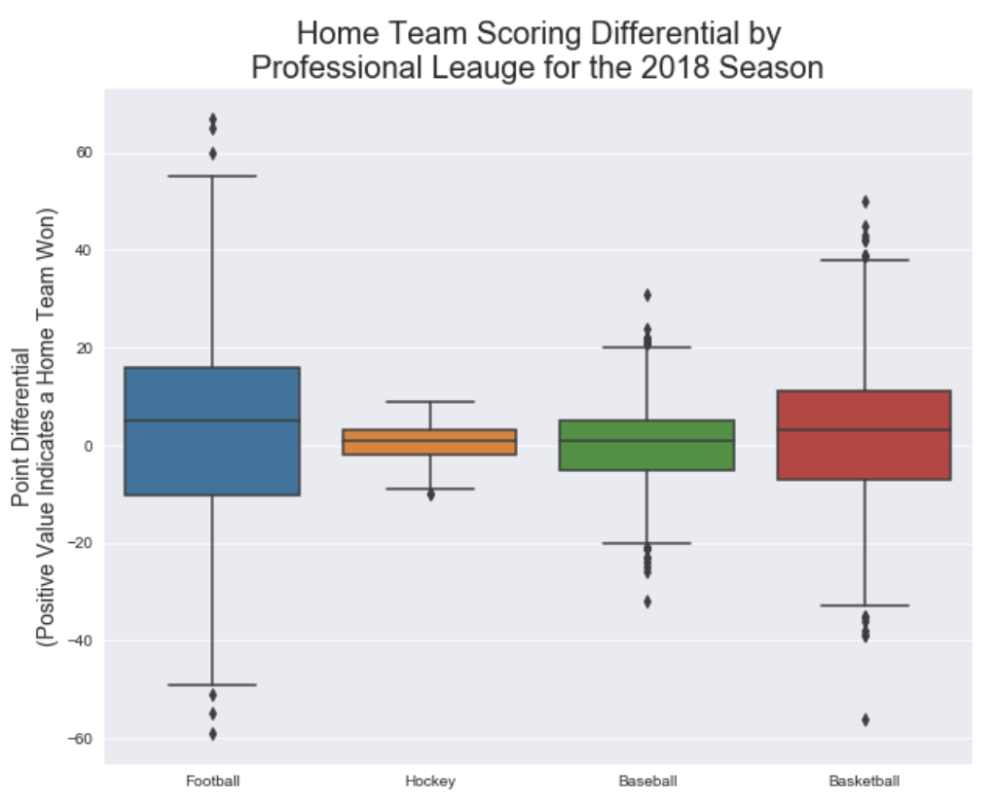
Visualizing the Differentials
Fig. 1 suggests that the average home team point differential is positive, indicating the potential for "home field advantage"

Slide 6
First Question Results
Sport | Sample Size | t-value | critical t-value | p-value (alpha = 0.05) | Result
Football | 256 | 2.519 | 1.651 | 0.01 | Reject Null
Hockey | 1,271 | 4.218 | 1.646 | 0.00002 | Reject Null
Baseball | 2,468 | 1.102 | 1.645 | 0.27 | Accept Null
Basketball | 1,868 | 5.822 | 1.646 | 0.00000007 | Reject Null

Slide 7
Second Question
Question 2: Is there an advantage to playing at home earlier in the season as compared to later in the season?
H0: There is no significant difference between the average home team’s point differential of late season games and the
average home team’s point differential of early season games
H1: The average home team’s point differential of late season games is significantly different than the average home team’s point differential of early season games

Slide 8
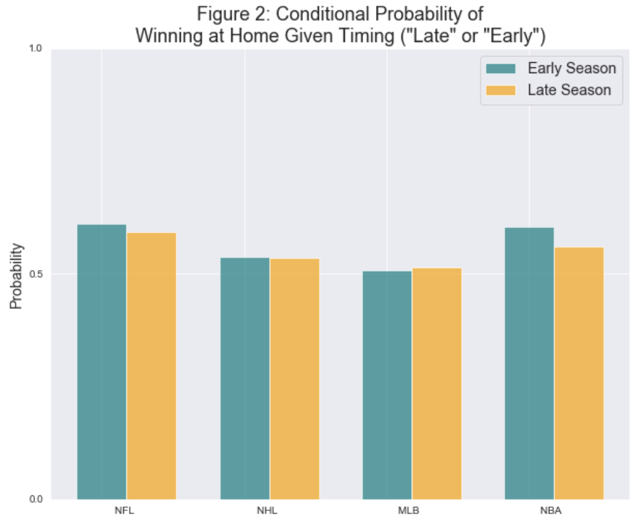
Visualizing the Conditional Probabilities
Split each season ( “Early” and “Late”)
Calculated point differential between Home Team and Away Team, and ran t-tests
Calculated conditional probabilities of Home Team wins given it was “Late” OR “Early”
Results of Conditional Probabilities:
NFL:
Probability of winning at home early in the season: 61.16%
Probability of winning at home late in the season: 59.26%
NHL:
Probability of winning at home early in the season: 53.68%
Probability of winning at home late in the season: 53.64%
MLB:
Probability of winning at home early in the season: 50.74%
Probability of winning at home late in the season: 51.41%
NBA:
Probability of winning at home early in the season: 60.36%
Probability of winning at home late in the season: 56.09%

Slide 9
Results
Sport | Effect Size | t-value | critical t-value | p-value (alpha = 0.05) | Result
Football | 0.001 | 0.013 | 1.969 | 0.98 | Accept Null
Baseball | -0.015 | 0.269 | 1.962 | 0.79 | Accept Null
Basketball | 0.009 | 0.222 | 1.961 | 0.82 | Accept Null
Basketball | -0.055 | 0.923 | 1.962 | 0.356 | Accept Null

Slide 10
Third Question
Question 3: In the NFL, do west coast teams cover the spread when traveling to the east coast?
H0: There is no statistical difference between the average away team score and the average home team score when west coast teams travel to the east coast (i.e., the away team is from the west coast and the home team is from the east coast)
H1: The average home team score is greater than the average away team score (accounting for the gambling spread) when west coast teams travel to the east coast
To answer this question, we ran a two-sample one-sided t-test on the following alternative hypothesis

Slide 11
Third Question Results
Differential Delta | Sample Size | Effect Size | t-value | critical t-value | p-value (alpha = 0.05) | Result
+11.5 (relative to East coast team) | 6.0 | 1.183 | 2.049 | 1.812 | 0.03 | Reject Null

Slide 12
Final Conclusion
“...good teams win, but great teams cover.” - unknown
“...life is too short to bet the under.” - ancient chinese proverb

Slide 13
APPENDIX
Other useful information

Slide 14








WORKFLOW :
1) Brainstorm
2) Collecting Data / Cleaning Data
3) Organize Data
4) Generated our Hypotheses
5) Data Analysis
6) Calculating Statistical values
7) Data Visualization
8) Rejecting or failing to reject our Hypotheses
8) Conclusion

Slide 15




DATA COLLECTING AND CLEANING
We collected data for the four major sports leagues (Football, Hockey, Baseball and Basketball)
We pulled data from using api calls from:
https://sportsdata.io/ https://rapidapi.com/
Grabbing data for: Grabbing data for:
NFL , NHL , MLB NBA
We cleaned our data and made tables
using Python and MySQL

