Slide 1


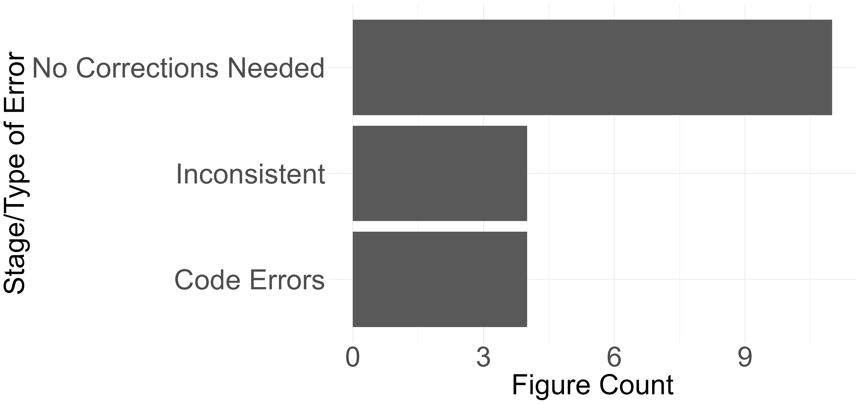
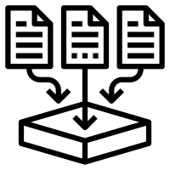
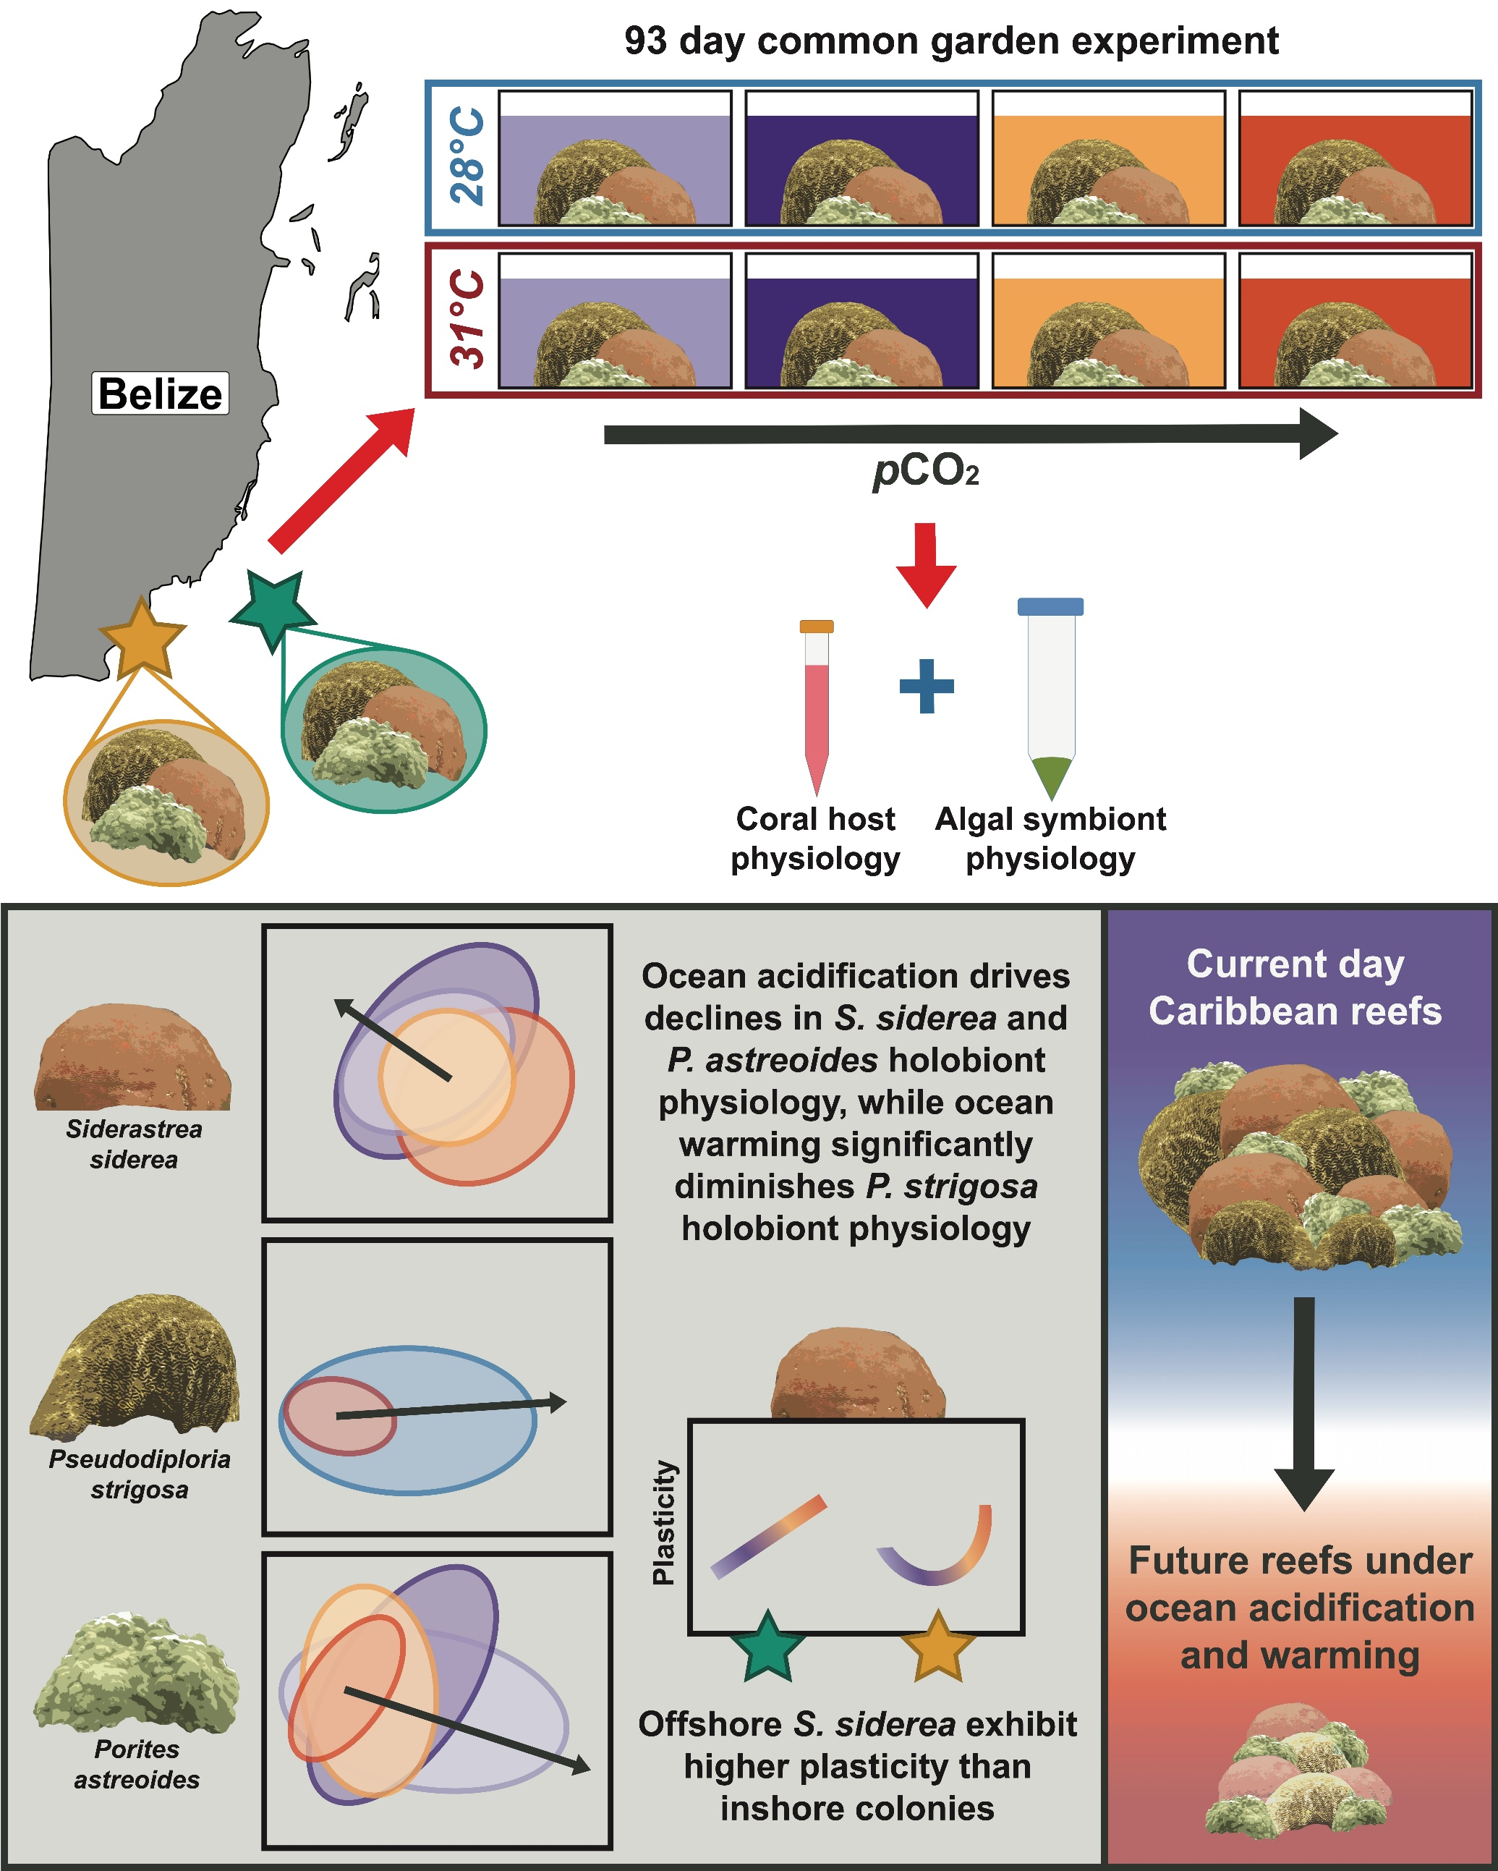

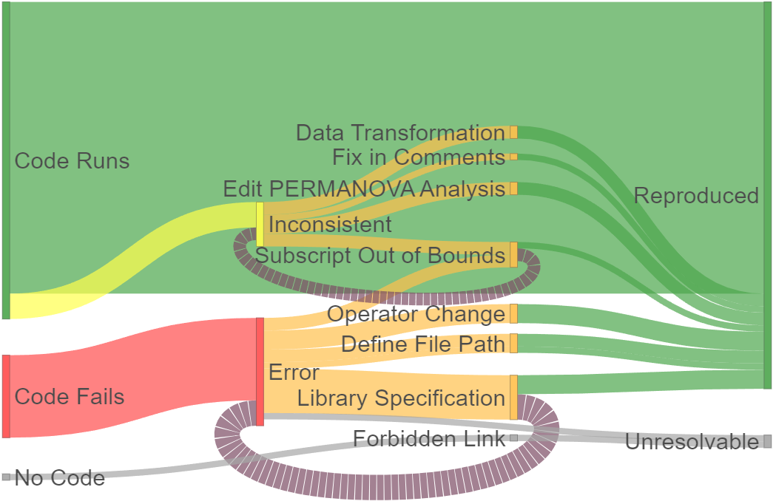

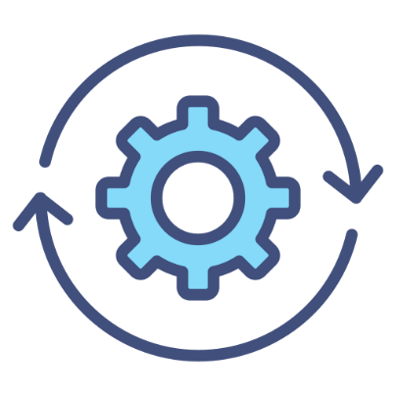


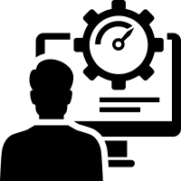


Teaching Reproducibility in Undergraduate Biostatistics:
Insights from Coral Reef Community Structure Analysis
Jonah Prober¹, Kara McCormack, PhD¹
¹Department of Biostatistics, University of North Carolina at Chapel Hill
GILLINGS SCHOOL OF PUBLIC HEALTH
Introduction
Results (Reproducibility)
Results (Workflow)
Objective:
To reproduce the figures and results of a published coral reef community structure analysis [1]
To use the reproducibility challenges encountered to inform the design of lab exercises for an early biostatistics course, guiding students in creating and replicating reproducible research
1. Figure Generation Overview
3. Reproducible Workflow
Figures generated with minimal discrepancy without any code edits
Data Collection/Sourcing
Coral reef community structure analysis [1]
Reproducibility Crisis [2]
Studies with available data access:
Data in machine readable format:
Data made available by request:
Manuscript with code available:
Studies could not be reproduced:
Generated figure is different than in the study
Get Package Versions
Set Up Environment
Version Control (Git)
67%
5%
Code syntax edits allowed the figure to generate properly
Include Randomization Seeds
Literate Programming with Plain Language
(Quarto, Jupyter, etc)
Set Paths to Repository
5%
* All categories are mutually exclusive
3%
No Subscripts (Row/Column Names)
Creation of Supplementary Data
12%
1. Displays the counts of figures by the necessary changes to reproduce them (upon cold run of code)
* Generalizability extends to meta-analyses in clinical psychology interventions
2. Reproducibility Challenges by Code Chunk
Generate Tables
Generate Figures
Unaltered
Mistakes Fixes
Result
Reproducibility in the Classroom
2 figures generated with inverted y-axes
2 PERMANOVA Analyses lacked individual terms
Create Public Facing Repository (GitHub) Containing All*
Create ReadMe file with individual file descriptions
Technology for Reproducibility [3]
Reprohackathons [4]
Teaching
AND
Practicing Reproducibility
Literate Programming | Version Control | Web Hosting
Quarto: Unifies plain language and code | Git: Tracks changes to code | GitHub: Hosts code from git
Introduce
students to reproducibility
and its growing
significance
Teach
version control, environments, and workflow technology
Students
prepare and present reproducible data “reanalysis"
Link Repository in Paper for Access
* In cases where data cannot be shared due for privacy concerns, a synthetic dataset can be manufactured to contain similar properties to the raw data
2 Unresolvable chunks generated data that were contained in repository
3. Workflow for reproducible research as used to create lab exercises
Methods
Conclusions and Next Steps
Reproducing Coral Study
Lab Assignment
2. Provides an overview of the errors encountered and fixes made in the reproducibility review
Bove’s coral reef community structure analysis is highly reproducible, especially considering the lack of reproducibility in similar studies
Studies like Bove’s which link access to data and code repositories have greater accountability, greater reproducibility
Next step: Further review of linked repositories to verify this observation
Lab exercises will be further adapted for BIOS 645, an early course in biostatistics which focuses on R programming
Next step: Beta testing lab with student volunteers
Administer student surveys to assess achievement of reproducibility learning objectives
Cloned GitHub Repository of [1] to local environment
Created project in RStudio (Quarto) and repository in GitHub
Journal
Designed Quarto environment as journal for reproducibility challenges and workflow fixes
Discussion
Modified manuscript of [1] to serve as a reproducibility journal
Downloaded and loaded packages
Dataset
Used UCI Machine Learning Repository dataset of simulated mushroom physiology [5]
Most figures and graphs successfully generated on another system (Fig 1). Most code errors faced likely due to a new environment, but a few fixes required more depth in reprogramming.
All figures eventually reproduced (Fig 2), except two supplementary datasets. As these datasets were included in the repository, the paper was fully reproducible, though creating these datasets natively would improve reproducibility.
Lab exercises were developed to mirror the process successes in the reproduced study and prevent the errors faced (Fig 3)
Ran Original Manuscript Code
Documented all errors and code chunks where figures or tables did not match
Regression Model
Employed logistic regression model to predict poisonous and edible mushrooms
Resolved errors and figure inconsistencies until fully reproduced
Tracked fixes and success
Exercises
Created lab exercises using reproducibility challenges from Coral Study [1] and workflow
Developed reproducible workflow based on the successes of the study and the challenges faced in reproducibility review
Goals
Internalize workflow and improve reproducibility in all future work
Literature cited
Bove CB, Davies SW, Ries JB, et al. Global change differentially modulates Caribbean coral physiology. PLOS ONE. 2022;17(9):e0273897. doi:10.1371/journal.pone.0273897
López-Nicolás R, Lakens D, López-López JA, et al. Reproducibility of Published Meta-Analyses on Clinical-Psychological Interventions. Advances in Methods and Practices in Psychological Science. 2024;7(1):25152459231202929. doi:10.1177/25152459231202929
Dogucu M, and Çetinkaya-Rundel M. Tools and Recommendations for Reproducible Teaching. Journal of Statistics and Data Science Education. 2022;30(3):251-260. doi:10.1080/26939169.2022.2138645
Cokelaer T, Cohen-Boulakia S, Lemoine F. Reprohackathons: promoting reproducibility in bioinformatics through training. Bioinformatics. 2023;39(Supplement_1):i11-i20. doi:10.1093/bioinformatics/btad227
Wagner D, Heider D, Hattab G. Mushroom data creation, curation, and simulation to support classification tasks. Sci Rep. 2021;11(1):8134. doi:10.1038/s41598-021-87602-3
Repositories
Reproducing Paper Lab Exercises
Further information
Please address questions or comments to Jonah Prober at jpro@unc.edu.
Funding
This work was supported by the UNC Biostatistics department as part of the Biostatistics Undergraduate Statistics Internship

