Slide 1

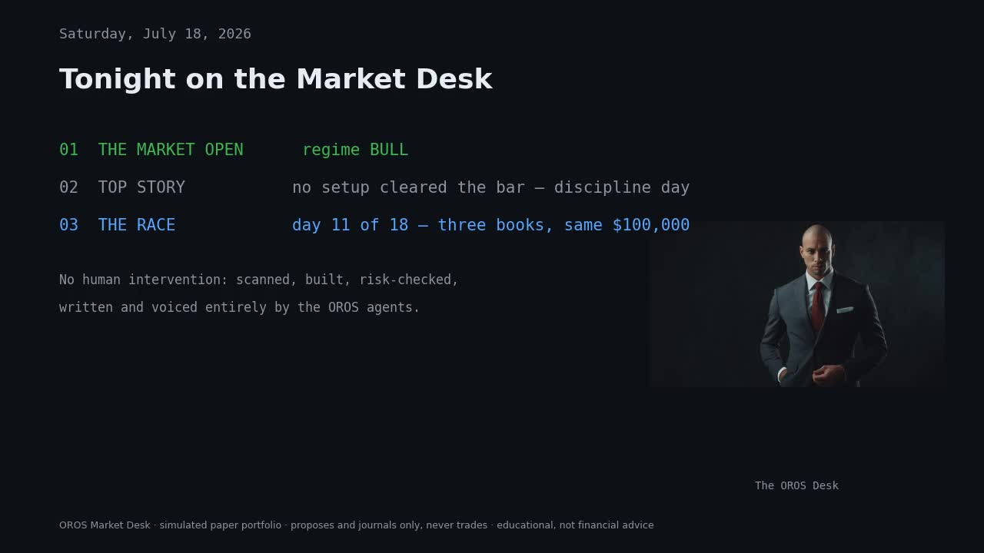
THIS MORNING'S EPISODE · AIRED 9:35 ET
“This episode aired at 9:35 this morning. No human was awake.”
The Desk That Runs Itself — an autonomous multi-agent GenAI system that publishes its own record, win or lose
JP Romero · Fordham MS in Artificial Intelligence · AIGB-7299 Capstone · July 29, 2026
Notes:
SAY THIS: Every position, every chart, and every word of that broadcast was produced by software with no human intervention. Tonight we answer the question the channel exists to ask: can a system that reflects on its own record hold its own?
- Open with 20 seconds of this morning's episode playing muted behind the title (unlisted YouTube link ready as demo insurance).
- JPM-style quote-led opening: scale and inevitability first, then make it yours.
- Sources: JPM (quote-led opening), Duarte/Design Thinking (audience-first hook).

Slide 2
02 · EXECUTIVE SUMMARY
Can an autonomous desk beat its own frozen past self — and prove it?
The question — can an autonomous agentic system beat its own frozen past self and the index, with zero human intervention, and prove it append-only?
The system — OROS: an orchestrator over specialist agents that scans the OROS 500 nightly, builds a paper portfolio, risk-checks itself, and broadcasts the result.
The proof — three simulated $100,000 books racing since July 6, journaled append-only, published daily on YouTube.
The value — verifiable transparency in a market of black boxes.
LIVE BOOK
[REFRESH 7/28]
started at $100,000 · July 6
FROZEN BOOK
[REFRESH 7/28]
started at $100,000 · July 6
SPY BENCHMARK
[REFRESH 7/28]
started at $100,000 · July 6
Standings final at the July 28 close — the finale episode airs the morning of this presentation.
OROS · The Desk That Runs Itself · Fordham MS-AI Capstone · 2
Notes:
SAY THIS: Answer first (Minto): OROS is an orchestrator over specialist agents that scans the OROS 500 nightly, builds a paper portfolio, risk-checks itself, and broadcasts the result — and it proves every claim with an append-only journal.
- The question: beat the frozen past self and the index with zero human intervention, provably.
- The proof mechanism: three simulated $100,000 books racing since July 6, journaled append-only, published daily on YouTube.
- The value: verifiable transparency in a market of black boxes.
- Sources: DT p.15 (Minto answer-first), JPM (metric hero tiles). Final standings dropped in on 7/28.

Slide 3
03 · BUSINESS PROBLEM & MOTIVATION
Agentic hype is peaking; verified track records are almost nowhere
$644B
GenAI spend in 2025, up 76% year over year (Gartner, via Ettl)
[REFRESH 7/28: journaled proposal JSON
+ git commit timestamp]
3 in 4 vs 5%
leaders report positive returns (Wharton) — yet only 5% of pilots generate significant value (MIT). Someone is wrong, or measurement is broken.
< 30%
of CEOs satisfied with AI returns; GenAI in the Trough of Disillusionment, Agentic AI at the Peak of Inflated Expectations (Gartner 2025)
Retail investors live the same gap: AI stock tools everywhere — verified track records almost nowhere.
OUR PROBLEM STATEMENT
Build an agentic system whose every claim is checkable — journaled before outcomes are known, never restated.
OROS · The Desk That Runs Itself · Fordham MS-AI Capstone · 3
Notes:
SAY THIS: We built an agentic system at the exact moment Gartner says agentic hype peaks. That is why we made honesty the architecture, not a disclaimer.
- Stack the stats so the tension tells itself: $644B spend vs the Wharton/MIT contradiction — someone is wrong, or measurement is broken.
- Retail investors face the same gap: AI stock tools everywhere, verified track records almost nowhere.
- Land the sharp problem statement (PROG: most projects fail because the problem was not specific enough).
- Sources: Gartner Hype Cycle 2025, MIT State of AI 2025, Wharton GBK 2025, Ettl p.2, Progress review p.3.

Slide 4
04 · STAKEHOLDERS & PERSONAS
Four stakeholders, one shared demand: a record they can trust
THE RETAIL LEARNER
THE STUDENT ANALYST
Self-directed investor watching the Market Desk
JP — operator and auditor, never an intervener
Needs: to learn stage analysis from a desk that shows its work — plainly, daily, with sources on air.
Needs: a harness he can trust while asleep — journals, traces, and rules that fail closed.
THE ADVISOR & EVALUATOR
THE SKEPTIC
Fordham faculty · industry advisor (Deloitte)
Compliance and regulation
Needs: defensible evaluation — evidence over enthusiasm, target vs actual, honest limits.
Needs: educational-only positioning, NIST-aware risk language, and a published, auditable record.
OROS · The Desk That Runs Itself · Fordham MS-AI Capstone · 4
Notes:
SAY THIS: Build the stakeholder map progressively (July 1 session style) — reveal learner, operator, evaluator, then the skeptic.
- The self-directed retail learner watches the Market Desk and learns stage analysis from a desk that shows its work.
- The student analyst (JP) is operator and auditor — never an intervener.
- The advisor and evaluator (Fordham faculty; industry advisor at Deloitte) grade evidence, not enthusiasm.
- The skeptic (compliance/regulation) needs educational-only positioning and NIST-aware vocabulary.
- Sources: DT pp.7-9 (progressive map), NIST (the skeptic's vocabulary).

Slide 5
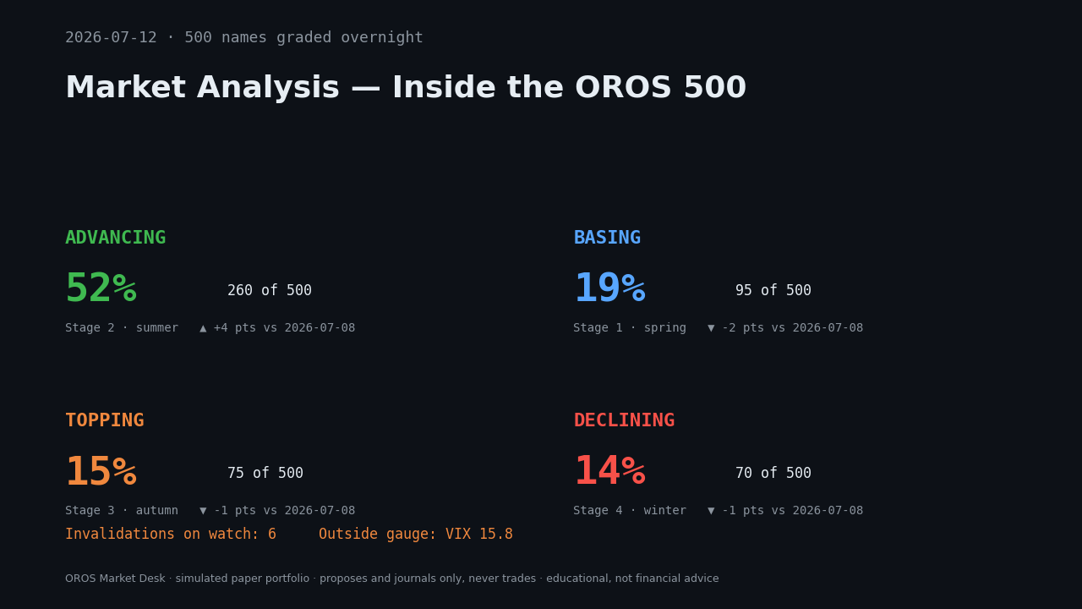
05 · SOLUTION OVERVIEW
The JPMorgan orchestrator pattern, shipped at $100k paper scale
DataAgent SEC XBRL, prices, macro, sentiment
RegimeAgent market weather: risk-on / risk-off
RouterAgent RAG over five author strategies
MemoryAgent reads the journaled record
ConstructionAgent builds the $100k paper book
RiskAgent independent veto — fails closed
OROS 500 stage seasons — real nightly output: every ticker classified into a Weinstein stage before the book is built.
Same pattern JPM ships in production — Coach routes to 24+ specialist agents; OROS routes to its own, with SEC-sourced numbers.
Nobody else publishes a negative record on purpose — human desks have no live book; AI dashboards have no broadcast.
+ 18 industry specialists · Chartist · Sentiment Analyst
OROS · The Desk That Runs Itself · Fordham MS-AI Capstone · 5
Notes:
SAY THIS: The harder problem was never the model. It was the harness: context engineering, tool design, observability, trust controls. That is where the semester went.
- JPM parallel, explicit: Coach routes to 24+ specialized agents with source citations; OROS routes to its specialists with SEC-sourced numbers — same pattern, $100k paper scale.
- Build journey (Laredo arc): prompting → RAG → tool use → multi-agent orchestration — OROS walked every step.
- Competitive positioning: human desks have no live book; AI dashboards have no broadcast; nobody else publishes a negative record on purpose.
- Sources: JPM (Coach architecture), DT p.2 (Laredo arc, harness quote), PwC p.1 (capability-table format).

Slide 6
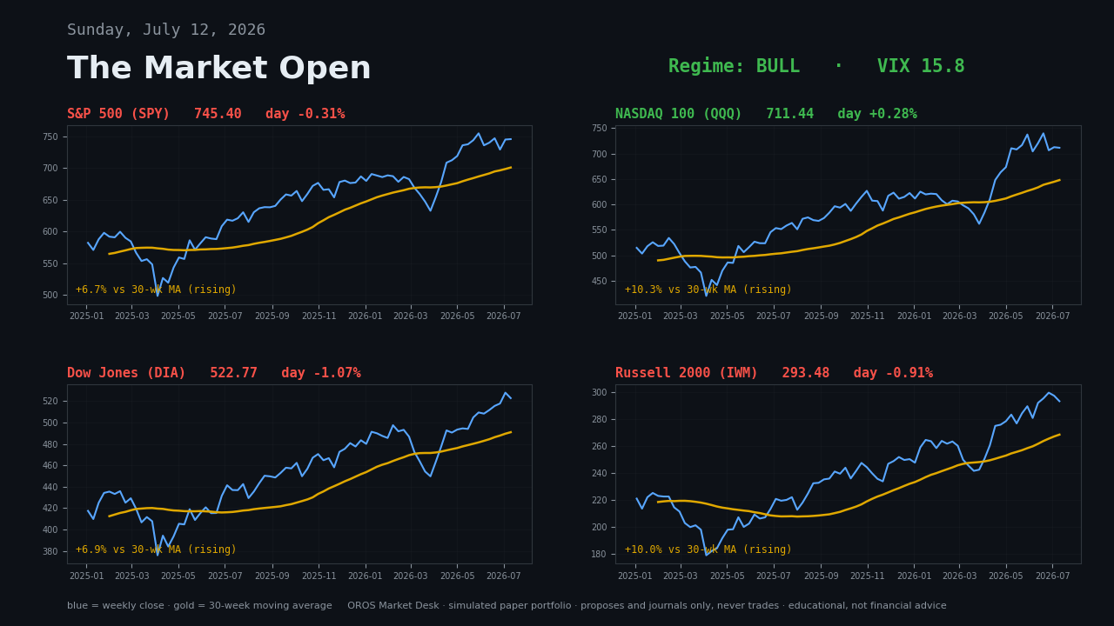
06 · DATA SOURCES
Every number on air traces back to a primary source
SEC EDGAR XBRL for structured financials — not scraped PDFs.
FRED for macro; daily market prices; news sentiment per ticker.
10-K text chunked section-aware into per-ticker vector stores (RAG).
Everything cached, rate-limited, and cited — the video credits its sources on air, every episode.
PROVENANCE STANDARD
Every fact traceable, every output carries its source — the PwC Deal Intelligence bar, applied to a market desk.
Market Open scene — four index charts drawn from the same cached, rate-limited price data the agents trade on.
OROS · The Desk That Runs Itself · Fordham MS-AI Capstone · 6
Notes:
SAY THIS: PwC's Deal Intelligence brief set our provenance bar — every fact traceable, every output carrying its source. The video credits its sources on air, every episode.
- SEC EDGAR XBRL for structured financials — not scraped PDFs (accuracy + confabulation defense).
- FRED for macro; daily market prices; per-ticker news sentiment.
- 10-K text chunked section-aware into per-ticker vector stores (RAG).
- Everything cached, rate-limited, and cited.
- Sources: PwC (traceability), Ettl (data-slide discipline).

Slide 7
07 · MVP WALKTHROUGH
One autonomous day: scan, decide, broadcast — for about a dollar
09:35 ET
GitHub Actions wakes: refresh prices, rank liquidity, scan the OROS 500 into Weinstein stages.
09:36
Agents build the book; the risk trio — 6% wallet cap, graduated throttle — sizes it; the journal commits, append-only.
[EMBED 7/29 morning episode clip — 90s]
09:37
Report PDF renders; the three-voice newscast generates itself: charts, scripts, ElevenLabs voices, chapters, captions.
Top Story · the trade plan taught plainly · the Race from the sports desk
09:38
Publishes to YouTube; the morning email goes out. No human was in the loop — or awake.
Demo insurance: July 28 episode downloaded as MP4 the night before — the deck is the story, the video is the proof.
OROS · The Desk That Runs Itself · Fordham MS-AI Capstone · 7
Notes:
SAY THIS: What you just watched cost about a dollar a day to produce and no minutes of human time.
- Walk one autonomous day end-to-end — this is 40% of the grade: works end-to-end for the core use case.
- 9:35 ET GitHub Actions: refresh prices, rank liquidity, scan the OROS 500 into Weinstein stages.
- Agents build the book; risk trio (6% wallet cap, graduated throttle) sizes it; journal commits.
- PDF renders; the three-voice Market Desk newscast generates itself (charts, scripts, ElevenLabs voices, chapters, captions); publishes to YouTube; email goes out.
- Then play 60-90 seconds of the real episode: Top Story with the trade plan taught plainly, the Race from the sports desk.
- Demo insurance: yesterday's episode downloaded as MP4; never depend on venue network.
- Sources: JPM (LLM Suite walkthrough style), Ettl pp.19-29.

Slide 8
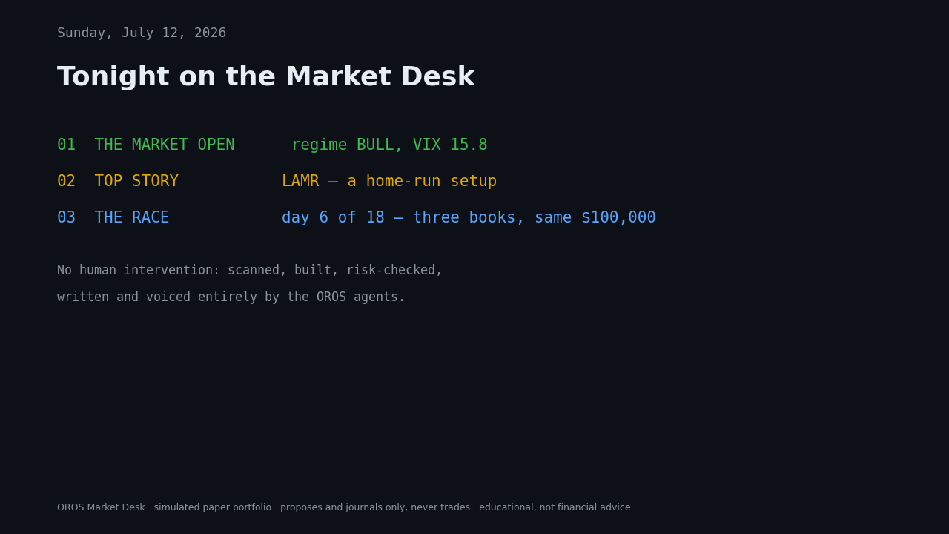
08 · THE JOURNEY
The scoreboard came back negative — and the system cut its own size
1 · BUILD THE ENGINE
2 · MAKE IT HONEST
3 · GIVE IT A VOICE
Weinstein-only scanner rebuilt into a book-agnostic strategy registry — RouterAgent now weighs five author mandates.
The forward scoreboard came back negative. The system throttled itself to quarter-size positions. We shipped that.
Local Mac runs became cloud-autonomous; text cards became a three-voice newscast with an anchor.
[REFRESH 7/28: expectancy scoreboard —
before / after throttle]
“JPM's pilot went 50% → 90% and scaled. Ours found a negative record and de-risked itself. Same discipline, opposite direction — that is the harness working.”
The broadcast rundown — built because JP watched the episodes as a viewer would.
OROS · The Desk That Runs Itself · Fordham MS-AI Capstone · 8
Notes:
SAY THIS: JPMorgan's pilot went 50 to 90 percent and scaled. Ours discovered its record was negative and de-risked itself. Same discipline, opposite direction — and that is the point of the harness.
- Started Weinstein-only; rebuilt as a book-agnostic strategy registry when one framework proved a bottleneck (RouterAgent now weighs five author mandates).
- The self-reflection moment: the forward scoreboard came back NEGATIVE — the system cut its own position sizes to quarter size. We shipped that instead of hiding it.
- From local Mac runs to fully cloud-autonomous with emailed PDF and auto-published video.
- From text cards to a three-voice newscast because JP watched the episodes as a viewer would.
- Git history is the receipts.
- Sources: JPM (evolution arc), PROG p.5 (what surprised you), DT (iteration loop).

Slide 9
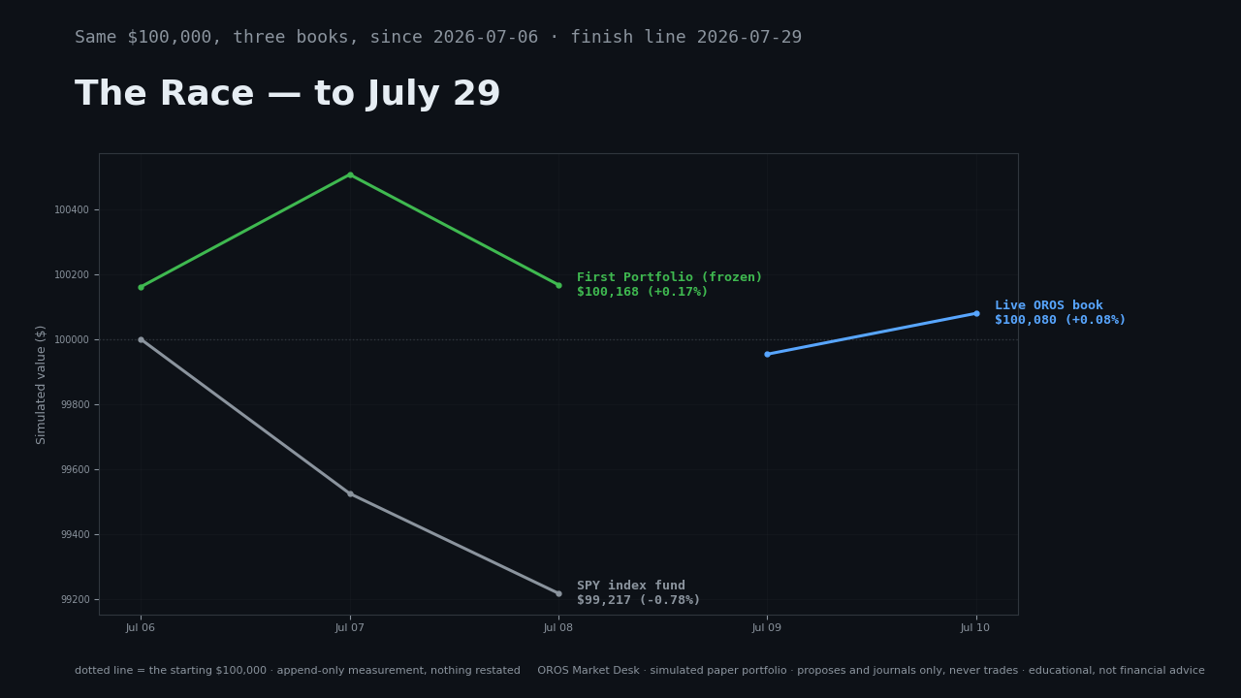
09 · BUSINESS IMPACT & VALUE
Eighteen trading days is a race, not a track record — here are the standings
FROZEN BOOK
[REFRESH 7/28]
LIVE BOOK
[REFRESH 7/28]
SPY (same-dollar)
[REFRESH 7/28]
Forward expectancy / strategy
[REFRESH 7/28]
Graded positions · stop exits
[REFRESH 7/28]
COST RIBBON ~$1/day in API + voice vs a human production desk.
The Race — frozen book vs live book vs SPY, drawn nightly from the append-only journal. Final render 7/28.
The value: a verifiable-transparency pattern any firm could adopt — the IBM CEO Study's “AI-agent flywheel”; AI-first adopters report +17% revenue growth.
HONEST CAVEAT 18 trading days is a race, not a track record.
OROS · The Desk That Runs Itself · Fordham MS-AI Capstone · 9
Notes:
SAY THIS: Be precise about what kind of value this is. The standings are the headline; the honest caveat sits on the same slide.
- Race standings as of July 28 close: frozen vs live vs SPY — final numbers dropped in the night before.
- Forward expectancy by strategy, graded positions count, stop-exit statistics.
- Cost ribbon: API + voice cost per episode vs a human production desk.
- Value proposition: a verifiable-transparency pattern any firm could adopt — IBM CEO Study calls the play an AI-agent flywheel; AI-first adopters report +17% revenue growth.
- Sources: CDI (results ribbon), Ettl (target-vs-actual), IBM CEO Study (+17%, flywheel), VAULT (defensible evaluation).

Slide 10
10 · VALIDATION — THE HUMAN BASELINE
JP raced his own system — every shortcut he took underperformed
The control experiment: replicate the nightly scan by hand in a real Chase account. 500 charts × 5 min each = 40+ hrs/week. OROS: one cloud run, ~$1.
Followed the system → it worked: TSLA exited +2.2% on its flag; HOOD sold into Stage 3 strength; AVGO invalidation cut leverage 2.15x → 1.3x.
Freelanced → it did not: TSM and TSEM picked outside the gates — both negative; TSEM lacks the 30-week history OROS requires before grading a name.
The legacy lesson: DY, held without stop discipline: [REFRESH 7/28]. OROS caps planned loss at ~1% of book ($225) by construction.
Book totals over the race window: human vs frozen OROS vs SPY [REFRESH 7/28] — the direction, not the decimals, is the finding.
[REFRESH 7/28: Chase positions
screenshot (anonymized)]
NVDA [REFRESH 7/28]
The one discretionary win — its stop now ratcheted above cost by the system's rule. A profit no afternoon panic can take back.
OROS · The Desk That Runs Itself · Fordham MS-AI Capstone · 10
Notes:
SAY THIS: I tested OROS by becoming its competition. Scanning five hundred charts by hand is not hard, it is impossible to sustain. Every position the process touched improved. Every shortcut I took underperformed. The human's edge is operating the system, not racing it.
- The control experiment: manually replicate the nightly scan in a real Chase Self-Directed account. 500 names at 5 min/weekly chart is 40+ hours a week; OROS does it in one cloud run for about a dollar.
- Where the human followed the system it worked: TSLA exited +2.2% on its flag; HOOD sold into Stage 3 strength; AVGO invalidation cut leverage 2.15x to 1.3x.
- Where the human freelanced it did not: TSM and TSEM picked outside the gates, both negative; TSEM lacks the 30-week history OROS requires before it will even grade a name.
- The legacy position DY, held without stop discipline, is the whole story — OROS caps planned loss per trade at ~1% of the account ($225 on this book) by construction.
- Windows differ; the direction, not the decimals, is the finding.
- Sources: PROG (what surprised you), JPM (a person mastering AI), VAULT (comparative evaluation), syllabus (user-test validation).

Slide 11

11 · LIMITATIONS & RISKS
Agents propose, rules dispose — and the limits are named out loud
Simulated paper trading only — no execution, slippage, or liquidity impact modeled.
LLMs are predictors, not deciders (CDI p.4) — every trade decision runs through deterministic gates. Agents propose; rules dispose.
Guardrail stack: entry gates · weekly-close invalidation · 6% wallet cap · graduated throttle · RiskAgent veto · append-only journal (full table: Appendix B).
NIST AI 600-1 alignment: confabulation → structured XBRL, not scraped text; information integrity → citations on air; transparency → published record.
Known defects, named: dividend-adjustment drift · regime computed twice per run · an 18-day sample.
Every episode ends the same way: the on-air disclosure — educational, not financial advice.
“Gartner puts agentic AI at the peak of inflated expectations. We agree. That is why OROS is built to disappoint us honestly rather than impress us falsely.”
OROS · The Desk That Runs Itself · Fordham MS-AI Capstone · 11
Notes:
SAY THIS: Gartner puts agentic AI at the peak of inflated expectations. We agree. That is why the system is built to disappoint us honestly rather than impress us falsely.
- Simulated paper trading only; no execution, slippage, or liquidity impact modeled.
- LLMs are predictors, not deciders (CDI p.4) — every trade decision runs through deterministic gates.
- Guardrails, JPM-style: entry gates, weekly-close invalidation, 6% wallet cap, graduated throttle, RiskAgent veto, append-only journal (full table in appendix).
- NIST AI 600-1 alignment: confabulation (structured XBRL over scraped text), information integrity (citations on air), transparency (published record).
- Known defects, named: dividend-adjustment drift; regime computed twice per run; 18-day sample.
- Sources: NIST, Gartner (TRiSM), CDI p.4, JPM (guardrail framing).

Slide 12
12 · ROADMAP
Next, picks get memory — then the system learns from its own record
NOW · 90 DAYS
NEXT · 6–12 MONTHS
BEYOND
Grade every Top Pick with the stop-aware ruler — picks get memory.
Leveraged-ETF holdings filter.
Regime determinism — one computation per run.
Meta-model trained on the journaled warehouse once a few hundred positions are graded.
The system learning from its own record — the flywheel turns.
The real question: under what evidence threshold would this system deserve real capital?
This sets up tonight's decision.
Keyed to the journal warehouse that already exists — every horizon is an evaluation gate, not a feature list.
OROS · The Desk That Runs Itself · Fordham MS-AI Capstone · 12
Notes:
SAY THIS: Three horizons, Gartner-style. Every horizon is an evaluation gate, not a feature list — and the far horizon sets up the close.
- Near (90 days): grade every Top Pick with the stop-aware ruler (picks get memory); leveraged-ETF holdings filter; regime determinism.
- Mid (6-12 months): meta-model trained on the journaled warehouse once a few hundred positions are graded — the system learning from its own record.
- Far: the real question — under what evidence threshold would this system deserve real capital?
- Sources: Gartner p.21 (horizon framing), IBM CEO Study (agent flywheel maturity).

Slide 13
13 · THE DECISION
Should OROS trade real money? Not yet — and the system agrees
The question: should OROS graduate from paper to a small real-money book?
CASE FOR
CASE AGAINST
End-to-end autonomy proven, daily, in public.
Risk rules enforced better than humans enforce them.
Every claim auditable — journaled append-only.
Costs trivial: ~$1 a day for the whole desk.
Early expectancy negative on an 18-day sample.
Simulated fills — no slippage or liquidity impact.
Regulatory and advice-boundary questions open.
Gartner peak-of-hype humility applies to us too.
final expectancy: [REFRESH 7/28]
OUR ANSWER: NOT YET — the throttle already votes no.
“Your portfolio will not be beaten by AI. It will be beaten by a person mastering the use of AI.” Build systems that let evidence — not confidence — set the risk.
OROS · The Desk That Runs Itself · Fordham MS-AI Capstone · 13
Notes:
SAY THIS (close): Your portfolio will not be beaten by AI; it will be beaten by a person mastering the use of AI. The takeaway: build systems that let evidence, not confidence, set the risk.
- Clone JPM's two-column decision close — put the class in the seat JPM put its executives in.
- The question: should OROS graduate from paper to a small real-money book?
- Our answer: not yet — and the fact that the system itself would agree (its throttle already says so) is the finding.
- Reference this morning's finale episode: the final standings aired at 9:35 today.
- Sources: JPM (Case For/Against + Dimon close), PROG (evidence over enthusiasm), the OROS Takeaway library.

Slide 14
Appendix
A · Race methodology B · Evaluation methodology & guardrails C · Sources & cited statistics
Full agent traces, episode index, cost accounting, human-baseline journal, and glossary available in the journal warehouse.
Notes:
Appendix per syllabus: supporting data and detail. Also available on request: full agent-trace examples for one run (all six agents), episode index with links, per-day cost accounting, my_portfolio.json human-baseline journal, YouTube-description glossary (stages, buy-stop, expectancy, throttle).

Slide 15
APPENDIX A
Race methodology: append-only chain, frozen baseline, same-dollar SPY
FROZEN
LIVE
SPY
The July 6 engine, snapshotted. Code and parameters never updated — the past self the live book must beat.
The engine as it evolves through the semester — every change journaled, every run committed.
Same-dollar buy-and-hold benchmark — identical cash injections mirrored into the index.
Append-only chain: every proposal is committed to git before outcomes are known — the commit timestamp is the notary. Nothing is restated, nothing backfilled.
Baseline freeze: the race is against the system's own past self, not a strawman — improvement has to show up as forward performance.
Common marks: all three books priced daily from the same cached data; standings rendered into every episode by the same pipeline.
OROS · The Desk That Runs Itself · Fordham MS-AI Capstone · 15
Notes:
- Three simulated $100,000 books started July 6: FROZEN (the July 6 engine, snapshotted, never updated), LIVE (the engine as it evolves), SPY (same-dollar buy-and-hold benchmark).
- Append-only journal: every proposal committed to git before outcomes are known; timestamps are the notary; nothing restated or backfilled.
- Baseline freeze: the live book must beat its own past self, not a strawman.
- SPY same-dollar construction mirrors identical cash into the benchmark.
- All books marked daily from the same cached price data; standings published in every episode.

Slide 16
APPENDIX B
Evaluation: stop-aware grading, forward expectancy, throttle thresholds
Stop-aware grading ruler: each pick graded against its planned stop and target — not raw return.
Expectancy = (win% × avg win) − (loss% × avg loss), computed forward on journaled positions only.
Throttle: negative expectancy → quarter-size entries; size re-earned gradually as the forward record recovers.
Guardrail | Rule | Fails closed?
Entry gates | Stage, trend, and liquidity checks pass before any name is even proposed | Yes
Invalidation | Confirmed weekly close beyond the 30-week MA exits the thesis | Yes
Wallet cap | Maximum 6% of the book in any single position | Yes
Graduated throttle | Negative forward expectancy cuts new position size to quarter | Yes
RiskAgent veto | An independent agent can kill any proposal, no appeal | Yes
Append-only journal | Proposals committed before outcomes are known; never restated | Yes
OROS · The Desk That Runs Itself · Fordham MS-AI Capstone · 16
Notes:
- Stop-aware grading ruler: each pick is graded against its planned stop and target, not raw return — discipline is measurable.
- Expectancy = (win% x avg win) - (loss% x avg loss), computed forward on journaled positions only — no backtest flattery.
- Throttle: negative expectancy cuts new position size to quarter; size is re-earned gradually as the forward record recovers.
- Guardrails all fail closed — when a rule and an agent disagree, the rule wins.

Slide 17
APPENDIX C
Sources and cited statistics
Source | What we cite
JPMorganChase HBS case | Foundation: orchestrator + 24 specialist agents; pilot→test→scale; Case For / Case Against close; “a person mastering the use of AI”
Gartner AI Hype Cycle 2025 | $644B GenAI spend in 2025, +76% YoY; Agentic AI at Peak of Inflated Expectations; GenAI in Trough of Disillusionment; <30% of CEOs satisfied; TRiSM vocabulary
MIT State of AI in Business 2025 | Only 5% of GenAI pilots generate significant value
Wharton GBK AI Adoption 2025 | 3 in 4 leaders report positive returns — the tension with MIT is the story
IBM 2026 CEO Study | AI-agent flywheel; +17% revenue growth for AI-first adopters; 10% now vs 72% by 2030 expectation gap
CDI 2026 (Prof. Wang) | LLMs are predictors, not deciders (p.4); results-ribbon styling
NIST AI 600-1 | GenAI risk taxonomy: confabulation, information integrity, transparency
PwC Deal Intelligence brief | Provenance bar: traceability, confidence, judgment over prediction
VAULT concept brief | Defensible comparative evaluation; cost-quality trade-offs
Capstone sessions (Ettl 6/10 · DT 7/1 · Progress 6/24) | Case-journey template and rubric; Laredo arc + Minto/Duarte; five success factors, sharp problem statements
OROS · The Desk That Runs Itself · Fordham MS-AI Capstone · 17
Notes:
Every statistic on the preceding slides, with its source. The JPM HBS case is the structural foundation; the stat stack comes from Gartner, MIT, Wharton, and the IBM CEO Study; risk vocabulary from NIST AI 600-1 and CDI.

