Slide 1
Extracting Functions from
Boolean Relations
Jordi Cortadella
Universitat Politècnica de Catalunya

Slide 2

Boolean relation: example
a
b
c
f
00001111
00110011
01010101
01010∗10
a
b
?
x
c
f
a
?
y
b
z
c
?
$$f=\overline{a}c+ab\overline{c}$$
a
b
c
Notes:
Example of Boolean relation to do a MUX-based decomposition.
It shows several decompositions

Slide 3
Boolean relation: example
a
b
c
f
x y z
00001111
00110011
01010101
01010∗10
a
b
?
x
c
f
a
?
y
b
z
c
?
$$f=\overline{a}c+ab\overline{c}$$
a
b
c

Slide 4
Boolean relation: example
a
b
c
f
x y z
00001111
00110011
01010101
01010∗10
0
x
0
∗
y
z
0
$$f=\overline{a}c+ab\overline{c}$$

Slide 5
Boolean relation: example
a
b
c
f
x y z
00001111
00110011
01010101
01010∗10
0∗0
0∗0
0∗0
0∗0
0
x
0
∗
y
z
0
$$f=\overline{a}c+ab\overline{c}$$

Slide 6
Boolean relation: example
a
b
c
f
x y z
00001111
00110011
01010101
01010∗10
0∗0
0∗0
0∗0
0∗0
∗
x
0
0
y
z
1
$$f=\overline{a}c+ab\overline{c}$$

Slide 7
Boolean relation: example
a
b
c
f
x y z
00001111
00110011
01010101
01010∗10
0∗0 | ∗01
0∗0 | ∗01
0∗0 | ∗01
0∗0 | ∗01
∗
x
0
0
y
z
1
$$f=\overline{a}c+ab\overline{c}$$

Slide 8
Boolean relation: example
a
b
c
f
x y z
00001111
00110011
01010101
01010∗10
0∗0 | ∗01
0∗0 | ∗01
0∗0 | ∗01
0∗0 | ∗01
1
x
1
∗
y
z
0
$$f=\overline{a}c+ab\overline{c}$$

Slide 9
Boolean relation: example
a
b
c
f
x y z
00001111
00110011
01010101
01010∗10
0∗0 | ∗01
1∗0
0∗0 | ∗01
1∗0
0∗0 | ∗01
1∗0
0∗0 | ∗01
1
x
1
∗
y
z
0
$$f=\overline{a}c+ab\overline{c}$$

Slide 10
Boolean relation: example
a
b
c
f
x y z
00001111
00110011
01010101
01010∗10
0∗0 | ∗01
1∗0
0∗0 | ∗01
1∗0
0∗0 | ∗01
1∗0
0∗0 | ∗01
∗
x
1
1
y
z
1
$$f=\overline{a}c+ab\overline{c}$$

Slide 11
Boolean relation: example
a
b
c
f
x y z
00001111
00110011
01010101
01010∗10
0∗0 | ∗01
1∗0 | ∗11
0∗0 | ∗01
1∗0 | ∗11
0∗0 | ∗01
1∗0 | ∗11
0∗0 | ∗01
∗
x
1
1
y
z
1
$$f=\overline{a}c+ab\overline{c}$$

Slide 12
Boolean relation: example
a
b
c
f
x y z
00001111
00110011
01010101
01010∗10
0∗0 | ∗01
1∗0 | ∗11
0∗0 | ∗01
1∗0 | ∗11
0∗0 | ∗01
1∗0 | ∗11
0∗0 | ∗01
∗
x
∗
∗
y
z
∗
$$f=\overline{a}c+ab\overline{c}$$

Slide 13
Boolean relation: example
a
b
c
f
x y z
00001111
00110011
01010101
01010∗10
0∗0 | ∗01
1∗0 | ∗11
0∗0 | ∗01
1∗0 | ∗11
0∗0 | ∗01
∗ ∗ ∗
1∗0 | ∗11
0∗0 | ∗01
∗
x
∗
∗
y
z
∗
$$f=\overline{a}c+ab\overline{c}$$

Slide 14
Boolean relation: example
a
b
c
x y z
00001111
00110011
01010101
0∗0 | ∗01
1∗0 | ∗11
0∗0 | ∗01
1∗0 | ∗11
0∗0 | ∗01
∗ ∗ ∗
1∗0 | ∗11
0∗0 | ∗01
a
b
?
x
c
f
a
?
y
b
z
c
?
a
b
c

Slide 15
Boolean relation: example
a
x
x y z
c
f
a
b
c
y
00001111
00110011
01010101
0∗0 | ∗01
1∗0 | ∗11
0∗0 | ∗01
1∗0 | ∗11
0∗0 | ∗01
∗ ∗ ∗
1∗0 | ∗11
0∗0 | ∗01
z
b
x
a
f
a
b
y
z
c
c
x
f
b
y
z
a
Notes:
Many solutions are possible. We want to find the one with minimum cost.
This is the problem of solving a Boolean relation

Slide 16
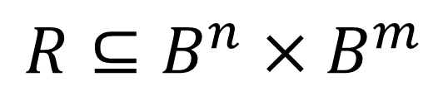
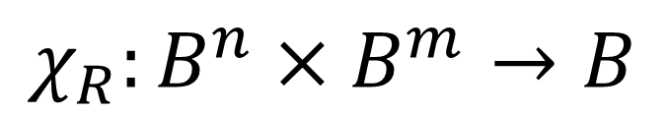
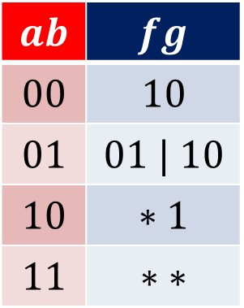
BR: characteristic function

Slide 17
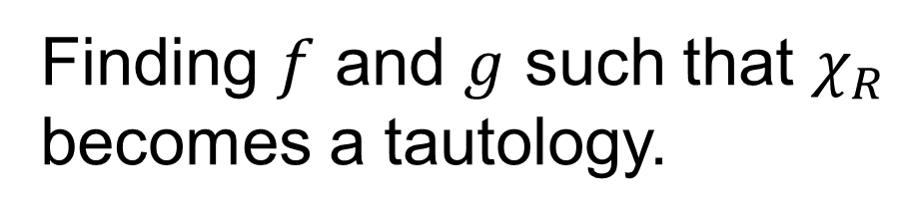
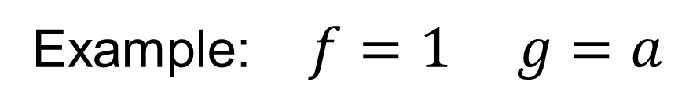
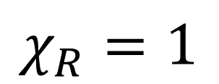
Solving a Boolean Relation

Slide 18

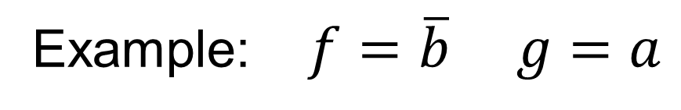
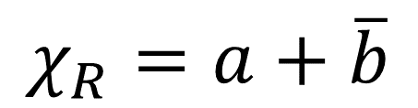
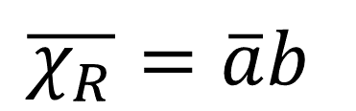
Solving a Boolean Relation

Slide 19
Exact 2-level solvers
The concept of prime must be redefined
  F. Somenzi and R.K. Brayton (1989)
    Method similar to Quine-McCluskey
    Extension of primes to c-primes
  S. Jeong and F. Somenzi (1992)
    Formulate the problem as a Binate Covering Problem

Slide 20
Heuristic 2-level solvers
Based on ESPRESSO:
  A. Ghosh, S. Devadas and A. R. Newton (1992)
  Y. Watanabe and R. K. Brayton (1993)
GYOCRO
x:=Initial Solution;
do
REDUCE(x);
EXPAND(x);
IRREDUNDANT(x);
while x is improved;

Slide 21
Modern approaches
Jie-Hong R. Jiang, Hsuan-Po Lin and Wei-Lun Hung, Interpolating Functions from Large Boolean Relations,
ICCAD 2009.
David Bañeres, Jordi Cortadella, and Mike Kishinevsky,
A Recursive Paradigm to Solve Boolean Relations,
DAC 2004.

Slide 22
Subclasses of Boolean Relations
a b
x y
a b
x y
a b
x y
00
01
10
11
10
11
01
10
00
01
10
11
10
11
∗1
∗∗
00
01
10
11
10
00 | 11
∗1
∗1 | 1∗
Completely
Specified
Functions
Incompletely
Specified
Functions
General
Boolean
Relations
We have efficient ISF solvers

Slide 23


ISF solvers
exact, expensive
$$B^{n} (n \text{inputs}, 1 \text{output})$$
Quine-McCluskey (SOP, exact)
Scherzo (SOP, ZDDs)
Espresso (SOP, heuristic)
Minato-Morreale (BDDs)
Craig Interpolation (AIG, SAT)
DC
Off
On
$$f$$
inexpensive, inexact

Slide 24

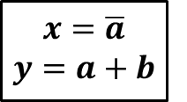
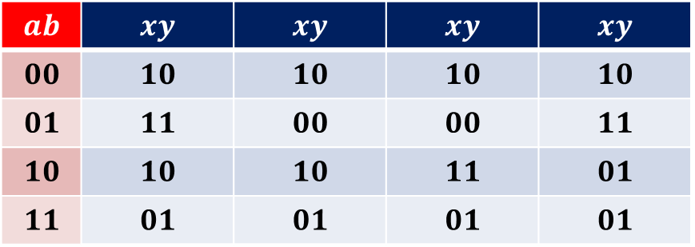

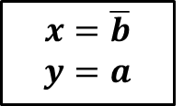
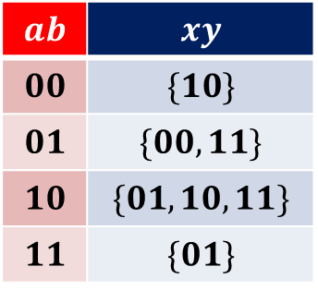

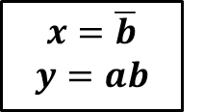
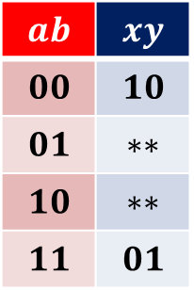


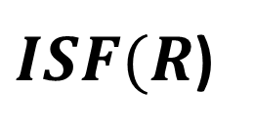
Example
$$ab$$ | $$xy$$
$$00$$ | $$\{10\}$$
$$01$$ | $$\{00,11\}$$
$$10$$ | $$\{01,10,11\}$$
$$11$$ | $$\{01\}$$
$$ab$$ | $$xy$$ | $$xy$$ | $$xy$$ | $$xy$$
$$00$$ | $$10$$ | $$10$$ | $$10$$ | $$10$$
$$01$$ | $$11$$ | $$00$$ | $$00$$ | $$11$$
$$10$$ | $$10$$ | $$10$$ | $$11$$ | $$01$$
$$11$$ | $$01$$ | $$01$$ | $$01$$ | $$01$$
$$R$$
Decoupling
individual
functions
$$x=\overline{a}+\overline{b}$$
$$y=b$$
$$x=\overline{b}$$
$$y=ab$$
$$x=\overline{b}$$
$$y=a$$
$$x=\overline{a}$$
$$y=a+b$$
$$ab$$ | $$xy$$
$$00$$ | $$10$$
$$01$$ | $$∗∗$$
$$10$$ | $$∗∗$$
$$11$$ | $$01$$
$$B^{n×m}$$
$$ISF(R)$$
$$R$$
$ISF(R$)

Slide 25
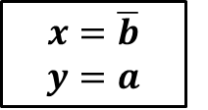
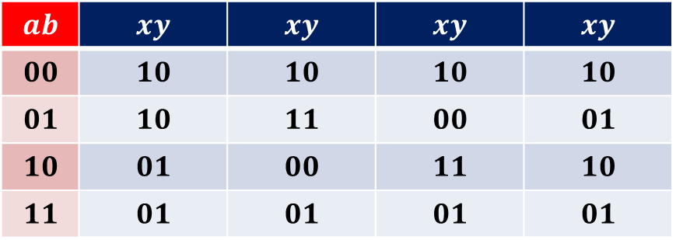
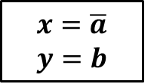
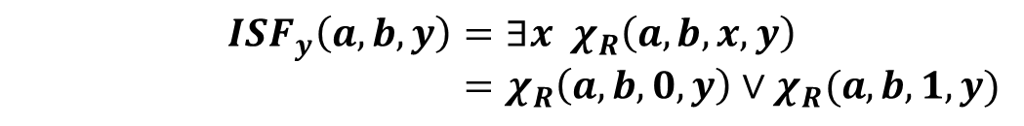
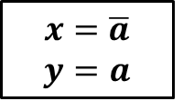
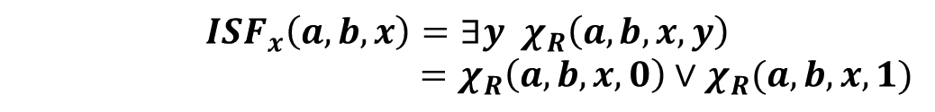
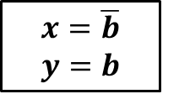
Decoupling the outputs
$$ab$$ | $$xy$$
$$00$$ | $$\{10\}$$
$$01$$ | $$\{00,11\}$$
$$10$$ | $$\{01,10,11\}$$
$$11$$ | $$\{01\}$$
$$ab$$ | $$xy$$ | $$xy$$ | $$xy$$ | $$xy$$
$$00$$ | $$10$$ | $$10$$ | $$10$$ | $$10$$
$$01$$ | $$10$$ | $$11$$ | $$00$$ | $$01$$
$$10$$ | $$01$$ | $$00$$ | $$11$$ | $$10$$
$$11$$ | $$01$$ | $$01$$ | $$01$$ | $$01$$
$$R$$
Decoupling
individual
functions
$$x=\overline{a}$$
$$y=a$$
$$x=\overline{a}$$
$$y=b$$
$$x=\overline{b}$$
$$y=a$$
$$x=\overline{b}$$
$$y=b$$
$$ab$$ | $$xy$$
$$00$$ | $$10$$
$$01$$ | $$∗∗$$
$$10$$ | $$∗∗$$
$$11$$ | $$01$$
$$ISF_{x}\left(a,b,x\right)=∃y χ_{R}\left(a,b,x,y\right)$$
$=χ_{R}\left(a,b,x,0\right)∨χ_{R}(a,b,x,1)$
$ISF(R$)
$$ISF_{y}\left(a,b,y\right)=∃x χ_{R}\left(a,b,x,y\right)$$
$=χ_{R}\left(a,b,0,y\right)∨χ_{R}(a,b,1,y)$
Easy implementation with BDDs or AIGs

Slide 26














Decoupling the outputs
$$ab$$ | $$xy$$
$$00$$ | $$\{10\}$$
$$01$$ | $$\{00,11\}$$
$$10$$ | $$\{01,10,11\}$$
$$11$$ | $$\{01\}$$
$$ab$$ | $$xy$$ | $$xy$$ | $$xy$$ | $$xy$$
$$00$$ | $$10$$ | $$10$$ | $$10$$ | $$10$$
$$01$$ | $$10$$ | $$11$$ | $$00$$ | $$01$$
$$10$$ | $$01$$ | $$00$$ | $$11$$ | $$10$$
$$11$$ | $$01$$ | $$01$$ | $$01$$ | $$01$$
$$R$$
Decoupling
individual
functions
$$x=\overline{a}$$
$$y=a$$
$$x=\overline{a}$$
$$y=b$$
$$x=\overline{b}$$
$$y=a$$
$$x=\overline{b}$$
$$y=b$$
$$ISF_{x}(a,b,x)$$
$$∨$$
$$ab$$ | $$xy$$
$$00$$ | $$10$$
$$01$$ | $$∗∗$$
$$10$$ | $$∗∗$$
$$11$$ | $$01$$
$ISF(R$)
$$R$$
$$R$$
$$a$$
$$b$$
$$x$$
$$y$$
$$a$$
$$b$$
$$x$$
$$y$$
$$0$$
$$1$$

Slide 27
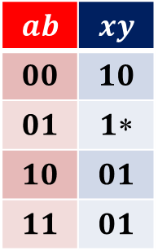

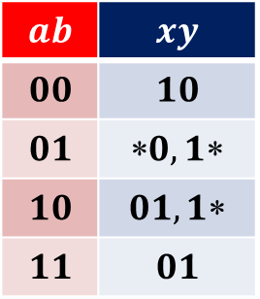
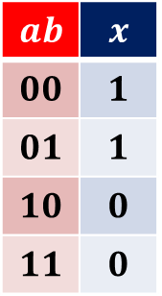
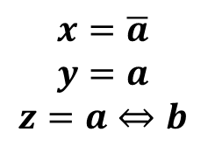
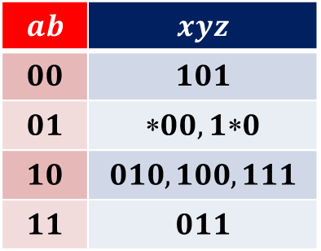

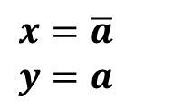


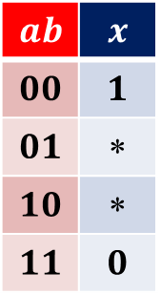
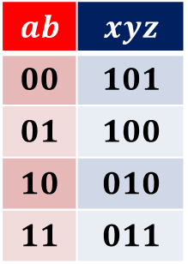

ICCAD 2009: Reduce and substitute
$$ab$$ | $$xyz$$
$$00$$ | $$101$$
$$01$$ | $$00,10$$
$$10$$ | $$010,100,111$$
$$11$$ | $$011$$
$$ab$$ | $$xy$$
$$00$$ | $$10$$
$$01$$ | $$0,1$$
$$10$$ | $$01,1$$
$$11$$ | $$01$$
$$ab$$ | $$x$$
$$00$$ | $$1$$
$$01$$ | $$$$
$$10$$ | $$$$
$$11$$ | $$0$$
$$∃z$$
$$∃y$$
ISF solver
(interpolation)
$$ab$$ | $$xyz$$
$$00$$ | $$101$$
$$01$$ | $$100$$
$$10$$ | $$010$$
$$11$$ | $$011$$
$$ab$$ | $$xy$$
$$00$$ | $$10$$
$$01$$ | $$1$$
$$10$$ | $$01$$
$$11$$ | $$01$$
$$ab$$ | $$x$$
$$00$$ | $$1$$
$$01$$ | $$1$$
$$10$$ | $$0$$
$$11$$ | $$0$$
$$\text{Subs} y$$
$$\text{Subs} x$$
$$x=\overline{a}$$
$$y=a$$
$$z=a⇔b$$
$$x=\overline{a}$$
$$y=a$$
$$x=\overline{a}$$

Slide 28


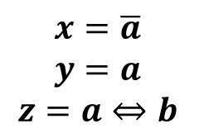

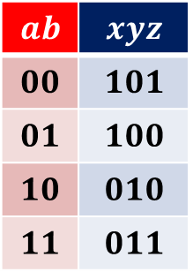
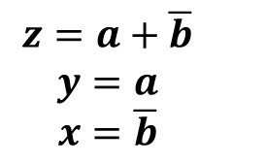
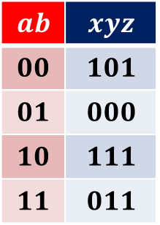

ICCAD 2009: Reduce and substitute
$$ab$$ | $$xyz$$
$$00$$ | $$101$$
$$01$$ | $$100$$
$$10$$ | $$010$$
$$11$$ | $$011$$
$$∃zy$$
$$x=\overline{a}$$
$$y=a$$
$$z=a⇔b$$
$$ab$$ | $$xyz$$
$$00$$ | $$101$$
$$01$$ | $$00,10$$
$$10$$ | $$010,100,111$$
$$11$$ | $$011$$
The final result depends on
the order of the reductions
$$ab$$ | $$xyz$$
$$00$$ | $$101$$
$$01$$ | $$000$$
$$10$$ | $$111$$
$$11$$ | $$011$$
$$∃xy$$
$$z=a+\overline{b}$$
$$y=a$$
$$x=\overline{b}$$
$∃$ abstractions: using AIGs
ISF minimization: using Craig interpolation

Slide 29
a b
x y
00
01
10
11
00
01
10
11
Boolean relation

Slide 30
00
01
10
11
00
01
10
11

Slide 31
00
01
10
11
00
01
10
11

Slide 32









00
01
10
11
00
01
10
11
00
01
10
11
00
01
10
11
00
01
10
11
00
01
10
11
01→10
01→11
$$R_{1}⊆R_{2}$$
⊆
00
01
10
11
00
01
10
11
00
01
10
11
00
01
10
11
Semi-lattice
00
01
10
11
00
01
10
11
00
01
10
11
00
01
10
11
00
01
10
11
00
01
10
11
00
01
10
11
00
01
10
11
Functions
00
01
10
11
00
01
10
11
00
01
10
11
00
01
10
11
00
01
10
11
00
01
10
11
00
01
10
11
00
01
10
11
00
01
10
11
00
01
10
11
00
01
10
11
00
01
10
11
00
01
10
11
00
01
10
11
00
01
10
11
00
01
10
11
$$x=\overline{a}b \\ y=a$$
$$x=b \\ y=a\overline{b}$$
$$x=a⊕b \\ y=a$$
$$x=a+b \\ y=a\overline{b}$$
$$x=\overline{a}b \\ y=a+b$$
$$x=b \\ y=a⊕b$$
$$x=a⊕b \\ y=a+b$$
$$x=a+b \\ y=a⊕b$$
Notes:
Explain the semi-lattice of BRs, with functions at the bottom

Slide 33
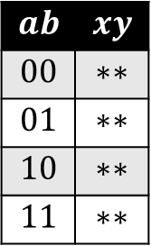

$$B^{n}×B^{m}$$
Maximum
flexibility
$$ab$$ | $$xy$$
$$00$$ | $$∗∗$$
$$01$$ | $$∗∗$$
$$10$$ | $$∗∗$$
$$11$$ | $$∗∗$$
Less
flexibility
Functions
Notes:
More on the lattice of ALL the Boolean relations

Slide 34
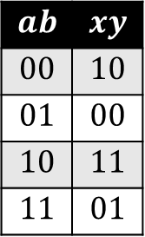
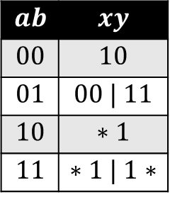
$$ab$$ | $$xy$$
$$00$$ | $$∗∗$$
$$01$$ | $$∗∗$$
$$10$$ | $$∗∗$$
$$11$$ | $$∗∗$$
$$ab$$ | $$xy$$
$$00$$ | $$10$$
$$01$$ | $$00 | 11$$
$$10$$ | $$∗1$$
$$11$$ | $$∗1 | 1∗$$
$$ab$$ | $$xy$$
$$00$$ | $$10$$
$$01$$ | $$00$$
$$10$$ | $$11$$
$$11$$ | $$01$$
Optimum-cost
function
Notes:
A preliminary idea of our approach: find successive constraints that lead to a function

Slide 35

$$B^{n}×B^{m}$$
Number of
inputs
Number of
outputs
$$\text{O}\left(2^{2^{n+m}}\right)$$
Functions
Size of the semi-lattice
Notes:
Size of the lattice. It shows that we cannot use brute-force approaches

Slide 36
Incompletely specified functions
Shortcut: use ISF minimizers !
(ESPRESSO, Minato-Morreale, Scherzo)
Notes:
Some BRs are ISFs. For this case, we can use directly 2-level minimizers

Slide 37
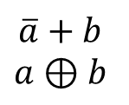
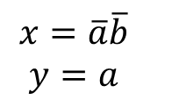
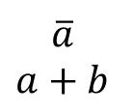
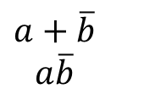

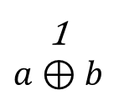
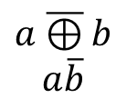
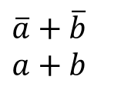
a b
x y
00
01
10
11
10
00 | 11
∗1
01 | 10
10
00
∗1
01 | 10
10
11
∗1
01 | 10
10
00
01
01 | 10
10
00
11
01 | 10
10
11
01
01 | 10
10
11
11
01 | 10
10
00
01
01
10
00
01
10
10
00
11
01
10
00
11
10
10
11
01
01
10
11
01
10
10
11
11
01
10
11
11
10
$$x=\overline{a}\overline{b}$$
$$y=a$$
$$a\overline{⊕}b$$
$$a\overline{b}$$
$$\overline{b}$$
$$a$$
$$a+\overline{b}$$
$$a\overline{b}$$
$$\overline{a}$$
$$a+b$$
$$\overline{a}+b$$
$$a⊕b$$
$$\overline{a}+\overline{b}$$
$$a+b$$
1
$$a⊕b$$

Slide 38
The recursive approach
(DAC 2004, BREL)

Slide 39

Projections ($∃$ abs)
a b
x
00
01
10
11
1
∗
∗
∗
a b
x y
x
a b
x y
00
01
10
11
10
00 | 11
∗1
01 | 10
00
01
10
11
10
∗∗
∗1
∗∗
merge
a b
y
00
01
10
11
0
∗
1
∗
R
y
R’
R’ is an incompletely specified function, but …
has more flexibility than R (R ⊆ R’)

Slide 40
ISF
BR
projection
Notes:
Some BRs are ISFs. For this case, we can use directly 2-level minimizers

Slide 41
ISF
ISF minimizer
done !
Notes:
Some BRs are ISFs. For this case, we can use directly 2-level minimizers

Slide 42
ISF
ISF minimizer
incompatible !
Notes:
Some BRs are ISFs. For this case, we can use directly 2-level minimizers

Slide 43
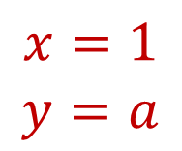
The recursive paradigm
a b
x y
x y
x y
x y
00
01
10
11
10
00 | 11
∗1
01 | 10
10
∗∗
∗1
∗∗
10
10
11
11
10
00 | 11
∗1
01 | 10
projection
minimization
compatible?
ISF
with more
flexibility
$$x=1$$
$$y=a$$

Slide 44
The recursive paradigm
a b
x y
x y
x y
x y
00
01
10
11
10
00 | 11
∗1
01 | 10
10
∗∗
∗1
∗∗
10
10
11
11
10
00 | 11
∗1
01 | 10
projection
minimization
compatible?
ISF
with more
flexibility
$$x=1$$
$$y=a$$

Slide 45
ISF
ISF minimizer
incompatible !
Notes:
Some BRs are ISFs. For this case, we can use directly 2-level minimizers

Slide 46
The recursive paradigm
pick one
conflict
a b
x y
x y
x y
x y
00
01
10
11
10
00 | 11
∗1
01 | 10
10
∗∗
∗1
∗∗
10
10
11
11
10
00 | 11
∗1
01 | 10
projection
minimization
compatible?
ISF
with more
flexibility
$$x=1$$
$$y=a$$

Slide 47
The recursive paradigm
x y
10
00
∗1
01 | 10
a b
x y
00
01
10
11
10
00 | 11
∗1
01 | 10
split
x y
10
11
∗1
01 | 10

Slide 48
ISF
ISF minimizer
incompatible !
Notes:
Some BRs are ISFs. For this case, we can use directly 2-level minimizers

Slide 49
BR₁ BR₂
Notes:
Some BRs are ISFs. For this case, we can use directly 2-level minimizers

Slide 50
The recursive paradigm
x y
x y
x y
x y
10
00
∗1
01 | 10
10
00
∗1
∗∗
10
00
11
01
⊆
10
00 | 11
∗1
01 | 10
a b
x y
00
01
10
11
10
00 | 11
∗1
01 | 10
ISF
√
split
x y
10
11
∗1
01 | 10

Slide 51
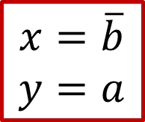
The recursive paradigm
x y
x y
x y
10
00
∗1
01 | 10
10
00
∗1
∗∗
10
00
11
01
$$x=\overline{b}$$
$$y=a$$
a b
x y
00
01
10
11
10
00 | 11
∗1
01 | 10
ISF
√
split
x y
x y
x y
10
11
∗1
01 | 10
10
11
∗1
∗∗
10
11
11
11
split ?
ISF
incompatible

Slide 52
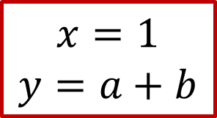
The recursive paradigm
x y
x y
x y
10
00
∗1
01 | 10
10
00
∗1
∗∗
10
00
11
01
$$x=\overline{b}$$
$$y=a$$
a b
x y
00
01
10
11
10
00 | 11
∗1
01 | 10
ISF
√
split
higher cost
x y
x y
x y
10
11
∗1
01 | 10
10
11
∗1
∗∗
10
11
11
11
$$x=1$$
$$y=a+b$$
ISF
incompatible

Slide 53

The recursive paradigm
x y
x y
x y
10
00
∗1
01 | 10
10
00
∗1
∗∗
10
00
11
01
$$x=\overline{b}$$
$$y=a$$
a b
x y
00
01
10
11
10
00 | 11
∗1
01 | 10
ISF
√
split
x y
x y
x y
10
11
∗1
01 | 10
10
11
∗1
∗∗
10
11
11
11
ISF
incompatible

Slide 54








a b
x y
00
01
10
11
10
00 | 11
∗1
01 | 10
10
00
∗1
01 | 10
split
10
11
∗1
01 | 10
10
00
01
01 | 10
10
00
11
01 | 10
10
11
01
01 | 10
10
11
11
01 | 10
10
00
01
01
10
00
01
10
10
00
11
01
10
00
11
10
10
11
01
01
10
11
01
10
10
11
11
01
10
11
11
10
$$x=\overline{a}\overline{b}$$
$$y=a$$
$$a\overline{⊕}b$$
$$a\overline{b}$$
$$\overline{b}$$
$$a$$
$$a+\overline{b}$$
$$a\overline{b}$$
$$\overline{a}$$
$$a+b$$
$$\overline{a}+b$$
$$a⊕b$$
$$\overline{a}+\overline{b}$$
$$a+b$$
$$1$$
$$a⊕b$$

Slide 55

a b
x y
00
01
10
11
10
00 | 11
∗1
01 | 10
10
00
∗1
01 | 10
split
10
11
∗1
01 | 10
$$x=1$$
$$y=a+b$$
incompatible
10
11
01
01 | 10
10
11
11
01 | 10
10
00
11
01
10
11
01
01
10
11
01
10
10
11
11
01
10
11
11
10
$$\overline{b}$$
$$a$$
$$\overline{a}$$
$$a+b$$
$$\overline{a}+b$$
$$a⊕b$$
$$\overline{a}+\overline{b}$$
$$a+b$$
$$1$$
$$a⊕b$$

Slide 56
a b
x y
00
01
10
11
10
00 | 11
∗1
01 | 10
10
00
∗1
01 | 10
split
10
11
∗1
01 | 10
$$x=1$$
$$y=a+b$$
incompatible
10
00
11
01
$$\overline{b}$$
$$a$$

Slide 57

BREL: algorithm
BREL(R, bestF)
R’= ISF(R) // obtains ISF: $R^{′}⊇R$
F = ISFsolver(R’) // obtains F
// Prune search if larger cost
if cost(F) $≥$ cost(bestF): return;
if F $⊆$ R: bestF = F // no conflict
else // split and recursive call
conf = pickConflict(F, R)
(R1, R2) = split(R, conf)
BREL(R1, bestF)
BREL(R2, bestF)
endif
R
F
bestF
R
R1
R2

Slide 58
 |  |  | Gyocro (ESPRESSO) |  |  | DAC 2004 (BREL)
 | PI | PO | LIT | AREA | CPU | LIT | AREA | CPU
int1 | 4 | 3 | 8 | 9280 | 0.03 | 9 | 8352 | 0.01
int10 | 6 | 4 | 32 | 44544 | 0.08 | 34 | 41296 | 0.02
c17i | 5 | 3 | 34 | 34336 | 0.04 | 30 | 32016 | 0.01
she1 | 5 | 3 | 16 | 16240 | 0.04 | 15 | 17632 | 0.00
she2 | 5 | 5 | 31 | 30624 | 0.09 | 24 | 26488 | 0.01
she3 | 6 | 4 | 23 | 24592 | 0.08 | 21 | 21344 | 0.01
she4 | 5 | 6 | 56 | 62176 | 0.14 | 40 | 46864 | 0.03
gr | 14 | 11 | 318 | 346608 | 3.43 | 313 | 322016 | 6.79
b9 | 16 | 5 | 321 | 382336 | 4.68 | 256 | 306240 | 0.19
int15 | 22 | 14 | 506 | 525248 | 21.94 | 459 | 472352 | 19.14
vtx | 22 | 6 | 117 | 151728 | 30.10 | 101 | 94656 | 0.58
Normalized sum |  |  | 1.00 | 1.00 | 1.00 | 0.89 | 0.86 | 0.44

Slide 59

ICCAD 2009: Craig interpolation
☹

Slide 60
Conclusions
Two options to solve Boolean Relations (applicable to other CS problems):
  Exploit the knowledge we have about our problem and use smart algorithms.
  “Admit” the lack of knowledge about of our problem and … (guess what)
  use Machine Learning.
Our knowledge:
  We know about SAT, AIGs, BDDs, ISF, Craig interpolants,…
  The semi-lattice of Boolean Relations is infested by ISFs!
Two ways:
  Small and accurate (BDDs, recursive, Branch & Bound).
  Large and less accurate (AIGs, SAT, Craig interpolants).
Can both methods be combined?

