Slide 1
ECE 667
Spring 2013
Synthesis and Verification of Digital Circuits
Scheduling Algorithms
Analytical approach - ILP

Slide 2
Scheduling – a Combinatorial Optimization Problem
NP-complete Problem
Optimal solutions for special cases and for ILP
  Integer linear program (ILP)
  Branch and bound
Heuristics
  iterative Improvements, constructive
Various versions of the problem
    Minimum latency, unconstrained (ASAP)
    Latency-constrained scheduling (ALAP)
    Minimum latency under resource constraints (ML-RC)
    Minimum resource schedule under latency constraint (MR-LC)
If all resources are identical, problem is reduced to multiprocessor scheduling (Hu’s algorithm)
    In general, minimum latency multiprocessor problem is intractable under resource constraint
    Under certain constraints (G(VE) is a tree), greedy algorithm gives optimum solution

Slide 3
Integer Linear Programming (ILP)
Given:
  integer-valued matrix A_{m x n}
  variables: x = ( x₁, x₂, … , x_{n} )^{T}
  constants: b = ( b₁, b₂, … , b_{m} )^{T} and c = ( c₁, c₂, … , c_{n} )^{T}
Minimize: c^{T} x
subject to:
A x ≤ b
x = ( x₁, x₂, … , x_{n} ) is an integer-valued vector
If all variables are continuous, the problem is called linear (LP)
Problem is called Integer LP (ILP) if some variables x are integer
  special case: 0,1 (binary) ILP

Slide 4
Linear Programming – example
Variables: x = [x₁, x₂]^{T}
Objective function: max F = -x₁ + x₂ = [-1 1] [x₁, x₂]^{T}
Constraints: -2x₁ + x₂ ≤ 1
x₁ + 2x₂ ≤ 5
x₂
F * =1.6
3
F=1
F=0
2
F *= 1.6
(x₁=0.6, x₂=2.2)
1
x₁
1
2
3
4
5

Slide 5
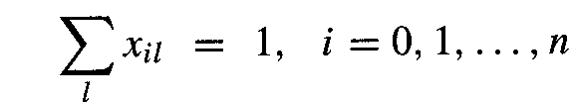
ILP Model of Scheduling
Binary decision variables x_{il}
x_{il} = 1 if operation v_{i} starts in step l,
otherwise x_{il} = 0
i = 0, 1, …, n (operations)
l= 1, 2, … λ+1 (steps, with limit λ )
Start time of each operation vi is unique:
l=t_{i} ^{L}
Note:
∑_{l} x_{il} = ∑ x_{il}
l=t_{i} ^{S}
where:
t _{i}^{S} = time of operation I computed with ASAP
t _{i}^{L} = time of operation I computed with ALAP

Slide 6
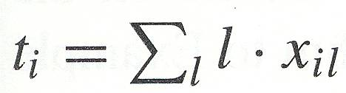
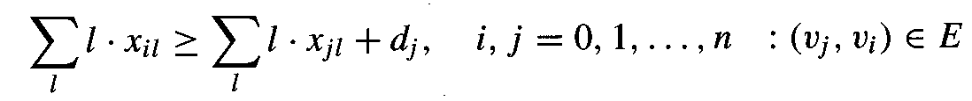
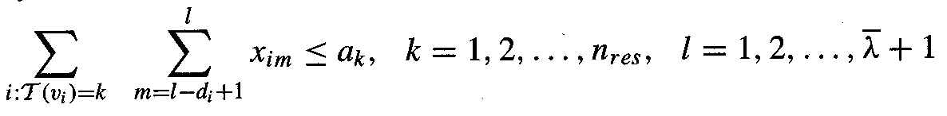
ILP Model of Scheduling - constraints
Start time for v_{i}:
Precedence relationships must be satisfied
Resource constraints must be met
  let upper bound on number of resources of type k be a_{k}

Slide 7
Latency Minimization - Objective Function
Function to be minimized: F = c^{T}t, where
Minimum latency schedule: c = [0, 0, …, 1]^{T}
  F = t_{n} = ∑_{l} l x_{nl}
  if sink has no mobility (x_{n,s} = 1), any feasible schedule is optimum
ASAP: c = [1, 1, …, 1]^{T}
  finds earliest start times for all operations ∑_{i} ∑_{l} x_{il}
  or equivalently:

Slide 8
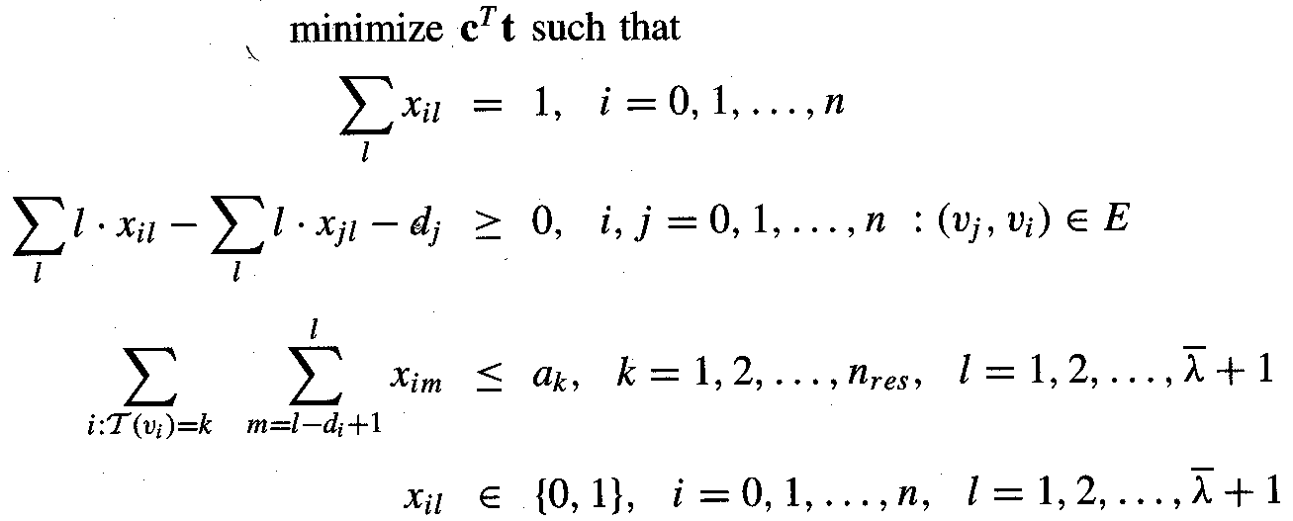
Minimum-Latency Scheduling under Resource Constraints (ML-RC)
Let t be the vector whose entries are start times
  t = [ t₀, t₁,…., t_{n} ]
Formal ILP model

Slide 9
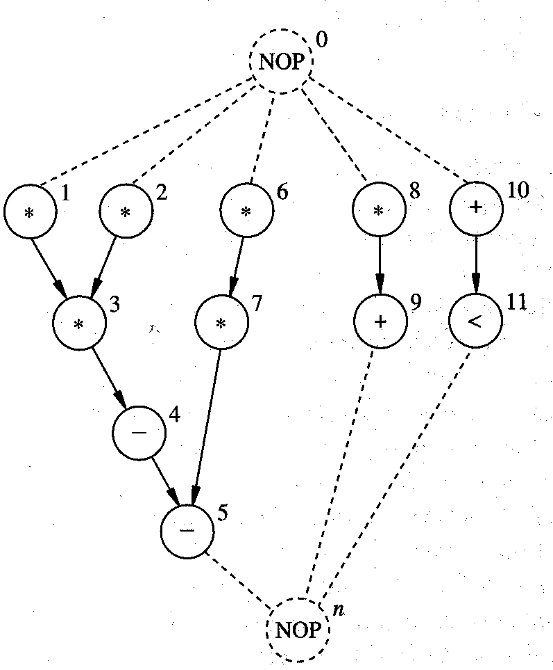
Example 1 – multiple resources
Two types of resources
  MULT
  ALU
    Adder, Subtractor
    Comparator
Each take 1 cycle of execution time
Assume upper bound on latency, L = 4
Use ALAP and ASAP to derive bounds on start times for each operator

Slide 10
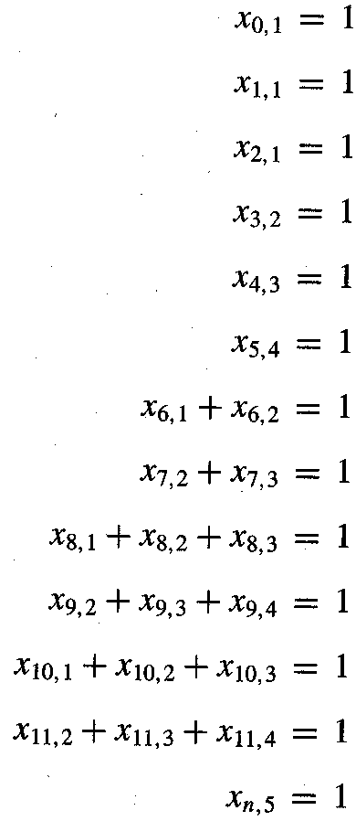
Example 1 (cont’d.)
Start time must be unique
l=t_{i} ^{L}
Recall:
∑_{l} x_{il} = ∑ x_{il}
where:
t _{i}^{S} = t_{i} computed with ASAP
t _{i}^{L} = t_{i} computed with ALAP
l=t_{i} ^{S}

Slide 11
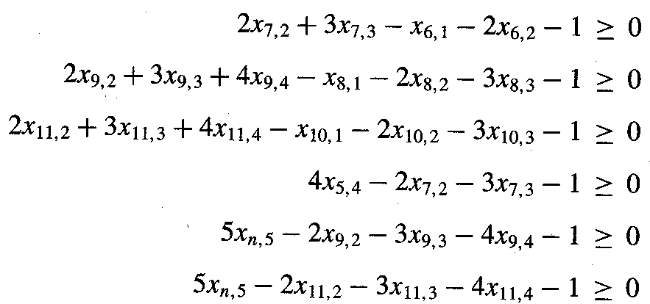
Example 1 (cont’d.)
Precedence constraints
  Note: only non-trivial ones listed

Slide 12
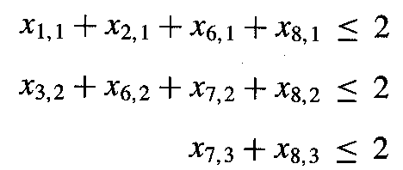
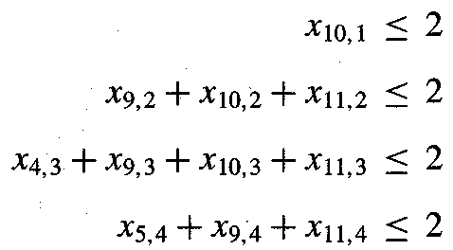
Example 1 (cont’d.)
Resource constraints
MULT
a1=2
ALU
a2=2

Slide 13
Example 1 (cont’d.)
Objective function (some possibilities): F = c^{T}t
F1: c = [0, 0, …, 1]^{T}
  Minimum latency schedule
  since sink has no mobility (x_{n,5} = 1), any feasible schedule is optimum
F2: c = [1, 1, …, 1] ^{T}
  finds earliest start times for all operations ∑ _{i} ∑ _{l} x_{il}
  or equivalently:

Slide 14
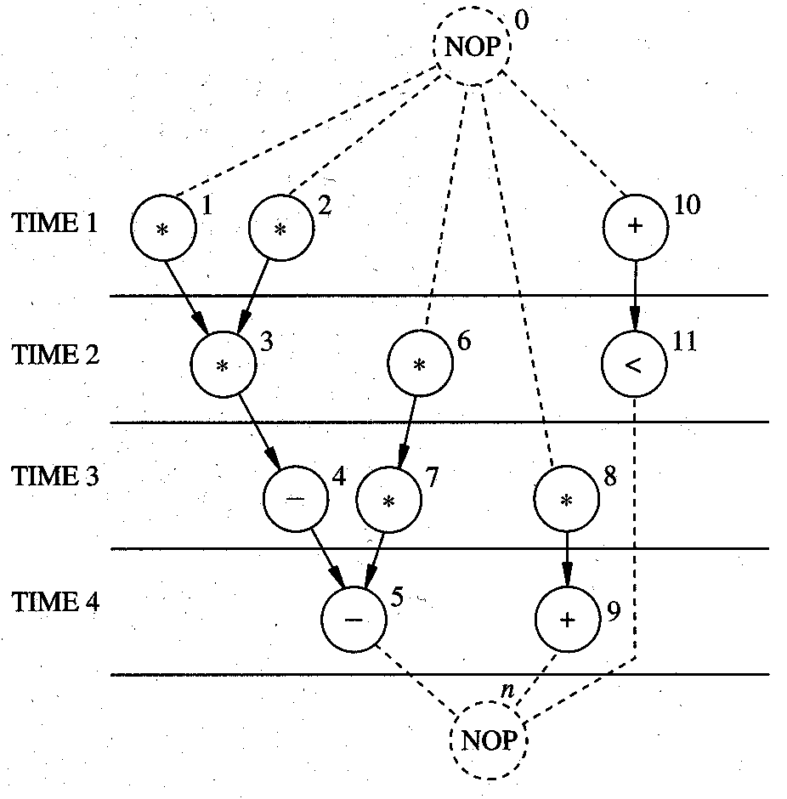
Example Solution 1:
Min. Latency Schedule Under Resource Constraint

Slide 15
Minimum Resource Scheduling under Latency Constraint (MR-LC)
Special case
  Identical operations, each executing in one cycle time
Given a set of operations {v₁,v₂,...,v_{n}},
  find the minimum number of operation units needed to complete the execution in k control steps (MR-LC problem)
Integer Linear Programming (ILP):
  Let y₀ be an integer variable (# units to be minimized)
  for each control step l =1, …, k, define variable x_{il} as
x_{il} = 1, if computation v_{i} is executed in the l-th control step
0, otherwise
  define variable y_{l} (number of units in control step l )
  y_{l} = x_{1l} + x_{2l} + ... + x_{nl} = Σ_{i} x_{il}

Slide 16
ILP Scheduling – simple MR-LC
Minimize: y₀
Subject to:
Each computation v_{i} can start only once:
  x_{il}= 1 for only one value of l (control step) (“vertical” constraint)
For each precedence relation:
  If v_{j} has to be executed after v_{i}
x_{j1} + 2 x_{j2}+ ... + k x_{jk} ≥ x_{i1} + 2 x_{i2} + ... + k x_{ik}+ d(i)
y_{l} ≤ y₀ for all l= 1,…, k (steps)
Meaning of y0:
  upper bound on the number of units, to be minimized

Slide 17
Example 2 - Formulation
n = 6 computations
k = 3 control steps
d(i) = 1
v₁
v₂
v₃
v₄
v₅
Execution constraints:
x_{i1} + x_{i2} + x_{i3} = 1 for i = 1,…, 6
v₆
Resource constraints:
y_{l} = x_{1l} + x_{2l} + x_{3l}+ x_{4l} + x_{5l} + x_{6l} for l = 1,…, 3 (steps)
Dependency constraints: e.g. v₄ executes after v₁
  x₄₁ + 2x₄₂+ 3x₄₃ ≥ x₁₁ + 2x₁₂ + 3x₁₃ +1
  . . . . . . . etc.

Slide 18
Example 2 - Solution
Minimize: y₀
Subject to:
  y_{l} ≤ y₀ for l = 1,…, 3
  Starting time constraints …
  Precedence constraints …
One possible solution:
y₀ = 2
x₁₁ = 1, x₂₁ = 1,
x₃₂ = 1, x₄₂ = 1,
x₅₃ = 1, x₆₃ = 1.
all other x_{il} = 0
v₁
v₂
v₄
v₃
v₆
v₅

Slide 19
Minimum Resource Scheduling under Latency Constraint – general MR-LC
General case: several operation units (resources)
Given
  vector c = [c₁, …, c_{r}] of resource costs (areas)
  vector a = [a₁, …, a_{r}] of number of resources (unknown)
Minimize total cost of resources
min c^{T}a
Resource constraints are expressed in terms of variables a_{k} = number of operators of type k

Slide 20
Example 3 – Min. Resources under Latency Constraint
Let c = [5, 1]
  MULT costs = 5 units of area, c₁ = 5
  ALU costs = 1 unit of area, c₂ = 1
Starting time constraint – as before
Sequencing constraints - as before
Resource constraints – similar to ML-RC, but expressed in terms of unknown variables a₁ and a₂
    a₁ = number of multipliers
    a₂ = number of ALUs (add/sub)
Objective function:
c^{T}a = 5·a₁ + 1·a₂

Slide 21
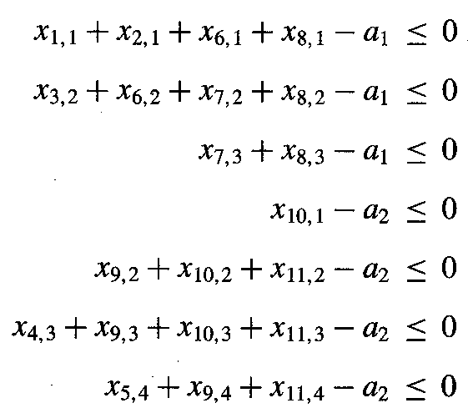
Example 3 (contd.)
Resource constraints
MULT
ALU

Slide 22
Example 3 - Solution
Minimize
c^{T}a = 5·a₁ + 1·a₂
Solution with cost = 12
  a1 = 2
  a2 = 2

Slide 23
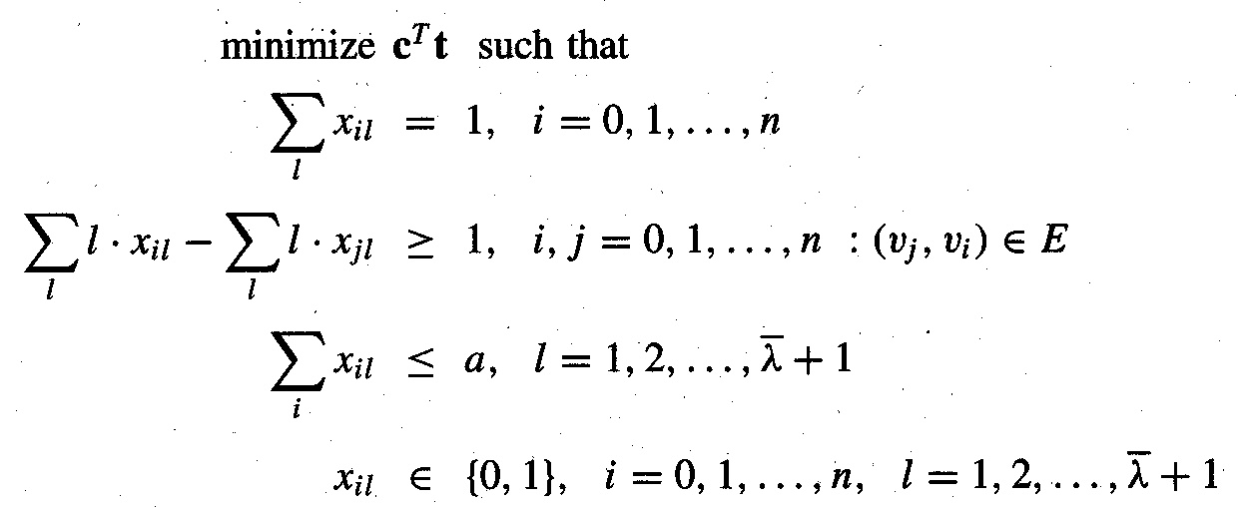
Precedence-constrained
Multiprocessor Scheduling
All operations performed by the same type of resource
  intractable problem; even if operations have unit delay
  except when the G_{c} is a tree (then it is optimal and O(n))
    Hu’s algorithm

