Slide 1
Placement
Mustafa Ozdal

Slide 2
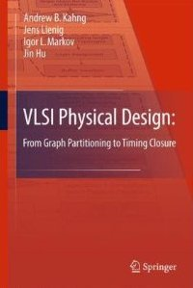
Chapter 2 – Netlist and System Partitioning
MOST SLIDES ARE FROM THE BOOK:
VLSI Physical Design: From Graph Partitioning to Timing Closure
MODIFICATIONS WERE MADE ON THE ORIGINAL SLIDES
Original Authors:
Andrew B. Kahng, Jens Lienig, Igor L. Markov, Jin Hu

Slide 3
Chapter 4 – Global and Detailed Placement
4.1 Introduction
4.2 Optimization Objectives
4.3 Global Placement
4.3.1 Min-Cut Placement
4.3.2 Analytic Placement
4.3.3 Simulated Annealing
4.3.4 Modern Placement Algorithms
4.4 Legalization and Detailed Placement

Slide 4
4.1 Introduction
System Specification
Partitioning
Architectural Design
ENTITY test is port a: in bit; end ENTITY test;
Functional Design and Logic Design
Chip Planning
Circuit Design
Placement
Physical Design
Clock Tree Synthesis
Physical Verification and Signoff
DRC LVS
ERC
Signal Routing
Fabrication
Timing Closure
Packaging and Testing
Chip

Slide 5
4.1 Introduction
a
Linear Placement
c
b
g
h
a
c
b
g
h
d
f
e
d
f
e
h
e
d
a
VDD
h
e
d
a
g
f
c
b
GND
g
f
c
b
© 2011 Springer Verlag
2D Placement
Placement and Routing with Standard Cells

Slide 6
4.1 Introduction
Global Placement
Detailed Placement

Slide 7
4.2 Optimization Objectives
Total Wirelength
Number of Cut Nets
Wire Congestion
Signal Delay
© 2011 Springer Verlag

Slide 8
Floorplanning vs Placement
Floorplanning .
Large blocks
Rectangles with arbitrary widths and heights
Rectangle packing
# of blocks not very large
Placement .
Much smaller cells
Cells with mostly identical heights
Placing cells on pre-defined rows
Up to a few million cells

Slide 9
4.2 Optimization Objectives – Total Wirelength
e
h
a
j
k
f
h
c
i
d
c
e
f
l
i
l
b
b
j
d
k
g
a
g
© 2011 Springer Verlag

Slide 10
4.2 Optimization Objectives – Total Wirelength
Wirelength estimation for a given placement
Half-perimeter wirelength (HPWL)
Complete graph (clique)
Monotone chain
Star model
4
8
5
Sait, S. M., Youssef, H.: VLSI Physical Design Automation, World Scientific
5
3
6
3
8
3
6
3
3
4
4
HPWL = 9
Clique Length = (2/p)Σ_{e ∈ clique}d_{M}(e) = 14.5
Chain Length = 12
Star Length = 15

Slide 11
4.2 Optimization Objectives – Total Wirelength
Wirelength estimation for a given placement (cont‘d.)
Rectilinear minimum spanning tree (RMST)
Rectilinear Steiner minimum tree (RSMT)
Rectilinear Steiner arborescence model (RSA)
Single-trunk Steiner tree (STST)
5
3
Sait, S. M., Youssef, H.: VLSI Physical Design Automation, World Scientific
3
6
+5
4
1
1
3
3
3
+2
2
RMST Length = 11
RSMT Length = 10
RSA Length = 10
STST Length = 10

Slide 12
4.2 Optimization Objectives – Total Wirelength
Wirelength estimation for a given placement (cont‘d.)
Preferred method: Half-perimeter wirelength (HPWL)
Fast (order of magnitude faster than RSMT)
Equal to length of RSMT for 2- and 3-pin nets
Margin of error for real circuits approx. 8% [Chu, ICCAD 04]
4
6
h
5
1
3
w
RSMT Length = 10
HPWL = 9

Slide 13
4.2 Optimization Objectives – Total Wirelength
Total wirelength with net weights (weighted wirelength)
For a placement P, an estimate of total weighted wirelength is
where w(net) is the weight of net, and L(net) is the estimated wirelength of net.
Example:
a₁
c
a
c₁
Nets Weights
N₁ = (a₁, b₁, d₂) w(N₁) = 2
N₂ = (c₁, d₁, f₁) w(N₂) = 4
N₃ = (e₁, f₂) w(N₃) = 1
d₁
d
f₁
f
d₂
f₂
b
b₁
e₁
e

Slide 14
4.2 Optimization Objectives – Number of Cut Nets
Cut sizes of a placement
To improve total wirelength of a placement P, separately calculate the number of crossings of global vertical and horizontal cutlines, and minimize
where Ψ_{P}(cut) be the set of nets cut by a cutline cut

Slide 15
4.2 Optimization Objectives – Number of Cut Nets
Cut sizes of a placement
Example:
Cut values for each global cutline ψ_{P}(v₁) = 1 ψ_{P}(v₂) = 2 ψ_{P}(h₁) = 3 ψ_{P}(h₂) = 2
Total number of crossings in P ψ_{P}(v₁) + ψ_{P}(v₂) + ψ_{P}(h₁) + ψ_{P}(h₂) = 1 + 2 + 3 + 2 = 8
Nets
N₁ = (a₁, b₁, d₂)
N₂ = (c₁, d₁, f₁)
N₃ = (e₁, f₂)
a₁
c
a
c₁
h₂
d₁
d
f₁
f
d₂
f₂
h₁
b
b₁
e₁
e
v₁
v₂

Slide 16
4.2 Optimization Objectives – Wire Congestion
Routing congestion of a placement
Formally, the local wire density φ_{P}(e) of an edge e between two neighboring grid cells is
where _{P}(e) is the estimated number of nets that cross e and σ_{P}(e) is the maximum number of nets that can cross e
If φ_{P}(e) > 1, then too many nets are estimated to cross e, making P more likely to be unroutable.
The wire density of P is
where E is the set of all edges
If Φ(P)  1, then the design is estimated to be fully routable, otherwise routing will need to detour some nets through less-congested edges

Slide 17
4.2 Optimization Objectives – Wire Congestion
Wire Density of a placement
Assume edge capacity is 3 for all edges
v₃
v₆
η_{P}(h₁) = 1 η_{P}(h₂) = 2 η_{P}(h₃) = 0 η_{P}(h₄) = 1 η_{P}(h₅) = 1 η_{P}(h₆) = 0
η_{P}(v₁) = 1 η_{P}(v₂) = 0 η_{P}(v₃) = 0 η_{P}(v₄) = 0 η_{P}(v₅) = 2 η_{P}(v₆) = 0
c
a
h₅
h₄
h₆
v₂
d
v₅
f
h₁
b
h₃
h₂
e
v₁
v₄
Maximum: η_{P}(e) = 2
Routable

Slide 18
4.2 Optimization Objectives – Signal Delay
Circuit timing of a placement
Static timing analysis using actual arrival time (AAT) and required arrival time (RAT)
AAT(v) represents the latest transition time at a given node v measured from the beginning of the clock cycle
RAT(v) represents the time by which the latest transition at v must complete in order for the circuit to operate correctly within a given clock cycle.
For correct operation of the chip with respect to setup (maximum path delay) constraints, it is required that AAT(v) ≤ RAT(v).

Slide 19
Global Placement
4.1 Introduction
4.2 Optimization Objectives
4.3 Global Placement
4.3.1 Min-Cut Placement
4.3.2 Analytic Placement
4.3.3 Simulated Annealing
4.3.4 Modern Placement Algorithms
4.4 Legalization and Detailed Placement

Slide 20
Global Placement
Partitioning-based algorithms:
The netlist and the layout are divided into smaller sub-netlists and sub-regions, respectively
Process is repeated until each sub-netlist and sub-region is small enough to be handled optimally
Detailed placement often performed by optimal solvers, facilitating a natural transition from global placement to detailed placement
Example: min-cut placement
Analytic techniques:
Model the placement problem using an objective (cost) function, which can be optimized via numerical analysis
Examples: quadratic placement and force-directed placement
Stochastic algorithms:
Randomized moves that allow hill-climbing are used to optimize the cost function
Example: simulated annealing

Slide 21
Global Placement
Partitioning-based
Analytic
Stochastic
Min-cut placement
Quadratic placement
Force-directed placement
Simulated annealing

Slide 22
4.3.1 Min-Cut Placement
Uses partitioning algorithms to divide (1) the netlist and (2) the layout region into smaller sub-netlists and sub-regions
Conceptually, each sub-region is assigned a portion of the original netlist
Each cut heuristically minimizes the number of cut nets using, for example,
Kernighan-Lin (KL) algorithm
Fiduccia-Mattheyses (FM) algorithm

Slide 23
4.3.1 Min-Cut Placement
Alternating cutline directions
Repeating cutline directions
2a
4a
4c
4a
3a
4e
3a
3b
2a
4b
4d
4b
3b
4f
1
1
4e
4g
4c
3c
4g
3c
3d
2b
4f
4h
4d
3d
4h
2b
© 2011 Springer Verlag

Slide 24
4.3.1 Min-Cut Placement
Input: netlist Netlist, layout area LA, minimum number of cells per region cells_min
Output: placement P
P = Ø
regions = ASSIGN(Netlist,LA) // assign netlist to layout area
while (regions != Ø) // while regions still not placed
region = FIRST_ELEMENT(regions) // first element in regions
REMOVE(regions, region) // remove first element of regions
if (region contains more than cell_min cells)
(sr1,sr2) = BISECT(region) // divide region into two subregions // sr1 and sr2, obtaining the sub- // netlists and sub-areas
ADD_TO_END(regions,sr1) // add sr1 to the end of regions
ADD_TO_END(regions,sr2) // add sr2 to the end of regions
else
PLACE(region) // place region
ADD(P,region) // add region to P

Slide 25
4.3.1 Min-Cut Placement – Example
Given:
1
4
2
5
6
3
Task: 4 x 2 placement with minimum wirelength using alternative cutline directions and the KL algorithm

Slide 26
4.3.1 Min-Cut-Platzierung: Beispiel
cut₁
1
4
2
5
6
3
Vertical cut cut₁: L={1,2,3}, R={4,5,6}
1
4
1
4
5
2
5
2
3
6
3
6
0
0
0
0
KL Algorithm
cut₁
cut₁

Slide 27
1
4
5
2
3
6
0
0
cut₁
Horizontal cut cut_{2L}: T={1,4}, B={2,0}
Horizontal cut cut_{2R}: T={3,5}, B={6,0}
1
4
3
5
cut_{2L}
cut_{2R}
2
0
0
6
cut_{3TL}
cut_{3TR}
1
4
5
3
1
4
5
3
0
2
6
0
cut_{3BL}
cut_{3BR}
2
6

Slide 28
4.3.1 Min-Cut Placement – Terminal Propagation
TR
2
2
2
3
3
4
1
3
1
4
1
4
BR
Terminal Propagation
External connections are represented by artificial connection points on the cutline
Dummy nodes in hypergraphs
x
TR
p‘
2
4
2
4
2
4
1
3
1
3
1
3
BR
© 2011 Springer Verlag

Slide 29
4.3.1 Min-Cut Placement
Advantages:
Reasonable fast
Objective function and be adjusted, e.g., to perform timing-driven placement
Hierarchical strategy applicable to large circuits
Disadvantages:
Randomized, chaotic algorithms – small changes in input lead to large changes in output
Optimizing one cutline at a time may result in routing congestion elsewhere

Slide 30
4.3.2 Analytic Placement – Quadratic Placement
Objective function is quadratic; sum of (weighted) squared Euclidean distance represents placement objective function
where n is the total number of cells, and c(i,j) is the connection cost between cells i and j.
Only two-point-connections
Minimize objective function by equating its derivative to zero which reduces to solving a system of linear equations

Slide 31
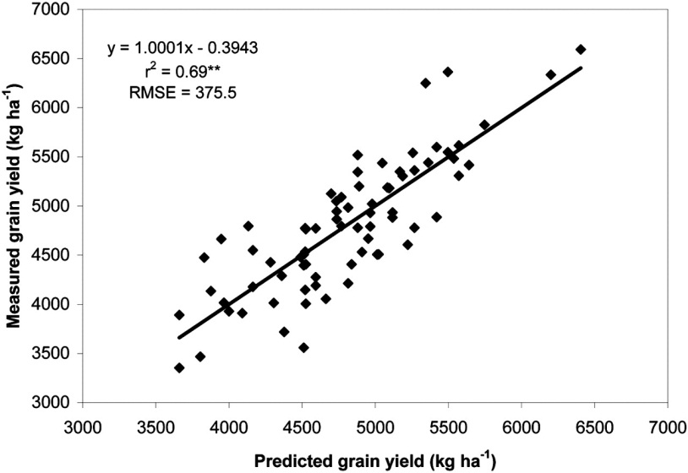
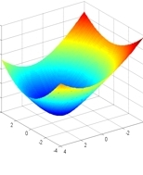
4.3.2 Analytic Placement – Quadratic Placement
Similar to Least-Mean-Square Method (root mean square)
Build error function with analytic form:
31
Notes:
31

Slide 32
4.3.2 Analytic Placement – Quadratic Placement
where n is the total number of cells, and c(i,j) is the connection cost between cells i and j.
Each dimension can be considered independently:
Convex quadratic optimization problem: any local minimum solution is also a global minimum
Optimal x- and y­-coordinates can be found by setting the partial derivatives of L_{x}(P) and L_{y}(P) to zero

Slide 33
4.3.2 Analytic Placement – Quadratic Placement
where n is the total number of cells, and c(i,j) is the connection cost between cells i and j.
Each dimension can be considered independently:
where A is a matrix with A[i][j] = -c(i,j) when i ≠ j, and A[i][i] = the sum of incident connection weights of cell i.
X is a vector of all the x-coordinates of the non-fixed cells, and b_{x} is a vector with b_{x}[i] = the sum of x-coordinates of all fixed cells attached to i.
Y is a vector of all the y-coordinates of the non-fixed cells, and b_{y} is a vector with b_{y}[i] = the sum of y-coordinates of all fixed cells attached to i.

Slide 34
4.3.2 Analytic Placement – Quadratic Placement
where n is the total number of cells, and c(i,j) is the connection cost between cells i and j.
Each dimension can be considered independently:
System of linear equations for which iterative numerical methods can be used to find a solution

Slide 35
4.3.2 Analytic Placement – Quadratic Placement
Second stage of quadratic placers: cells are spread out to remove overlaps
Methods:
Adding fake nets that pull cells away from dense regions toward anchors
Geometric sorting and scaling
Partitioning, etc.

Slide 36
Cell Spreading Based on Partitioning
Geometric partitioning:
Enforce partition constraints based on sizes of the regions
Try to respect the relative cell locations during partitioning
Define center of gravity for each partition, and add it as a constraint to the quadratic placer.
Terminal propagation

Slide 37
4.3.2 Analytic Placement – Quadratic Placement
Advantages:
Captures the placement problem concisely in mathematical terms
Leverages efficient algorithms from numerical analysis and available software
Can be applied to large circuits without netlist clustering (flat)
Stability: small changes in the input do not lead to large changes in the output
Disadvantages:
Connections to fixed objects are necessary: I/O pads, pins of fixed macros, etc.

Slide 38
4.3.2 Analytic Placement – Quadratic Placement
Mechanical analogy: mass-spring system
Squared Euclidean distance is proportional to the energy of a spring between these points
Quadratic objective function represents total energy of the spring system; for each movable object, the x (y) partial derivative represents the total force acting on that object
Setting the forces of the nets to zero, an equilibrium state is mathematically modeled that is characterized by zero forces acting on each movable object
At the end, all springs are in a force equilibrium with a minimal total spring energy; this equilibrium represents the minimal sum of squared wirelength
Result: many cell overlaps

Slide 39
4.3.2 Analytic Placement – Force-directed Placement
Cells and wires are modeled using the mechanical analogy of a mass-spring system, i.e., masses connected to Hooke’s-Law springs
Attraction force between cells is directly proportional to their distance
Cells will eventually settle in a force equilibrium  minimized wirelength

Slide 40
4.3.2 Analytic Placement – Force-directed Placement
Given two connected cells a and b, the attraction force exerted on a by b is where
c(a,b) is the connection weight (priority) between cells a and b, and
is the vector difference of the positions of a and b in the Euclidean plane
The sum of forces exerted on a cell i connected to other cells 1… j is
Zero-force target (ZFT): position that minimizes this sum of forces

Slide 41
4.3.2 Analytic Placement – Force-directed Placement
Zero-Force-Target (ZFT) position of cell i
a
i
d
b
ZFT Position
c
min F_{i} = c(i,a) ∙ (a – i ) + c(i,b) ∙ (b – i ) + c(i,c) ∙ (c – i ) + c(i,d) ∙ (d – i )
© 2011 Springer Verlag

Slide 42
4.3.2 Analytic Placement – Force-directed Placement
Basic force-directed placement
Iteratively moves all cells to their respective ZFT positions
x- and y-direction forces are set to zero:
Rearranging the variables to solve for x_{i}⁰ and y_{i}⁰ yields
Computation of ZFT position of cell i connected with cells 1 … j

Slide 43
4.3.2 Analytic Placement – Force-directed Placement
Example: ZFT position
Given:
Circuit with NAND gate 1 and four I/O pads on a 3 x 3 grid
Pad positions: In1 (2,2), In2 (0,2), In3 (0,0), Out (2,0)
Weighted connections: c(a,In1) = 8, c(a,In2) = 10, c(a,In3) = 2, c(a,Out) = 2
Task: find the ZFT position of cell a
In2
In1
In1
2
In2
1
Out
1
In3
In3
Out
0
1
2

Slide 44
4.3.2 Analytic Placement – Force-directed Placement
Example: ZFT position
Given:
Circuit with NAND gate 1 and four I/O pads on a 3 x 3 grid
Pad positions: In1 (2,2), In2 (0,2), In3 (0,0), Out (2,0)
Solution:
ZFT position of cell a is (1,2)

Slide 45
4.3.2 Analytic Placement – Force-directed Placement
Example: ZFT position
Given:
Circuit with NAND gate 1 and four I/O pads on a 3 x 3 grid
Pad positions: In1 (2,2), In2 (0,2), In3 (0,0), Out (2,0)
Solution:
In2
a
In1
2
1
In3
Out
ZFT position of cell a is (1,2)
0
1
2

Slide 46
4.3.2 Analytic Placement – Force-directed Placement
Input: set of all cells V
Output: placement P
P = PLACE(V) // arbitrary initial placement
loc = LOCATIONS(P) // set coordinates for each cell in P
foreach (cell c ∈ V)
status[c] = UNMOVED
while (!ALL_MOVED(V) || !STOP()) // continue until all cells have been // moved or some stopping // criterion is reached
c = MAX_DEGREE(V,status) // unmoved cell that has largest // number of connections
ZFT_pos = ZFT_POSITION(c) // ZFT position of c
if (loc[ZFT_pos] == Ø) // if position is unoccupied,
loc[ZFT_pos] = c // move c to its ZFT position
else
RELOCATE(c,loc) // use methods discussed next
status[c] = MOVED // mark c as moved

Slide 47
4.3.2 Analytic Placement – Force-directed Placement
Finding a valid location for a cell with an occupied ZFT position
(p: incoming cell, q: cell in p‘s ZFT position)
If possible, move p to a cell position close to q.
Chain move: cell p is moved to cells q’s location.
Cell q, in turn, is shifted to the next position. If a cell r is occupying this space, cell r is shifted to the next position.
This continues until all affected cells are placed.
Compute the cost difference if p and q were to be swapped. If the total cost reduces, i.e., the weighted connection length L(P) is smaller, then swap p and q.

Slide 48
4.3.2 Analytic Placement – Force-directed Placement (Example)
Given:
Nets Weight
N₁ = (b₁, b₃) c(N₁) = 2
N₂ = (b₂, b₃) c(N₂) = 1
b₁
b₂
b₃
0
1
2

Slide 49
4.3.2 Analytic Placement – Force-directed Placement (Example)
Given:
Nets Weight
N₁ = (b₁, b₃) c(N₁) = 2
N₂ = (b₂, b₃) c(N₂) = 1
b₁
b₂
b₃
0
1
2
L(P) before move
Incoming
cell p
ZFT position of cell p
Cell q
L(P) / placement after move
b₃
b₁
b₃
b₂
b₁
L(P) = 5
L(P) = 5
3
2
1
⇒ No swapping of b₃ and b₁

Slide 50
4.3.2 Analytic Placement – Force-directed Placement (Example)
Given:
Nets Weight
N₁ = (b₁, b₃) c(N₁) = 2
N₂ = (b₂, b₃) c(N₂) = 1
b₁
b₂
b₃
0
1
2
L(P) before move
Incoming
cell p
ZFT position of cell p
Cell q
L(P) / placement after move
b₃
b₁
b₃
b₂
b₁
L(P) = 5
L(P) = 5
3
2
1
→ No swapping of b₃ and b₁
b₂
b₃
L(P) = 5
L(P) = 3
b₁
b₃
b₂
→ Swapping of b₂ and b₃

Slide 51
4.3.2 Analytic Placement – Force-directed Placement
Advantages:
Conceptually simple, easy to implement
Primarily intended for global placement, but can also be adapted to detailed placement
Disadvantages:
Does not scale to large placement instances
Is not very effective in spreading cells in densest regions
Poor trade-off between solution quality and runtime
In practice, FDP is extended by specialized techniques for cell spreading
This facilitates scalability and makes FDP competitive

Slide 52
Modern Force-Directed Placement Algorithms
Similar to the quadratic placement algorithms:
Cell locations are determined through quadratic optimization
Cell overlaps are eliminated through repulsive forces
Repulsive forces: Perturbation to the quadratic formulation
Move cells from over-utilized regions to under-utilized regions
Overlaps not resolved in a single iteration
Repulsive forces updated based on the cell distribution in every iteration
Accumulated over multiple iterations

Slide 53
4.3.3 Simulated Annealing
Cost
Time
Analogous to the physical annealing process
Melt metal and then slowly cool it
Result: energy-minimal crystal structure
Modification of an initial configuration (placement) by moving/exchanging of randomly selected cells
Accept the new placement if it improves the objective function
If no improvement: Move/exchange is accepted with temperature-dependent (i.e., decreasing) probability

Slide 54
4.3.3 Simulated Annealing – Algorithm
Input: set of all cells V
Output: placement P
T = T₀ // set initial temperature
P = PLACE(V) // arbitrary initial placement
while (T > T_{min})
while (!STOP()) // not yet in equilibrium at T
new_P = PERTURB(P)
Δcost = COST(new_P) – COST(P)
if (Δcost < 0) // cost improvement
P = new_P // accept new placement
else // no cost improvement
r = RANDOM(0,1) // random number [0,1)
if (r < e ^{-Δcost/T}) // probabilistically accept
P = new_P
T = α ∙ T // reduce T, 0 < α < 1

Slide 55
Simulated Annealing – Animation
Source: http://www.biostat.jhsph.edu/~iruczins/teaching/misc/annealing/animation.html

Slide 56
4.3.3 Simulated Annealing
Advantages:
Can find global optimum (given sufficient time)
Well-suited for detailed placement
Disadvantages:
Very slow
To achieve high-quality implementation, laborious parameter tuning is necessary
Randomized, chaotic algorithms - small changes in the input lead to large changes in the output
Practical applications of SA:
Very small placement instances with complicated constraints
Detailed placement, where SA can be applied in small windows (not common anymore)
FPGA layout, where complicated constraints are becoming a norm

Slide 57
4.3.4 Modern Placement Algorithms
Predominantly analytic algorithms
Solve two challenges: interconnect minimization and cell overlap removal (spreading)
Two families:
Quadratic placers
Non-convex optimization placers

Slide 58
4.3.4 Modern Placement Algorithms
Solve large, sparse systems of linear equations (formulated using force-directed placement) by the Conjugate Gradient algorithm
Perform cell spreading by adding fake nets that pull cells away from dense regions toward carefully placed anchors
Quadratic placers
Non-convex optimization placers

Slide 59
4.3.4 Modern Placement Algorithms
Model interconnect by sophisticated differentiable functions, e.g., log-sum-exp is the popular choice
Model cell overlap and fixed obstacles by additional (non-convex) functional terms
Optimize interconnect by the non-linear Conjugate Gradient algorithm
Sophisticated, slow algorithms
All leading placers in this category use netlist clustering to improve computational scalability (this further complicates the implementation)
Quadratic placers
Non-convex optimization placers

Slide 60
4.3.4 Modern Placement Algorithms
Pros and cons:
Quadratic placers are simpler and faster, easier to parallelize
Non-convex optimizers tend to produce better solutions
As of 2011, quadratic placers are catching up in solution quality while running 5-6 times faster ^{[1]}
Quadratic Placement
Non-convex optimization placers
[1] M.-C.Kim, D. Lee, I. L. Markov: SimPL: An effective placement algorithm. ICCAD 2010: 649-656

Slide 61
4.4 Legalization and Detailed Placement
4.1 Introduction
4.2 Optimization Objectives
4.3 Global Placement
4.3.1 Min-Cut Placement
4.3.2 Analytic Placement
4.3.3 Simulated Annealing
4.3.4 Modern Placement Algorithms
4.4 Legalization and Detailed Placement

Slide 62
4.4 Legalization and Detailed Placement
Global placement must be legalized
Cell locations typically do not align with power rails
Small cell overlaps due to incremental changes, such as cell resizing or buffer insertion
Legalization seeks to find legal, non-overlapping placements for all placeable modules
Legalization can be improved by detailed placement techniques, such as
Swapping neighboring cells to reduce wirelength
Sliding cells to unused space
Software implementations of legalization and detailed placement are often bundled

Slide 63
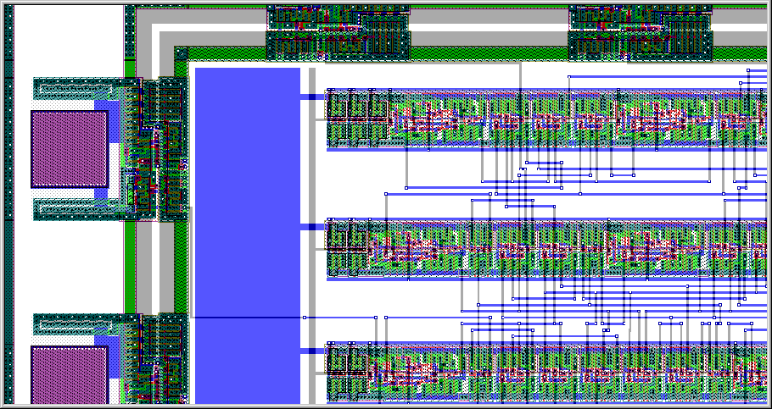
4.4 Legalization and Detailed Placement
Legal positions of standard cells between VDD and GND rails
Power Rail
Standard Cell Row
VDD
GND
INV
NAND
NOR
© 2011 Springer Verlag

Slide 64
Summary of Chapter 4 – Problem Formulation and Objectives
Row-based standard-cell placement
Cell heights are typically fixed, to fit in rows (but some cells may have double and quadruple heights)
Legal cell sites facilitate the alignment of routing tracks, connection to power and ground rails
Wirelength as a key metric of interconnect
Bounding box half-perimeter (HPWL)
Cliques and stars
RMSTs and RSMTs
Objectives: wirelength, routing congestion, circuit delay
Algorithm development is usually driven by wirelength
The basic framework is implemented, evaluated and made competitive on standard benchmarks
Additional objectives are added to an operational framework

Slide 65
Summary of Chapter 4 – Global Placement
Combinatorial optimization techniques: min-cut and simulated annealing
Can perform both global and detailed placement
Reasonably good at small to medium scales
SA is very slow, but can handle a greater variety of constraints
Randomized and chaotic algorithms – small changes at the input can lead to large changes at the output
Analytic techniques: force-directed placement and non-convex optimization
Primarily used for global placement
Unrivaled for large netlists in speed and solution quality
Capture the placement problem by mathematical optimization
Use efficient numerical analysis algorithms
Ensure stability: small changes at the input can cause only small changes at the output
Example: a modern, competitive analytic global placer takes 20mins for global placement of a netlist with 2.1M cells (single thread, 3.2GHz Intel CPU) ^{[1]}
[1] M.-C.Kim, D. Lee, I. L. Markov: SimPL: An effective placement algorithm. ICCAD 2010: 649-656

Slide 66
Summary of Chapter 4 – Legalization and Detailed Placement
Legalization ensures that design rules & constraints are satisfied
All cells are in rows
Cells align with routing tracks
Cells connect to power & ground rails
Additional constraints are often considered, e.g., maximum cell density
Detailed placement reduces interconnect, while preserving legality
Swapping neighboring cells, rotating groups of three
Optimal branch-and-bound on small groups of cells
Sliding cells along their rows
Other local changes
Extensions to optimize routed wirelength, routing congestion and circuit timing
Relatively straightforward algorithms, but high-quality, fast implementation is important
Most relevant after analytic global placement, but are also used after min-cut placement
Rule of thumb: 50% runtime is spent in global placement, 50% in detailed placement ^{[1]}
[1] M.-C.Kim, D. Lee, I. L. Markov: SimPL: An effective placement algorithm. ICCAD 2010: 649-656

