Slide 1
ECE 667
Spring 2013
Synthesis and Verification of Digital Systems
Word-level (decision) Diagrams
BMDs, TEDs

Slide 2
Outline
Review of design representations
  common representations of Boolean and arithmetic functions
Motivation for word-level diagrams
  RTL synthesis, verification and verification
  Need more abstract representation
Higher level “decision” diagrams
  Binary Moment Diagram (BMD) – word level
  Taylor Expansion Diagram (TED) – symbolic level

Slide 3
Motivation (Verification)
Equivalence checking
  Logic, RTL, behavioral, algorithmic
  Difficulty: different levels of abstraction
Current approaches
  Structural (cut points)
  Functional (canonical BDDs)
  Not efficient for designs with arithmetic components
Q: how to perform verification of dataflow designs w/out bit-blasting
A: a canonical representation on a higher level of abstraction (BMD,TED)
B
+
A
F₁
*
1
0
-
a_{k}
D
s₁
>
b_{k}
A
*
F₂
-
0
1
B
*
a_{k}
D
s₂
b_{k}

Slide 4
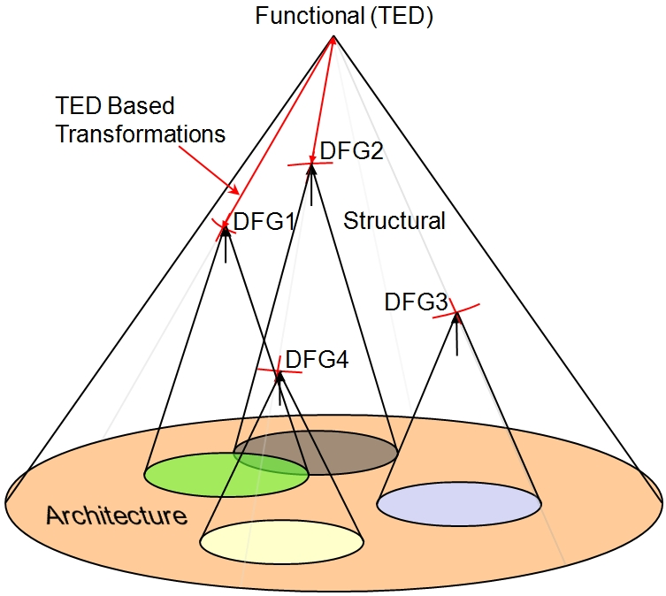
Motivation (Synthesis)
Typical design flow: single DFG extracted
  “what you write is what you get”
Better design space exploration
  Canonical representation
  Not required for synthesis, but useful in design space exploration
C, C++, HDL
Functional specification
DFG extraction
DFG extraction
High Level Synthesis
RTL HDL

Slide 5
Design Representations
Boolean functions ( f : B → B )
  Truth table, Karnaugh map
  SoP, PoS, ESoP
  Reed-Muller expansions (XOR-based)
  Decision diagrams (BDD, ZDD, etc.)
Arithmetic functions ( f : B → Int )
  Binary Moment Diagrams (*BMD, K*BMD, *PHDD)
  Multi-terminal, Algebraic Decision Diagrams (ADD)
Arithmetic functions (f : Int → Int )
  Taylor Expansion Diagrams (TED)

Slide 6
Canonical Representations
Each minimal, canonical representation is characterized by
  Decomposition type
    Shannon, Davio, moment decomposition, Taylor exp., etc.
  Reduction rules
    Redundant nodes, isomorphic sub-graphs, etc.
  Composition method (“APPLY”, or compose rule)
What they represent
  Boolean functions (f : B → B)
  Arithmetic functions (f : B → Int )
  Algebraic expressions (f : Int → Int )

Slide 7
Decomposition Types
Shannon expansion (used in BDDs)
  f = x f_{x} + x’ f_{x’}
Moment decomposition (BMD):
  replace x’=1-x,
  f = x f_{x} + (1-x) f_{x’} = f_{x’} + x f_{Δx}
  where f_{Δx} = f_{x} - f_{x’}
  also called positive Davio decomposition
Notes:
Derivation of Negative Davio:
Add and subtract f_{x} to Shannon expansion, then group by (1-x):
f_{x} - f_{x} + x f_{x} + (1-x) f_{x’} = f_{x} - (1-x) f_{x} + (1-x) f_{x’} = f_{x} + (1-x) (f_{x’} – f_{x})

Slide 8
Binary Moment Diagrams (*BMD)
Devised for word-level operations, arithmetic
Based on modified Shannon expansion (positive Davio)
  f = x f_{x} + x’ f_{x’} = x f_{x} + (1-x) f_{x’}
  = f_{x’} + x (f_{x} - f_{x’} ) = f_{x’} + x f_{Δx}
where f_{x’} = f_{x=0}, is zero moment
f_{Δ x} ⁼ (f_{x} - f_{x’} ) is first moment, first derivative
Additive and multiplicative weights on edges (*BMD)

Slide 9
*BMD - Construction
Unsigned integer: X = 8x₃ + 4x₂ + 2x₁ + x₀
X(x₃=1) = 8 + 4x₂ + 2x₁ + x₀
X(x₃=0) = 4x₂ + 2x₁ + x₀
X_{Δx3} = 8
x3
x3
*BMD
x2
x2
8
4
x1
x1
BMD
2
x0
1
x0
0
1
0
1
2
4
8
Multiplicative edges

Slide 10
*BMD - Word Level Representation
Efficiently modeling symbolic word-level operators
X Y
y2
X+Y
y2
y1
4
y1
2
4
y0
y0
2
1
x2
1
x2
4
4
x1
x1
2
2
x0
1
x0
1
0
1
0
1
Word level
Word level

Slide 11
Limitations of *BMD
*BMD requires bit-level expansion
  works on Boolean fundamentals
  modeled with constant and first moment only
BMD representation of F = X² , X={x₂, x₁, x₀}
x2
8
x1
x1
4
x0
x0
x0
0
1
2

Slide 12
Are BDDs and *BMDs sufficiently High Level?
Both are canonical for fixed variable order
BDDs
  Good for equivalence checking and SAT
  Inefficient for large arithmetic circuits (multipliers)
BMDs
  Efficient for word-level operators
  Less compact for Boolean logic than BDDs
  Good for equivalence checking, but not for SAT
  Insufficient for high-order arithmetic expressions

Slide 13
Symbolic Level Representation
Can we devise a more general representation than “word-level” *BMD ?
X + Y
X Y
Y
Y
X
X
0
1
0
1
Symbolic level
Symbolic level

Slide 14
Taylor Expansion Diagram (TED)
Function F treated as a continuous function
Taylor Expansion (around x=0):
  F(x) = F(0) + x F’(0) + ½ x² F’’(0) + …
Notation:
  F₀(x) = F(x=0) 0-child - - - - - -
  F₁(x) = F’(x=0) 1-child ----------
  F₂(x) = ½ F’’(x=0) 2-child ======
  etc.
F(x) = F₀(x) + x F₁(x) + x² F₂(x) + …
F(x)
x
…
F₀(x)
F₁(x)
F₂(x)

Slide 15
Construction - Your First TED
F = A²B + 2C + 3
A
F₀(A) = F_{|A=0} = 2C + 3
F₁(A) = F’_{|A=0} = 2AB_{|A=0} = 0
A
H
F₂(A) = ½ F’’_{|A=0} = B
B
G= 2C + 3
B
H₀(B) = B_{|B=0} = 0
C
H₁(B) = B’ = 1
C
G₀(C) = (2C+3)_{|C=0} = 3
0
3
2
1
G₁(C) = (2C+3)’ = 2
(normalization will move weights from terminals to edges)

Slide 16
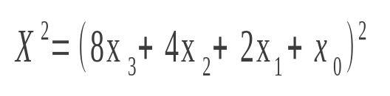
TED – a few Examples
(A+B)C +1
(A+B)(A+2C)
64
A
A
x3
1
16
1
B
16
x2
x2
B
B
1
8
C
C
4
4
1
x1
x1
2
1
4
2
1
0
1
1
x0
x0
0
1
1
1
0
1

Slide 17
TED Reduction Rules - 1
Eliminate redundant nodes:
a) Nodes with all empty edges
b) with only a constant term
f
f
a
a
g
g
b
0
b
0
0
f = 0 a² + 0 a + g(b) = g(b),
independent of a
f = 0 a² + 0 a + 0 = 0

Slide 18
TED Reduction Rules - 2
2. Merge isomorphic subgraphs (identical nodes)
(A² + 5A + 6)(B + C)
A
A
6
1
6
5
5
1
B
B
B
B
C
C
C
C
1
0
1
0
1
1
0

Slide 19
TED Normalization
TED is normalized if
  there are no more than two terminal nodes: 0 and 1
  weights of edges of a given node must be relatively prime (to allow sharing isomorphic graphs)
2(A + B + 3)
2
2A + 2B + 6
A
A
A
2
B
B
2
B
1
3
1
1
3
6
2
2
0
1
normalized
1

Slide 20
Normalization - Example
(A² + 5A + 6)(B + C)
A
A
A
6
1
6
5
5
1
B
B
B
B
B
B
B
C
C
C
C
C
C
C
6
0
5
0
1
1
0
1
0
1
1
0

Slide 21
TED: Composition (APPLY operation)
Recursive composition of nodes, starting at the top
f
g
h = f OP g
x
=
z
q
u
OP
y
v
OP = (+, - , •)
Operation depends on relative order of variables x, y
  if x = y, then z = x, and
  h(x) = f(x) OP g(x)
  = f₀(x) OP g₀(y) + x [f₁(x) OP g₁(y)] + x² [f₂(x) OP g₂], …
  if x > y, then z = x, and
  h(x) = f₀(x) OP g(y) + x [f₁(x) OP g(y)] + x² [f₂(x) OP g], …
  else ….

Slide 22
APPLY Operation - Example
A+B
A+2C
A
4
A
6
A
4•6
1•1
B
3
=
B
3•1
B
3•5
*
C
5
+
C
0•5
1•5
1•5
C
0
1
0
2
1
0•0
0•2
1•0
1•2
1•0
1•2
0•1
1•1
A
(A+B)(A+2C)
B
B
B
8+7
B
8
C
7
+
C
C
0+7
=
2
0
2
1
0
2
0
1
0+0
0+2
1

Slide 23
Properties of TED
Canonical (if ordered, reduced, normalized)
Linear for polynomials of arbitrary degree
Can contain word-level, and Boolean variables
TEDs can be manipulated (add, mult) using simple APPLY operator, similar to BDD or BMD:
    f = g + h; APPLY(+, g, h)
    f = g * h; APPLY(*, g, h)
    f = g – h; APPLY(+, g, APPLY(*, -1, h))

Slide 24
Properties of TED
Canonical
Compact
Linear for polynomials of arbitrary degree
  TED for X^{k}, k = const, with n bits, has k(n-1)+1 nodes.
Can contain symbolic, word-level, and Boolean variables
It is not a Decision Diagram
n = 4, k = 2
X²=(8x₃+4x₂+2x₁+x₀)²
64
x3
1
16
16
x2
x2
1
8
4
x1
4
x1
1
4
2
1
x0
x0
1
1
1
0
1

Slide 25
TED for Boolean logic
Needed to model arithmetic-Boolean interface
Same as *BMD for Boolean logic
x’ = (1-x)
x ∧y = x y
x ∨ y = (x + y – x y)
x ⊕ y = (x + y – 2 x y)
x
x
x
x
1
-1
y
y
y
y
y
0
1
-1
-2
1
1
NOT
0
1
0
1
0
1
AND
OR
XOR

Slide 26
TED for Arithmetic Circuits
Arithmetic circuits contain related word-level (A, B) and Boolean (a_{k}, b_{k}) variables
A = [ a_{n-1}, …, a_{k} , …,a₀ ] = 2^{(k+1)}A_{hi} + 2^{k} a_{k} + A_{lo}
A_{hi}
A_{lo}
A_{hi}
B
+
A
F₁
*
1
0
a_{k}
2^{(k+1)}
-
2^{k}
a_{k}
D
s₁
A_{lo}
>
b_{k}
s₁ = a_{k} (1-b_{k})
0
1

Slide 27
Applications to RTL Verification
Equivalence checking with TEDs
  interacting word-level and Boolean variables
A = [a_{n-1}, …,a_{k},…,a₀] = [A_{hi},a_{k},A_{lo}], B = [b_{n-1}, …,b_{k},…,b₀] = [B_{hi},b_{k},B_{lo}]
B
+
A
A
*
F₂
F₁
-
0
1
*
1
0
-
B
*
a_{k}
D
s₁
a_{k}
D
s₂
>
b_{k}
b_{k}
F₁ = s₁(A+B)(A-B) + (1-s₁)D
s₁ = (a_{k} > b_{k}) = a_{k} (1-b_{k})
F₂ = (1-s₂) (A²-B²) + s₂ D
s₂ = a_{k}’ ∨ b_{k} = 1 - a_{k} + a_{k} b_{k}

Slide 28
RTL Verification – cont’d.
F₁ = F₂
D
Related word-level and Boolean variables
F₁ = s₁(A+B)(A-B) + (1-s₁)D
  A = [A_{hi}, a_{k}, A_{lo}]
  B = [B_{hi}, b_{k}, B_{lo}]
s₁ = (a_{k} > b_{k}) = a_{k} (1-b_{k})
a_{k}
a_{k}
b_{k}
b_{k}
-1
-1
2^{2k+2}
A_{hi}
1
B_{hi}
2^{k+2}
-2^{2k+2}
This is a common (isomorphic)
TED for both designs:
TED(F1) ≡ TED(F2)
A_{lo}
A_{lo}
-2^{k+2}
2^{k}
2^{k+1}
B_{lo}
2^{k}
1
1
1

Slide 29
Verification of Algorithmic Specifications
Use TED to prove equivalence: IFFT_{i}=C_{i}
A0
A1
A2
FFT(A)
FAB1
IFFT0
x
A3
FAB2
IFFT1
x
InvFFT(FAB)
FAB2
IFFT2
B0
x
IFFT3
B1
x
FAB3
B2
FFT(B)
≡
B3
≡
A[0:3]
C0
C1
Conv(A,B)
C2
B[0:3]
C3

Slide 30
Summary
Features of TED
  Canonical, minimal, normalized
  Compact (linear for polynomials)
  Represents word-level blocks and Boolean logic
Applications
  Equivalence checking, RTL verification
  Symbolic simulation (representation)
  Algorithm verification
Open problems
  Satisfiability, functional test generation
  Finite precision arithmetic

