Slide 1
Global Routing
Mustafa Ozdal

Slide 2
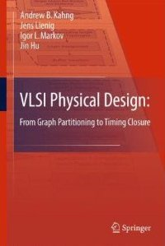
Chapter 2 – Netlist and System Partitioning
MOST SLIDES ARE FROM THE BOOK:
VLSI Physical Design: From Graph Partitioning to Timing Closure
MODIFICATIONS WERE MADE ON THE ORIGINAL SLIDES
Original Authors:
Andrew B. Kahng, Jens Lienig, Igor L. Markov, Jin Hu

Slide 3
Chapter 5 – Global Routing
5.1 Introduction
5.2 Terminology and Definitions
5.3 Optimization Goals
5.4 Representations of Routing Regions
5.5 The Global Routing Flow
5.6 Single-Net Routing
5.6.1 Rectilinear Routing
5.6.2 Global Routing in a Connectivity Graph
5.6.3 Finding Shortest Paths with Dijkstra’s Algorithm
5.6.4 Finding Shortest Paths with A* Search
5.7 Full-Netlist Routing
5.7.1 Routing by Integer Linear Programming
5.7.2 Rip-Up and Reroute (RRR)
5.8 Modern Global Routing
5.8.1 Pattern Routing
5.8.2 Negotiated-Congestion Routing

Slide 4
5.1 Introduction
System Specification
Partitioning
Architectural Design
ENTITY test is port a: in bit; end ENTITY test;
Functional Design and Logic Design
Chip Planning
Circuit Design
Placement
Physical Design
Clock Tree Synthesis
Physical Verification and Signoff
DRC LVS
ERC
Signal Routing
Fabrication
Timing Closure
Packaging and Testing
Chip

Slide 5
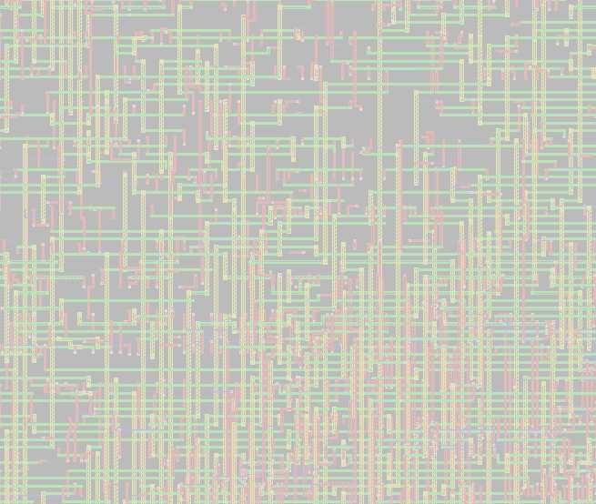
5.1 Introduction
Given a placement, a netlist and technology information,
determine the necessary wiring, e.g., net topologies and specific routing segments, to connect these cells
while respecting constraints, e.g., design rules and routing resource capacities, and
optimizing routing objectives, e.g., minimizing total wirelength and maximizing timing slack.

Slide 6
5.1 Introduction: General Routing Problem
Netlist:
Placement result
N₁ = {C₄, D₆, B₃}
N₂ = {D₄, B₄, C₁, A₄}
N₃ = {C₂, D₅}
N₄ = {B₁, A₁, C₃}
3
4
C
1
A
1
2
4
Technology Information (Design Rules)
1
3
B
4
5
6
4
D

Slide 7
5.1 Introduction: General Routing Problem
Netlist:
N₁ = {C₄, D₆, B₃}
N₂ = {D₄, B₄, C₁, A₄}
N₃ = {C₂, D₅}
N₄ = {B₁, A₁, C₃}
3
4
C
1
A
1
2
4
N₁
Technology Information (Design Rules)
1
3
B
4
5
6
4
D

Slide 8
5.1 Introduction: General Routing Problem
Netlist:
N₁ = {C₄, D₆, B₃}
N₂ = {D₄, B₄, C₁, A₄}
N₃ = {C₂, D₅}
N₄ = {B₁, A₁, C₃}
3
4
C
1
A
1
2
N₄
4
N₂
N₃
N₁
Technology Information (Design Rules)
1
3
B
4
5
6
4
D

Slide 9
5.1 Introduction
Routing
Multi-Stage Routing of Signal Nets
Global Routing
Detailed
Routing
Timing-Driven Routing
Large Single- Net Routing
Geometric Techniques
Coarse-grain assignment of routes to routing regions (Chap. 5)
Fine-grain assignment of routes to routing tracks (Chap. 6)
Net topology
optimization
and resource
allocation to
critical nets
(Chap. 8)
Power (VDD) and Ground (GND)
routing (Chap. 3)
Non-Manhattan and clock routing
(Chap. 7)

Slide 10
5.1 Introduction
Global Routing
Wire segments are tentatively assigned (embedded) within the chip layout
Chip area is represented by a coarse routing grid
Available routing resources are represented by edges with capacities in a grid graph
Nets are assigned to these routing resources
© 2011 Springer Verlag

Slide 11
5.1 Introduction
Global Routing
Detailed Routing
N₃
N₃
N₁
N₁
N₂
N₂
N₃
N₃
N₃
N₃
N₁
N₁
N₂
N₁
N₁
N₂
Horizontal Segment
Vertical Segment
Via

Slide 12
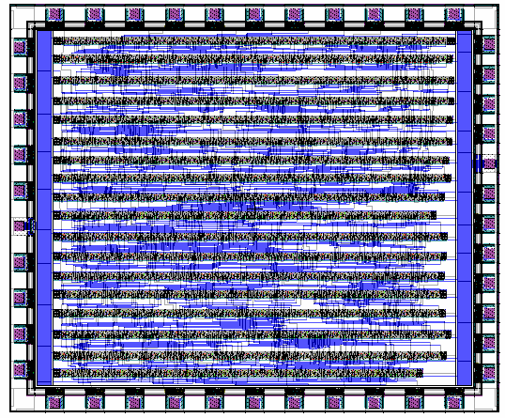
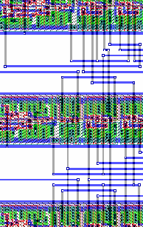
5.2 Terminology and Definitions
Channel
Rectangular routing region with pins on two opposite sides
Standard cell layout (Two-layer routing)

Slide 13
5.2 Terminology and Definitions
Channel
Rectangular routing region with pins on two opposite sides
Routing channel
Routing channel
Standard cell layout (Two-layer routing)

Slide 14
5.2 Terminology and Definitions
Capacity
Number of available routing tracks or columns
Horizontal Routing Channel
B
B
C
D
B
C
B
d_{pitch}
h
A
C
A
B
B
C
D

Slide 15
5.2 Terminology and Definitions
Capacity
Number of available routing tracks or columns
For single-layer routing, the capacity is the height h of the channel divided by the pitch d_{pitch}
For multilayer routing, the capacity σ is the sum of the capacities of all layers.
Horizontal Routing Channel
B
B
C
D
B
C
B
d_{pitch}
h
A
C
A
B
B
C
D

Slide 16
5.2 Terminology and Definitions
Switchbox (Two-layer macro cell layout)
Vertical Channel
Intersection of horizontal and vertical channels
B
C
3
Horizontal Channel
B
B
Horizontal Channel
A
C
A
B
Vertical Channel
Horizontal channel is routed after vertical channel is routed

Slide 17
5.2 Terminology and Definitions
T-junction (Two-layer macro cell layout)
B
C
C
B
B
Horizontal Channel
A
C
A
B
Vertical Channel

Slide 18
5.2 Terminology and Definitions
Gcells (Tiles) with macro cell layout
Metal1
Metal3
Metal2
Metal4
etc.

Slide 19
5.2 Terminology and Definitions
Gcells (Tiles) with standard cells
Metal1 (Standard cells)
Metal3
Metal2 (Cell ports)
Metal4
etc.

Slide 20
5.3 Optimization Goals
Global routing seeks to
determine whether a given placement is routable, and
determine a coarse routing for all nets within available routing regions
Considers goals such as
minimizing total wirelength, and
reducing signal delays on critical nets

Slide 21
5.4 Representations of Routing Regions
5.1 Introduction
5.2 Terminology and Definitions
5.3 Optimization Goals
5.4 Representations of Routing Regions
5.5 The Global Routing Flow
5.6 Single-Net Routing
5.6.1 Rectilinear Routing
5.6.2 Global Routing in a Connectivity Graph
5.6.3 Finding Shortest Paths with Dijkstra’s Algorithm
5.6.4 Finding Shortest Paths with A* Search
5.7 Full-Netlist Routing
5.7.1 Routing by Integer Linear Programming
5.7.2 Rip-Up and Reroute (RRR)
5.8 Modern Global Routing
5.8.1 Pattern Routing
5.8.2 Negotiated-Congestion Routing

Slide 22
5.4 Representations of Routing Regions
Routing regions are represented using efficient data structures
Routing context is captured using a graph, where
nodes represent routing regions and
edges represent adjoining regions
Capacities are associated with both edges and nodes to represent available routing resources

Slide 23
5.4 Representations of Routing Regions
Grid graph model
1
2
3
4
5
1
2
3
4
5
6
7
8
9
10
6
7
8
9
10
11
12
13
14
15
11
12
13
14
15
16
17
18
19
20
16
17
18
19
20
21
22
23
24
25
21
22
23
24
25
ggrid = (V,E), where the nodes v ∈ V represent the routing grid cells (gcells) and the edges represent connections of grid cell pairs (v_{i},v_{j})

Slide 24
5.4 Representations of Routing Regions
Channel connectivity graph
4
4
5
5
1
2
3
6
9
1
2
3
6
9
7
7
8
8
G = (V,E), where the nodes v ∈ V represent channels, and the edges E represent adjacencies of the channels

Slide 25
5.4 Representations of Routing Regions
Switchbox connectivity graph
1
4
11
1
4
11
5
9
12
5
9
12
2
6
2
6
7
10
13
7
10
13
3
8
14
3
8
14
G = (V, E), where the nodes v ∈ V represent switchboxes and an edge exists between two nodes if the corresponding switchboxes are on opposite sides of the same channel

Slide 26
5.5 The Global Routing Flow
Defining the routing regions (Region definition)
Layout area is divided into routing regions
Nets can also be routed over standard cells
Regions, capacities and connections are represented by a graph
Mapping nets to the routing regions (Region assignment)
Each net of the design is assigned to one or several routing regions to connect all of its pins
Routing capacity, timing and congestion affect mapping

Slide 27
5.6 Single-Net Routing
5.1 Introduction
5.2 Terminology and Definitions
5.3 Optimization Goals
5.4 Representations of Routing Regions
5.5 The Global Routing Flow
5.6 Single-Net Routing
5.6.1 Rectilinear Routing
5.6.2 Global Routing in a Connectivity Graph
5.6.3 Finding Shortest Paths with Dijkstra’s Algorithm
5.6.4 Finding Shortest Paths with A* Search
5.7 Full-Netlist Routing
5.7.1 Routing by Integer Linear Programming
5.7.2 Rip-Up and Reroute (RRR)
5.8 Modern Global Routing
5.8.1 Pattern Routing
5.8.2 Negotiated-Congestion Routing

Slide 28
5.6.1 Rectilinear Routing
B (2, 6)
B (2, 6)
S (2, 4)
C (6, 4)
C (6, 4)
A (2, 1)
A (2, 1)
Rectilinear minimum spanning tree (RMST)
Rectilinear Steiner minimum tree (RSMT)

Slide 29
5.6.1 Rectilinear Routing
An RMST can be computed in O(p²lgp) time, where p is the number of terminals in the net using methods such as Prim’s Algorithm
Prim’s Algorithm builds an MST by starting with a single terminal and greedily adding least-cost edges to the partially-constructed tree
Advanced computational-geometric techniques reduce the runtime to O(p log p)
29

Slide 30
5.6.1 Rectilinear Routing
Characteristics of an RSMT
An RSMT for a p-pin net has between 0 and p – 2 (inclusive) Steiner points
The degree of any terminal pin is 1, 2, 3, or 4 The degree of a Steiner point is either 3 or 4
A RSMT is always enclosed in the minimum bounding box (MBB) of the net
The total edge length L_{RSMT} of the RSMT is at least half the perimeter of the minimum bounding box of the net: L_{RSMT}  L_{MBB} / 2

Slide 31
5.6.1 Rectilinear Routing
Transforming an initial RMST into a low-cost RSMT
p₂
p₂
p₂
p₂
p₃
p₃
p₃
S
p₃
S₁
p₁
p₁
p₁
p₁
Construct L-shapes between points with (most) overlap of net segments
Final tree (RSMT)

Slide 32
Converting an MST to RSMT
p₂
p₂
p₁
p₁
p₁
p₃
p₃
p₃
p₄
p₄
p₄
Start with a minimum spanning tree (MST) with flylines
Consider the bounding boxes with largest overlaps
Choose the L-routes leading to the max segment sharing

Slide 33
5.6.1 Rectilinear Routing
Hanan grid
Adding Steiner points to an RMST can significantly reduce the wirelength
Maurice Hanan proved that for finding Steiner points, it suffices to consider only points located at the intersections of vertical and horizontal lines that pass through terminal pins
The Hanan grid consists of the lines x = x_{p}, y = y_{p} that pass through the location (x_{p},y_{p}) of each terminal pin p
The Hanan grid contains at most (n²-n) candidate Steiner points (n = number of pins), thereby greatly reducing the solution space for finding an RSMT

Slide 34
5.6.1 Rectilinear Routing
Terminal pins
Intersection lines
Hanan points ( )
RSMT

Slide 35
5.6.1 Rectilinear Routing
A Sequential Steiner Tree Heuristic
Find the closest (in terms of rectilinear distance) pin pair, construct their minimum bounding box (MBB)
Find the closest point pair (p_{MBB},p_{C}) between any point p_{MBB} on the MBB and p_{C} from the set of pins to consider
Construct the MBB of p_{MBB} and p_{C}
Add the L-shape that p_{MBB} lies on to T (deleting the other L-shape). If p_{MBB} is a pin, then add any L-shape of the MBB to T.
Goto step 2 until the set of pins to consider is empty

Slide 36
5.6.1 Rectilinear Routing: Example Sequential Steiner Tree Heuristic
1

Slide 37
5.6.1 Rectilinear Routing: Example Sequential Steiner Tree Heuristic
1
2
1

Slide 38
5.6.1 Rectilinear Routing: Example Sequential Steiner Tree Heuristic
p_{c}
1
3
2
1
MBB

Slide 39
5.6.1 Rectilinear Routing: Example Sequential Steiner Tree Heuristic
1
3
1
3
2
1
2
2
4
p_{MBB}

Slide 40
5.6.1 Rectilinear Routing: Example Sequential Steiner Tree Heuristic
1
3
1
3
1
3
2
1
2
2
2
3
4
4
5

Slide 41
5.6.1 Rectilinear Routing: Example Sequential Steiner Tree Heuristic
1
3
1
3
1
3
2
1
2
2
2
3
4
4
5
1
3
2
4
4
6
5

Slide 42
5.6.1 Rectilinear Routing: Example Sequential Steiner Tree Heuristic
1
3
1
3
1
3
2
1
2
2
2
3
4
4
5
1
3
1
3
2
4
2
5
4
4
6
5
6
5
7

Slide 43
5.6.1 Rectilinear Routing: Example Sequential Steiner Tree Heuristic
1
3
1
3
1
3
2
1
2
2
2
3
4
4
5
1
3
1
3
1
3
2
4
2
5
2
6
4
4
4
6
5
6
5
6
5
7
7

Slide 44
5.6.1 Rectilinear Routing: Example Sequential Steiner Tree Heuristic
1
3
1
3
1
3
2
1
2
2
2
3
4
4
5
1
3
1
3
1
3
2
4
2
5
2
6
4
4
4
6
5
6
5
6
5
7
7

Slide 45
What is wrong with this heuristic?

Slide 46
What is wrong with this heuristic?

Slide 47
What is wrong with this heuristic?

Slide 48
What is wrong with this heuristic?

Slide 49
What is wrong with this heuristic?

Slide 50
What is wrong with this heuristic?
Sequential processing of the pins leads to suboptimality.
Using the dashed segments would decrease the total wirelength.

Slide 51
Iterated 1-Steiner Approach
Notation:
ΔMST(A, x) = cost(MST(A)) – cost(MST(A U x))
i.e. the change in the MST cost after we add the extra point x
Iterated 1-Steiner Heuristic:
1. Start with the original point set P
2. Find the Steiner point x such that ΔMST(P, x) is maximum
3. If ΔMST(P, x) > 0 then add x to P
4. Remove the Steiner points in P that have degree ≤ 2
5. Repeat steps 2-4 until ΔMST(P, x) < 0

Slide 52
Example: Iterated 1-Steiner
Construct initial MST

Slide 53
Example: Iterated 1-Steiner
Determine the new Steiner point that will reduce the wirelength most

Slide 54
Example: Iterated 1-Steiner
Determine the new Steiner point that will reduce the wirelength most

Slide 55
Example: Iterated 1-Steiner
Determine the new Steiner point that will reduce the wirelength most

Slide 56
Example: Iterated 1-Steiner
Final Steiner tree

Slide 57
5.6.2 Global Routing in a Connectivity Graph
4
4
Channel connectivity graph
5
5
1
2
3
6
9
1
2
3
6
9
7
7
8
8
Switchbox connectivity graph
1
4
11
1
4
11
5
9
12
5
9
12
2
6
2
6
7
10
13
7
10
13
3
8
14
3
8
14

Slide 58
5.6.2 Global Routing in a Connectivity Graph
Channel connectivity graph
Switchbox connectivity graph

Slide 59
5.6.2 Global Routing in a Connectivity Graph
Combines switchboxes and channels, handles non-rectangular block shapes
Suitable for full-custom design and multi-chip modules
Overview:
1
2
3
4,2
4,2
4,2
4,2
3,1
4,2
1
A
2
3
B
4
1,2
1,5
1,2
1,2
7
1,2
0,4
0,1
1,2
4
5
6
7
5
6
A
8
4,2
4,2
9
4,2
4,2
8
B
9
10
11
12
2,2
2,7
2,2
2,2
2,7
2,2
10
11
12
Routing regions
Graph representation
Graph-based path search

Slide 60
5.6.2 Global Routing in a Connectivity Graph
Defining the routing regions
+
Horizontal macro-cell edges
Vertical macro-cell edges

Slide 61
5.6.2 Global Routing in a Connectivity Graph
Defining the connectivity graph
1
8
17
21
23
1
8
17
21
23
2
9
18
2
9
18
3
10
3
24
19
24
10
19
4
11
12
4
11
12
5
13
14
15
20
22
25
5
13
14
15
20
22
25
6
26
6
26
7
16
27
16
27
7

Slide 62
5.6.2 Global Routing in a Connectivity Graph
Horizontal capacity of routing region 1
Vertical capacity of routing region 1
2 Tracks
1
1,2
8
17
21
23
1 Track
1
8
17
21
23
2
9
18
2
9
18
3
10
3
24
19
24
10
19
4
11
12
4
11
12
5
13
14
15
20
22
25
5
13
14
15
20
22
25
6
26
6
26
7
16
27
16
27
7

Slide 63
5.6.2 Global Routing in a Connectivity Graph
1
8
17
21
23
1,2
1,3
1,1
1,4
1,1
1
8
17
21
23
2
9
18
2,2
2,3
2,1
2
9
18
3
10
3
24
2,2
1,1
19
4,1
24
6,1
10
19
4
11
12
4
11
12
2,2
2,1
2,1
5
13
14
15
20
22
25
5
13
14
15
20
22
25
3,2
3,1
3,1
3,1
3,1
3,4
3,1
6
26
6
1,2
26
1,1
7
16
27
16
27
7
1,2
1,8
1,1

Slide 64
l
1
2
3
w
1
A
2
3
4,2
4,2
4,2
Example
Global routing of the nets A-A and B-B
B
4
5
6
7
4
1,2
1,5
1,2
1,2
7
A
5
6
8
B
9
8
4,2
4,2
9
10
11
12
2,2
2,7
2,2
10
11
12

Slide 65
l
1
2
3
w
1
A
2
3
4,2
4,2
4,2
Example
Global routing of the nets A-A and B-B
B
4
5
6
7
4
1,2
1,5
1,2
1,2
7
A
5
6
8
B
9
8
4,2
4,2
9
10
11
12
2,2
2,7
2,2
10
11
12
1
2
3
A
4,2
3,1
4,2
B
4
1,2
0,4
0,1
1,2
7
A
5
6
B
8
4,2
4,2
9
2,2
2,7
2,2
10
11
12

Slide 66
l
1
2
3
w
1
A
2
3
4,2
4,2
4,2
Example
Global routing of the nets A-A and B-B
B
4
5
6
7
4
1,2
1,5
1,2
1,2
7
A
5
6
8
B
9
8
4,2
4,2
9
10
11
12
2,2
2,7
2,2
10
11
12
1
2
3
A
4,2
3,1
4,2
B
4
1,2
0,4
0,1
1,2
7
A
5
6
B
8
4,2
4,2
9
2,2
2,7
2,2
10
11
12
1
2
3
A
4,2
2,1
3,1
B
4
1,2
0,4
0,1
1,1
7
A
5
6
B
8
3,1
4,1
9
1,1
1,7
1,1
10
11
12

Slide 67
l
w
1
A
2
3
Example
Global routing of the nets A-A and B-B
B
4
5
6
7
A
8
B
9
10
11
12
A
B
A
B

Slide 68
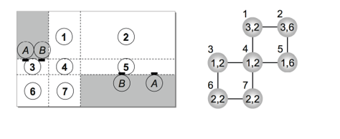
Quiz 10

Slide 69
1
2
3
Example
Determine routability of a placement
1
2
3
3,1
3,4
3,3
B
A
5
6
7
4
5
6
7
4
1,4
1,1
1,4
1,3
B
8
9
A
10
3,4
3,1
3,3
8
9
10
1
2
3
3,1
3,4
3,3
1
2
3
B
A
5
6
7
4
5
6
7
4
0,3
0,1
0,4
0,2
B
8
9
A
10
3,4
3,1
2,2
8
9
10
1
2
3
3,1
3,4
3,3
?
1
2
3
5
6
7
B
A
4
0,3
0,1
0,4
0,2
4
5
6
7
B
8
9
A
10
3,4
3,1
2,2
8
9
10

Slide 70
1
2
3
Example
Determine routability of a placement
1
2
3
3,1
3,4
3,3
B
A
5
6
7
4
5
6
7
4
1,4
1,1
1,4
1,3
B
8
9
A
10
3,4
3,1
3,3
8
9
10
1
2
3
3,1
3,4
3,3
1
2
3
B
A
5
6
7
4
5
6
7
4
0,3
0,1
0,4
0,2
B
8
9
A
10
3,4
3,1
2,2
8
9
10
1
2
3
2,0
2,3
3,3
1
2
3
5
6
7
B
A
4
0,2
0,0
0,3
0,2
4
5
6
7
B
8
9
A
10
2,3
2,0
2,2
8
9
10

Slide 71
Example
Determine routability of a placement
1
2
3
B
A
4
5
6
7
B
8
9
A
10
1
2
3
B
A
4
5
6
7
B
8
9
A
10

Slide 72
Single Net Routing Algorithms
Lee’s maze routing algorithm
Maze routing enhancements
Line search algorithms
Routing nets with multiple terminals
Dijkstra’s algorithm
A* search

Slide 73
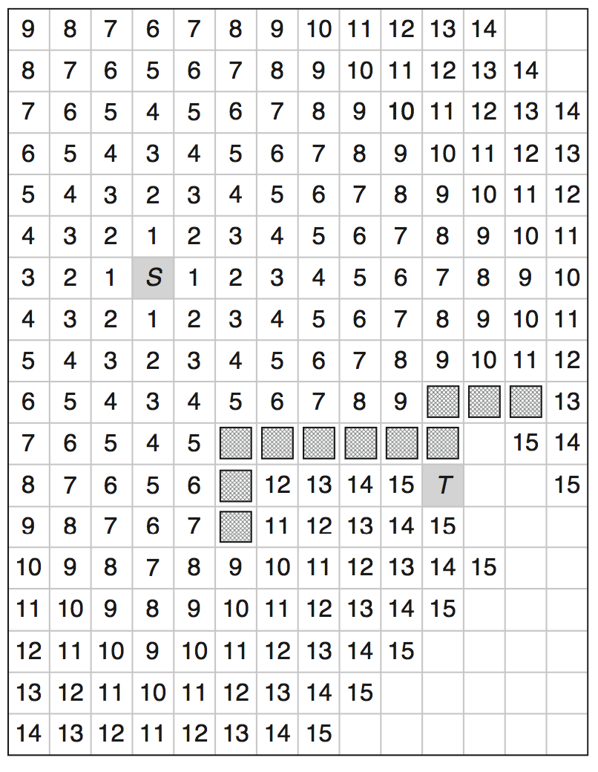
Lee’s Maze Routing Algorithm
Assumption:
Each grid cell has equal cost
Similar to breadth-first search
Two steps:
1. Expand a wavefront
2. Backtrace
Finds an optimal path

Slide 74
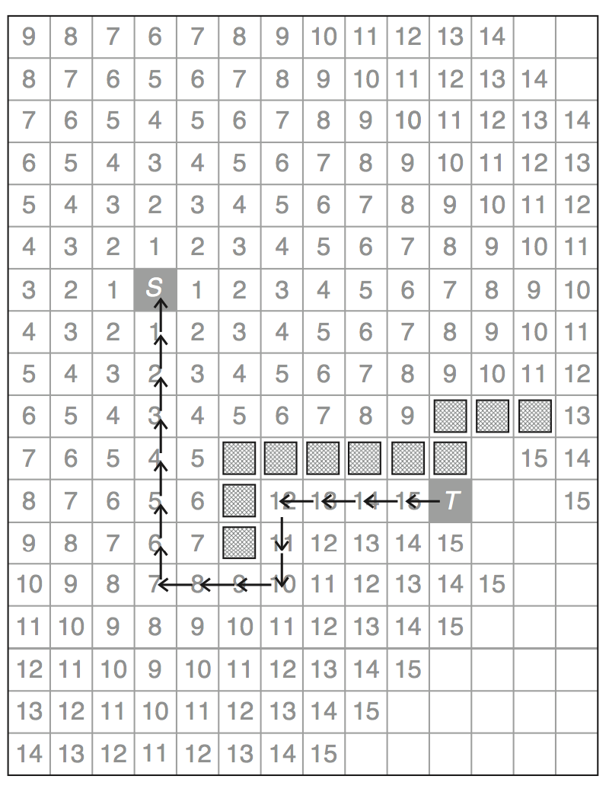
Lee’s Maze Routing Algorithm
Assumption:
Each grid cell has equal cost
Similar to breadth-first search
Two steps:
1. Expand a wavefront
2. Backtrace
Finds an optimal path

Slide 75
Exercise
s
t

Slide 76
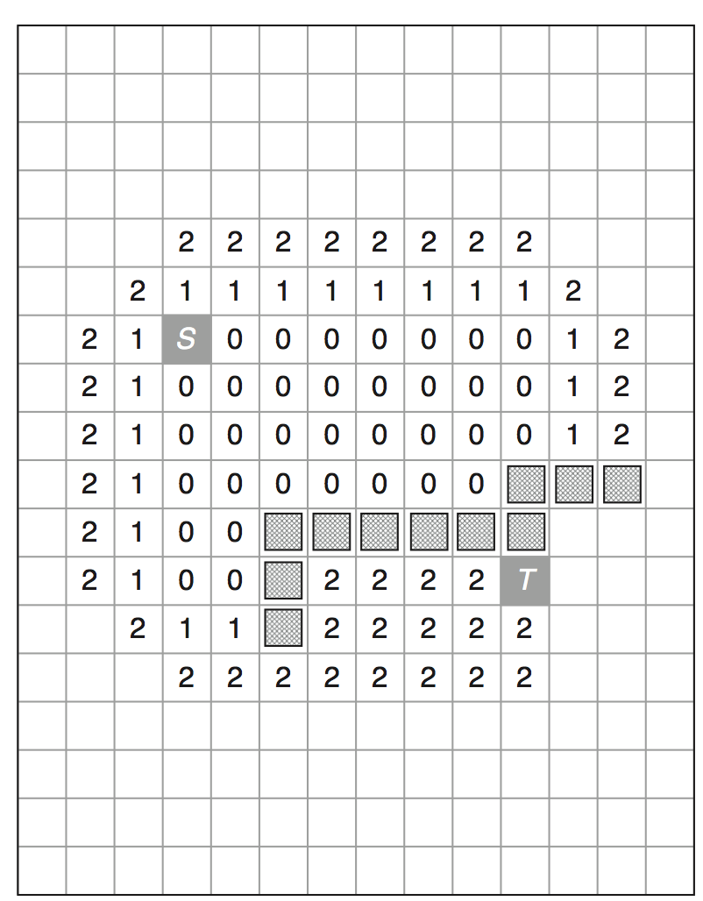
Hadlock’s Min Detour Algorithm
Observation: Shortest-path is the same as the path with min detour value.
Uses the detour number as cell label.
Cells with smaller labels expanded before others.
Finds an optimal path.

Slide 77
Wavefront Comparison
Lee’s Maze Router
Hadlock’s Min Detour Router

Slide 78
Exercise
s
t

Slide 79
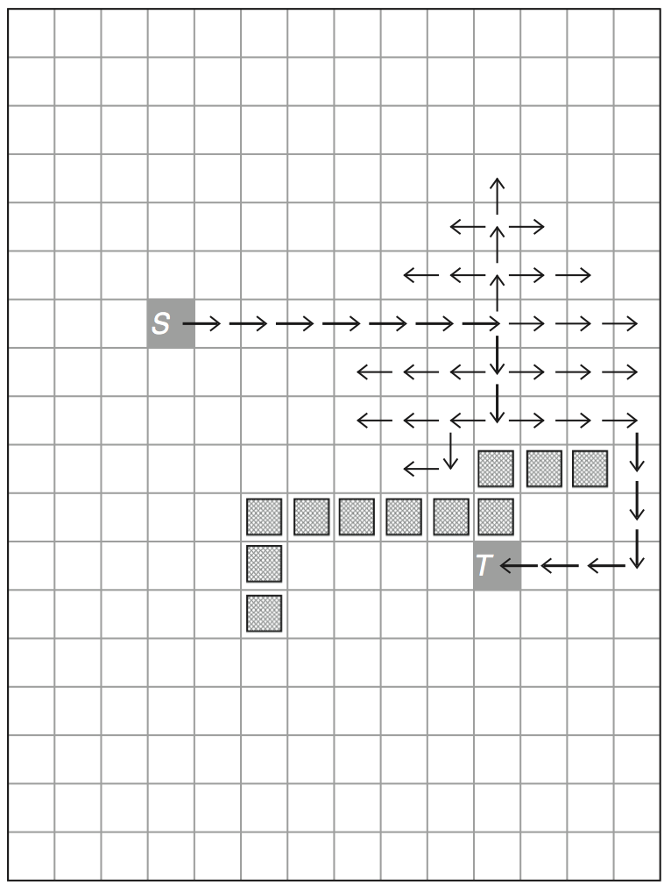
Soukup’s Fast Maze Routing Algorithm
Iteratively conducted in 2 phases:
Expand towards target without changing direction until an obstacle is encountered.
Expand all directions as in the original maze routing algorithm. When a cell in the direction toward target is found, switch back to phase 1.
Not guaranteed to find optimal path

Slide 80
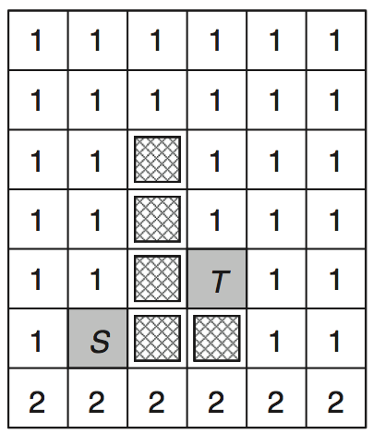
Maze Routing for Arbitrary Unit Costs
Previously assumed: All grid cells have equal costs.
What if different cells have different costs?
Will the original maze routing algorithm work?

Slide 81
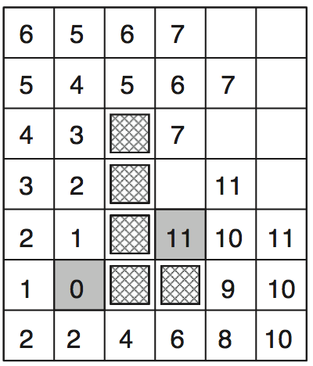
Maze Routing for Arbitrary Unit Costs
Consider Lee’s original maze routing algorithm.
This example illustrates the stage when the wavefront from the source reaches the target the first time.
Is this the optimal path?

Slide 82
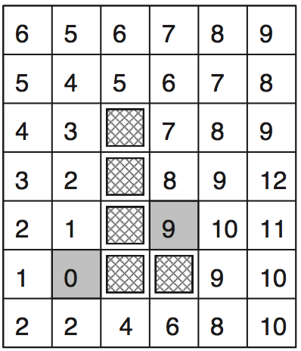
Maze Routing for Arbitrary Unit Costs
Continue expanding after reaching the target.
A longer path may turn out to have smaller cost.
Need to continue expanding after reaching the target.
The issue: We are using BFS on a graph with weighted edges.
➔ Use Dijkstra’s algorithm instead

Slide 83
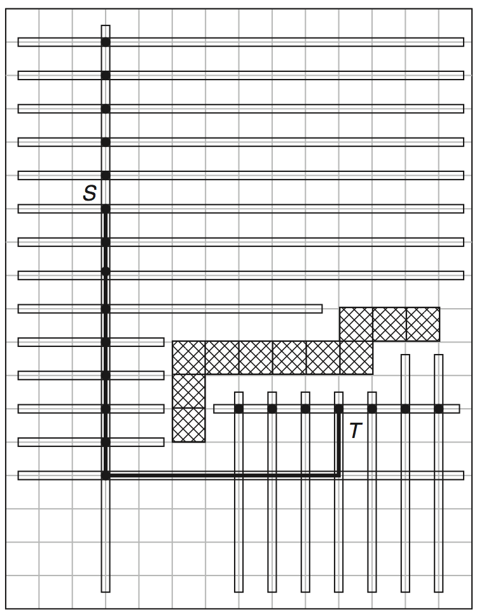
Mikami-Tabuchi’s Line Search Algorithm
Expand a horizontal and vertical line from source and target.
In every iteration, expand from the last expanded line.
Continue until a line from the source intersects another line from the target.
Backtrace from the intersection.
Guaranteed to find min-bend path

Slide 84
Exercise
s
t

Slide 85
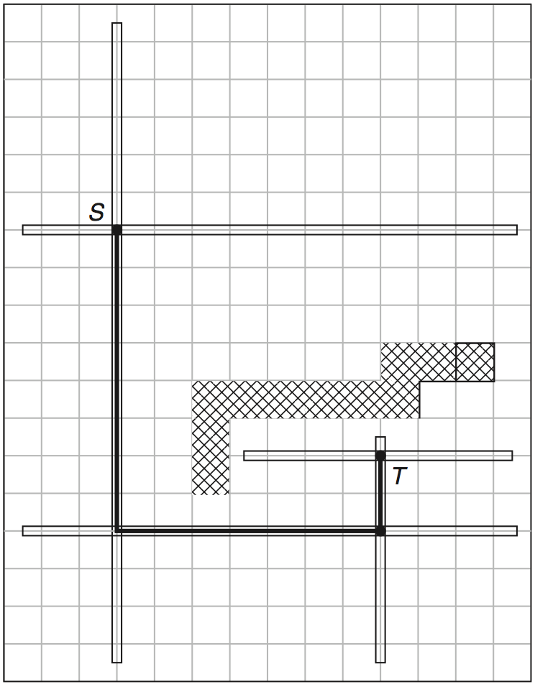
Hightower’s Line Search Algorithm
Does not expand from every point.
Identifies “escape lines” based on the positions of the obstacles that blocked the previous line.
Reduces the # of expansions significantly.
Not guaranteed to find a valid path even if one exists.

Slide 86
Exercise
s
t

Slide 87
Maze Routing and Line Search Algorithms Summary
Maze routing:
A variation of breadth-first search (BFS)
Worst case complexity when all costs are uniform: O(NxM)
where NxM is the grid size
➔ this complexity not guaranteed for arbitrary weights
Usually better to use Dijkstra’s algorithm for arbitrary weights
Line search:
Doesn’t have to visit all grid points
The runtime complexity depends on the # of bends
Good when the number of bends in the solution is small
Good when there are not many blockages in the design

Slide 88
5.6.3 Finding Shortest Paths with Dijkstra’s Algorithm
Finds a shortest path between two specific nodes in the routing graph
Input
graph G(V,E) with non-negative edge weights W,
source (starting) node s, and
target (ending) node t
Maintains three groups of nodes
Group 1 – contains the nodes that have not yet been visited
Group 2 – contains the nodes that have been visited but for which the shortest-path cost from the starting node has not yet been found
Group 3 – contains the nodes that have been visited and for which the shortest path cost from the starting node has been found
Once t is in Group 3, the algorithm finds the shortest path by backtracing

Slide 89
5.6.3 Finding Shortest Paths with Dijkstra’s Algorithm
Example
s
1,4
8,8
1
4
7
Find the shortest path from source s to target t where the path cost ∑w₁ + ∑w₂ is minimal
8,6
9,7
3,2
2
2,6
5
2,8
8
t
1,4
2,8
4,5
3
9,8
6
3,3
9

Slide 90
s
1
1,4
4
8,8
7
Group 2 | Group 3
8,6
9,7
3,2
(1)
2
2,6
5
2,8
8
t
1,4
2,8
4,5
3
9,8
6
3,3
9
Current node: 1

Slide 91
s
1
1,4
4
8,8
7
Group 2 | Group 3
N [2] 8,6
8,6
9,7
3,2
W [4] 1,4
[1]
2
2,6
5
2,8
8
t
W [4] 1,4
1,4
2,8
4,5
parent of node [node name] ∑w₁(s,node),∑w₂(s,node)
3
9,8
6
3,3
9
Current node: 1 Neighboring nodes: 2, 4
Minimum cost in group 2: node 4

Slide 92
s
1
1,4
4
8,8
7
Group 2 | Group 3
N [2] 8,6
8,6
9,7
3,2
W [4] 1,4
[1]
2
2,6
5
2,8
8
t
N [5] 10,11
W [7] 9,12
W [4] 1,4
1,4
2,8
4,5
N [2] 8,6
3
9,8
6
3,3
9
parent of node [node name] ∑w₁(s,node),∑w₂(s,node)
Current node: 4
Neighboring nodes: 1, 5, 7
Minimum cost in group 2: node 2

Slide 93
s
1
1,4
4
8,8
7
Group 2 | Group 3
N [2] 8,6
8,6
9,7
3,2
W [4] 1,4
[1]
2
2,6
5
2,8
8
t
N [5] 10,11
W [7] 9,12
W [4] 1,4
1,4
2,8
4,5
N [3] 9,10
W [5] 10,12
N [2] 8,6
3
9,8
6
3,3
9
N [3] 9,10
parent of node [node name] ∑w₁(s,node),∑w₂(s,node)
Current node: 2
Neighboring nodes: 1, 3, 5
Minimum cost in group 2: node 3

Slide 94
s
1
1,4
4
8,8
7
Group 2 | Group 3
N [2] 8,6
8,6
9,7
3,2
W [4] 1,4
[1]
2
2,6
5
2,8
8
t
N [5] 10,11
W [7] 9,12
W [4] 1,4
1,4
2,8
4,5
N [3] 9,10
W [5] 10,12
N [2] 8,6
3
9,8
6
3,3
9
W [6] 18,18
N [3] 9,10
Current node: 3
Neighboring nodes: 2, 6
N [5] 10,11
Minimum cost in group 2: node 5
parent of node [node name] ∑w₁(s,node),∑w₂(s,node)

Slide 95
s
1
1,4
4
8,8
7
Group 2 | Group 3
N [2] 8,6
8,6
9,7
3,2
W [4] 1,4
[1]
2
2,6
5
2,8
8
t
N [5] 10,11
W [7] 9,12
W [4] 1,4
1,4
2,8
4,5
N [3] 9,10
W [5] 10,12
N [2] 8,6
3
9,8
6
3,3
9
W [6] 18,18
N [3] 9,10
N [6] 12,19
Current node: 5
Neighboring nodes: 2, 4, 6, 8
N [5] 10,11
W [8] 12,19
Minimum cost in group 2: node 7
W [7] 9,12
parent of node [node name] ∑w₁(s,node),∑w₂(s,node)

Slide 96
s
1
1,4
4
8,8
7
Group 2 | Group 3
N (2) 8,6
8,6
9,7
3,2
W (4) 1,4
(1)
2
2,6
5
2,8
8
t
N (5) 10,11
W (7) 9,12
W (4) 1,4
1,4
2,8
4,5
N (3) 9,10
W (5) 10,12
N (2) 8,6
3
9,8
6
3,3
9
W (6) 18,18
N (3) 9,10
N (6) 12,19
Current node: 7
Neighboring nodes: 4, 8
N (5) 10,11
W (8) 12,19
Minimum cost in group 2: node 8
N (8) 12,14
W (7) 9,12
N (8) 12,14
parent of node [node name] ∑w₁(s,node),∑w₂(s,node)

Slide 97
s
1
1,4
4
8,8
7
Group 2 | Group 3
N (2) 8,6
8,6
9,7
3,2
W (4) 1,4
(1)
2
2,6
5
2,8
8
t
N (5) 10,11
W (7) 9,12
W (4) 1,4
1,4
2,8
4,5
N (3) 9,10
W (5) 10,12
N (2) 8,6
3
9,8
6
3,3
9
W (6) 18,18
N (3) 9,10
N (6) 12,19
Retrace from t to s
N (5) 10,11
W (8) 12,19
N (8) 12,14
W (7) 9,12
N (8) 12,14

Slide 98
s
1
1,4
4
9,12
7
12,14
2
5
8
t
3
6
9
Optimal path 1-4-7-8 from s to t with accumulated cost (12,14)

Slide 99
5.6.4 Finding Shortest Paths with A* Search
A* search operates similarly to Dijkstra’s algorithm, but extends the cost function to include an estimated distance from the current node to the target
Expands only the most promising nodes; its best-first search strategy eliminates a large portion of the solution space
30
21
29
19
28
t
22
13
O
11
20
t
5
4
O
O
6
1
5
12
O
3
1
s
Source
31
O
4
s
2
7
6
O
2
s
t
Target
27
18
10
3
8
14
26
17
9
15
23
O
Obstacle
25
16
24
Dijkstra‘s algorithm
(exploring 31 nodes)
A* search
(exploring 6 nodes)

Slide 100
A* Search
“Best-first” search
Cost function: f(x) = g(x) + h(x)
g(x): the cost of the partial path src → x
h(x): the estimated cost of the remaining path x → tgt
Note: If h(x) = 0 ➔ same as Dijkstra’s algorithm
Optimality: If h(x) is admissible then the path computed is guaranteed to be optimal
h(x) is admissible if it does not overestimate the cost

Slide 101
A* Search: Example
6
6
Assume each grid cell has cost = 1
t
5
5
O
O
5
5
An easy choice for h(x): the Manhattan
distance between x and tgt
➔ Guaranteed to be a lower bound
6
O
5
s
6
6
Another practical heuristic:
For identical f(x) values, break ties
based on h(x)
f(x) = 1 + 4 = 5
actual cost
s→x
est. cost
x→tgt

Slide 102
Optimality of A* Search
h(x) is admissible: h(x) does not overestimate the cost to target
Optimality proof:
When A* terminates its search at node t:
What is the cost of the path found?
f(t) = g(t)
Can there be another node y that has f(y) < f(t) ?
No, because we expand from the min cost node
Can there be another node y that can lead to a shorter path?
No, because f(y) = g(y) + h(y), and
h(y) underestimates the path length to target.

Slide 103
Inadmissible Heuristics
We may want to use inadmissible heuristics when:
We cannot find an effective admissible heuristics
e.g. When the edge weights differ a lot. What if there is a 0-cost edge?
We don’t want to explore all nodes with equal f(x) values
Possible to tradeoff solution quality vs. runtime using inadmissible heuristics
"Weighted A star with eps 5" by Subh83 - Own work. Licensed under CC BY 3.0 via Commons - https://commons.wikimedia.org/wiki/File:Weighted_A_star_with_eps_5.gif#/media/File:Weighted_A_star_with_eps_5.gif

Slide 104
Exercise
s
t

Slide 105
5.7 Full-Netlist Routing
5.1 Introduction
5.2 Terminology and Definitions
5.3 Optimization Goals
5.4 Representations of Routing Regions
5.5 The Global Routing Flow
5.6 Single-Net Routing
5.6.1 Rectilinear Routing
5.6.2 Global Routing in a Connectivity Graph
5.6.3 Finding Shortest Paths with Dijkstra’s Algorithm
5.6.4 Finding Shortest Paths with A* Search
5.7 Full-Netlist Routing
5.7.1 Routing by Integer Linear Programming
5.7.2 Rip-Up and Reroute (RRR)
5.8 Modern Global Routing
5.8.1 Pattern Routing
5.8.2 Negotiated-Congestion Routing

Slide 106
5.7 Full-Netlist Routing
Global routers must properly match nets with routing resources, without oversubscribing resources in any part of the chip
Signal nets are either routed
simultaneously, e.g., by integer linear programming, or
sequentially, e.g., one net at a time
When certain nets cause resource contention or overflow for routing edges, sequential routing requires multiple iterations: rip-up and reroute

Slide 107
5.7.2 Rip-Up and Reroute (RRR)
Rip-up and reroute (RRR) framework: focuses on hard-to-route nets
Idea: allow temporary violations, so that all nets are routed, but then iteratively remove some nets (rip-up), and route them differently (reroute)
B
A’
D’
Routing without allowing violations
A
Routing with allowing violations and RRR
B’
D
C
C’
B
A’
B
A’
D’
D’
A
A
B’
B’
D
C
D
C
C’
C’
WL = 21
WL = 19

Slide 108
5.8 Modern Global Routing
5.1 Introduction
5.2 Terminology and Definitions
5.3 Optimization Goals
5.4 Representations of Routing Regions
5.5 The Global Routing Flow
5.6 Single-Net Routing
5.6.1 Rectilinear Routing
5.6.2 Global Routing in a Connectivity Graph
5.6.3 Finding Shortest Paths with Dijkstra’s Algorithm
5.6.4 Finding Shortest Paths with A* Search
5.7 Full-Netlist Routing
5.7.1 Routing by Integer Linear Programming
5.7.2 Rip-Up and Reroute (RRR)
5.8 Modern Global Routing
5.8.1 Pattern Routing
5.8.2 Negotiated-Congestion Routing

Slide 109
5.8 Modern Global Routing
General flow for modern global routers, where each router uses a unique set of optimizations:
Global Routing Instance
Net Decomposition
Initial Routing
no
Violations?
Layer Assignment
(optional)
yes
Final Improvements
Rip-up and Reroute

Slide 110
5.8 Modern Global Routing
Pattern Routing
Searches through a small number of route patterns to improve runtime
Topologies commonly used in pattern routing: L-shapes, Z-shapes, U-shapes
Up-Right L-Shape
Right-Up L-Shape
Up-Right-Up Z-Shape
Right-Up-Right Z-Shape
Detour-Up Vertical U-Shape
Detour- Down Vertical U-Shape
Detour- Left Horizontal U-Shape
Detour- Right Horizontal U-Shape

Slide 111
5.8 Modern Global Routing
Negotiated-Congestion Routing
Each edge e is assigned a cost value cost(e) that reflects the demand for edge e
A segment from net net that is routed through e pays a cost of cost(e)
Total cost of net is the sum of cost(e) values taken over all edges used by net:
The edge cost cost(e) is increased according to the edge congestion φ(e), defined as the total number of nets passing through e divided by the capacity of e:
A higher cost(e) value discourages nets from using e and implicitly encourages nets to seek out other, less used edges
Iterative routing approaches (Dijkstra’s algorithm, A* search, etc.) find routes with minimum cost while respecting edge capacities

Slide 112
Summary of Chapter 5 – Types of Routing
Global Routing
Input: netlist, placement, obstacles + (usually) routing grid
Partitions the routing region (chip or block) into global routing cells (gcells)
Considers the locations of cells within a region as identical
Plans routes as sequences of gcells
Minimizes total length of routes and, possibly, routed congestion
May fail if routing resources are insufficient
Variable-die can expand the routing area, so can't usually fail
Fixed-die is more common today (cannot resize a block in a larger chip)
Interpreting failures in global routing
Failure with many violations => must restructure the netlist and/or redo global placement
Failure with few violations => detailed routing may be able to fix the problems

Slide 113
Summary of Chapter 5 – Types of Routing
Detailed Routing
Input: netlist, placement, obstacles, global routes (on a routing grid), routing tracks, design rules
Seeks to implement each global route as a sequence of track segments
Includes layer assignment (unless that is performed during global routing)
Minimizes total length of routes, subject to design rules
Timing-Driven routing
Minimizes circuit delay by optimizing timing-critical nets
Usually needs to trade off route length and congestion against timing
Both global and detailed routing can be timing-driven

Slide 114
Summary of Chapter 5 – Types of Routing
Large-Net Routing
Nets with many pins can be so complex that routing a single net warrants dedicated algorithms
Steiner tree construction
Minimum wirelength, extensions for obstacle-avoidance
Nonuniform routing costs to model congestion
Large signal nets are routed as part of global routing and then split into smaller segments processed during detailed routing
Clock Tree Routing / Power Routing
Performed before global routing to avoid competition for resources occupied by signal nets

Slide 115
Summary of Chapter 5 – Routing Single Nets
Usually ~50% of the nets are two-pin nets, ~25% have three pins, ~12.5% have four, etc.
Two-pin nets can be routed as L-shapes or using maze search (in a connectivity graph of the routing regions)
Three-pin nets usually have 0 or 1 branching point
Larger nets are more difficult to handle
Pattern routing
For each net, considers only a small number of shapes (L, Z, U, T, E)
Very fast, but misses many opportunities
Good for initial routing, sometimes is sufficient
Routing pin-to-pin connections
Breadth-first-search (when costs are uniform)
Dijkstra's algorithm (non-uniform costs)
A*-search (non-uniform costs and/or using additional distance information)

Slide 116
Summary of Chapter 5 – Routing Single Nets
Minimum Spanning Trees and Steiner Minimal Trees in the rectilinear topology (RMSTs and RSMTs)
RMSTs can be constructed in near-linear time
Constructing RSMTs is NP-hard, but feasible in practice
Each edge of an RMST or RSMT can be considered a pin-to-pin connection and routed accordingly
Routing congestion introduces non-uniform costs, complicates the construction of minimal trees (which is why A*-search still must be used)
For nets with <10 pins, RSMTs can be found using look-up tables (FLUTE) very quickly

Slide 117
Summary of Chapter 5 – Full Netlist Routing
Routing by Integer Linear Programming (ILP)
Capture the route of each net by 0-1 variables, form equations constraining those variables
The objective function can represent total route length
Solve the equations while minimizing the objective function (ILP software)
Usually a convenient but slow technique, may not scale to largest netlists (can be extended by area partitioning)
Rip-up and Re-route (RRR)
Processes one net at a time, usually by A*-search and Steiner-tree heuristics
Allows temporary overlaps between nets
When every net is routed (with overlaps), it removes (rips up) those with overlaps and routes them again with penalty for overlaps
This process may not finish, but often does, else use a time-out
Both ILP-based routing and RRR can be applied in global and detailed routing
ILP-based routing is usually preferable for small, difficult-to-route regions
RRR is much faster when routing is easy

Slide 118
Summary of Chapter 5 – Modern Global Routing
Initial routes are constructed quickly by pattern routing and the FLUTE package for Steiner tree construction - very fast
Several iterations based on modified pattern routing to avoid congestion - also very fast
Sometimes completes all routes without violations
If violations remain, they are limited to a few congested spots
The main part of the router is based on a variant of RRR called Negotiated-Congestion Routing (NCR)
Several proposed alternatives are not competitive
NCR maintains "history" in terms of which regions attracted too many nets
NCR increases routing cost according to the historical popularity of the regions
The nets with alternative routes are forced to take those routes
The nets that do not have good alternatives remain unchanged
Speed of increase controls tradeoff between runtime and route quality

