Slide 1
Excess Deaths in the United States during the COVID-19 Pandemic
Jason Rutberg

Slide 2
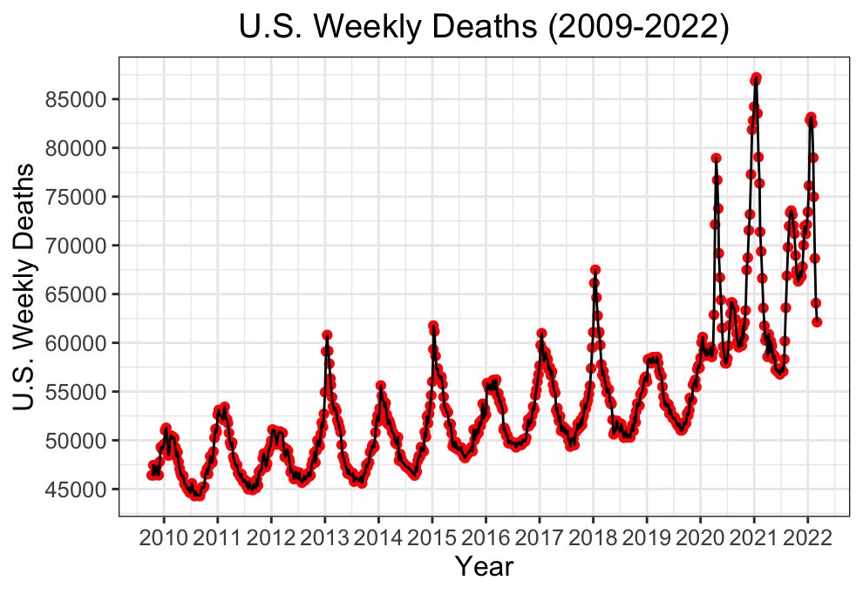
Time Series of Weekly Deaths in the United States

Slide 3
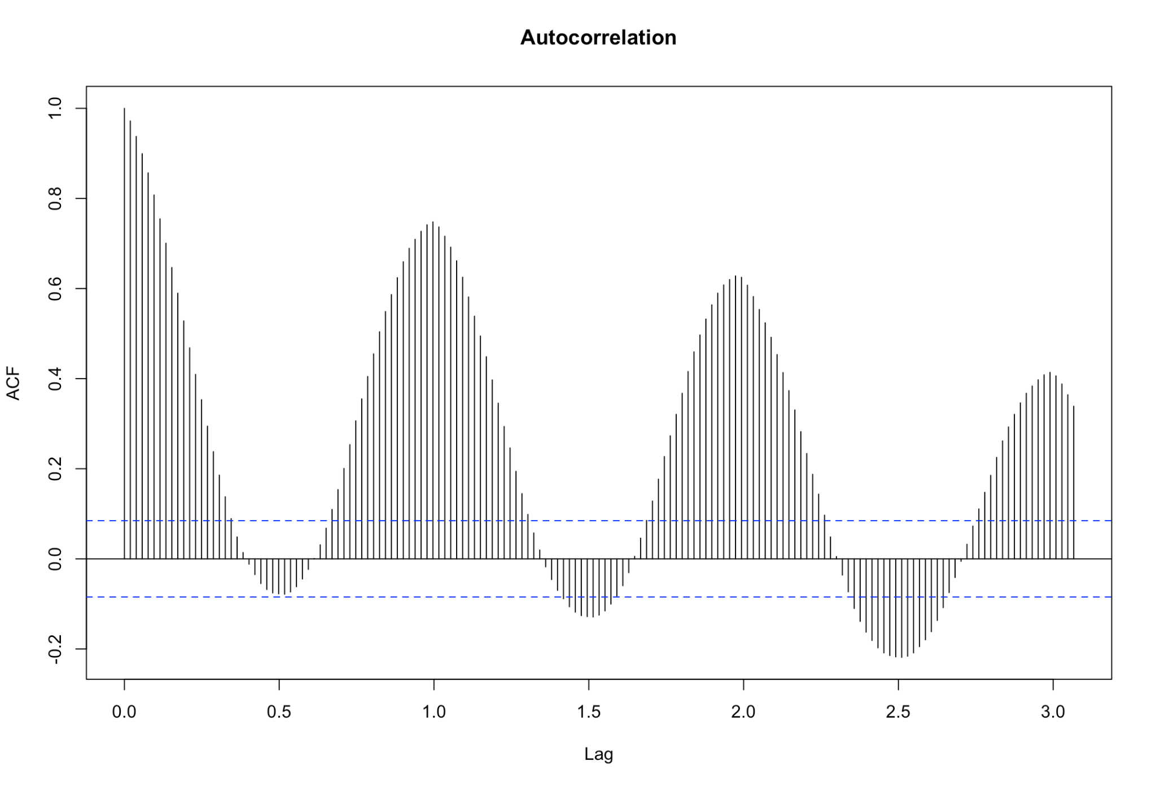
Autocorrelation
Notes:
Autocorrelation measures the linear relationship between lagged values of a time series. When data are seasonal, the autocorrelations will be larger for the seasonal lags (at multiples of the seasonal frequency) than for other lags

Slide 4
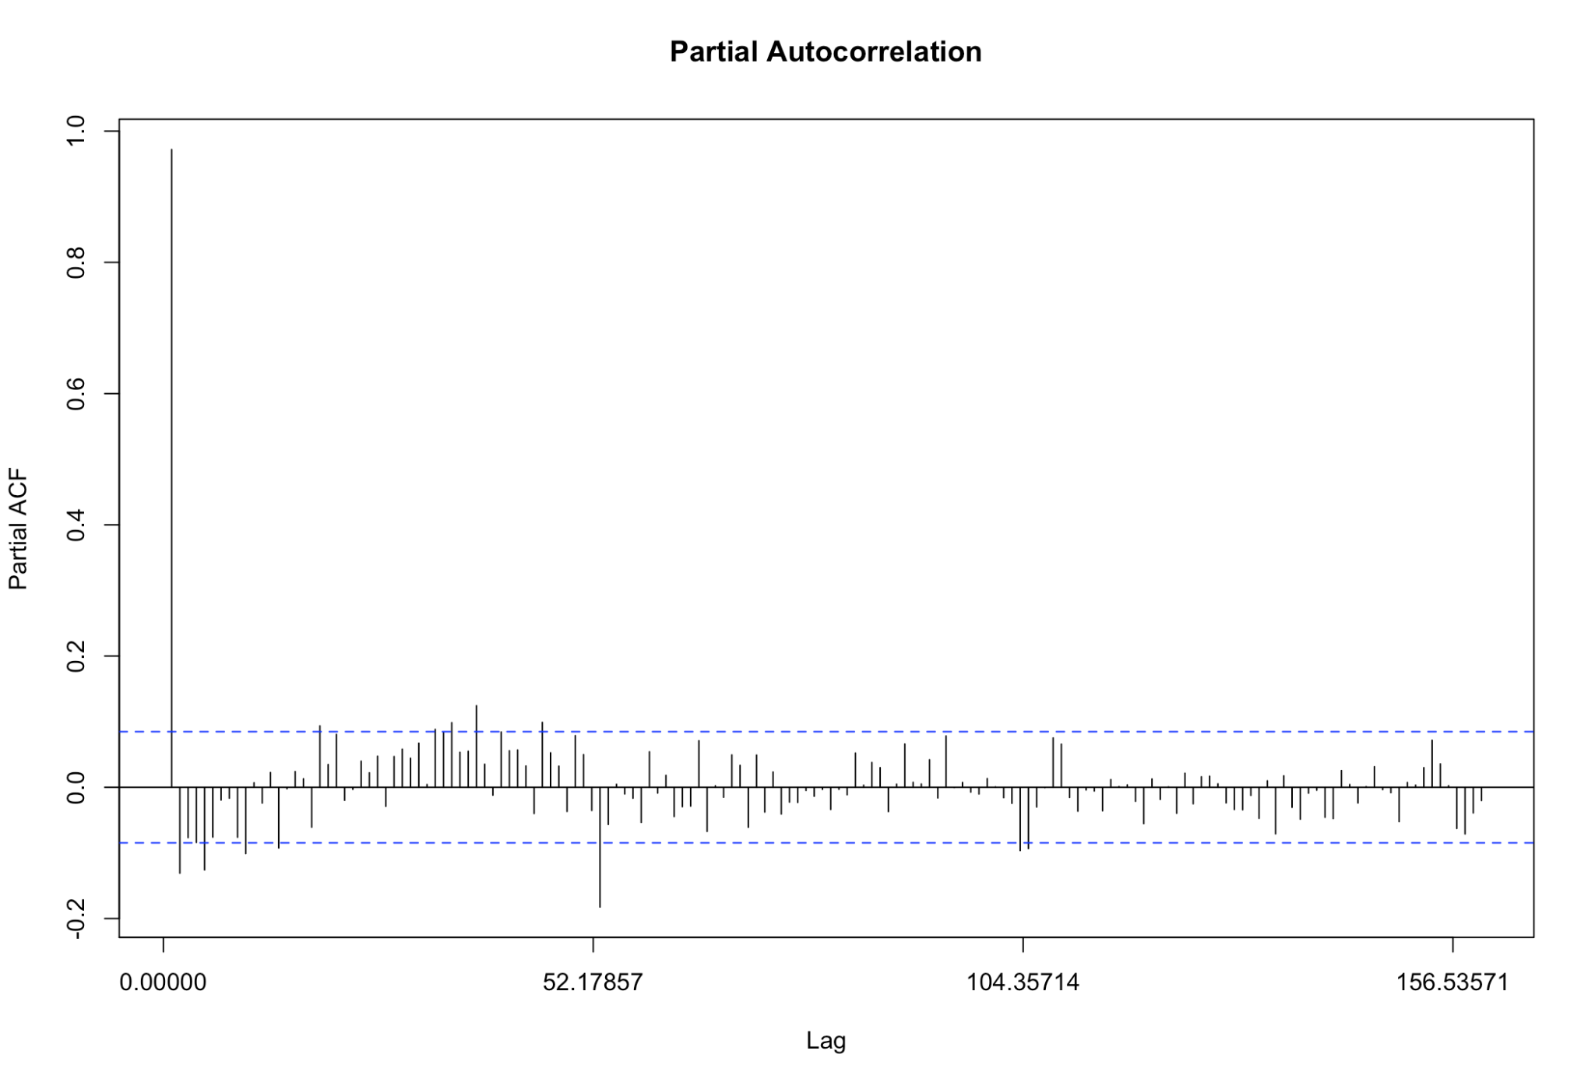
Partial Autocorrelation
Notes:
Partial autocorrelation measures the relationship between y_t and y_(t − k) after removing the effects of lags 1 , 2 , 3 , … , k − 1

Slide 5
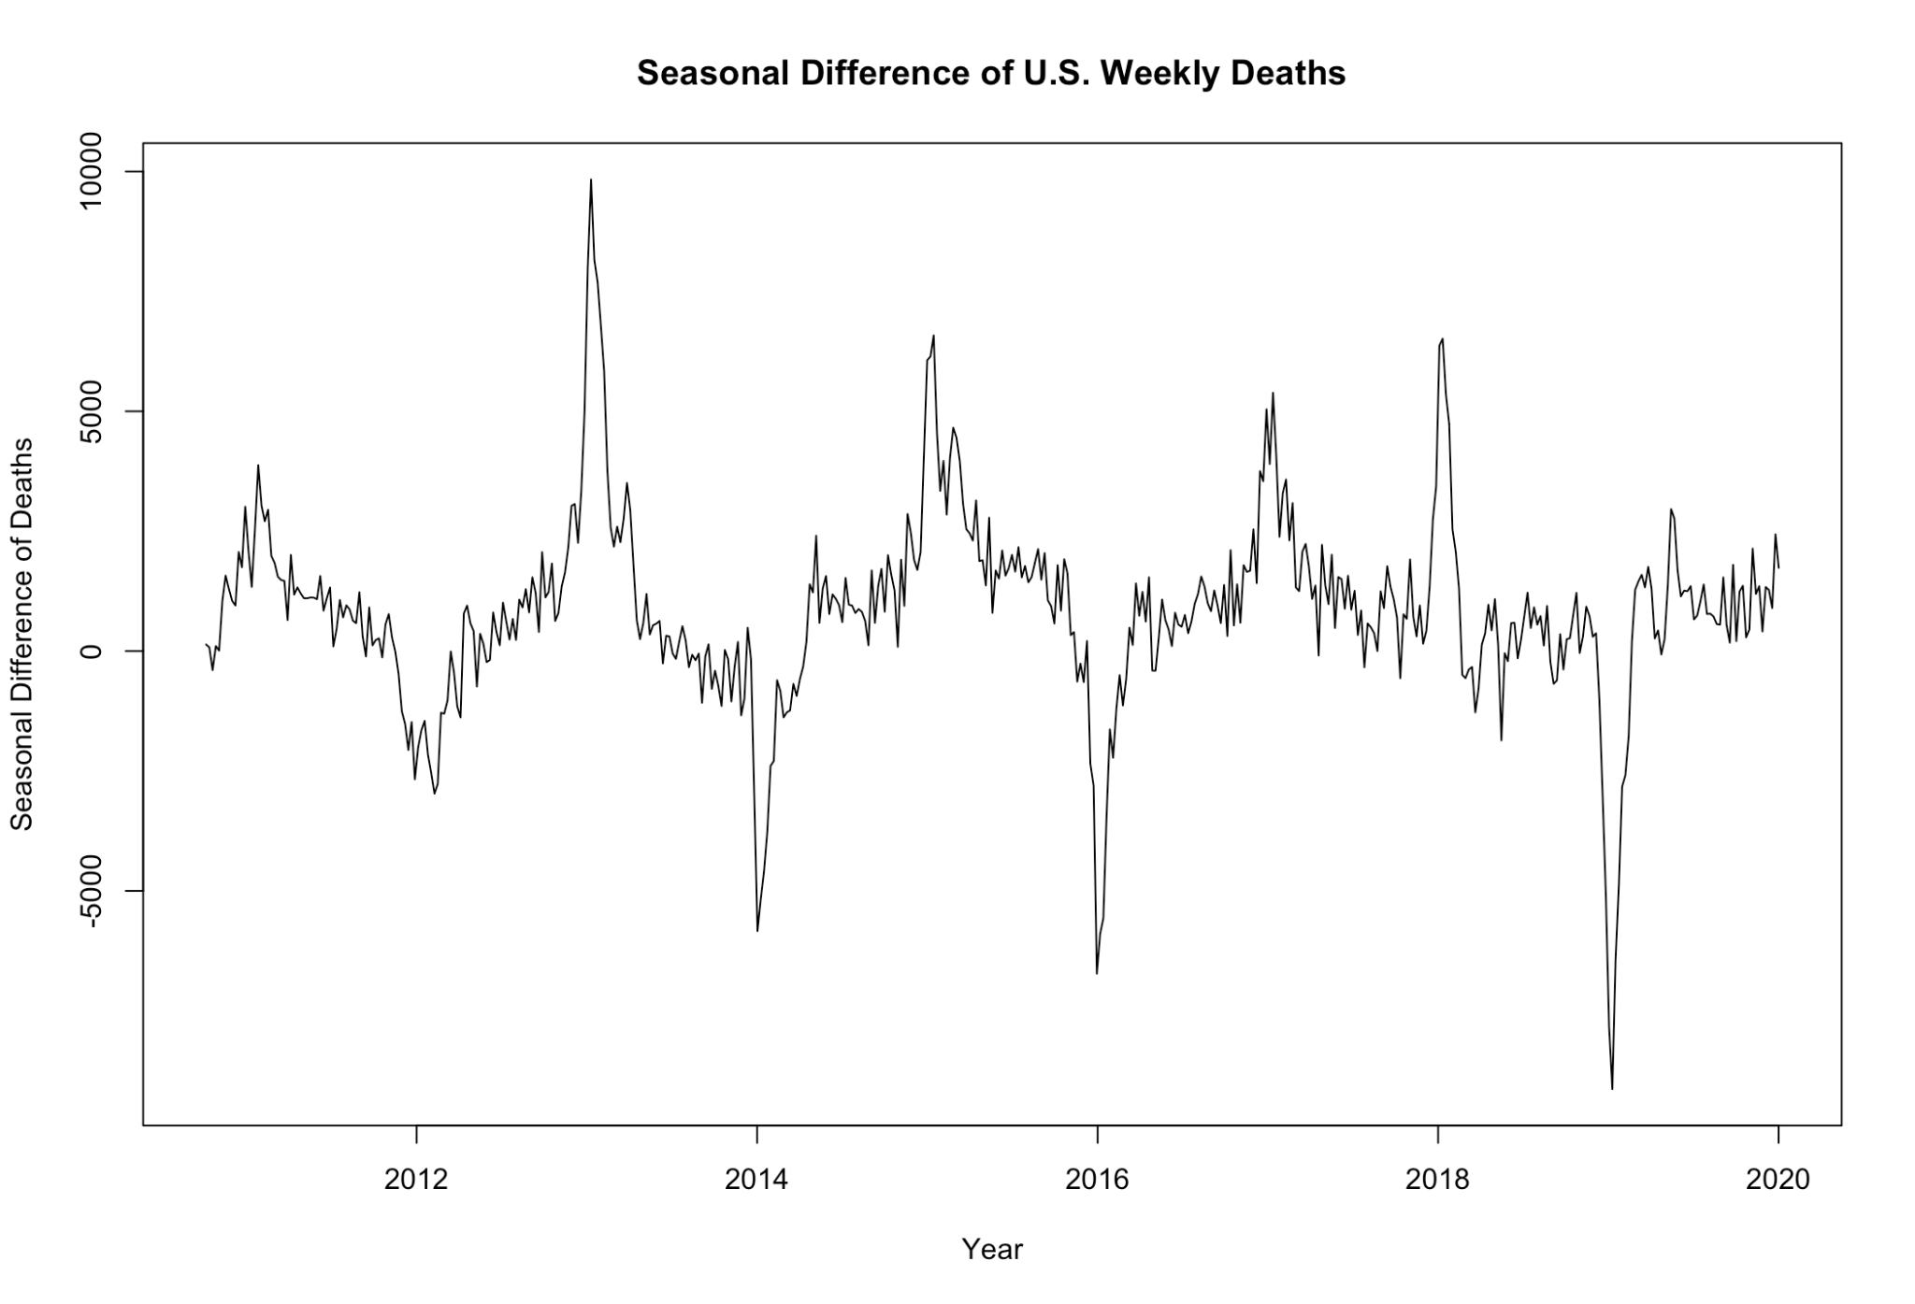
Seasonal Difference of Weekly Deaths
Notes:
Using the original time series, we performed the Kwiatkowski-Phillips-Schmidt-Shin (KPSS) test for stationarity (null hypothesis: data are stationary; alternative hypothesis: data are NOT stationary). The test statistic was 3.31 (p-value < 0.01). Thus, differencing was necessary. After taking the seasonal difference, the test statistic was 0.1032 (p-value > 0.10)

Slide 6
Time Series Models
Autoregressive of Order p [AR(p)]
Moving Average of Order q [MA(q)]
ARIMA(p, d, q)

Slide 7
Selected Model
Seasonal ARIMA Model: ARIMA (1, 0, 2) (2, 1, 1)₅₂
 | AR1 | MA1 | MA2 | SAR1 | SAR2 | SMA1 | Drift
Point Estimate | 0.8539 | -0.0389 | 0.1085 | -0.2593 | -0.1050 | -0.4760 | 16.3609
Standard Error | 0.0308 | 0.0535 | 0.0500 | 0.1365 | 0.0921 | 0.1349 | 1.9858
𝜎² = 497,003 AIC = 7747.58
Notes:
Selected Model (Using auto arima function): ARIMA(1, 0, 2)(2, 1, 1)[52]

Slide 8
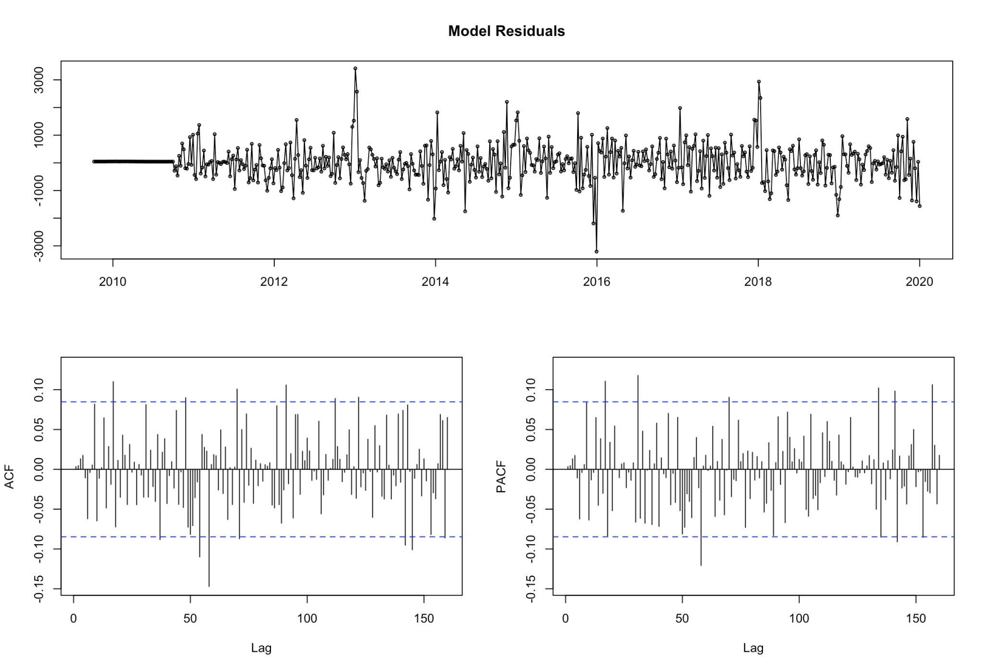
Model Residuals

Slide 9
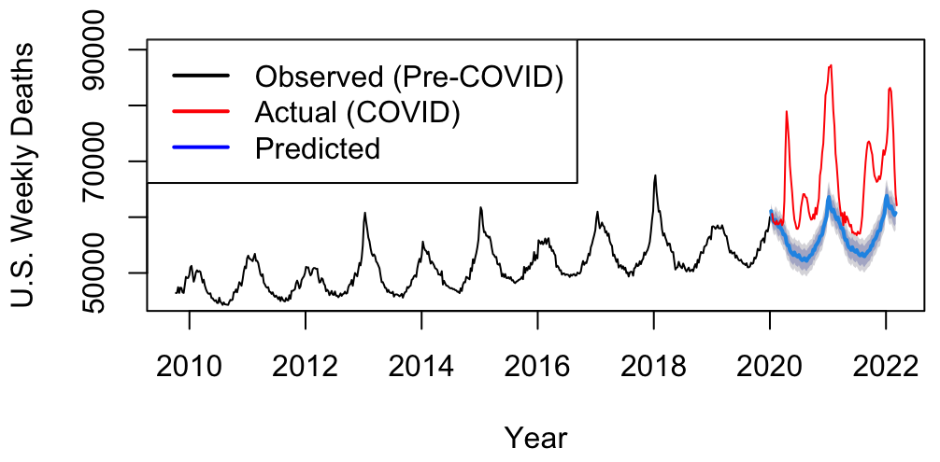
Model Predictions

Slide 10
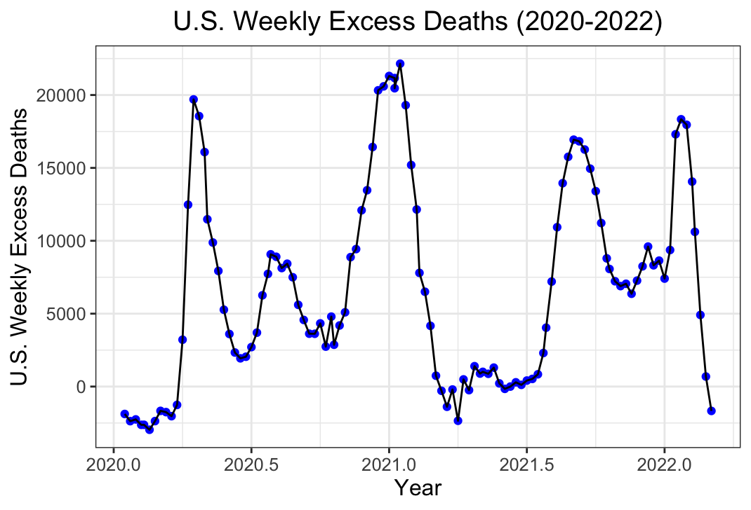
Weekly Excess Deaths in the United States
Notes:
According to this model, there were a total of 779,745 excess deaths in the U.S. from January 2020 to February 2022. Excess Deaths were defined as Actual Deaths – 95% Upper Limit from Prediction Interval.

Slide 11
References
1. CDC. Weekly U.S. Influenza Surveillance Report. Centers for Disease Control and Prevention. Published May 18, 2022. https://www.cdc.gov/flu/weekly/index.htm
‌2. Oracle.com. Published 2022. https://blogs.oracle.com/ai-and-datascience/post/introduction-to-forecasting-with-arima-in-r
3. Chapter 8 ARIMA models | Forecasting: Principles and Practice. Otexts.com. Published 2019. https://otexts.com/fpp2/arima.html
4. arima function - RDocumentation. www.rdocumentation.org. Accessed December 5, 2023. https://www.rdocumentation.org/packages/stats/versions/3.6.2/topics/arima
5. Using R for Time Series Analysis — Time Series 0.2 documentation. a-little-book-of-r-for-time-series.readthedocs.io. https://a-little-book-of-r-for-time-series.readthedocs.io/en/latest/src/timeseries.html
6. Time Series Analysis in R. GeeksforGeeks. Published April 20, 2020. https://www.geeksforgeeks.org/time-series-analysis-in-r/

