Slide 1
Data Analytics Course Project

Slide 2
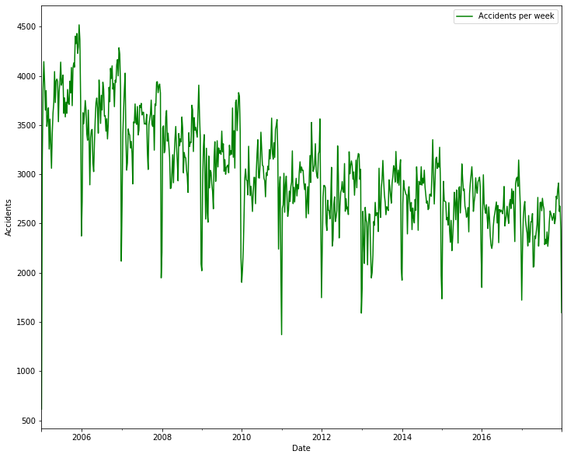
Can we try to forecast future accident data from current data?
We can use time series based modelling approaches to forecast future accident trends from current data. Let us look at a plot of the number of accidents per week over the years:

Slide 3
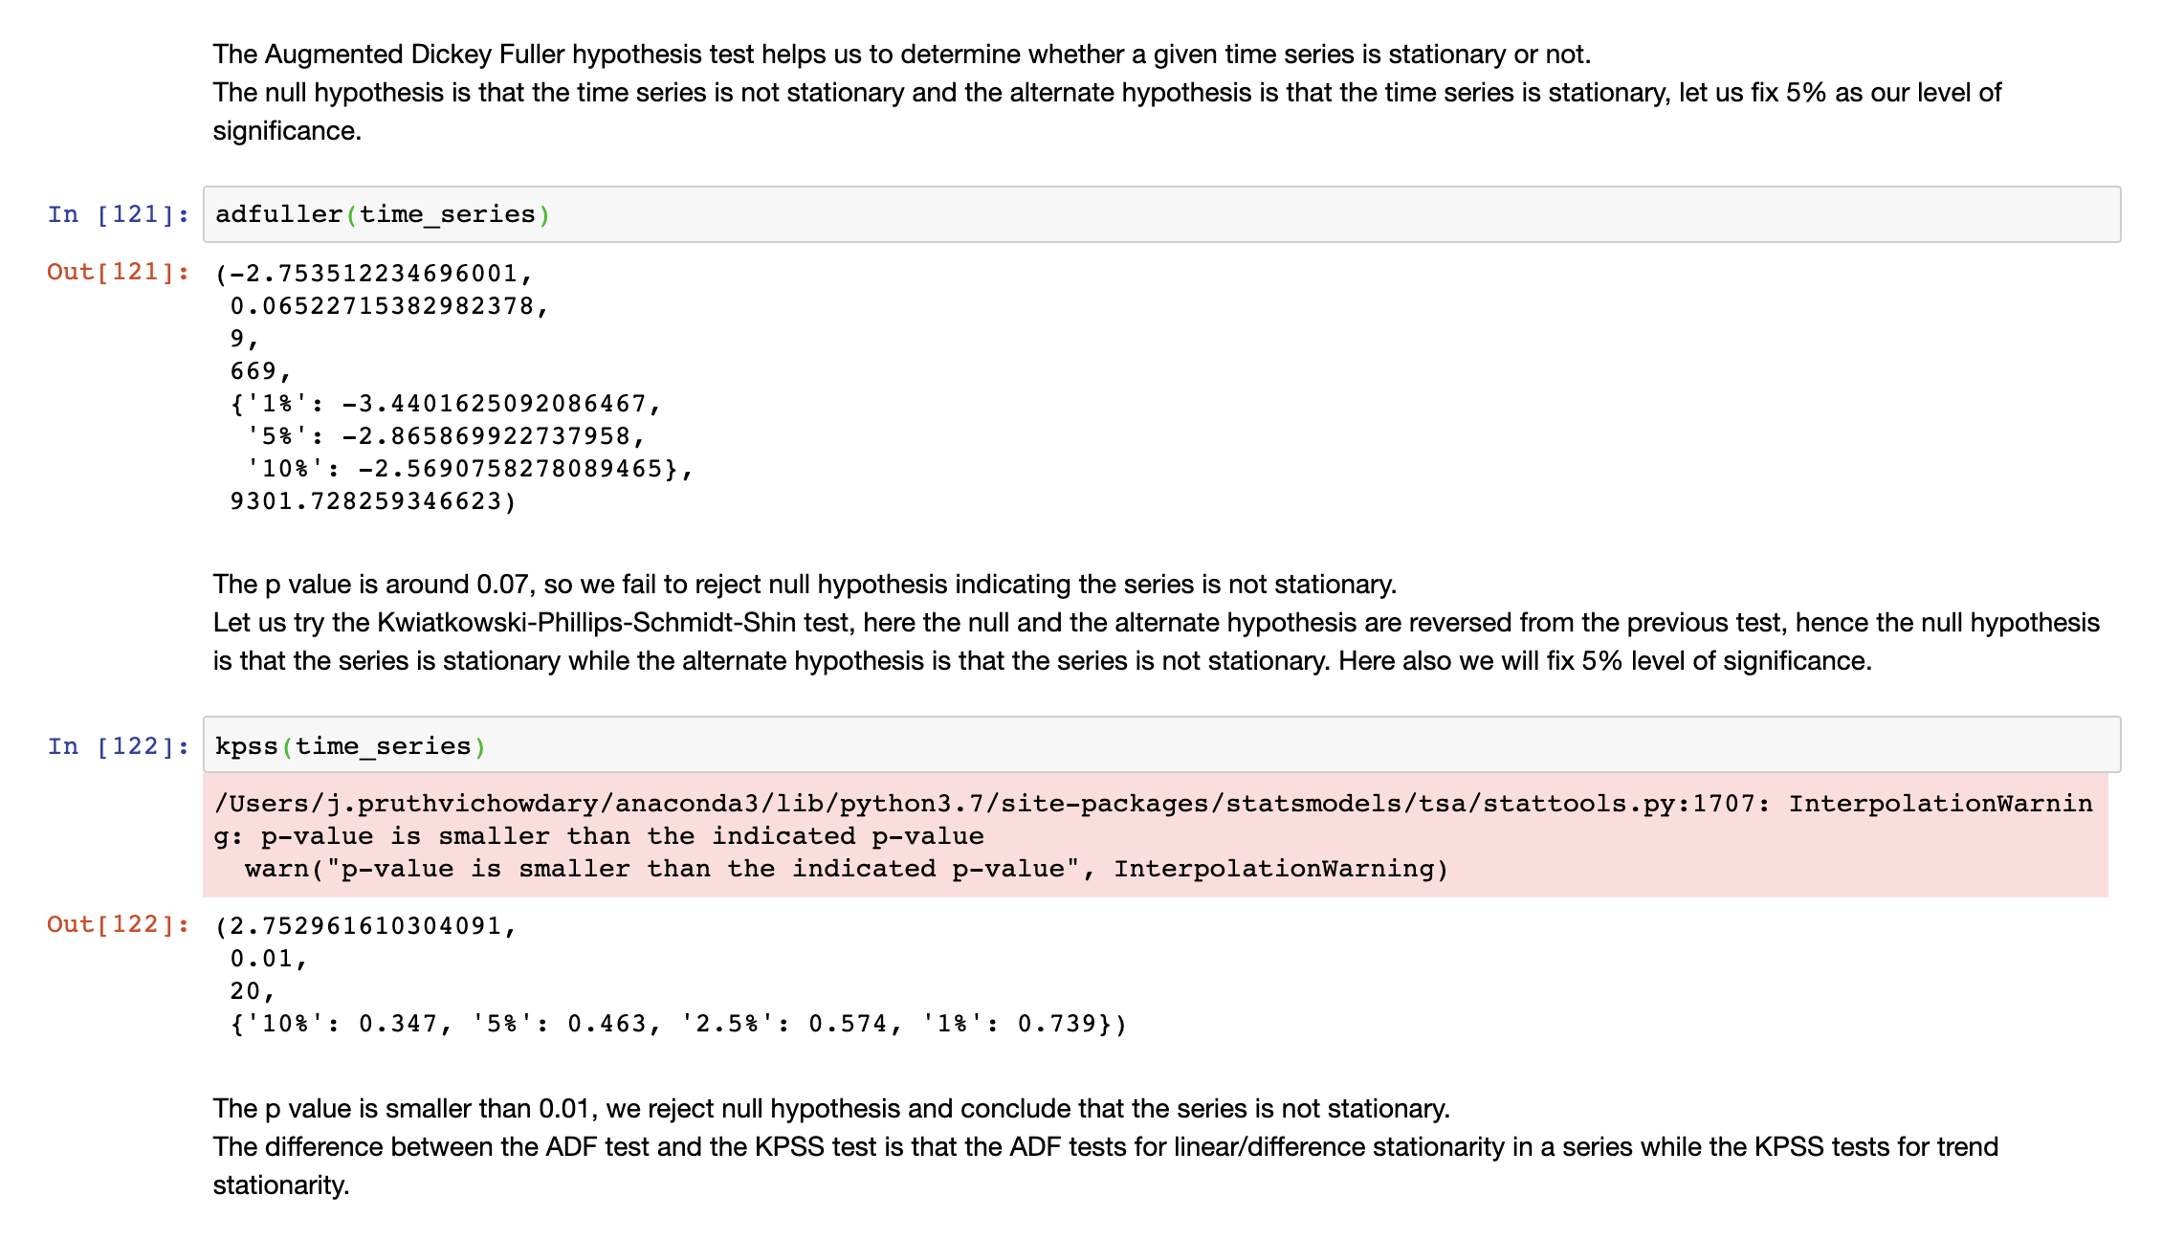
Visually we can see that the above series is not stationary, because clearly the mean of the data is changing over time.
We can also do this formally by using a variety of statistical tests:

Slide 4
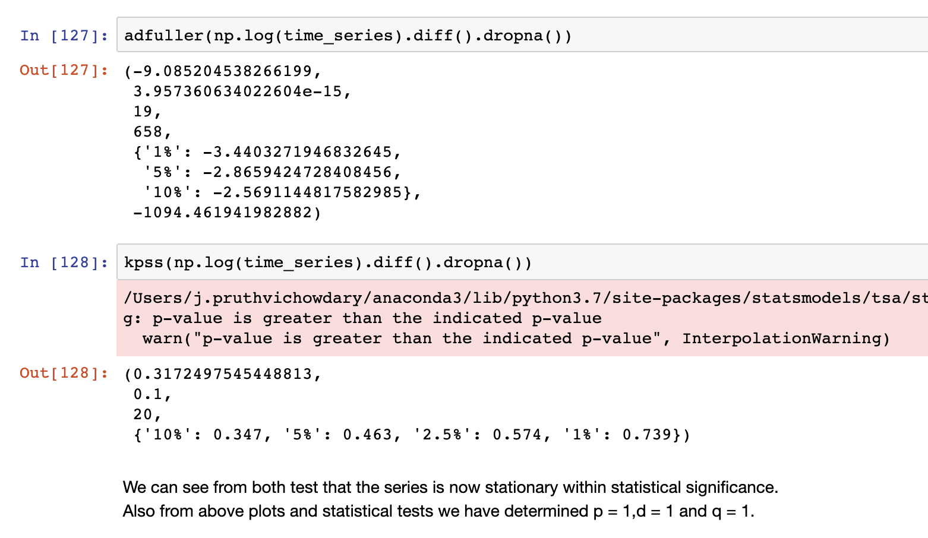
Now in order to stationarize the time series, we can apply log transformation so that it penalizes the higher values and hence decreases the trend in the data.
We can also try differencing(subtract the consecutive terms) in order to stationarise the time series.
We tried both log transform and first order differencing in order to stationarize this data.

Slide 5
Type of model used
We used ARIMA model which has both an auto-regressive component as well as a moving average one.
ARIMA fits a linear regression model between it’s own lags(AR) as well it’s own lagged forecast errors.
We can get the order of the AR term(p) from PACF plot and the order of the MA term from the ACF plot(q). The differencing was fixed as 1 as seen previously.

Slide 6
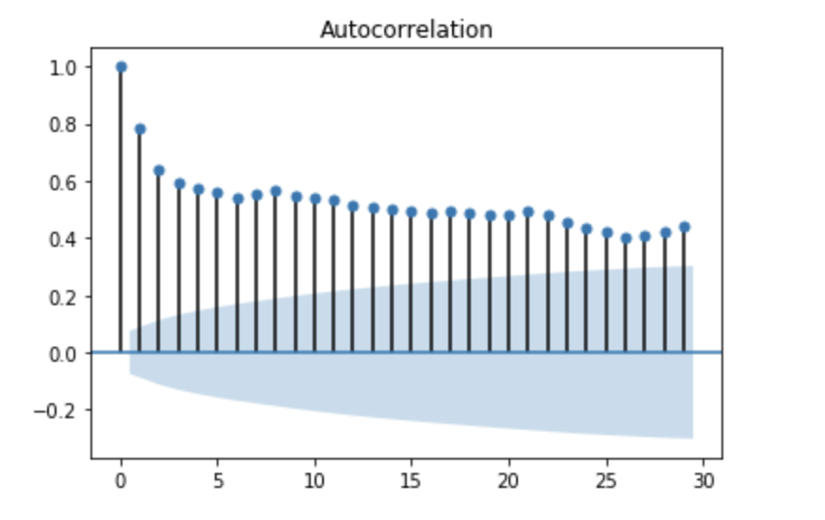
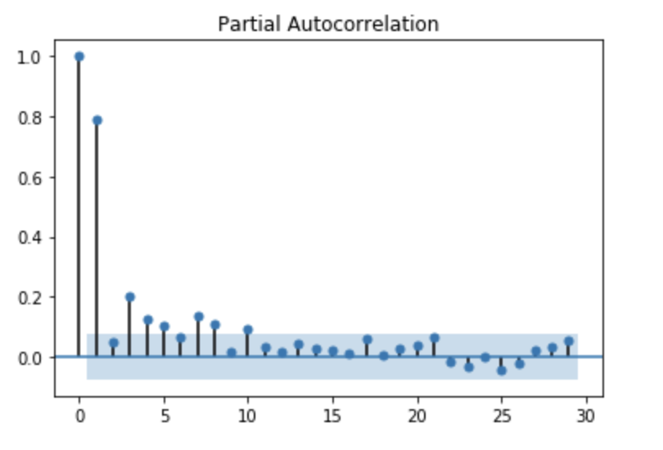
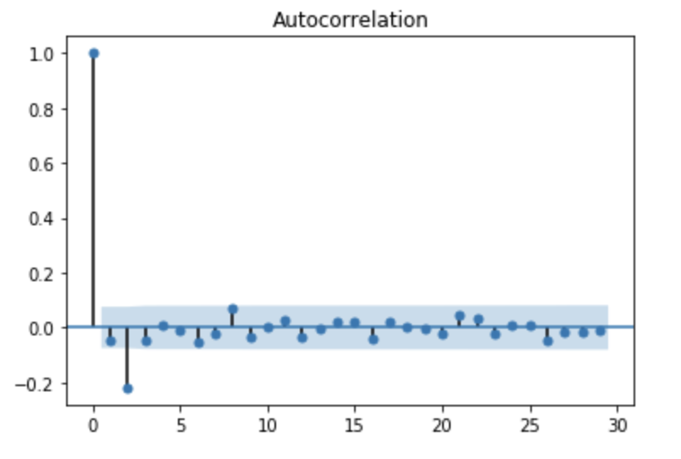
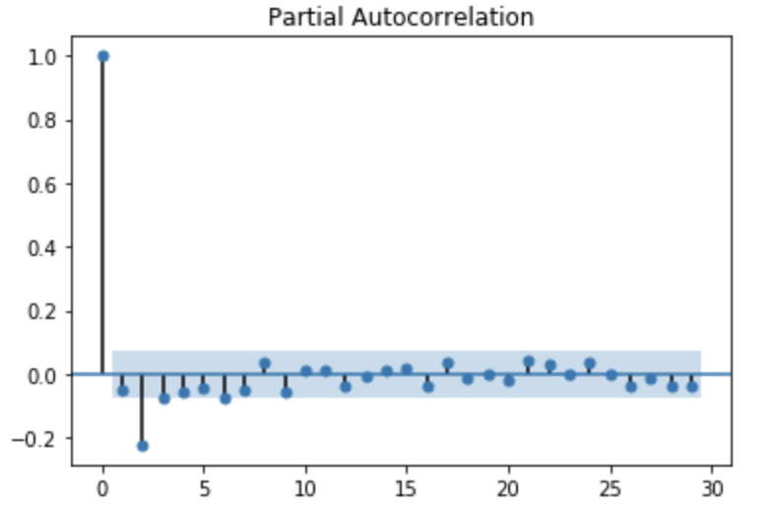
Correlation plots before transformation:
After transformation:

Slide 7
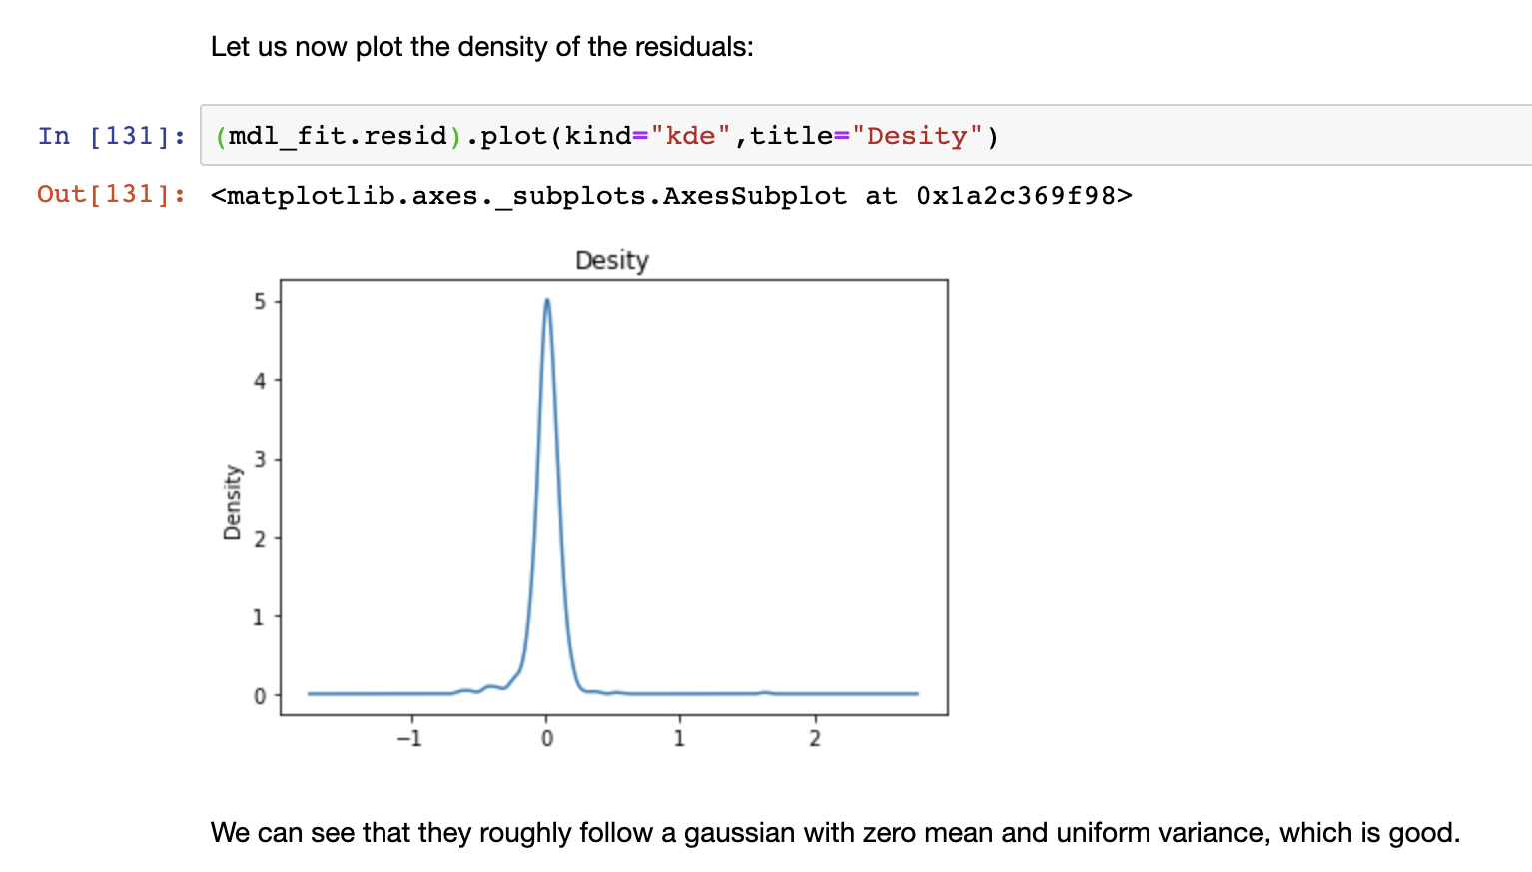
Plot of residuals:
Residuals are also uncorellated

Slide 8
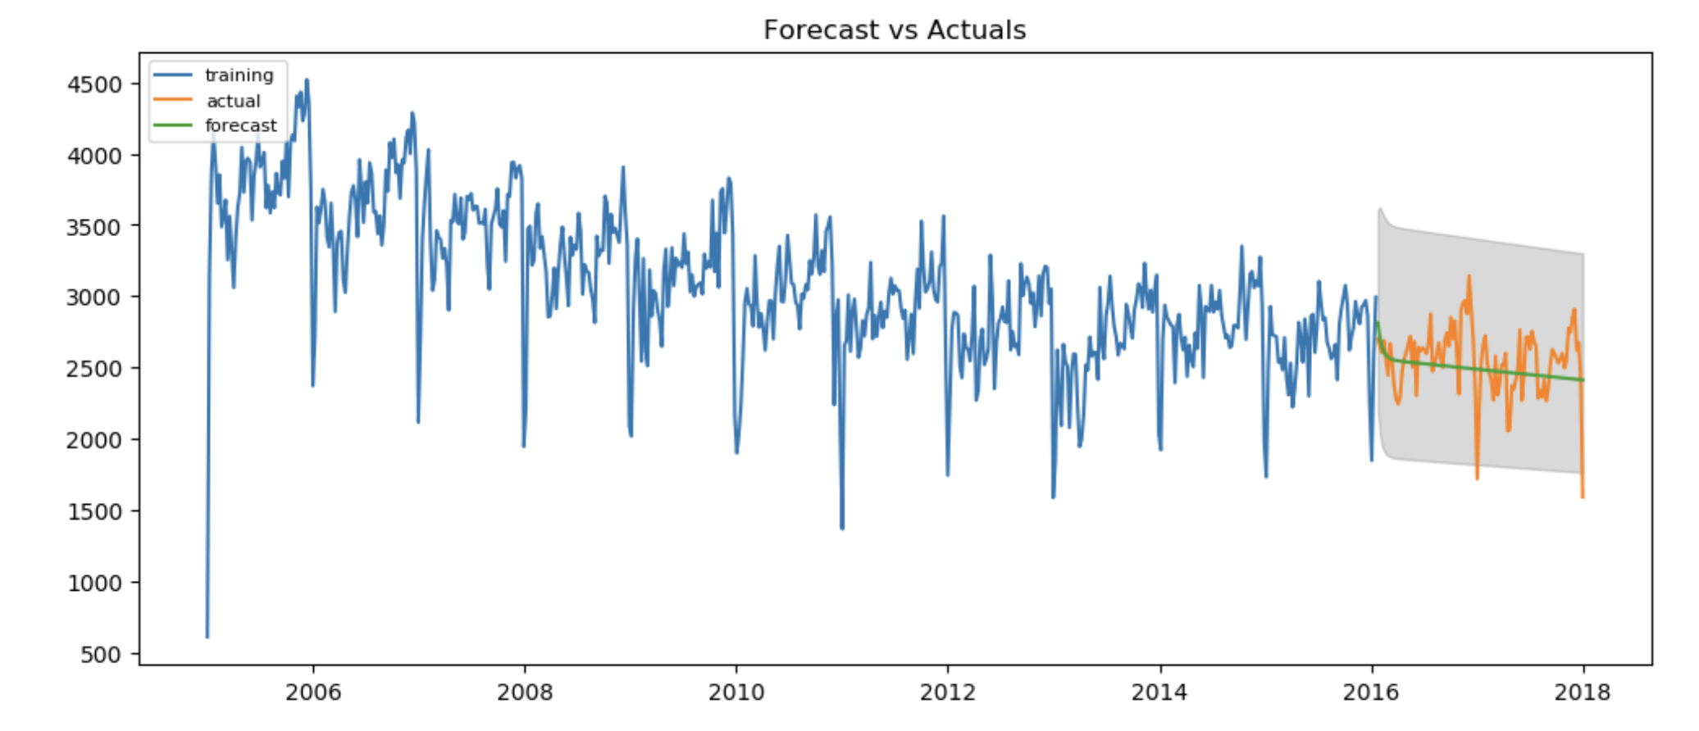
Forecast on validation set(85%train,15%test)

