Slide 1
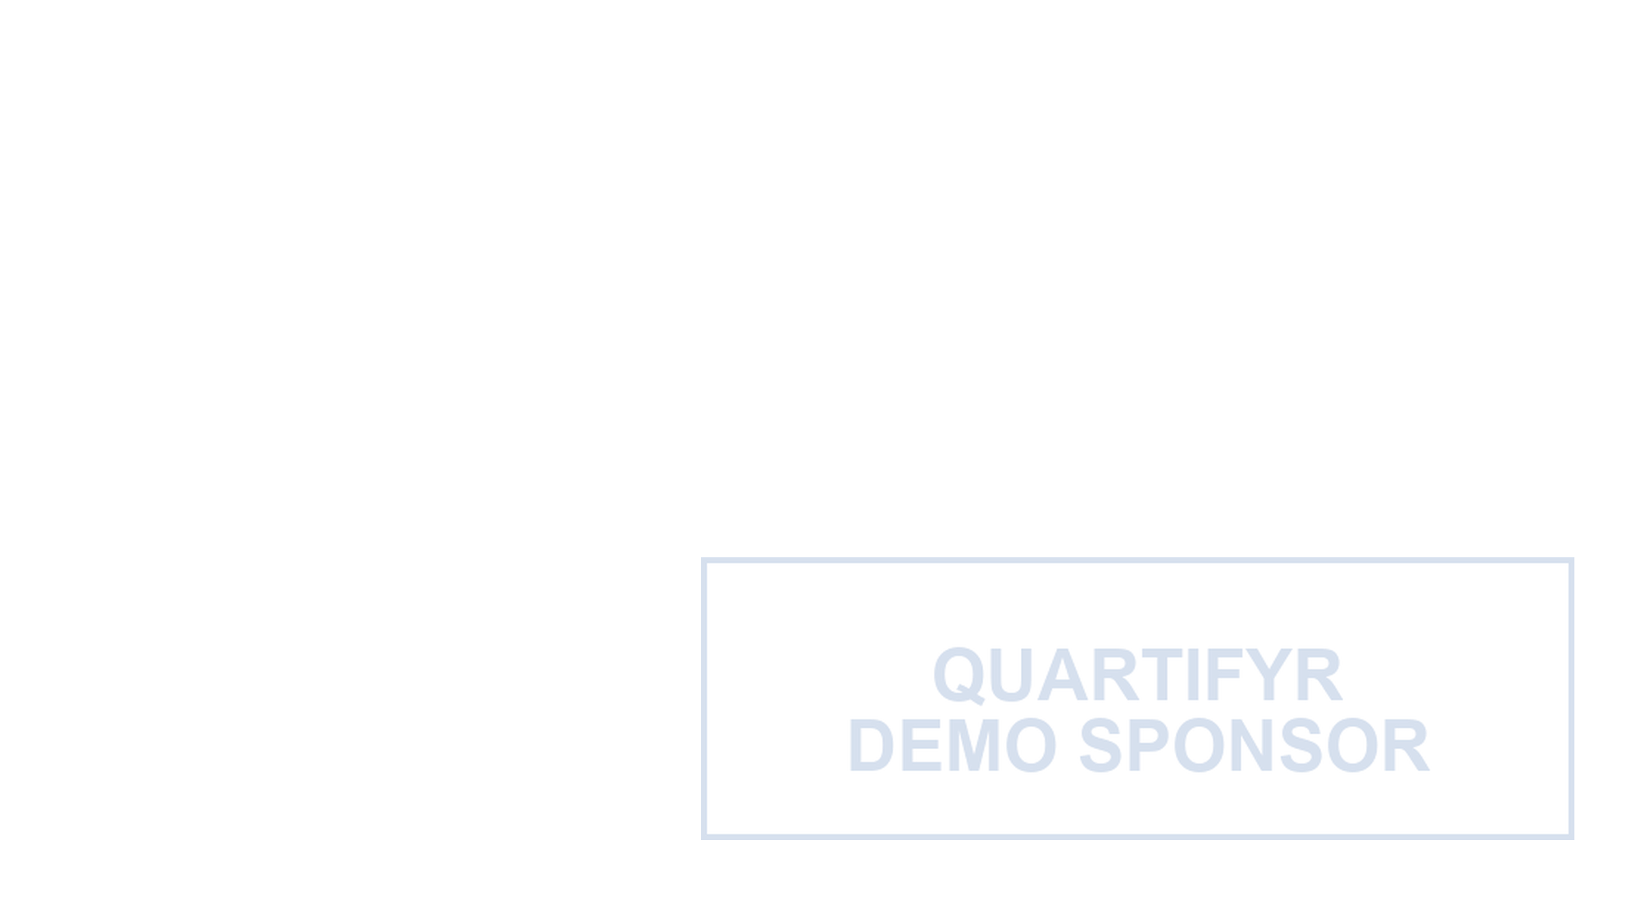
Theophylline PK Summary
DEMO
Concentration-time profiles from the built-in Theoph dataset
Deckifyr Demo
1 / 6

Slide 2
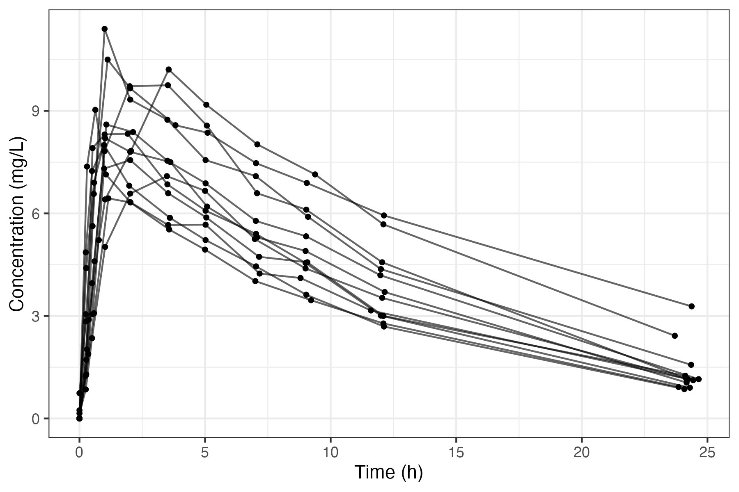
Concentration-Time Profile
Data source
Data are from the built-in Theoph dataset, produced by reportifyr's two-pass pipeline (see quartifyr's demo-report example).
Each line traces one participant's observed PK profile after a single oral dose; no model-based estimation was performed.
DEMO
Source: scripts/01_analysis.R 2026-08-11 22:28:55
Notes: This plot shows individual concentration-time trajectories for subjects in the study. The x-axis represents time (hours) and the y-axis shows drug concentration (ng/mL). Each line corresponds to a subject's concentration profile, illustrating variability in pharmacokinetics across the population. Key points like peak concentration (Cmax) and time to peak (Tmax) can be identified visually. No aggregation or smoothing has been applied, preserving the raw individual data. Data are from the built-in Theoph dataset.
Abbreviations: PK: pharmacokinetic.
Deckifyr Demo
2 / 6
Notes:
Point out the rapid absorption phase in the first 1-2 hours, then the
slower elimination tail. No PK modeling is shown here -- this is the
raw observed data only.

Slide 3
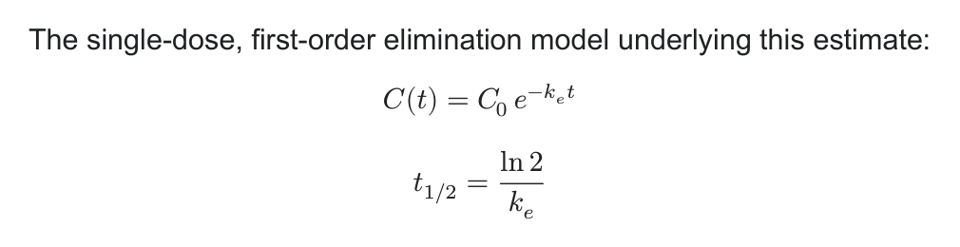
Elimination Half-Life
Fitting a simple log-linear elimination model to each of the 12 participants’ terminal-phase concentrations in the built-in `Theoph` dataset gives a population mean elimination half-life of 8.5 hours – consistent with theophylline’s established ~8-hour half-life.
This is a simple per-participant regression for illustration, not a population PK model.
DEMO
Deckifyr Demo
3 / 6

Slide 4
Per-Participant PK Summary
Participant | Weight (kg) | Dose (mg/kg) | Cmax (mg/L) | Tmax (hr)
1 | 79.6 | 4.02 | 10.50 | 1.12
2 | 72.4 | 4.40 | 8.33 | 1.92
3 | 70.5 | 4.53 | 8.20 | 1.02
4 | 72.7 | 4.40 | 8.60 | 1.07
5 | 54.6 | 5.86 | 11.40 | 1.00
6 | 80.0 | 4.00 | 6.44 | 1.15
7 | 64.6 | 4.95 | 7.09 | 3.48
8 | 70.5 | 4.53 | 7.56 | 2.02
9 | 86.4 | 3.10 | 9.03 | 0.63
10 | 58.2 | 5.50 | 10.21 | 3.55
11 | 65.0 | 4.92 | 8.00 | 0.98
12 | 60.5 | 5.30 | 9.75 | 3.52
DEMO
Deckifyr Demo
4 / 6

Slide 5
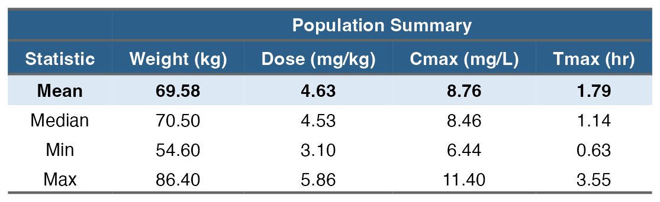
Reportifyr Table Formats: Native vs. Flextable
Participant | Weight (kg) | Dose (mg/kg) | Cmax (mg/L) | Tmax (hr)
1 | 79.6 | 4.02 | 10.50 | 1.12
2 | 72.4 | 4.40 | 8.33 | 1.92
3 | 70.5 | 4.53 | 8.20 | 1.02
4 | 72.7 | 4.40 | 8.60 | 1.07
5 | 54.6 | 5.86 | 11.40 | 1.00
6 | 80.0 | 4.00 | 6.44 | 1.15
7 | 64.6 | 4.95 | 7.09 | 3.48
8 | 70.5 | 4.53 | 7.56 | 2.02
9 | 86.4 | 3.10 | 9.03 | 0.63
10 | 58.2 | 5.50 | 10.21 | 3.55
11 | 65.0 | 4.92 | 8.00 | 0.98
12 | 60.5 | 5.30 | 9.75 | 3.52
DEMO
Notes: Population-level summary statistics (mean, median, min, max) across all 12 participants; the mean row is highlighted.
Abbreviations: PK: pharmacokinetic.
Notes: Raw per-participant values, one row per participant, with no aggregation or smoothing applied.
Deckifyr Demo
5 / 6

Slide 6
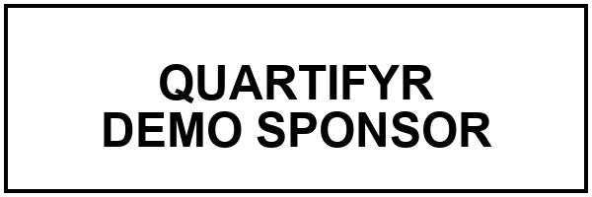
DEMO
Generated with deckifyr
This deck was compiled entirely from version-controlled YAML in this directory -- design.yaml, layouts.yaml, and presentation.yaml -- with no manual slide editing.
Deckifyr Demo
6 / 6

