Slide 1
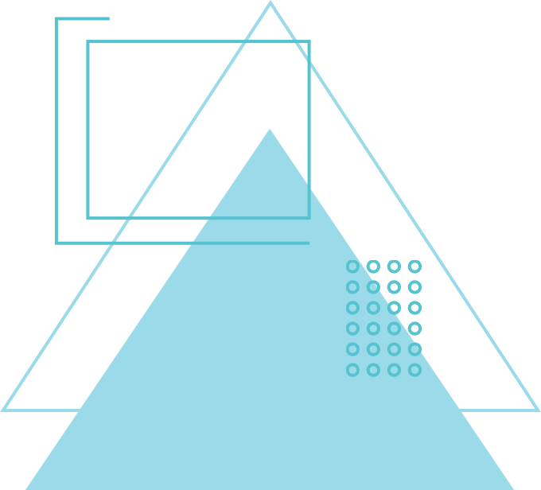
JUMP POINT SEARCH (JPS) VISUALIZER
By: Kushagra Gupta(24BCE1671) & Riddhima Singhal (24BCE1157)

Slide 2
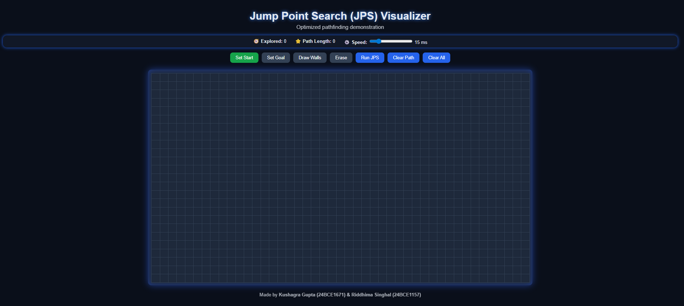
PROJECT OVERVIEW
  Interactive web tool for finding shortest paths on a grid
  User sets start/goal, creates walls, and controls animation speed with a speed bar
  Shows shortest path using JPS (Jump Point Search)—can clear path or reset grid instantl

Slide 3
CORE PROBLEM
  How do we find the shortest route across a map with obstacles?
  This challenge is common in video games (enemy chasing), robotics (robot navigation), and mapping software.
  Standard algorithms can be slow or check too many grid points; a smarter approach improves speed and user experience.

Slide 4
SOLUTION APPROACH
  Jump Point Search (JPS): A specialized algorithm for grid pathfinding.
  Users click to set start, goal, and draw/remove walls
  Speed bar lets you slow down or speed up the path discovery animation to observe each step
  Visual feedback makes it easy for users to understand the grid and the computed path.

Slide 5
ALGORITHM
JUMP-SEARCH(arr, n, key)
step ← √n
prev ← 0
// Finding the block where the element may be present
while arr[min(step, n) - 1] < key do
prev ← step
step ← step + √n
if prev ≥ n then
return "Not Found"
// Linear search within the identified block
while arr[prev] < key do
prev ← prev + 1
if prev = min(step, n) then
return "Not Found"
if arr[prev] = key then
return prev
// Element found at index 'prev'
return "Not Found"

Slide 6
KEY FEATURES
  Interactive grid allows users to set and move starting and goal nodes.
  Fine-tune animation speed for step-by-step or fast demo
  Click to add or remove walls – customize obstacles easily.
  "Find Path" button calculates and displays shortest path with clear visualization.
  "Clear Path" lets you find a new route, "Clear All" resets everything for fresh testing.

Slide 7
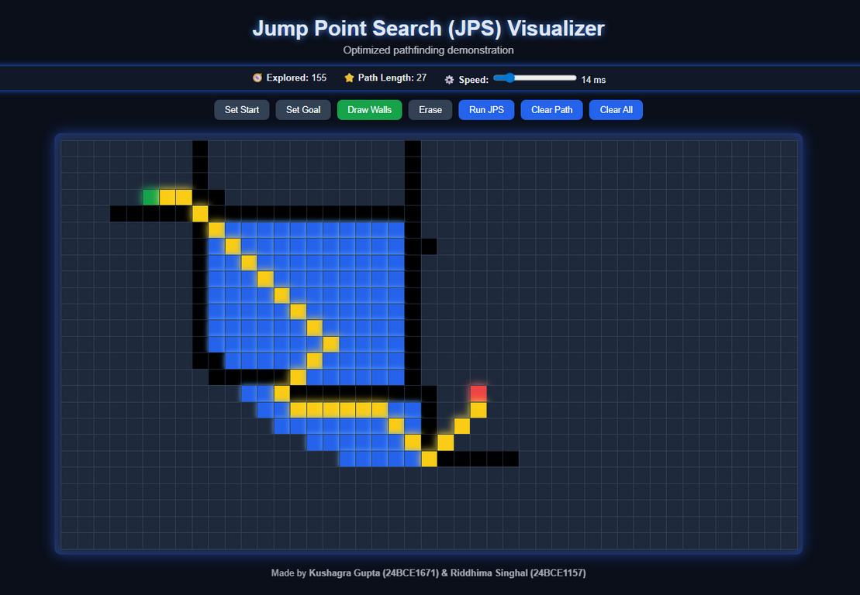
USER INTERACTION EXAMPLE
  Step 1: Place start and goal cells anywhere
  Step 2: Draw or erase walls directly on the grid
  Step 3: Adjust speed bar (slow for demo, fast for quick results)
  Step 4: Click “Find Path” to see the shortest route appear
  Step 5: Use clear buttons to experiment with new setups

Slide 8
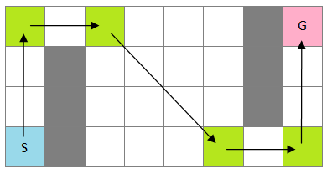
WHAT IS JUMP POINT SEARCH (JPS)?
  JPS is an advanced algorithm for grid maps
  It speeds up searches by jumping over stretches of open cells
  Only “jump points” (where direction changes, or an obstacle/goal is found) are checked
  Ideal for large, open grids where other algorithms slow down

Slide 9
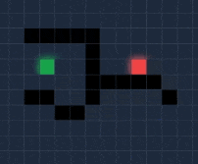
HOW DOES JPS WORK?
  Starts at the defined start cell
  Jumps in straight lines (up, down, left, right, diagonals)
  Stops to check only at obstacles, forced turns, or the goal
  Builds the full shortest path by connecting these critical points

Slide 10
WHY IS JPS FASTER?
  Skips checking all unnecessary middle cells between obstacles
  Focuses on potential path changes, reducing redundancy
  Makes real-time pathfinding and animation practical, even with speed slowed for learning

Slide 11
THANK YOU
By: Kushagra Gupta(24BCE1671) & Riddhima Singhal (24BCE1157)
GitHub & Vercel deploy link

