Slide 1
Demo of the Skynet project
Team AT16

Slide 2

Tools
Python language
Postman
Pycharm
Git
GitHub
Docker
MongoDB
PostgreSQL
FFmpeg
Image Magick
Exiftools
Tesseract
Sourcetree

Slide 3
Microservices
Booking microservices
Booking
Person
Resource
Reporting microservices
Report Age Gender
Report Date Person Country
Report Model Type
Report Time Person Gender
Report State Person Gender
Converter Microservices
Audio converter
Video to image converter
Image converter
Wav to text converter
Image to text (OCR) converter
Translator converter
Metadata extractor
Machine learning microservices:
Object recognizer model VGG16
Object recognizer model Inception
Iris recognizer model G6

Slide 4
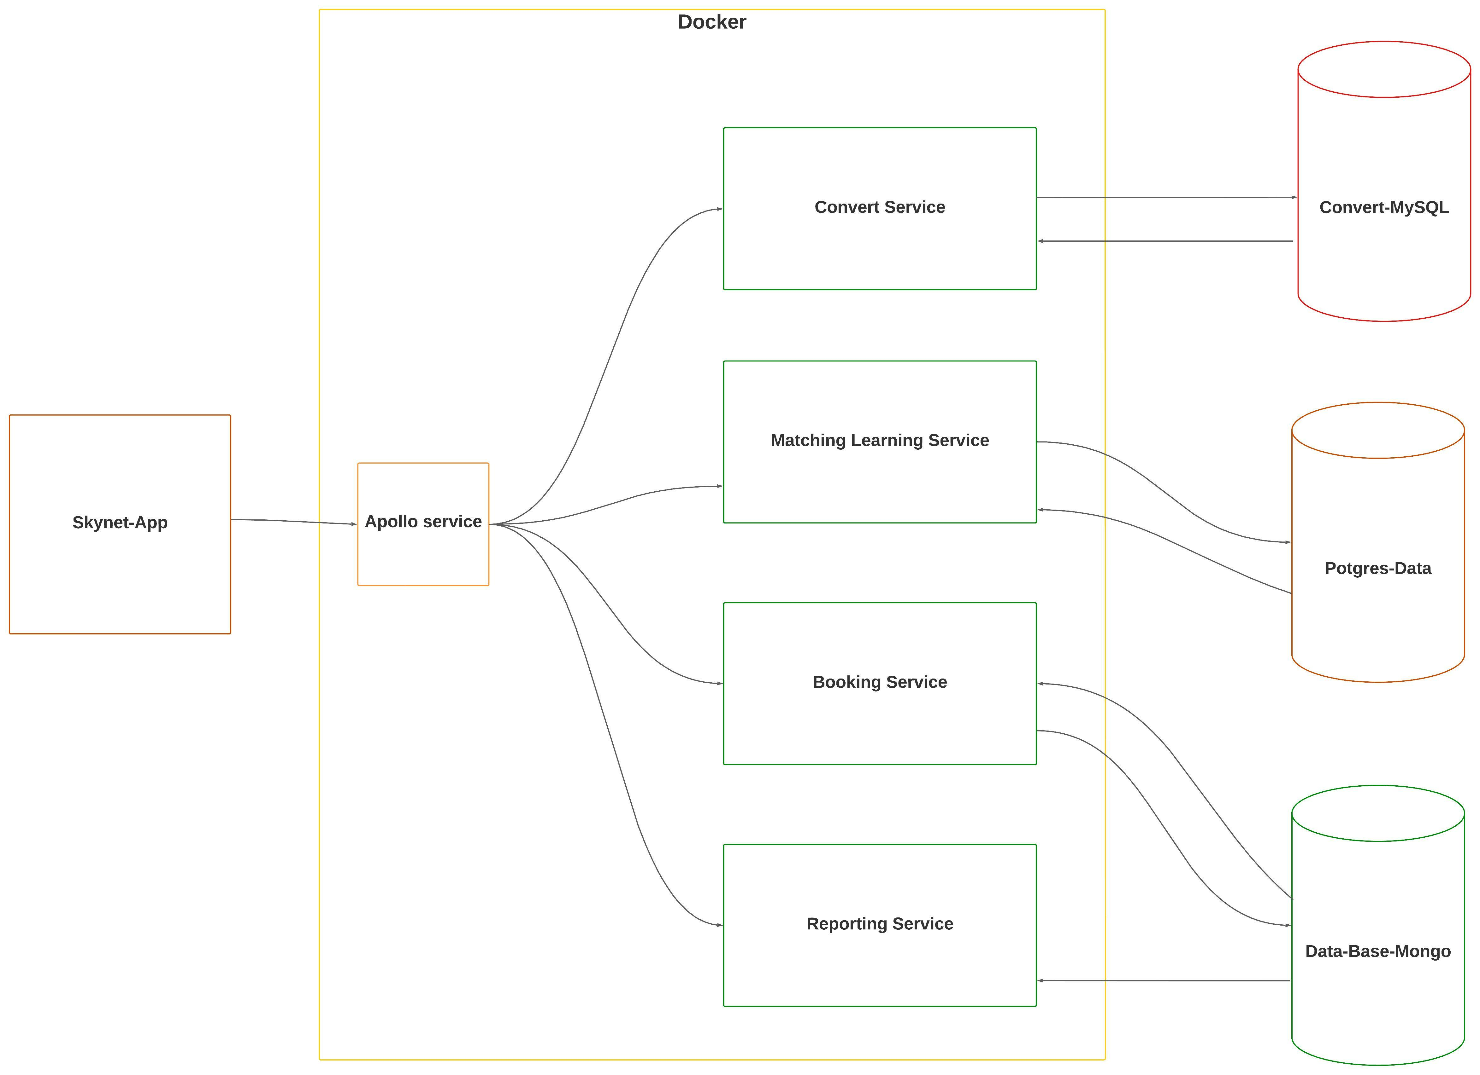
Architecture of the program
Ready
In process
Almost ready
Stay hold

Slide 5
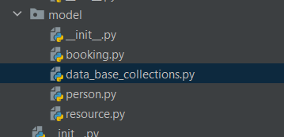
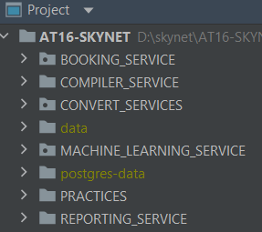
SOLID
For the “S” we created classes to have only one responsibility per class.
For the “O” the program should be Open to expand and Close for modify.

Slide 6
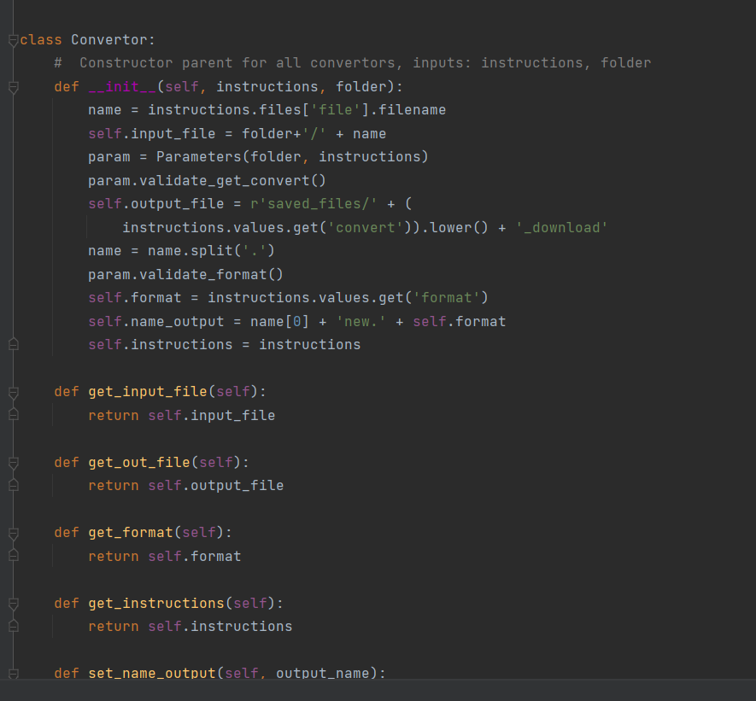
SOLID
For the “L”
The Liskov Substitution Principle (LSP) is one of five SOLID object-oriented design principles. It states that a superclass object should be replaceable with a subclass object without breaking the functionality of the software. It is a type of behavioral subtyping defined by semantic, rather than syntactic, design consideration.

Slide 7
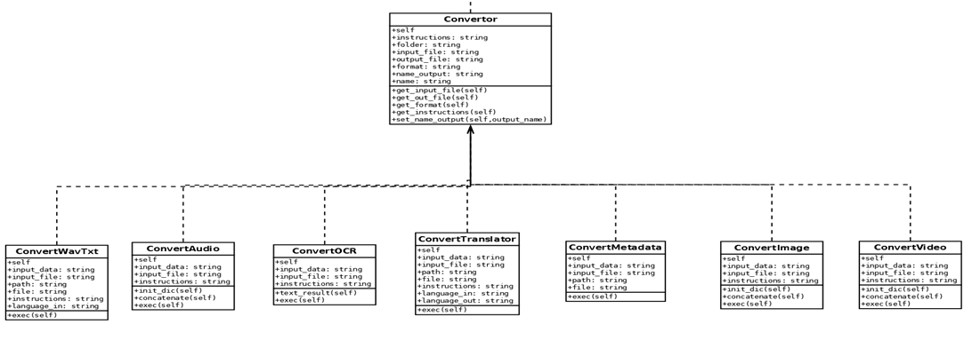
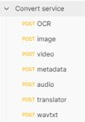
SOLID
For the I” we create different interfaces for different converters linked to a father class
For the “D” Entities must depend on abstractions, not on concretions. It states that the high-level module must not depend on the low-level module, but they should depend on abstractions. (This principle has not implemented in Skynet yet)

Slide 8
The services are running in docker
Linux system operating, alpine 3.10
Python 3
Requirements.txt

Slide 9

What is Docker?
Docker is an application build and deployment tool. It is based on the idea of that you can package your code with dependencies into a deployable unit called a container.
For a visual explanation, think of the shipping containers used for intermodal shipping. You put your package (code and dependencies) in the container, ship it using a boat or train (laptop or cloud) and when it arrives at its destination it works (runs) just like it did when it was shipped.

Slide 10

Why do we need ‘Docker’?
Docker streamlines the development lifecycle by allowing developers to work in standardized environments using local containers which provide your applications and services.

Slide 11
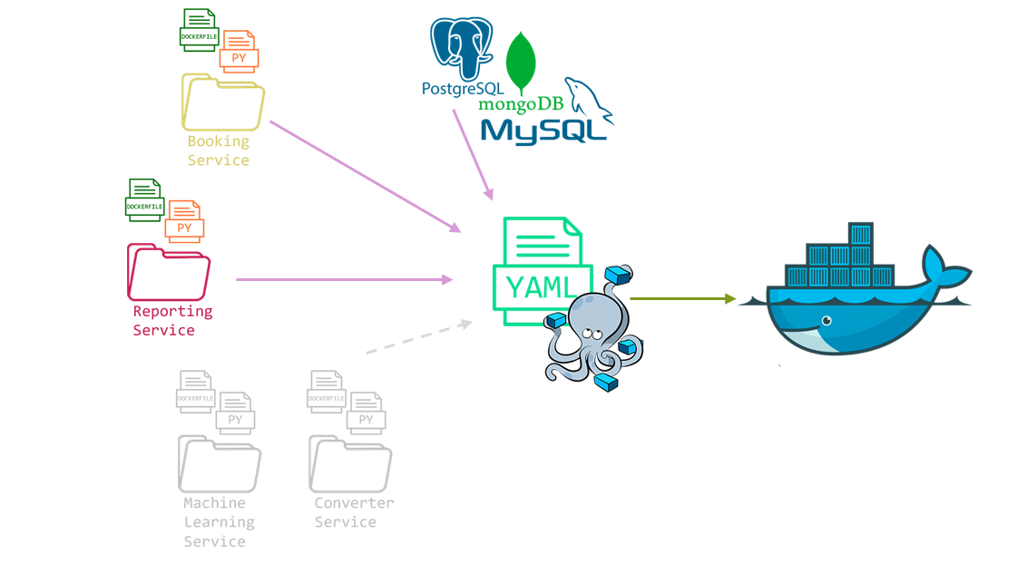
Skynet Docker Flow

Slide 12
Booking service
Booking is a service for save resource data, person data and booking details.
This service saves data that the user is going to insert.

Slide 13

This service has 17 endpoints for the crud.
These endpoints are to create, update, delete, search and get all the information of the mongo data base.
The ports of end points are “6002” with the local host.

Slide 14
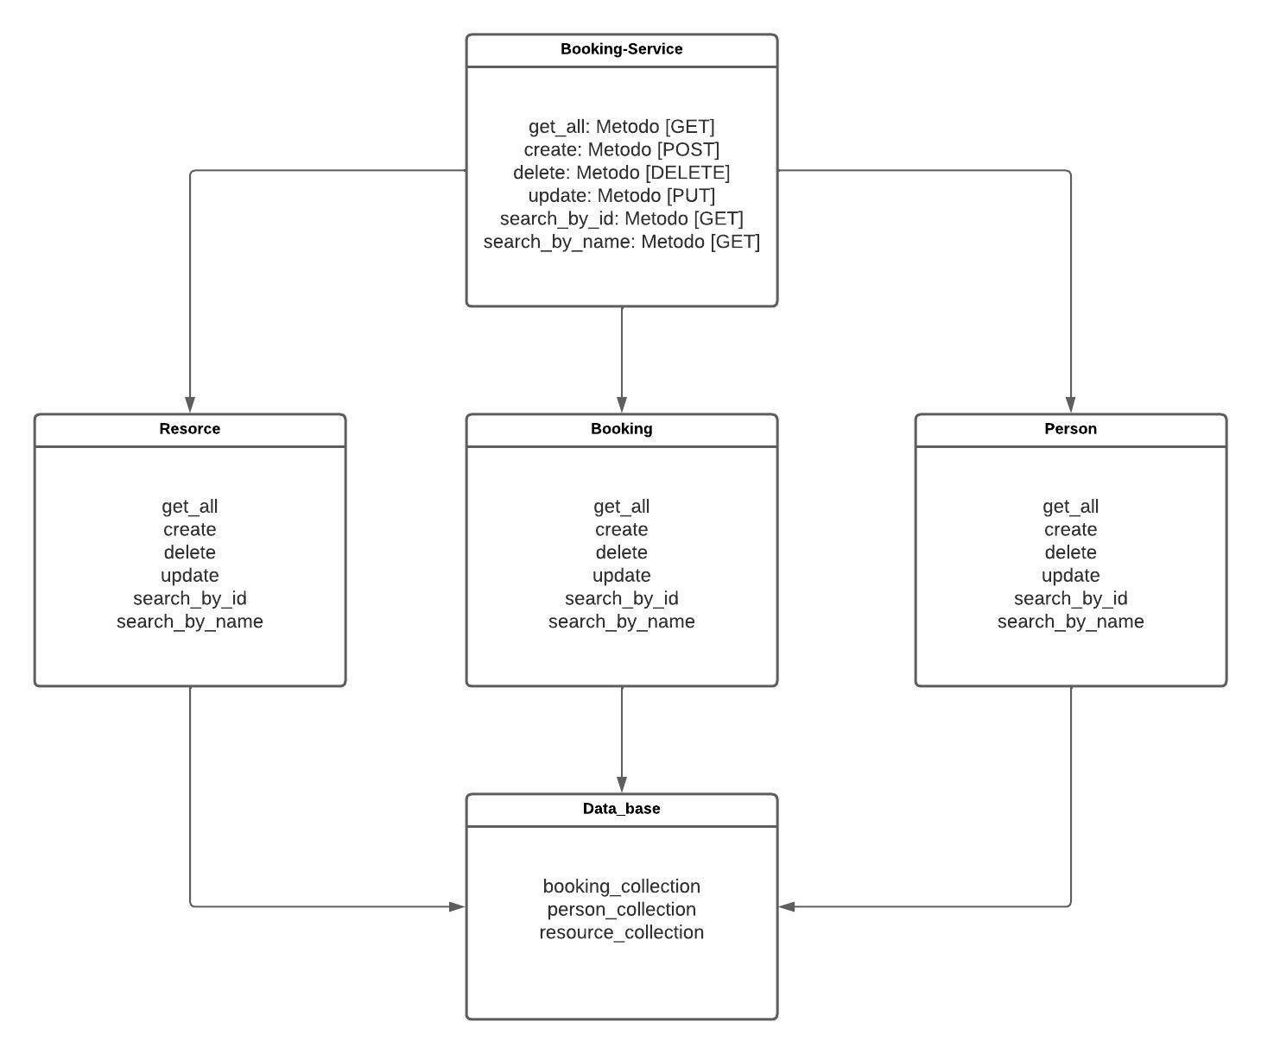
Class diagram

Slide 15
REPORTing service
Reporting service allow all users to interact with the data that is most important to them and the enterprise, conceive the true standing of their business and overall, it helps to make market decisions.

Slide 16
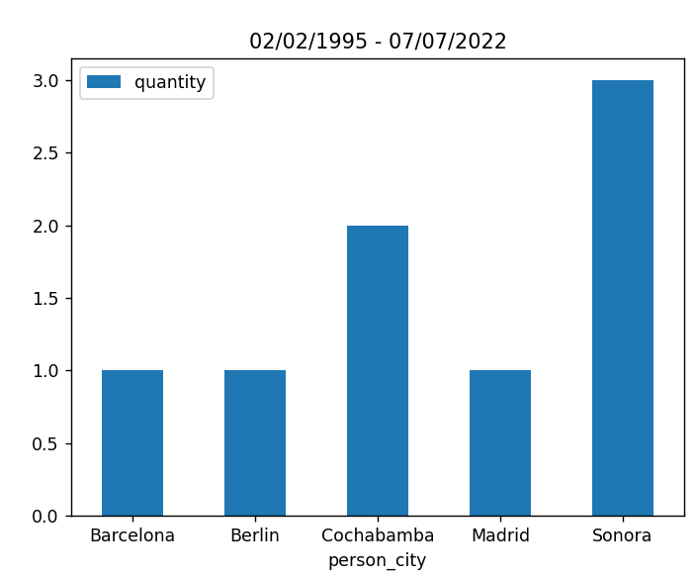
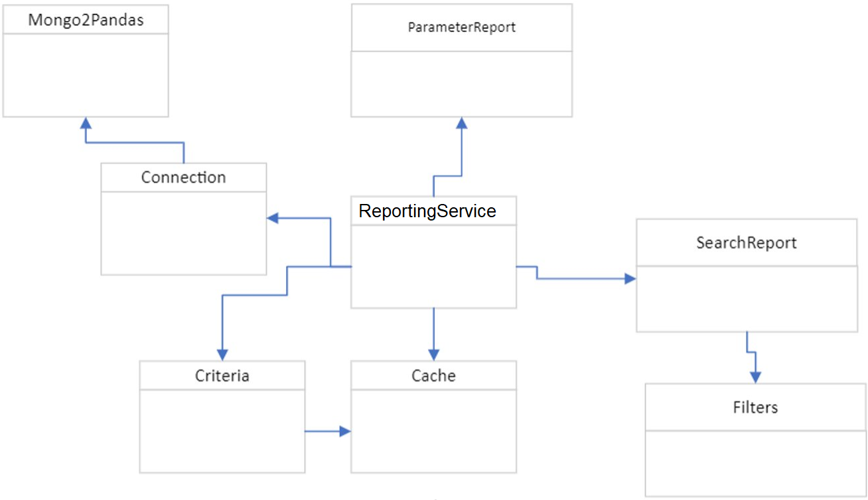
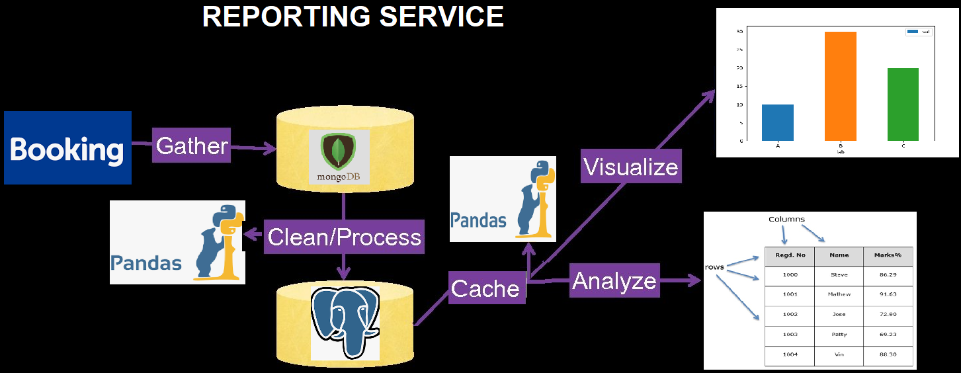
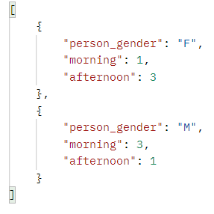
Class diagram
Notes:
The service have six end points with the method POST to obtain the required data.
The reporting service extract data from the booking database, processes/cleans the data with pandas, and inserts the data into PostgreSQL. Finally, the data is cached to be processed with pandas to parse or visualize the clean data.
The ports of end points are “6003” with the local host.

Slide 17
MACHINE LEARNING SERVICE
Machine learning service use trained machine learning models to search and recognize objects and persons in different images or videos

Slide 18
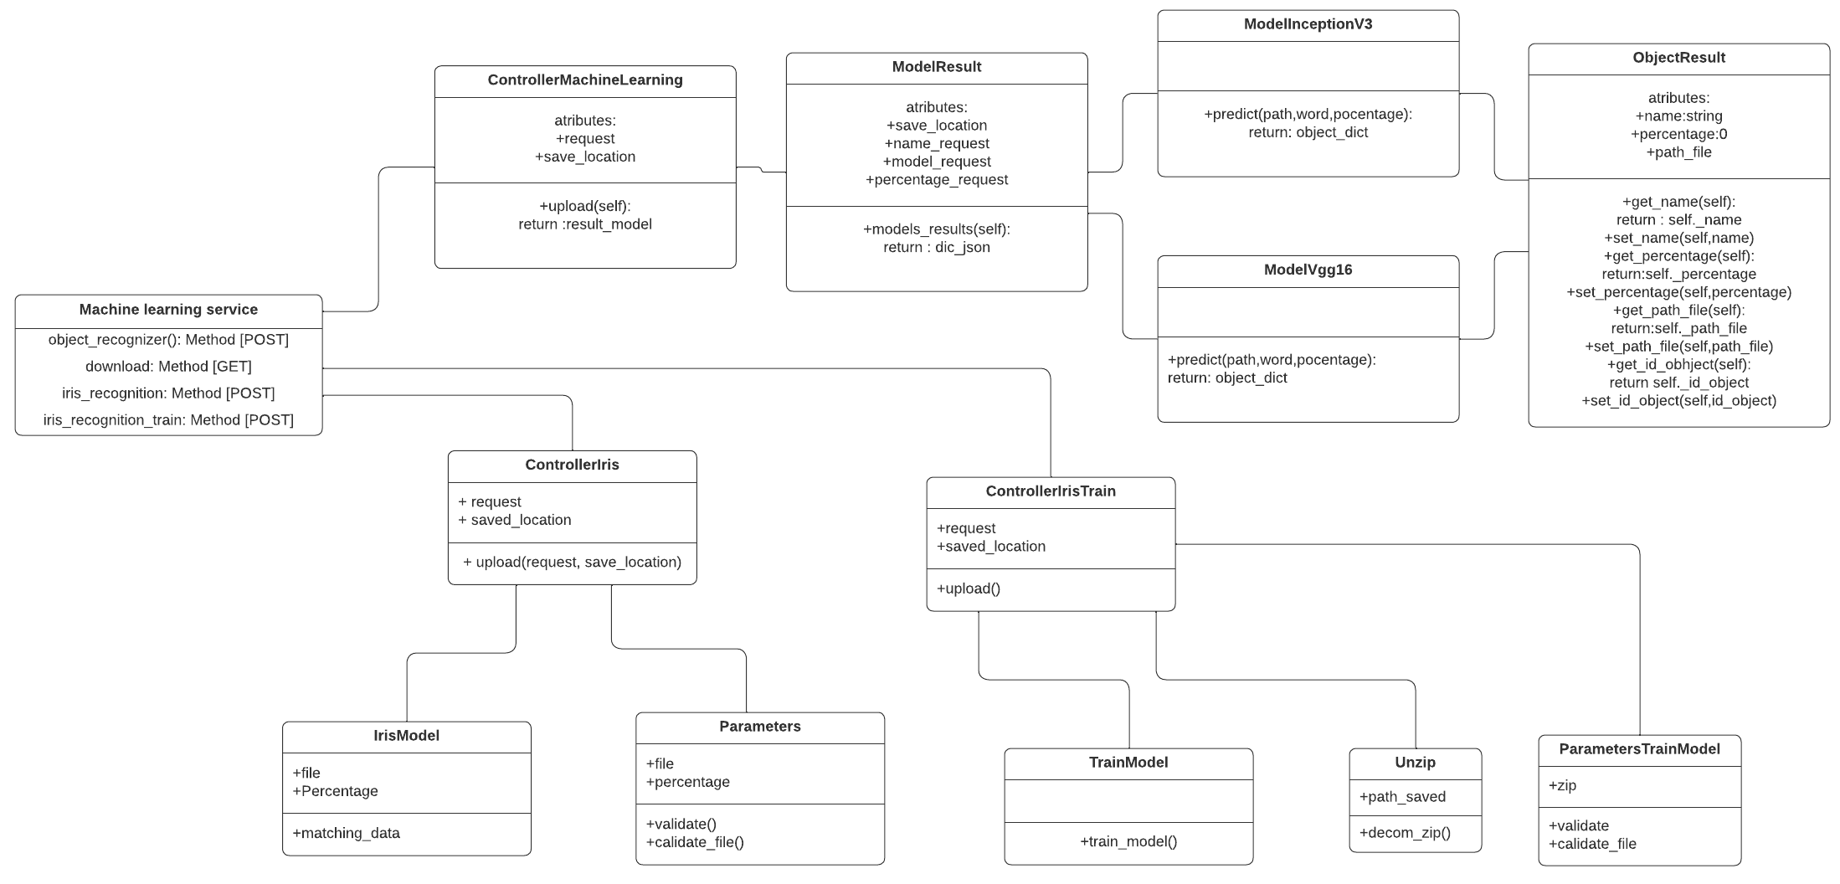
Class diagram

Slide 19


CONVERT SERVICES
The converter service of the project has its main function which is to be able to convert a great variety of files into other formats.
we have some models with which we can convert different formats such as audio, video, image, metadata, OCR. and others.

Slide 20
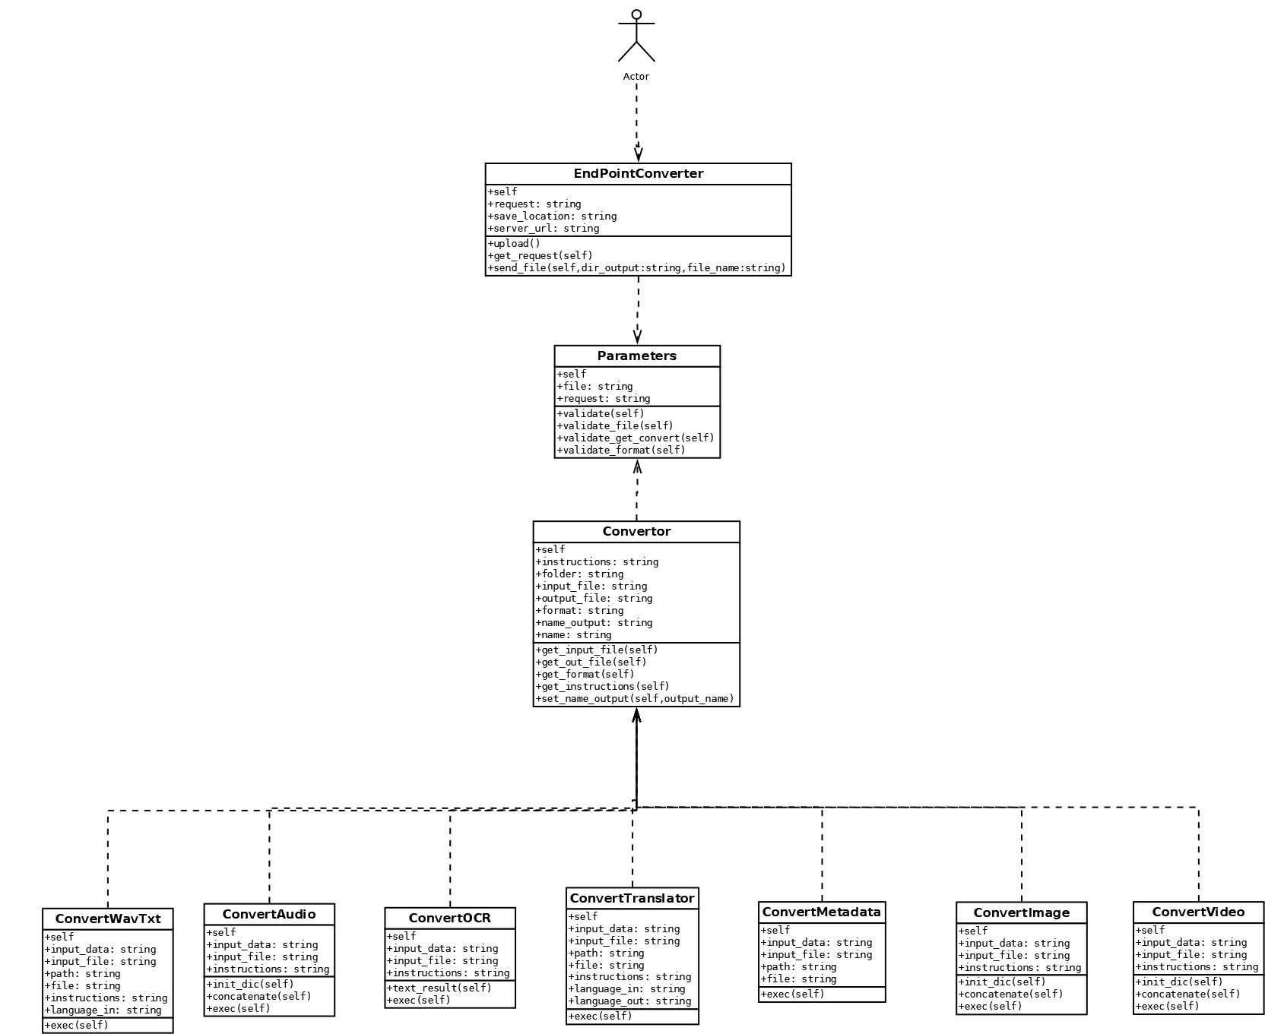
CLASS DIAGRAM

Slide 21
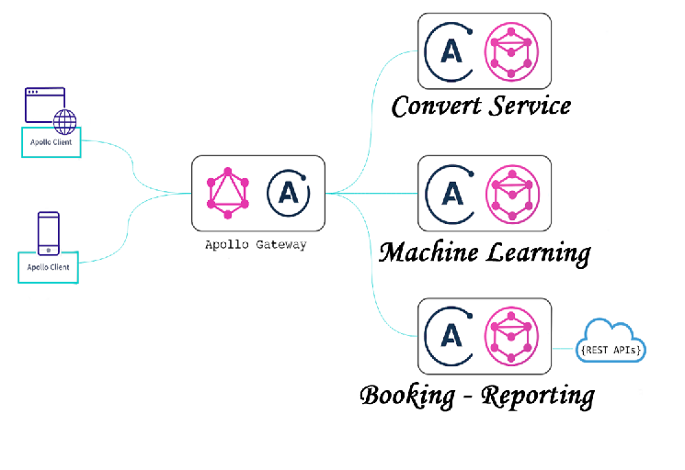
What is apollo?

Slide 22
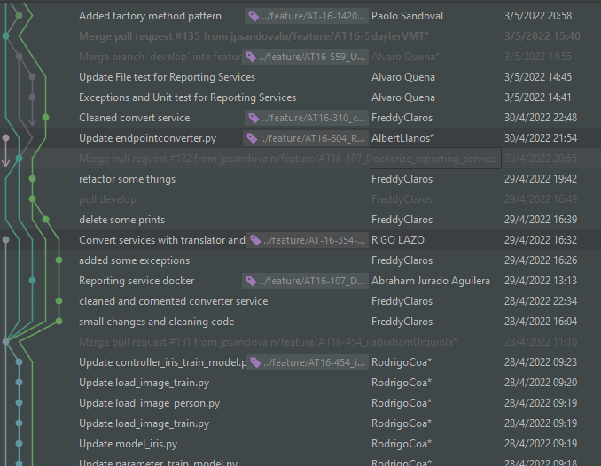
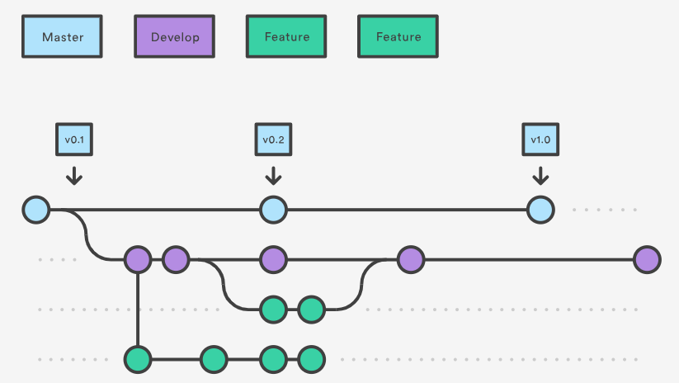
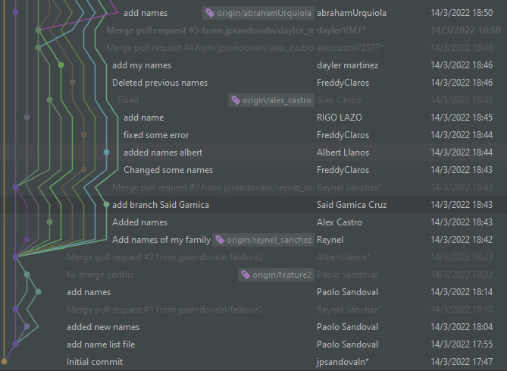
Git -git flow

Slide 23
Known issues
Machine learning:
Model object recognizer Resnet not working
Service needs a cleaning
Service needs to be in Docker
Convert Services:
A different format of audio in wavtxt convertor is not permissive
In translator only accept txt files

Slide 24
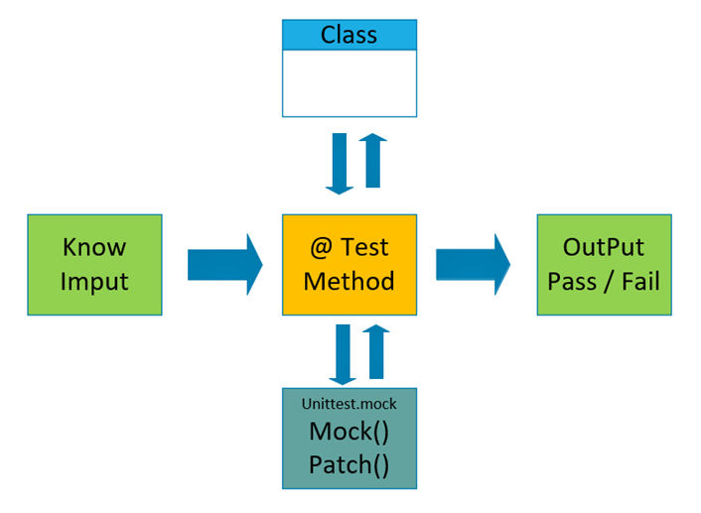

Unit test
Services
Booking
Reporting

Slide 25
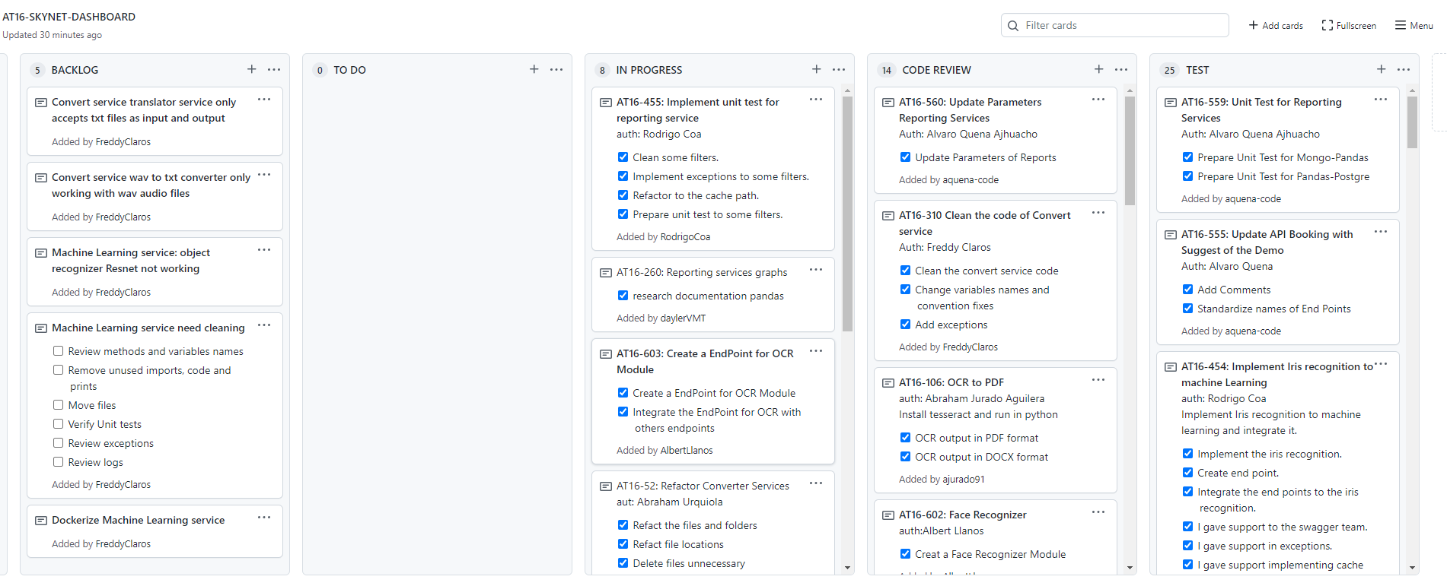
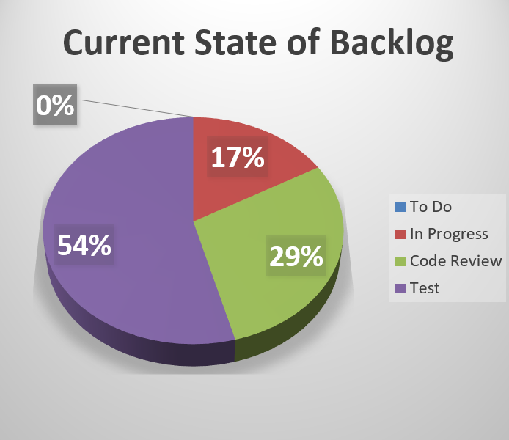
Backlog tasks
To Do | In Progress | Code Review | Test | Total Tickets
0 | 8 | 14 | 26 | 48

Slide 26
Error handler
Each service count with his owns error handlers for his exceptions and unit test
Booking service: is in progress and we have a features for this in backlog
Reporting service: is in progress and we have a features for this in backlog
Convert service: is in progress and we have a features this in backlog
Machine learning: is in progress and we have a features this in backlog

Slide 27



DEMO

Slide 28

Any question?
We will be happy to answer them now.

Slide 29


