Slide 1

Django Project
ATLatam 2

Slide 2
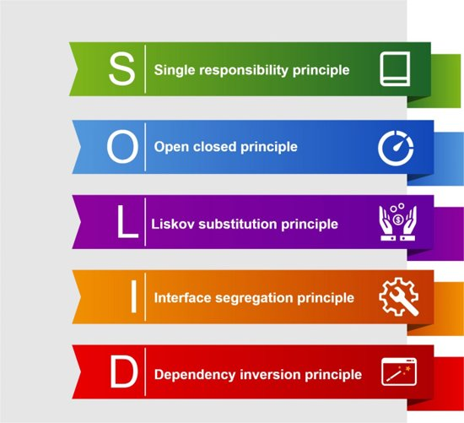
SOLID
SOLID is an acronym for the first five object-oriented design (OOD) principles by Robert Martin.
Remove bad designs
Avoid refactoring
Build efficient code
Easy to maintain

Slide 3

SOLID
Single-Responsibility Principle
A class should have one and only one reason to change, meaning that a class should have only one job.
Open close principle
Objects or entities should be open for extension but closed for modification.

Slide 4
SOLID
Liskov Substitution principle
If class A is a subtype of class B, we should be able to replace B with A without disrupting the behavior of our program.
Interface Segregation Principle
Larger interfaces should be split into smaller ones. By doing so, we can ensure that implementing classes only need to be concerned about the methods that are of interest to them.

Slide 5
SOLID
Dependency Inversion Principle
The principle of dependency inversion refers to the decoupling of software modules. This way, instead of high-level modules depending on low-level modules, both will depend on abstractions

Slide 6
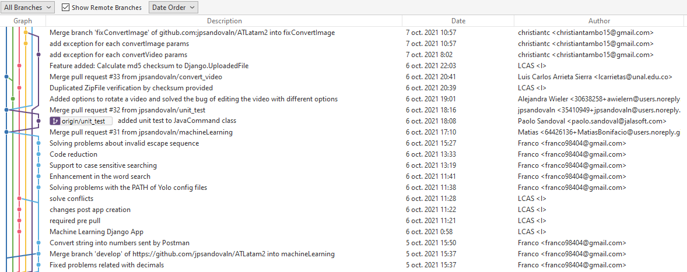
GITFLOW

Slide 7
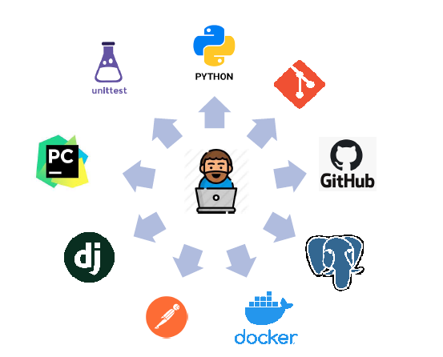
TECHNOLOGIES USED

Slide 8
DJANGO
Maintainable website.
Fast development.
Secure.
Scalable.

Slide 9
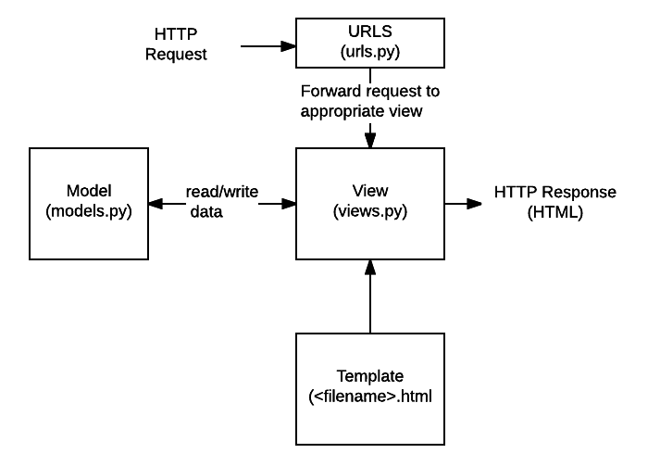
DJANGO ARCHITECTURE

Slide 10
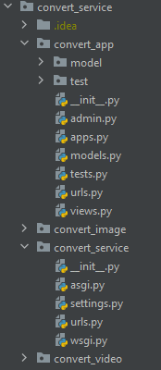
DJANGO STRUCTURE
settings.py
urls.py
manage.py

Slide 11
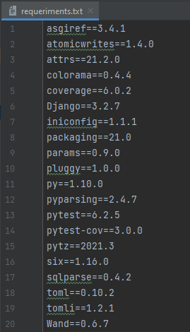
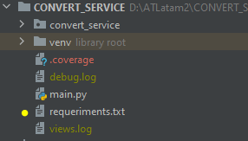
DJANGO STRUCTURE
BUILD TOOLS
Build tools are programs that automate the creation of executable applications from source code

Slide 12
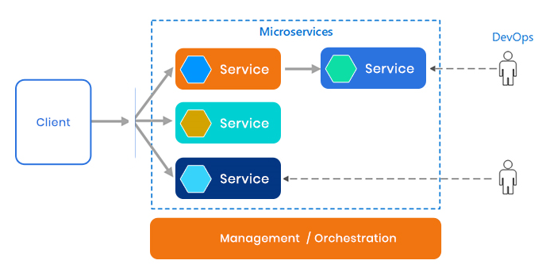
MICROSERVICES

Slide 13


DOCKER

Slide 14
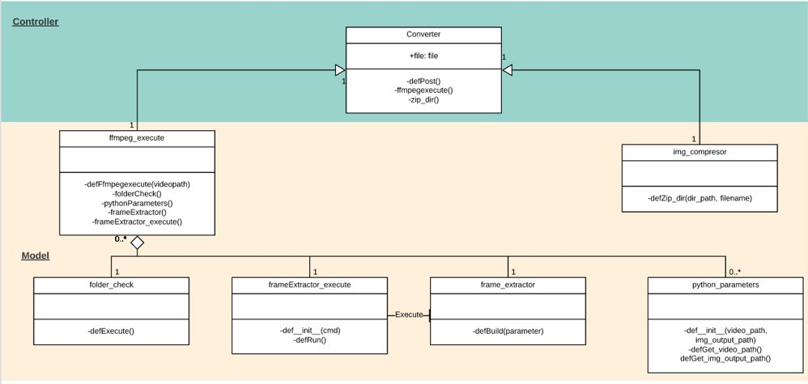
CLASS DIAGRAM

Slide 15
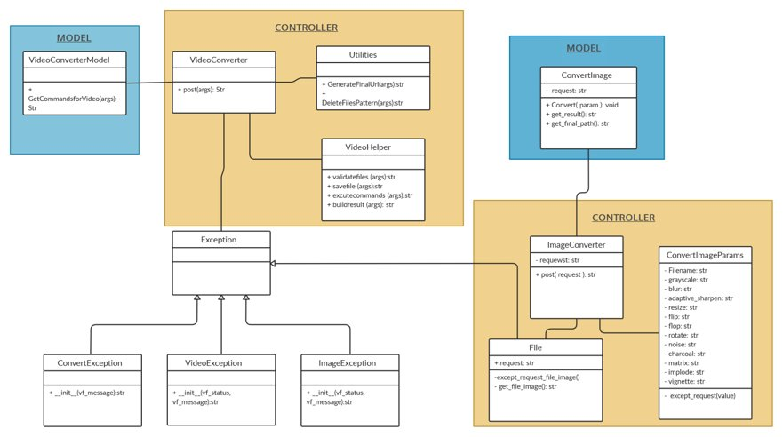
CLASS DIAGRAM

Slide 16
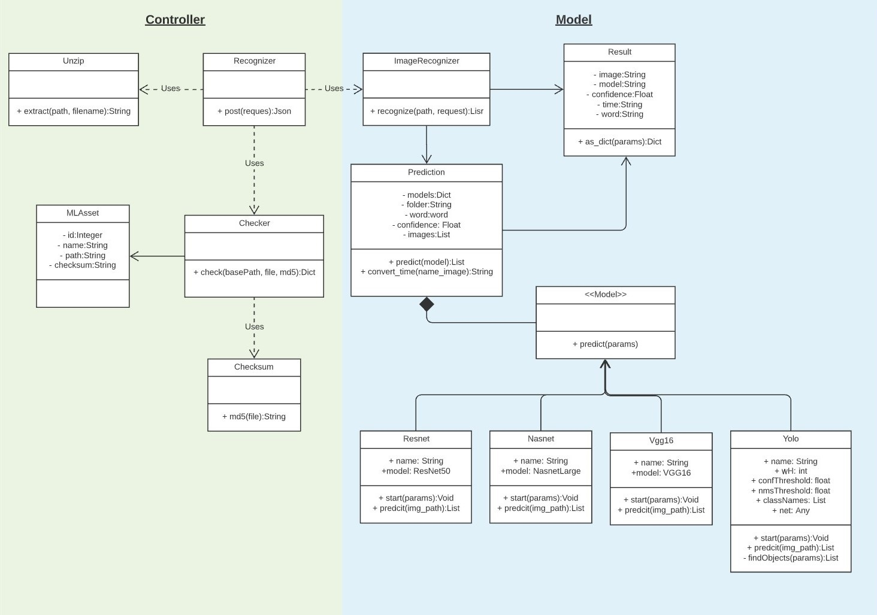
CLASS DIAGRAM

Slide 17
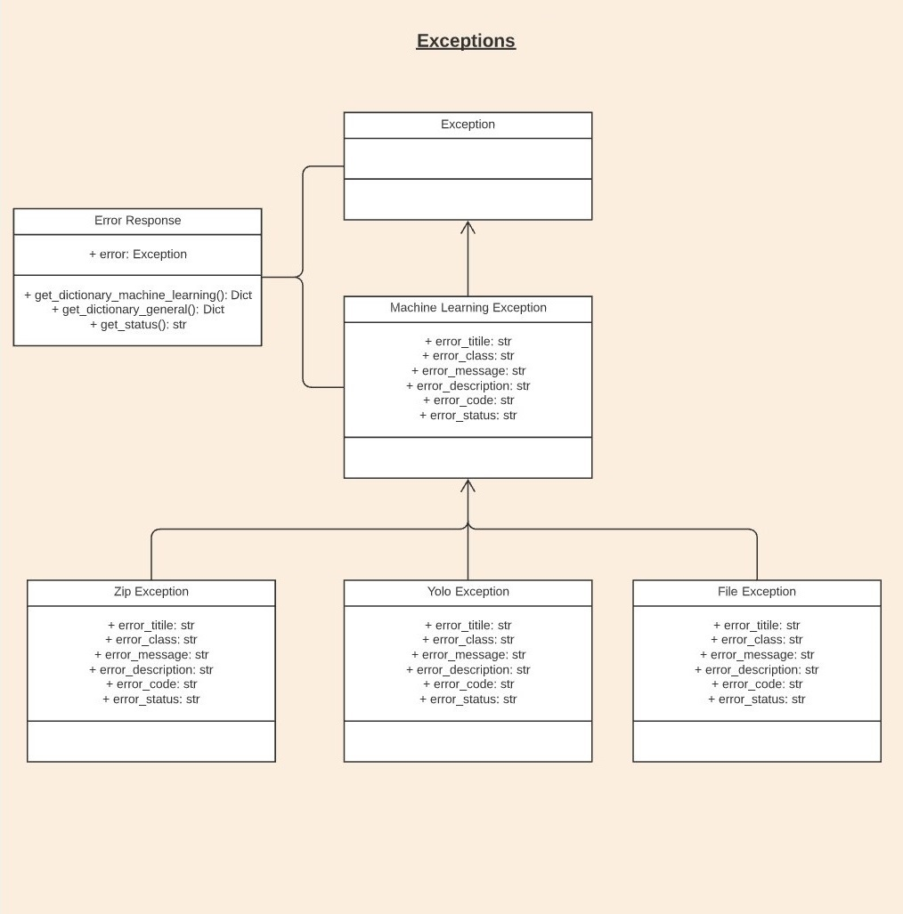
CLASS DIAGRAM

Slide 18
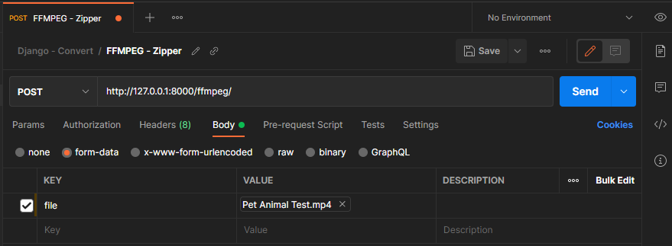
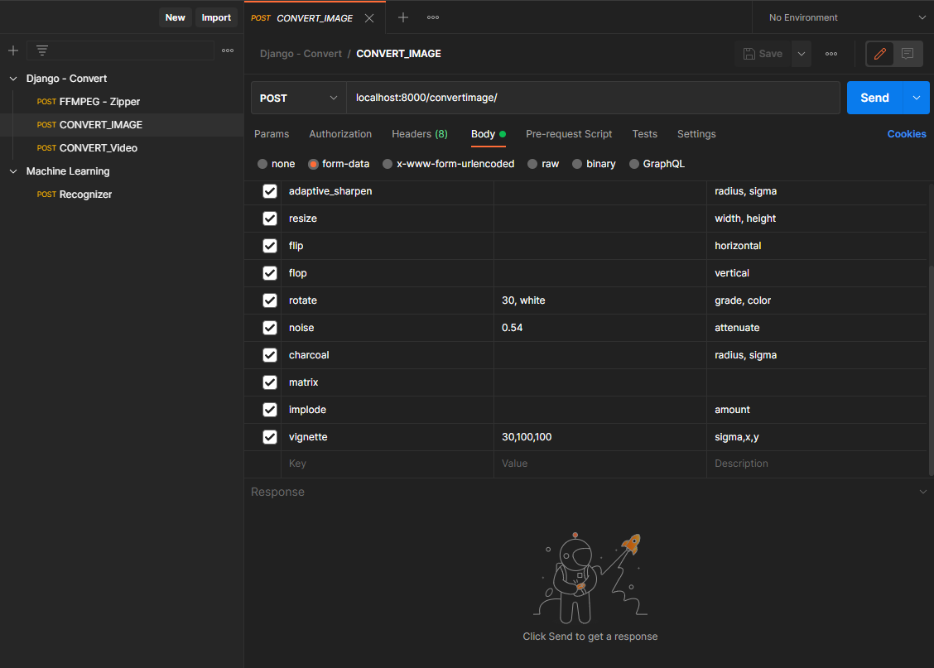
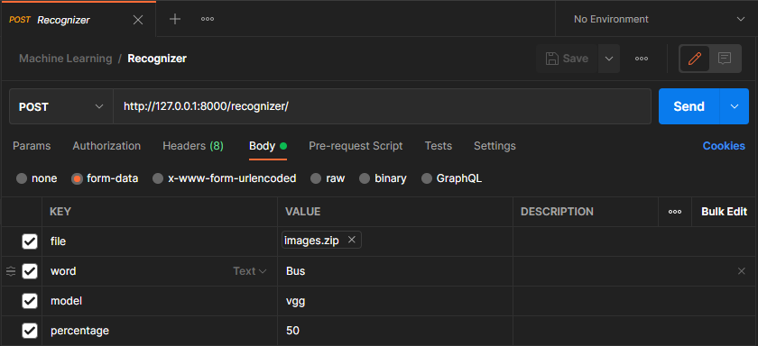
Documentation - Postman

Slide 19
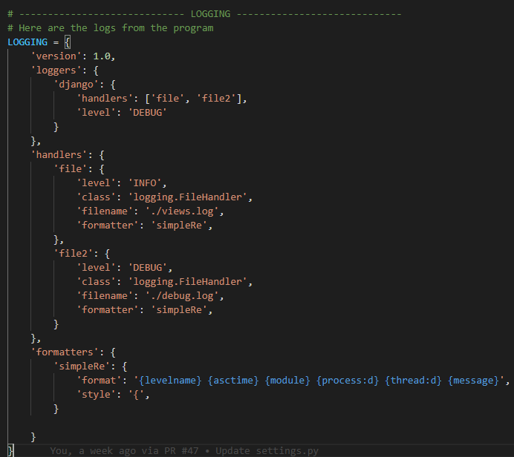
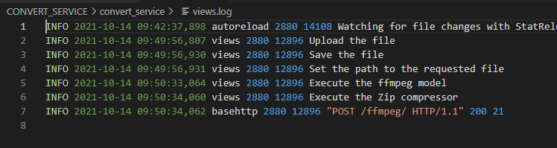
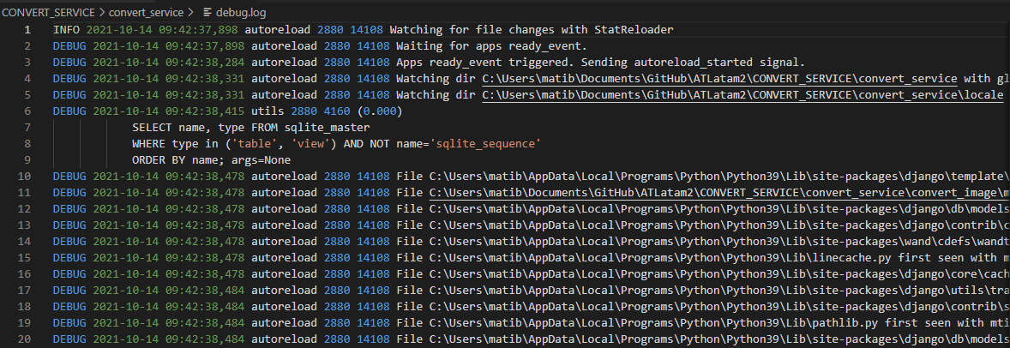
Documentation - Logs

Slide 20
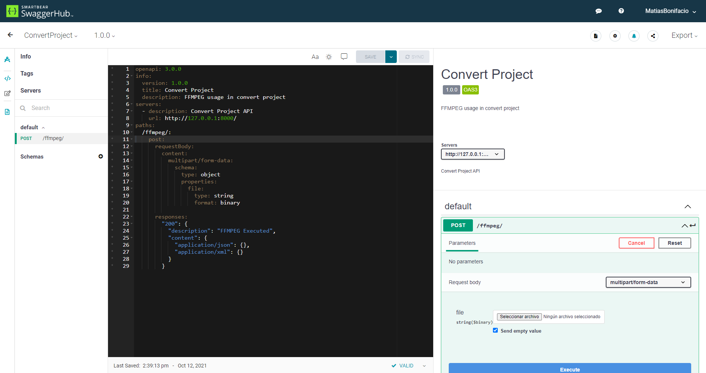
Documentation - Swagger Hub

Slide 21
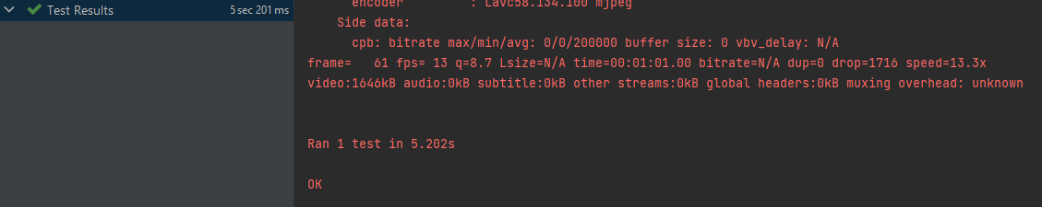
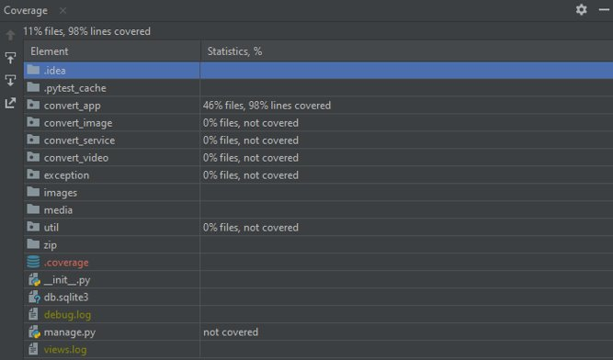
UNIT TEST FFMPEG Execute

Slide 22
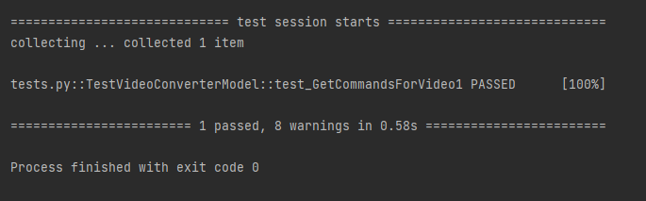
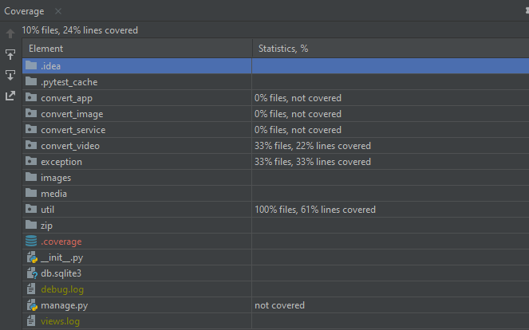
UNIT TEST Video Converter

Slide 23
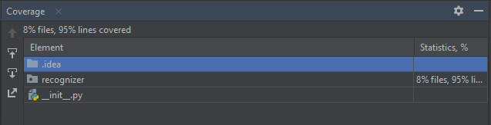
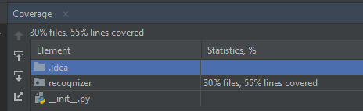
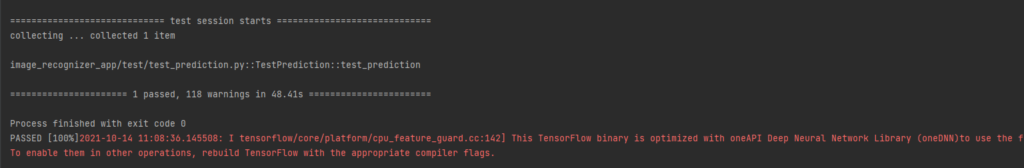
UNIT TEST

Slide 24
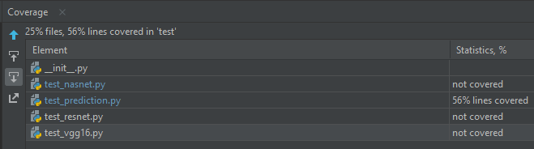
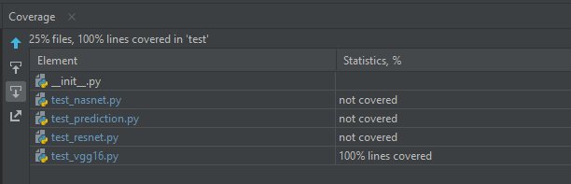
UNIT TEST

Slide 25
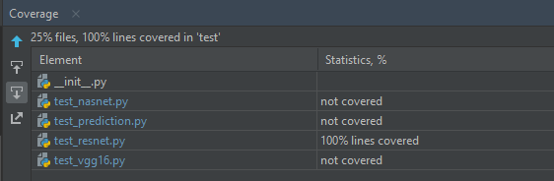
UNIT TEST

Slide 26
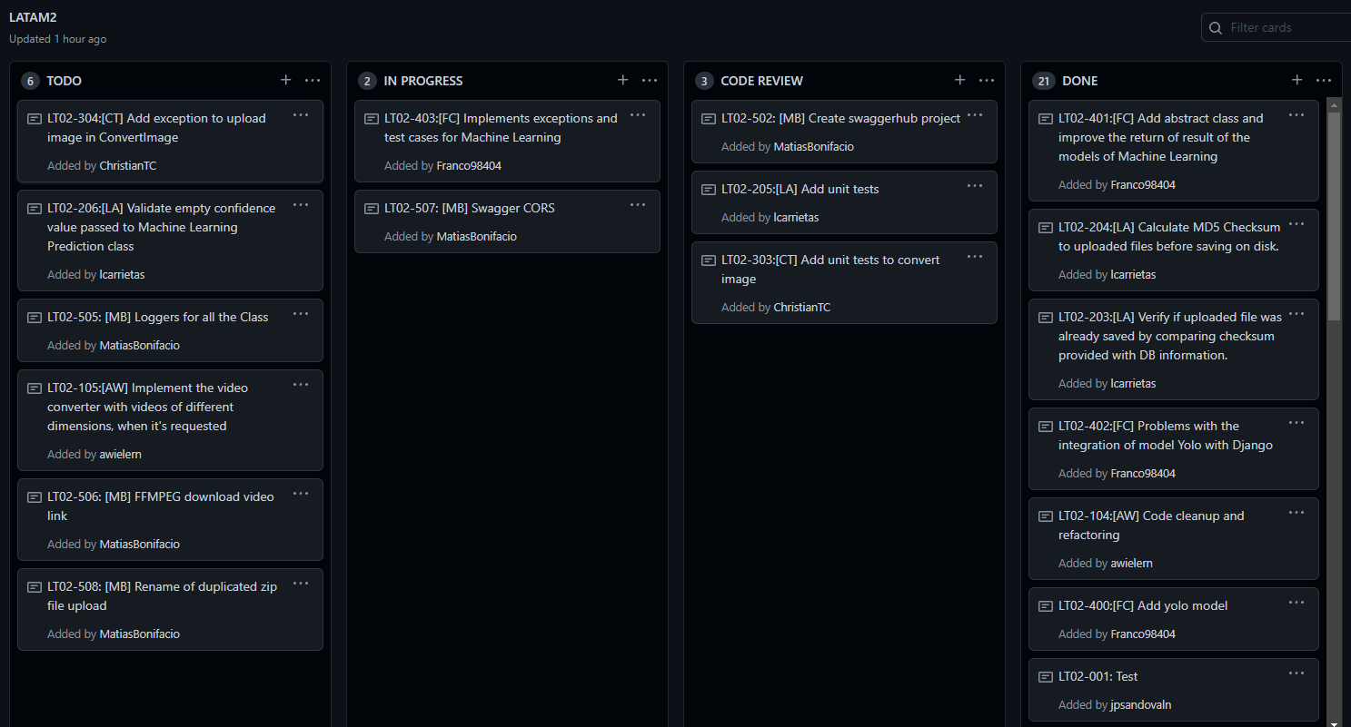
Backlogs Task

Slide 27

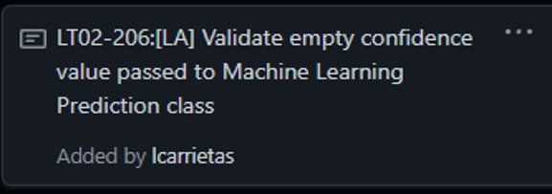
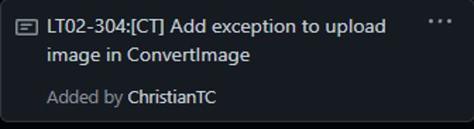
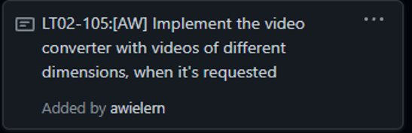


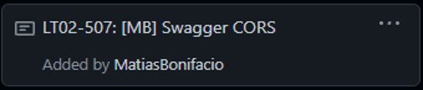
Known Issues

