Slide 1
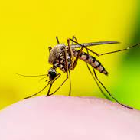
DSI24 Project 4: West Nile Virus
By Team CJE

Slide 2
Agenda
Problem Statement
EDA
Model Evaluation
Cost-Benefit Analysis
Conclusion & Recommendation

Slide 3
Problem Statement
We are a team working for the Mayor of Chicago who is interested in predicting the area of Chicago that has high presence of WNV in order to take the appropriate mitigation measures
Predict the presence of WNV given a location, species with the weather condition
Determine if spraying help to mitigate the the epidemic in a cost-effective way
Notes:
Mayor of Chicago, interested to predict area of Chicago that has high presence of WNV in order to decide when take spraying action
Goal to predict presence of WNV given features
Determine if spraying help to mitigate the epidermic in a cost effective way

Slide 4
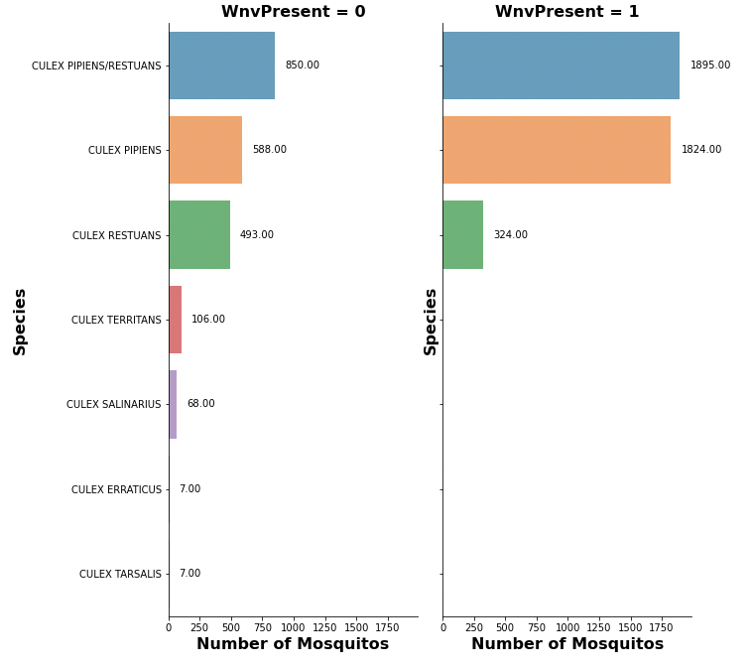
EDA – Train dataset
3 species contribute to the WNV
Found out that there is another type of mosquito 'UNSPECIFIED CULEX’ in the Test data
Might have negative impact if 'UNSPECIFIED CULEX’ is a positive carrier of WNV
Notes:
In test dataset, eda one more species found in test dataset, this might complicate our prediction and might predict fn and it will become a serious prob
Sensitivity is important in this case as we want to reduce the false negative
we have 2 barcharts which plot the number of mosquitoes vs species. Left side show the number of mosquito without the virus, right side show the mosquitos that carry the virus. Here we found out that there are 3 species that contribute to this virus. An interesting finding we also found out is that there is another type of mosquitos called the ‘Unspecified Culex’, this might have an negative impact if the species is a positive carrier of WNV, as our model would most likely predict a false negative for this species which will affect our prediction accuracy.

Slide 5
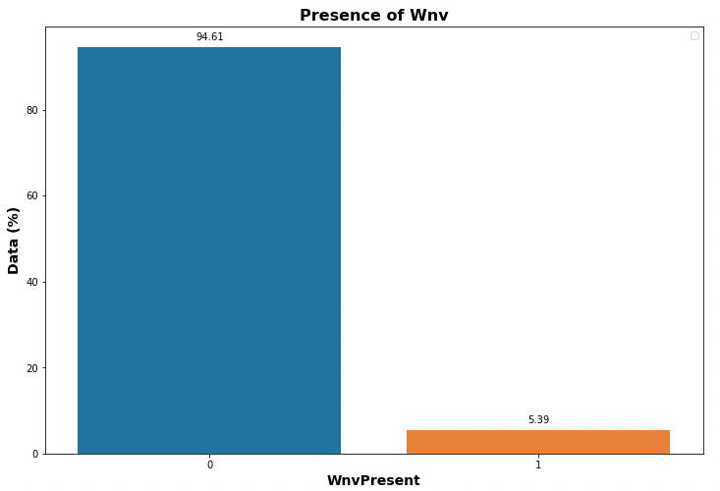
EDA – Train dataset Data Imbalance
Imbalance train dataset with >90% of the data having absence of WNV
Oversample the dataset using SMOTENC
Mixture of continuous and categorical features
Notes:
Imbalance data, notice mixture of cateforical smotenc over smote

Slide 6
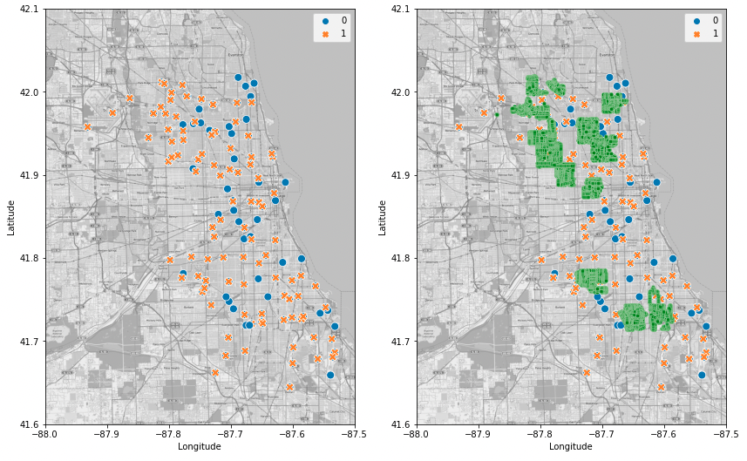
EDA – Spray vs WnvPresent
Location of Wnv
Location of Spraying
Notes:
Trying to find out whether the spraying will help to reduce the virus

Slide 7
EDA – Spray vs WnvPresent
Location of Wnv
Location of Spraying

Slide 8
EDA – Spray vs WnvPresent
Location of Wnv
Location of Spraying
SPRAYING DOES NOT HELP!!!!

Slide 9
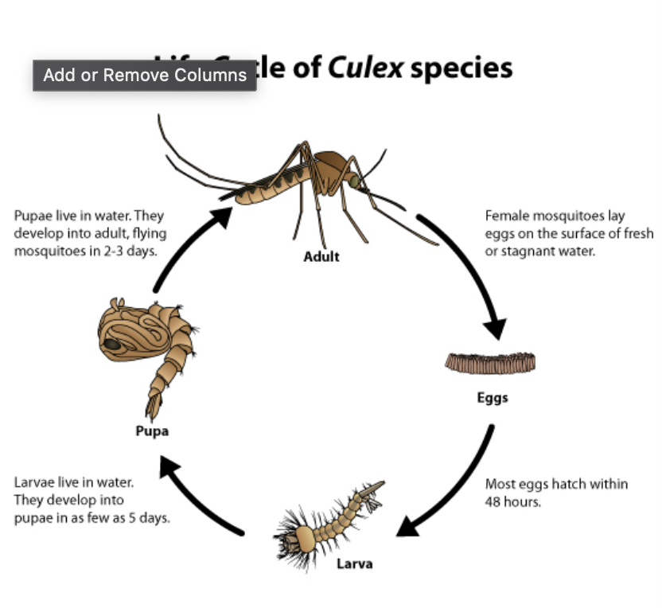
Modeling Assumptions
Species: 3 out of 7 are historically WNV-positive
Trap ID: Not all traps are equal (e.g. T115)
Longitude and latitude: Areas towards the east seem to be less prone to WNV
Weather-related features: Temperature, Dew Point, Wet Bulb, Total Precipitation
Our research shows that mosquitoes have a life cycle of 7 days
Any effect on mosquito-breeding due to changes in weather might be seen only a few days later
Weather variables lagged by up to 7 days
Month and week of the year: August seems to be most prone to WNV, followed by September

Slide 10
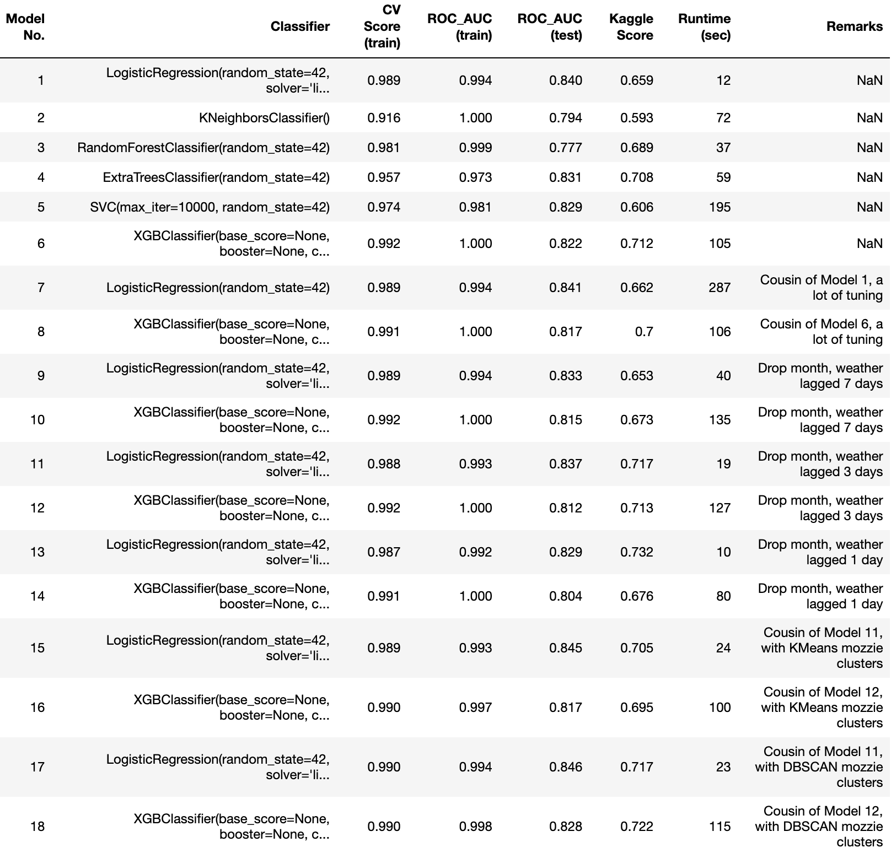
Results
BASELINE ACCURACY: 0.95
BASELINE ROC_AUC: 0.50
Step 1: Test six baseline models. Pick the best two models for intensive hyperparameter tuning.
Step 2: Intensive grid search of hyperparameters seems to work slighter better for Logistic model but worse for XGBoost
Step 3: Drop `month` which has 95% correlation to `week`. But results worsen.
Steps 4 and 5: Play around number of lagged days for weather variables. Jump in Kaggle scores. Lagged up to 3 days work best.
Steps 6 and 7: Drop GPS coordinates, create ‘mosquito-infection clusters’. DBSCAN works better than KMeans.

Slide 11
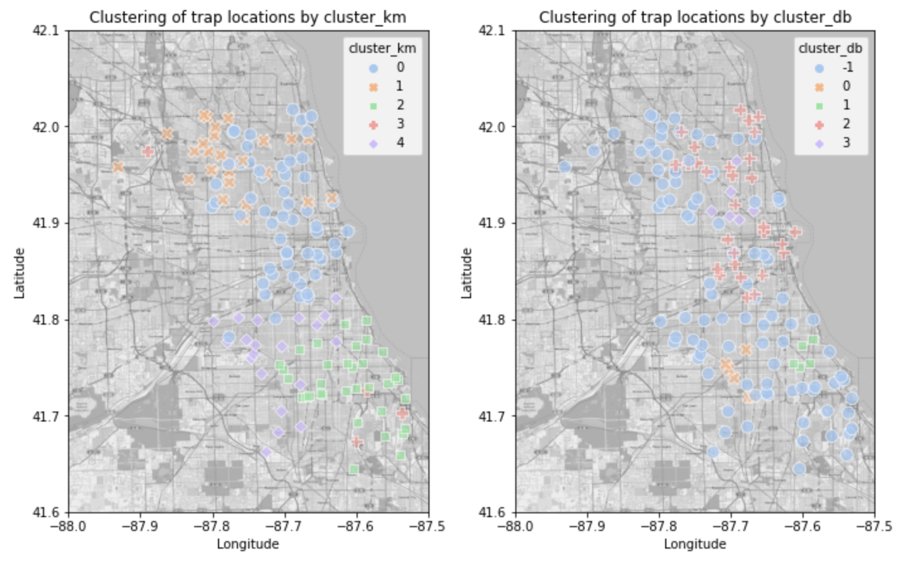
KMeans Clustering
DBSCAN Clustering

Slide 12
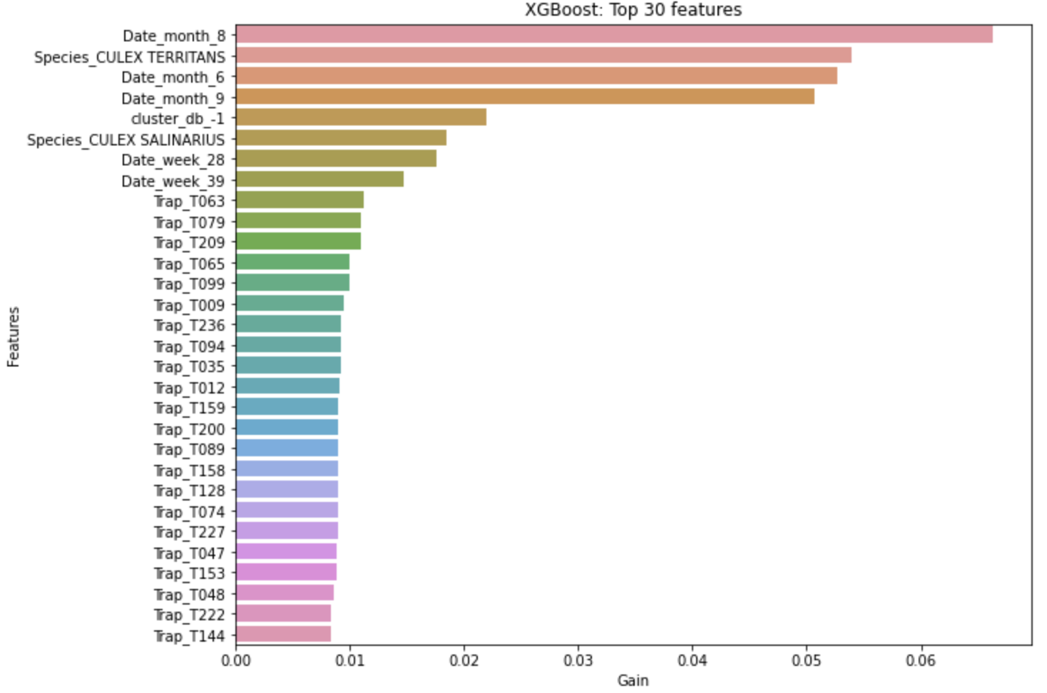
Features of Importance
IN ORDER OF IMPORTANCE
Month: Most important predictor, August responsible for improving AUC_ROC score by 6.5%
Species: Next most important, with Culex Territans responsible for 5.5% of improvement
Mozzie cluster: DBSCAN cluster ‘-1’ is next on the list, 2.5% of improvement. The locations are in the Northwest and South of Chicago.
Week: #28 and #39
Trap: Generally responsible for <1% of the score improvement
Weather: Interestingly, not in the Top 30 chart

Slide 13
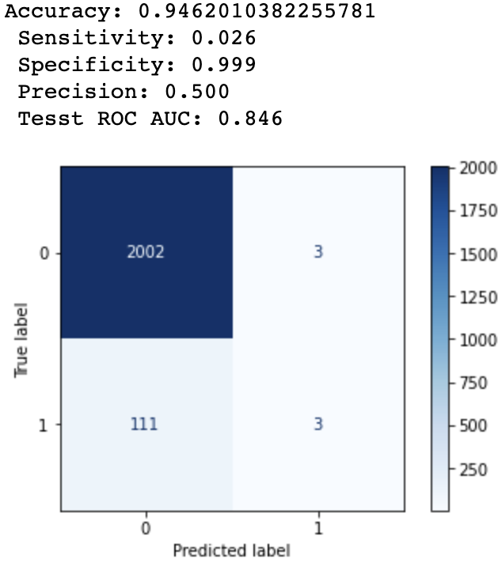
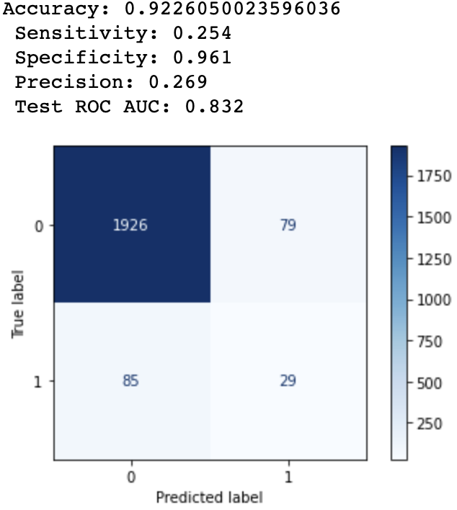
Model Selection: Not just AUC_ROC
Model 17: Logistic, weather lagged 3 days, DBSCAN clusters
A naïve model: accuracy 0.95, AUC 0.50
Model 17 (logistic regression): accuracy 0.95, AUC 0.85
Model 18 (XGBoost): accuracy of 0.92, AUC score 0.83
On paper, one should pick Model 17 over Model 18, however...
Model 17 does not seem to be useful for city officials when deciding where to focus their spraying efforts
6 out of 2119 cases are predicted to be positive (99.9% negative predictions)
Model 18 is braver, choosing 79+29 = 108 predictions to be positive (94.9% negative predictions)
Model 18’s sensitivity of 0.254 is more than 800% higher than Model 17’s sensitivity of 0.026!
Selected model: XGBoost, weather variables lagged 1-3 days, DBSCAN clusters
Model 18: XGBoost, weather lagged 3 days, DBSCAN clusters

Slide 14
Cost-Benefit Analysis
13 weeks of spraying
66 WNV cases in 2013
Cost
Medical cost is the key reason why we should reduce WNV cases, especially for severe cases
Reduction of 1 case saves $18,000
Current vector control program (VCP) needs to reduce cases by at least 58 for the benefit of the vector control program to outweigh the cost of WNV cases
Are the current VCP capable of reducing the case load by 58? We will use mosquito numbers to help us find out!
Benefit
Spraying
$6,100
Reduce Medical Cost
$874,000
Trap Surveillance
$149,000
Reduce
Economic Cost
$333,000

Slide 15
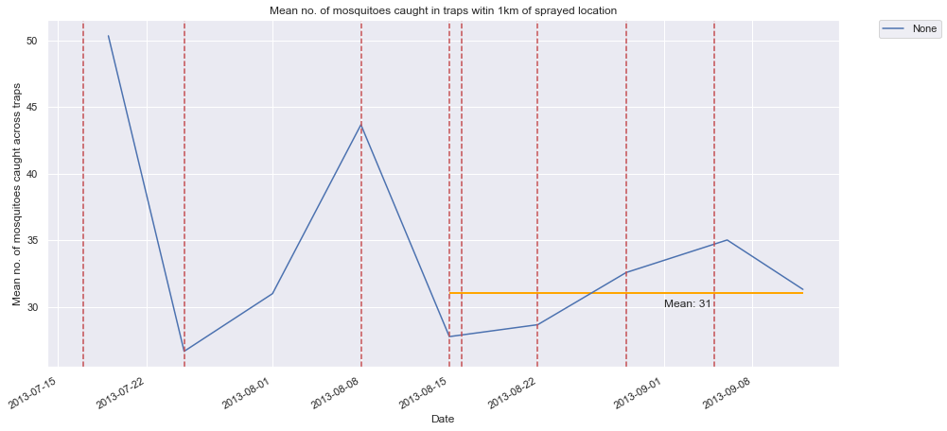
Effects of Spraying on Mosquitos Numbers
Legend
Date of Spraying
Mid-July
Mid-August onwards
Using mosquito numbers as predictor of WNV cases
51 mosquitoes
31 mosquitoes
66 -> 40 cases
This is the most probably the cue for spraying to commence
Mosquitoes number did not fluctuate that much and came down to an average of 31 mosquitoes
----> 40% decrease
Decrease of 26 WNV cases is not sufficient to justify cost of spraying (58 required)

Slide 16
Recommendation & Conclusion
The Chicago Department of Public Health should focus on all areas where the traps in the DBSCAN Cluster “-1” and traps T063, T079 and T209 are located as they are strong predictors for WNV cases
Spraying seems to have short term effect of reducing mosquito numbers but it does not help to eradicate sufficient mosquitoes which carries West Nile Virus
There is an ‘Unspecified’ Culex species which is not part of the Train set but exist in the Test set. Further monitoring of this species is required to determine if they are carriers of the WNV

Slide 17
Model Selection: Not just AUC_ROC
Model 17: Logistic, weather lagged 3 days, DBSCAN clusters
A naïve model: accuracy 0.95, AUC 0.50
Model 17 (logistic regression): accuracy 0.95, AUC 0.85
Model 18 (XGBoost): accuracy of 0.92, AUC score 0.83
On paper, one should pick Model 17 over Model 18, however...
Model 17 does not seem to be useful for city officials when deciding where to focus their spraying efforts
6 out of 2119 cases are predicted to be positive (99.9% negative predictions)
Model 18 is braver, choosing 79+29 = 108 predictions to be positive (94.9% negative predictions)
Model 18’s sensitivity of 0.254 is more than 800% higher than Model 17’s sensitivity of 0.026!
Selected model: XGBoost, weather variables lagged 1-3 days, DBSCAN clusters
Model 18: XGBoost, weather lagged 3 days, DBSCAN clusters

Slide 18
Features of Importance
IN ORDER OF IMPORTANCE
Month: Most important predictor, August responsible for improving AUC_ROC score by 6.5%
Species: Next most important, with Culex Territans responsible for 5.5% of improvement
Mozzie cluster: DBSCAN cluster ‘-1’ is next on the list, 2.5% of improvement. The locations are in the Northwest and South of Chicago.
Week: #28 and #39
Trap: Generally responsible for <1% of the score improvement
Weather: Interestingly, not in the Top 30 chart

Slide 19
Cost Benefit
Analysis
13 weeks of spraying
66 WNV cases in 2013
Cost
Medical cost is the key reason why we should reduce WNV cases, especially for severe cases
Reduction of 1 case saves $18,000
Current vector control program (VCP) needs to reduce cases by at least 58 for the benefit of the vector control program to outweigh the cost of WNV cases
Are the current VCP capable of reducing the case load by 58? We will use mosquito numbers to help us find out!
Benefit
Spraying
$6,100
Reduce Medical Cost
$874,000
Trap Surveillance
$149,000
Reduce
Economic Cost
$333,000

Slide 20
Effect of Spraying on Mosquitoes Numbers
51
Legend
Date of Spraying
Mid-July
Mid-August onwards
Using mosquito numbers as predictor of WNV cases
51 mosquitoes
31 mosquitoes
66 -> 40 cases
This is the most probably the cue for spraying to commence
Mosquitoes number did not fluctuate that much and came down to an average of 31 mosquitoes
----> 40% decrease
Decrease of 26 WNV cases is not sufficient to justify cost of spraying (58 required)

Slide 21
Recommendation & Conclusion
The Chicago Department of Public Health should focus on all areas where the traps in the DBSCAN Cluster “-1” and traps T063, T079 and T209 are located as they are strong predictors for WNV cases
Spraying seems to have short term effect of reducing mosquito numbers but it does not help to eradicate sufficient mosquitoes which carries West Nile Virus
There is an ‘Unspecified’ Culex species which is not part of the Train set but exist in the Test set. Further monitoring of this species is required to determine if they are carriers of the WNV

