Slide 1
Which are the states that can increase the participation rates for ACT and SAT scores?
Sook Yee, Jasper, Jazreel, Chuan Hui

Slide 2
Introduction
States and school districts are focusing on ensuring that students move to college and a career after graduating from high school.
However, there are limited resources to be given to each state to encourage their students to take the tests, provide training programs, hire career guidance coaches, etc.
So we need to focus and identify states that have potential to further increase than mean participation rate.

Slide 3
Aim
Identify which states with higher than mean participation rates, to further increase their participation rates for both the ACT and SAT scores.
Note that the aim is NOT to identify states with the lowest participation rates.

Slide 4
Methods
The datasets are from year 2017 and 2018. They are organized at the state level with participation rates and Total, Composite and component (English, Math, Reading, Science) scores. The ACT components in 2018 are not available.
This allows for a state-by-state comparison of participation rates and scores for each test.

Slide 5
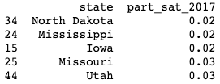
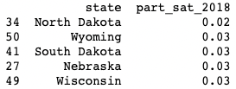
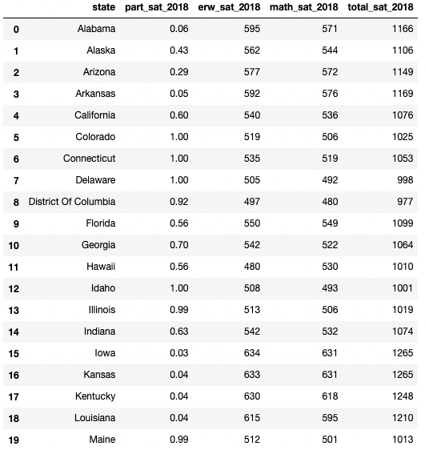
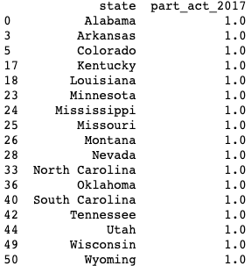
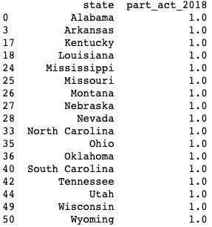
Methods
Which states have the lowest SAT participation rate?
Test components
SAT 2017, 2018 participation rates by states
Which states have the highest ACT participation rate (normalized?
States
SAT 2018 mean scores, by state, by component
ACT 2017, 2018 participation rates by states

Slide 6
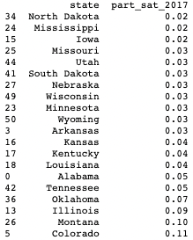
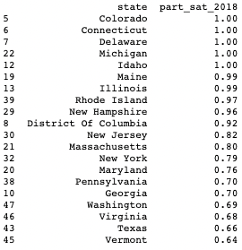
Methods
It can be observed that there was a significant increment in the SAT participation rate for Illinois and Colorado by ~90% from 2017 to 2018
Due to change in policy, SAT is mandatory to all high schools juniors for college admissions from 2017
SAT 2017 lowest participation rate by states
SAT 2018 highest participation rate by states

Slide 7
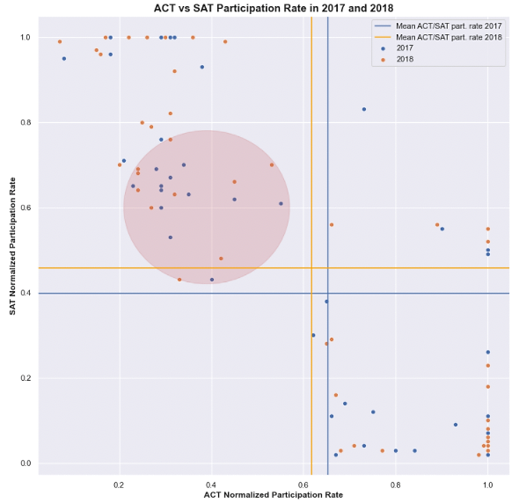
Higher than mean SAT participation
9 states that fall within the red circle
California, Georgia, Indiana, Maryland, Oregon, Texas, Vermont, Virginia and Washington
SAT vs ACT participation rate by state 2017 and 2018

Slide 8
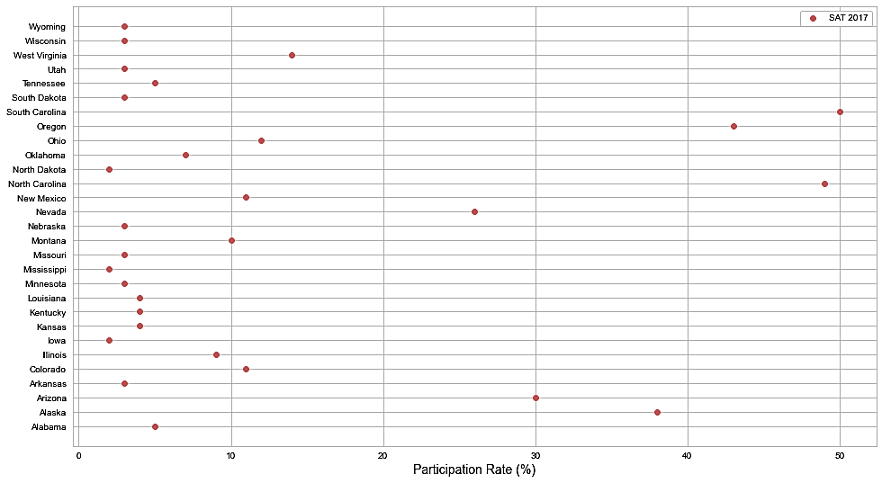
Participation rates for SAT scores in 2017

Slide 9
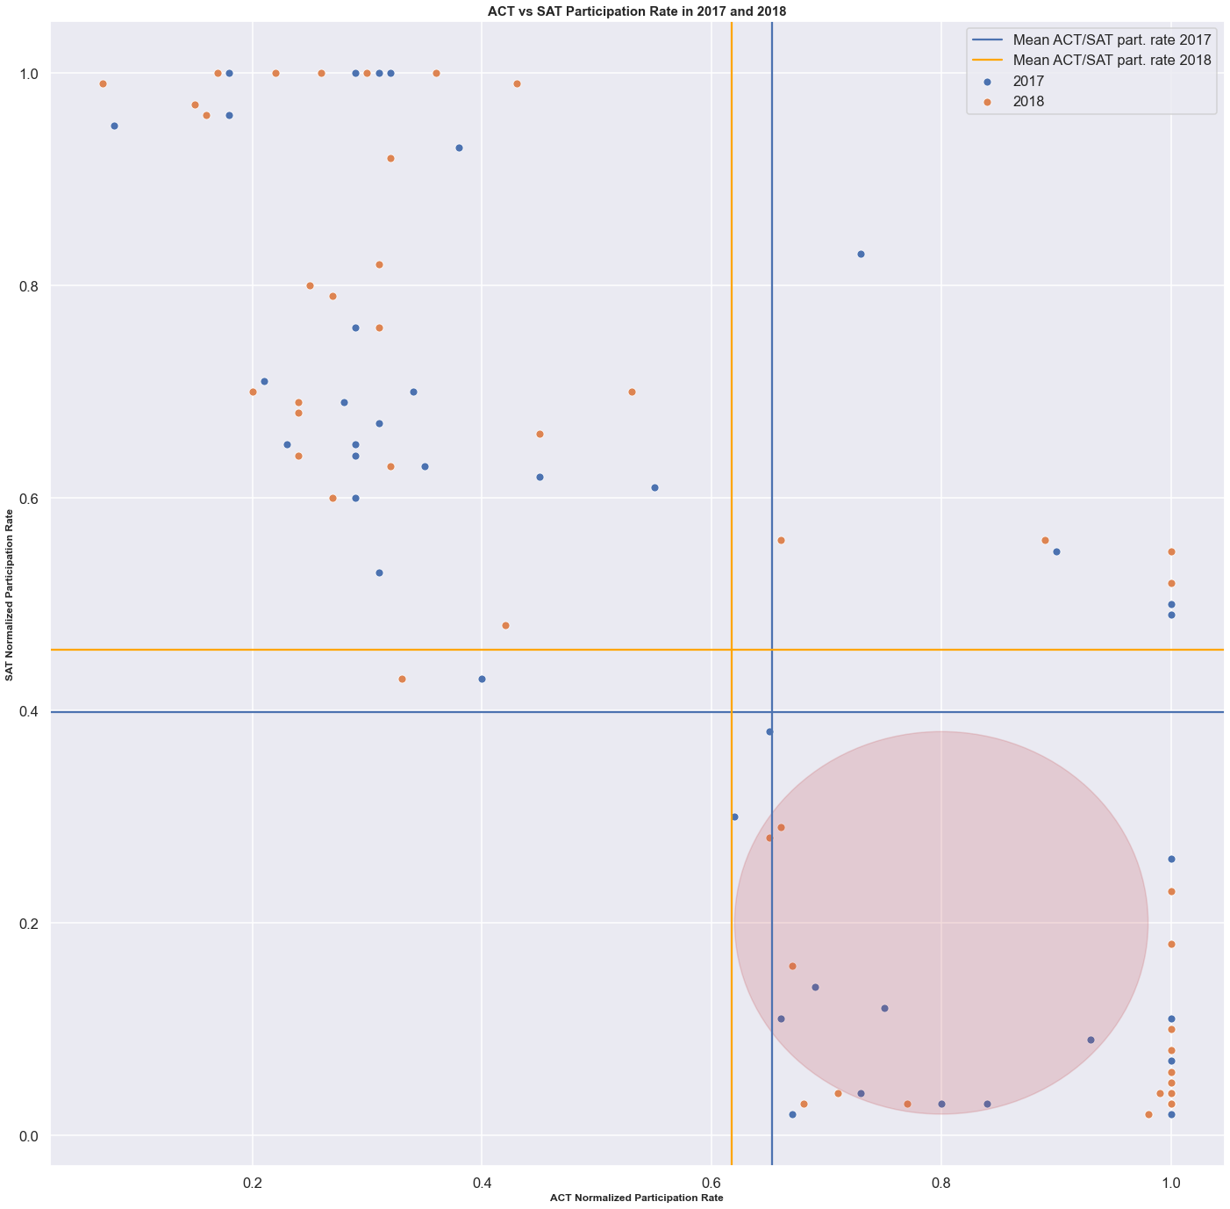
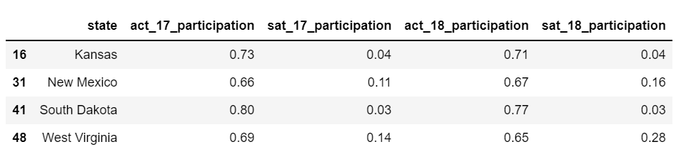
Higher than mean ACT participation
4 states that fall within the red circle
Kansas, New Mexico, South Dakota and West Virginia
SAT vs ACT participation rate by state 2017 and 2018

Slide 10
Conclusion and Recommendation
9 states (California, Georgia, Indiana, Maryland, Oregon, Texas, Vermont, Virginia and Washington) have relatively higher than mean participation rates in SAT.
4 states (Kansas, New Mexico, South Dakota and West Virginia) have relatively higher than mean participation ACT.
So these 13 states have potential to further encourage students to participate in these standardized tests.

