Slide 1
Classification model for boardgames and mobilegames
Jasper

Slide 2
Contents
Problem Statement
Data Cleaning
Model Comparison
Causes of Misclassification
Possible Improvement on Misclassification
Conclusion

Slide 3
Problem Statement
As a Data Scientist in a new company which aims to develop both mobile games and board games, building a classification model that can correctly classify these 2 categories based on posts/comments on social media platform
This project aims to make use of the posts by the users in the 2 subreddit groups namely 'boardgames' and 'MobileGaming' for the modeling of this classification model

Slide 4
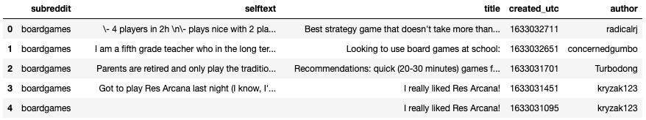
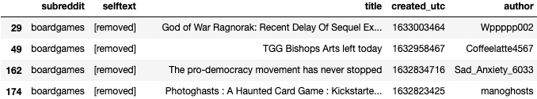
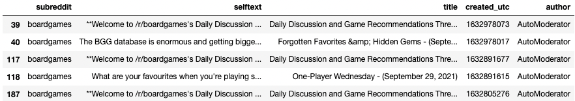
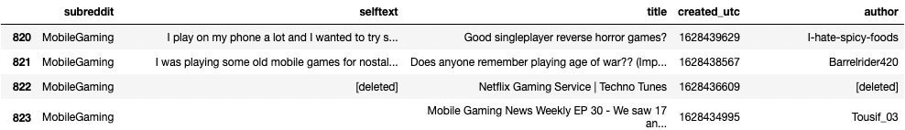
Data Cleaning
empty string
removed post
moderator post
deleted post

Slide 5
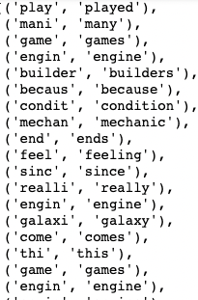
Data Cleaning – Lemmatizing vs Stemming
stemming
lemmatizing

Slide 6
Data Cleaning – Lemmatizing vs Stemming
stemming
lemmatizing
Lemmatizer CHOSEN

Slide 7
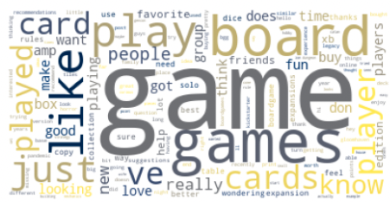
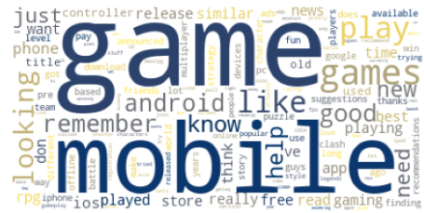
Data Cleaning - Stopwords
Boardgames
Mobile games

Slide 8
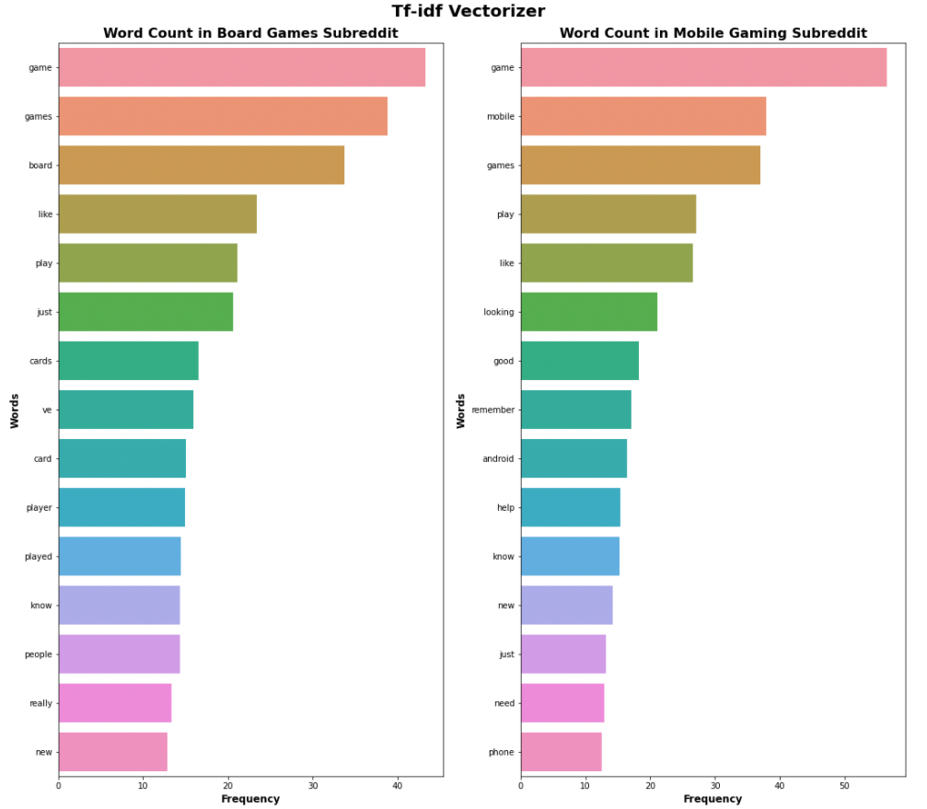
Data Cleaning - Stopwords
Boardgames
Mobile games

Slide 9
Data Cleaning - Stopwords
Other words like 'games', 'play', 'new' , 'like', 'just' might not be helpful for classification

Slide 10
Model Comparison - Logistic Regression vs Random Forest
 | Train CV | Accuracy | Sensitivity | Specificity | Precision | F1_score
Logistic Regression | 88.6% | 85.7% | 85.3% | 86.1% | 85.7% | 85.5%
Random Forest | 85.8% | 85.5% | 82.8% | 88% | 87.1% | 84.9%
Sensitivity & Specificity IMPORTANT METRICS

Slide 11
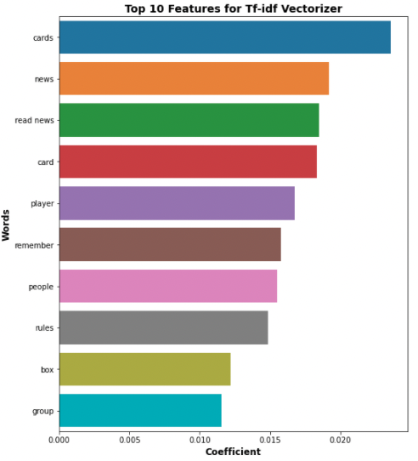
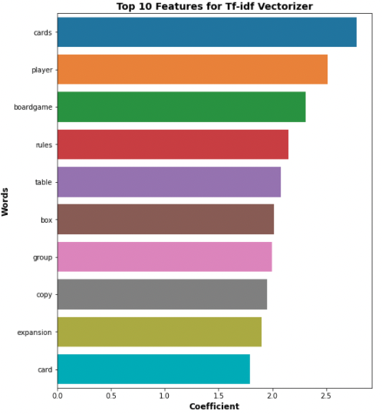
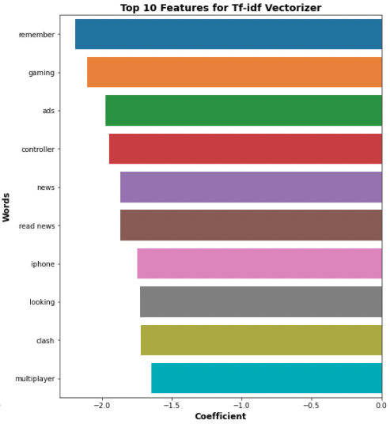
Model Comparison – Feature Importance
Random Forest
Logistic Regression
Boardgames
Mobile games

Slide 12
Causes of Misclassification
Content of the post too short
Lack of key words to classify
Key word that belong to another category
text | comment
what popular game in what popular game in | Content too short
I like it i have played it alot on my own can t wait to play it with my friends but i don t get the sorcerer he is the only one that does the least amount of damage if you face the cage spider simple lvl monster it is basicly game over since it has defence weakness skilled and health it takes stamina cards and soul arrows cards out of to kill him provided that you drew the right cards so if you are lucky it will still take cards damage card since it takes turns to kill him that is almost half your deck and you lost weapon cards and that is just enemy other classes can keep their weapons while dealing damage so they make atleast some progress against defence enemies can someone tell me how that is balanced dark souls the card game question | 'cards’ is key word in ‘boardgames, hence wrongly classified as ‘boardgames

Slide 13
Possible improvement on Misclassification
Only scrape in data with enough content
Add in more stopwords

Slide 14
Conclusion
Logistic Regression is chosen as the model for the classification
Achieve highest accuracy of 85.7% as well as high sensitivity and specificity of 85.3% and 86.1% respectively
Features in logistic regression are more informative
Misclassification can be due to limited content or words that might be associated with the other subreddit

